Slide 1
Machine Learning applications for luminosity maximization
Xiaofeng Gu
Collaborators:
MSU: Yue Hao, Will Fung
LBNL: Ji Qiang, Sherry Li, Yi-Kai Kan
BNL: Xiaofeng Gu, Robert-Demolaize, Takeshi Kanesue
MAC Review

Slide 2
Outline:
Introduction
APEX for RHIC Luminosity
GPTune and EBIS
Summary and Acknowledgement

Slide 3
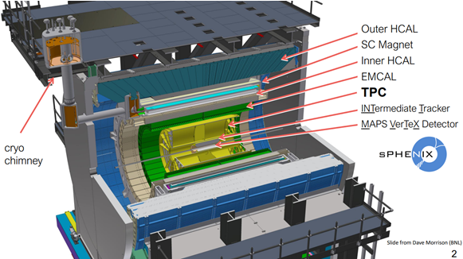
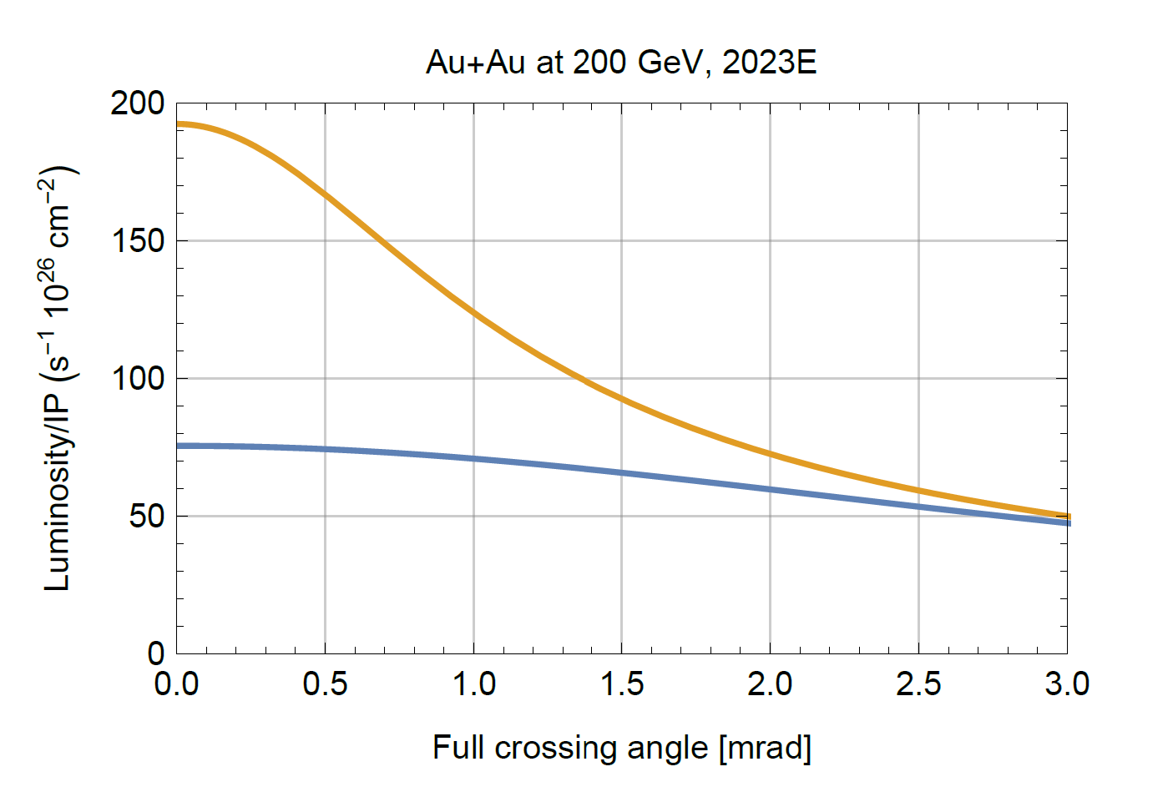
RHIC luminosity Optimization
$$L=\frac{N_{1}N_{2}fH}{2π\sqrt{σ_{x1}^{2}+σ_{x2}^{2}}\sqrt{σ_{y2}^{2}+σ_{y2}^{2}}}$$
sPHENIX:
VTX (+/-10 cm)
Crossing angle (2mrad)
S/N - Background
Global Parameters:
Orbit (Dipole)
Tune (Quadrupole),
Chromaticity (Sextuple)
Octupole
Local (IR8) Parameters:
Beta*
S* (more sensitive than head on)
Transverse offset
Other Parameters:
RF Voltage
Collimator Position
ALL
VTX
Courtesy of W. Fischer

Slide 4
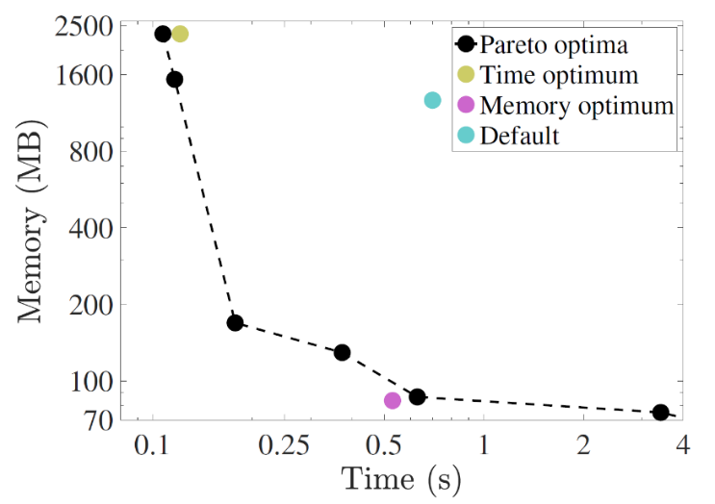
Bayesian optimization at LBNL GPTune
Several features of GPTune (BLNL) are very useful for HPC simulation codes, including:
relies on dynamic process management for running applications with varying core counts and GPUs
can incorporate coarse performance models to improve the surrogate model
allows multi-objective tuning such as tuning a hybrid of computation, memory and communication
allows multi-fidelity tuning to better utilize the limited resource budget
supports checkpoints and reuse of historical performance database.
Application:
Conduct parameter optimization for several HPC codes. The most notable result is for the multiscale production-level full-blown simulation codes, M3D-C1 and NIMROD that are used in the fusion Tokamak design.
https://github.com/mkturkcan/GPTune
https://nimrodteam.org/meetings/team_mtg_5_21/nimrod_meeting_YangLiu.pdf

Slide 5
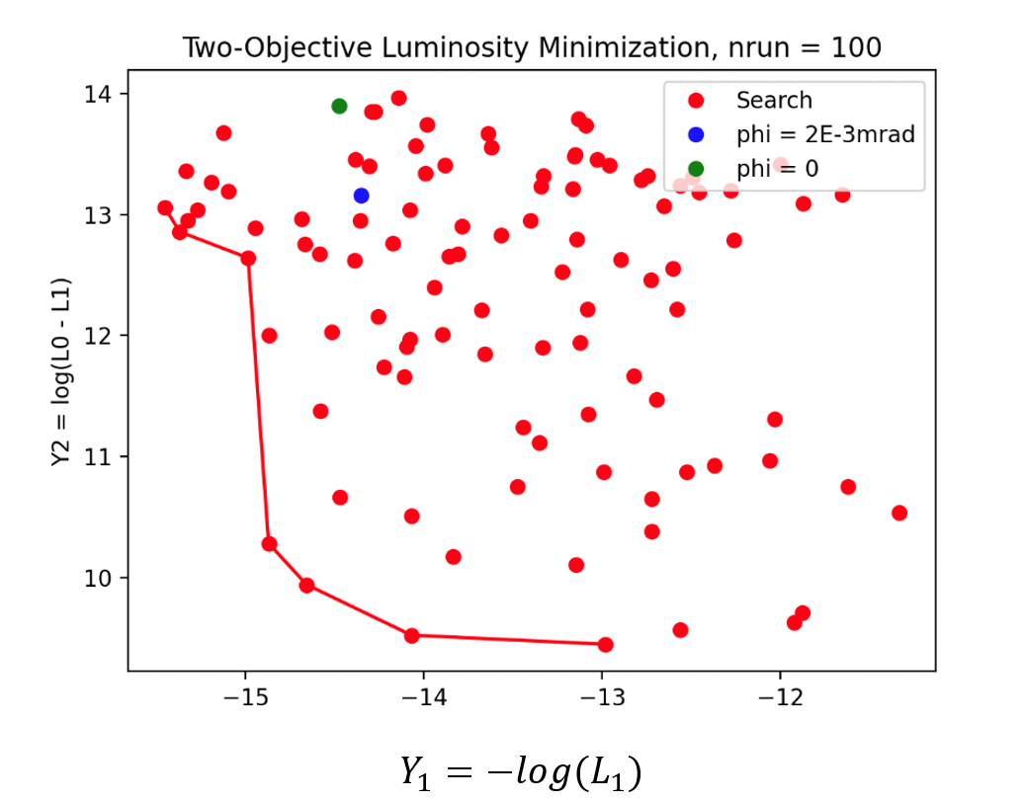
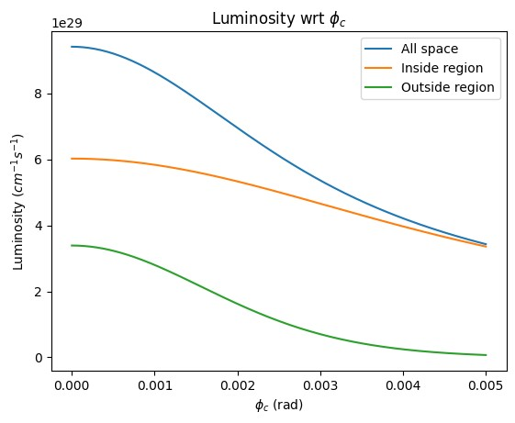
GPTune Optimization with the Analytical Model
background
Vertex signal

Slide 6
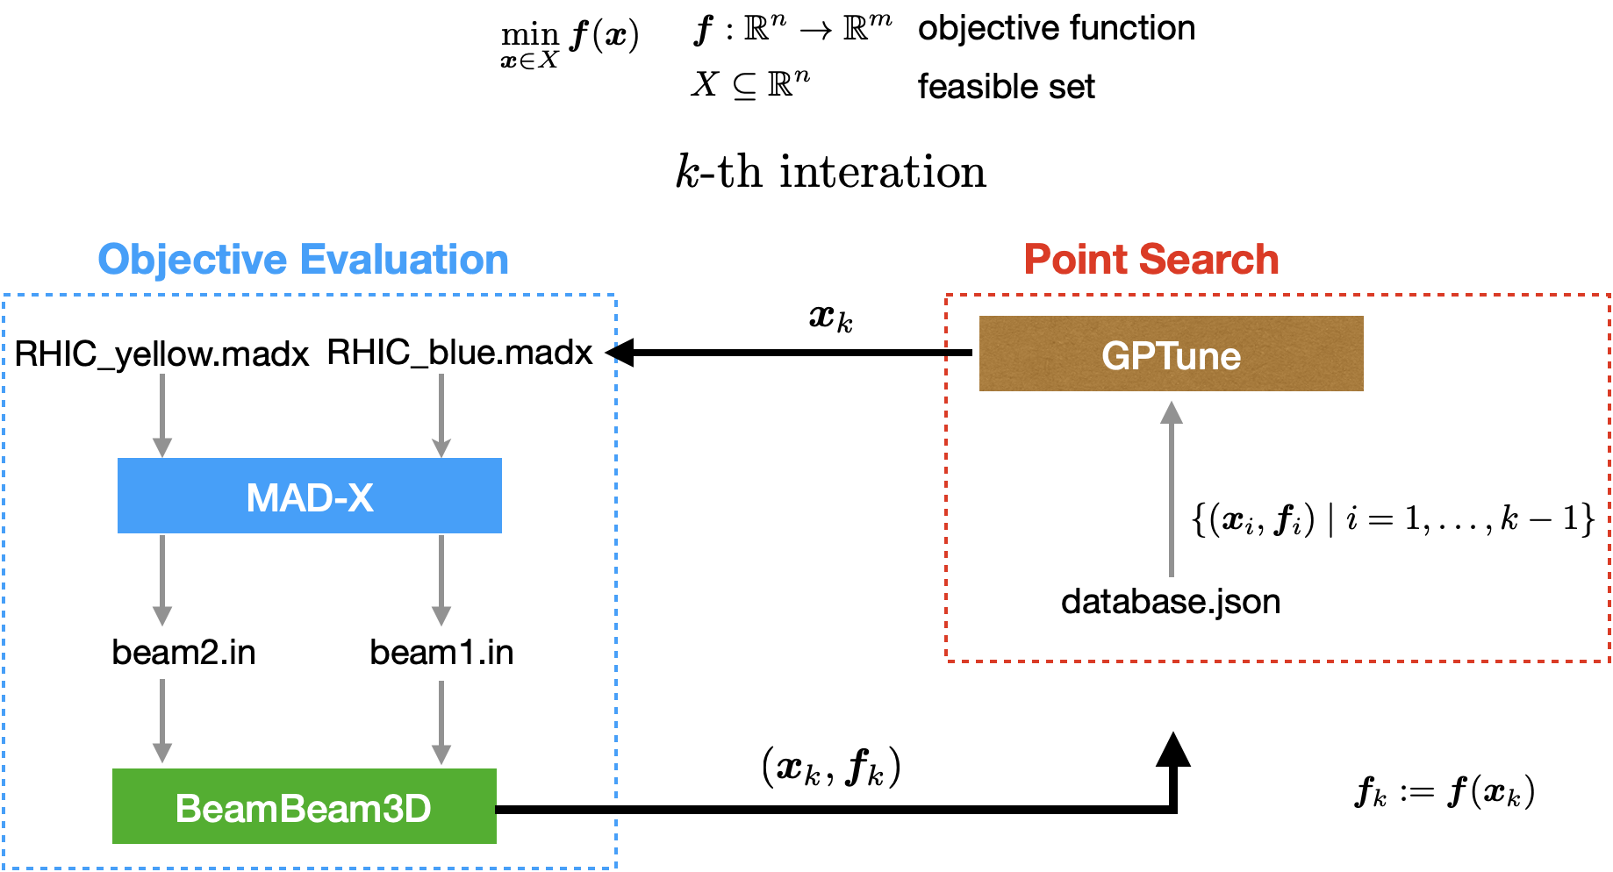
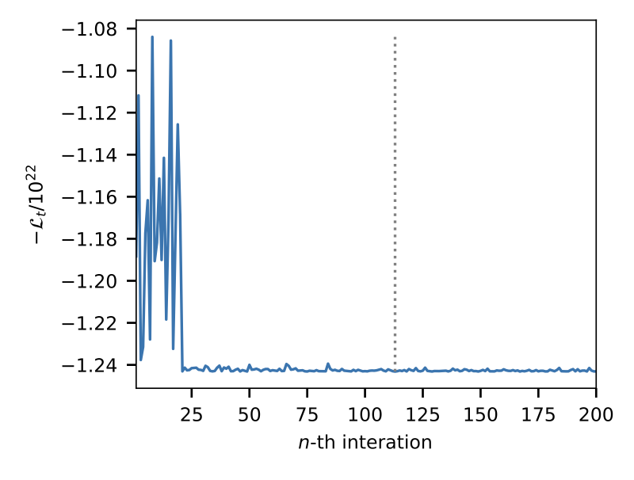
Bayesian optimization for RHIC Luminosity
The optimization of the lattice setting with respect to the luminosity is performed for the head-on collision of two Au-Au beams in the Relativistic Heavy Ion Collider (RHIC). The parameters of the lattice setting with only two variables $ΔS_{x}$ and $ΔS_{y}$.
The value of the objective function converges when more optimization steps are executed. This implies the value of the objective function is minimized and hence the total luminosity $L_{t}$is maximized.

Slide 7
Integration of Online Luminosity Optimization
S* and beta* changing scripts: Tested
change the target s*, beta* within ‘deltas.dat’ file;
run ‘madx job.madx_Au16-e0::store’ command, will get ‘IP8knob.dat’ file;
run ‘CreateSend.IP8’ command, will get ‘SendTrim.IP8’ file;
run ‘SendTrim.IP8’ command.
Machine
parameters
Luminosity Measurement
Optimization method
GPTune: Tested
Installed and tested
Did some optimizations EBIS and got some good results.
VTX
signal
GPTune
S*
Vertex Signal: contacted with sPHINEX people:
Did it with PHENIX before
Send the vertex data several ways.

Slide 8
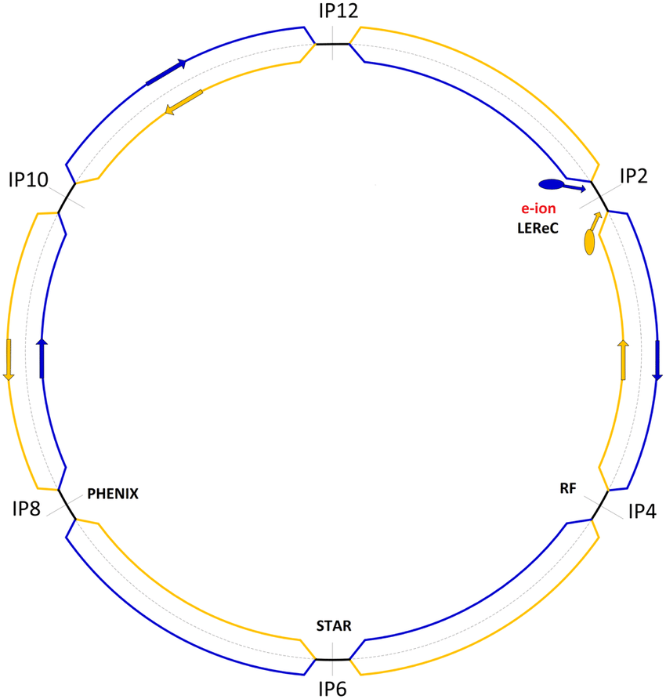
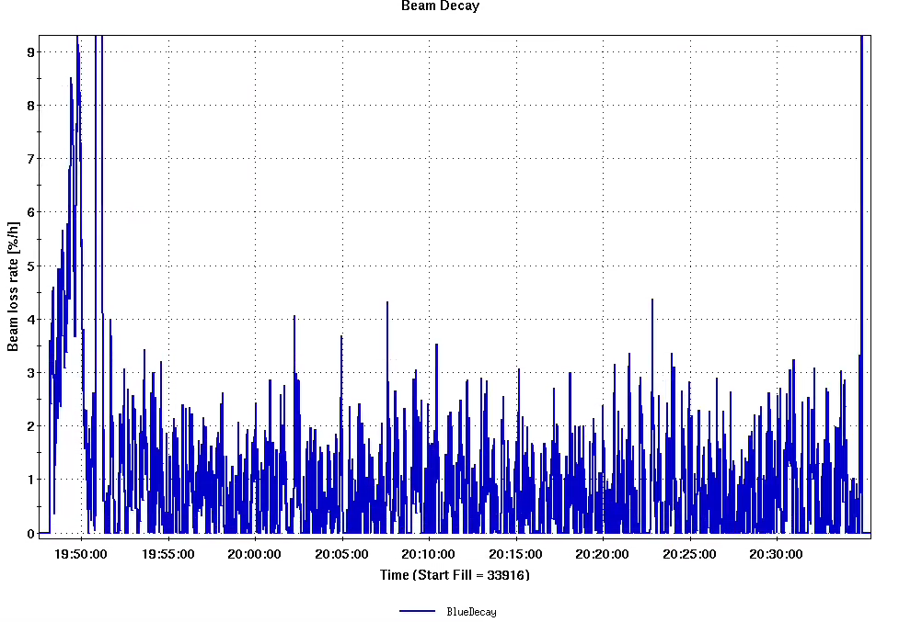
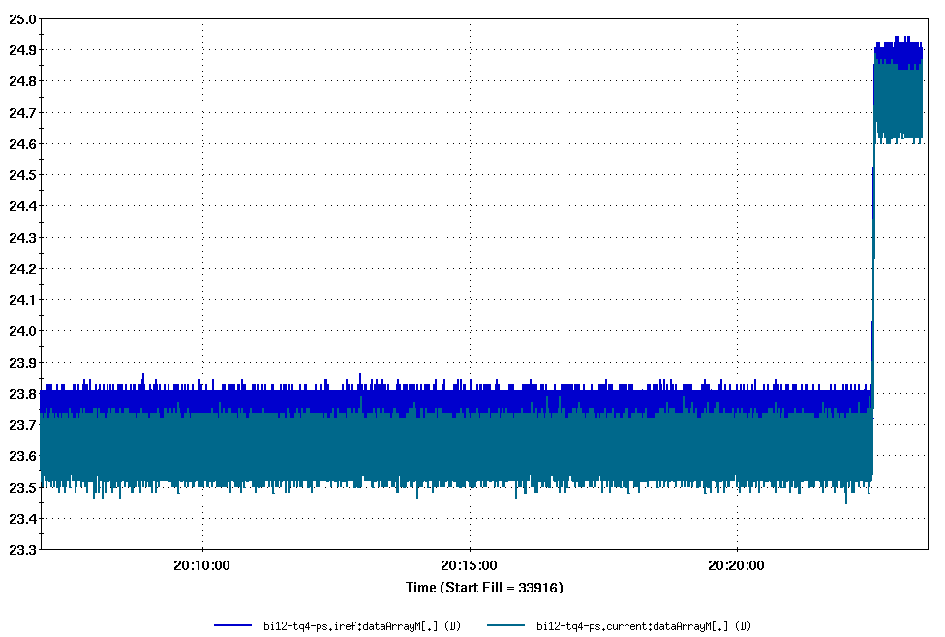
S* and beta* Script Test at IR12
Successfully test the s* script at store (IR12).
No additional significant beam loss during +/- 0.5 m s* change.
Will explore a large safety range next time at IR12 without separation bump.
Offline Data Analysis

Slide 9
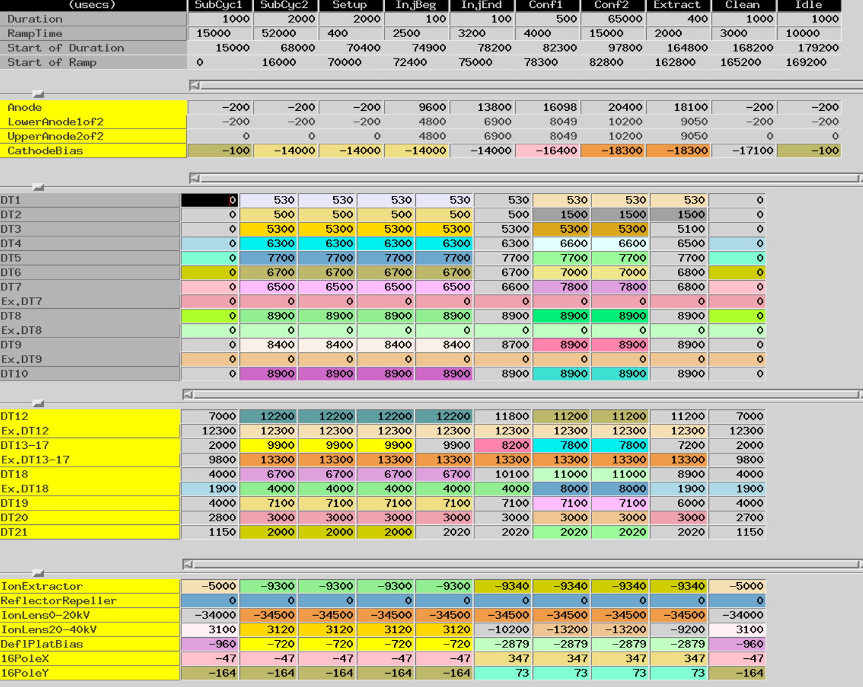
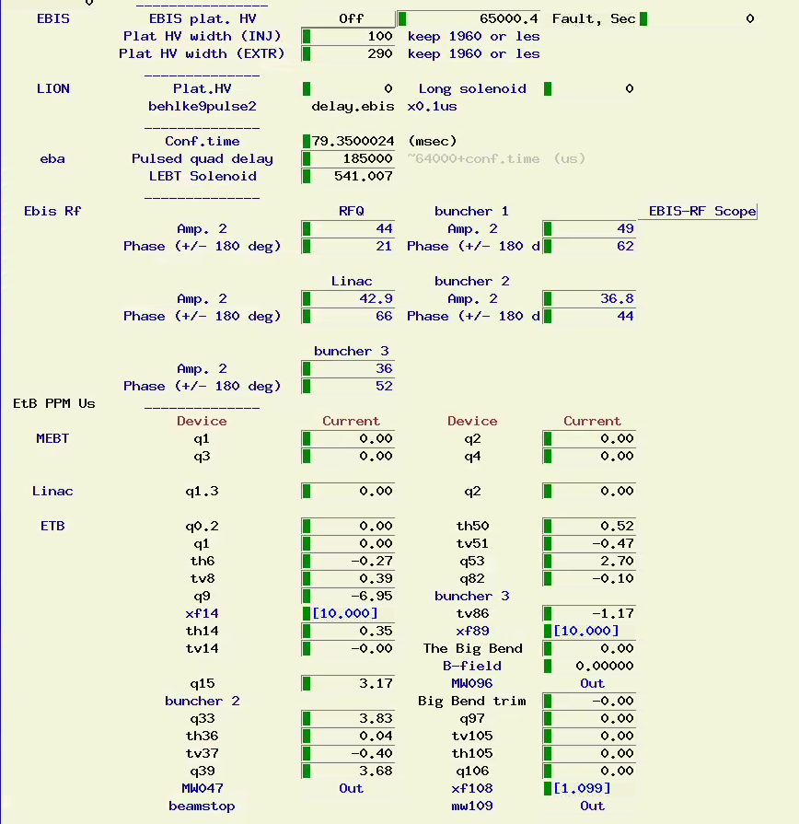
GPTune Test: EBIS Intensity Optimization
LION
FC96
1
2
RFQ
LINAC
3
4
5
6
7
8
EBIS
Buncher1
XF14
Buncher2
Buncher3
LION
EBIS Injection Line (fc96)
EBIS
EBIS Extraction line (xf14)
RFQ
MEBT
Linac
HEBT

Slide 10
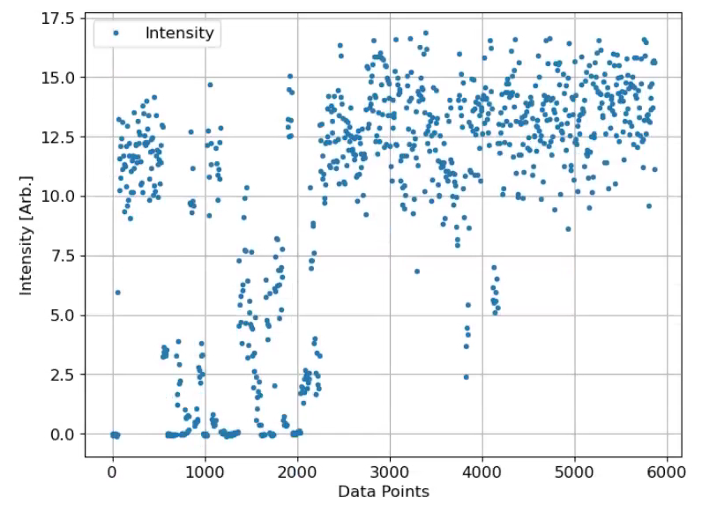
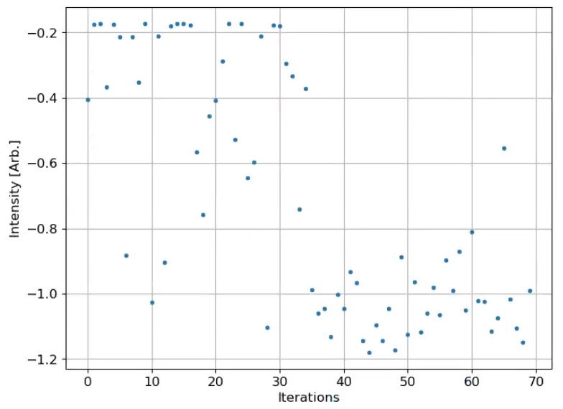
GPTune: EBIS Injection Line (9 parameters)
~14.0
11.5
~22% improvement after optimization
fc96 Intensity
script was running from 12:33 to 13:36 (~63 min)
1 beam / supercycle [6.6 s]; it takes 2 supercycles for the powers settle down;4 supercycles for measurement.
fc96 measurement was used for injection optimization
9 control parameters after 70 iterations

Slide 11
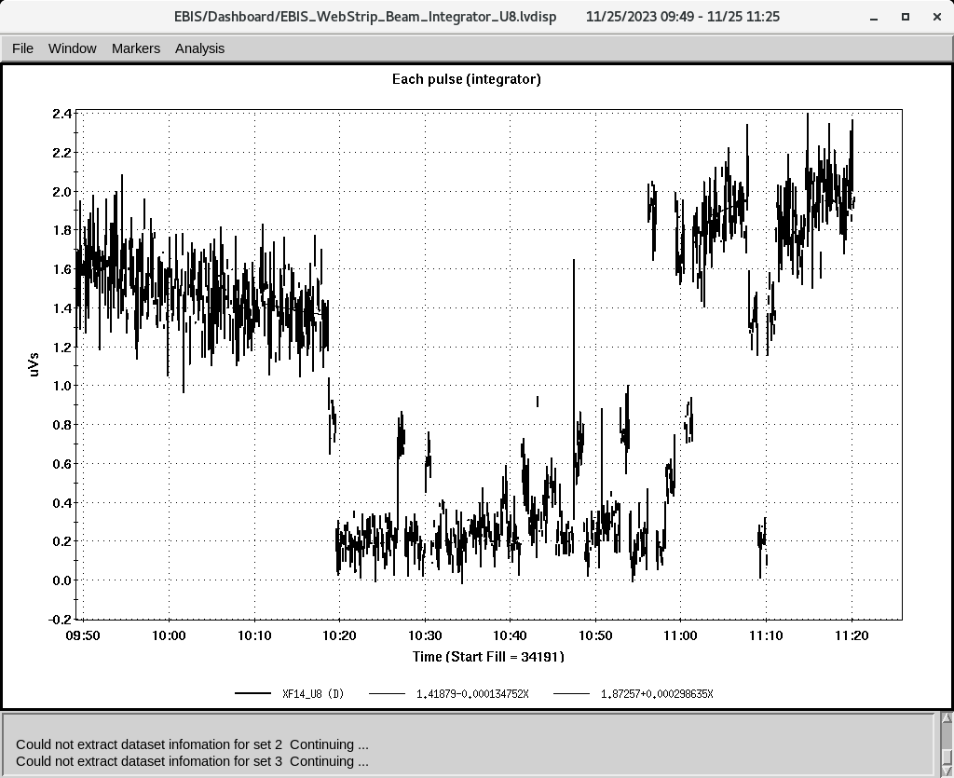
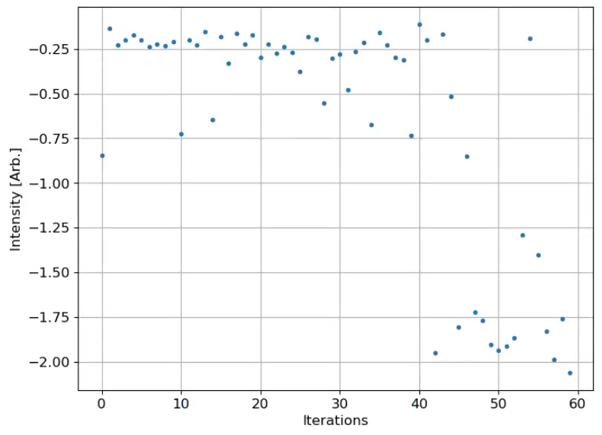
GPTune: EBIS Extraction Line (10 parameters)
~2.0
~43% improvement after optimization
Xf14 Intensity
1.4
script was running from 10:18 to 11:15 (~57 min)
2 beam / supercycle [6.6 s].
xf14 measurement was used for extraction optimization.
10 control parameters after 60 iterations

Slide 12
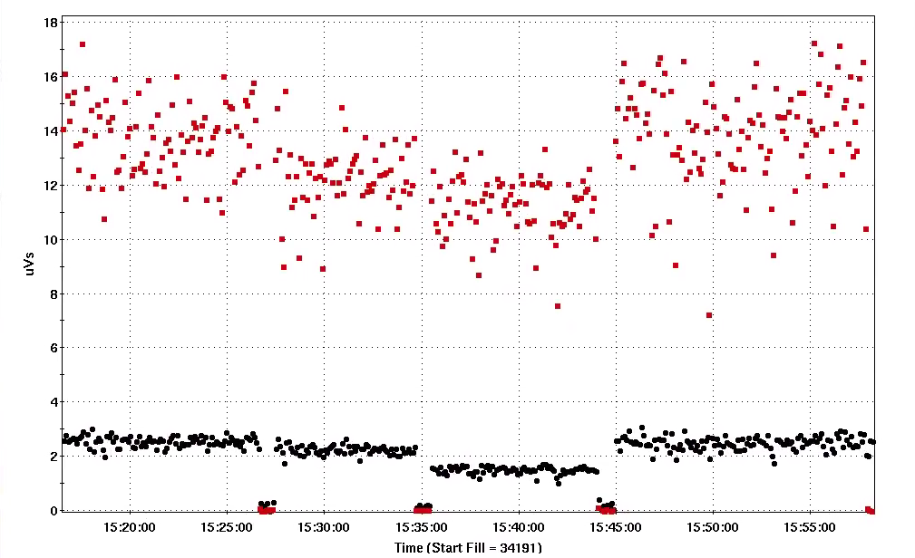
GPTune: EBIS Intensity Gain (11/25/2023)
13.67±1.40
12.16±1.23
13.89±1.76
11.22±1.05
GPTune works with std ±10% (pp ±15% ) noisy signals!
Possible more gain with fc96 instead of xf14 for the extraction line?
Inj+Ext.
Ext.
Original.
Inj+Ext.
2.53±0.20
2.23±0.17
2.49±0.24
1.48±0.13
Intensity detector | Original | Ext. optimized with xf14 | Gain | + Inj. Optimized with FC96 | Total Gain | Total Gain
xf14 (uVs) | 1.48 | 2.23 | 42~50% | 2.53/2.49 |  | 68~71%
fc96 (uVs) | 11.22 | 12.61 | 8.4% | 13.67/13.89 |  | 22-24%
?

Slide 13
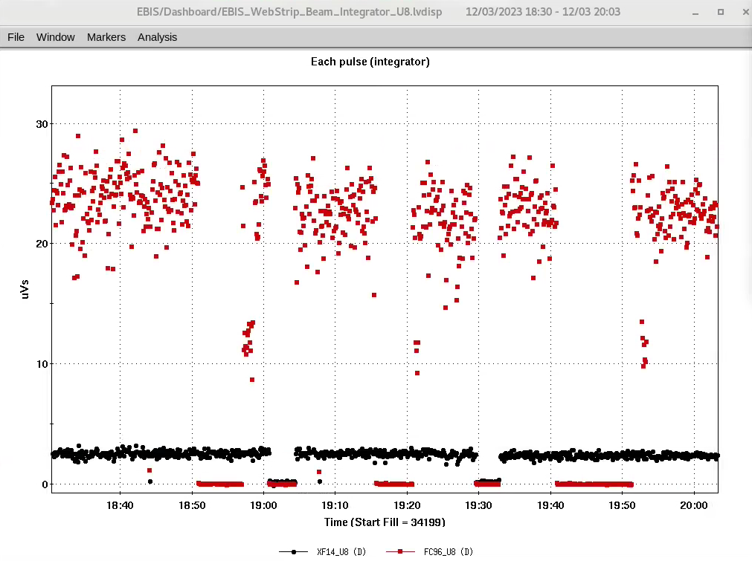
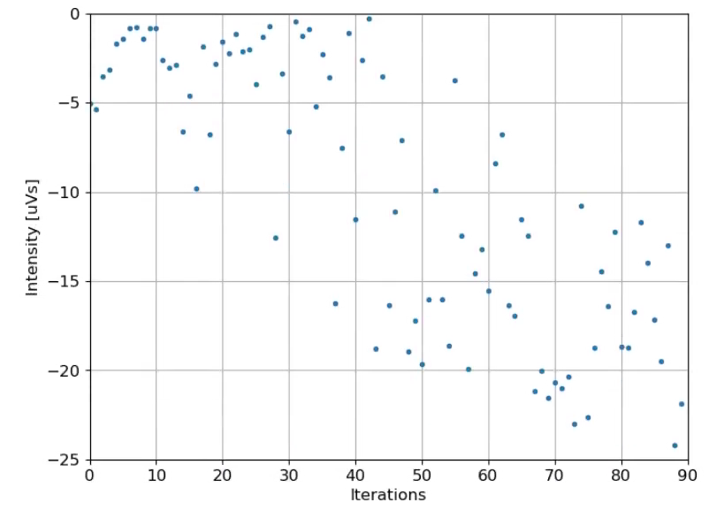
GPTune: EBIS Injection + Extraction (19 parameters)
23.56
22
23
24.2
12/03/2023:
22 the condition optimized on 11/25 (22%)
23 after-80-iterations condition
23.56 after-90-iterations condition (7%) 30%?

Slide 14
About the last year’s recommendations
Develop a plan and assess the resources needed to carry out the plan. The plan needs to have well-defined and achievable goals. (Scripts for Luminosity optimization are tested at IR12. IR12-injection, IR12-Store, IR8-Store-w/o, IR8-Store-w)
and include defined measures and actions to protect the machine and the detector.(No significant loss during the test.)
The protection measures need to be agreed upon with sPHENIX management. (Sure, will coordinate with SPHENIX. Have contacted with them about the vertx signals already. )

Slide 15
Acknowledgement
Robert-Demolaize
Takeshi Kanesue
Masahiro Okamura
John Morris

Slide 16
Summary
Scripts for Luminosity optimization have been tested at IR12. No significant loss during the test.
The planned was developed. (IR12-injection, IR12-Store, IR8-Store-w/o, IR8-Store-w)
GPTune has been demonstrated as a powerful tool for machine optimization. It was used for EBIS intensity optimization and got ~30% intensity improvement, with noisy signals.
GPTune could be used for other beam lines in RHIC complex (any proposals?).
The experience of luminosity optimization with a cross angle is very useful for EIC.

