Slide 1
High current laser ion source
Funding Opportunity Announcement (FOA), FY23 & FY24
Maashiro Okamura (BNL), Guy Garty (Columbia University)
Dec. 20, 2023

Slide 2
Project goals
Develop Laser ion source (LIS) and Radio Frequency Quadrupole (RFQ).
Very high current and highly charged state ion beam will be delivered.
Use Direct Plasma Injection Scheme which was invented by the PI.
Target species are from light to medium mass ions.

Slide 3
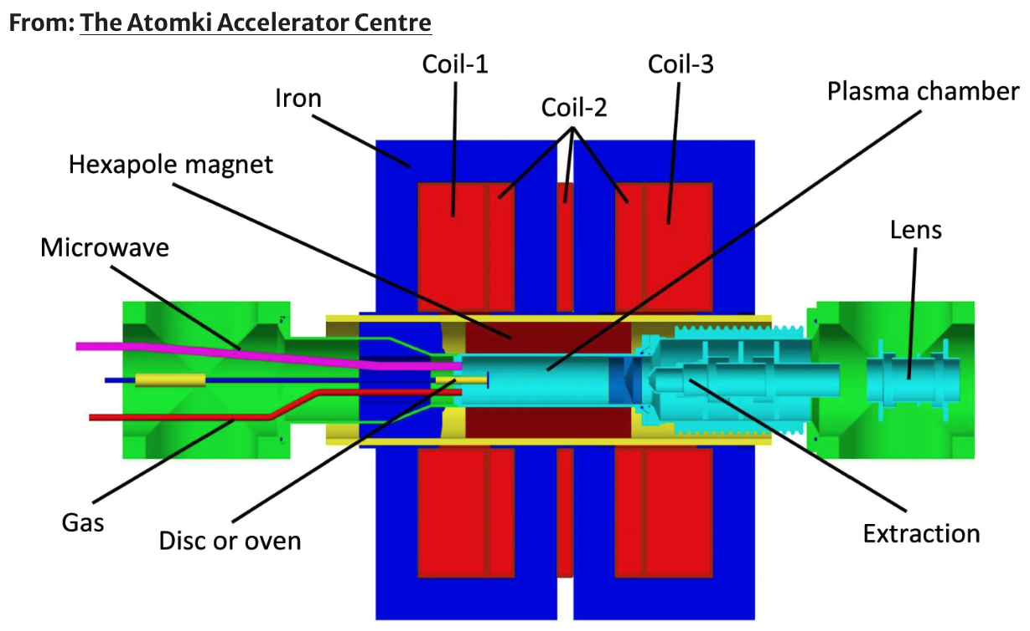
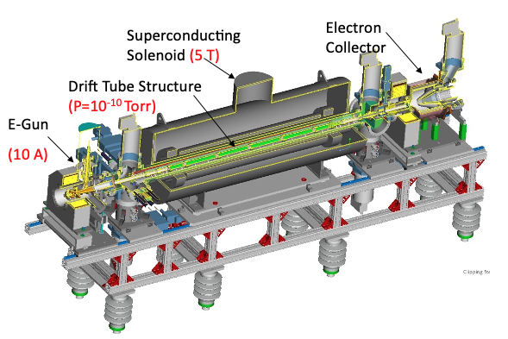
State of the art ion sources for heavy ion beams
Electron Cyclotron Resonance Ion Source (ECIRS)
Good for CW beam ( cyclotron or LINAC)
High average current
Biri, S., Vajda, I.K., Hajdu, P. et al. The Atomki Accelerator Centre. Eur. Phys. J. Plus 136, 247 (2021). https://doi.org/10.1140/epjp/s13360-021-01219-z
Electron Beam Ion Source (EBIS)
Pulsed beam for synchrotron
High flexibility

Slide 4
laser ion source (LIS)
x
x
Plasma formed
x
Plasma expands
Laser
z
Ion beam
z
z
Target
~20 deg.
Drift length
Extraction field
~ns
~ a few ns
∼μs
Scheme of laser ion source
High density plasma created from a solid.
Fast switching target materials.
Low temperature after adiabatic expansion.
Uniform density of beams.

Slide 5
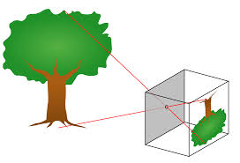
Hot plasma becomes very cold at the extraction
Plasma
Ion beam
Thermal distribution
Pin point ionization
-uniform plasma density-
Less emittance growth

Slide 6
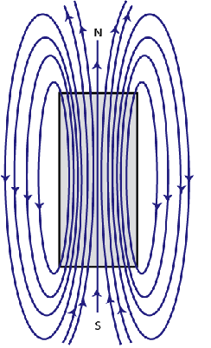
Magnetic field at extraction point increases emittance.
Ion born at extraction
r
Solenoid axis
No strong magnetic field in laser ion source

Slide 7
Why Laser Ion Source is good for next generation accelerators??
LIS provide very high current beam
No hysteresis effect
High charge state ions using high laser power density
LIS has been spoken badly: poor stability
uncontrollable emittance
not great for long time operation

Slide 8
Why Laser Ion Source is good for next generation accelerators??
LIS provide very high current beam
No hysteresis effect
High charge state ions using high laser power density
LIS has been spoken badly: poor stability
uncontrollable emittance
not great for long time operation
These are false statements

Slide 9
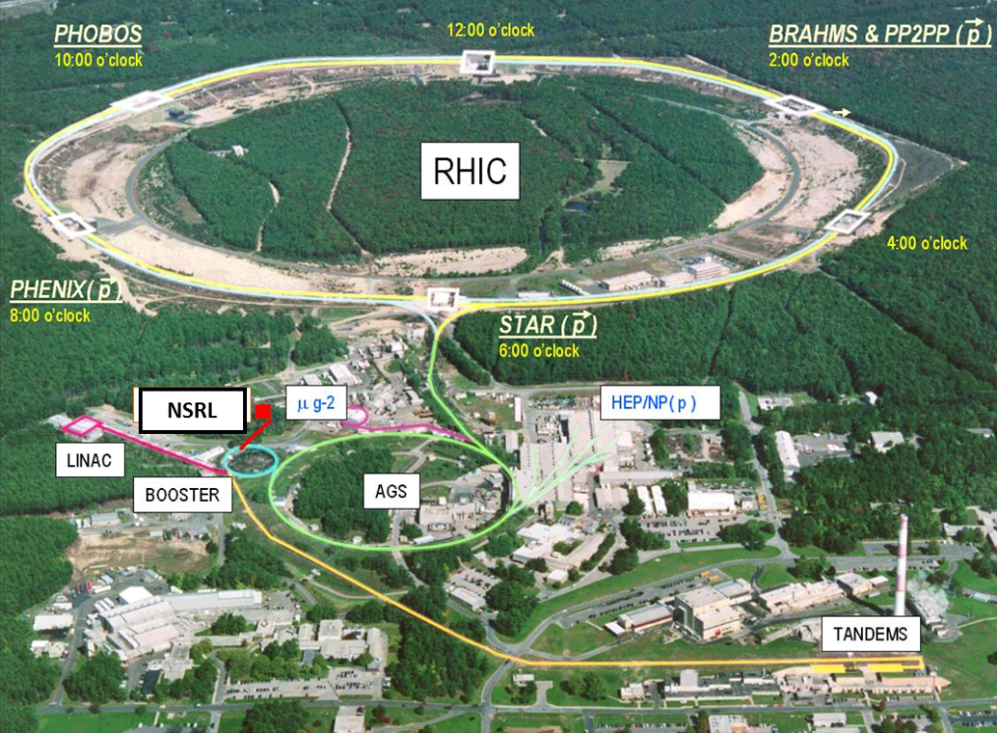
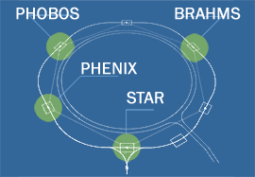
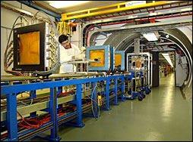
Low current LIS is providing beams to
Relativistic Heavy Ion Collider
NASA Space Radiation Lab
 | NSRL | RHIC
For what? | Simulate galactic cosmic rays | Create quark gluon plasma
species | All kinds of cosmic rays | Au
energy | Fe ~1GeV/n | 100GeV/n
Ion source needs to serve two major users simultaneously

Slide 10
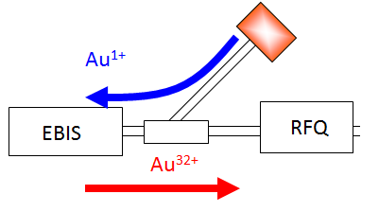
Laser ion source
(LION)
EBIS
4rod RFQ
IH DTL
Since 2014, we have provided various ion beams without major maintenances.
Never opened the beam extractor assembly.
No need to change optical window or lens for laser beam.
Very good beam current reproducibility.

Slide 11

What is Direct Plasma Injection Scheme (DPIS)?
Since the plasma start from solid state ( not gas ),
the current density can be very high.
Expanding plasma
Laser light

Slide 12
We can provide ultra high current, but,,
It’s not so easy to put it into an RFQ!!
Microwave
Electrode
RFQ
-
+
+
+
+
+
+
+
+
+
Confine field
+
-
+
+
+
-
Solenoid
Solenoid
S
N
S
N
DPIS source
Traditional injection scheme is not good for very high current beam

Slide 13
Direct Plasma Injection Scheme (DPIS)
RFQ
Solid target
+
+
+
+
+
+
+
+
-
-
-
+
+
-
-
-
-
+
-
-
+
+
-
-
-
+
+
-
-
+
+
-
+
+
+
+
+
+
+
+
+
+
-
-
+
+
+
+
+
+
+
+
-
+
-
+
+
+
-
-
+
-
-
-
-
-
-
-
-
-
-
-
-
-
-
-
+
+
+
+
-
-
+
+
Laser
Plasma guide
Dense expanding plasma from solid targets.
Retaining high brightness, heavy ions can be delivered to RFQ.
Since ions in plasma state, space charge effect can be neglected.
No focusing lenses.
No high voltage cage, no isolating transformer.
Performance of DPIS was verified by some limited species.
We explore possibility to accelerate heavy ions with DPIS.
This work will give a benchmark for future accelerator project.

Slide 14
Project Status (control milestones)
FY2023-Q1
1 Subcontract with Columbia University
Dec. 31, 2022 Dec. 22
2 Open call for a postdoc position
Dec. 31, 2022 Oct. 4 Madhawa joined Sep. 1 2023
FY2023-Q2
1 The first beam through the RFQ
Feb. 28, 2023 Feb. 10 (¹¹B⁵)
FY2023-Q3
1 The second species acceleration
Jun. 30, 2023 Jun. 30 (¹²C⁶)
2 Design of new laser irradiation box
Jun. 30, 2023 May 20
FY2023-Q4
1 Design of RFQ electrodes
Sep. 30, 2023 Sep. 30
3 Presentation at international conference
Sep. 30, 2023 Sep. 30, 5 presentations at ICIS2023
FY2024-Q1
1 Procurement of new electrodes type 1
Dec. 31, 2023 In progress
2 The third species acceleration
Dec. 31, 2023 Sep. 20 (²⁶Mg¹⁰)

Slide 15
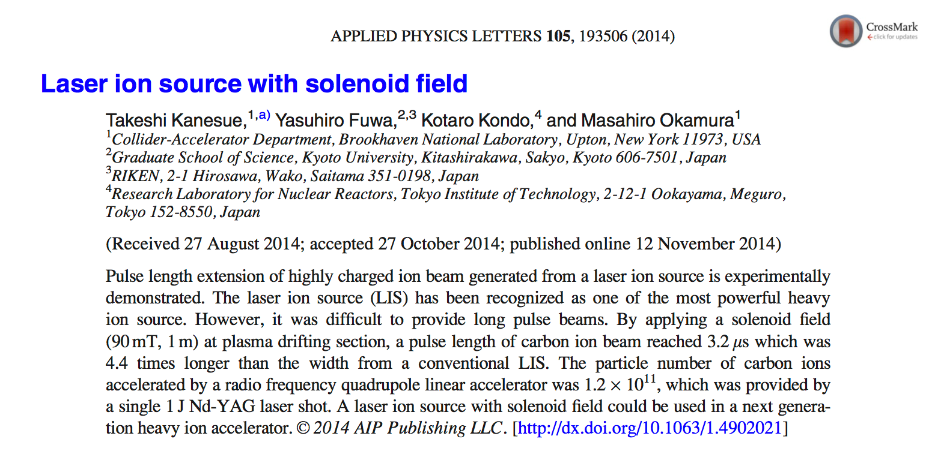
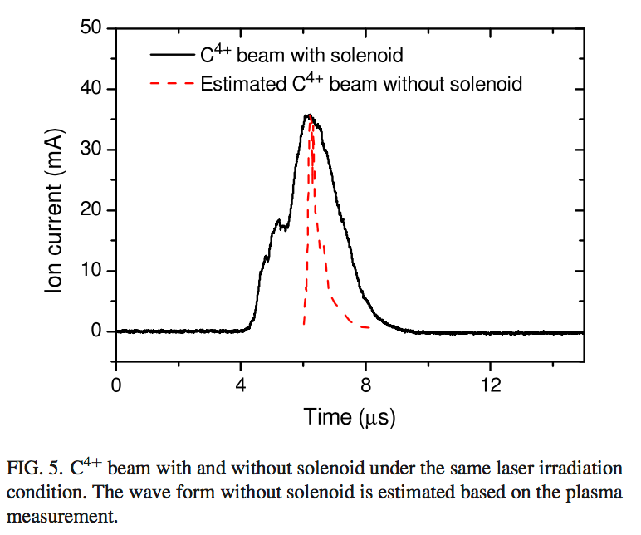
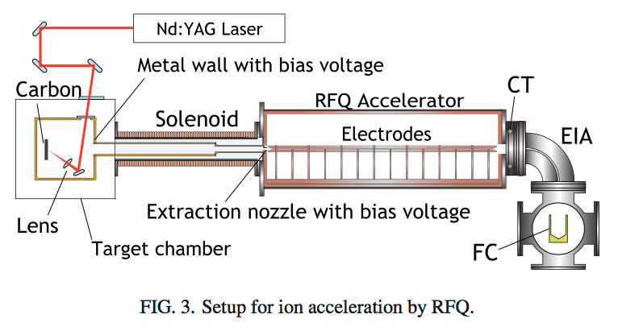
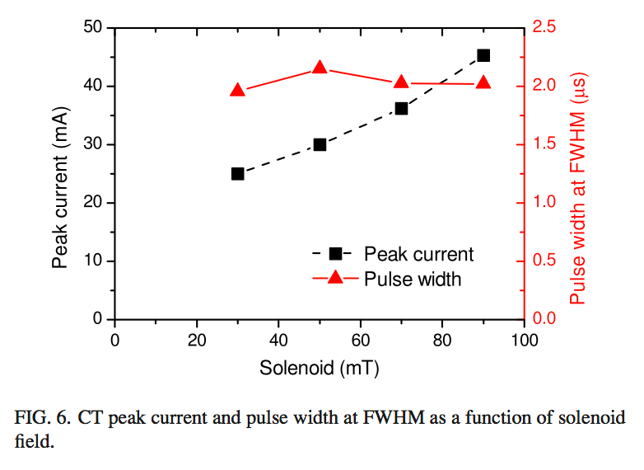
Carbon beam, before FOA funded
We have demonstrated that 1.2x10¹¹ of C⁴⁺ can be provided by a single laser shot.

Slide 16
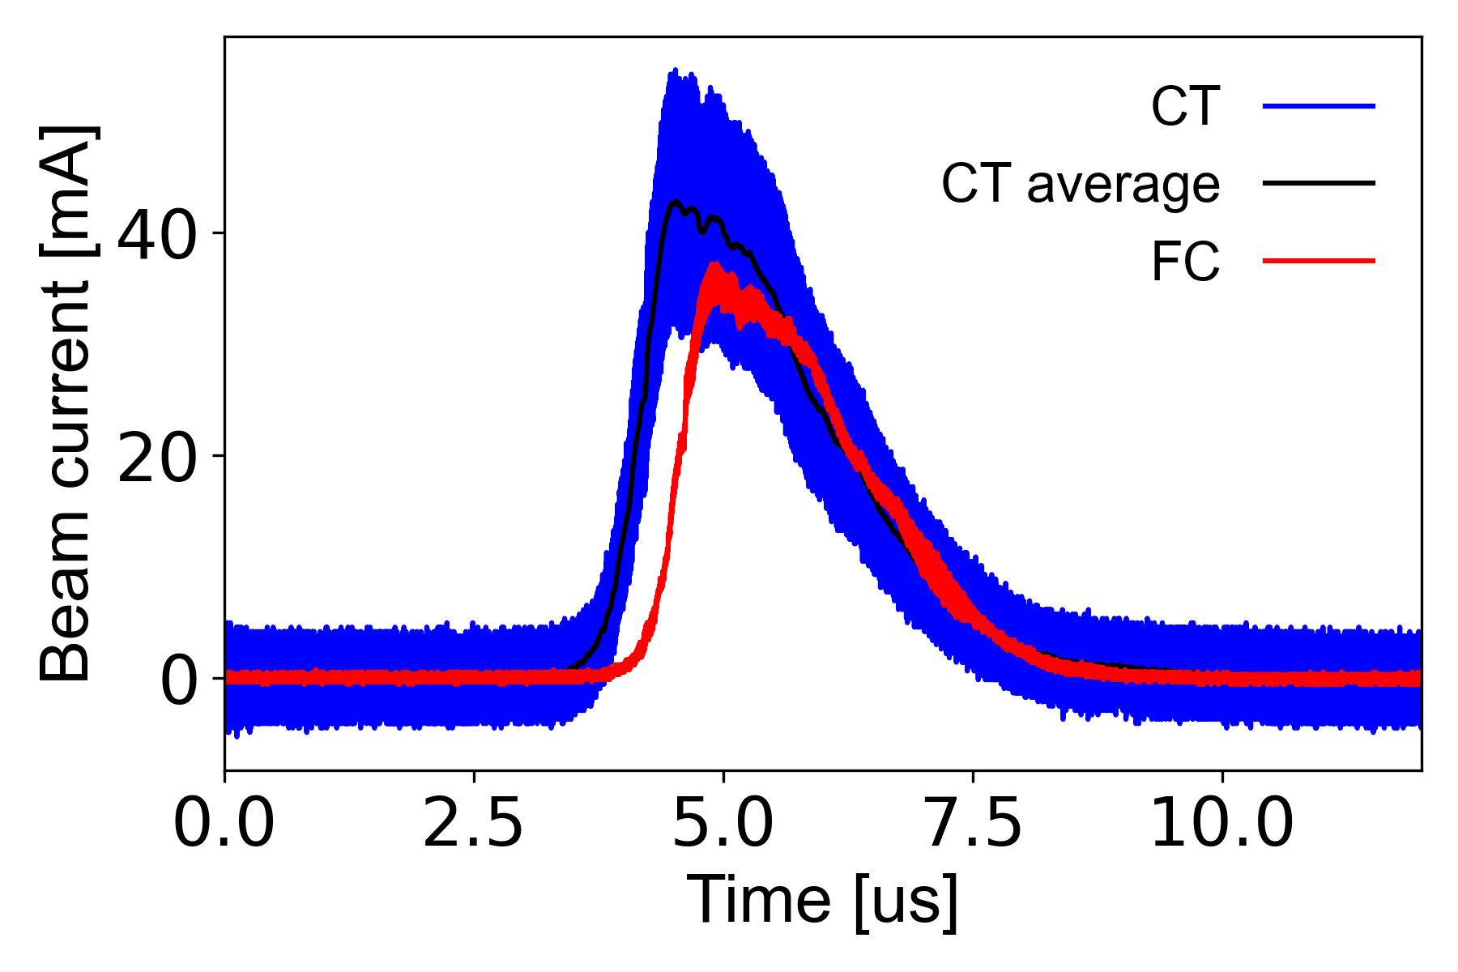
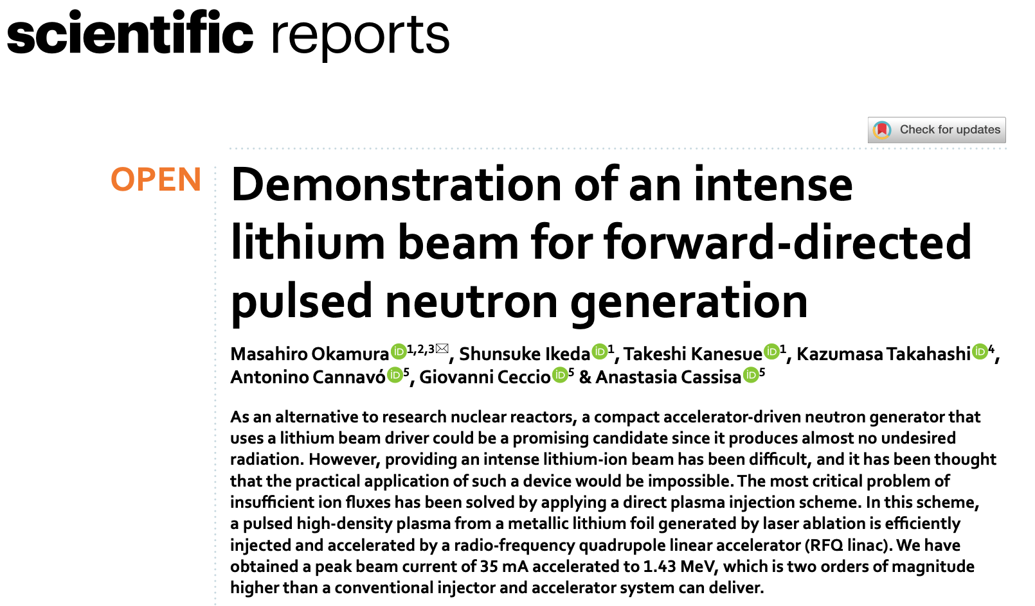
⁷Li³⁺ beam, before FOA funded
(parameters from target to FC were optimized for 7Li3+)
Laser
  Thales
  QS220 us,
  1.6 J at laser exit (~0.8 J at target)
Solenoid : 15 A (790 G)
Extraction voltage : 52 kV
RF power : ~ 100 kW
Q1 : 8A
Q2 : 13.2 A
Q3 : 6.8 A
Dipole : 110 A (2.7 kG)
Ring bias : -400 V
CT peak : 43 mA, 95 nC
FC peak : 35 mA, 74 nC
FWHM : 2.0 us

Slide 17
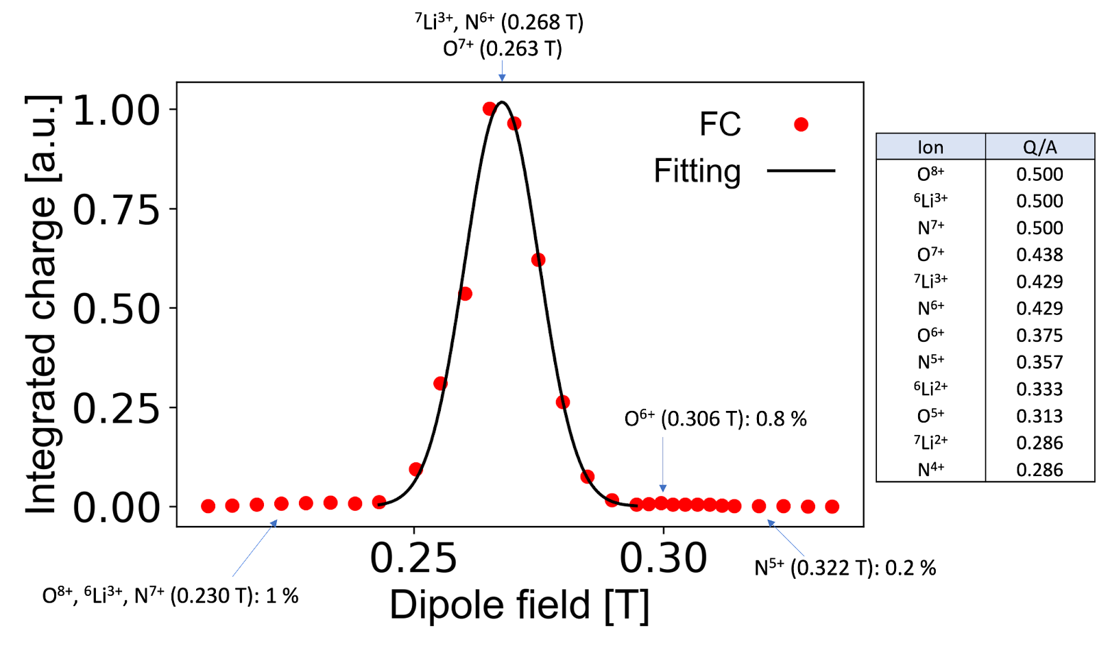
Analyzed beam
Contamination ~ 2 %

Slide 18
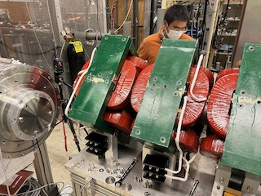
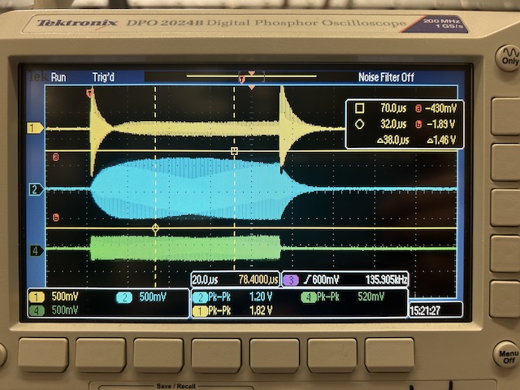
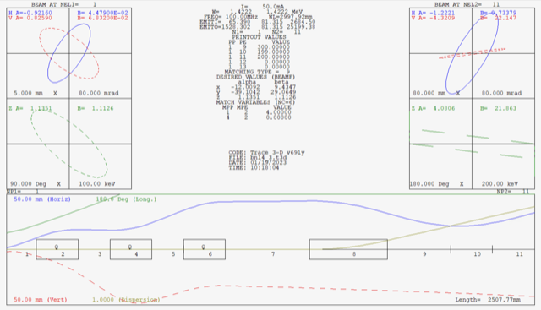
Improvement of the accelerator system and R&Ds

Slide 19
Test of new beam extraction structure

Slide 20
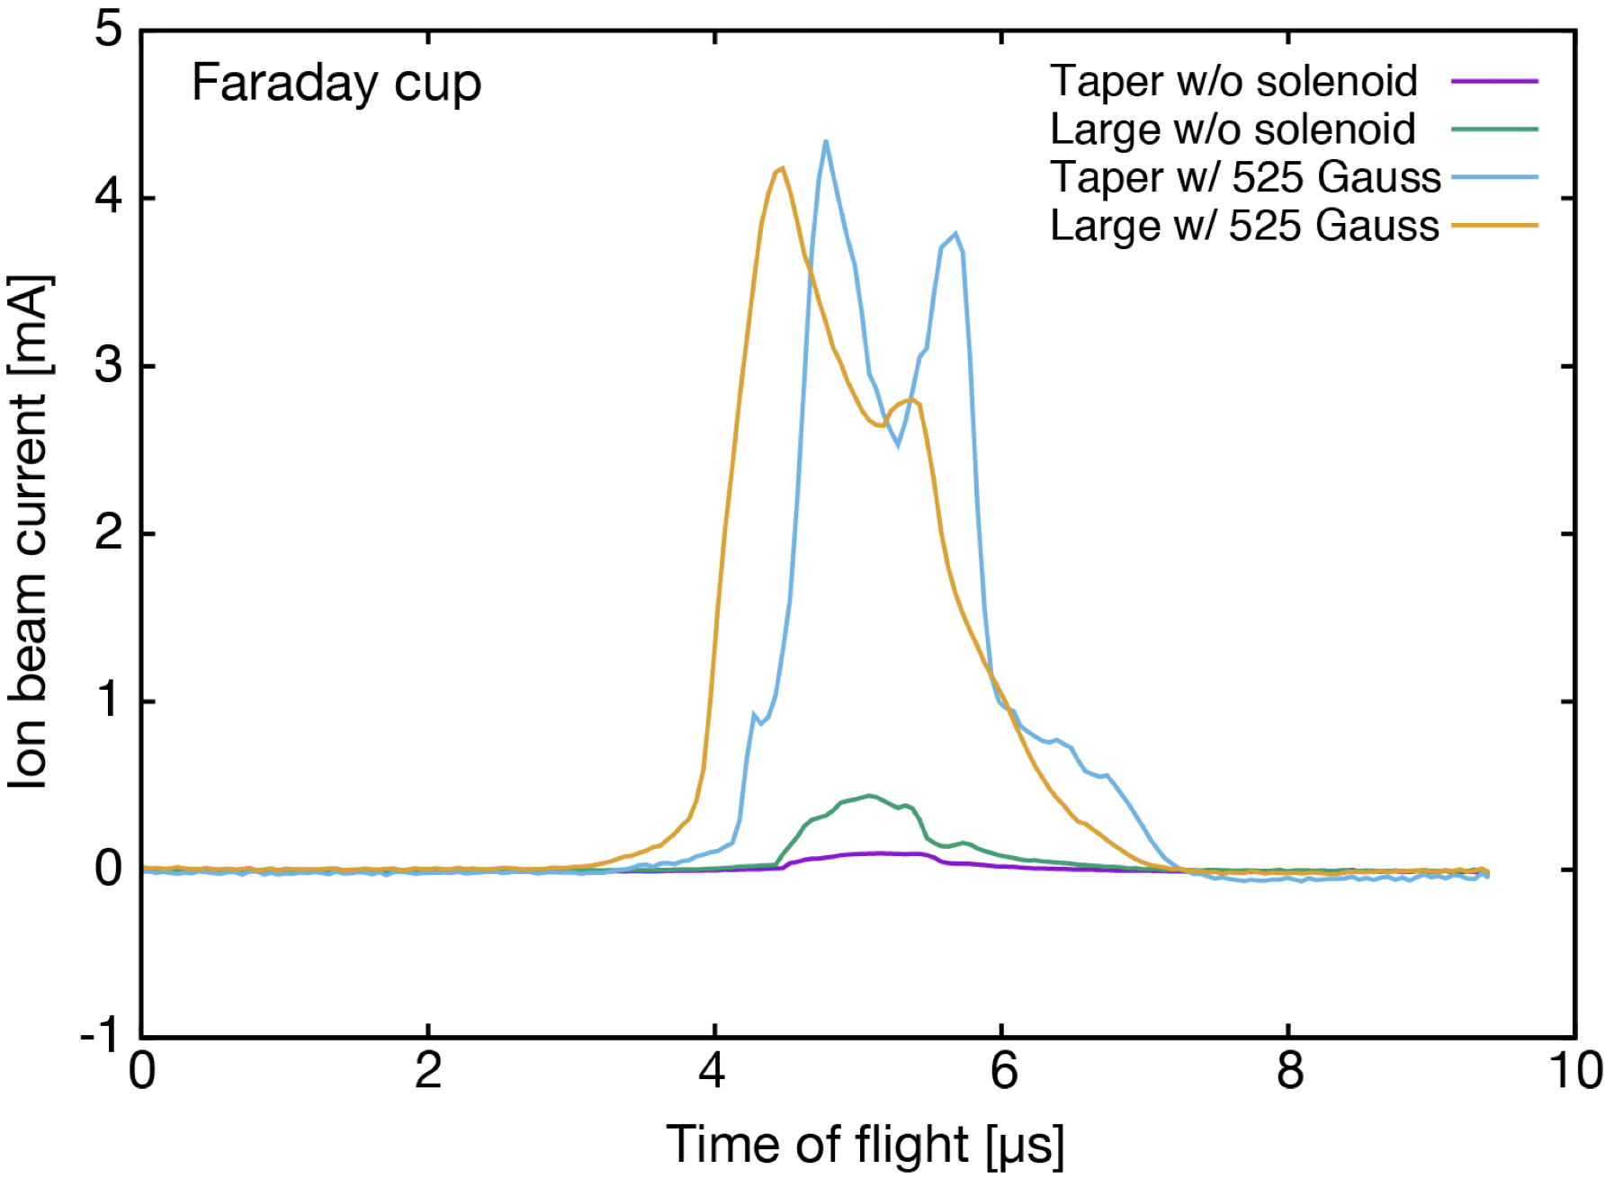
¹¹B⁵ beam was accelerated. Accelerated particle number reached 7.43E9 ions.

Slide 21
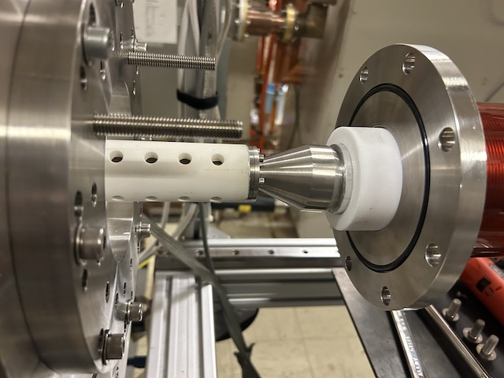
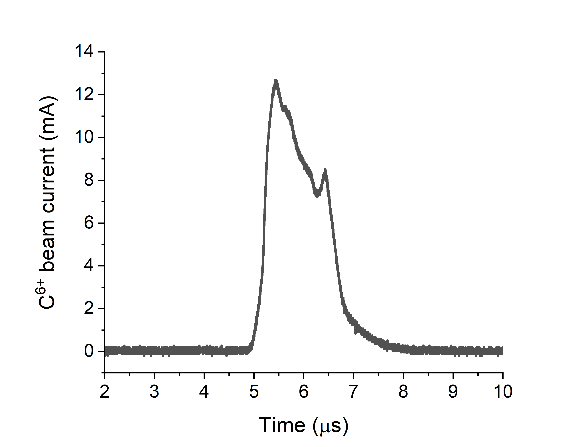
¹²C⁶ beam with the new ion source structure.
1.58E10 ions (BNL EBIS: 2.5E9)
12.7 mA peak current
To prevent magnetron discharge in the
solenoid, the space was filled by Teflon.
So far, we tested Li, B, C and Mg.

Slide 22
New design of RFQ electrode (type 1)
Design criteria
Max m/q = 7/3 (assuming ⁷Li³⁺)
Target output peak current > 100 emA
Extraction voltage ~50 kV
100 MHz
Transmission ~ 75% inter-vane voltage of 105 kV
Kilpatrick factor <2
2 m long
Output energy 280 keV/n

Slide 23
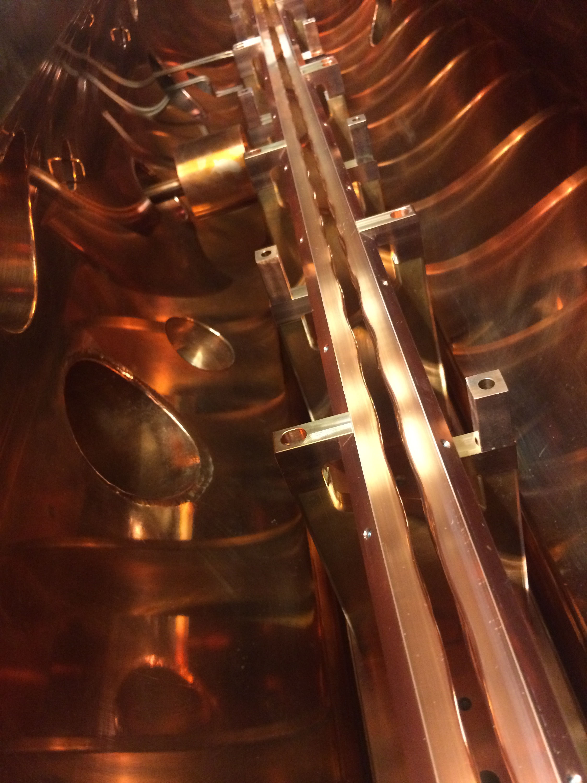
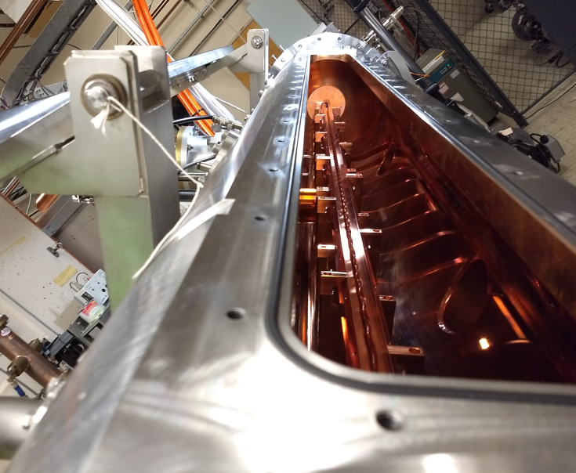
BNL test RFQ for DPIS

Slide 24
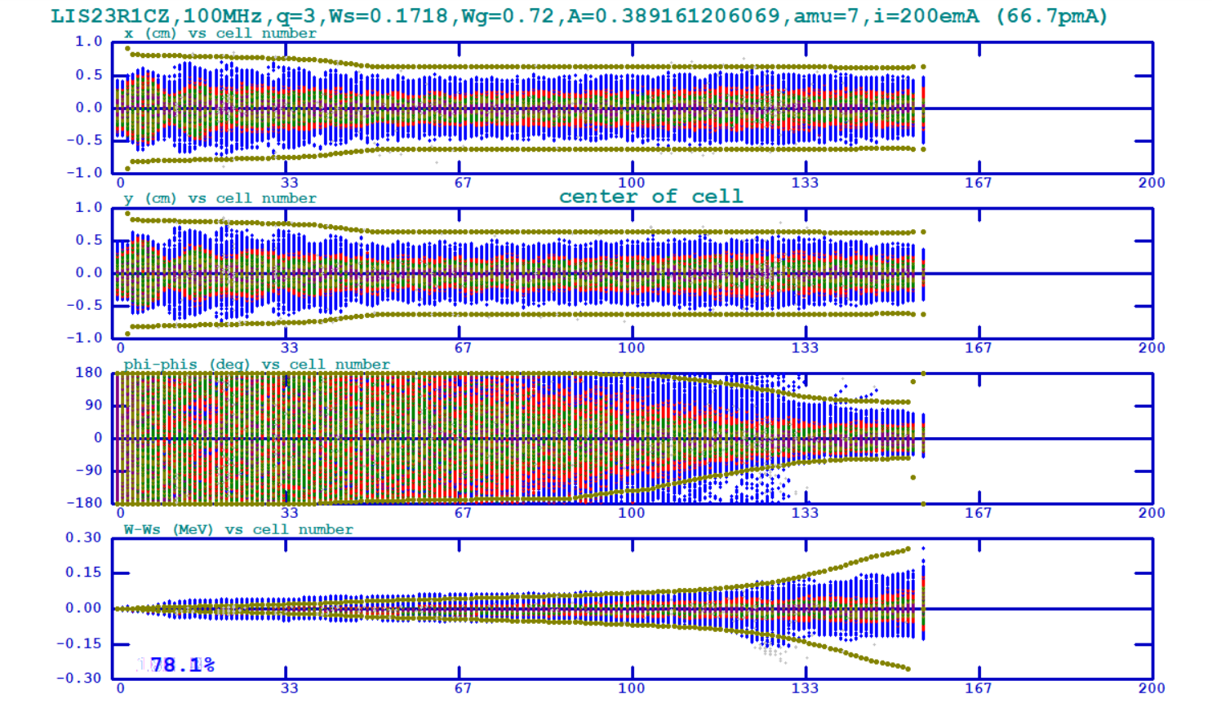

Slide 25
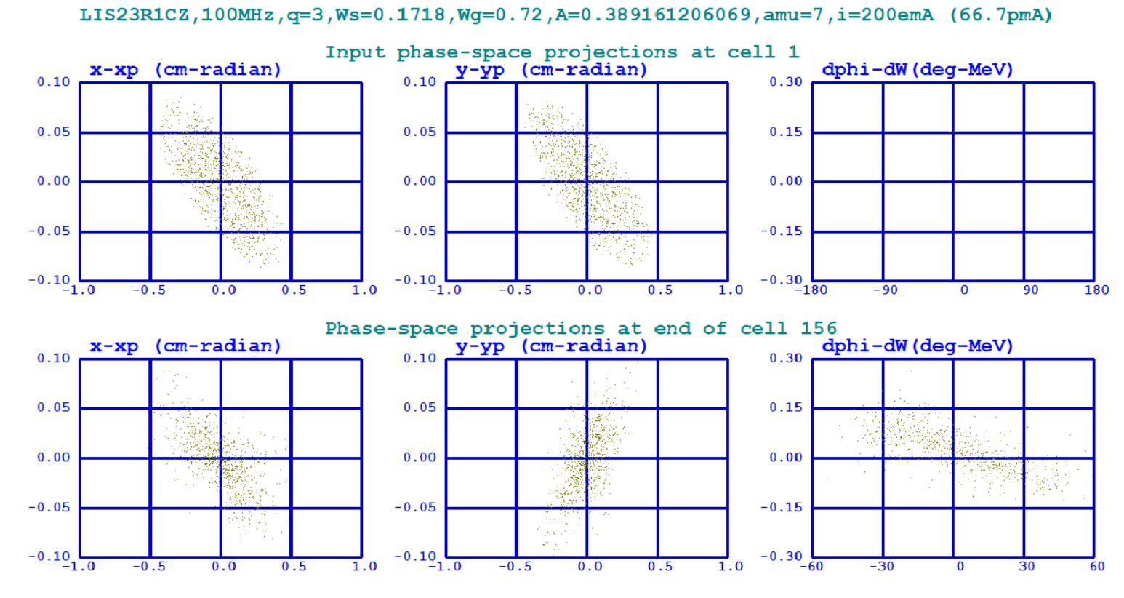

Slide 26
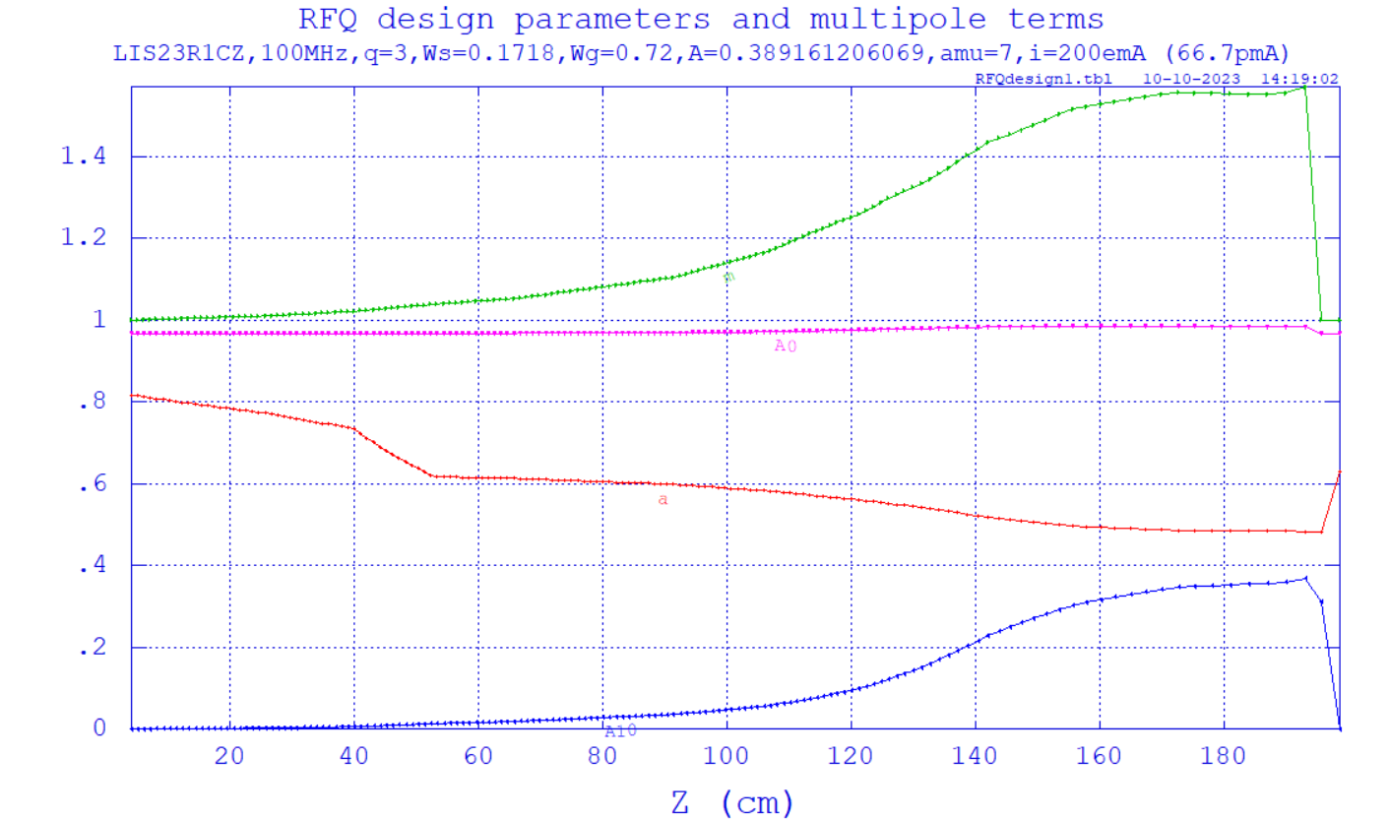

Slide 27
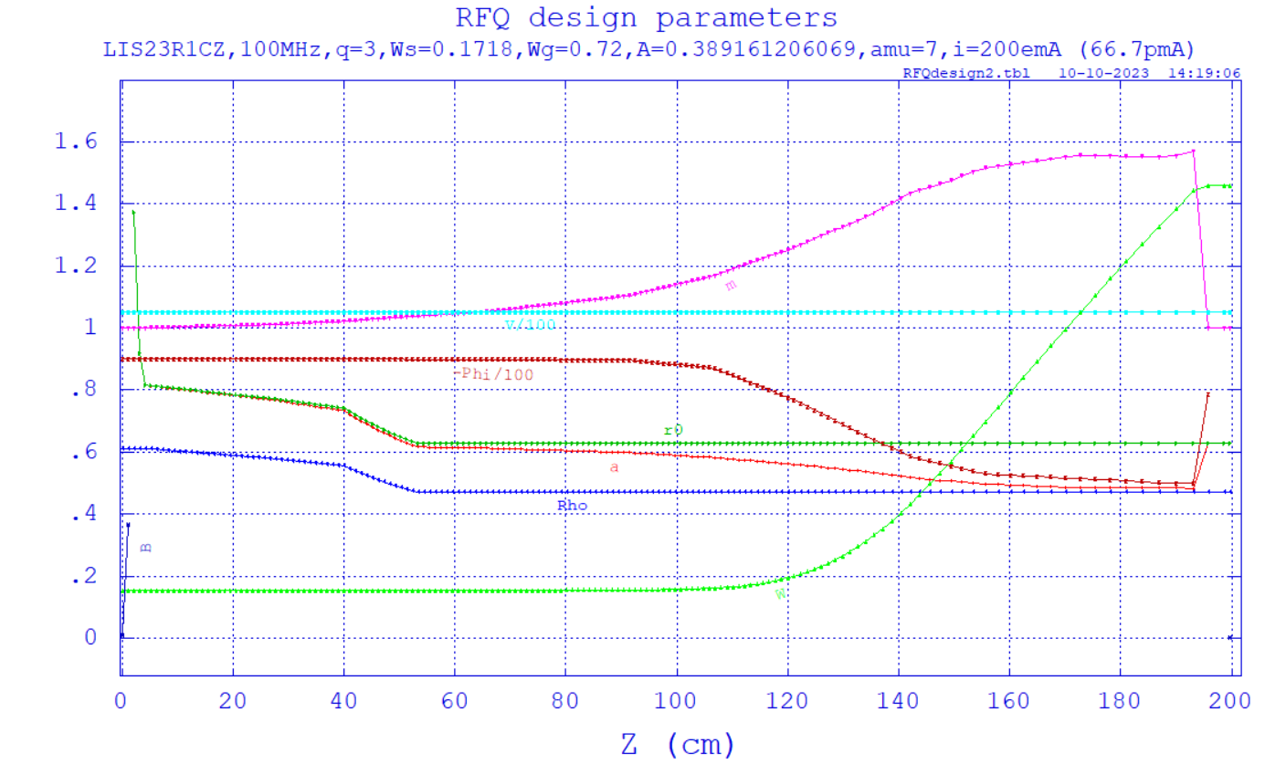

Slide 28
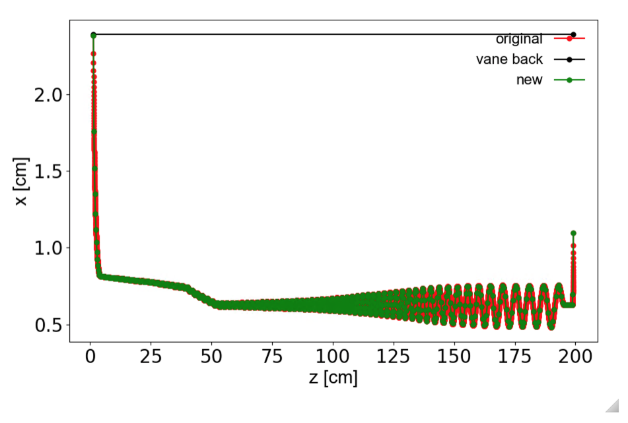
Variable aperture design
r0 [cm]
Larger aperture around injection to keep beam radius large until finishing bunch formation.
Property as a RF resonator need to be verified.

Slide 29
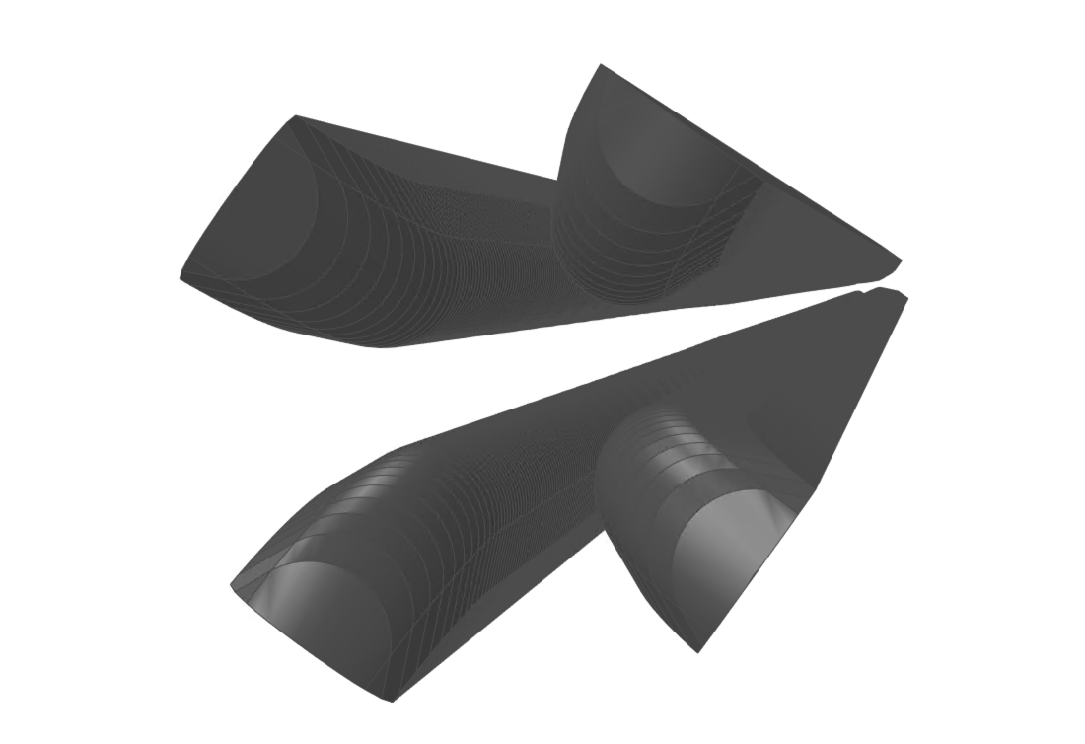
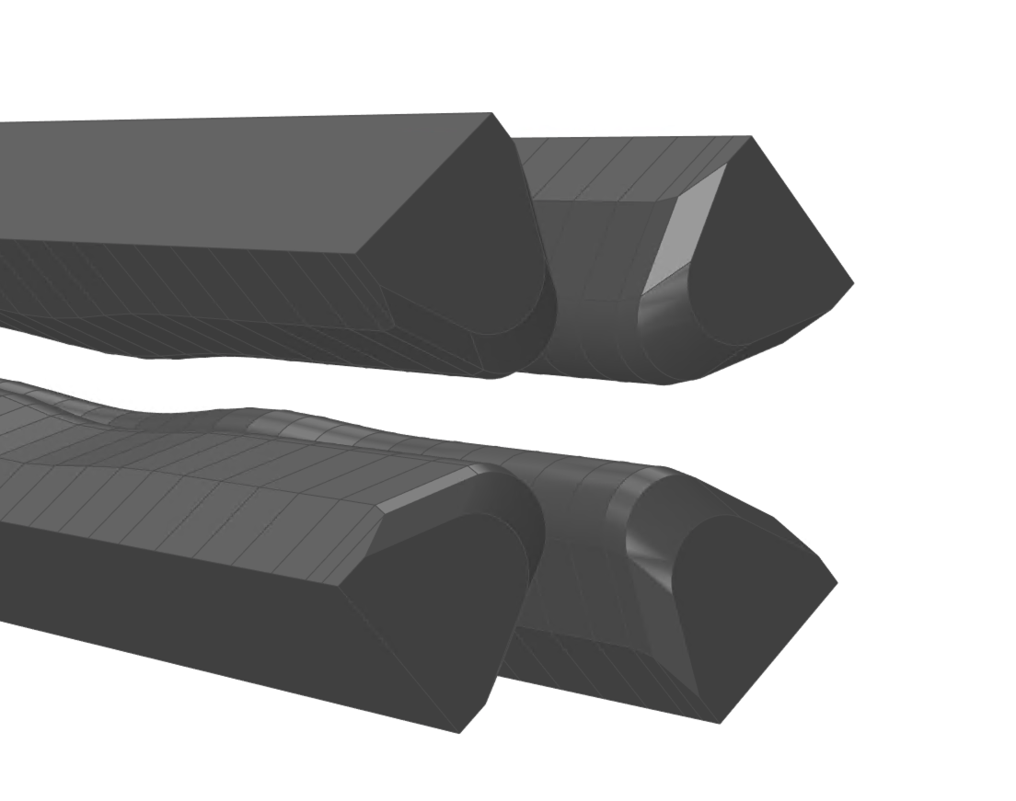
Shape of RFQ vanes
Injection
~2m
Extraction

Slide 30
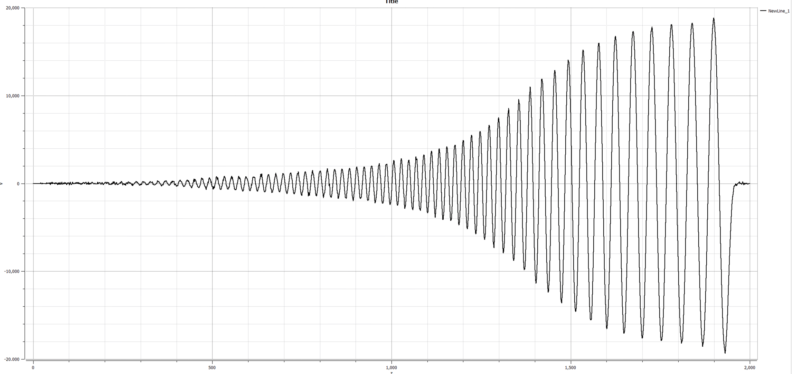
20 kV
10 kV
Voltage on axis [V]
Distance from wall [mm]
3D modeling is almost done. Ready for RF simulation
Simulation: Pk-pk = 36.4 kV
Design: A0=0.36, V=105kV -> 37.8 kV

Slide 31
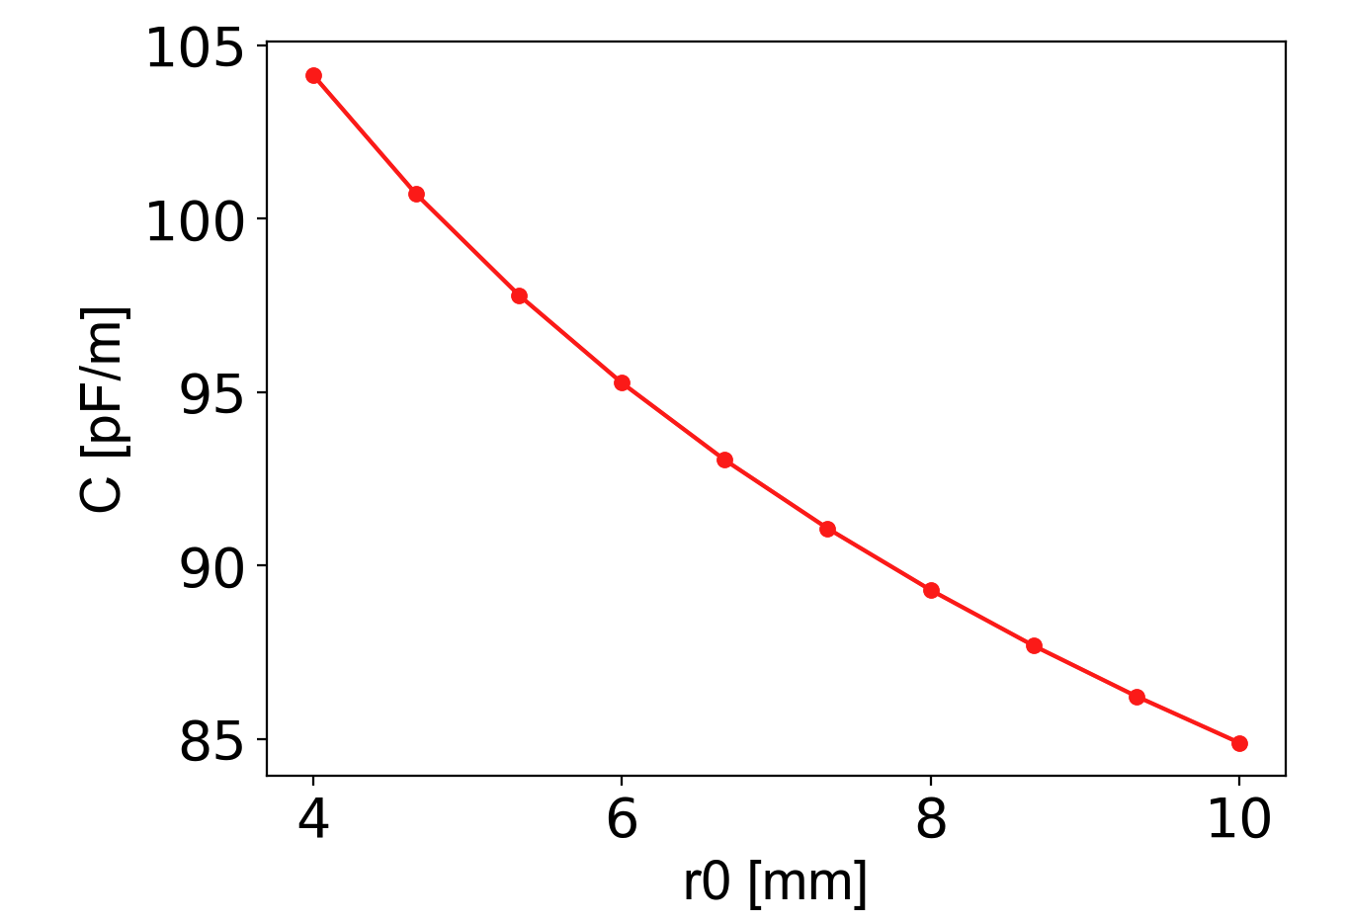
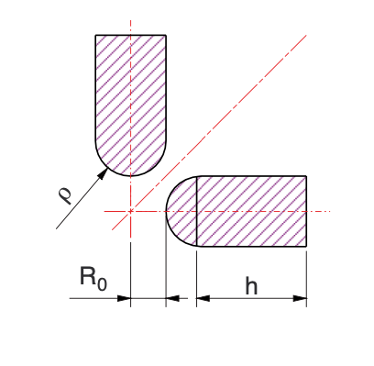
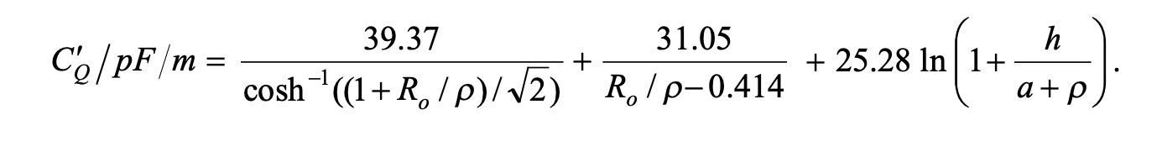
Consideration of capacitance variation
Extraction
Injection
As r0 is reduced from entrance to exit, capacitance of electrodes also decreases
This may result in variation of resonant frequency and electrode voltage

Slide 32
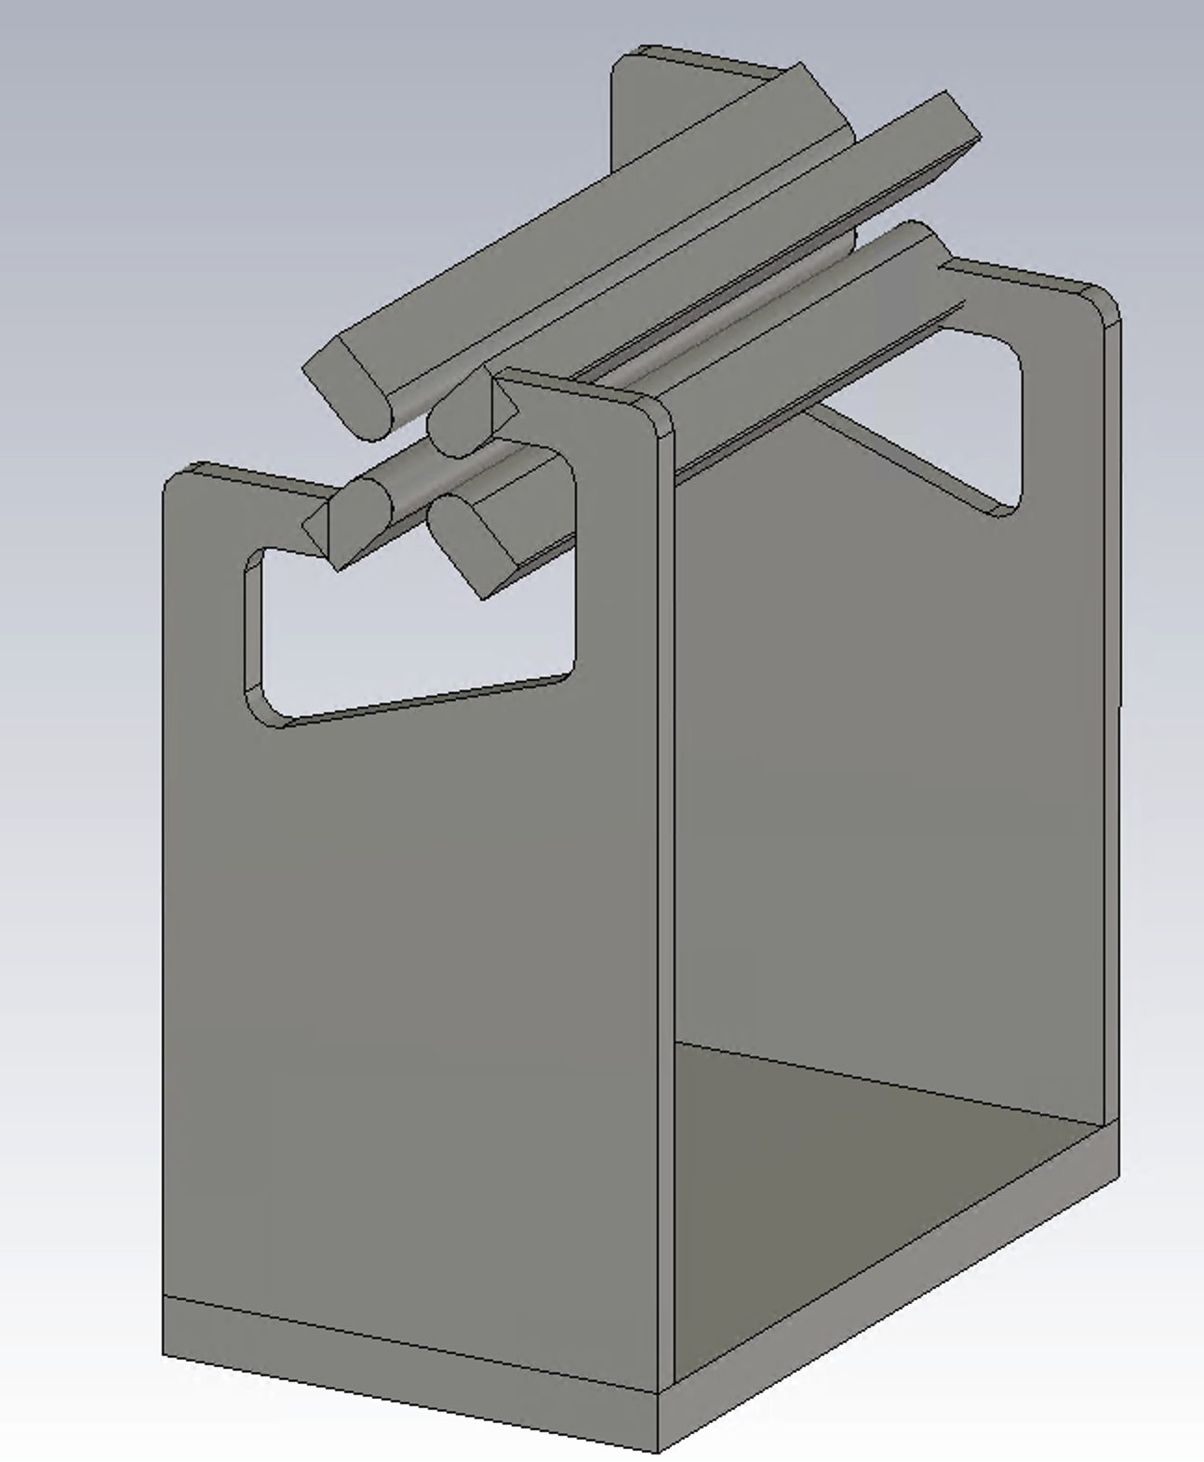
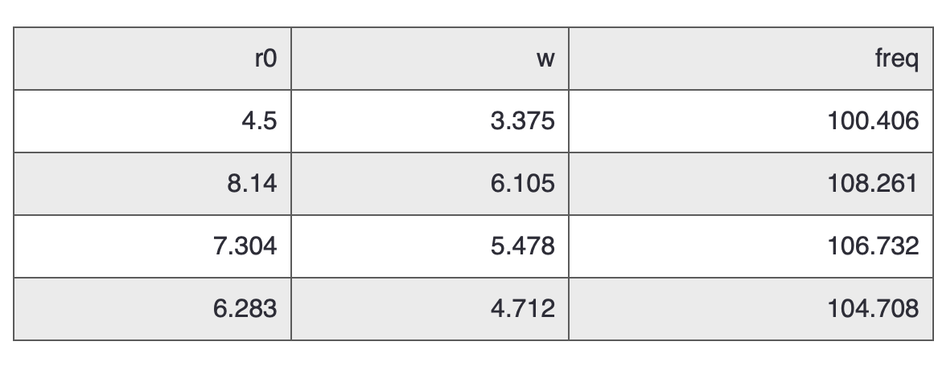
Investigation of resonant frequency variation with simple model
Entrance
Variation
Exit
Vane shape needs to be designed to have small variation of capacitance and voltage
Short model with periodic boundary condition
The final RF property is being simulated by CST.

Slide 33
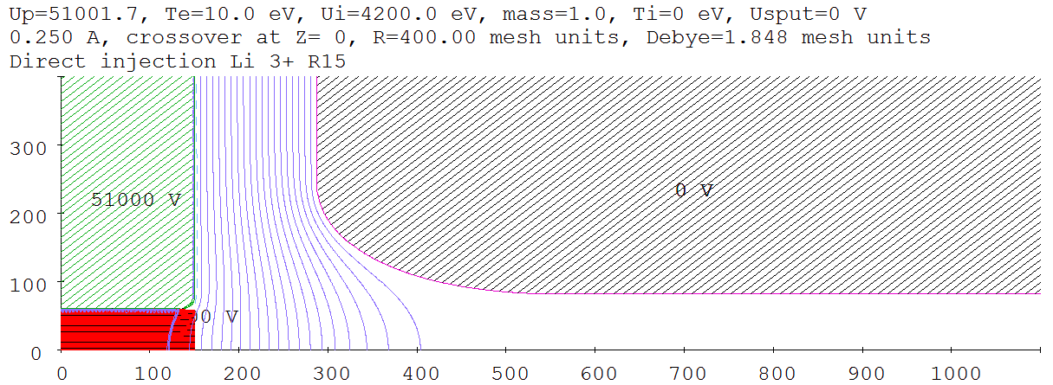
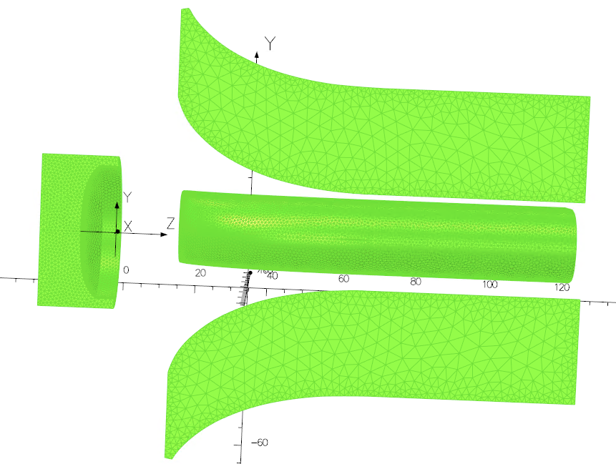
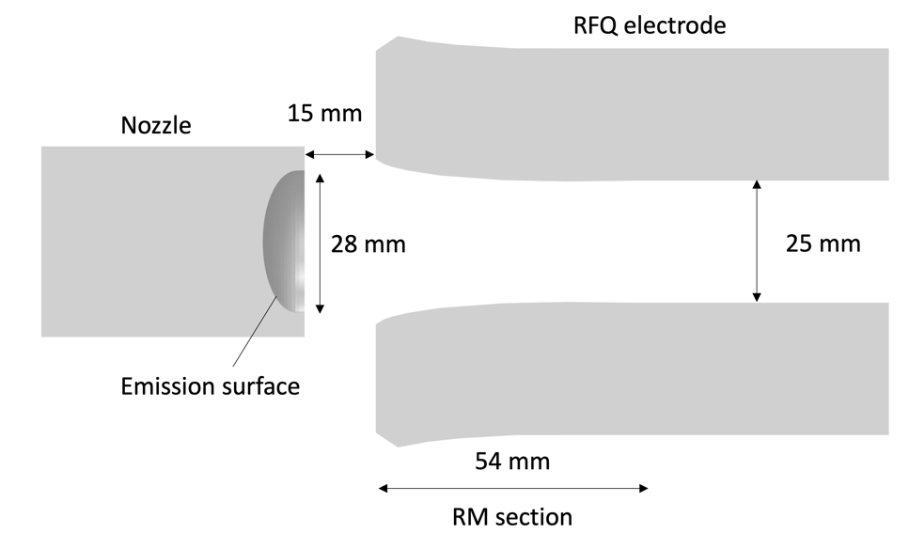
Simulation strategy at the injection region
Plasma sheath: IGUN
3D field: OPERA
Tracking: GPT
Anode nozzle
Parmteq design
Optimized design
The first set of the vanes are being procured.

Slide 34
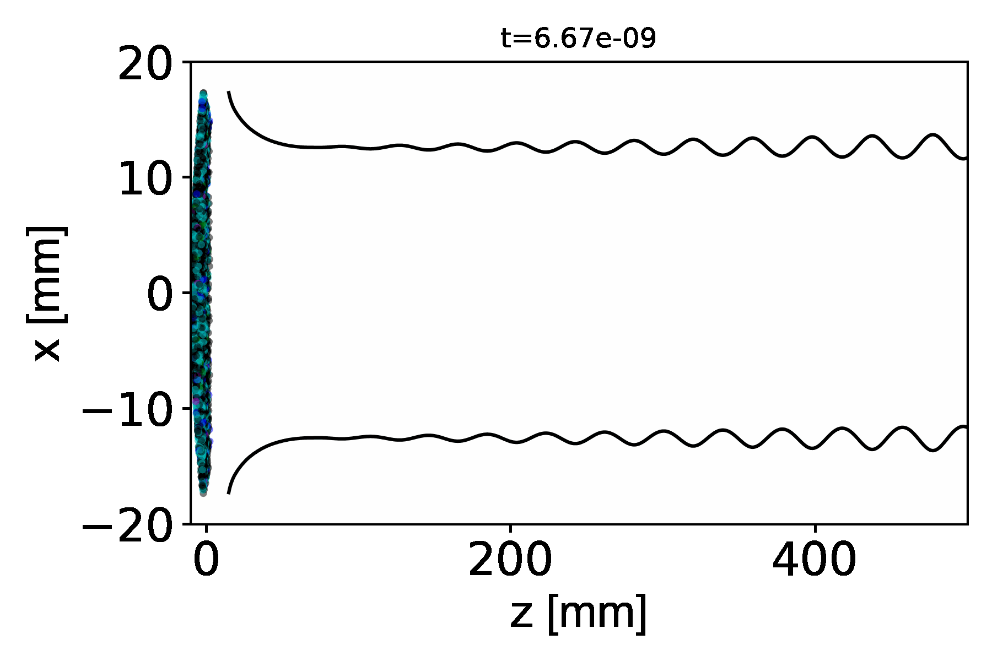
A simulation paper for current limit is almost ready to submit.
L = 25 mm, dt = 100 ns, I_peak = 1 A - 1.3 A, 4.2 keV initial kinetic energy
OPERA
Formula
Simulation condition
GPT + OPERA/Formula
10 RF periods
red 6Li1
green 6Li2
blue 6Li3
magenta 7Li1
cyan 7Li2
black 7Li3
100%
82%
59%
51%
Particle removal start
at Z=77mm
Output current
7Li3 : 350 mA
Others : almost no ions accelerated

Slide 35
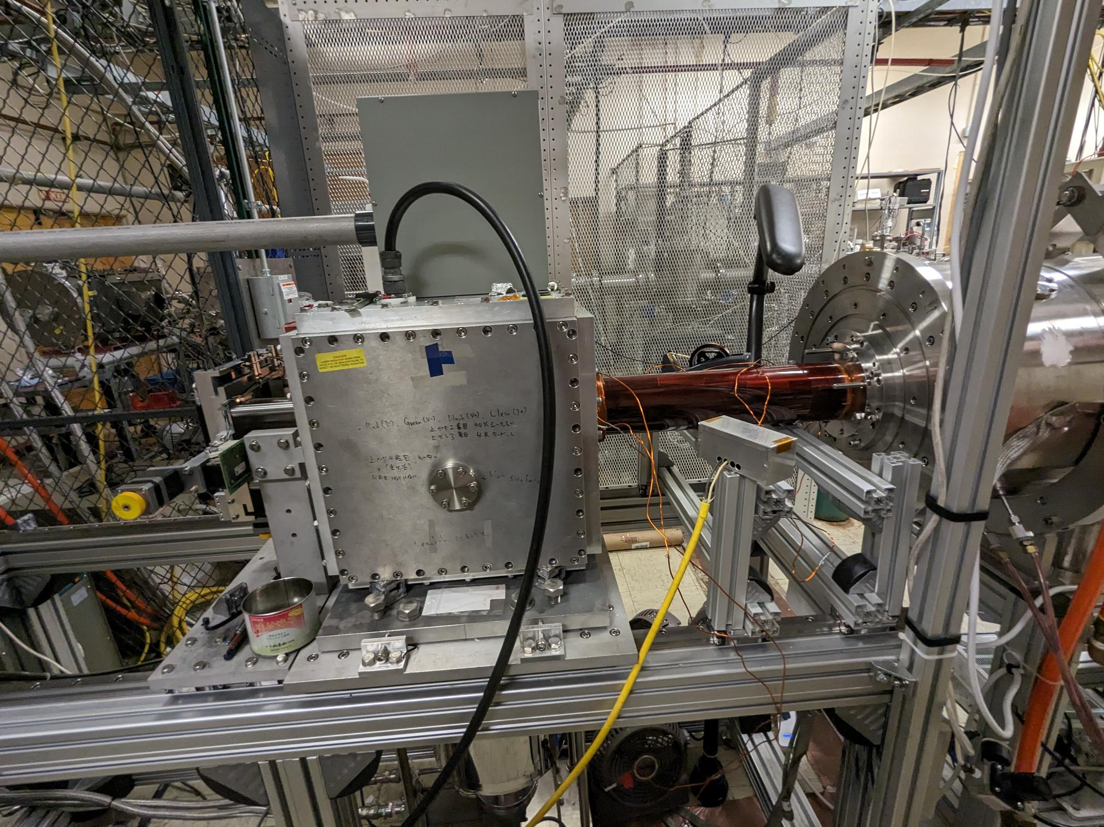
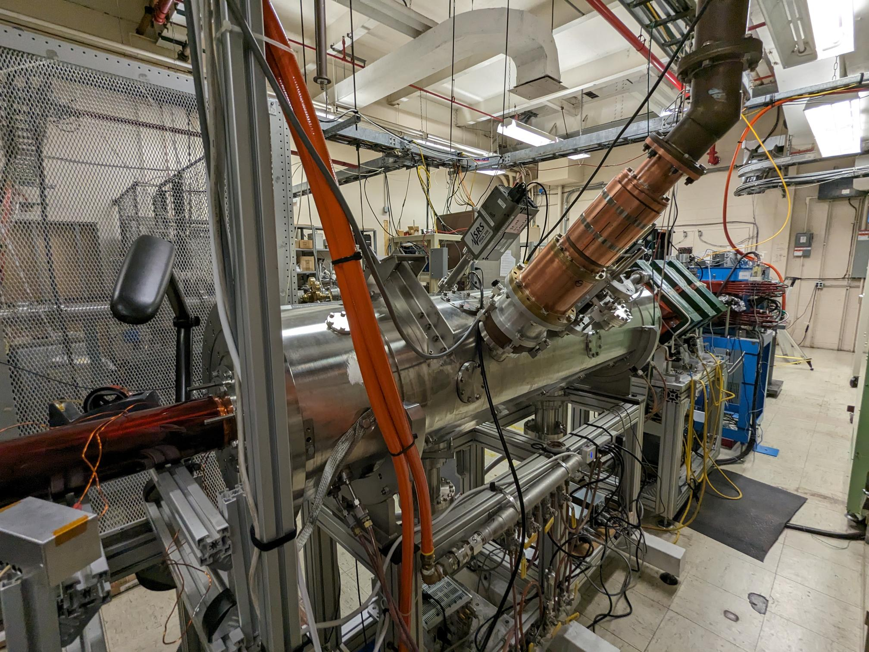
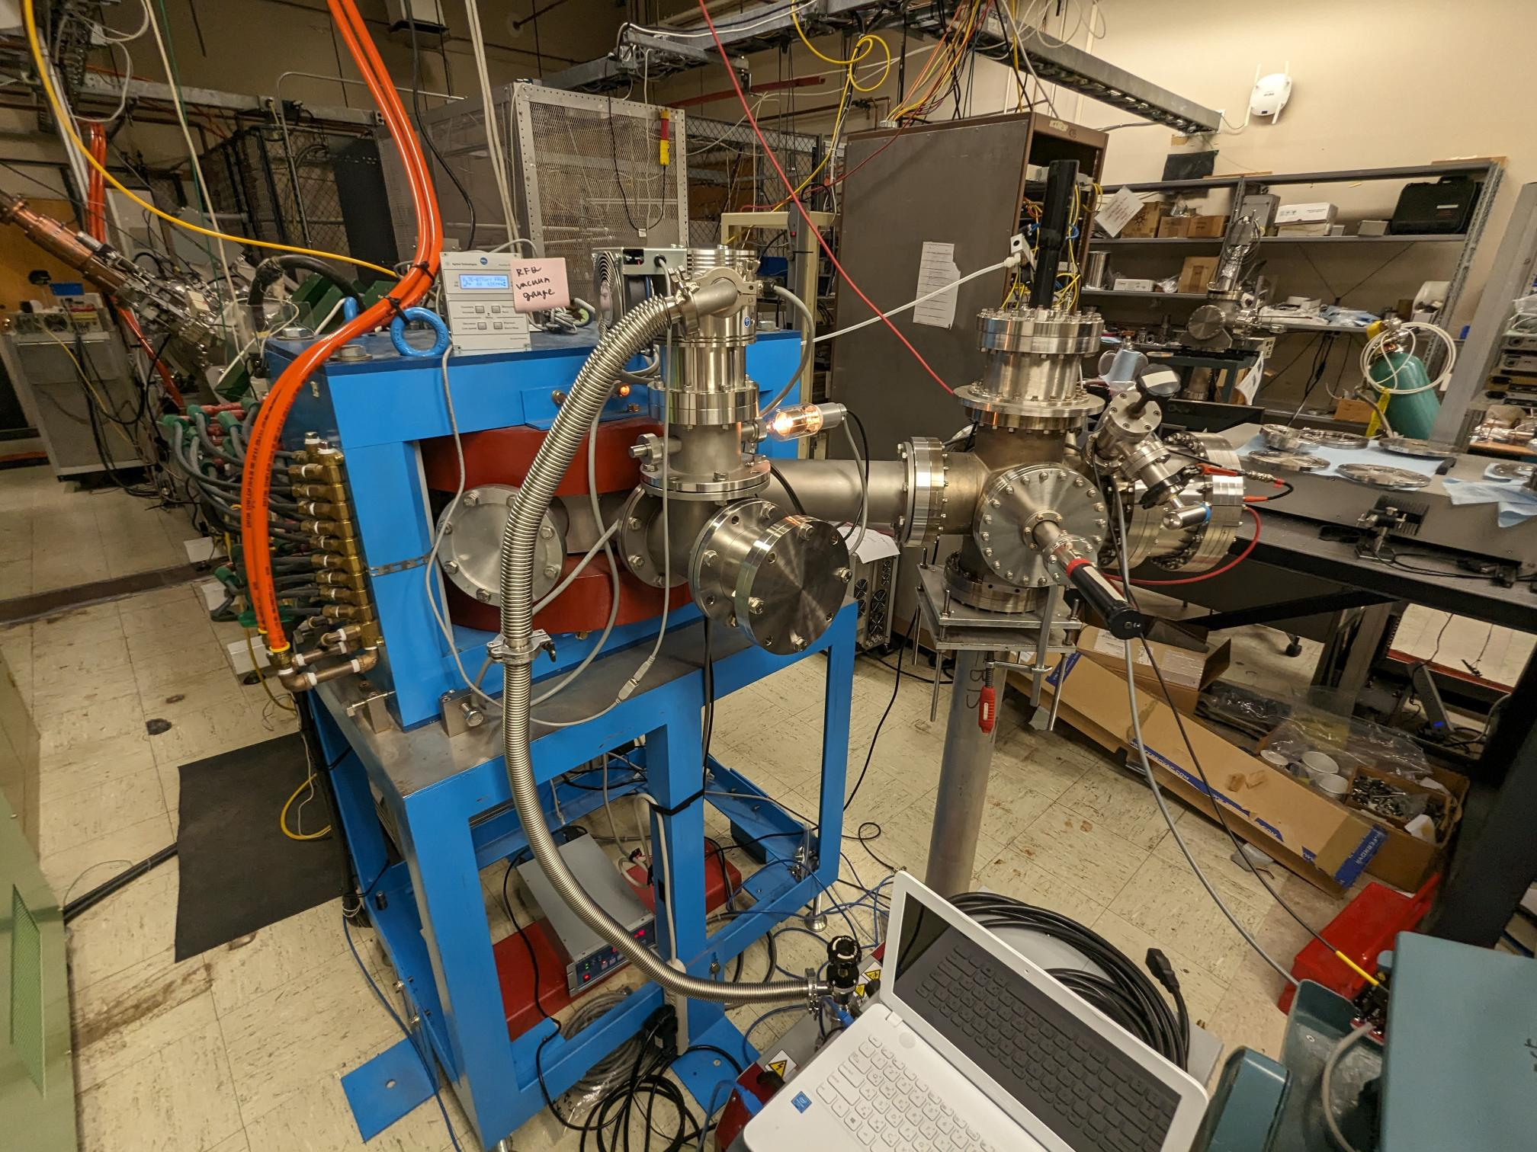
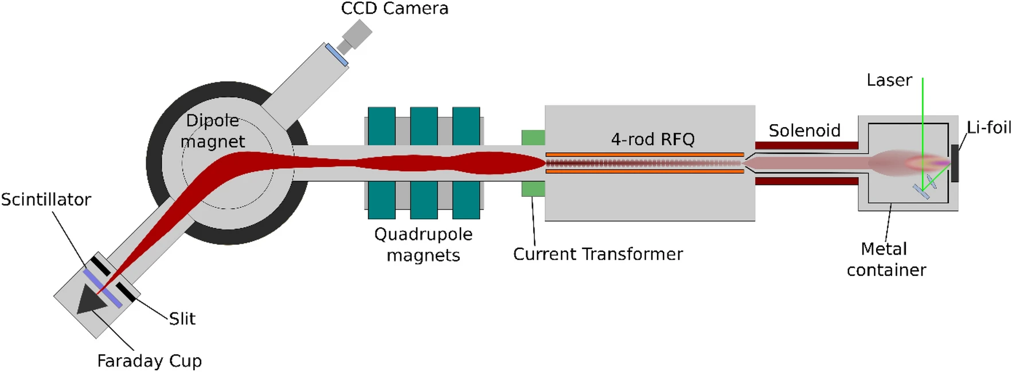
Mg acceleration test
Plasma Chamber
RFQ accelerator and beam line
Dipole magnet and end of beamline
Solid targets

Slide 36
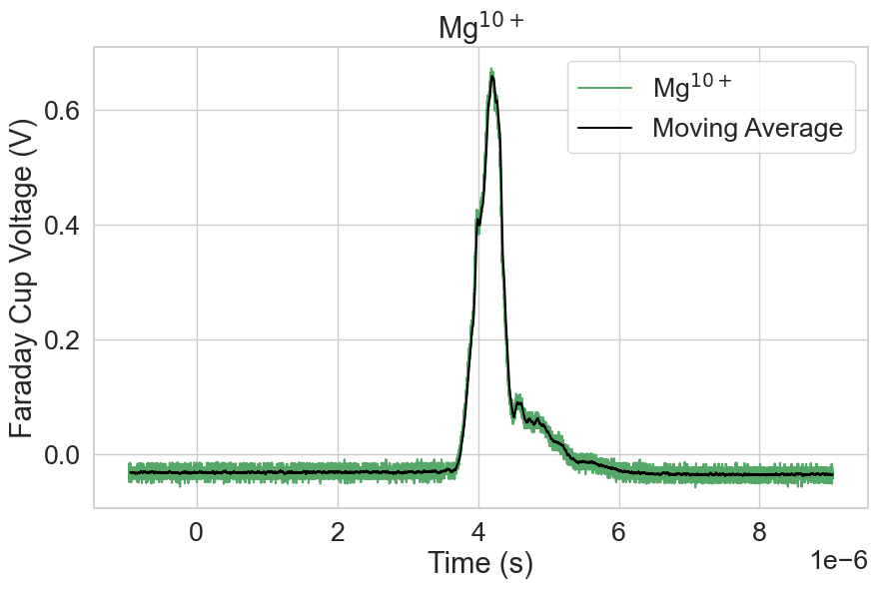
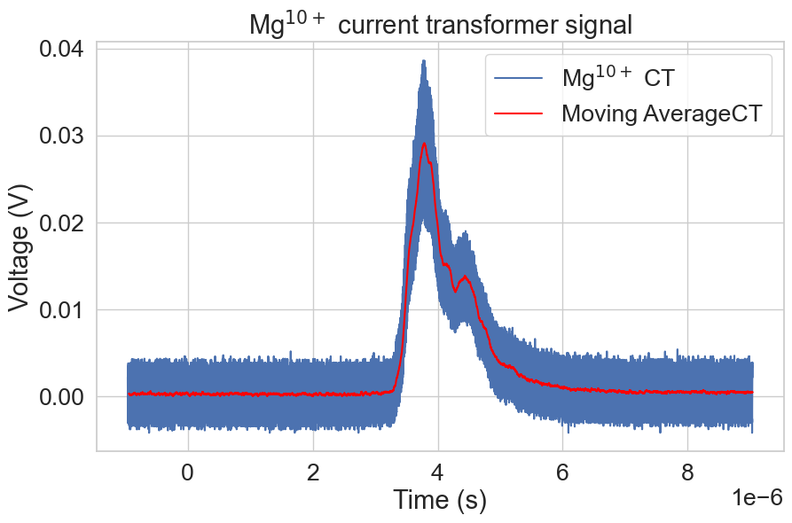
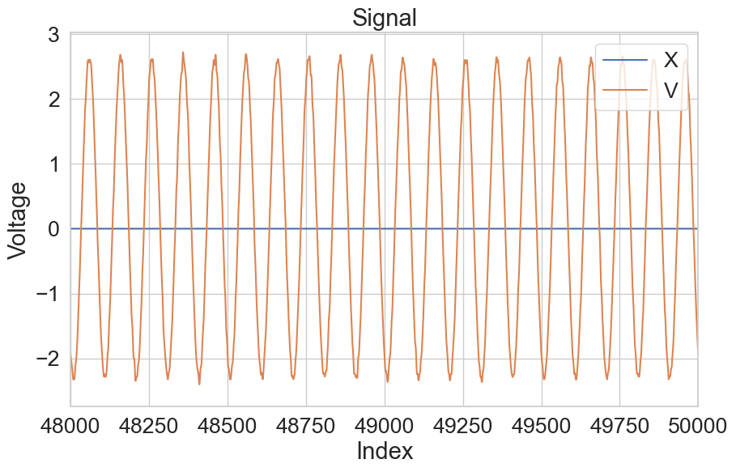
Faraday Cup Signal
Current Transformer Signal
RFQ cavity signal

Slide 37
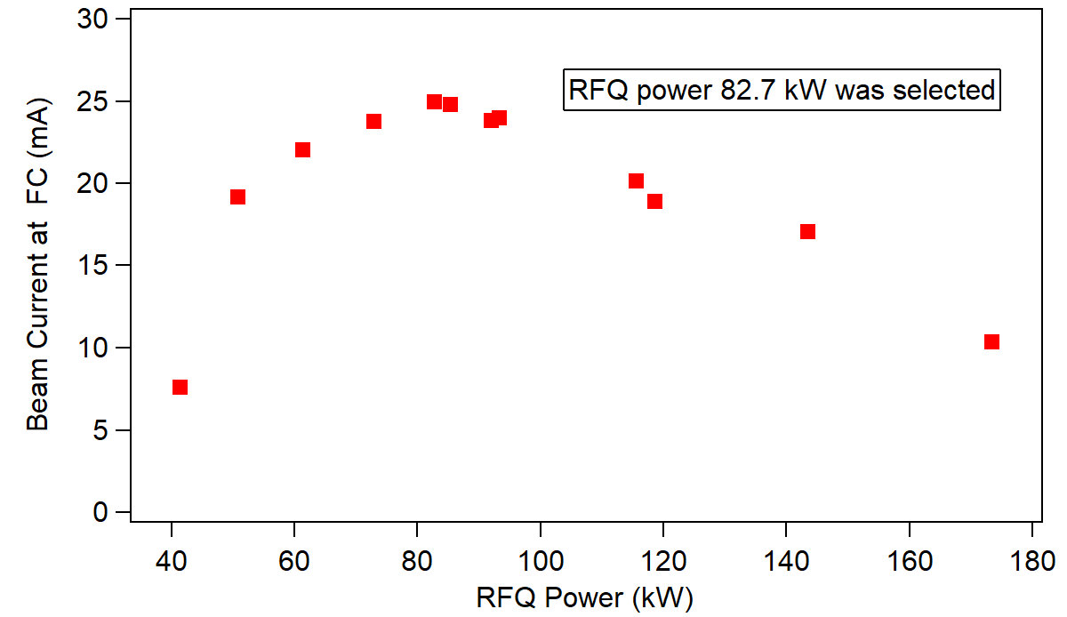
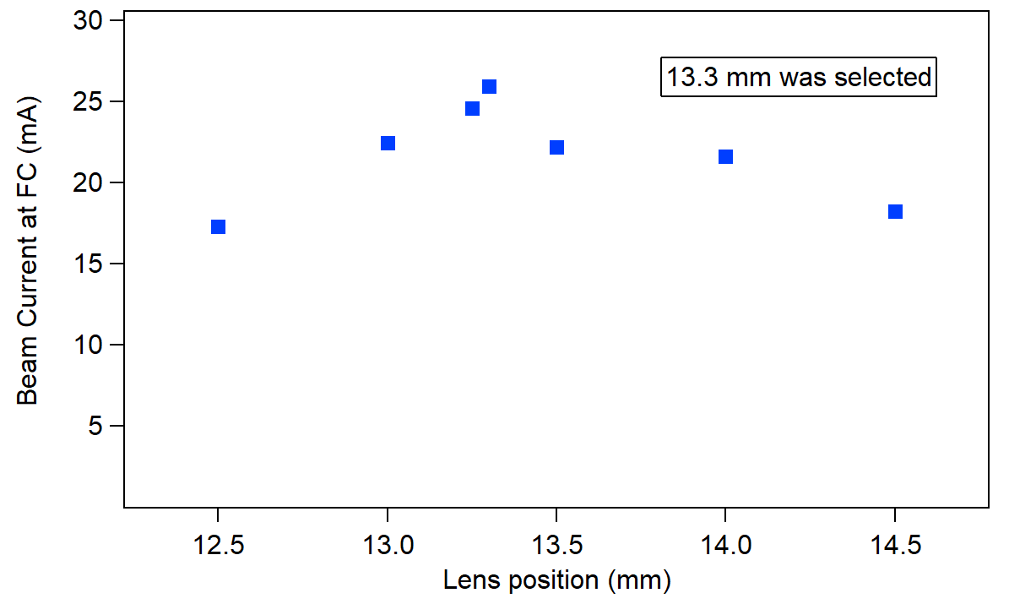
FC Max Voltage vs RFQ Power
FC Max Voltage vs Lens Position
These data were taken without biasing Faraday cup.

Slide 38
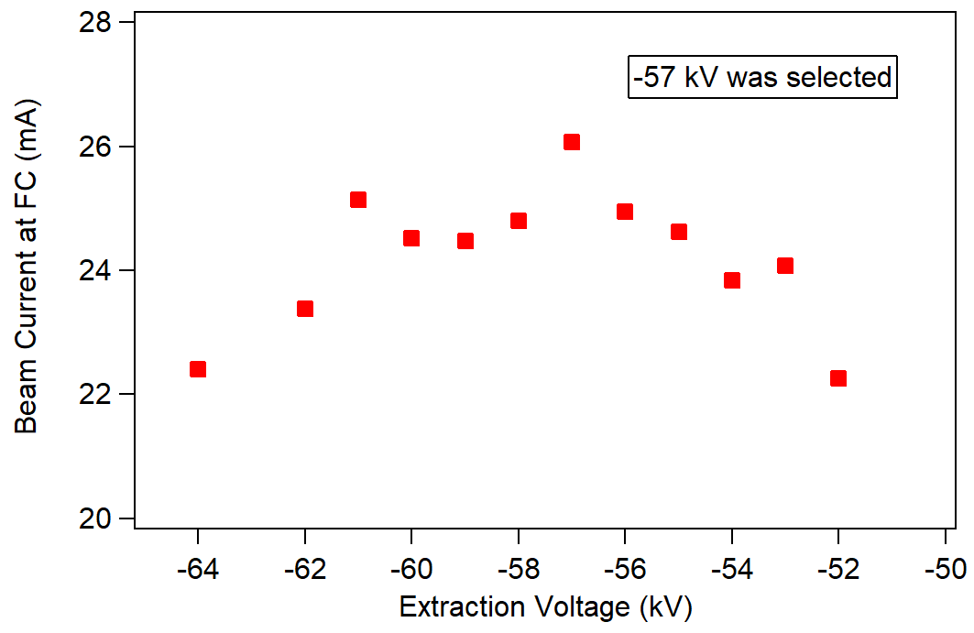

FC Max Voltage vs Extraction Voltage
FC Max Voltage vs Bias Voltage

Slide 39

Good working region at a low field

Slide 40

Mg¹⁰⁺ max beam current (Tentative results)
Parameters FC | Analysis | Measured from Oscilloscope
Area under the curve | 785 nVs | 689.9 nVs
Ch2 Max Voltage | 1.153 V | 1.137 V
Total charge | 1.57e-08 C
No of particles | 9.82e+09
Beam current at faraday cup | 23.07 mA

Slide 41

Parameters CT | Value
Vmax | 0.039 V
Beam current | 31.39 mA
Area under curve | 40 nVs

Slide 42

Mg¹²⁺ max beam current
Parameters FC | Analysis | Measured from Oscilloscope
Area under the curve | 238 .7 nVs | 133.6 nVs
Faraday Cup Max Voltage | 0.61 V | 0.609 V
Total charge | 4.77e-09 C
No of particles | 2.49e+09
Beam current ar faraday cup | 12.34 mA

Slide 43

Parameters CT | Value
Vmax | 0.022 V
Beam current | 17.65 mA

Slide 44
Scintillator image of Mg¹⁰⁺ beam
Slit width ~25 mm
Mg¹⁰⁺ using Image J software

Slide 45
Data analysis of Mg beam is in progress
Isotopes separation
m for Mg Isotopes | q | m/q | Dipole current based on Mg¹⁰⁺
24 | 12 | 2 | 102.5
25 | 12 | 2.083333 | 106.7708
26 | 12 | 2.166667 | 111.0417
24 | 11 | 2.181818
25 | 11 | 2.272727 | 116.4773
26 | 11 | 2.363636 | 121.1364
24 | 10 | 2.4 | 123
25 | 10 | 2.5 | 128.125
26 | 10 | 2.6 | 133.25
24 | 9 | 2.666667 | 136.6667
25 | 9 | 2.777778 | 142.3611
26 | 9 | 2.888889 | 148.0556
24 | 8 | 3 | 153.75
25 | 8 | 3.125 | 160.1563
26 | 8 | 3.25 | 166.5625
24 | 7 | 3.428571 | 175.7143
25 | 7 | 3.571429 | 183.0357
26 | 7 | 3.714286 | 190.3571
Isotope | Abundance
²⁴Mg | 79%
²⁵Mg | 10%
²⁶Mg | 11%
Scan from 117A -129 A dipole current range to find isotopes and contaminants that could be influence to Mg¹⁰⁺ beam current
m | q | m/q | Dipole Current | Ion
16 | 7 | 2.285714 |  | 16O7+
14 | 6 | 2.333333 |  | 14N6+
26 | 11 | 2.363636 | 121.1364 | 26Mg11+
24 | 10 | 2.4 | 123 | 24Mg10+
12 | 5 | 2.4 |  | 12C5+

Slide 46

Charge State | FC Beam Current (mA) | CT Beam Current (mA)
Mg¹²⁺ | 0.51 | 31.38
Mg¹¹⁺ | 2.58 | 31.85
Mg¹⁰⁺ | 14.51 | 31.27
Mg⁹⁺ | 4.85 | 30.31
Mg⁸⁺ | 0.14 | 32.37
Mg⁷⁺ | 0.01 | 30.96
Charge state distribution optimized for Mg¹⁰⁺

Slide 47
Major deliverables up to now
Test RFQ and beam analyzing line were improved and commissioned.
New beam extraction system was introduced.
Plasma guide solenoid and ion source chamber were modified.
A low solenoid field region for good working condition was discovered.
High current heavy ion RFQ was designed.
Four species were accelerated. (Mg¹⁰⁺ more than 20 mA)
Peak currents of ⁵B¹¹⁺, ²⁶Mg¹⁰⁺ and particle number of ¹²C⁶⁺ are world records.
Fully striped Mg was detected. (Mg¹²⁺ more than 10 mA)

Slide 48
Schedule
FY2024-Q2
1 Installation of electrodes type 1
Mar. 30, 2024
2 The fourth species acceleration (plan to accelerate Oxygen)
Mar. 30, 2024
FY2024-Q3
1 Procurement of new electrodes type 2 (This is for heavier species)
Jun. 30, 2024
FY2024-Q4
1 Installation of electrodes type 2
Aug. 30, 2024
2 The fifth species acceleration (Ti, Fe,,,)
Sep. 30, 2024
3 Submit a journal paper
Sep. 30, 2024

Slide 49
Thank you for your attention

