Slide 1
Alternative tracker layout and what-if schedule
Elke Aschenauer
Rolf Ent
November 2nd 2023

Slide 2
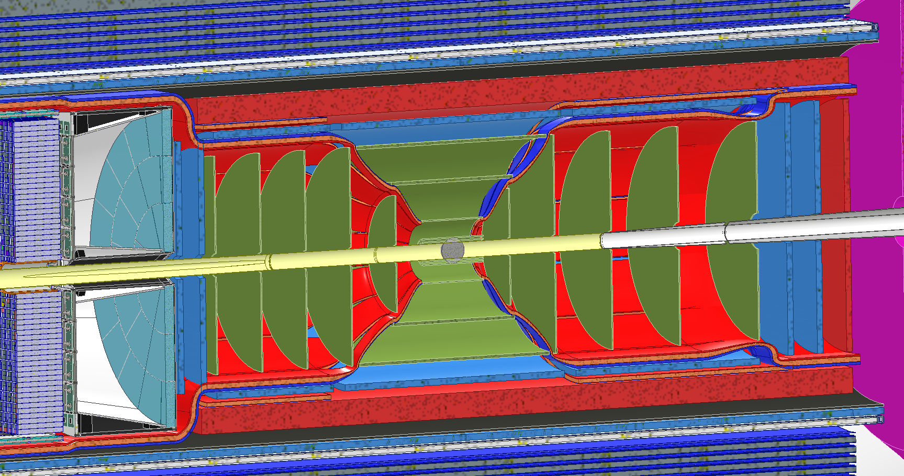
Current layout - Summary
Reminder
L0, L1, L2 are ITS3
L3, L4 are ITS3 Large-Area Sensor
Two outer MPGD-barrel layers: inner is MicroMegas-based, outer is GEM-muRwell-based
5 LAS-based disks followed by 2 MPGD (GEM-based) disks on each side

Slide 3
Branchpoints
Reminder
ITS3 technology works with a timeline compatible with the EIC project but the LAS fork-off has a delay which makes timelines incompatible with EIC project timelines
Mitigation (text from TIC meeting):
The disks in the Electron and Hadron Endcaps are replaced with MPGD disks derived from the disks of the outer MPGD tracker; nominally, this will then result in 7 (near-)identical MPGD disks on each side,
The two Outer Barrel layers are replaced with MPGD barrel layers derived from the outer MPGD tracker, specifically its innermost (curved, μMegas) layer.
ITS3 technology for vertex and sagitta layers works but there is a delay which makes timelines incompatible with EIC project timelines
Mitigation (text from TIC meeting):
The Inner Barrel is replaced with two or three layers based on the existing ITS2 sensor, as used in ALICE and sPHENIX without EIC-specific modifications,
The Outer Barrel and Endcaps are replaced with MPGD barrel and disks as in the first branch point.

Slide 4
P6 Milestone Summary
Reminder
Tracking
eRD108 (MPGD)
Complete beam test validation of cylindrical μRWELL with prototype [September 2023]
Complete validation of use of light-weight cylindrical Micromegas with 2D readout patterns as derived from the earlier used cylindrical technology [December 2024?]
eRD104 (Service Reduction)
Develop powering scheme based on serial powering to mitigate service space needs of DC-DC scheme. [December 2023]
Evaluate radiation tolerant FPGAs and high-speed fiber optic transmission option with beam test. Complete prototype multiplexing firmware. [December 2024]
eRD111 (Si Tracker)
Report completed on barrel and disc cooling options, allowing cooling choice [December 2023]
R&D completed for stitching of sensors [September 2024]
eRD113 (Si Sensors/ITS3)
End-of-R&D Milestone: EIC vertex sensor quantification finalized [September 2026]
(Note: link in P6 to EIC large area sensor production start [February 2027])

Slide 5
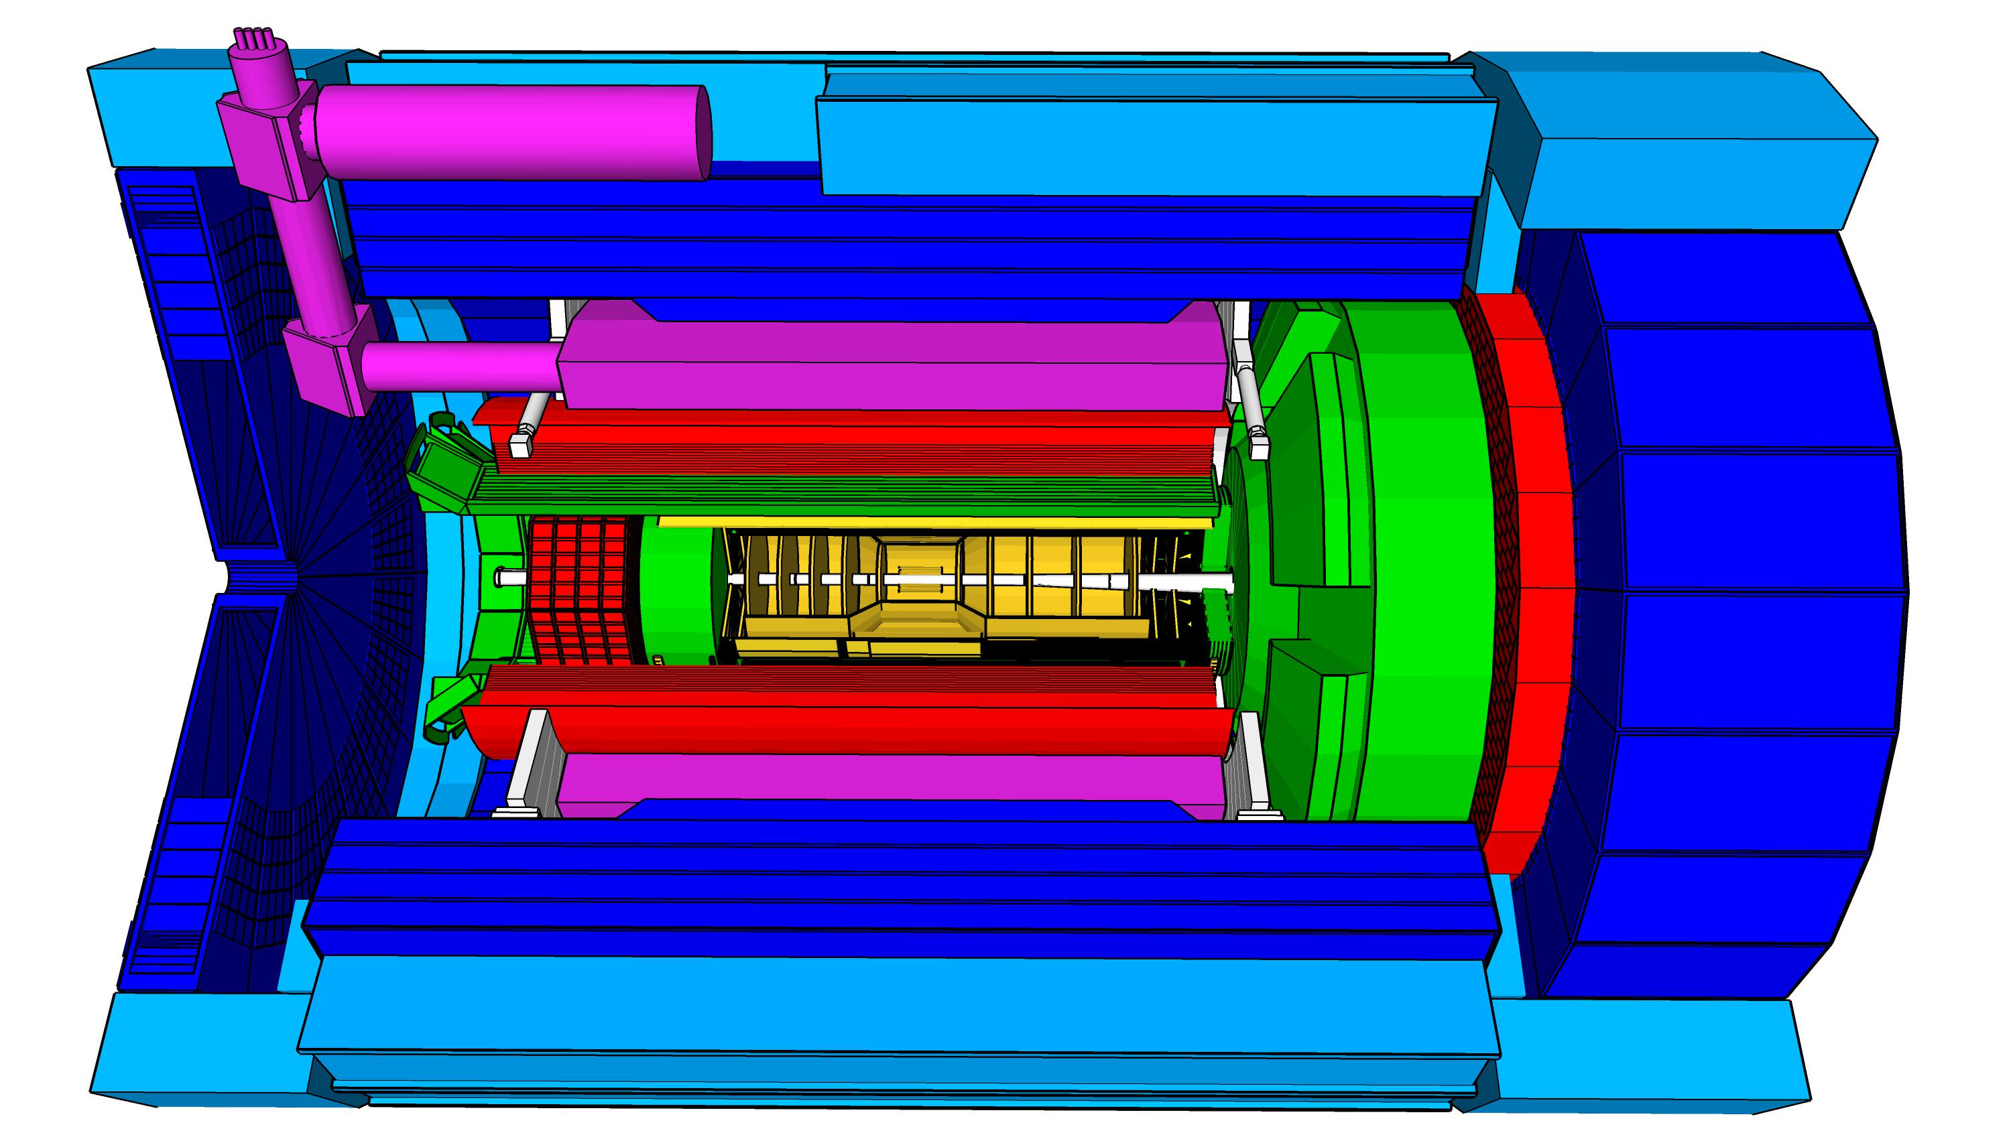
High Level Installation Schedule
Reminder
Oct 2028
Jan 2029
Milestone
PO_0305_0900
Apr. 2031
CD-3
04/2025
April 2029
Dec 2029
early CD-4
09/2032
CD-4
09/2034
June 2030
Oct 2030
Jan 2031
Construction
Pre-OPS
IR-6 ready
for installation
Detector Assembled and Ready for Cosmic Data Taking
Early start of
Operations
&
Science
Start of
Operations
&
Science
lower half
barrel Hcal
installed
Solenoid
delivered
Endcap HCals
completed
Solenoid
Field mapping
done in beam position
Hadron Endcap
Detectors
installed
Trackers, dRICH
ECal
done in Assembly Hall
Barrel Ecal
ready
for installation
Barrel Hcal
& Solenoid
installed
followed by low
power test
Lepton Endcap
Detectors
installed
Trackers, bRICH
ECal
Barrel Detectors
installed
ECal, DIRC,
ToF, Trackers
Take Away:
Solenoid and Barrel HCal need to be ready by Jan 2029
all other subdetectors need to be ready between 06/29 to 06/30 depending on their location in the detector

Slide 6
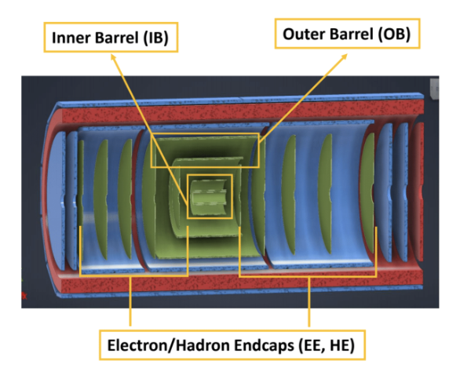
Alternate What-If Tracking Layout - DRAFT
First branch point (“what-if scenario” [1]): ITS3 technology works with a timeline compatible with the EIC project timelines, but the EIC-LAS (“fork”) incurs delays that make its timeline incompatible with the EIC project timelines.
Second branch point (“what-if scenario” [2]): ITS3 technology works but delays are incurred that make its timeline in ePIC incompatible with the EIC project timelines
[2] Replaced by two or three layers based on the existing ITS2 sensor, as used in ALICE and sPHENIX without EIC-specific modifications.
[1] Replaced with MPGD barrel layers derived from the outer MPGD tracker, specifically its innermost (curved, μMegas) layer.
[1] Replaced with MPGD disks derived from the disks of the outer MPGD tracker; nominally, this will then result in (up to) 7 (near-)identical MPGD disks on each side.

Slide 7
Alternate What-If Tracking Schedule - DRAFT
First branch point (“what-if scenario” [1]): ITS3 technology works with a timeline compatible with the EIC project timelines, but the EIC-LAS (“fork”) incurs delays that make its timeline incompatible with the EIC project timelines.
Second branch point (“what-if scenario” [2]): ITS3 technology works but delays are incurred that make its timeline in ePIC incompatible with the EIC project timelines
Some relevant dates:
(P6 milestone) EIC vertex sensor quantification finalized [September 2026]
(P6 milestone) EIC large area sensor production start [February 2027]
(P6 milestone) Tracking detectors installed [June 2030]
(schedule float: ~12 months beyond Level-2 Milestone PO_0305_0900)
(Tracking WG info) Production of “what-if’ MPGD detectors (including readout): ~3 years -
but will need to procure GEM foils and PCBs roughly a year ahead.
First branch point: ~June 2026? (4 years before June 2030)
Second branch point: ~September 2027? (assumed ITS2 assembly ~ ITS3 time, and used one year float)
Still difficult to say, would need more info on how long it takes to do ITS2, Micromegas
Oct 2028
Jan 2029
Milestone
PO_0305_0900
Apr. 2031
CD-3
04/2025
April 2029
Dec 2029
early CD-4
09/2032
CD-4
09/2034
June 2030
Oct 2030
Jan 2031
Construction
Pre-OPS
IR-6 ready
for installation
Detector Assembled and Ready for Cosmic Data Taking
Early start of
Operations
&
Science
Start of
Operations
&
Science

