Slide 1
ePIC Collaboration News
J. Lajoie, S. Dalla Torre
November 2, 2023

Slide 2
Hey John, start the recording….

Slide 3
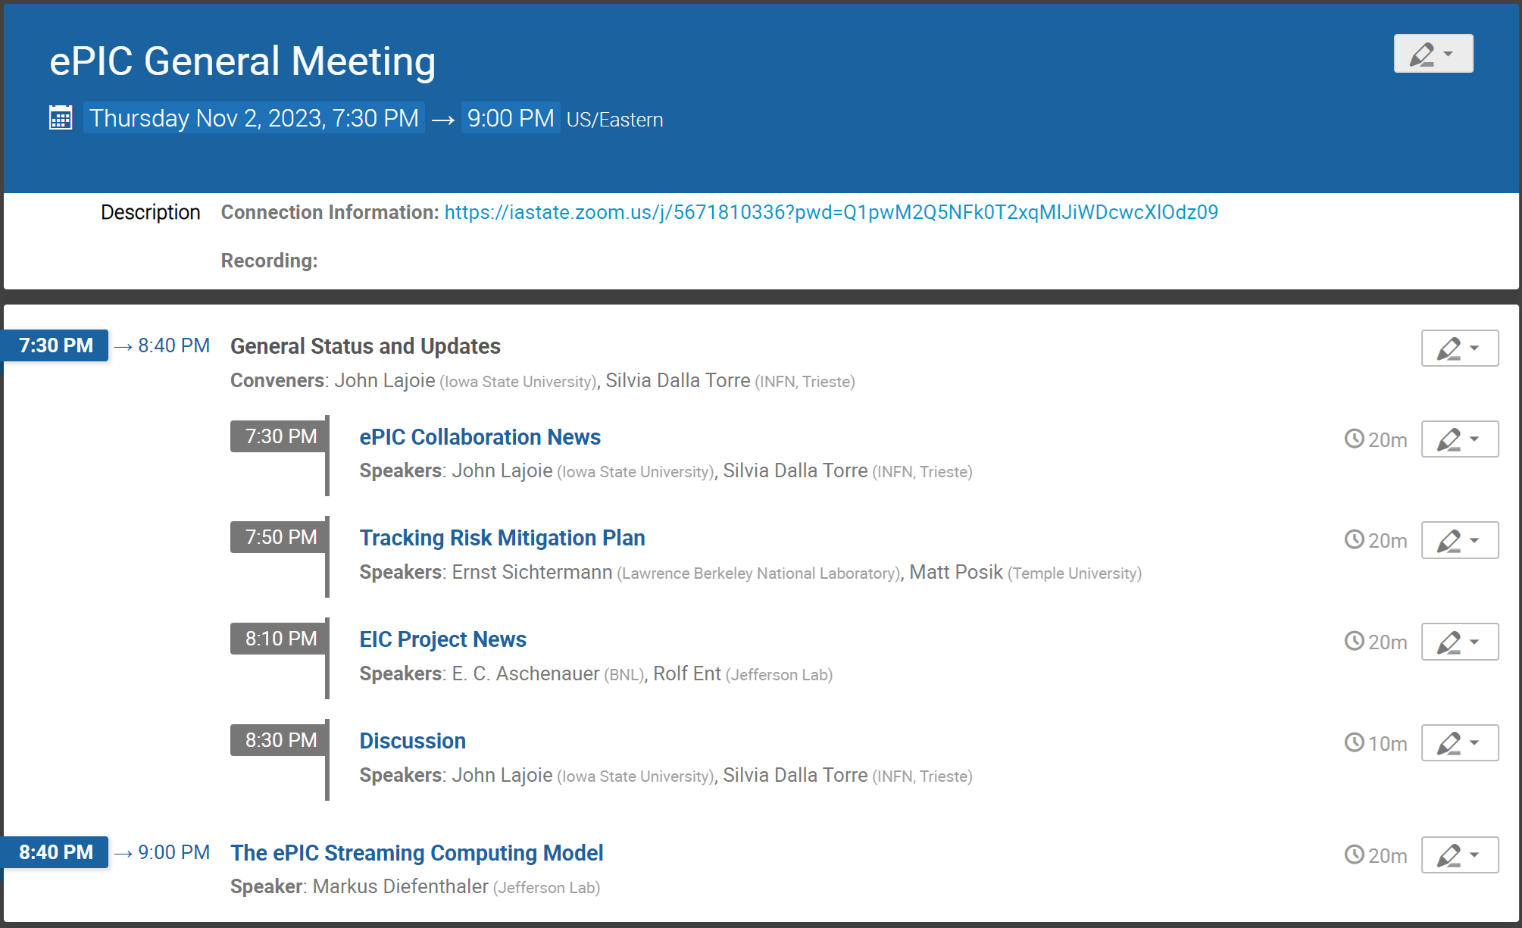
Today’s Agenda
News from SP Office
Tracking
News from the Project
Streaming Computing Model

Slide 4
Reviews, Reviews, Reviews…
July 5 + 6: Particle Identification Detectors Interim Design Review
July 21: Final Design Review of the PbWO4 Crystals for the ePIC Backward EM Calorimeter (LLP)
August 28 + 31: DAC Review of Detector R&D
August 29 + 30: ePIC Comprehensive Design Review by DAC
September 13: SciFi Applications Final Design Review (LLP)
September 14: SiPM Applications Final Design Review (LLP)
September 25: Final Design Review Forward HCAL W & Steel (LLP)
October 5-6: Final Design Review of Magnet (MARCO)
October 10-12: DOE CD-3A Director’s Review
October 19-20: ePIC Computing Model Review
November 14-16: DOE CD-3A Independent Project Review
December 7 + 8: 2nd Resource Review Board meeting @ CUA
Dec/Jan (TBD): Preliminary Design Review of Far-Forward/Far-Backward Detectors

Slide 5
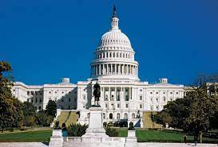
Streaming Computing Model Review
Review held Oct 19-20th, SURA HQ in Washington D.C.
Called by David Dean and Haiyan Gao
At this stage, approximately ten years prior to data collection, is there a comprehensive and cost-effective long-term plan for the software and computing of the experiment?
Are the plans for integrating international partners' contributions adequate at this stage of the project?
Are the plans for software and computing integrated with the HEP/NP community developments, especially given data taking in ten years?
Are the resources for software and computing sufficient to deliver the detector conceptional and technical design reports?
Are the ECSJI plans to integrate into the software and computing plans of the experiment sufficient?
EIC Computing and Software Advisory Committee (ECSAC)
Mohammad Al-Turany (GSI)
David Brown (LBNL)
Simone Campana (CERN)
Pere Mato (CERN)
Christoph Pauss (MIT)
Heidi Schellman (UOregon)
Frank Wuerthwein (UCSD)

Slide 6
Review Agenda
Introducing the ePIC Experiment: Exploring Use Cases and Workflows
Rosi Reed
ePIC Software Stack: Status and Plans
Sylvester Joosten
The ePIC Computing Model
Markus Diefenthaler
Organizational Structure of ECSJI
Eric Lancon and Amber Boehnlein
International Data Facilities Perspective on the Computing Model
Andrea Bressan (with input from Canada, Italy, and the UK)
ePIC talks are posted in ePIC-accessible Indico (S&C Weekly):
https://indico.bnl.gov/event/20894/
https://indico.bnl.gov/event/20960/

Slide 7
Recommendations
All charge questions answered in the affirmative:
Q1 (… comprehensive and cost-effective long-term plan …):
We recommend that ECSJI verify the readiness of simulation and reconstruction for the TDR by May 2024.
We recommend that ePIC document a first computing needs assessment by the next ECSAC review, in roughly one year.
Q3 (… integrated with the HEP/NP community developments …):
We recommend that the ePIC collaboration starts, by the time of next year’s ECSAC review, an evolving list of software dependencies that includes: the packages, who the primary supporters are, and what the ePIC collaboration contributes to them.
Link to full closeout slides: https://indico.bnl.gov/event/20960/contributions/82384/attachments/50617/86563/Review%20-Closeout.pdf

Slide 8
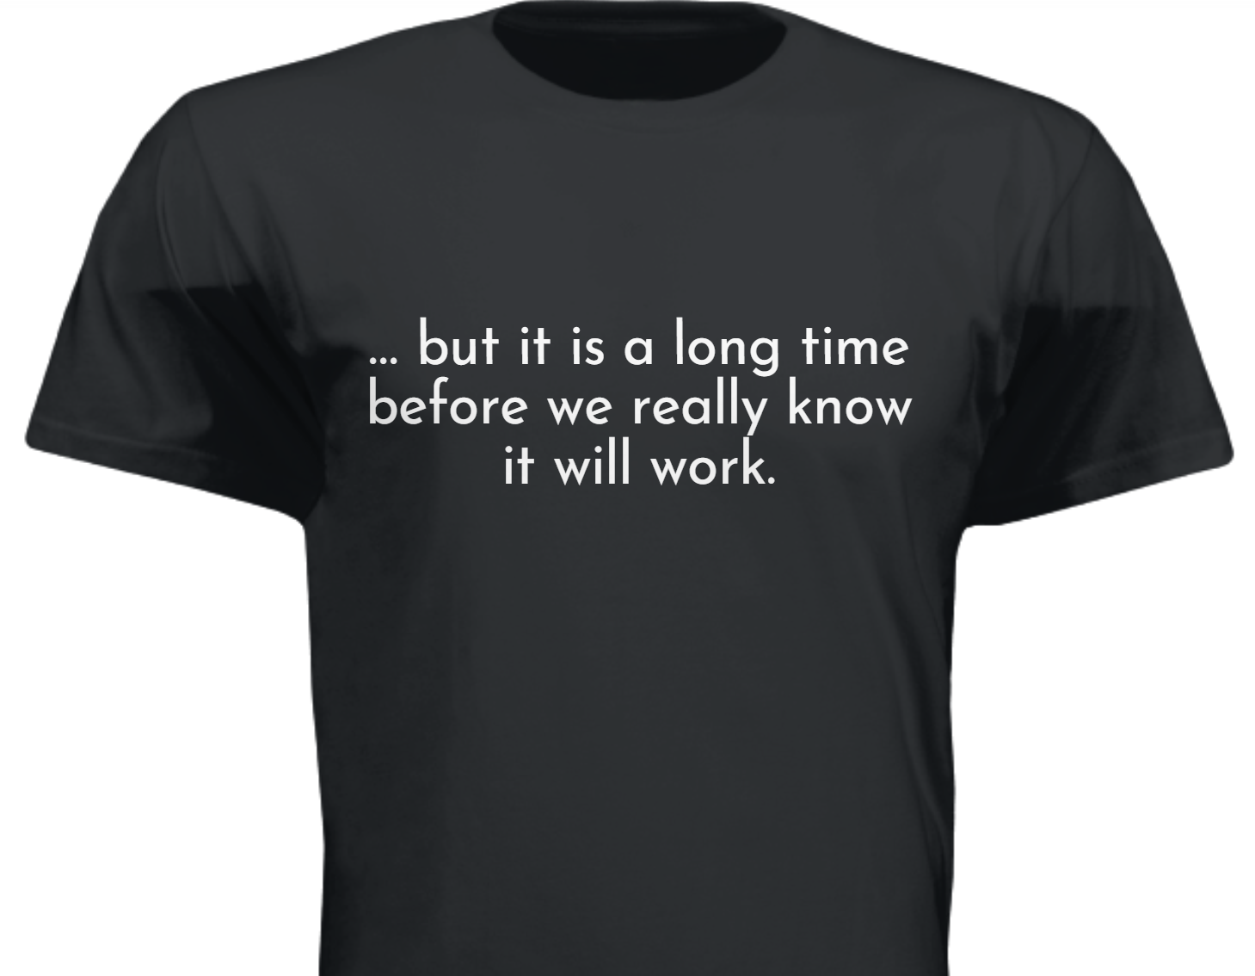
front
(Q1 comment)
“A job well done” – congratulations to the ePIC S&C Coordinators, Working Group Conveners, and all the WG participants. This is an accomplishment to be proud of!
back (Q1 charge response)

Slide 9
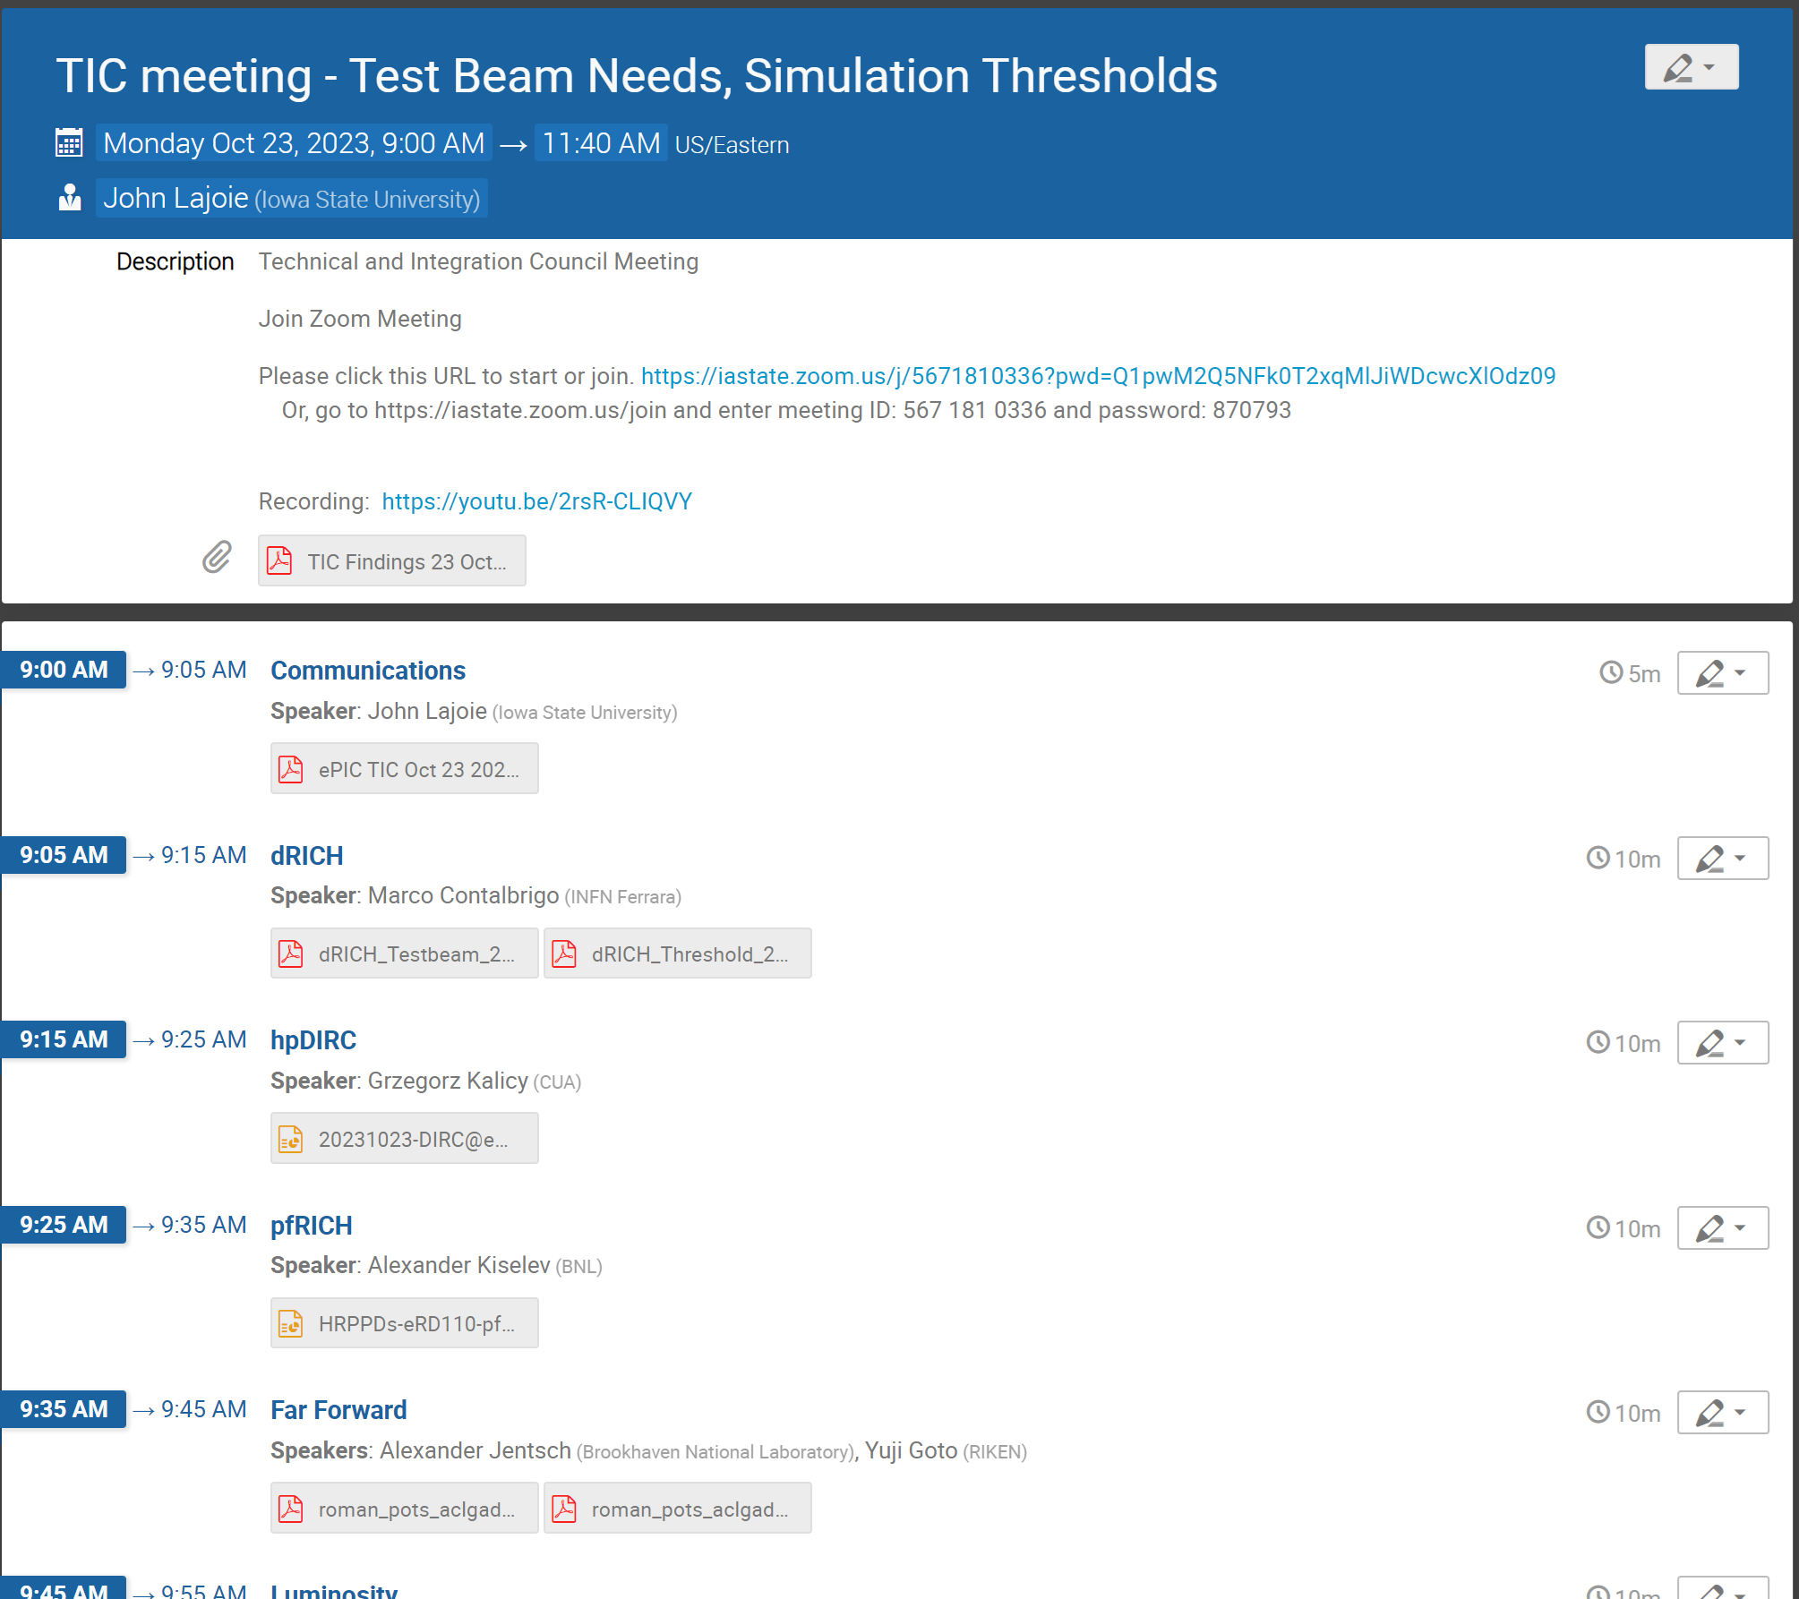
News from TIC (I)
Oct. 23rd : Test Beam, Sim. Thresholds
https://indico.bnl.gov/event/20913/
Goal: Collect test beam needs (2024 focus), report on simulation thresholds.
Next slide for test beam needs
Most DSC’s reported on thresholds, but needed some additional discussion

Slide 10
Test Beam Needs (FTBF 2024)
Four DSC’s reported a need for the FTBF in 2024:
pfRICH: HRPPD tests, assessment of HRPPD timing performance (1 week), pfRICH prototype (2 weeks)
Far‐Forward: AC‐LGAD + EICROC0 ASIC (just need MIPs)
Barrel EMCal: Three stages of AstroPix testing with GlueX prototype (1 week each stage, w/ATLAS Telescope program)
AC‐LGAD TOF: 2+ weeks with prototype AC‐LGAD sensor and ASIC
pfRICH, Barrel EMCal, AC-LGAD TOF have submitted a response to the FTBF questionnaire
A. Kislev following up with Evan Niner @ FNAL to make ePIC needs clear and possible overlaps and coordination (midnight shifts, etc.)
Far-Forward encouraged to consider submitting a proposal to STAR, in similar fashion to the forward hcal insert (UCR)

Slide 11
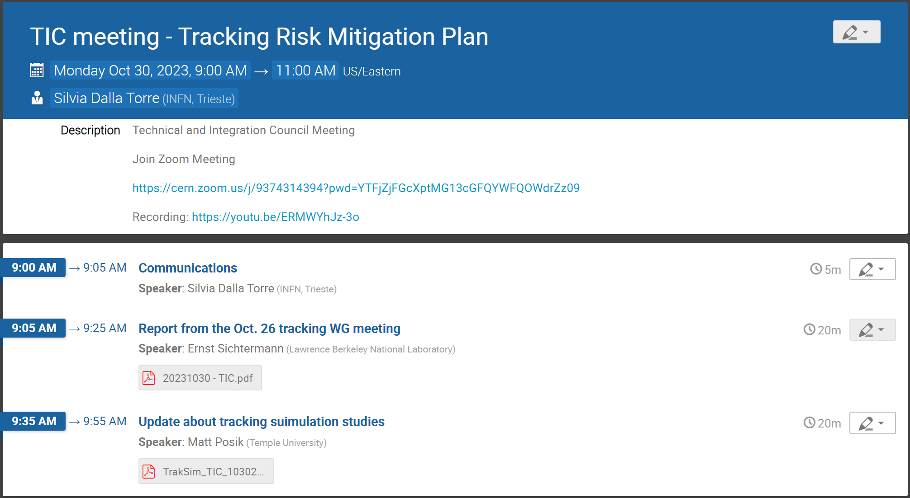
News from TIC (II)
Oct. 30th : Tracking Risk Mitigation
https://indico.bnl.gov/event/20648/
Goal: Following the Tracking WG meeting efforts to respond to a recommendation from the CD-3A Director’s Review
Topic of next talk …

Slide 12
Upcoming TIC Meetings….
TIC Meetings (almost) every Monday 9AM ET.

Slide 13
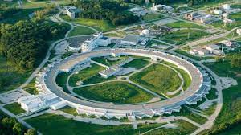
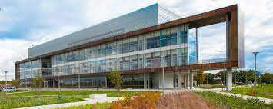
Next Collaboration Meeting – Jan 2024
Jan 9-13th, 2024 @ ANL
Three days of parallel workfests followed by two days of plenary sessions:
https://indico.bnl.gov/event/20473/
Send your students and postdocs!
Student support available: https://indico.bnl.gov/event/20473/page/575-student-support
General registration coming early November
Make your travel plans now!!

Slide 14
Jan 2024 ePIC Meeting Workfests
Workshop Title | Organizers
Barrel ECAL DSC | Maria Zurek, Sylvester Joosten
SVT DSC | Laura Gonella, Ernst Sichtermann
Tracking | Ernst Sichtermann, Matt Posik
Jets & HF (Particle Flow) | Brian Page, Olga Evdokimov, Derek Anderson
Jets & HF (Vertex) | Brian Page, Olga Evdokimov, Shujie Li, Barak Schmookler
Streaming Computing Model / Electronics & DAQ | Fernando Barbosa, Jin Huang, Jeff Landgraf, Marco Battaglieri, Markus Diefenthaler
FFWD, FBKWD & Exclusive, Diffractive and Tagging, eA | Raphael Dupre, Rachel Montgomery, Alex Jentsch, Kong Tu, Simon Gardner, Nathaly Santiesteban, Dhevan Gangadharan, Nick Zachariou
Backgrounds | Kolja Kauder, Elke-Caroline Aschenauer, Shujie Li, Barak Schmookler
AC-LGAD DSC | Alessandro Tricoli, Alex Jentcsh, Wei Li, Zhenyu Ye
Common PID | Thomas Ullrich, Oskar Hartbrich
Software & Sim TDR Readiness | Markus Diefenthaler, Sylvester Joosten, Wouter Deconinck, Torre Wenaus

Slide 15
ePIC Web Page (Draft)
https://www.bnl.gov/eic/epic.php
To be integrated into the main EIC website. Keep in mind this is for the general public.
Have a look – comments welcome! (This is currently a draft accessible only from this link.)
Gary Schroeder, Karen McNulty Walsch, Thomas Ullrich, JGL

Slide 16
Speaker Policies Reminder
From Brian and Maria’s presentation an 10/27 CC Meeting.

Slide 17
Upcoming Speaking Opportunities
XXX Cracow Epiphany Conference
8-12 January 2024, Krakow, Poland
https://epiphany.ifj.edu.pl/epiphany2024/index.html
Invited Talks:
Please Send Nominations "ePIC Physics Program Overview"
NSTAR24 Conference
York, UK, June 17-21 2024
https://indico.jlab.org/event/729/
Invited Talks:
Please Send Nominations "Hadron Spectroscopy at the EIC"
The list of the conferences and the talks we are notified about is here: https://wiki.bnl.gov/EPIC/index.php?title=Conferences#Upcoming_Conferences
If people don't see their talks/conferences there they should let Maria and Brian know.

Slide 18
The ePIC Executive Board
The ePIC Executive Board is formed as of 10/27 CC Meeting:
CC Elected Members: Barbara Jacak (Berkeley), Paul Newman (Birmingham), Taku Gunji (Tokyo)
DE&I Member: Megan Connors (GSU)
Early Career Member: Fernando Flor (Yale)
Coordinators: Markus Diefenthaler (JLab), Salvatore Fazio (Calabria), Rosi Reed (Lehigh), TC (future nomination)
CC Chair/Vice Chair (non-voting): Ernst Sichtermann (LBNL), Bernd Surrow (Temple)
Silvia and I look forward to working with the EB to keep pushing ePIC forward !

Slide 19
Upcoming General Meeting Schedule
Regularly scheduled general meetings:
SKIP Nov 17th @ 10:30AM ET (Immediately following CD-3A review)
Fri, Dec. 1st @ 10:30AM ET
Thurs, Dec. 14th @ 7:30PM ET
CC Meetings will be called by the CC Chair as needed
EB Meetings planned by the SP Office:
Fri, Nov. 17th @ 10:30AM ET
Wed, Dec. 18-22 (TBD)

Slide 20
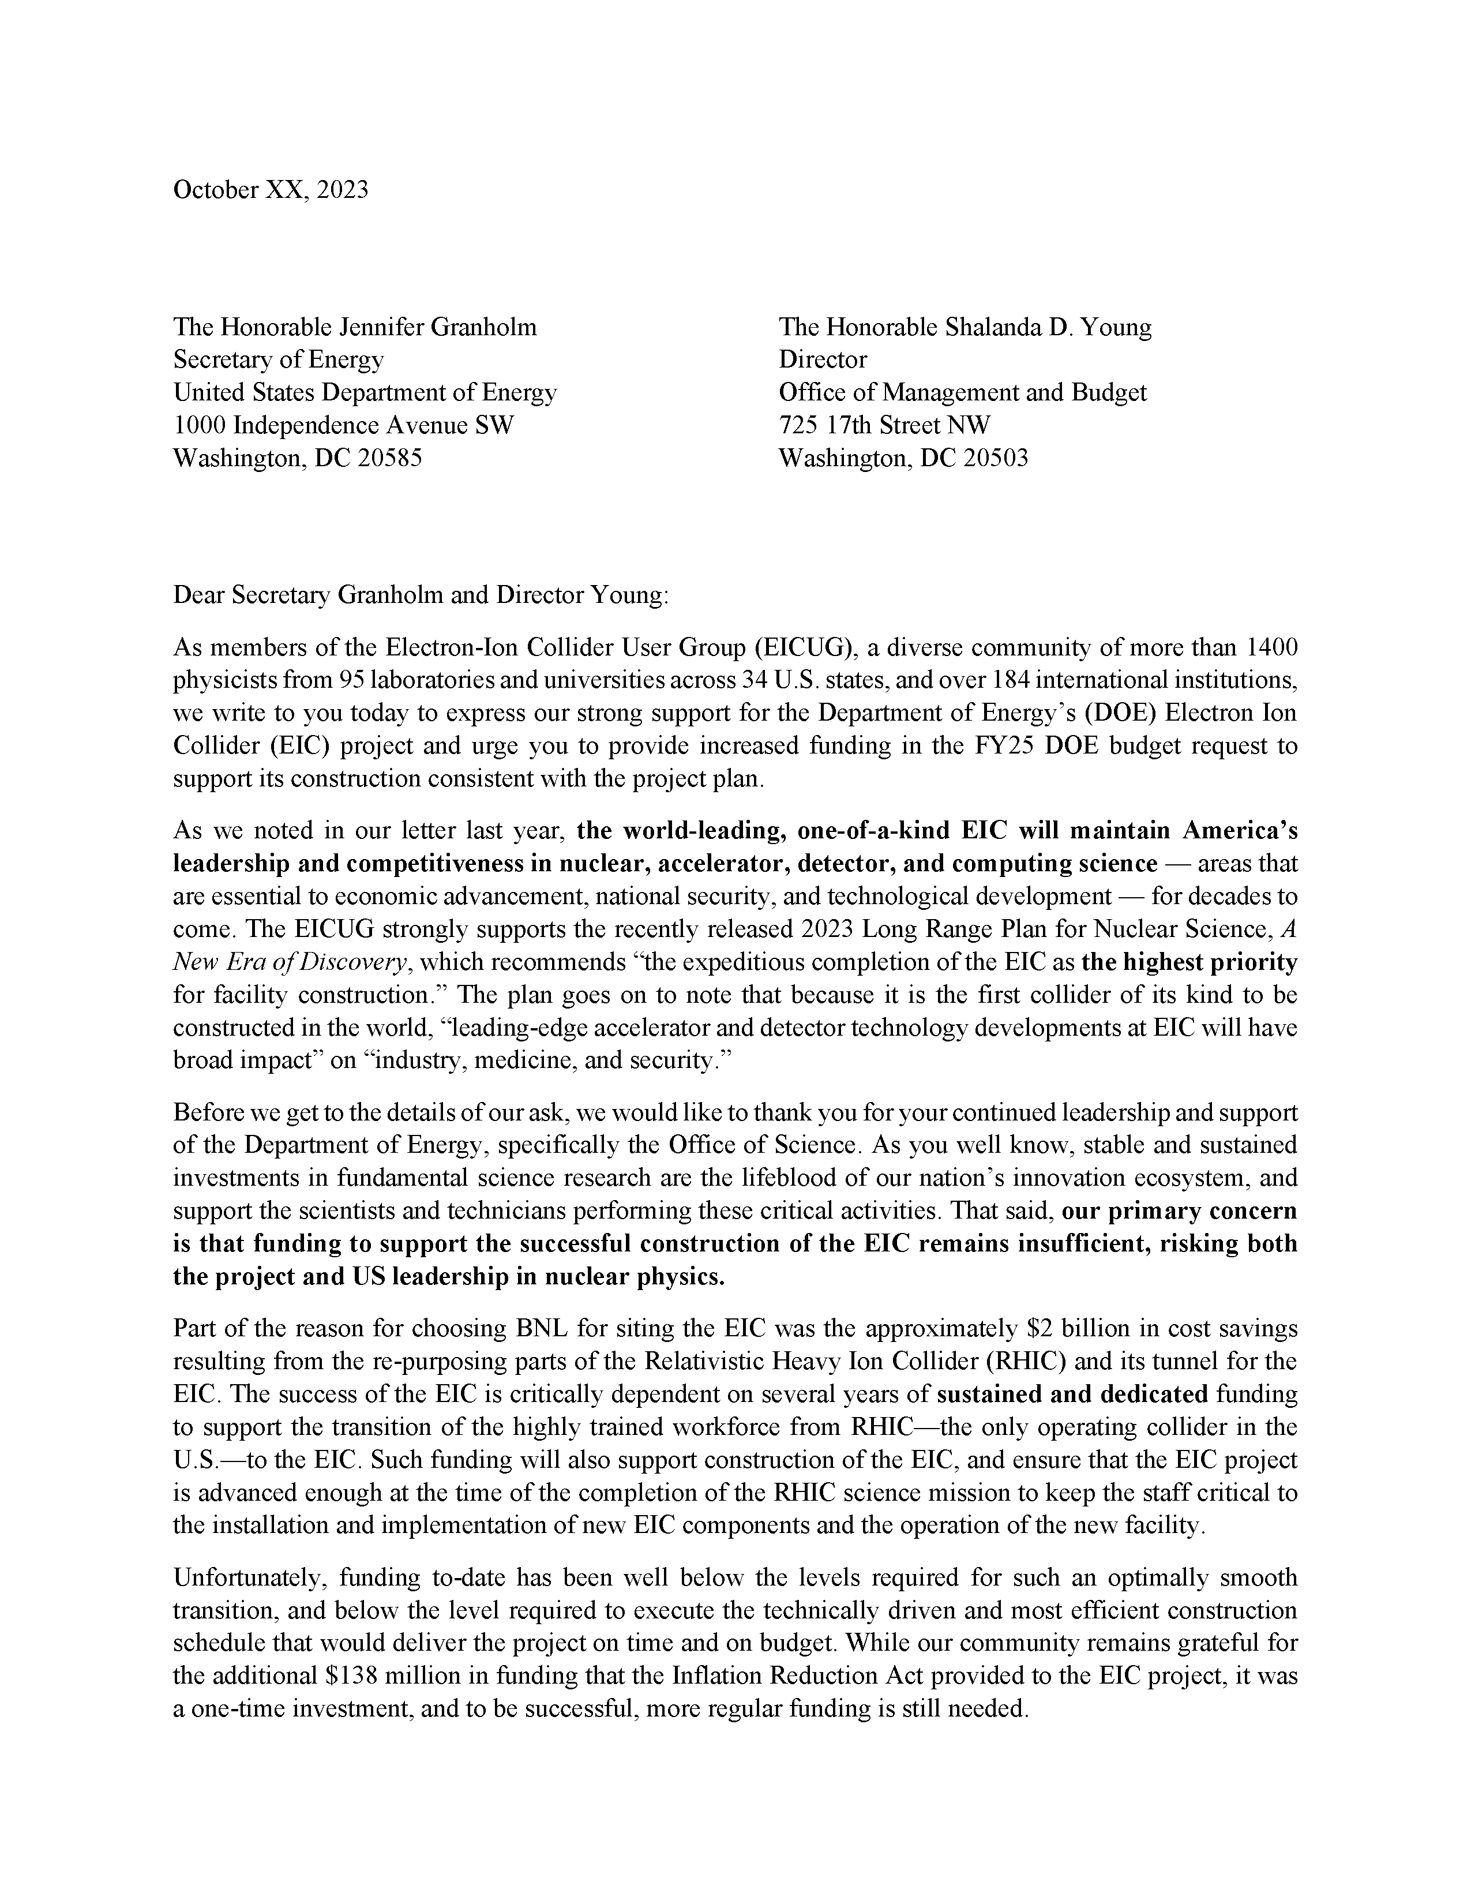
EICUG Letter
The EICUG is soliciting signatures on a letter of support for EIC funding.
PDF of letter linked to Indico agenda
Didn’t receive an email?
Contact Marco (marco.radici0@gmail.com) and include a non .gov/.org email address
Dear EIC Users,
We are writing to share with you a letter, addressed to the Secretary of Energy and Director of the Office of Management and Budget, asking for increased funding in the FY25 US budget request to support the construction of the EIC consistent with project planning. We cannot stress enough how important it is for the community to show their commitment to the EIC project. If you would like to support this initiative and sign the letter please provide your name and affiliation at the link below.
https://forms.gle/4ik4LWvuyt9gBEg49 [urldefense.com]
Thank you for your time and thank you for supporting the EIC!
Best Regards,
Marco Radici, Chair
Or Hen, Chair-elect
Renee Fatemi, Past Chair
Notes:
Thomas Phillips (Battelle)

Slide 21
Tidbits…
Draft form of the application for CERN Recognized Experiment ready, to be submitted soon
Recognized Experiments Committee meeting to approve early 2024
EIC-Asia Meeting in Taiwan Jan. 29-31, 2024
ePIC Software and Computing meeting @ CERN April 22nd-26th
SP Office meeting with Tim Hallman Dec. 11th
Needs of research groups in ePIC
Standing DSC Requests: https://wiki.bnl.gov/EPIC/index.php?title=DSC_Requests
There is progress on the phonebook (more coming in due time)

Slide 22
Summary
The ePIC Collaboration and the EIC Project are continuing to make progress on CD milestones and the development of the ePIC technical design.
BUT… it will be a long time before we will know if it will work
Start planning NOW to attend the Jan 2024 Collaboration Meeting!
This is a great opportunity to get new people involved!
Reach out to your friends and colleagues not already in ePIC!
Contact workfest organizers if you want to contribute to the agenda

Slide 24
Proposals for ePIC Membership
from the ePIC Charter:
After initial formation, new institutions are admitted to EPIC by a super-majority vote as described in Voting and Elections provisions of this Charter, after a proposal made to the Collaboration Spokesperson and Executive Board.
University of Debrecen
Nara Women’s University

Slide 25
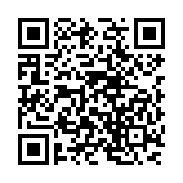
ePIC Resources – Get Connected!
Mailing Lists – https://lists.bnl.gov/mailman/listinfo
Indico Agenda - https://indico.bnl.gov/category/402/
Wiki - https://wiki.bnl.gov/EPIC
ePIC Software Training:
https://eic.github.io/tutorial-setting-up-environment/
https://eic.github.io/tutorial-geometry-development-using-dd4hep/
https://eic.github.io/tutorial-simulations-using-ddsim-and-geant4/
https://eic.github.io/tutorial-jana2/
Recordings: https://www.youtube.com/@eicusergroup1532
QR code for Mattermost channels:

Slide 26
EICUG Membership
The EICUG is a vital organization to promote the interests of the EIC community!
Without the EICUG we would never have gotten far enough to form ePIC!
Please register your institution!
Check with your EICUG IB representative to get registered as a member
https://www.eicug.org/content/join.html

