Slide 1
Electronics & DAQ WG
Fernando Barbosa (JLab)
26 October 2023

Slide 2
Agenda
Welcome & News
FY24 eRD109 Update
Requests for Input updates:
VTRX+ quantities
Qmin/Qmax
Institution/Group commitments
Qmin/Qmax for Micromegas - Irakli
AOB

Slide 3
FY24 eRD109 Update
FY23 – All contracts have been awarded.
FY24 – Proposals, DAC reviewed 28-31 August 2023:
 | Detector/Technology | Discrete/ASIC | Group
A | Calorimeter | Discrete | IUCF
B | Calorimeter | HGCROC | ORNL
C | dRICH | ALCOR | INFN – BO, TO
D | AC-LGAD | EICROC | Omega/IN2P3/IJCLab/CEA/IRFU
 |  | FCFD | FNAL
 |  | Barrel L-M Serv. Hybrid | ORNL
 |  | High Precision Clock Distribution | BNL/Rice/UIC
E | MPGD/µRWell | SALSA | CEA
 |  |  | USP
The synergies, commitments and responsibilities of the various groups working on the clock and GTU will be considered at an upcoming Electronics & DAQ WG meeting.
Good news - eRD109 proposals have been approved as requested.
Documentation for award of contracts - in progress.

Slide 4
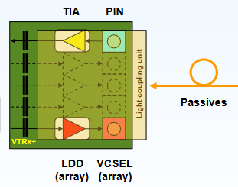
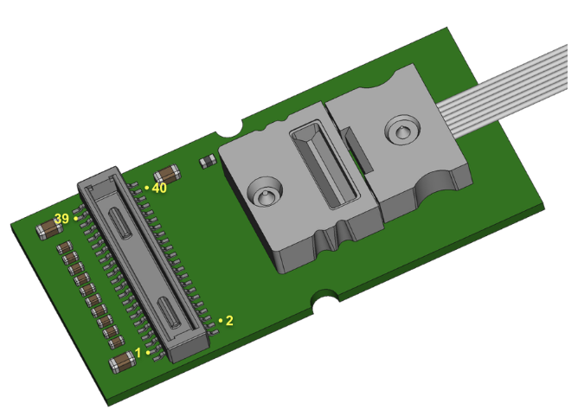
VTRX+ Update
VTRX+ - Versatile Link + Optical Link Module
TX: 5-10 Gbps
Rx: 2.5 – 5 Gbps
Pd ~ 320 mW
20 mm x 10 mm x 2.5 mm
~ $150.
1 RX
4 Tx
Multi-Mode Fiber
Rad Hard ASICs
COTs – Rad Tol screened
CERN-initiated production to start in early 2024.
Ken Wyllie is managing production requests for us on needed documentation to commit to production, to purchase, etc.
We need input from you regarding fit, needs and quantities.
Refer to latest VTRxPlus_spec.pdf here DAQ&Electronics

Slide 5
Requests for Input
1 – VTRX+ quantities – Plan to finalize this by 31 October 2023
At our meeting last week, we discussed procurement of this module and we have two options:
Procure only quantities where this module is absolutely required and use cheaper COTS transceivers everywhere else:
Radiation, Size
MAPS (~1,300) + dRICH (~1,000) + QA enhancement = 3,000 - 3,500
Cost ~US$ 500,000.00
Standardize on VTRX+ for EIC:
Product discontinuation
Cost >US$ 1 M

Slide 6
Requests for Input
2 – Qmin – Qmax – Plan to finalize this by 1 December 2023
We need to finalize the specifications/requirements for the ASICs:
Minimum signal of interest
Maximum expected signal
Maximum rates per channel (Elke).
Sub-Detector groups to provide these specs (from simulations, tests, …).
These quantities need to be finalized this Fall 2023.
3 – Development Commitments – Plan to finalize this by 19 January 2024
We need to assess and establish responsibilities for development of the electronics & DAQ HW/FW/SW for all the sub-detectors:
Adapter, FEB, RDO, GTU, DAM, cabling, tests, …
Parts or full RO chain.
List of sub-detectors with institutions, groups, people, …
Enter values into ePIC Detector Information Request.xlsx here DAQ Electronics

