Slide 1
Introduction to event and recovery plans
Russell Feder
11/28/23

Slide 2
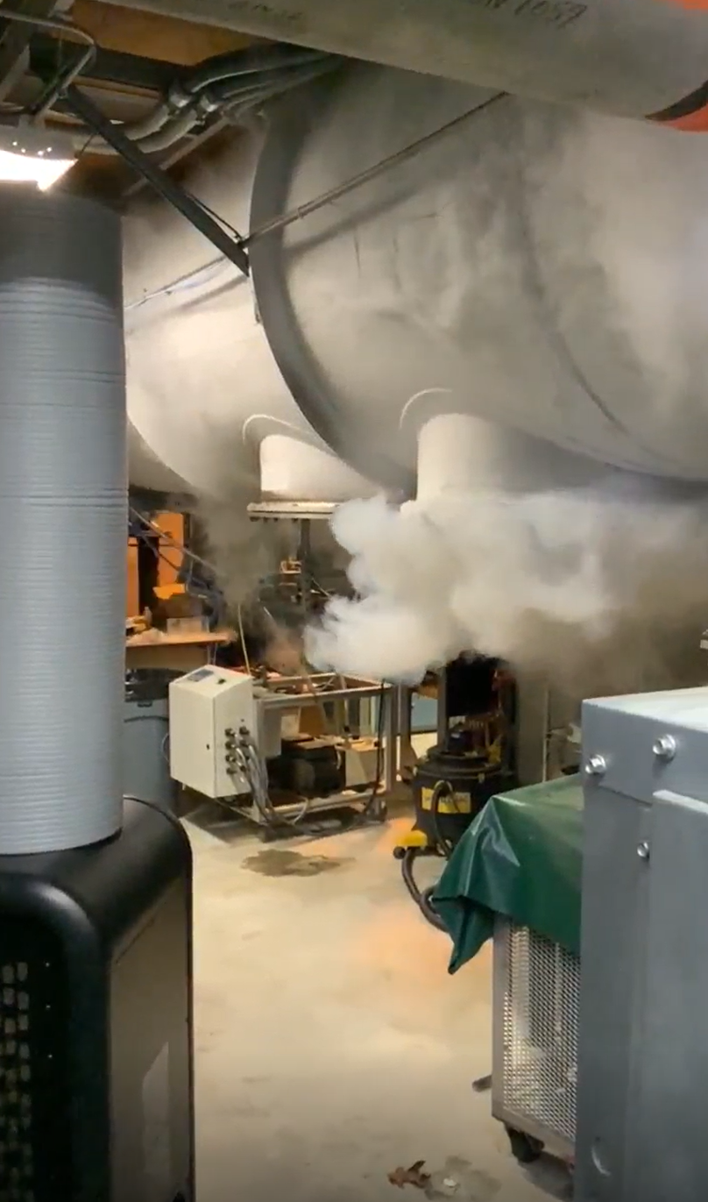
Incident and initial entry by emergency team
Show initial entry video
For more information on the 1004B ODH analysis and the RHIC ASE revision
→ Talk later today by Ray Fliller, Roberto Than, Ashish Shukla, and Chintan Sheth

Slide 3
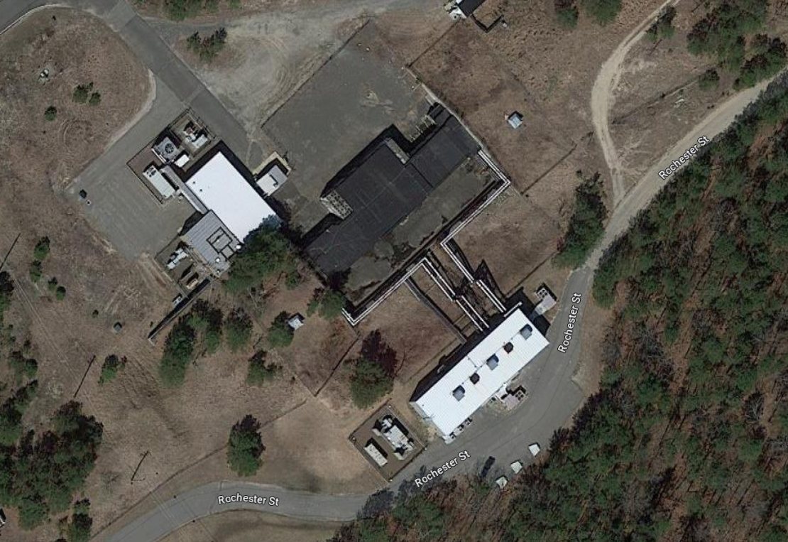
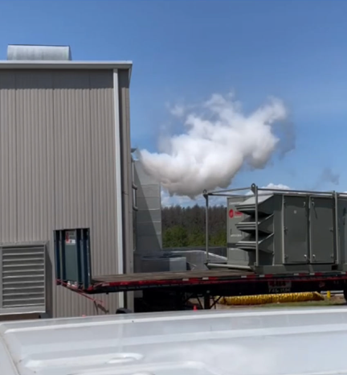
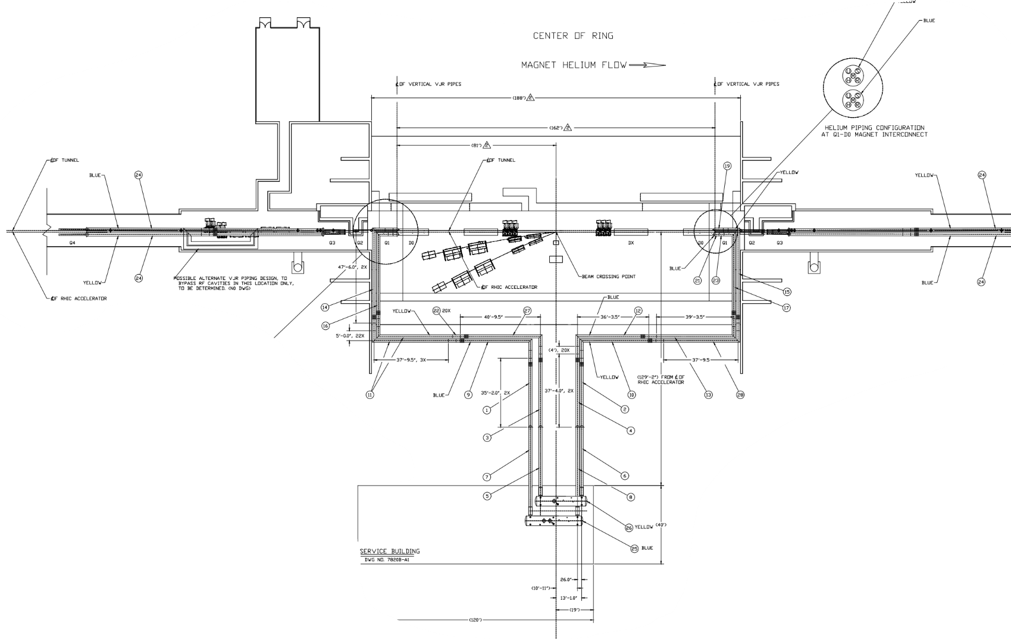
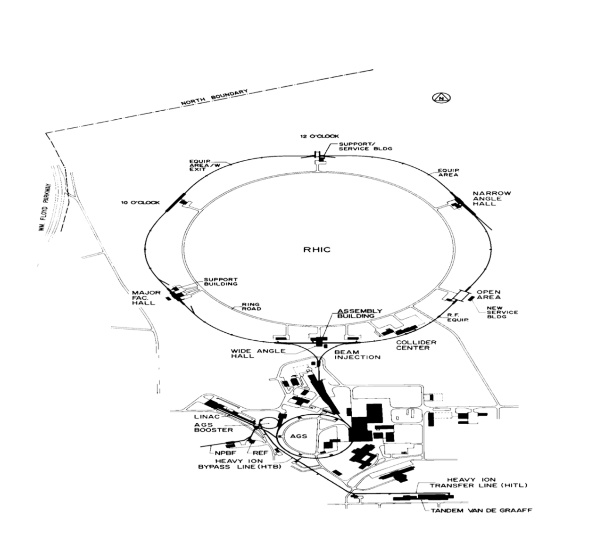
1004B, The 4:00 Service Building

Slide 4
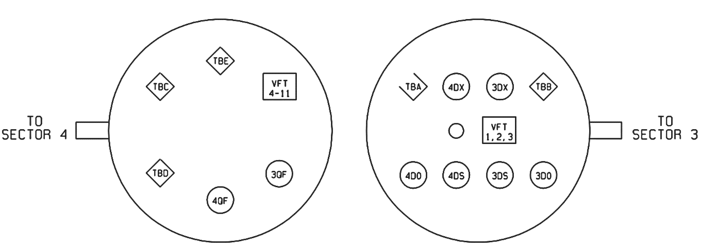
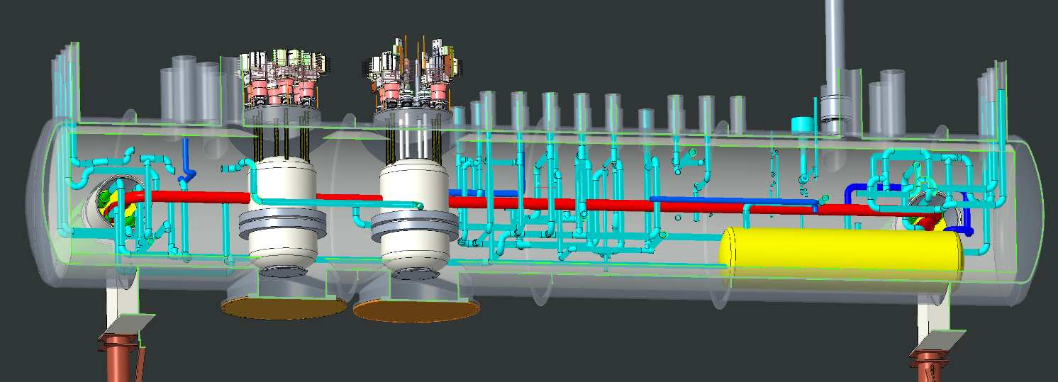
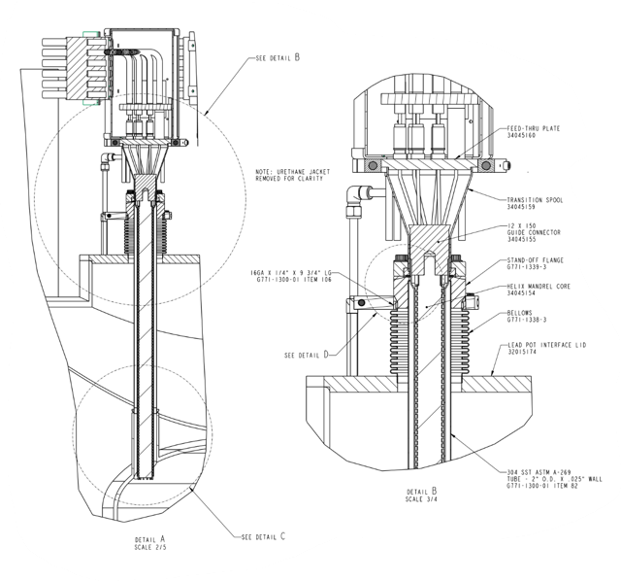
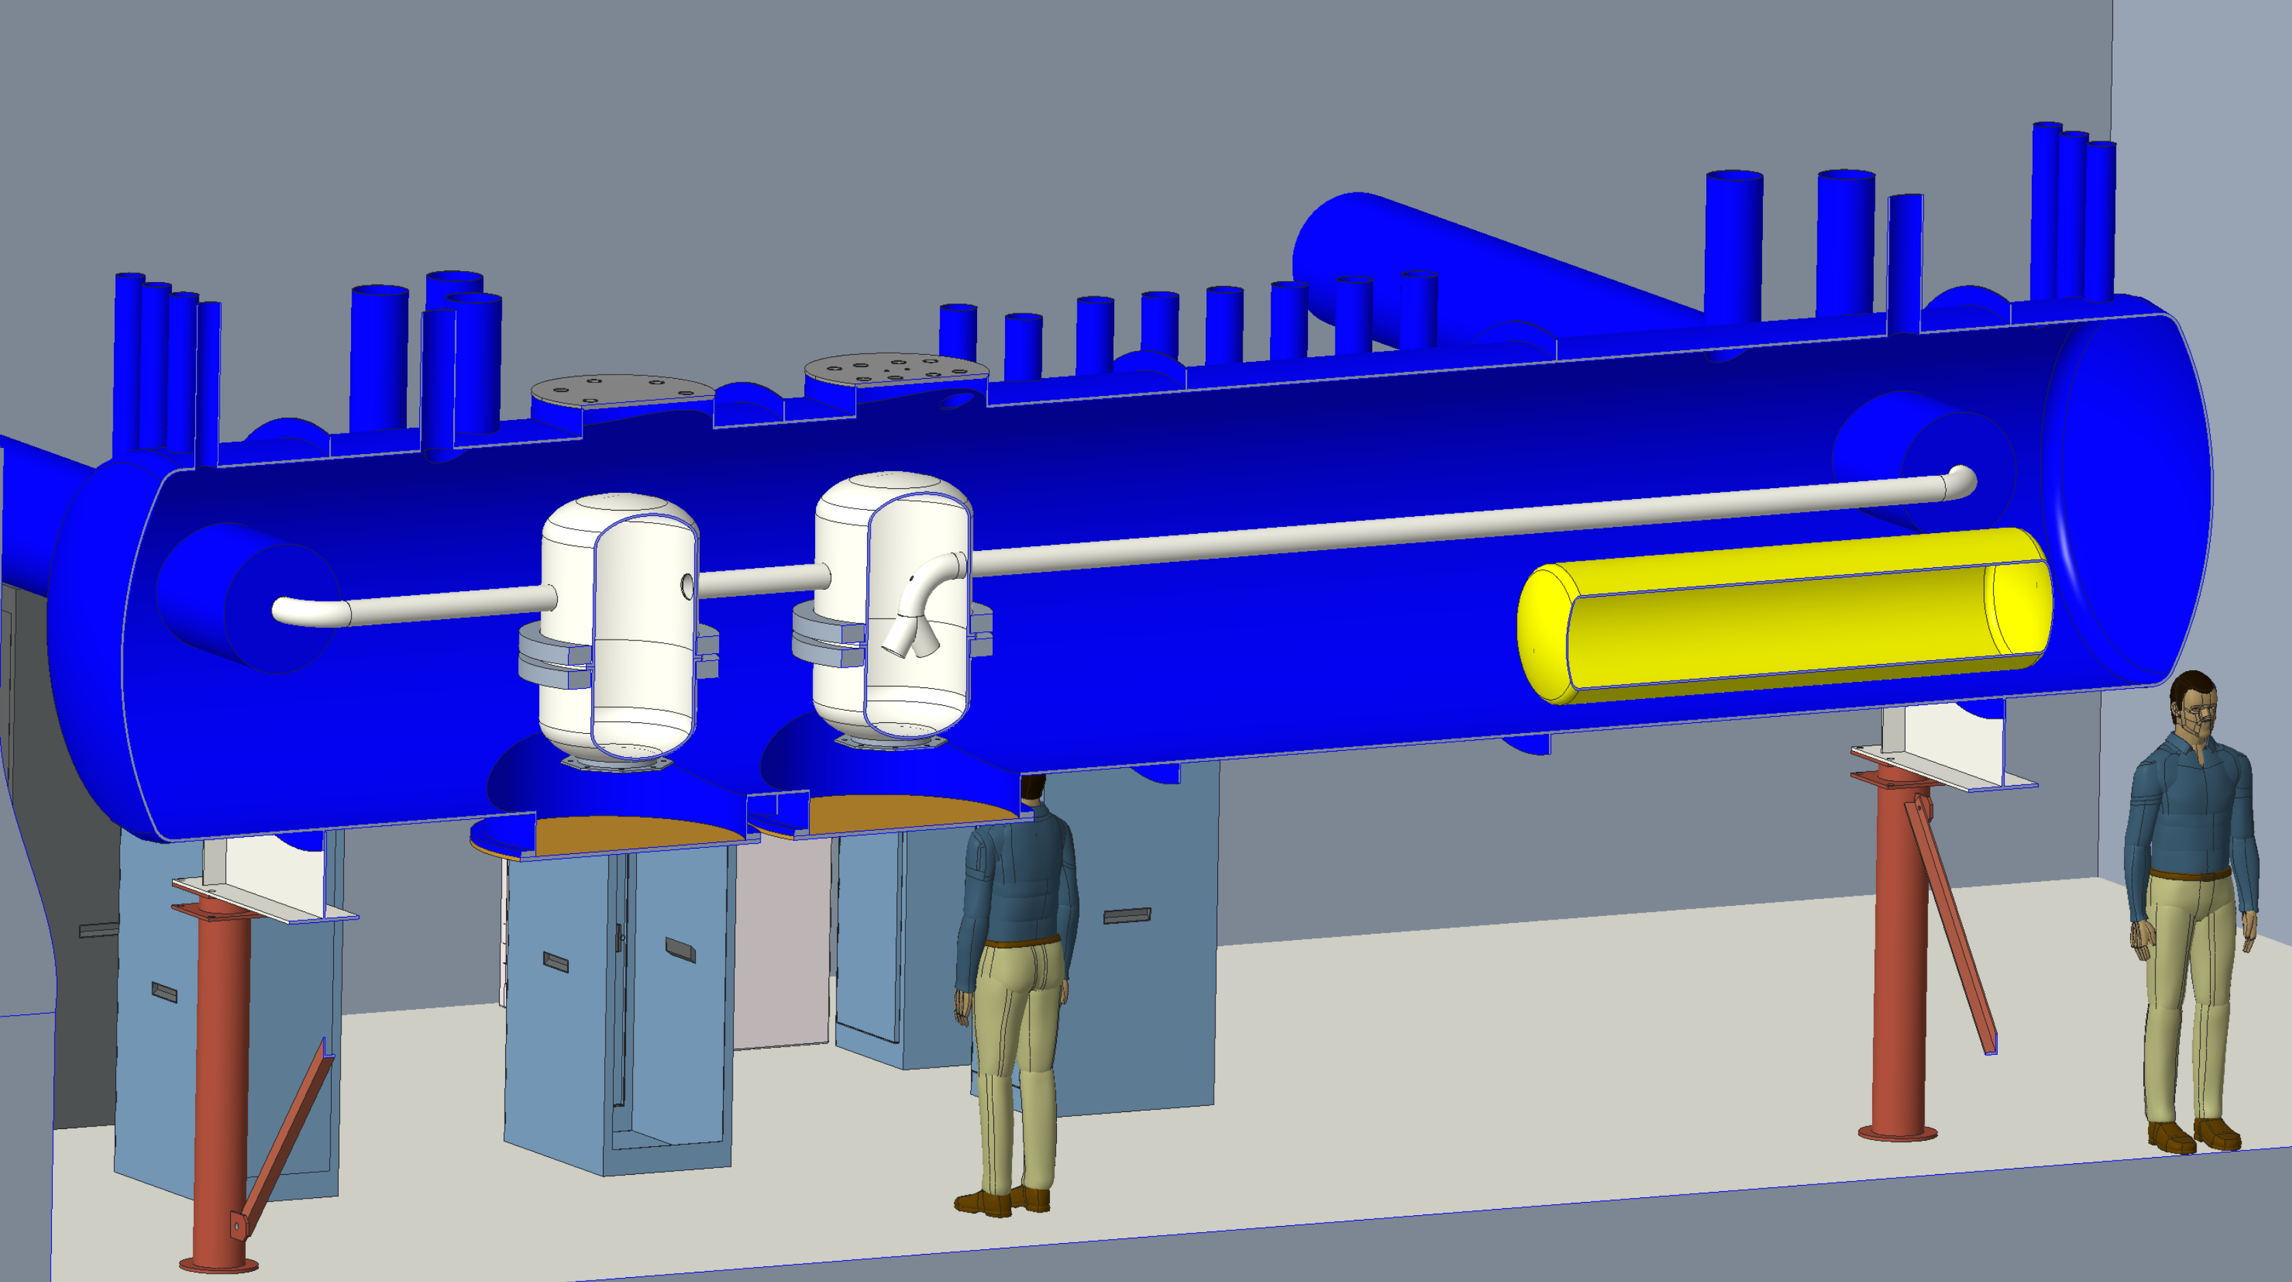
1004B Blue Valve Box
CAD models and drawings
1004B Blue Valve Box Feedthrough Map (from above)
1004B Blue Valve Box CAD model
1004B Blue Valve Box CAD model
“TBD” 12X150 current lead cross section

Slide 5
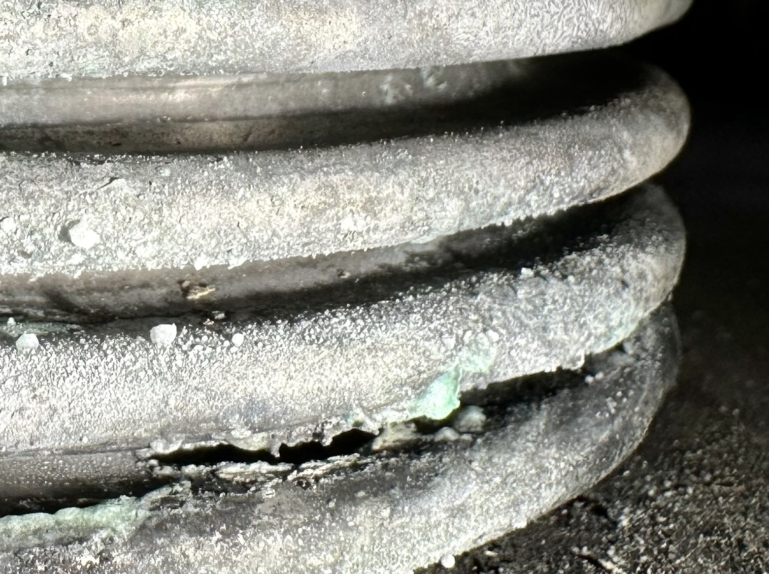
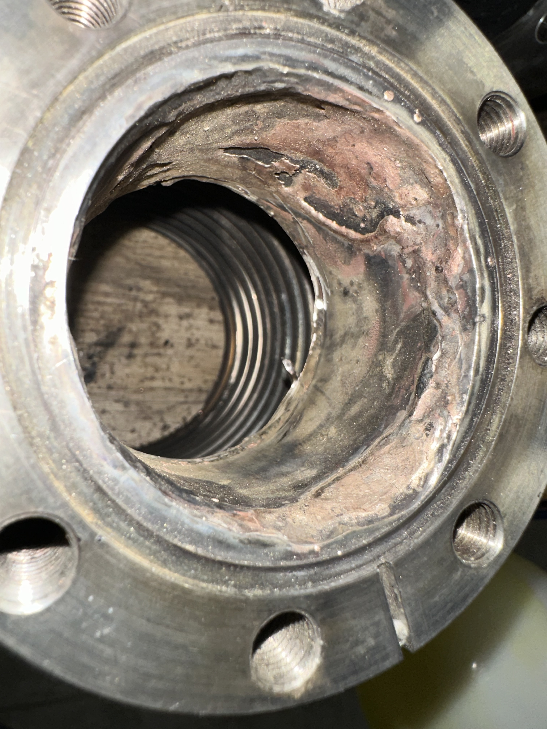
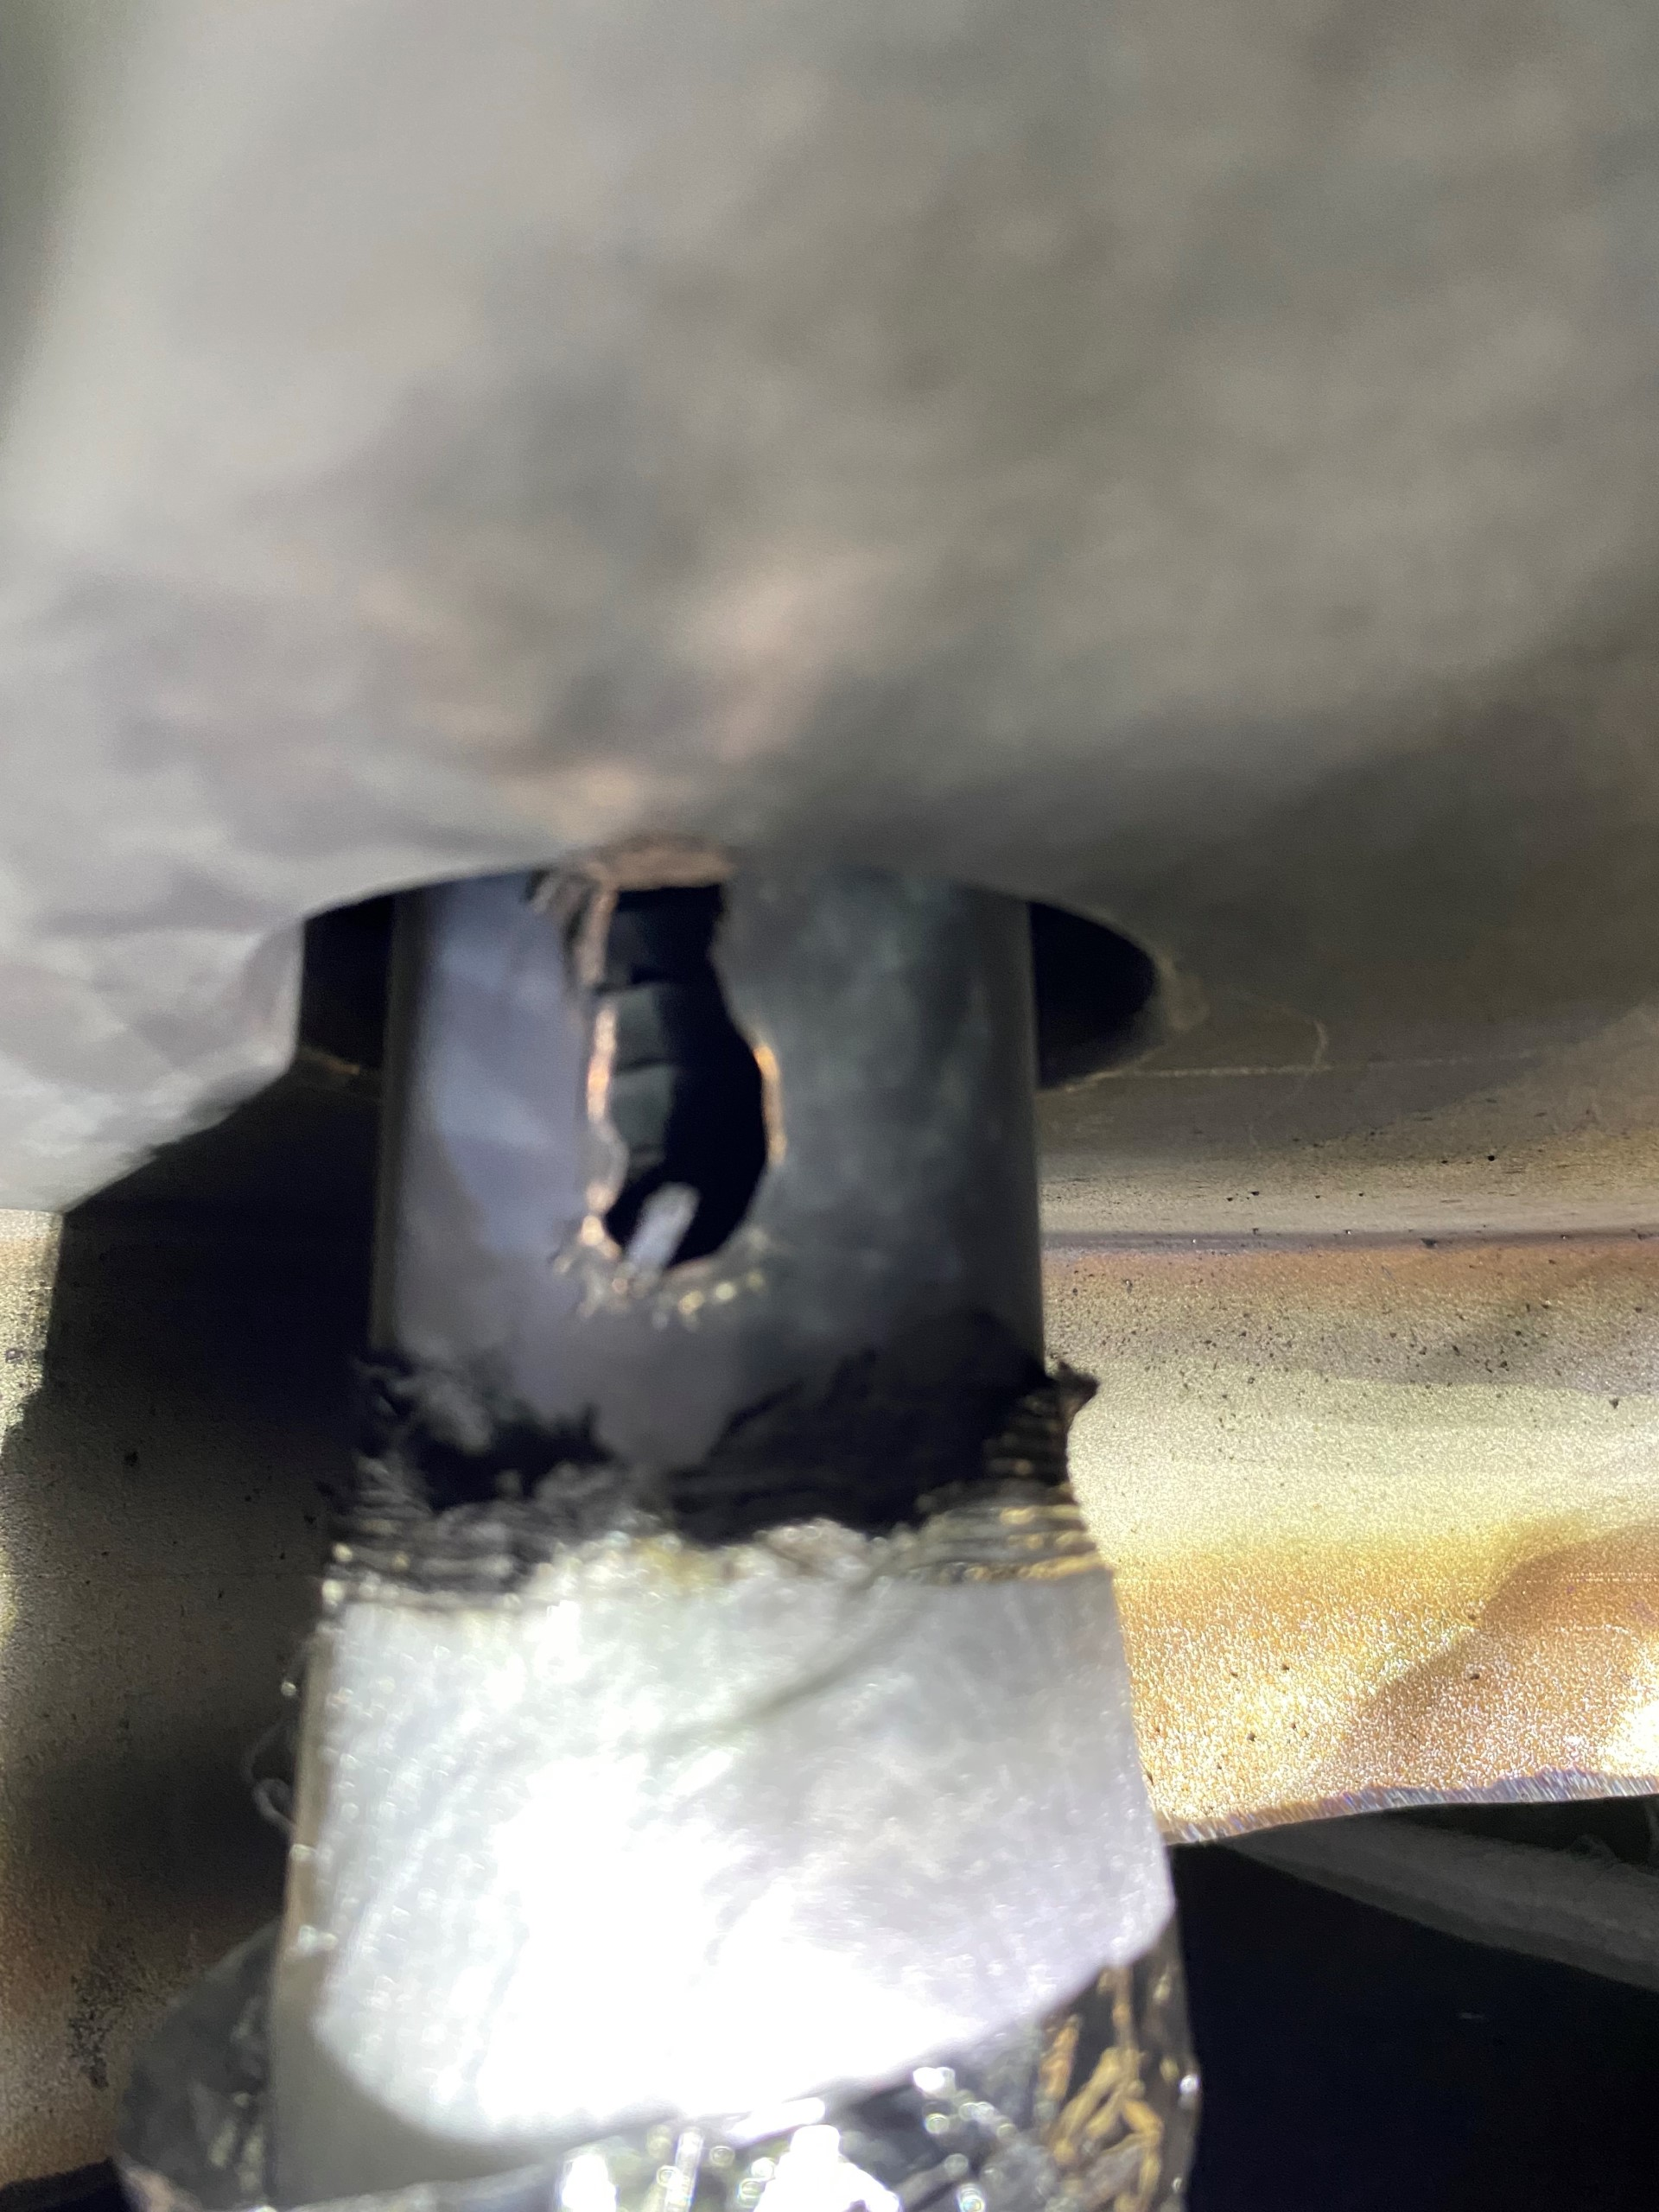
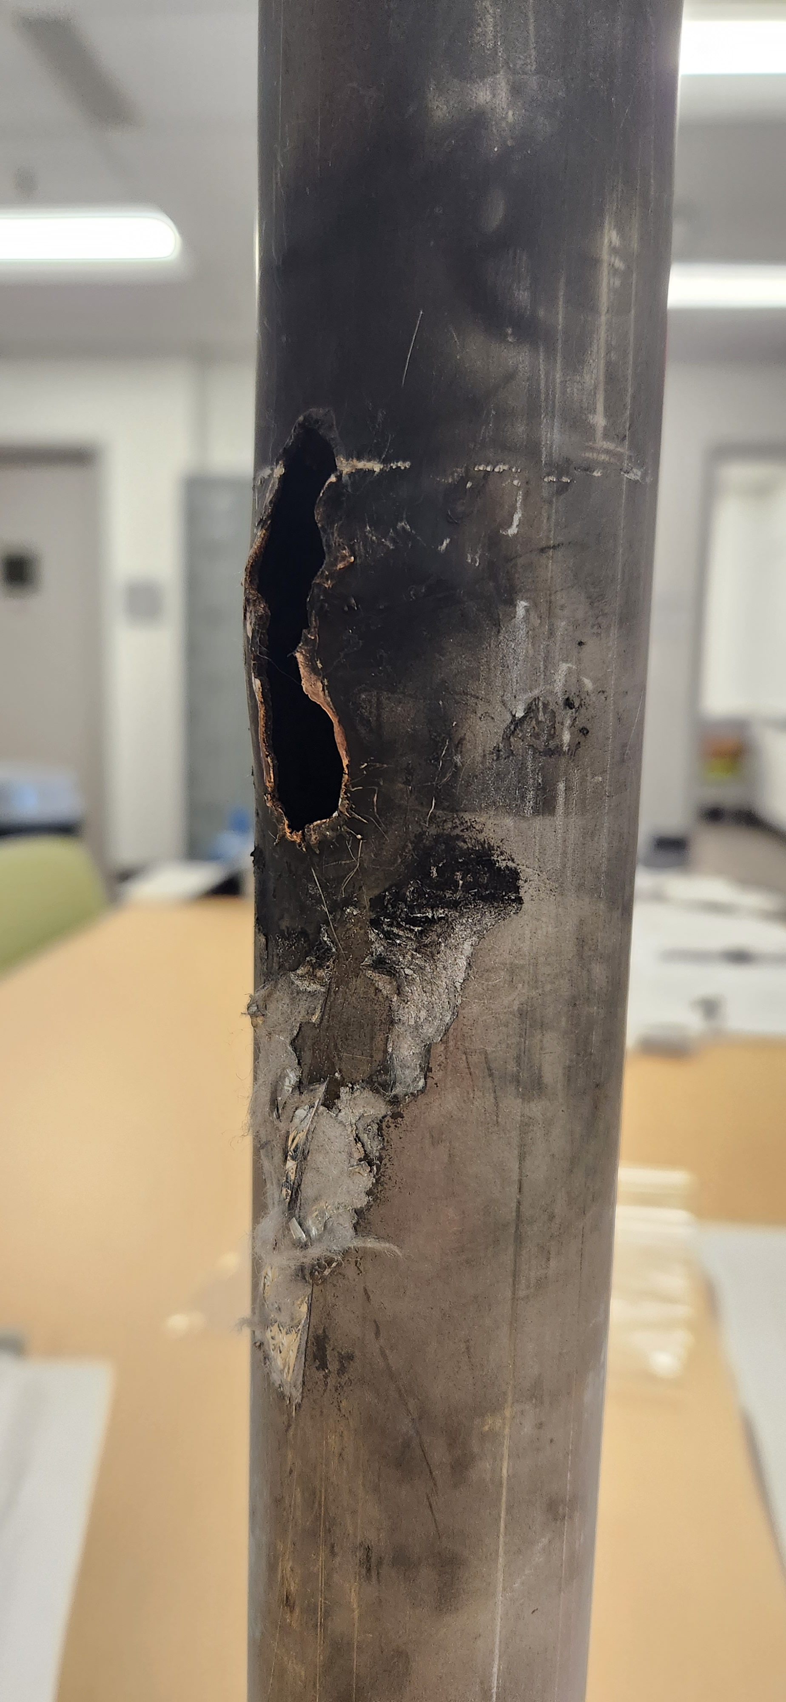
Lead pot “A” “TBD” feedthrough piping damage
This feedthrough is part of the M-line pressure boundary and the valve box pressure boundary
Bellows rupture
Copper from the melted current lead re-deposited on inside of feedthrough flange
Feedthrough tube rupture
Feedthrough tube rupture
.025” wall feedthrough tube and bellows were ruptured by current lead arc failure
“TBD” 12X150 current lead cross section
For more information on the causal analysis and electrical events that lead to this damage
→ Talks coming up next by Jon Sandberg, Chaofeng Mi, and John Escalier

Slide 6
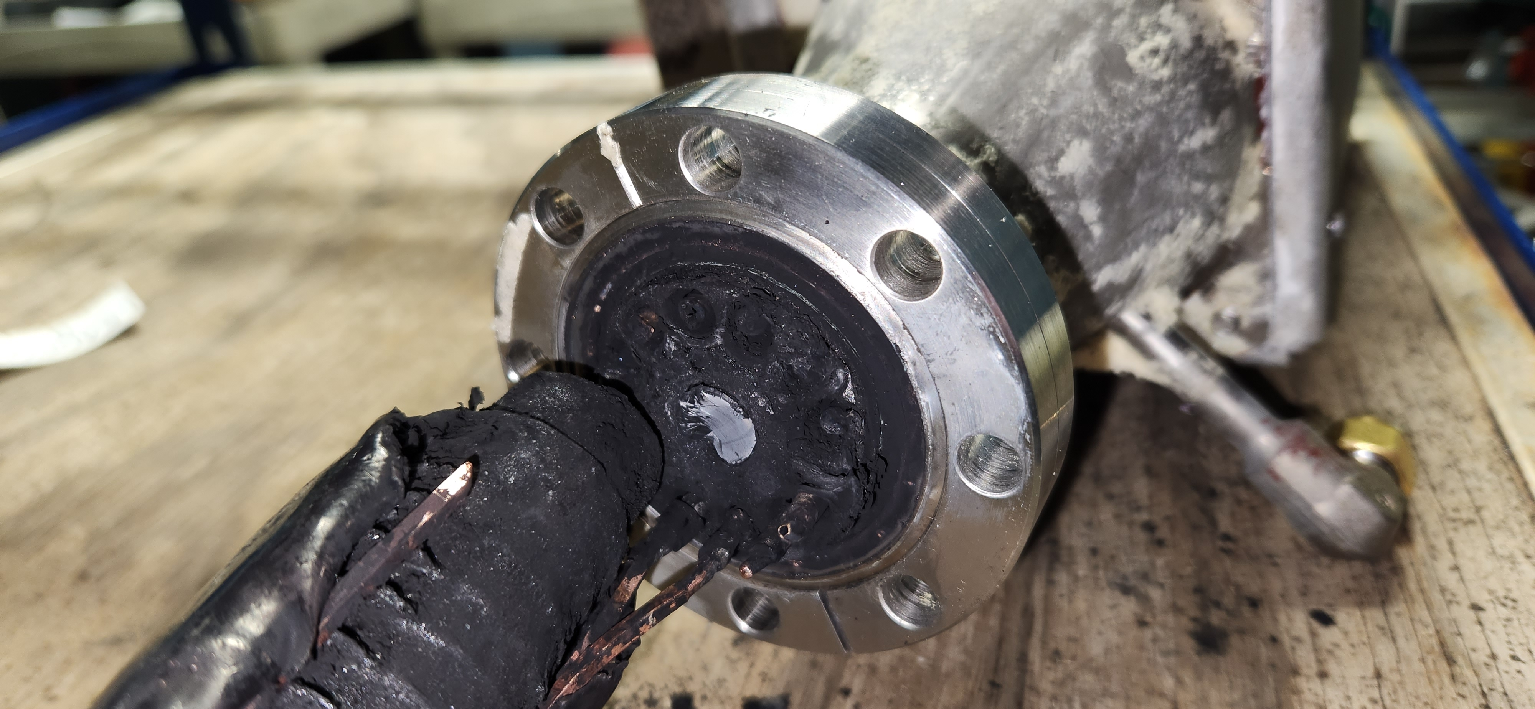
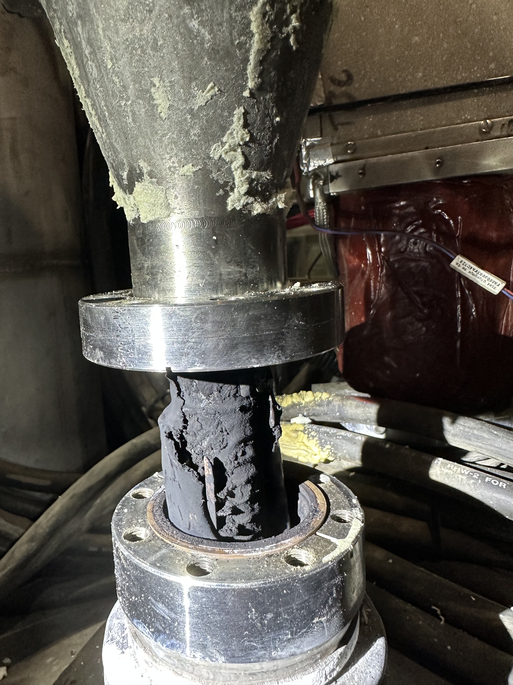
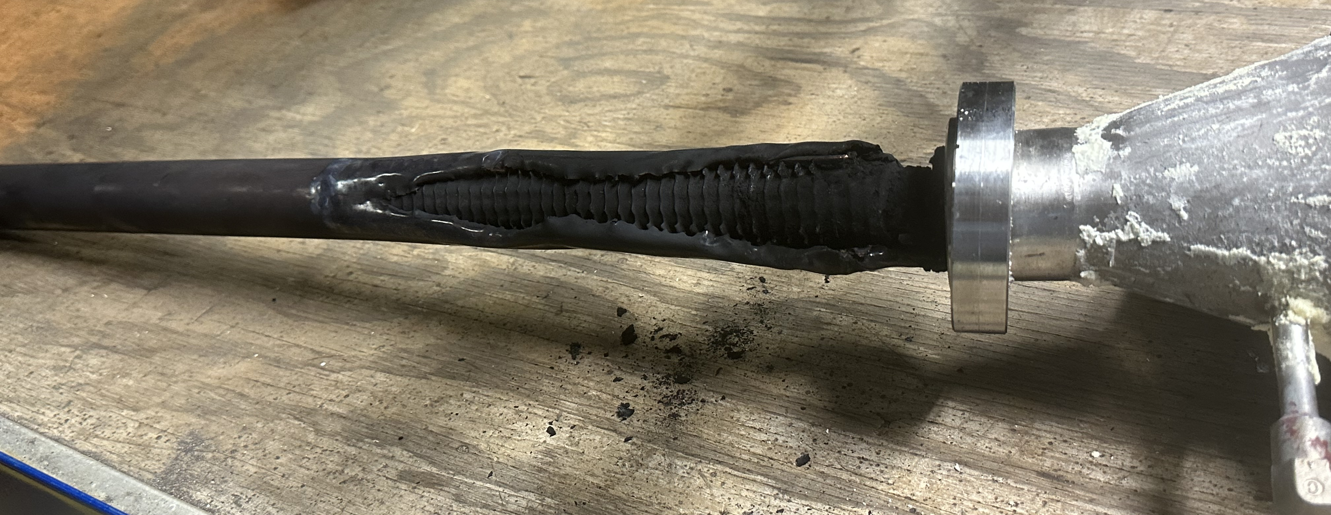
Lead pot “A” “TBD” 12X150 current lead damage
Photos of the damaged 12X150 current lead
For more information on the causal analysis and electrical events that lead to this damage
→ Talks coming up next by Jon Sandberg, Chaofeng Mi, and John Escalier

Slide 7
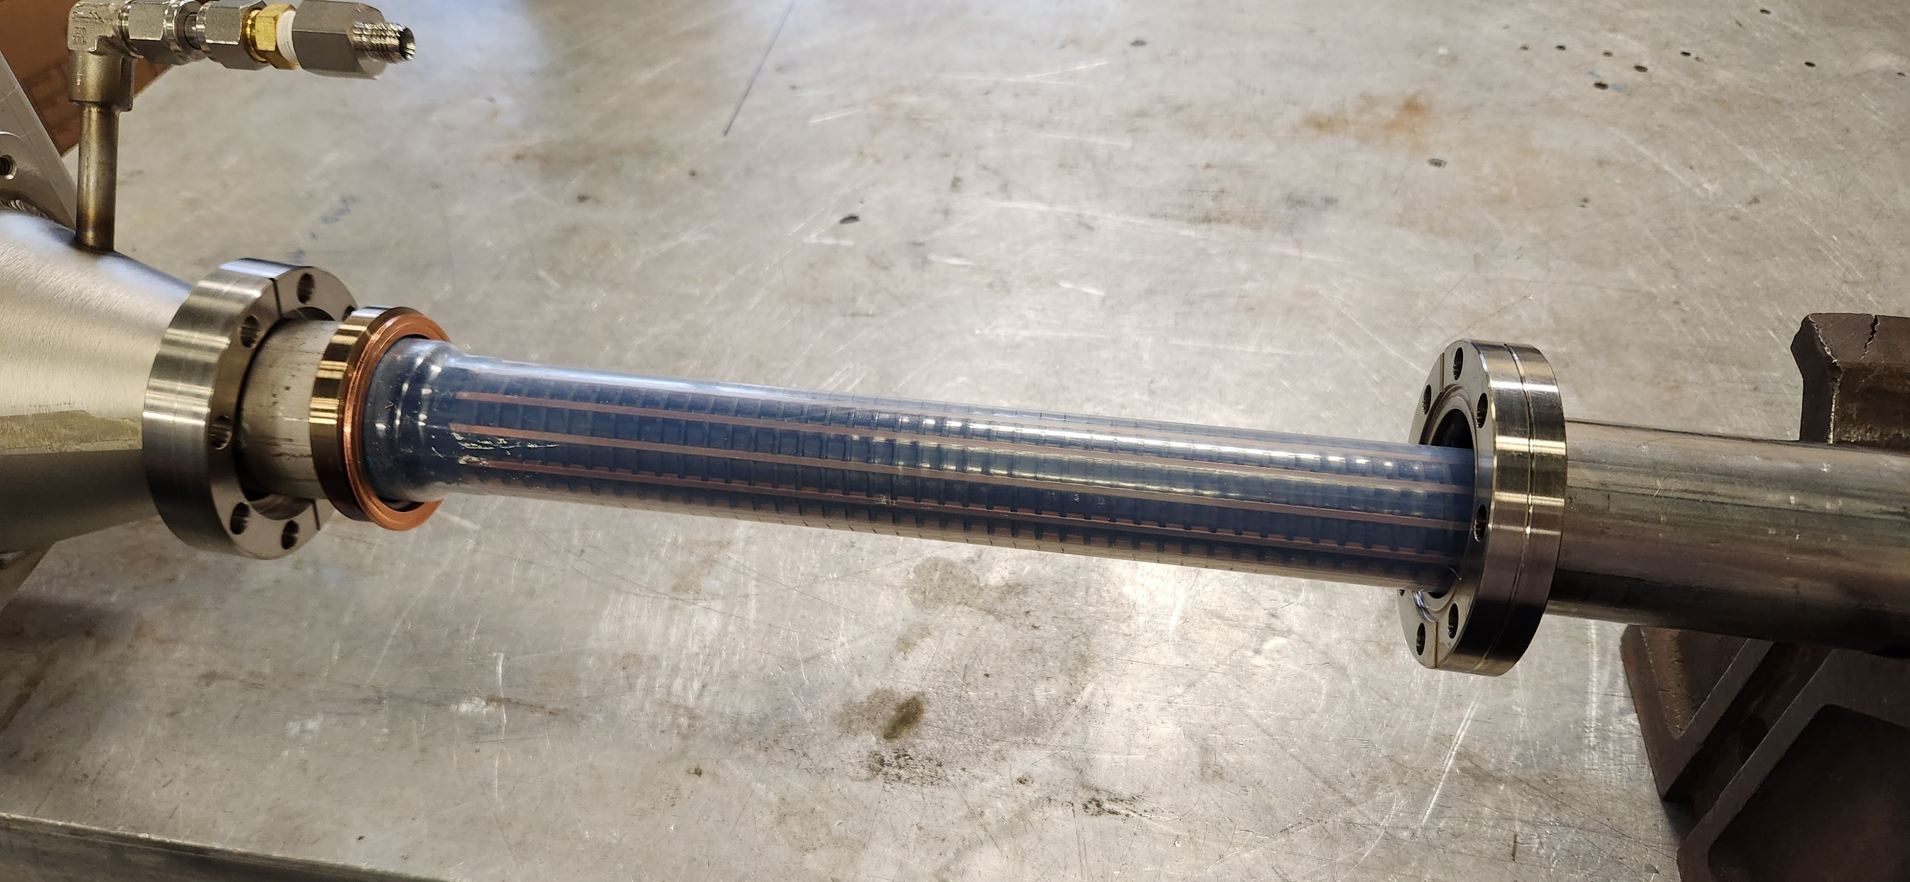
Lead pot “A” “TBD” 12X150 current lead damage
New 12X150 amp current lead
Scorched 1004B Blue “TBD” 12X150 amp current lead
For more information on the causal analysis and electrical events that lead to this damage
→ Talks coming up next by Jon Sandberg, Chaofeng Mi, and John Escalier

Slide 8
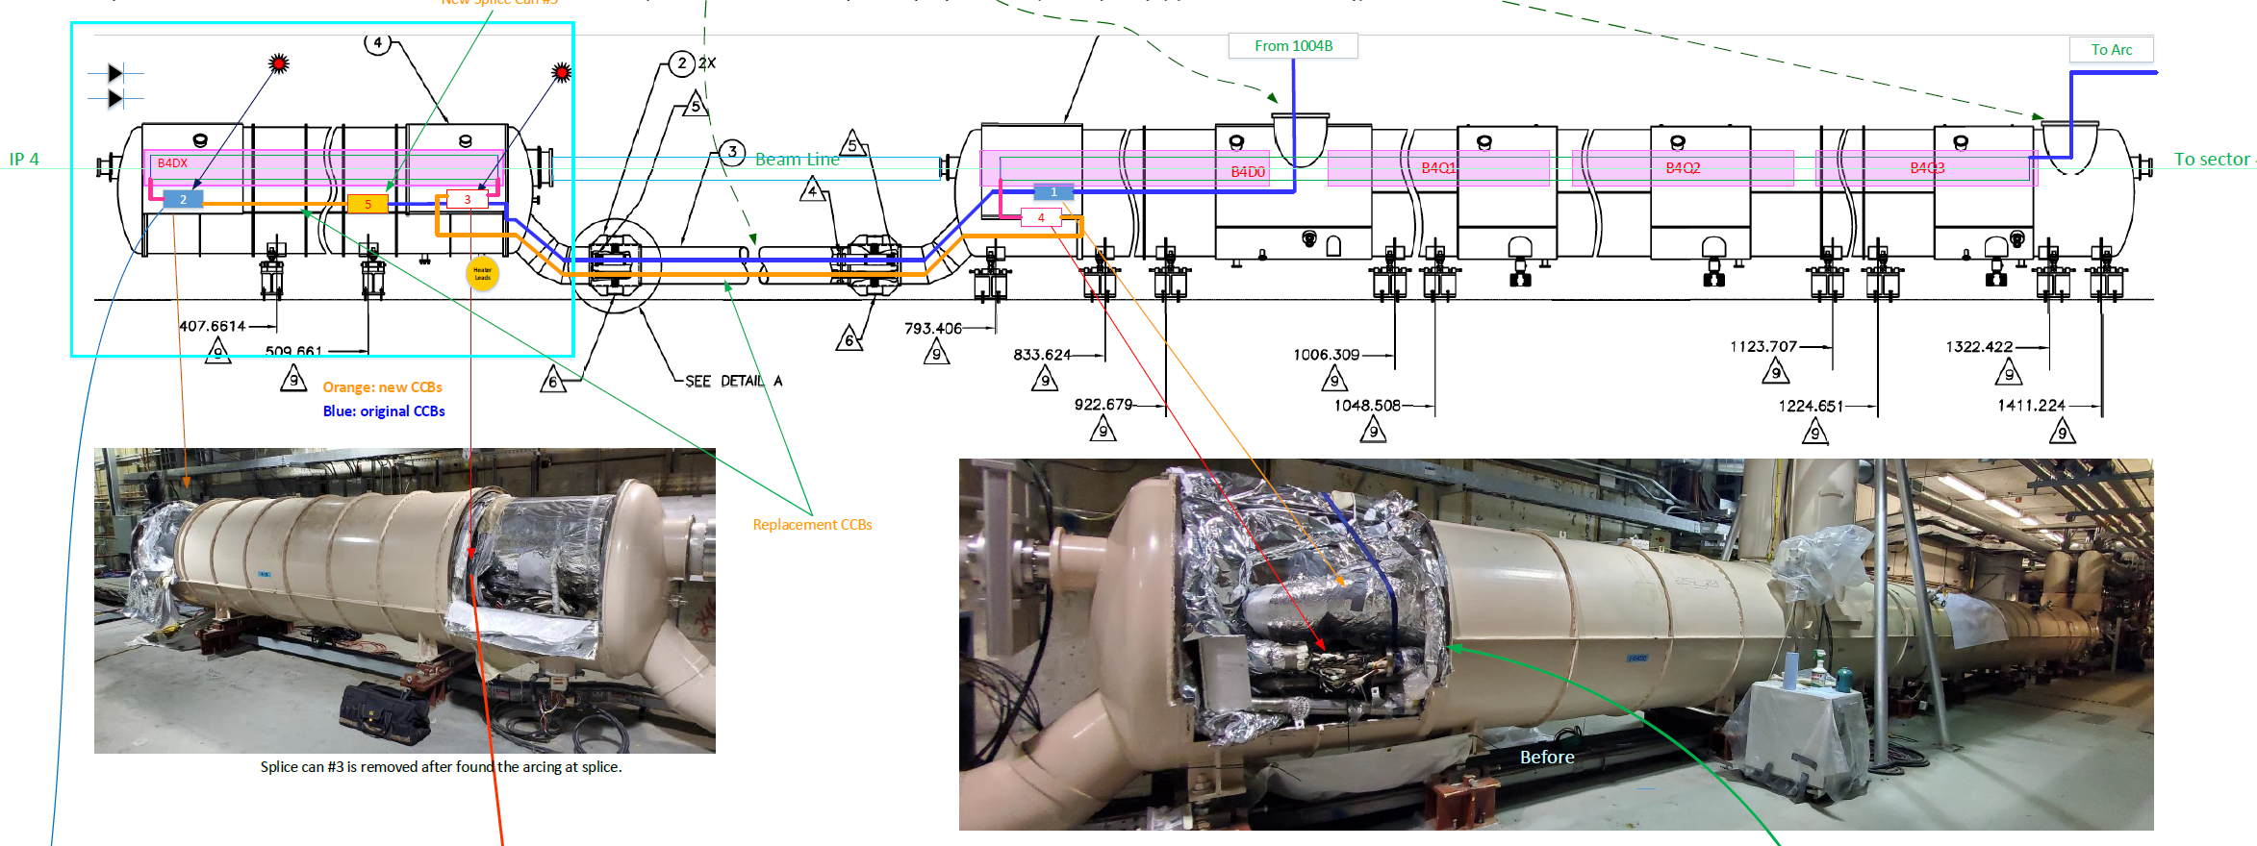
4:00 DX and D0 cryostats and magnets
After the damaged 12X150 current lead was removed, the team was still measuring shorts-to-ground in the dipole and quad bus back towards the 4:00 D0-DX magnets
Found damage in the #2 and #3 splice cans at the B4DX magnet
For more information on the causal analysis and electrical events that lead to this damage
→ Talks coming up next by Jon Sandberg, Chaofeng Mi, and John Escalier

Slide 9
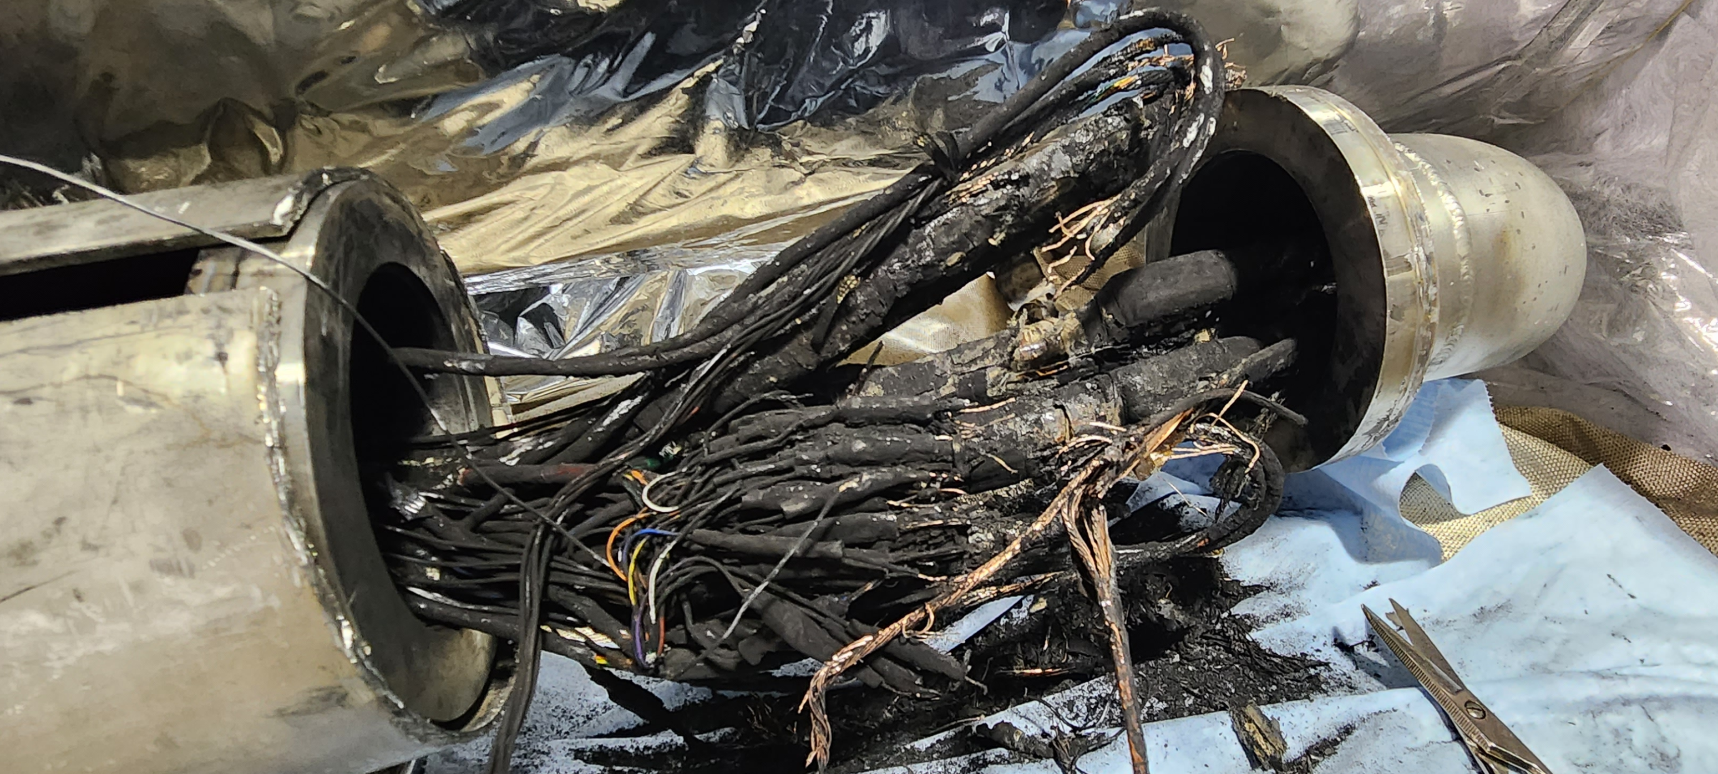
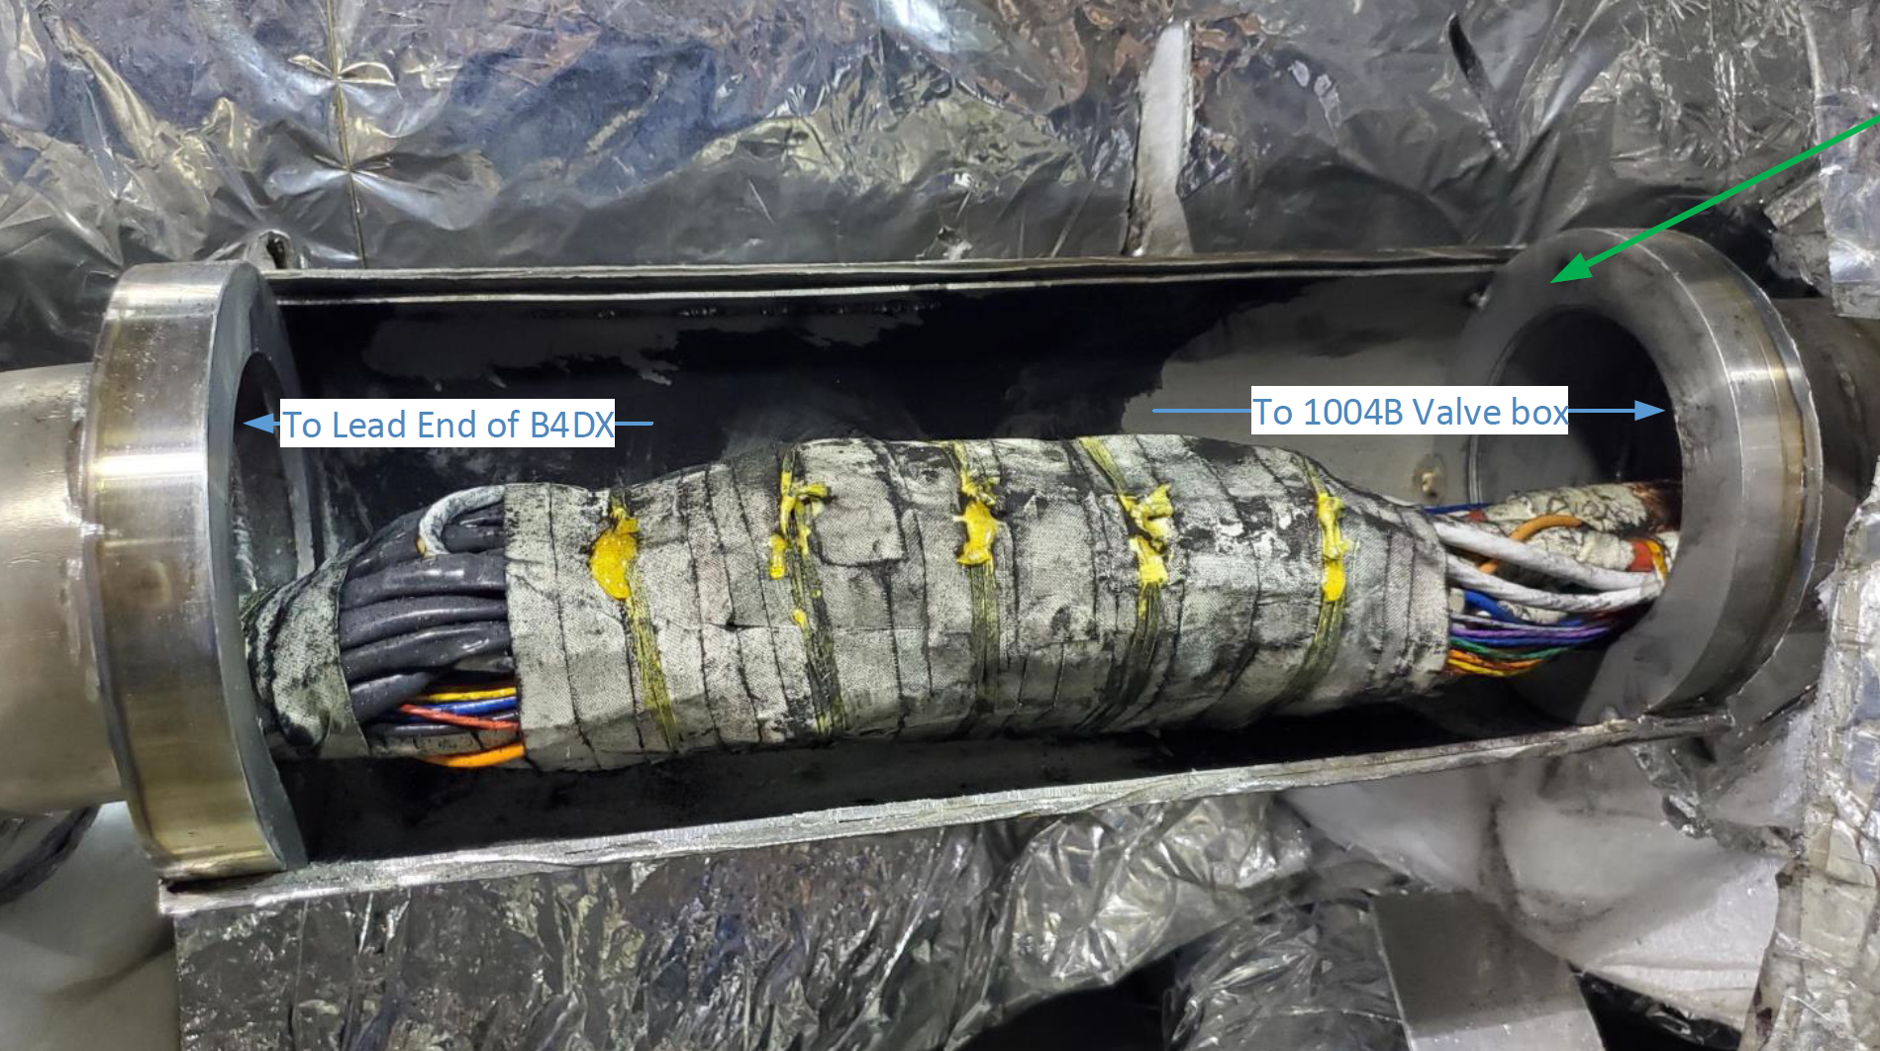
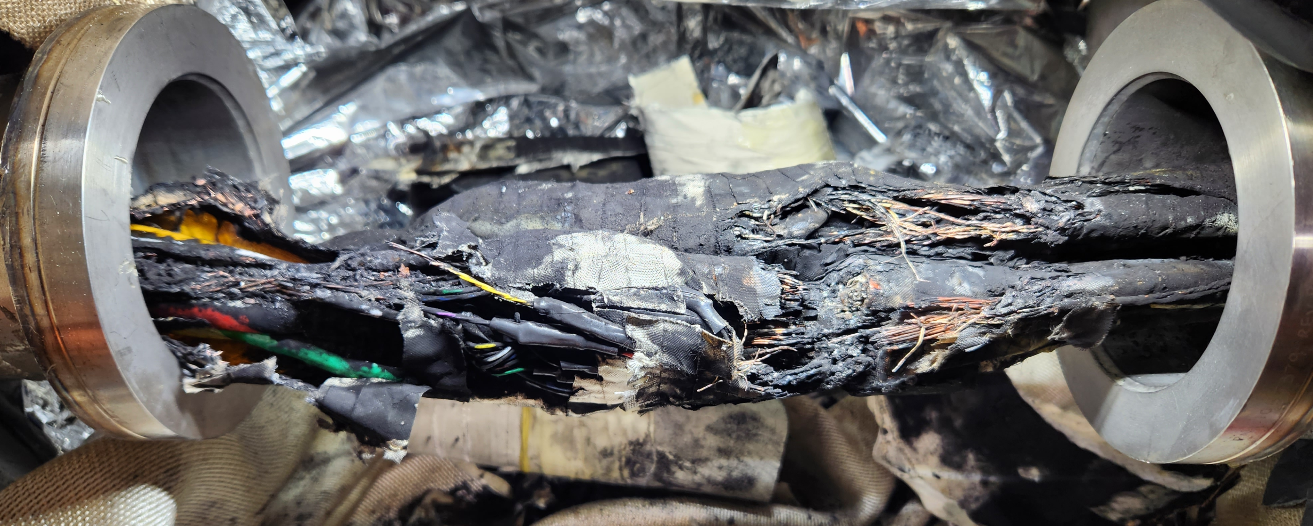
Incinerated splice joints found in DX splice cans #2 and #3
Source of shorts-to-ground in dipole and quad bus
Sooty, but undamaged splice can #1
Splice Can #2
Splice Can #3
For more information on the causal analysis and electrical events that lead to this damage
→ Talks coming up next by Jon Sandberg, Chaofeng Mi, and John Escalier

Slide 10
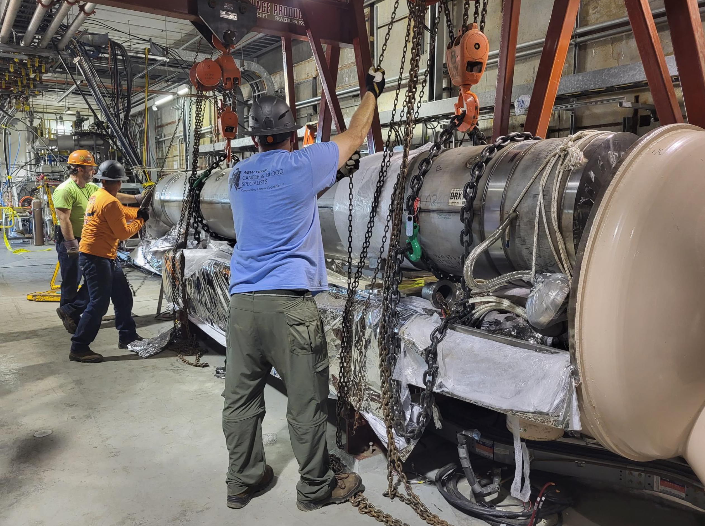
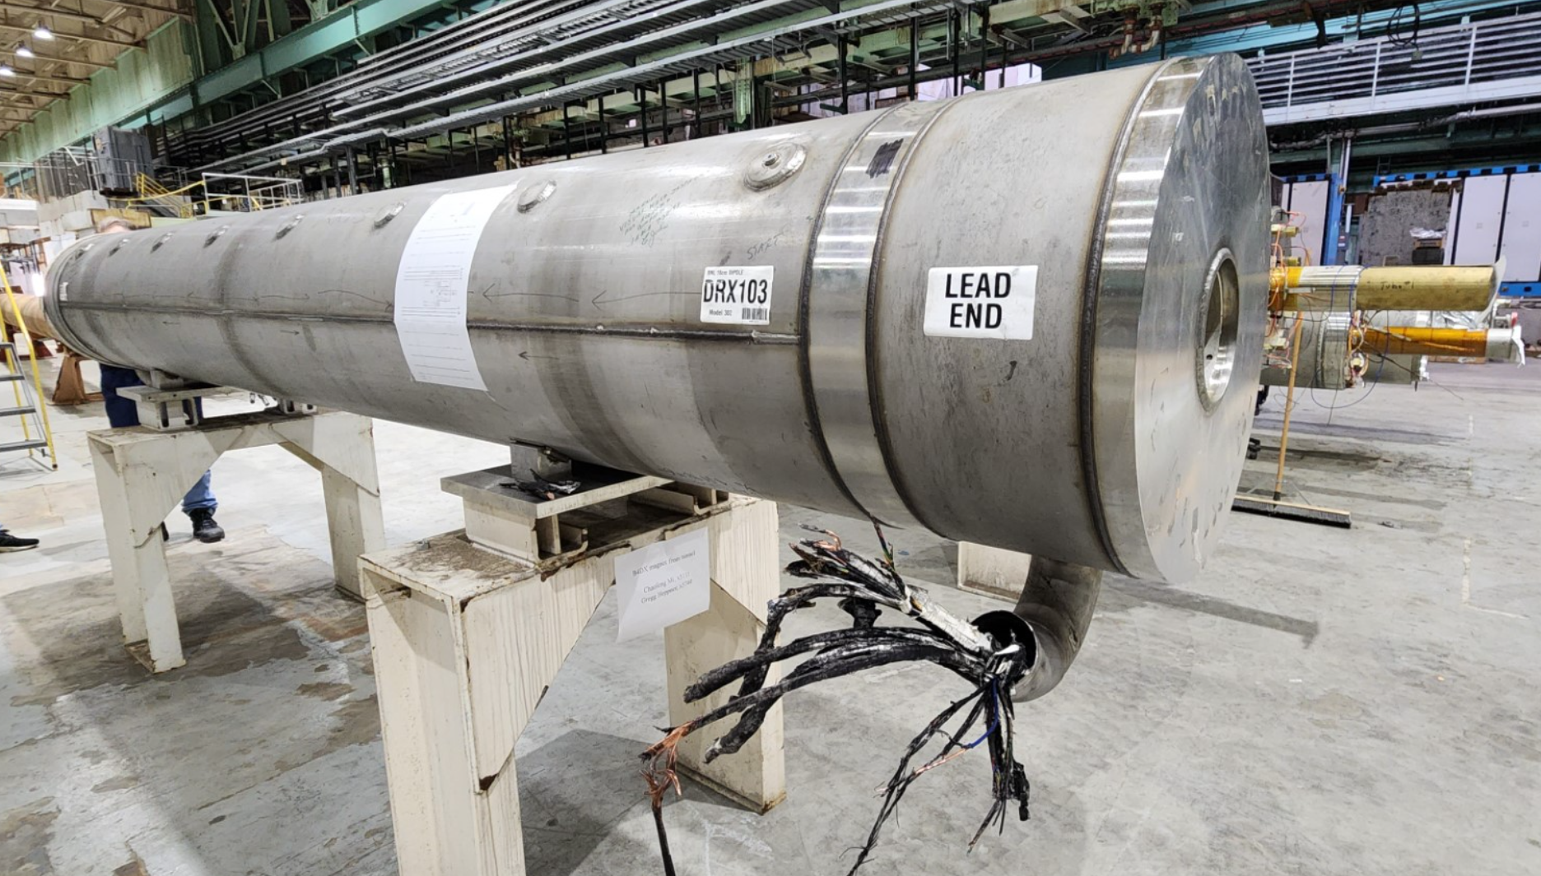
B4DX DX magnet removed to start 4:00 repairs
For more information on the DX magnet recovery work
→ Talk coming up by Joe Tuozzolo and Scott Seberg

Slide 11
RHIC Recovery Schedule
Technically-driven RHIC restart date, 3/27/24
45k wave start requires ASE approval
Activity | Start | End | Aug 23 | Sept 23 | Oct 23 | Nov 23 | Dec 23 | Jan 24 | Feb 24 | Mar 24 | April 24
1004B and 4:00 failure investigation, design, fabricate | 8/1/23 | 10/31/23
1004B Valve Box: Feedthrough Pipe Repair | 11/1/23 | 11/19/23
1004B Valve Box: Install Spare 12x150 Current Lead | 11/20/23 | 12/8/23
1004B Valve Box: Close lead-pots | 12/11/23 | 12/22/23
1004B Valve Box: Close and pump down | 1/22/24 | 1/26/24
DX magnet: Prep spare at bldg. 912 | 10/1/23 | 11/28/23
DX magnet: Magnet testing at bldg. 902 (SMD) | 11/29/23 | 12/13/23
DX magnet: transport to 4:00, re-connect, electrical tests | 12/13/23 | 1/12/24
4:00: Pre-DX repair and splice-in new SC bus cables | 10/11/23 | 12/13/23
4:00: Close splice cans and ready for M-line test | 1/13/24 | 1/17/24
1004B and 4:00: M-line pressure test | 1/18/24 | 1/21/24
4:00 Close DX-DO cryostats, install and bake beam tube | 1/22/24 | 2/23/24
RHIC ASE and USI draft through ALD ESH approval | 10/24/23 | 12/19/23
RHIC ASE and USI review and approval | 12/20/23 | 2/18/24
Cryo: Start system scrub | 1/22/24 | 2/18/24
Cryo: Start 45K wave | 2/19/24 | 3/18/24
Cryo: 4.5K wave | 3/19/24 | 3/26/24
RHIC 2024 Start + DX and 12X150 lead cold tests start | 3/27/24

Slide 12
On the road to RHIC recovery
BNL team effort supporting several parallel workstreams
1004B valve box mechanical repairs
1004B spare 12X150 current lead preparation and valve box electrical work
4:00 DX magnet and magnet bus repairs, mechanical and electrical work
912 and 902 DX magnet preparation and testing
Spare 12X150 current lead preparation and valve box electrical work
ASE and USI documents and supporting ODH calculations
Schedule pacers
New DX magnet install at 4:00 → M-line pressure test
M-line piping pressure test → Close 1004B valve box, close DX-DO cryostats
M-line piping pressure test → Cryo-scrub and 45K cooldown wave each require ~1-month
ODH modeling, USIs, and RHIC ASE revision
Updated service building ODH models to now include o-ring and bellows leaks into room
There are two USIs. The first pertains to RHIC room-temperature scrubbing. The second requires a change to the RHIC Accelerator Safety Envelope (ASE) to allow operation of RHIC below 285K.
Causal analysis team understands what happened
Spare 12X150 current lead for remaining two RHIC campaigns + possible improvements in gas-cooled lead flow control to limit current lead thermal cycling (see following presentations)
Improved 12X150 design for EIC

Slide 13
Backup Material

Slide 14
1004B valve box failure → Cryo controls alarms
The event timeline as seen from the cryo control system, filtered for the first event that indicated a problem -Ring Recooler Level. The second alarm, Valve Box Insulating Vacuum Failure, is when the slide valve closed which isolated the 4VB vessel from the vacuum pumps because helium was leaking into the vacuum space. The chain continues until the cryo interlock opens about a minute later.
The timestamps have a high degree of precision, however, this should not be considered as absolute reference time. The actual events preceded these times by as much as 5 seconds.
08/01/2023 | 12:32:06.339 | ALM_ALM92 | RING RECOOLER LHe LEVEL HI/LO ALARM - - - - - - - - - - - - - - - - D237
08/01/2023 | 12:32:09.457 | ALM_ALM63 | VALVE BOX INSULATING VACUUM FAILURE - - - - - - - - - - - - - - - D245
08/01/2023 | 12:32:09.457 | ALM_ALM92 | RING RECOOLER LHe LEVEL HI/LO ALARM - - - - - - - - - - - - - - - - D237
08/01/2023 | 12:32:09.457 | ALM_ALM63 | VALVE BOX INSULATING VACUUM FAILURE - - - - - - - - - - - - - - - D245
08/01/2023 | 12:32:21.900 | ALM_ALM61 | REFRG SUPPLY TO RING FLOW FE210H OUT OF LIMITS - - - - - - - - - - D37
08/01/2023 | 12:32:43.590 | ALM_ALM92 | RING RECOOLER LHe LEVEL HI/LO ALARM - - - - - - - - - - - - - - - - D237
08/01/2023 | 12:32:56.119 | ALM_ALM132| BLU RING 'S' HEADER PRESS CNTRL (H4501A) DP DEVIATION ALARM - - - D101
08/01/2023 | 12:33:01.289 | ALM_ALM92 | RING RECOOLER LHe LEVEL HI/LO ALARM - - - - - - - - - - - - - - - - D237
08/01/2023 | 12:33:01.289 | ALM_ALM95 | RING CORRECTOR LEAD FLOW - HIGH FLOW ALARM - - - - - - - - - - - - D223
08/01/2023 | 12:33:01.289 | ALM_ALM92 | RING RECOOLER LHe LEVEL HI/LO ALARM - - - - - - - - - - - - - - - - D237
08/01/2023 | 12:33:08.535 | ALM_ALM91 | CRYO PERMISSIVE INTERLOCK OPEN, CRYO STATUS - NOT READY! - - - - - D19

Slide 15
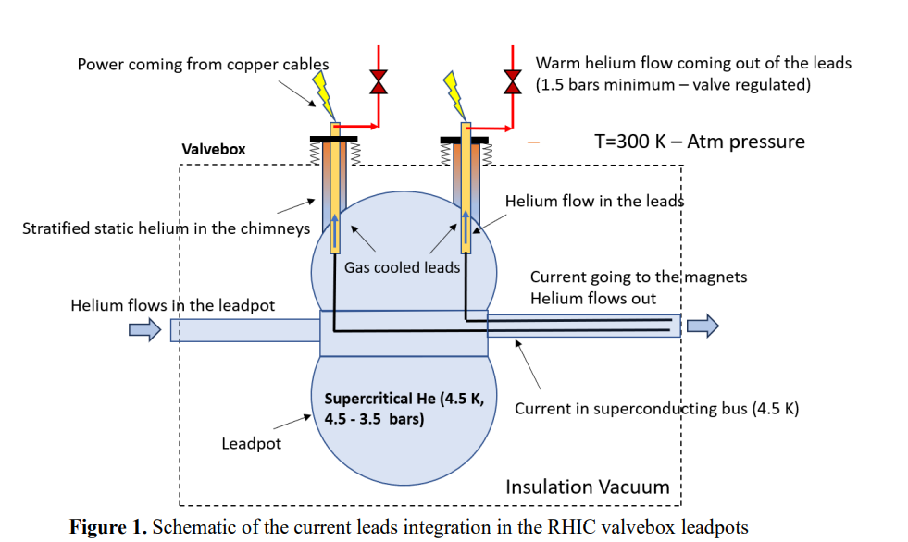
RHIC Valve Box Lead Pots and Gas-Cooled Current Leads
Schematic created by Frederic Micolon

Slide 16
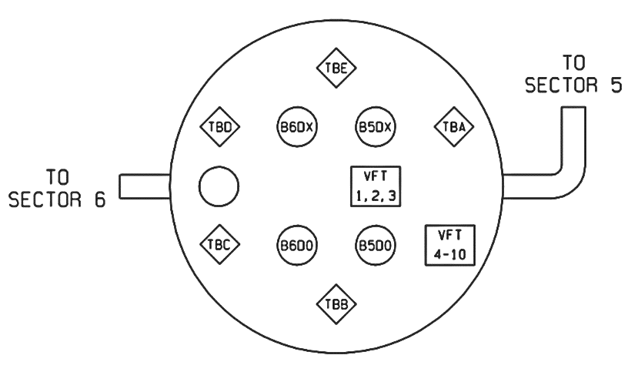
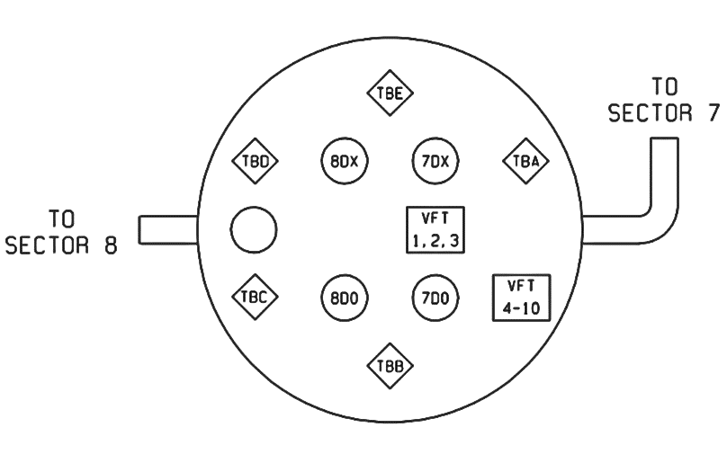
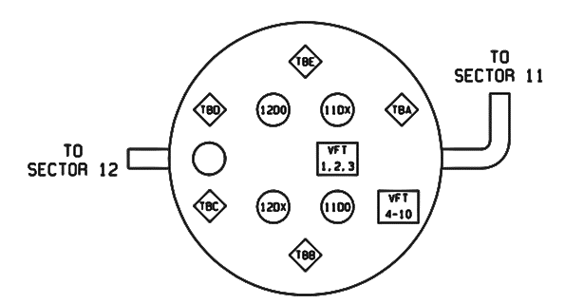
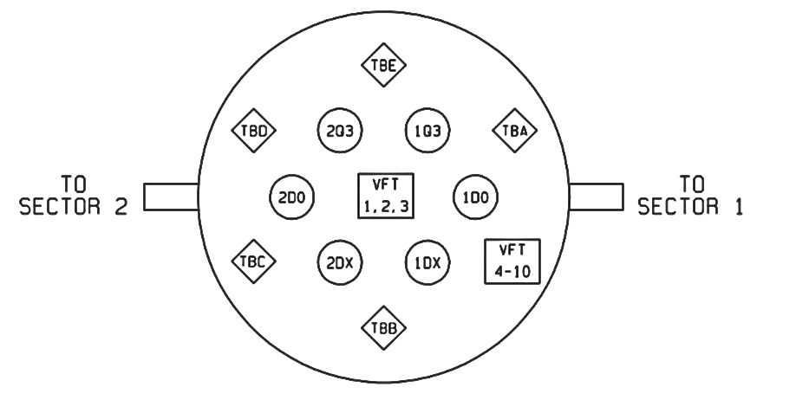
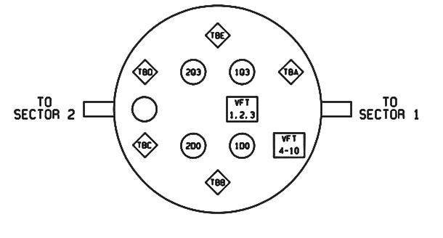
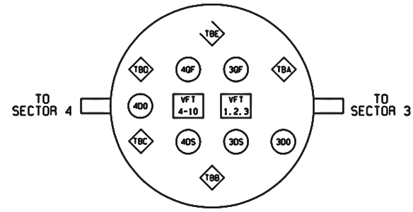
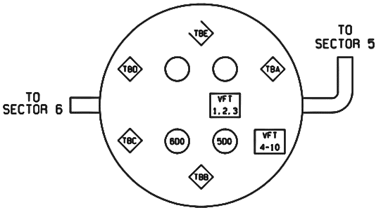
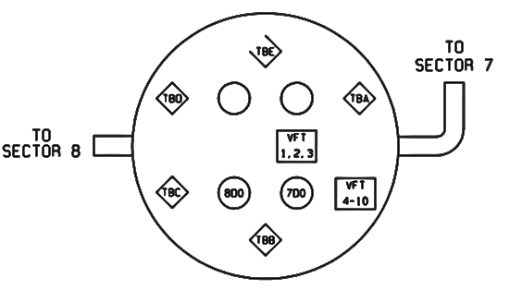
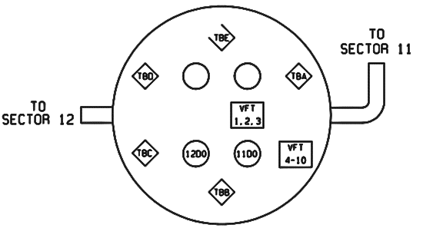
RHIC Valve Box Power Leads Map
TBX
= 12 x 150 amp
12D0
= XXXXXX
XXXX
XXXXX
= XXXXXX
 | 2:00 | 4:00 | 6:00 | 8:00 | 10:00 | 12:00
B
Y
A
A
A
A
A
B
B

