Slide 1
RHIC Run 23 – failure
Event chronology proposal and analysis summary
F.Micolon – November 2023

Slide 2
A proposition of event chronology
Event | Event | Supporting evidence/analysis
1 | Thermal fatigue solder cracks in the leads | Observation from John Analysis of the solder joint thermal fatigue Experimental test campaign (when possible)
2 | Arcing inside the lead cracked joint – side eruption | Observation from John
3 | Inter-lead arcing Q1-Q9 | Voltage difference across Q1 - Q9 Analysis of lead Paschen arcing
4 | QPS turns ON – DX heaters fire - 500+ V on dipole bus
5 | Lead arcing expands to D6 – Quad/Dipole/Ground are now connected - intense current sharing
6 | DX quench warms up the helium – flow out through splice cans – quench of the splices and conductors in DX splice cans | DX quench warm up analysis
7 | Burnout of the “Trim cable” in DX splice cans. CCB stays intact | DX conductor burnout analysis

Slide 3
RHIC Run 23 – 12x150A lead failure
Solder joint thermal fatigue
F.Micolon - November 2023

Slide 4
Intro/context
A failure has occurred on Aug 1st around 12:30 pm that terminated the RHIC23 run
DX quench heaters were triggered and a helium leak was observed in the sector 4 blue valvebox.
A 12x150A lead was badly damaged (blue 4 Q1Q2Q3QDQ9D6). An autopsy revealed a lead burn seemingly originating from the solder location, more pronounced on the D6 conductor. See John’s report.

Slide 5
Data log on Q2 conductor
The Q2 conductor has the highest current (and voltage) of all leads.
The helium flow seems to increase with a delay (around 3 min+) after the current increase.
A voltage overshoot is observed (+60 mV peak and 43 mV steady state) in line with the resistance.

Slide 6
Simulation

Slide 7
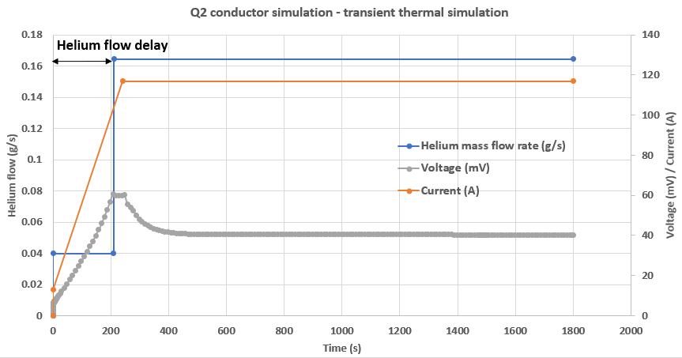
Simulation
A simulation of a FEA model was made to try to replicate these conditions.
Q2 voltage simulated
The voltage overshoot is visible and with the correct amplitude (helium flow delay was set at 3.5 min)

Slide 8
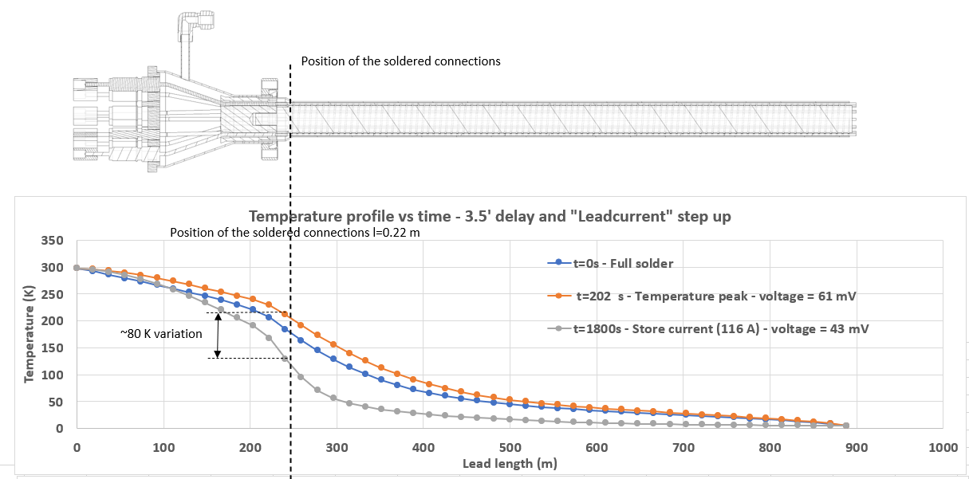
Simulation
The voltage overshoot is linked to the temperature profile overshoot (higher temperature = higher resistivity).
A temperature swing of ~80 K is seen at the solder location. This takes place at each current ramp-up to store (several times a day during a run)

Slide 9
Why the temperature swing ?

Slide 10
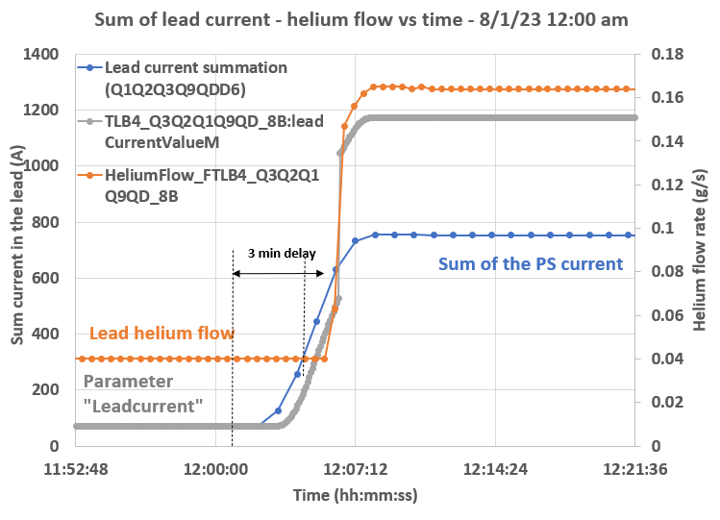
Why such a temperature swing ? Going up…
The delay in helium flow will produce a temperature overshoot of the lead.
The flow is left at idle (0.04 g/s) until the lead current reaches 360 A (set by controls).
The lead current ramps up to 720 A in 6’, so it takes 3’ to reach 360 A.
The “Leadcurrent” parameter has a delay of ~0.5’.
This sums up to 3.5’ delay approx.
Tare - No helium flow increase until “Leadcurrent” has reached 360 A

Slide 11
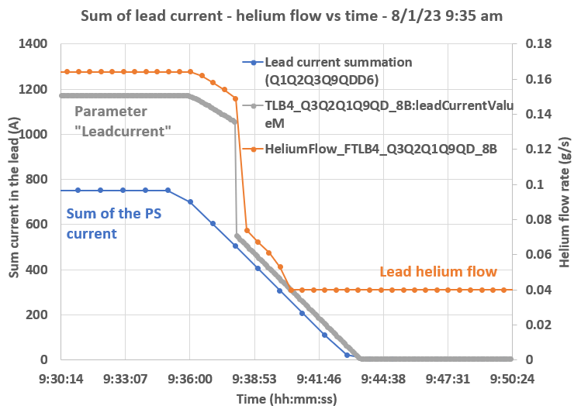
Why such a temperature swing ? …Going down
While the lead current follows a linear increase (blue) the parameter “LeadCurrent” used to work out the current setpoint jumps up or down (when the actual current reaches 500 A).
G. Ganetis remembers some steps were left in the control system to avoid lead runaway. This was not really optimized by “a lack of time” when commisionning.
This leads to a severe lead overcooling (and most of the temperature swing is because of this overcooling – see slide 5).

Slide 12
Solder crack

Slide 13
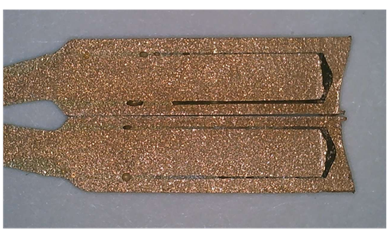
Solder crack ?
John’s autopsy of the joint shows cracked joints and a solder filling factor of only 30% (no weep hole).
The FEA model was used to understand the temperature profile and loading of the solder joint for full coverage and 30 % coverge of the joint.
0.5”
Geometrical assumption for FEA model
0.15”
Φ 0.104” hole ID
Φ 0.09” OD
John Escallier
Solder thickness
= 0.007”

Slide 14
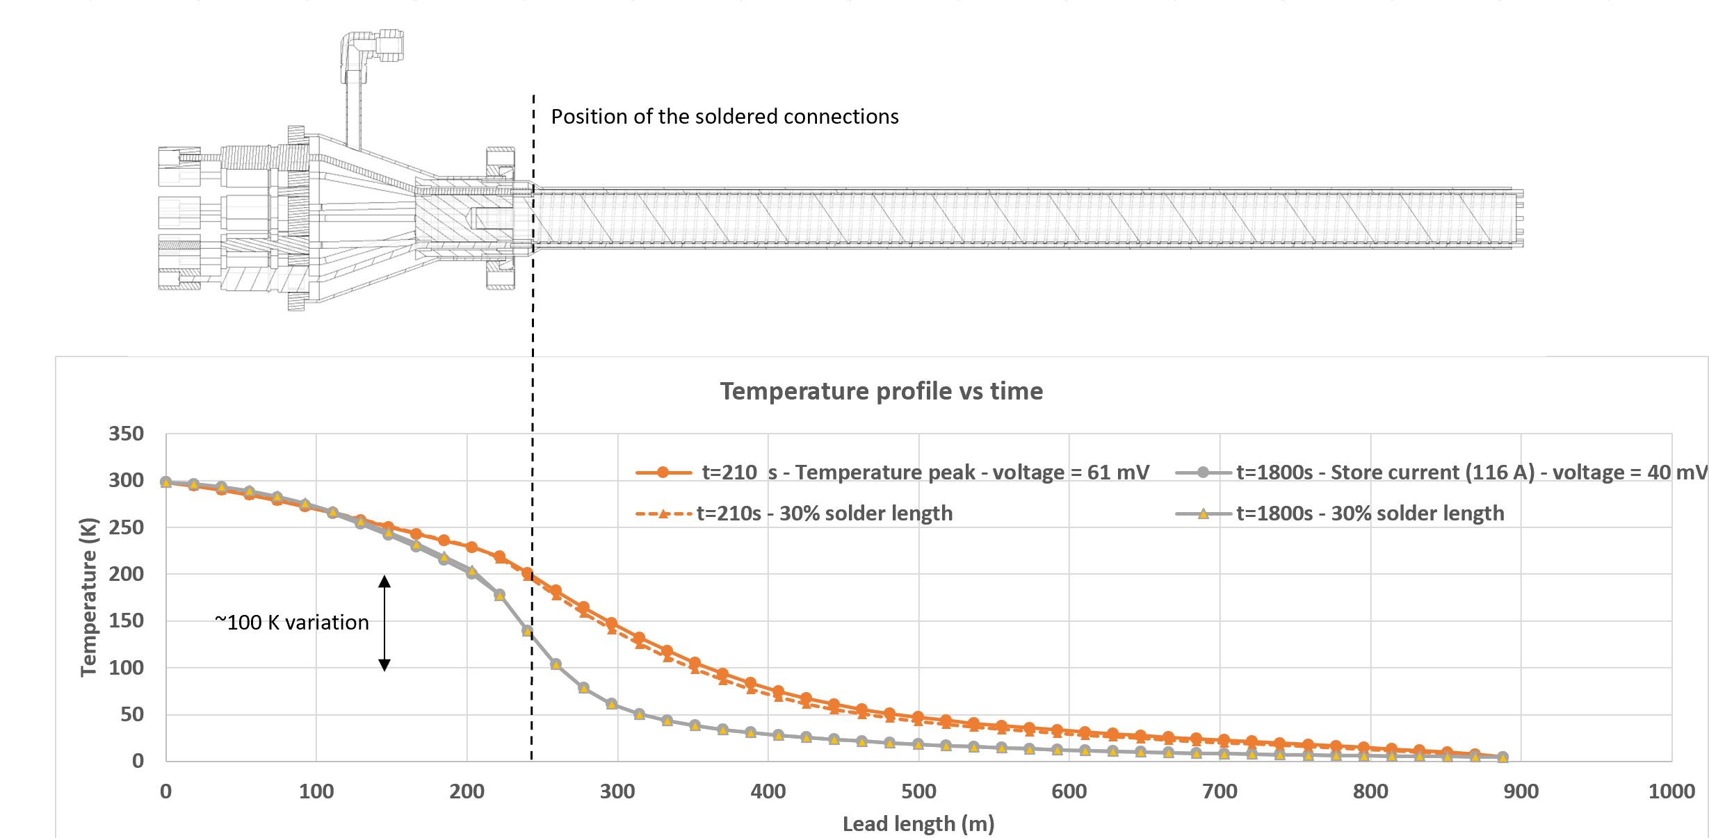
Solder crack ?
The 30% solder penetration does not produce a noticeable difference in temperature or voltage (Resistive heating in the 30% solder ~0.014 W – rest of the lead ~7W). → Not a good telltale to detect other faulty joints.
However a temperature gradient through the Tin will put it under more tension. Less tin means more more temperature gradient and in turn more tensile stress (more risk of crack propagation).

Slide 15
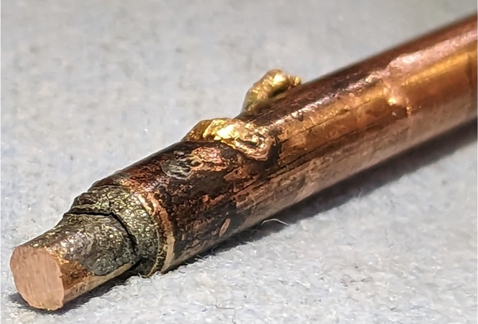
Solder crack ?
The solder has a higher thermal contraction than copper.
When cooled it will be put under tension and shear.
Sn96Ag4 is reported to have a brittle transition (DBTT) around 200 K ¹
Tin-based solder have been reported to crack when subject to thermal cycling at cryo temperature ²
In our case (annular filling with CTE mismatch) the colder the solder joint gets, the more susceptible it is to thermal cracking.
In this sense D6 wil be the worst solder joint (no resistive heating).
A numerical analysis shows tensile stresses up to 70 MPa in a D6 solder joint with perfect filling (62 MPa in Q2).
The tensile stress of Sn96Ag4 is given as 85 MPa at 200 K (brittle failure).
The likelihood of initiating and propagating cracks in this solder joint configuration is important.
Note: at the “idle flow” temperature profile these stresses are 35 – 45 MPa. So limiting the cool down will help mitigating.
¹ P. Ratchev et al "Brittle to Ductile Fracture Transition in Bulk Pb-Free Solders" doi: 10.1109/TCAPT.2007.901744
² J. Buckley “Low temperature solder for joining large cryogenic systems” NASA TM 81836 Link

Slide 16
Path forward – avoiding the temperature swing

Slide 17
Ideas avoid the temperature swing ?
The temperature swing is due to :
a delay in ramping the helium flow (~3.5W)
a “step” up in helium flow producing severe overcooling
The delay in helium flow ramping can be overcome by seting the tare current to a low current value and putting an offset in the helium flow instead.
If possible, a new helium flow regulation should be set to avoid the steps and maintain a good margin to runaway.

Slide 18
Helium flow setpoint law proposal
The 12x150 A leads were designed (and tested) to function with 0.09 (g/s)/kA (all leads powered to the same current). This lead was coded to work at 0.14 g/s/kA (Q2 is powered far above the other leads).
- We can lower the tare flow current and remove the “LeadCurrent” parameter step
→ But need a long testing phase of each lead to identify the runaway parameters.
or
- We can design a law monitoring the resistance in each lead. For a given current we can work out the runaway voltage. We will regulate the helium flow to keep a margin to the runaway voltage.
The danger of a too low helium flow are twofold :
- Lead runaway (unstable heating of the lead – visible with an exponential growth of the voltage)
- Quench of the SC bus (progressive quench of the cold bus – visible with a gradual increase of voltage)

Slide 19
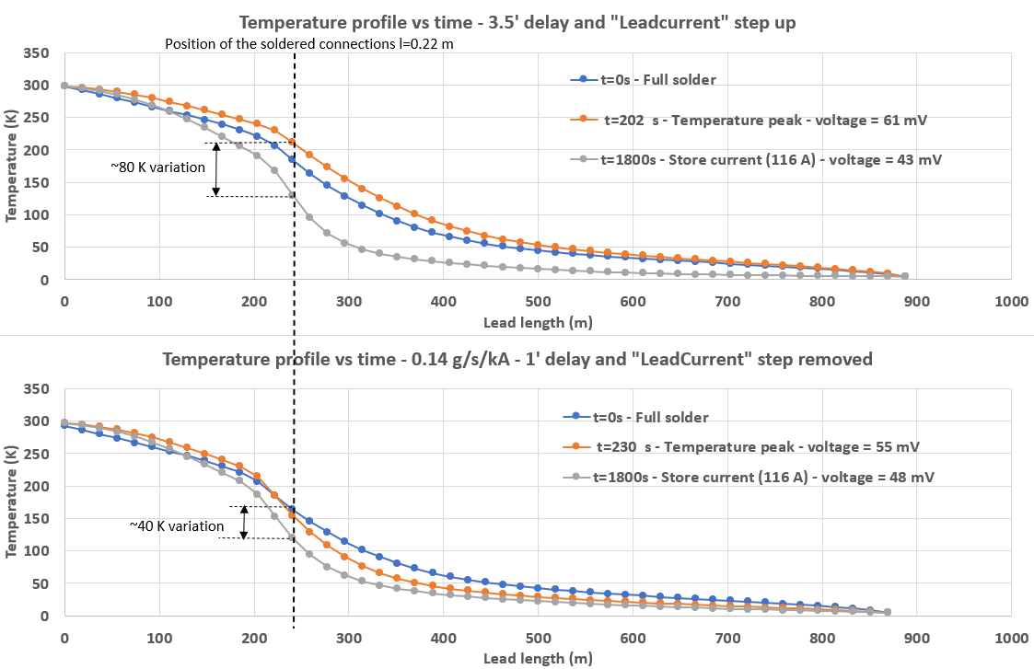
Helium flow setpoint proposal
By limiting the helium flow delay and removing the helium flow step :
The temperature swing can be reduced from 80 K to 40 K
It can even be reduced to 25 K if the helium flow is reduced to 0.105 (g/s)/kA
But what is the actual margin to runaway ???
This would need to be tested lead per lead…

Slide 20
Back to event chronology :

Slide 21
Analysis of lead Paschen arcing
F.Micolon – November 2023

Slide 22
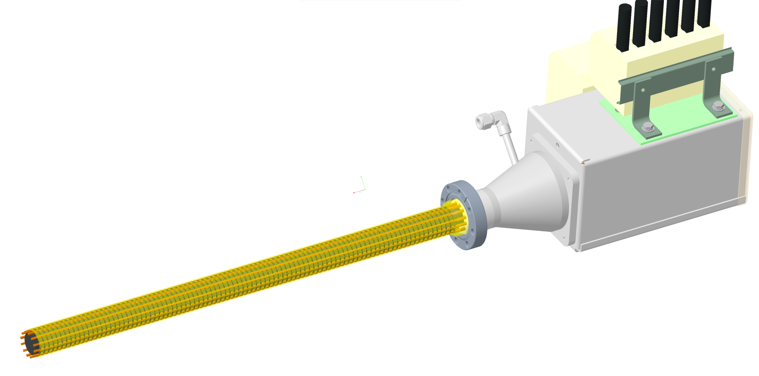
12x150 A solder configuration
Solder region

Slide 23
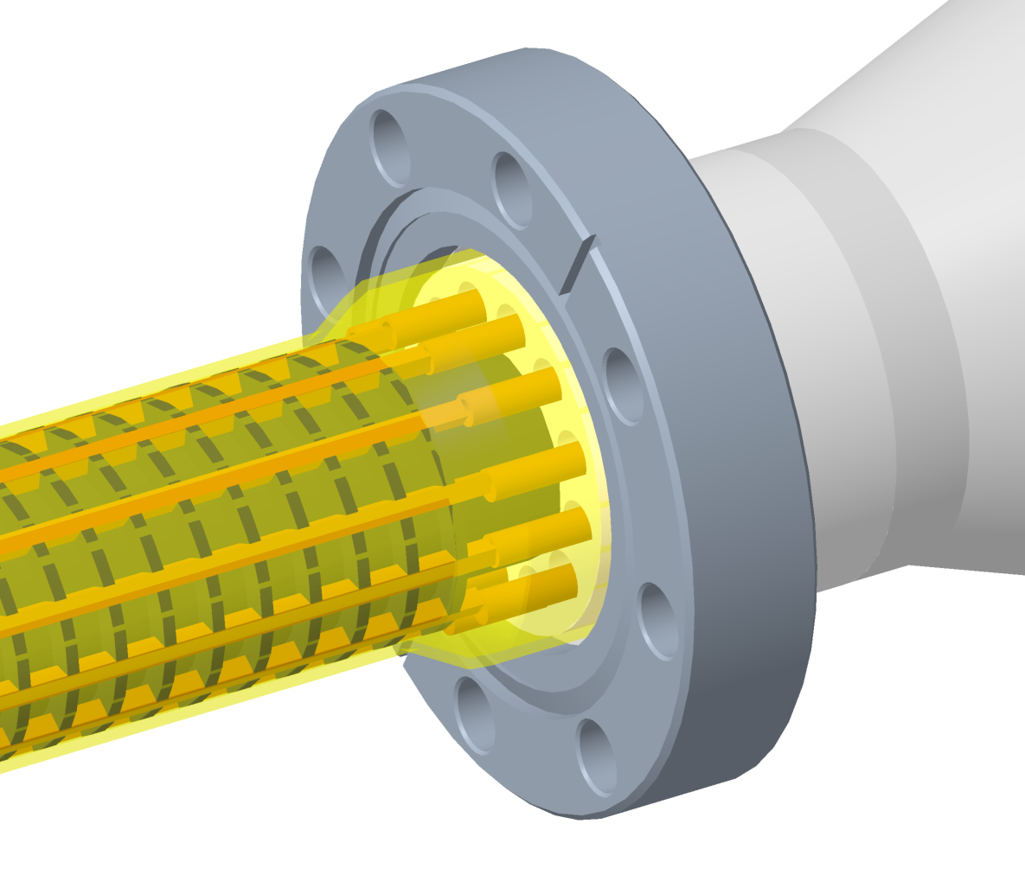
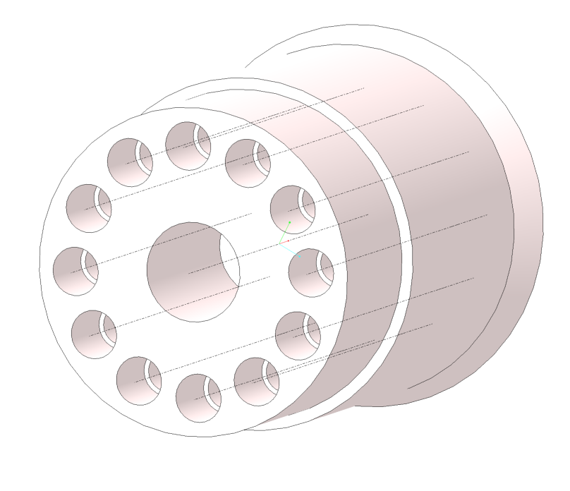
12x150 A solder joint
0.336”
Holes are Φ 0.200”
Distance between holes axis is 0.336”
So conductors (Φ0.156”) can be as close as 0.136” (3.5 mm)

Slide 24
Eruptions on the solder joint
Eruptions have been observed on the solder joint. These are believed to be due to solder joint cracking and subsequent arcing within the joint.
J. Escallier
0.05”
0.05”
The protrusion was measured to be 0.05” out.
The space between conductors could then reduce to 0.09” or less (~2.3 mm).

Slide 25
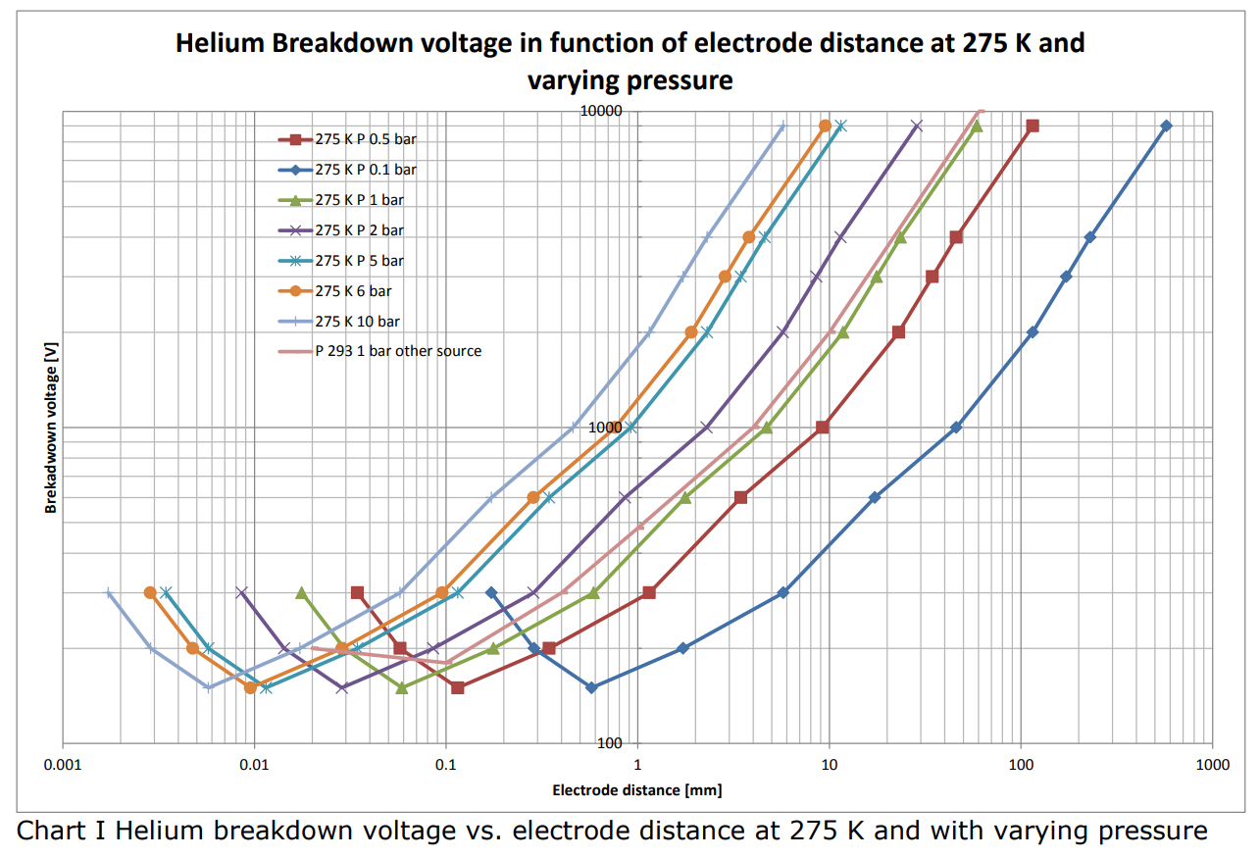
Paschen curve for helium
At a 2 mm gap, arcing can be initiated at a voltage around 1 kV per the Paschen curve (P(He)~3 bars).
Potentially much less if the eruption has produced a sharp tip acting as an electrode.
Arcing is possible :
Provided that a few 100s V of voltage difference is present
and
The insulation sleeve has been damaged by the arcing previously.
1,8 kV (5 bars)
0.9 kV (2 bars)
2 mm

Slide 26
Back to event chronology :

Slide 27
DX quench warm up analysis
F.Micolon – November 2023

Slide 28
DX quench warmup analysis
When the quench heaters are fired, all the DX inductive energy will be released.
The coils will dissipated this heat resistively and the helium will take some of this heat away by convection/expansion.
Assuming only the coil and helium take the energy released here is the temperature reached by the coil + helium system :
The equilibrium temperature of the coil+helium system is 52 K.
At constant pressure (4 bars), the helium density is 35x less at 52 K (vs 4.5 K)
So a large portion of the helium will have flowed out though the splice can.
→ “Warm” helium convection in the splice cans and probable quench of the conductors and soldered joints.
DX inductive energy = 6.3e5 J
(5050 A, 49 mH)
52 K

Slide 29
Back to event chronology :

Slide 30
Burnout resistance of the DX trim bus
F.Micolon – Nov 2023

Slide 31
Intro/context
This work is based on the observations and analysis made by J. Escallier
The soldered connection in the splice box were found burnt both upstream and downstream of the DX
This slideshow summarizes the burnout resistance of the D6 cables located in the DX splice box

Slide 32
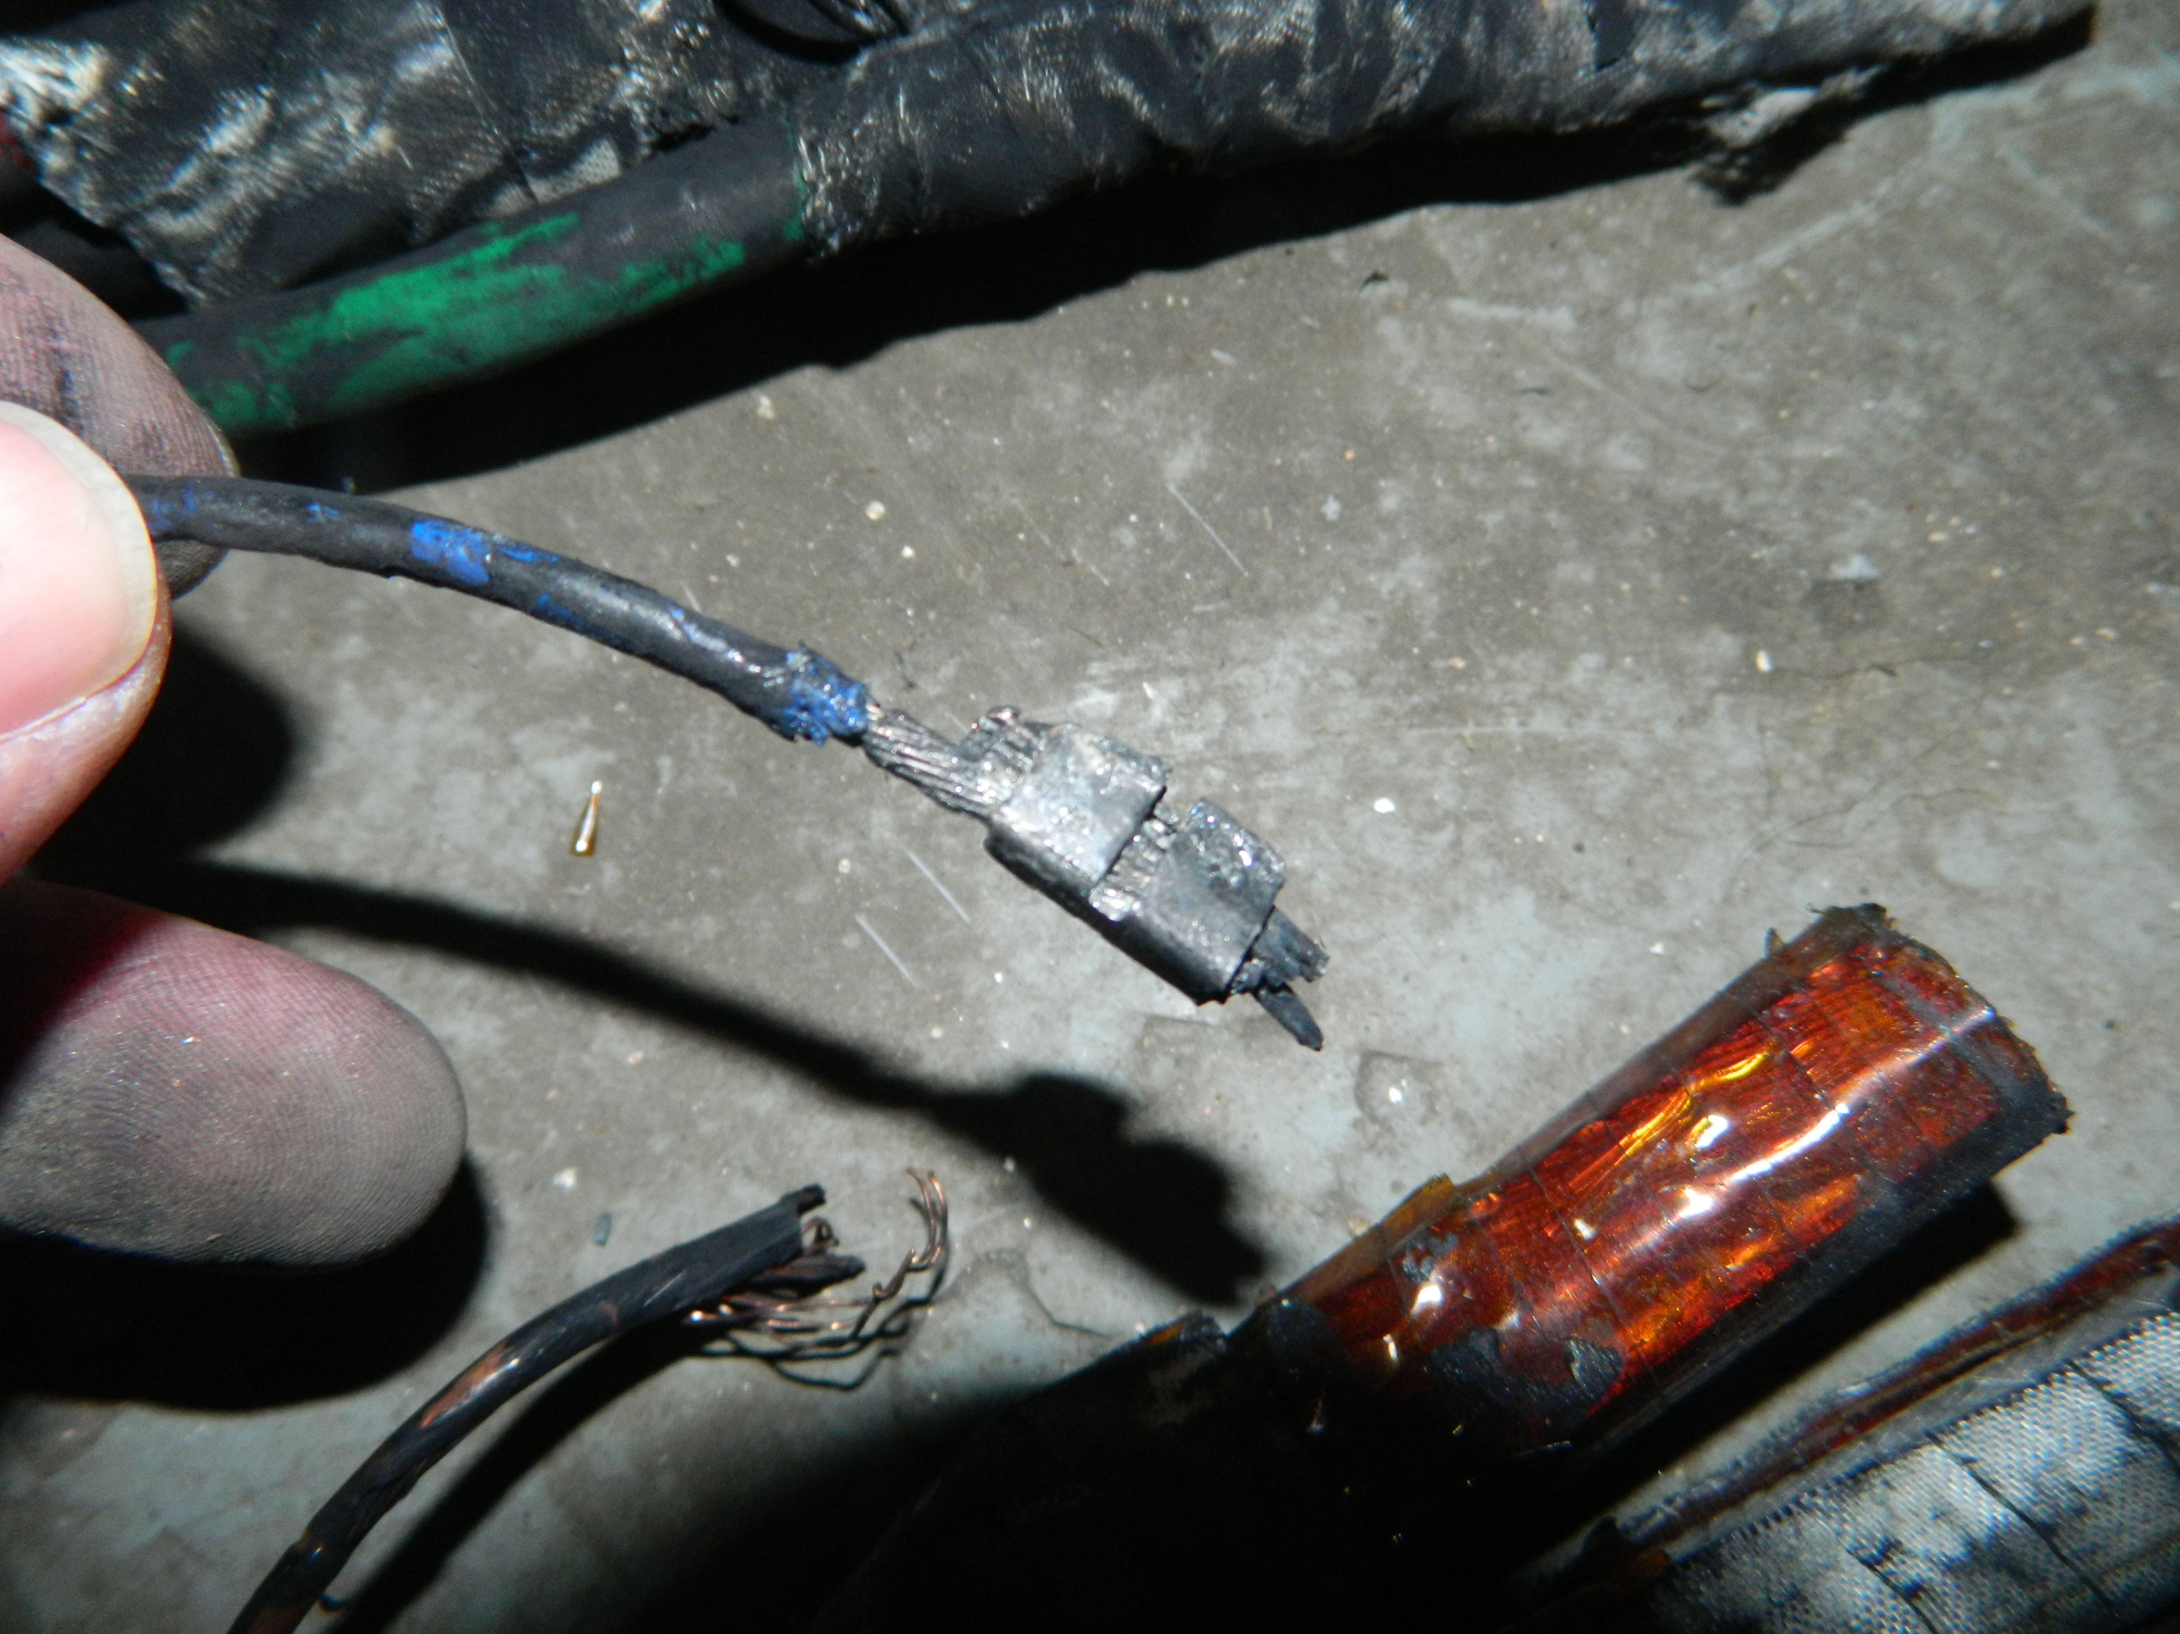
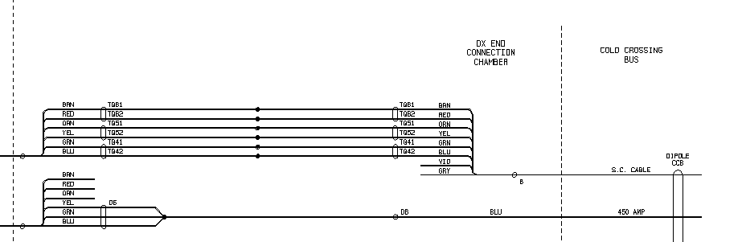
D6 splice connection
J. Escallier
The D6 has seen a large current when connected to the quad bus (and/or to ground).
John mentions >500 A had to flow through these wires.
So both the blue “Test cable” and smaller “trim cables” has to take 500+ A.
They both consist of 3x CBA 0.0268” SC wires with a critical current of 2400 A (at 0 T field).
→ The conductor will not quench before 2400 A !
The blue “Test cable” is more heavily stabilized with copper while the “trim cables” are only 3x SC wires.
The blue “test cable” has a burnout resistance of 1.5 10⁶ A².s (MIITS)
The 3x trim wires have a resistance of 0.15 10⁶ A².s or 10x times less
(Bob Lambiaise)
3x 150 A “trim
Cables”
CCB – blue “test cable”
Soldered connection

Slide 33
D6 splice connection
J. Escallier
Here is the temperature evolution when quench occurs on 3x “trim cable” conductor (2 current flow hypothesis):
0.12 MIITS (10^6 A^2.s)
0.12 MIITS (10^6 A^2.s)
3x 150 A “trim
Cables”
CCB – blue “test cable”
Soldered connection
The complete cable burnout is expected in a few seconds.
At 0.12 MIITS the blue “test” cable will have reached a temperature of only ~10 K which explains why it still looks intact.
T=0s starts when the cable is quenched
What has caused the cable to quench ?
Solder joint heating ?
DX “warm” helium flow out after quench heaters ON ?

Slide 34
Back to event chronology :

