Slide 1
4B Valve Box Failure Likelihood of Reocurrence Nov 28, 2023 Jon Sandberg
Thanks To: C.Mi, J. Escallier, T. Samms, G. Heppner, D. Bruno, C. Schultheiss, R. Lambiase, F. Micolon, G.Ganetis

Slide 2
The investigation is ongoing and detailed inspection of voltage and current signals have been extensive and are continue.
We have not found a precursor that would have indicated a failure was imminent.

Slide 3
What we know
The Quench Link Interlock (QLI) was pulled due to a problem in its cabling or its electronics. A magnet or power supply event did not trigger this QLI.
QLI’s have occurred many hundreds of times over the 23 years RHIC has been in operations. A QLI is a normal occurrence, and the system is designed to handle it. It should be less disruptive than an actual quench or power supply failure.
The energy extraction system worked correctly and the currents in the magnets began decaying normally.
After ~ 60 ms there was an event in the TBD feedthrough which caused the copper wires soldered to the feedthrough studs to flashover and to burn a hole in the metal pipe which separated the helium from the insulating vacuum.

Slide 4
What we know
All but two of the copper wires were burned off the feedthrough but the superconductor connected to the copper were intact.
Almost 1.5 seconds later there were voltage disturbances on the TQ voltages. These signals go through the splice boxes on the DX magnet and are not associated with the TBD feedthrough. This indicates that these splices burned after the feedthrough failure
Evidence from the postmortem indicates that the solder joints between the copper wire and the feedthrough were problematic. There were indications of arcing between the copper wire and the feedthrough studs to which they were attached. This left eruptions on the surface of studs and compromised the voltage hold off between studs. There was evidence that the solder had cracked in places, probably due to thermal expansion and contraction.

Slide 5
What we Know
Several of the adjacent studs on the feedthroughs were connected to the middle of the return buss and the beginning of the supply buss. They would have the largest voltage differential during a QLI of any feedthrough pins in the system
There is evidence that there is a large temperature change in TBD gas cooled leads (GCL) when the magnets are energized. This in part because of the helium flow to the leads and the rate at which the current changes. This would aggravate problems with the solder joints.
There were no indications in the splice cans that there had been a short to ground in the can even though the bundle of wires was touching the can in places.

Slide 6
What we don’t Know
What exactly caused the flashover in the feedthrough.
The solder joints were problematic, and the surface conditions of the studs would have compromised the voltage hold between studs. Could it have flashed over?
Could one of the wires tried to pull out of its stud and try to open a current carrying circuit?
Why did both the splice joints associated with the DX magnet fail? They certainly had experience many QLI’s with their DX heaters firing. The difference is that the TBD feedthrough had failed and there were substantial ground currents and helium was being vented out of the valve box.
With the quad and dipole buss shorted together and high ground currents some of the superconducting wires in the slice box may have been carrying larger currents than normal.
The currents in the CCB may no longer have been balanced causing a magnetic field in the buss which changed its critical temperature.
When the DX heaters fired and the magnet quenched, warmer gas flowed over the splices.
The splice can in the DO magnet which presumably had the same current as the other spice cans did not fail.

Slide 7
Can this Happen Again
There will certainly be many QLI’s in the Future. This is unavoidable and the system must successfully withstand these events.
We have not seen a precursor to this failure and our best information suggest that it occurred due to a long-term degradation of the 12 X 150 feedthrough. It is likely that other feedthroughs in the system are in similar condition. We therefore can not say this will not happen again with any certainty.
Given these circumstances we must develop a plan to go forward trying to mitigate the risk of recurrence.

Slide 8
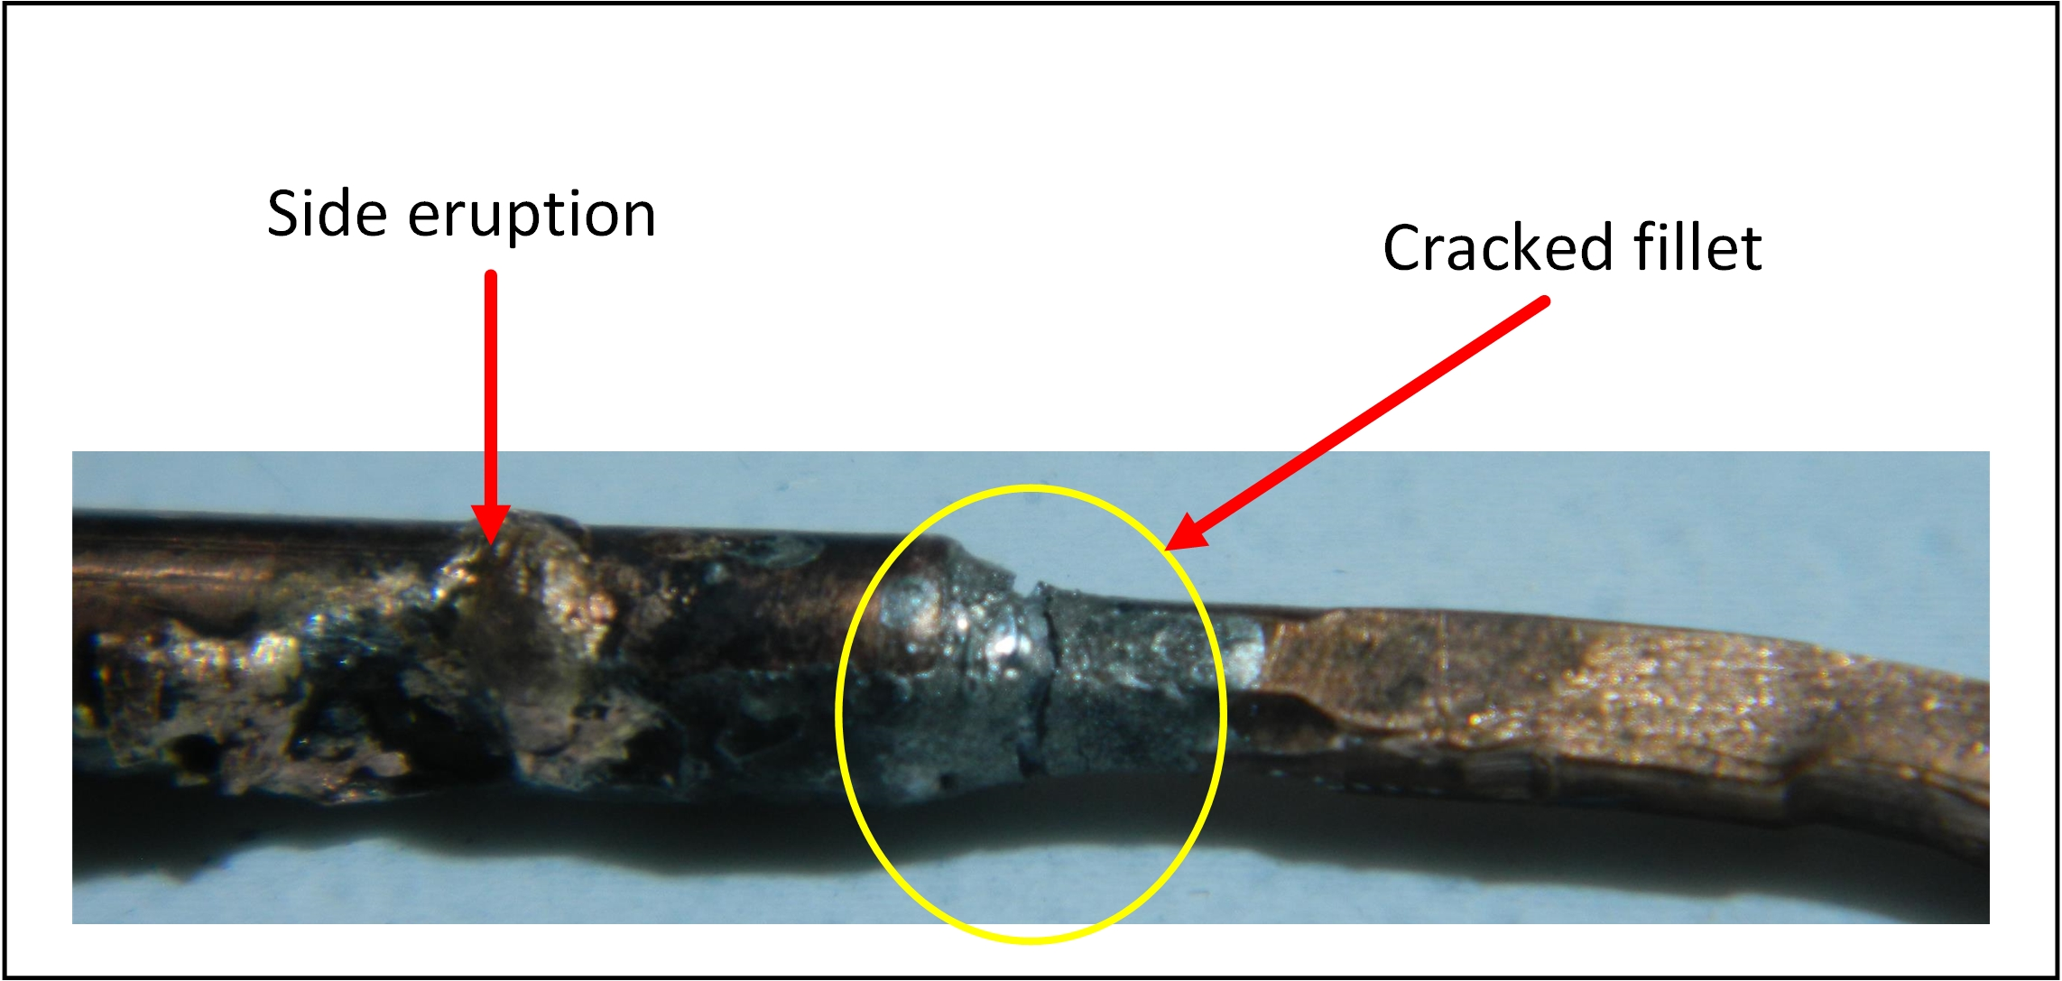
Path Forward
There are two theories on why the feedthrough arced over. Both theories revolve around temperature excursions of the feedthroughs solder joint:
A solder joint may have cracked and attempted to open an energized circuit causing an arc which ingulfed surrounding leads.
A Flashover occurred during ramp down of the quad buss centered around a previous eruption of the solder joint. This created a sharp emitting surface, reduced the distance between live conductors, and punctured the Tefzel insulation wrap, greatly reducing the voltage holdoff of the feedthrough.

Slide 9
Plan Going Forward
Reassemble the TBD feedthrough with improved soldering techniques learned from the postmortem of the failed unit. Limit the temperature excursions on the 12 X 150 feedthroughs. Monitor the temperature changes on each 12 X 150 and alarm if these changes go outside a specified limit. Run in this mode until the end of RHIC operations (2 years). At that time open a sample of other valve boxes and lead pots and assess the condition of other feedthroughs. A new feedthrough is being designed for EIC so that it can run at higher currents. If inspection shows damage to the existing feedthroughs they can be replaced with the newer design.
The existing feedthroughs have run for 23 years with one failure the probability of another going in the next two years is low. The 4 B valve box feedthroughs see the larges voltage difference between pins in a quench.

Slide 10
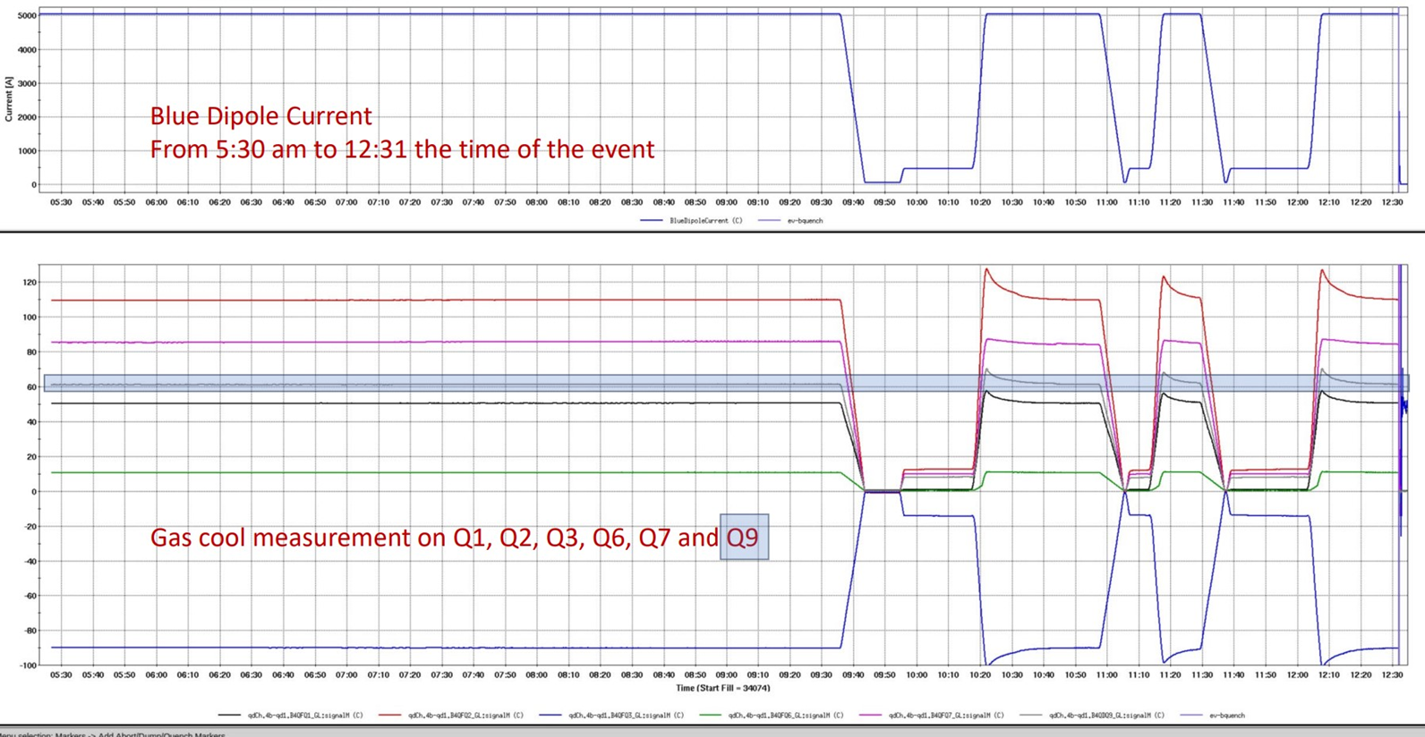
Minimizing Temperature Excursions
The lead flow must be adjusted for every operating cycle to minimize temperature excursions on the 12 X 150 feedthroughs as measured by the voltage drops across them
The current waveshapes should be adjusted to align with the response time of the helium flow
The control system should track the temperature excursions and alarm if they are exceeded.

Slide 11
Questions?

Slide 13
Slide from Frederic Micolon

Slide 14
Slide from Frederic Micolon

