Slide 1
12 by 150 amp warm to cold feedthrough
Failure analysis
John Escallier
11/28/23

Slide 2
Observations
Three failures occurred during the incident.
  The 12 by 150 amp feedthrough confusingly labelled “TBD”
  Two splice packs located in the DX cryostat in the tunnel.
The location of the feedthrough damage is at the solder joint between the ceramic feedthrough and the square 90 mil copper conductors of the cooling helix
The mechanism responsible for the feedthrough failure is believed to be temperature cycle fatigue of the solder joints.
The failure of the splice joints in the DX cryostat is believed to be caused by the excessive currents caused by the feedthrough arc connecting the dipole buss to quad buss. The wires were rated to carry much higher currents, but the solder joints were not designed for that.
A remediation plan has been developed to limit further exposure to this specific failure mechanism.

Slide 3
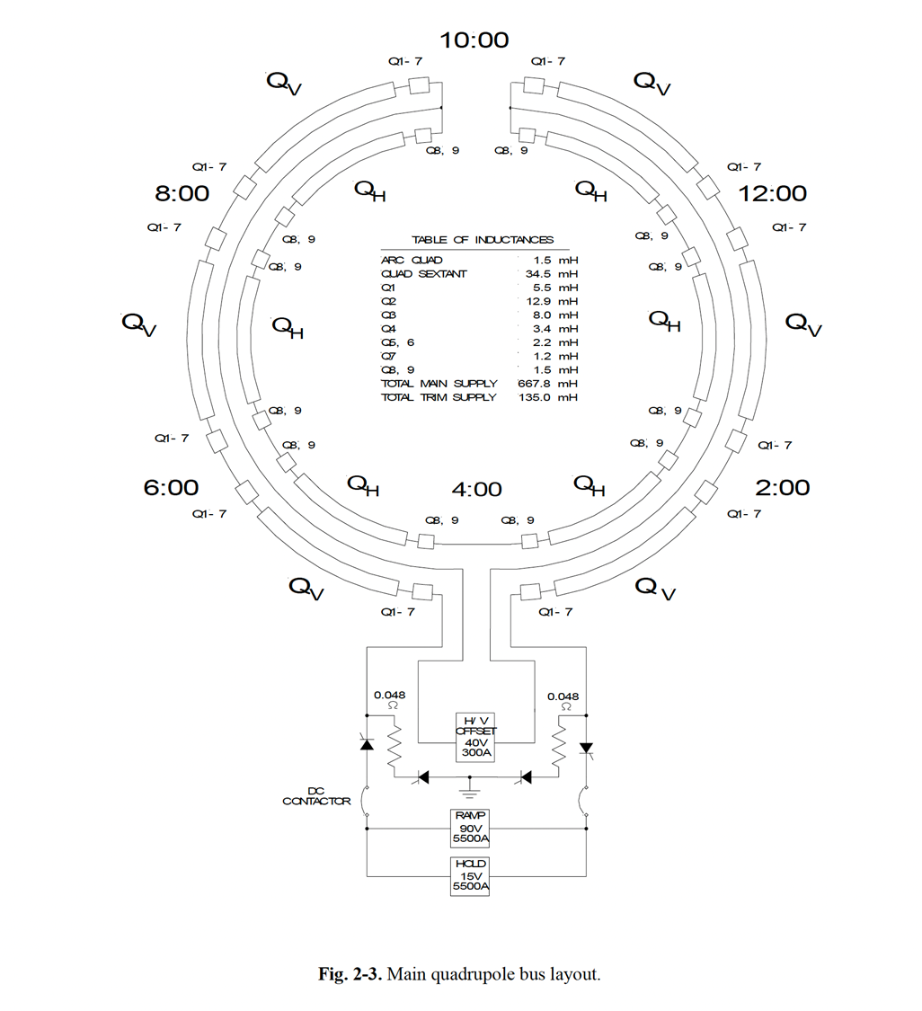
ARC connections
The feedthrough arc shorted this entire half of the quad circuit and connected to the dipole buss
Feedthrough TBD
Where it connects to in the ring
Terminals 8 through 12 connect the 5500 A buss here
Terminals 2 through 7 connect the 5500 A return buss here

Slide 4
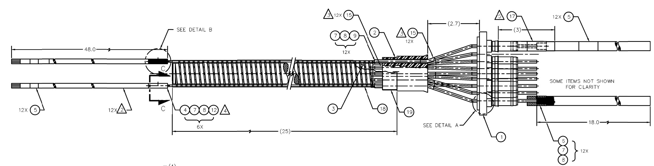
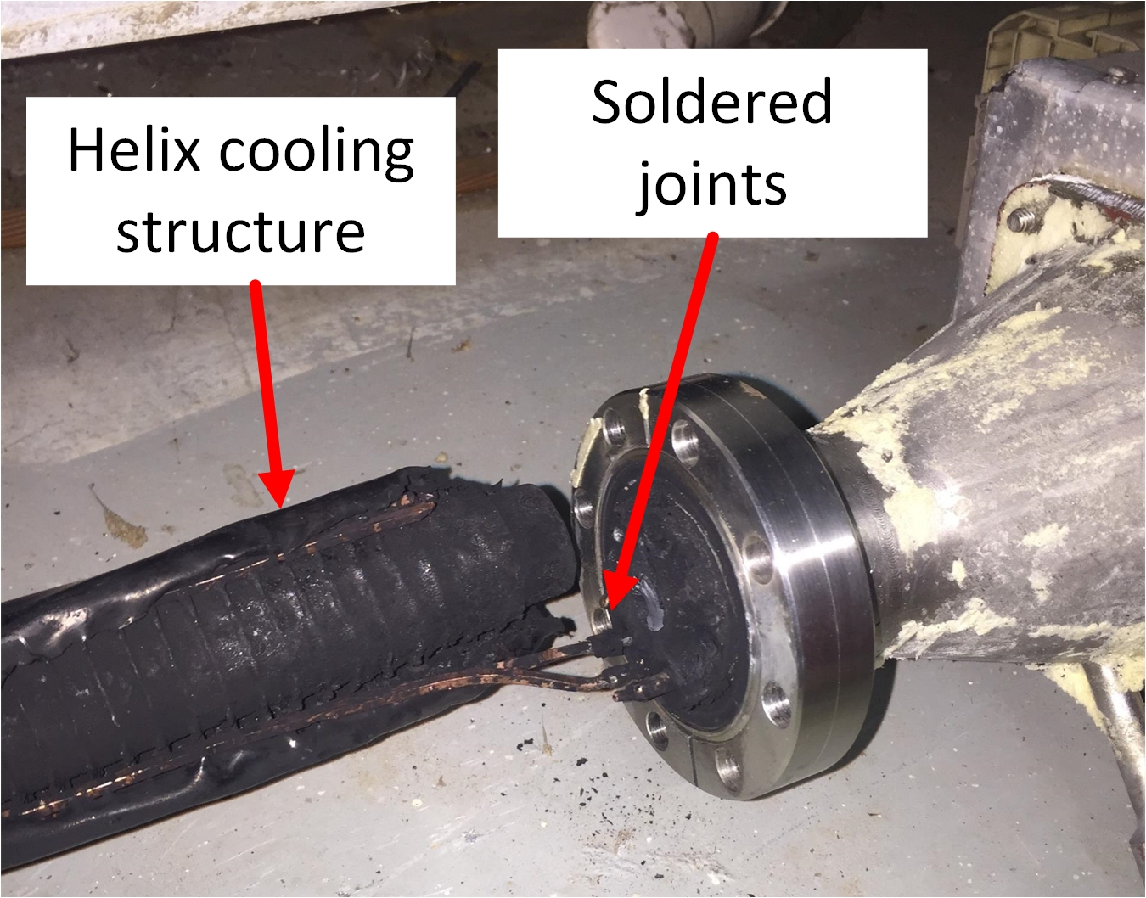
Standard 12 by 150 amp warm to cold feedthrough
Noryl helix
Arc location
Ceramic
feedthroughs
Superconducting leads (12 by 4)
90 by 90 mil
ETP copper wire
(12 leads

Slide 5
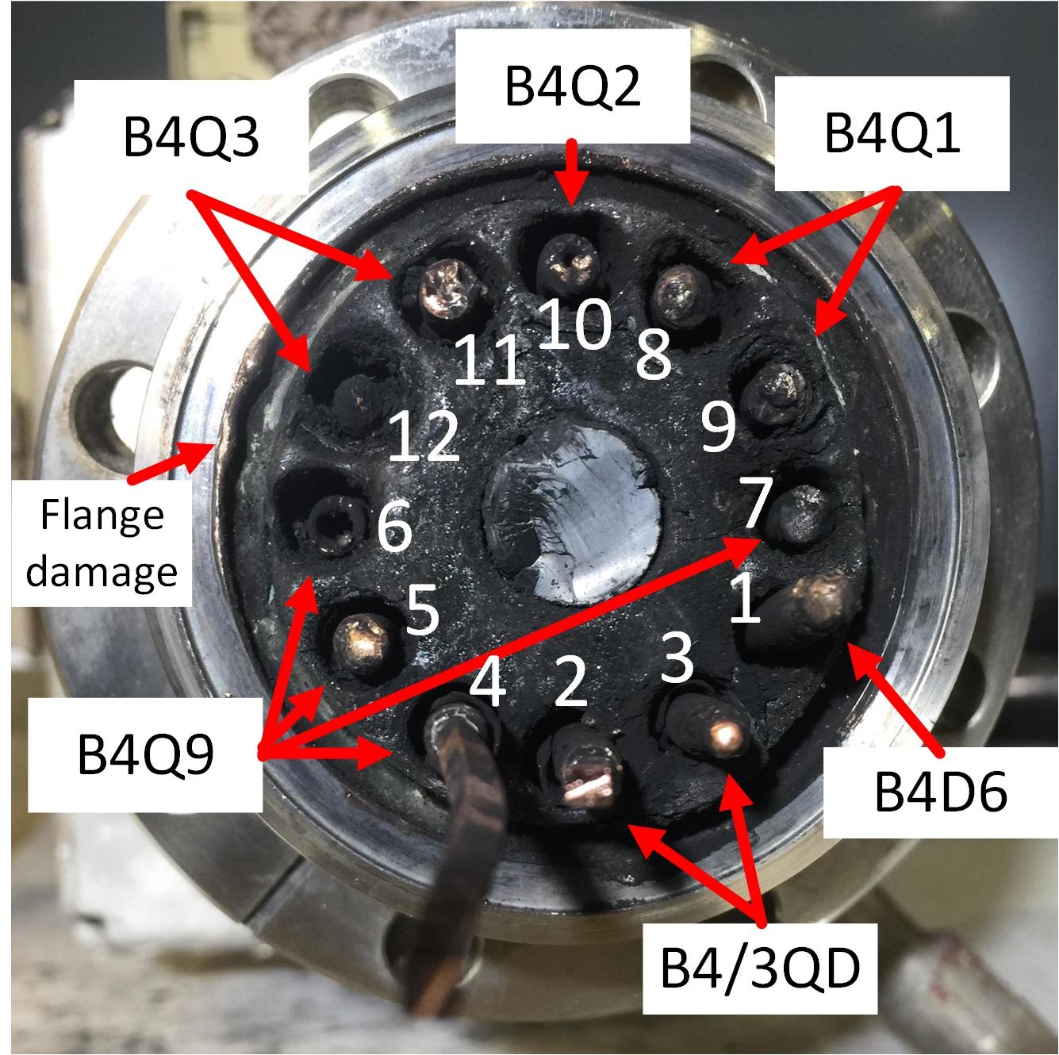
Terminal layout at the end flange
Note pin pairs 9/7 and 12/6 have half the full quad string voltage between them during ramp up and down
Quad 5500 amp buss connections
Quad 5500 amp return buss connections
Dipole 5500 amp buss connection
Terminal connection schematic
Not used
144 Amps
85.8 Amps
97.4 Amps
Two conductors untouched by arc at flange. Both were cut at the bench
117 Amps
158 Amps

Slide 6
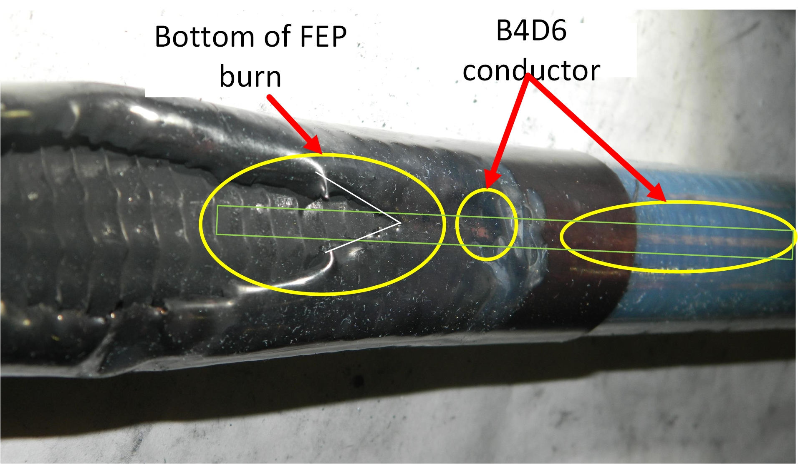
Burn pattern in the heat-shrink Teflon (FEP) points to one conductor
The B4D6 conductor connects directly to the dipole 5500 amp buss at magnet D6. It remained energized the longest of all the conductors in the feedthrough.
When the arc initialized, it instantly connected the dipole buss directly to the quad buss. At .45 seconds, the hard quad connection broke to intermittent. The dipole remained hard to ground until 1.35 seconds in, then went intermittent. During this fault, very high currents were travelling through the B4D6 wire. These currents exceeded the solder joint design capability in the splice bundles at the ends of the DX cryostat.

Slide 7
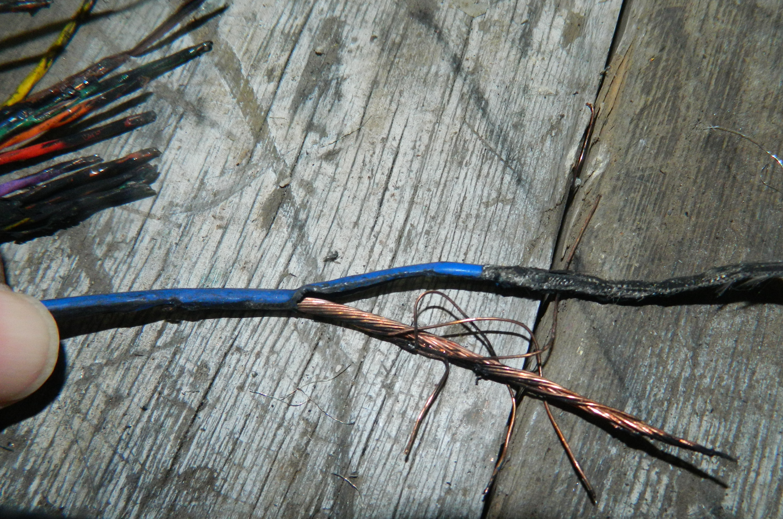
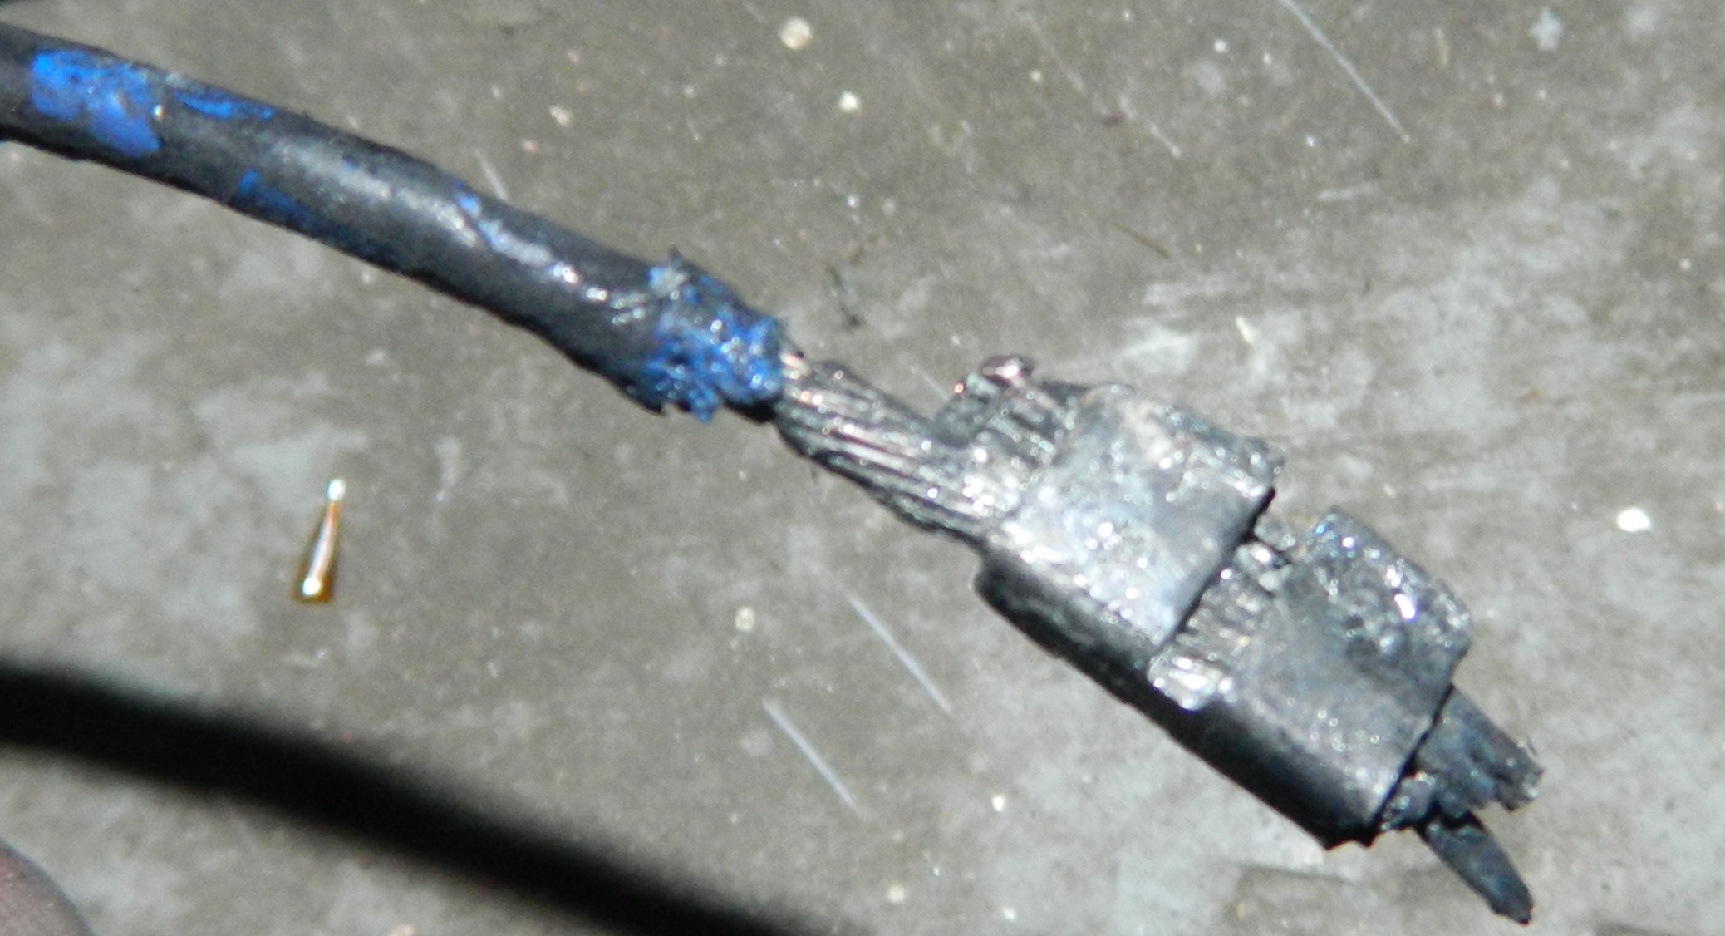
Wires that were burned in the splice joint in the tunnel: B4D6 (blue) and trim supers for Quad shunts
Note the mechanical attachment prior to soldering
Quad shunt conductors
B4D6 to DX trim supers splice joint
B4D6 conductor
The splice package had to support the >500 amp ground currents on quad and dipole through these wires and splices. As a result, the splice dissipation forced the conductors to go normal and burn. The 5500 amp cables were not burned in this manner, they had sufficient mass to carry them through the event.

Slide 8
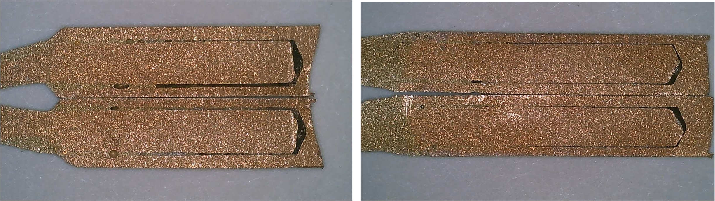
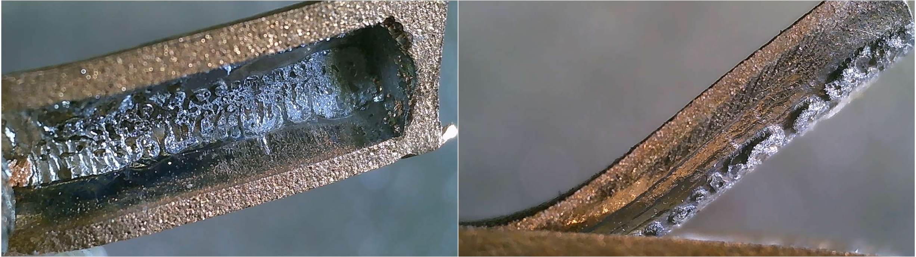
Wire EDM slitting of the feedthrough ceramic lead to 90 mil square copper solder joints
Joint 1
Note the complete lack of solder in this area
Joint 3
Joint 3
Joint 3
Both show voids in the 60 to 70% range. Joint 3 is peeled back to reveal the hidden voids.
There are NO weep holes in the lead, soldering was attempted into a blind hole. These voids are consistent with a failure to include weep holes.

Slide 9
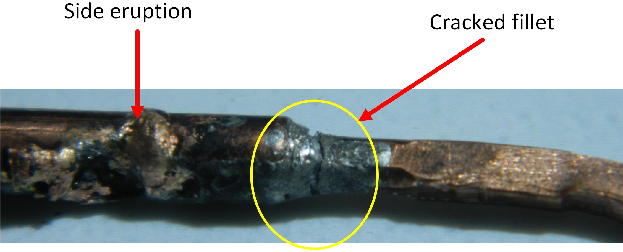
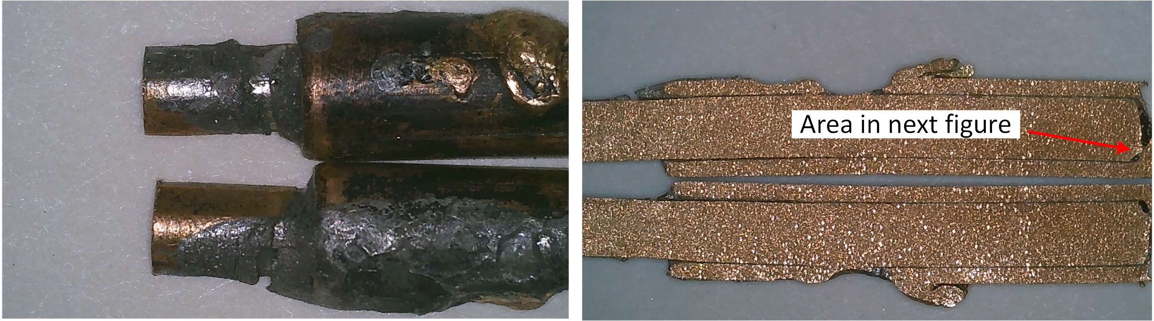
Joint #4, which was untouched by the arc. The entire fillet was cracked, and there was a side eruption
Lead is welded into place
Note the copper/tin intermetallic
This is protruding out 50 mils (1.27mm)

Slide 10
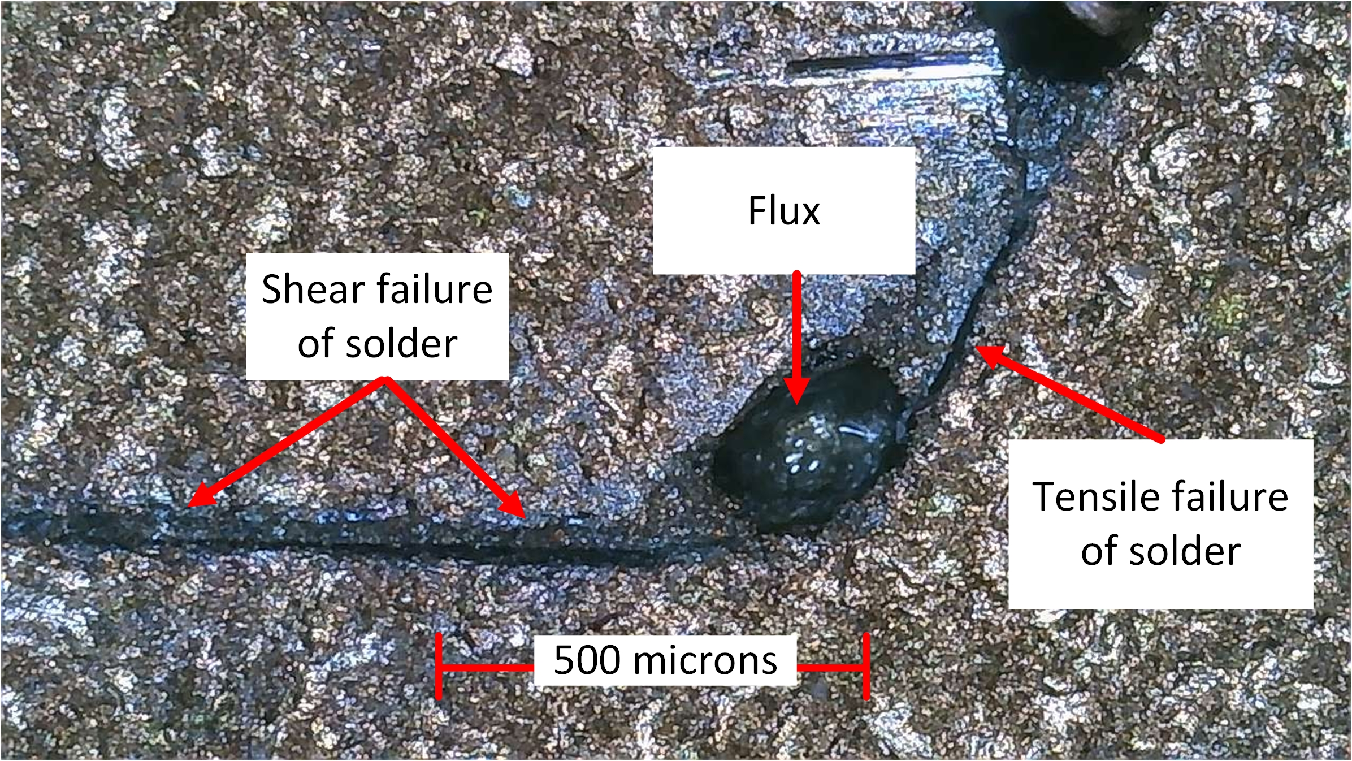
Joint #4, showing failure of the entire solder joint internal to the joint

Slide 11
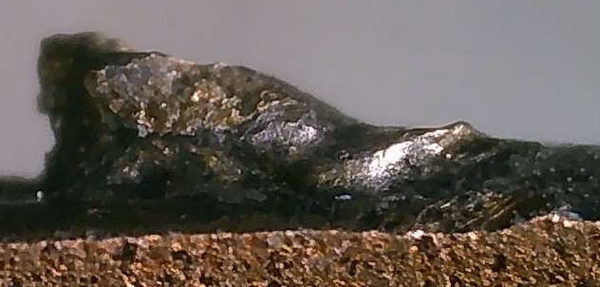
Joint #2, which was also untouched by the arc. The entire fillet was cracked, and there was a side eruption as well
This is protruding out 25 mils (.65 mm)
Both joint 2 and 4 show extensive evidence of thermal cycle fatigue. Both have a fully detached solder joint, and both have a side eruption which welded the inner wire to the outer.
The side eruption also destroyed the tefzel heatshrink tubing that covered the end of the lead, lowering the voltage withstanding capability to any neighbor.

Slide 12
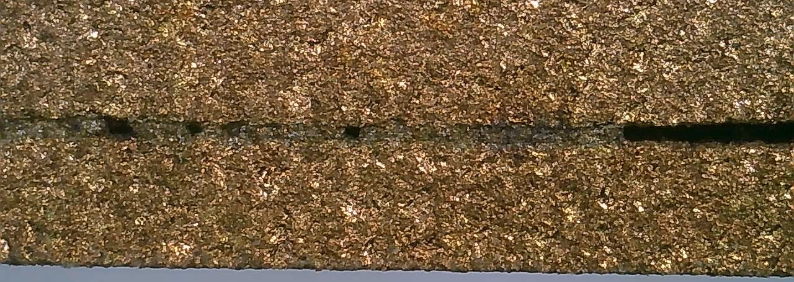
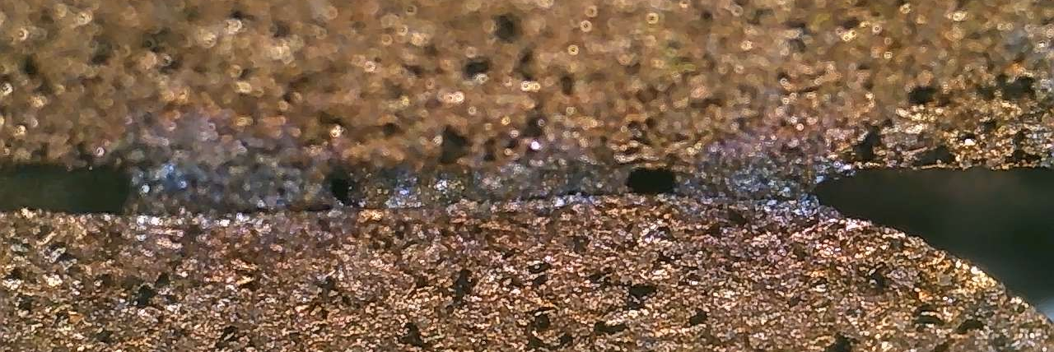
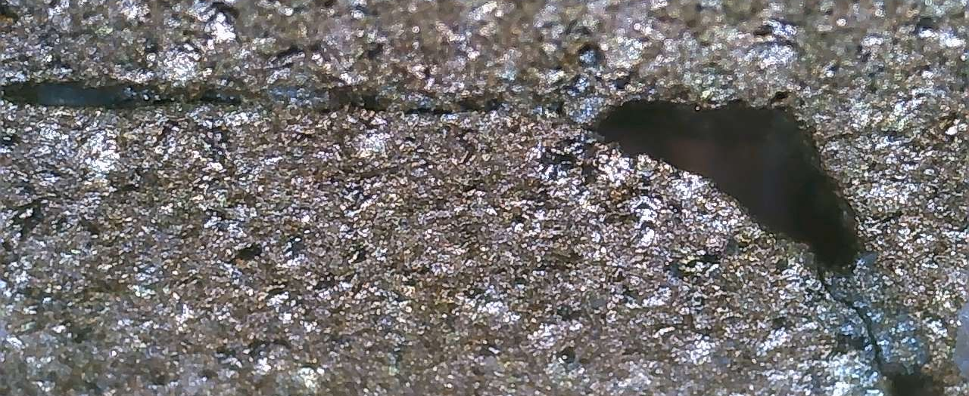
Joints 2, 5, and 8 also show shear failure of the solder. Leads 6,7,9,10,11, and 12 have nothing left to examine.
Joint 2
Joint 5
4 joints show mechanical failure of the solder by temp cycle fatigue.
6 joints had nothing left to view, all was vaporized.
Both eruption leads have temp cycle fatigued solder joints.
Joint 8

Slide 13
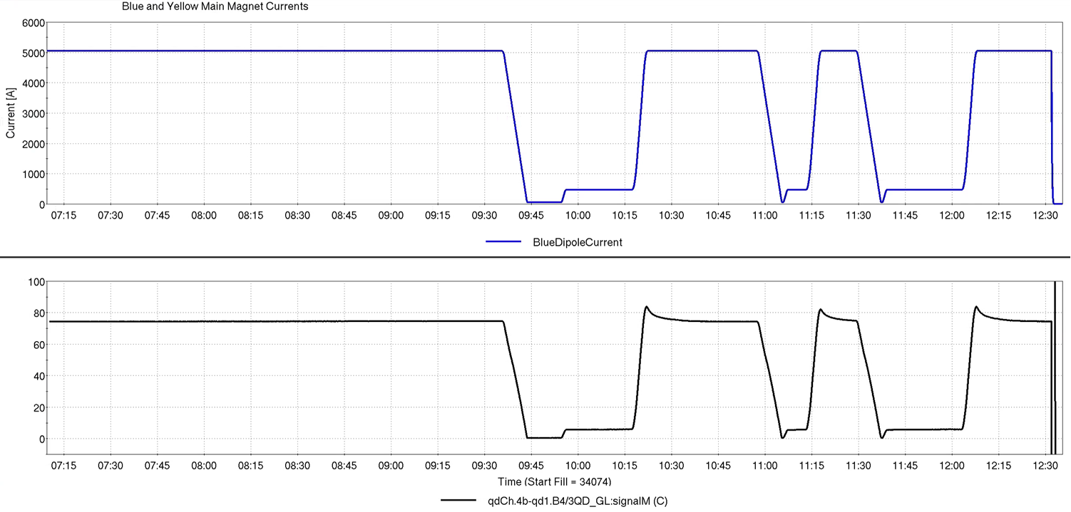
Telemetry of the feedthrough was then examined. It shows that the solder joint area of the feedthrough was experiencing thermal swings of between 50 to 150ºC during every RHIC ramp to full energy. The overshoot at the leading edge represents the increased resistance of the lead.
Dipole top energy
Arc event
Dipole ramp up
Dipole ramp down
Injection/fill
Thermal overshoot
Feedthrough telemetry B4/3QD
Supply wire resistance drop
at current (50 mV)
Telemetry courtesy of Michiko Minty
The resistance of copper increases .4% per degree C. With the 50 mV of the 2/0 wiring drop subtracted, this 85 to 75 mV drop is actually 35 to 25 mV in the feedthrough. This represents a 40% drop in voltage of the lead on average, or 100ºC on average. Since the super did not quench, the lead bottom never exceeds 10 Kelvin.

Slide 14
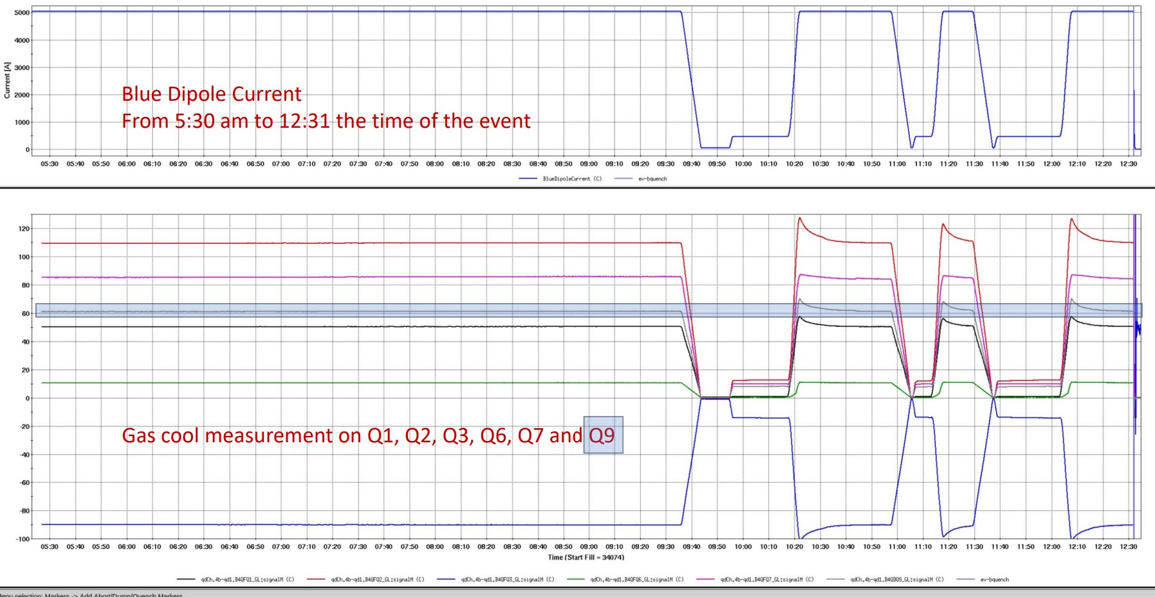
Telemetry for all quad supplies at this Blue valve box
No thermal overshoot. These two are in a different feedthrough
Telemetry courtesy of Chaofeng Mi
This shows that it should be possible to adjust the helium gas flow rate algorithm to minimize thermal cycling of the solder joints.

Slide 15
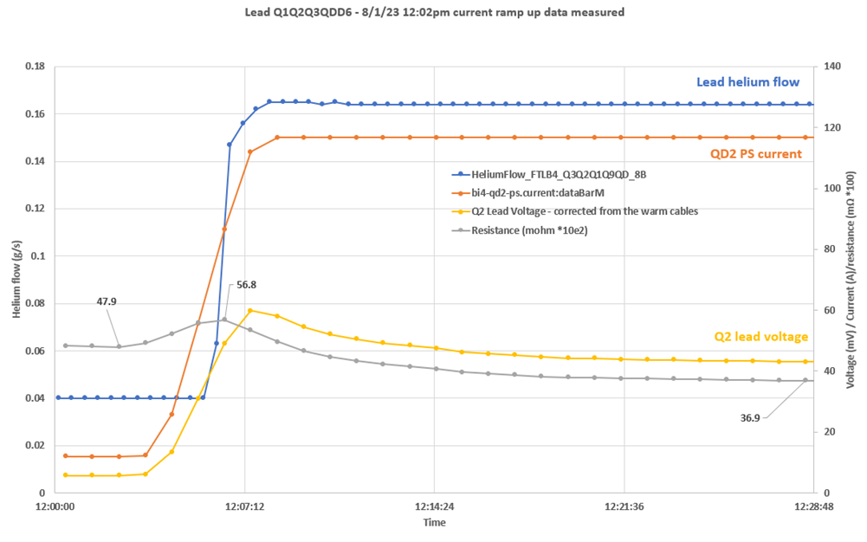
Telemetry for Blue 4 Q2 feedthrough (highest current, worst case)
The peak to steady state resistance reduction is 35% W/R to the peak, this reflects an 87ºC change in average temperature using room temperature resistance coefficients
The entire feedthrough is being drastically overcooled. This was to prevent thermal runaway, but introduces temperature cycling
This temperature peak is caused by the delay of helium cooling
Analysis courtesy of Frederic Micolon
It should be possible to advance the helium cooling to minimize the peak and decrease the overcooling to reduce the final temperature. Tests in that regard must look for thermal runaway of the lead, a known factor..

Slide 16
Final notes on feedthrough design
Solder joints are being used as a mechanical lock. The prime rule with solder joints is make a solid mechanical connection first, then solder
  Silver braze would be more appropriate to handle temperature cycling on a copper to copper joint, but cannot be used on a superconductor due to the high temperature required
Blind holes should never be used for soldering. Trapped flux and evolving gases will conspire to prevent filling of the joints with solder.
In this feedthrough, 9 ribs of the helix structure were not present under the Teflon heatshrink, 7 more were cracked but in place (in just the lower 4.5 inches)
  Build tolerance issues were not carefully considered, the worst case tolerance failure is 6.5 mils of interference.
  Interference fit of the conductors along the 24 inches of the helix conspired to cause tension at the upper solder joints by stiction, helping with the temp cycle failures.
  Unfilled noryl was used. Filled noryl will be more robust and be a better TCE match to copper.

Slide 17
Summary
The initial failure is believed to be a result of a compromised lead solder joint caused by temperature cycling of the leads due to overcooling by the helium control system.
This compromised lead joint reduced the ability to withstand high voltage potentials, initiating an arc.
The erroneous quench signal was not the problem, ramping the quad ring down through the quench system caused high voltages between two pins of the feedthrough, this is where the arc occurred.
Modification of the control loop of the helium cooling can be used to prevent further temperature cycling degradation, preventing further degradation of the feedthroughs.
The high voltage at this feedthrough in valve box 4 is the highest in the ring. The 2 and 6 o’clock valve boxes have only 66% of the voltage, the 12 and 8 boxes have 33%, and 10 o’clock has zero potential.
Return to operation tests will develop the proper gas cooled lead parameters to reduce the temp cycle fatigue issues.

Slide 18
Backup slides

Slide 19
Dipole ground current, quad ground current, and Q1 current sequence
Q1 ramped up until dipole and quad connected at arc
Dipole and quad “ground” currents start, tracking equal and opposite. Suspicion is each system detects the current transfer between as opposite sign.
Quad and dipole connect to ground, dropping dipole to quad transfer currents
Telemetry courtesy of Chaofeng Mi

Slide 20
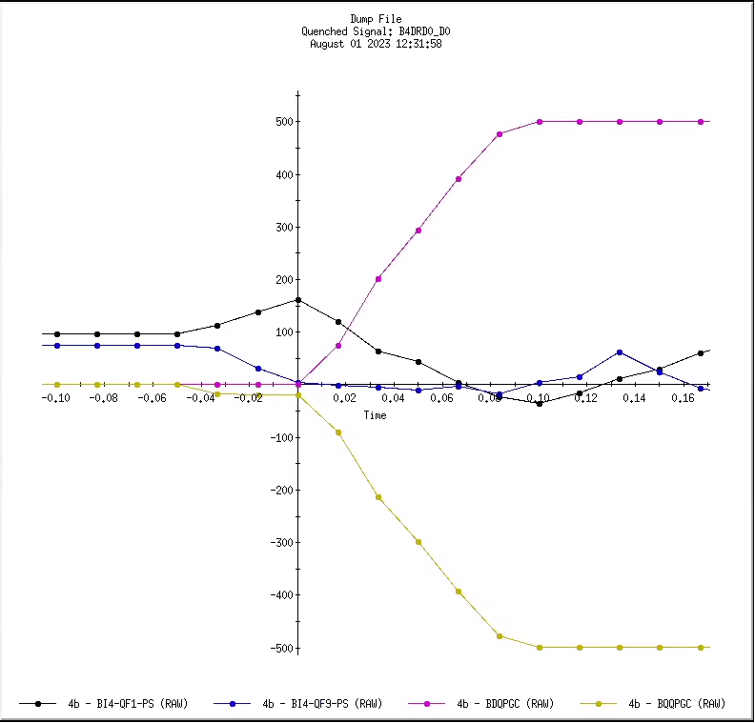
Dipole ground current, quad ground current, Q1 and Q9 current sequence
Q1 and Q9 deviate at the exact same time, 11 mSec after QLI
Three consecutive pins
Q1
Q9
B4D6
Q1
Q9
Dipole and quad “ground” currents start, tracking equal and opposite. Suspicion is each system detects the current transfer between as opposite sign.
Telemetry courtesy of Theodoro Samms

Slide 21
ARC connections
Quad shunt connections in center of series string
Main dipole connections
Main quad connections

Slide 22
Q1 fast log data
This is an odd disturbance in the supply current. What caused this?
Is this supply the aggressor, or is it a victim of another event?
Telemetry courtesy of Chaofeng Mi

Slide 23
Step 2: lower the overcooling to flatline the temperature.
Step 1: start helium ramp at start of current ramp. This will suppress the peak temperature.
Analysis courtesy of Frederic Micolon

