Slide 1
Valve Box Repair Mechanical Engineering
Russell Feder
11/28/23

Slide 2
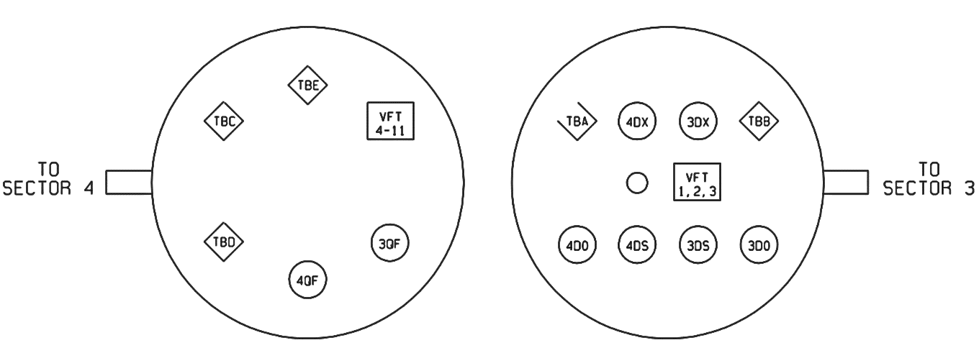
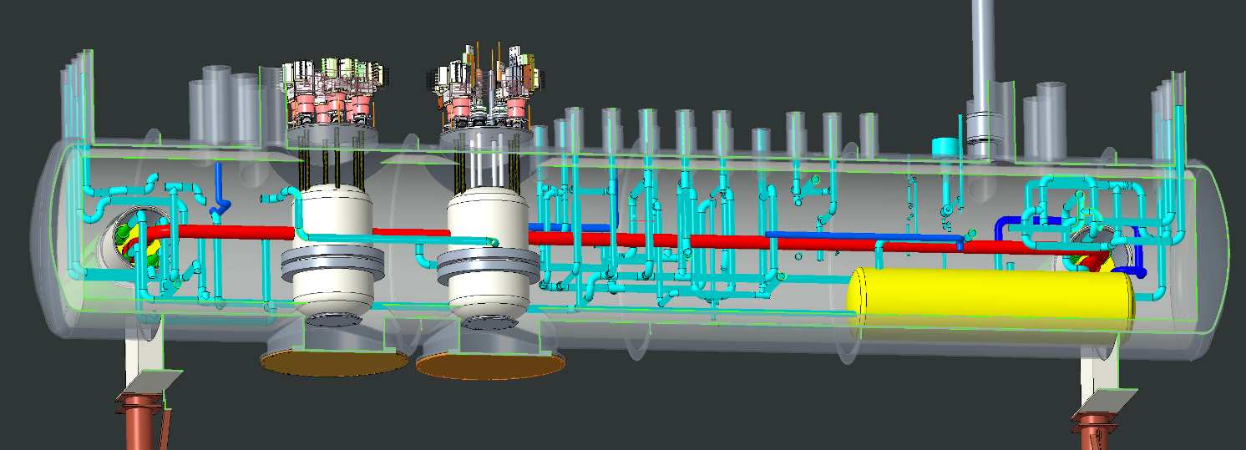
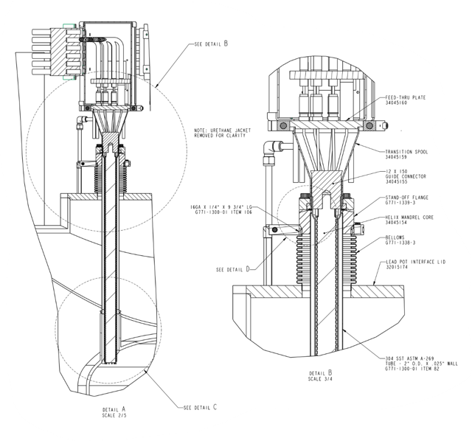
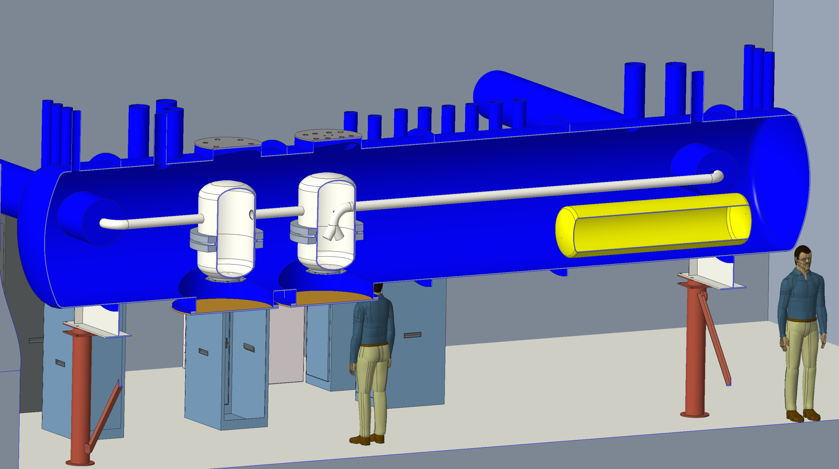
1004B Blue Valve Box
CAD models and drawings
1004B Blue Valve Box Feedthrough Map (from above)
1004B Blue Valve Box CAD model
1004B Blue Valve Box CAD model
“TBD” 12X150 current lead cross section

Slide 3
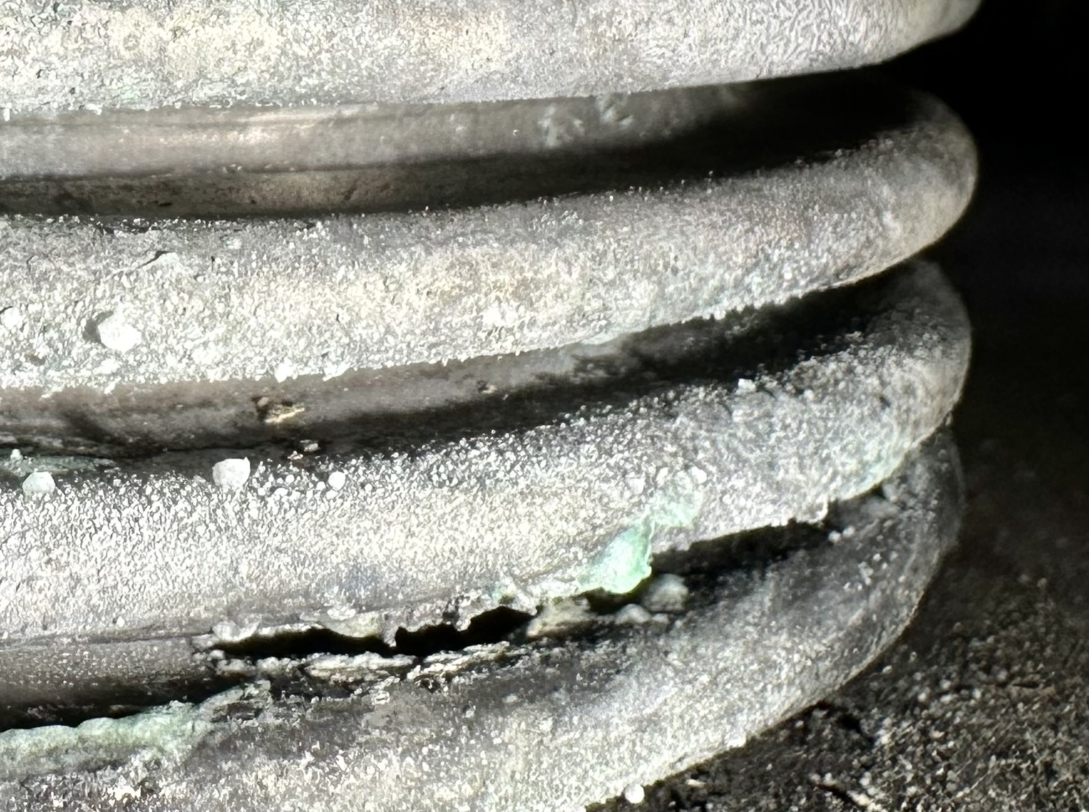
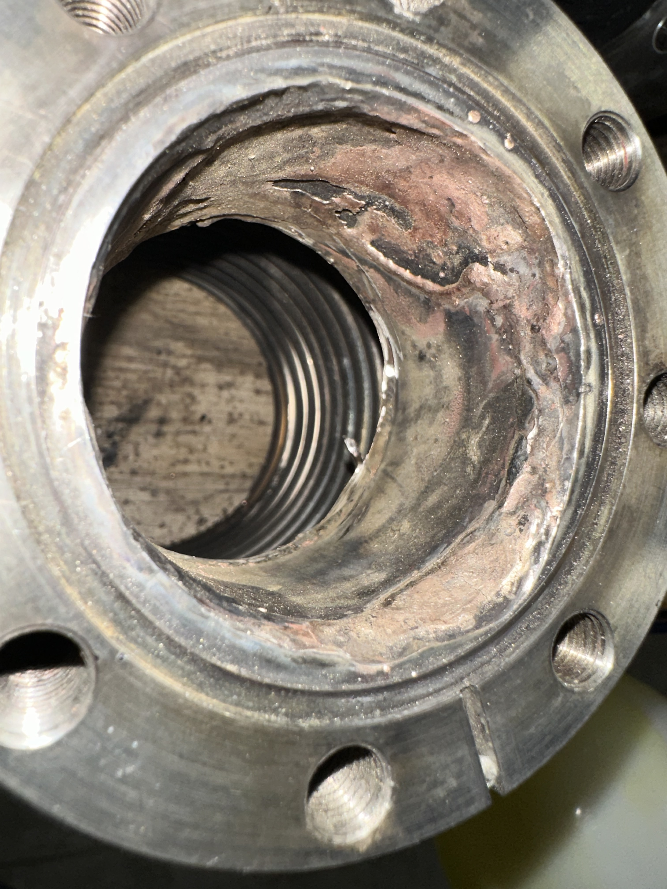
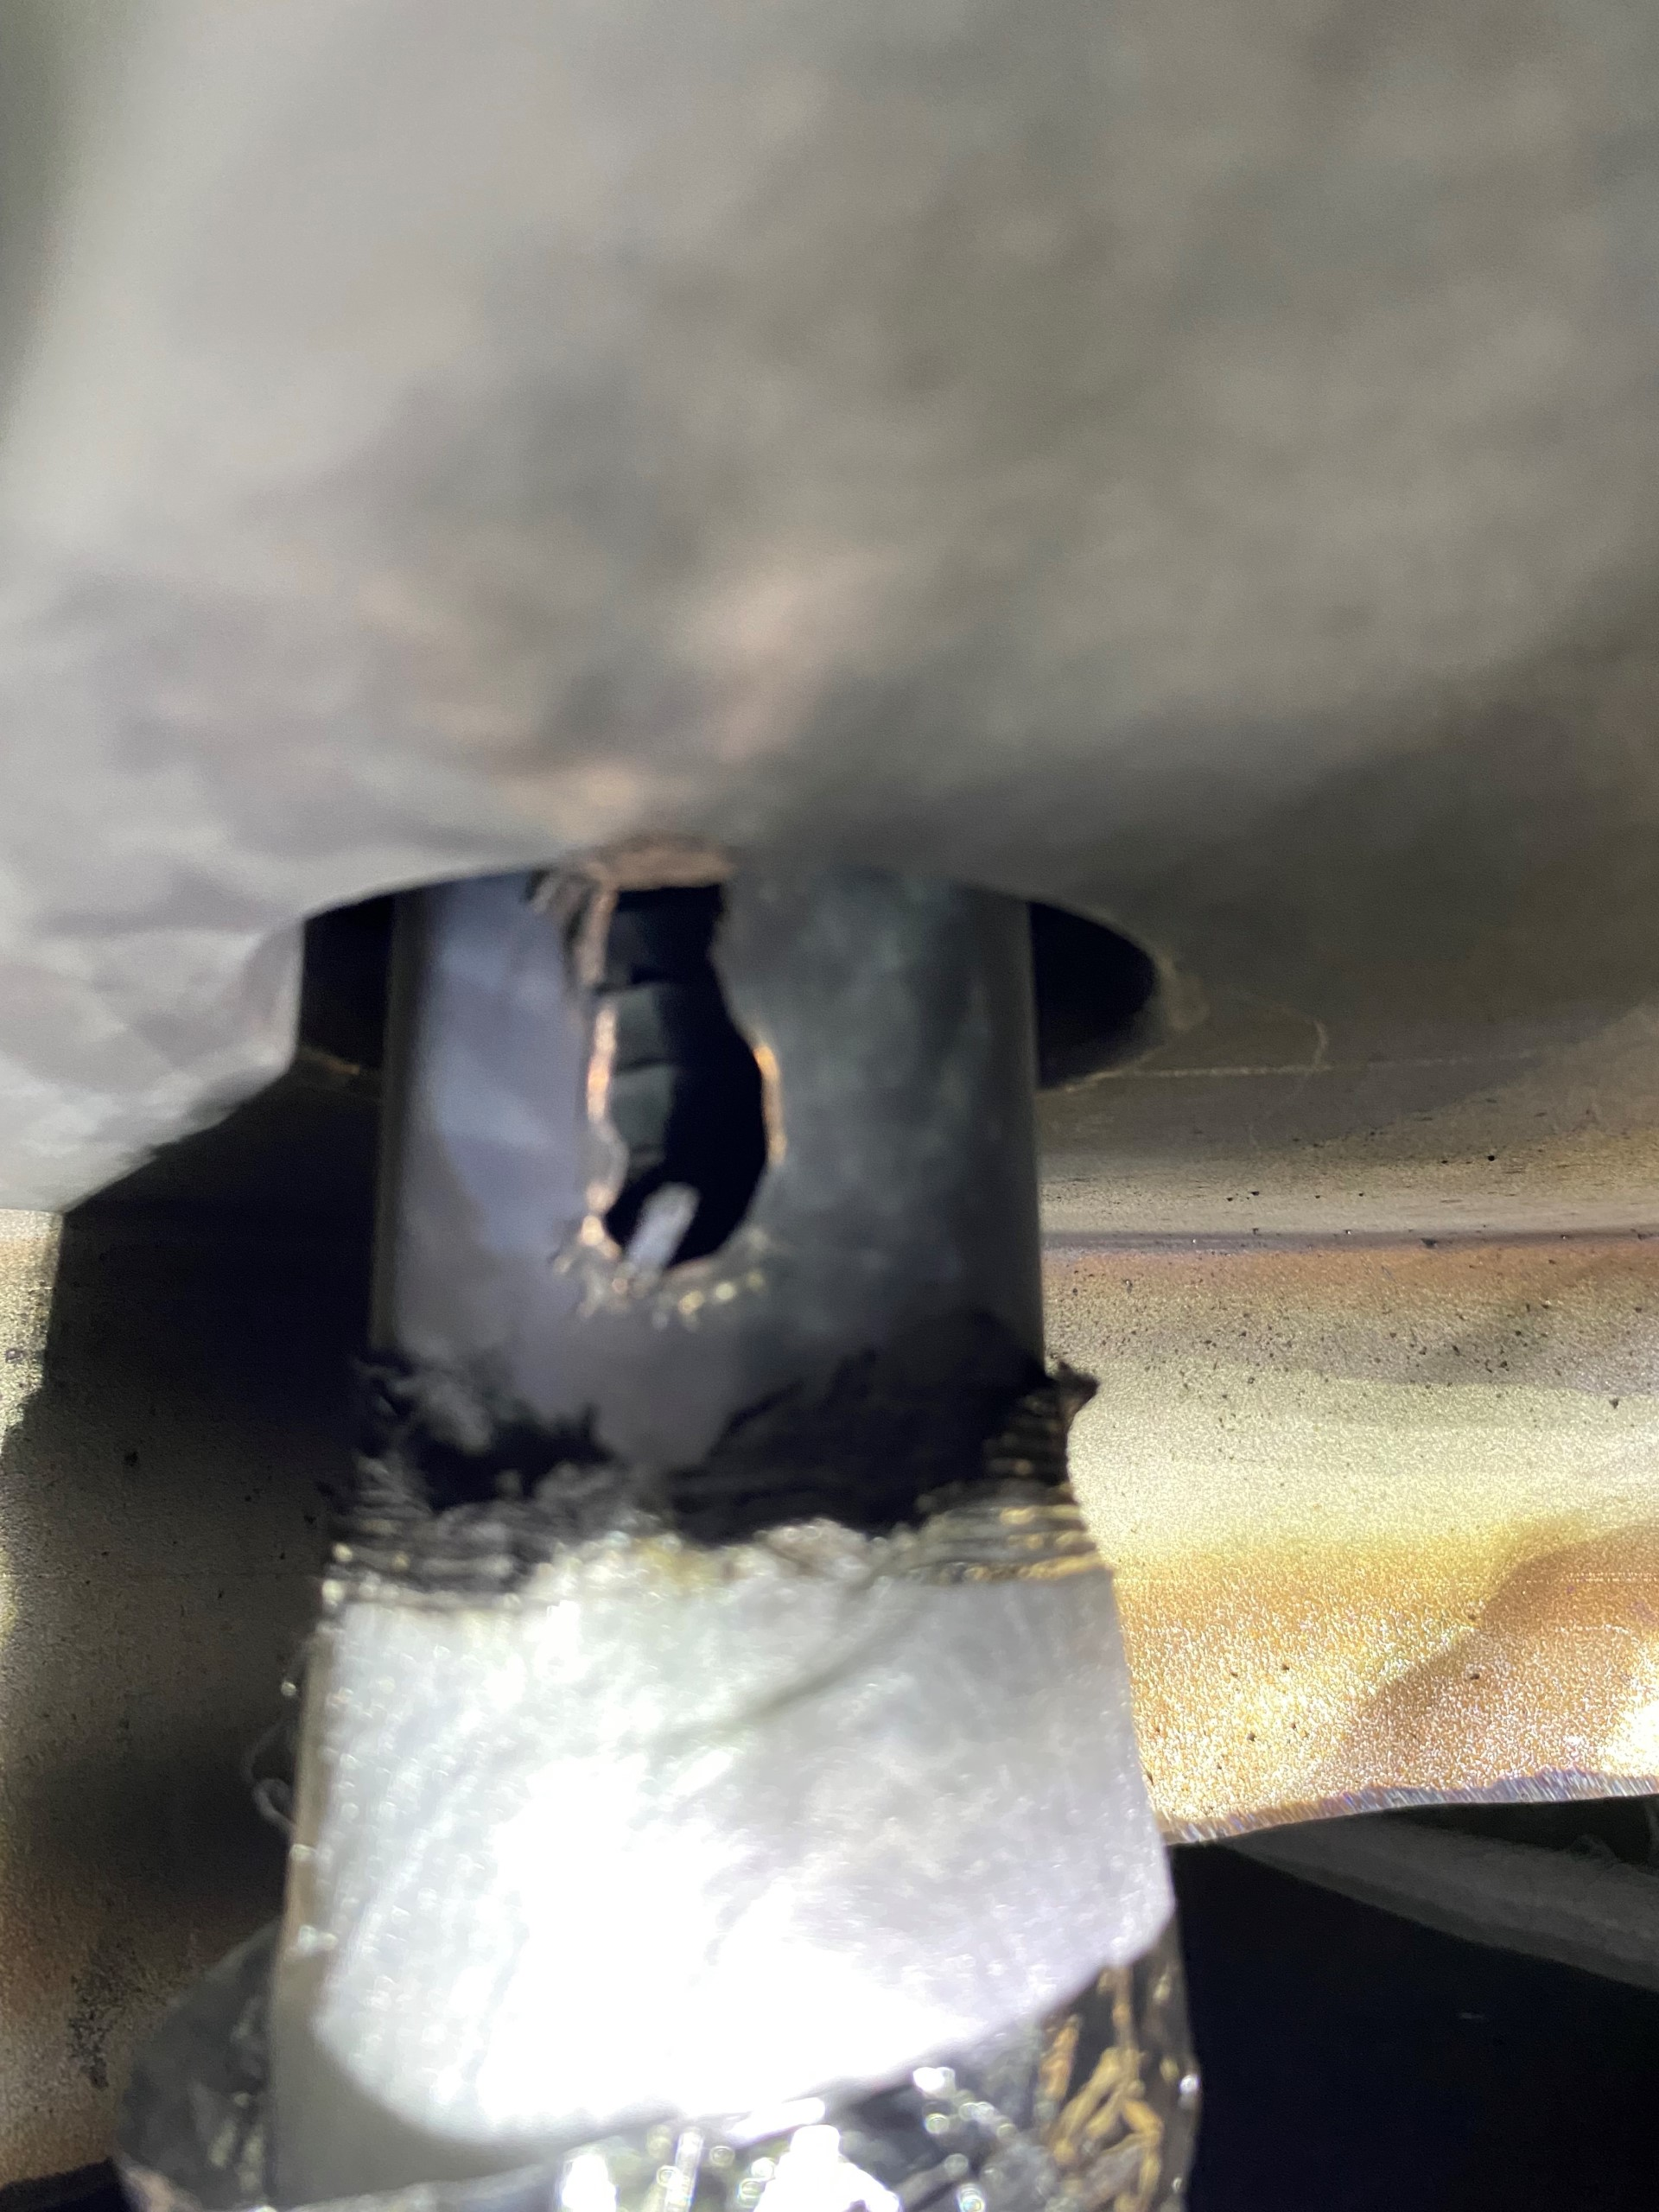
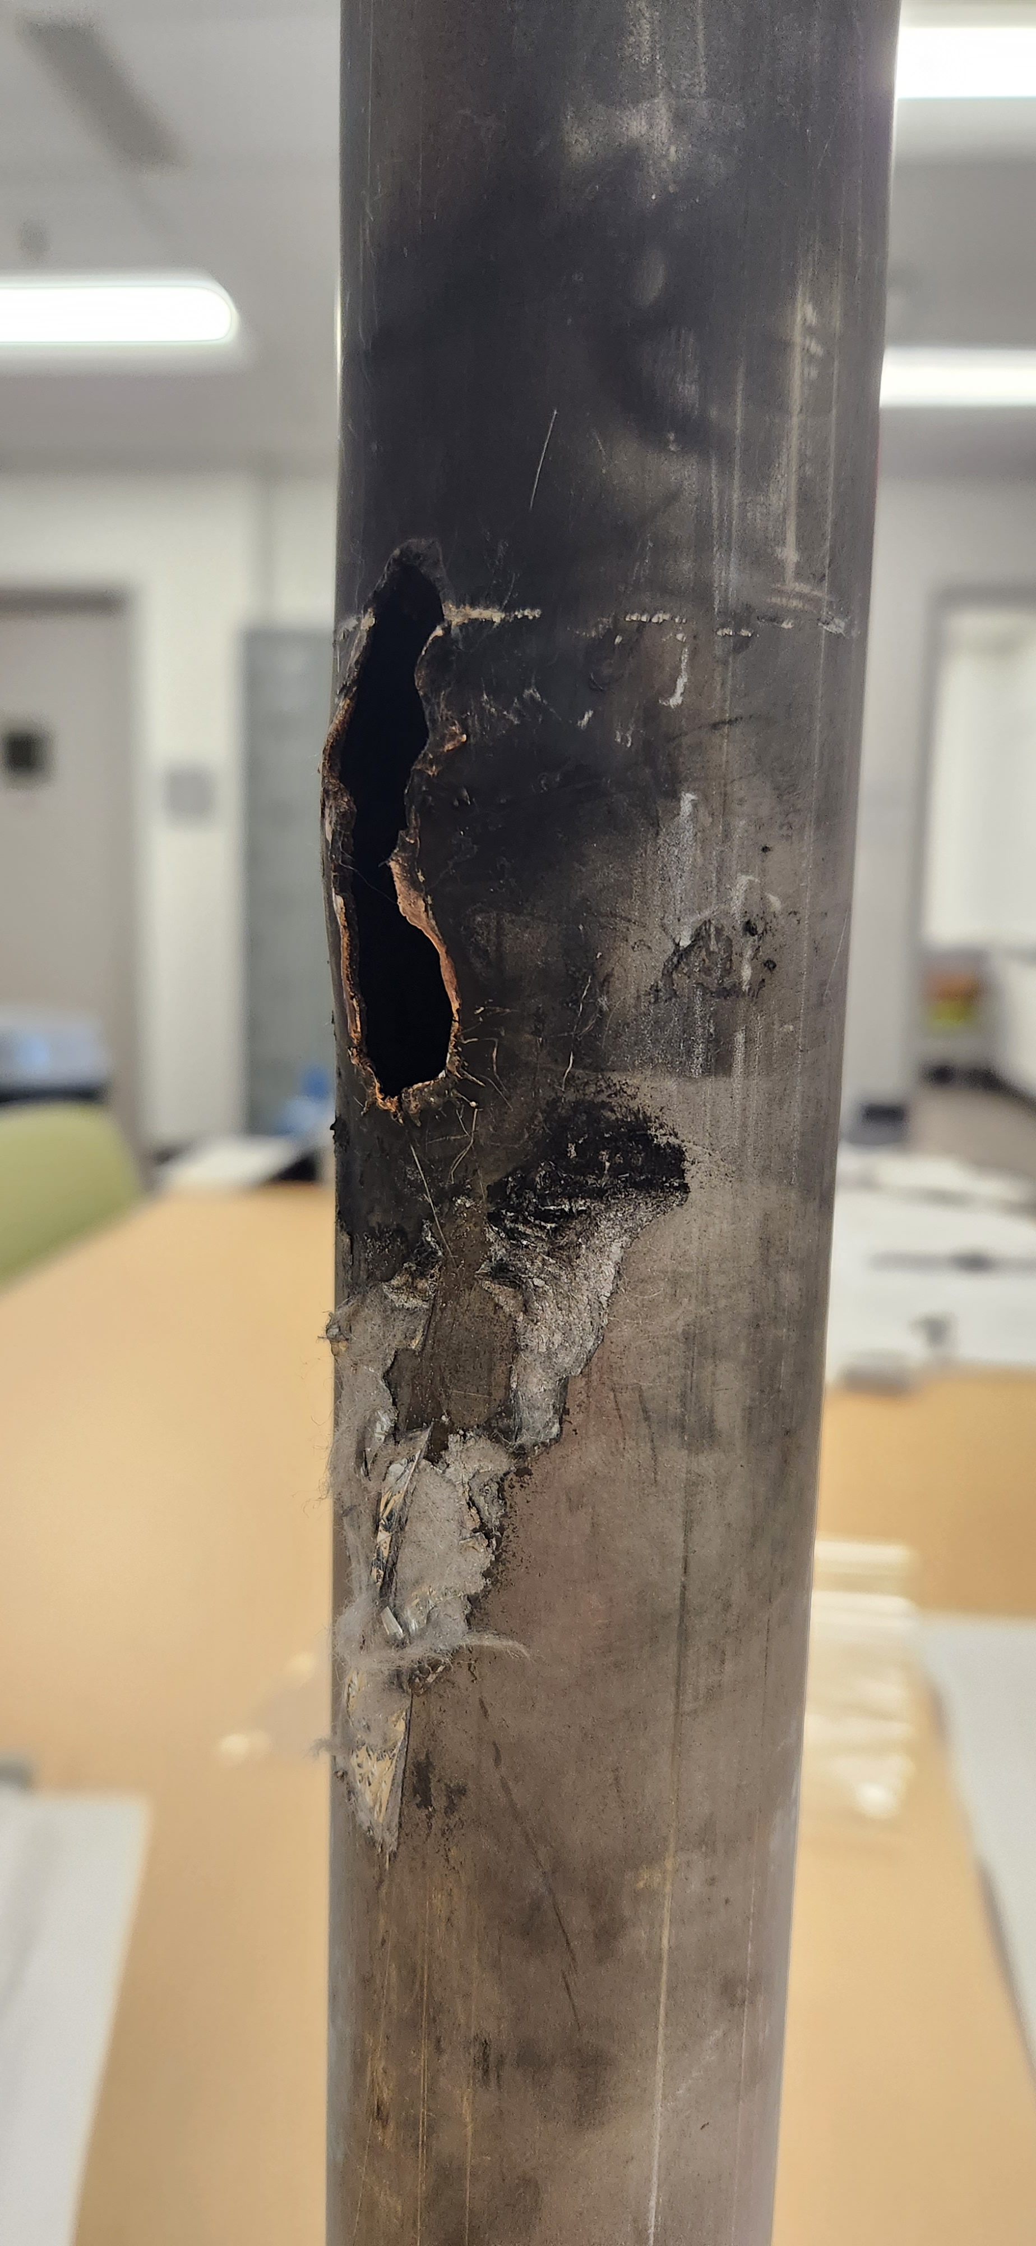
Lead pot “A” “TBD” feedthrough piping damage
This feedthrough is part of the M-line pressure boundary and the valve box pressure boundary
Bellows rupture
Copper from the melted current lead re-deposited on inside of feedthrough flange
Feedthrough tube rupture
Feedthrough tube rupture
.025” wall feedthrough tube and bellows were ruptured by current lead arc failure
“TBD” 12X150 current lead cross section
For more information on the causal analysis and electrical events that lead to this damage
→ Talks coming up next by Jon Sandberg, Chaofeng Mi, and John Escalier

Slide 4
1004B Blue Valvebox Mechancial Failures and Repairs
What failed | Why | Repair | Future Mitigation
Lead pot feedthrough tube | The thin walled tube (.025” thick) was ruptured by the energetic 12X150 current lead arc. |  | There is no room to increase the thickness of the feedthrough tube. Need to prevent similar 12X150 current lead failures.
Lead pot feedthrough bellows | The thin walled bellows (.XX” thick) was ruptured by the energetic 12X150 current lead arc.
Manhole cover o-ring seal | The o-ring got very cold and cracked in three places | Installed new viton o-rings | Prevent similar 12X150 current lead failures ODH credited controls → XXXX For EIC → Design some kind of umbrella or shroud to prevent or slow freezing

Slide 5
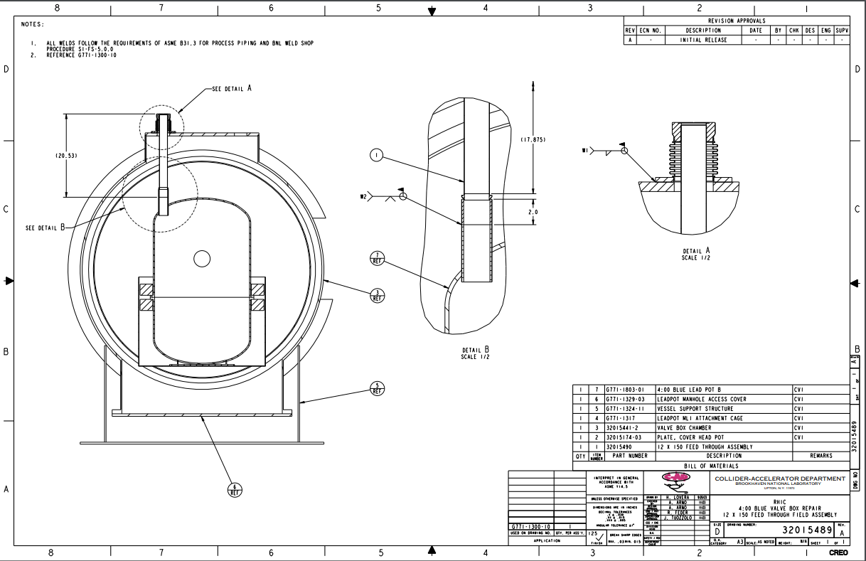
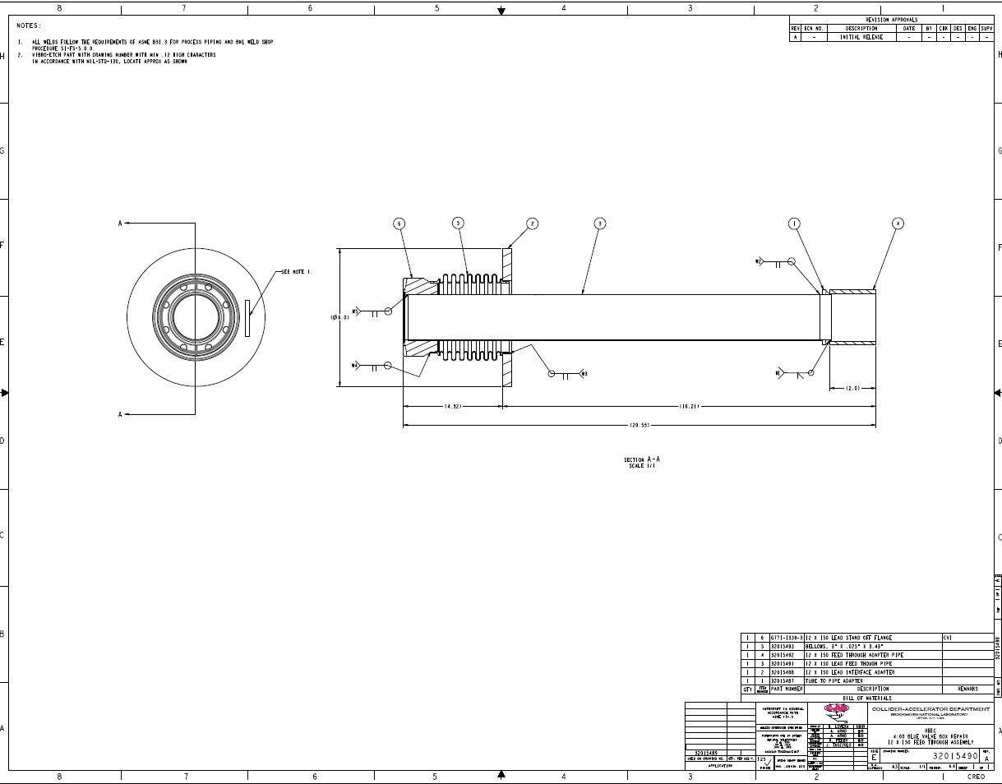
Lead pot “A” “TBD” feedthrough repair design
Harlan Lovera and Richard Muscolino

Slide 6
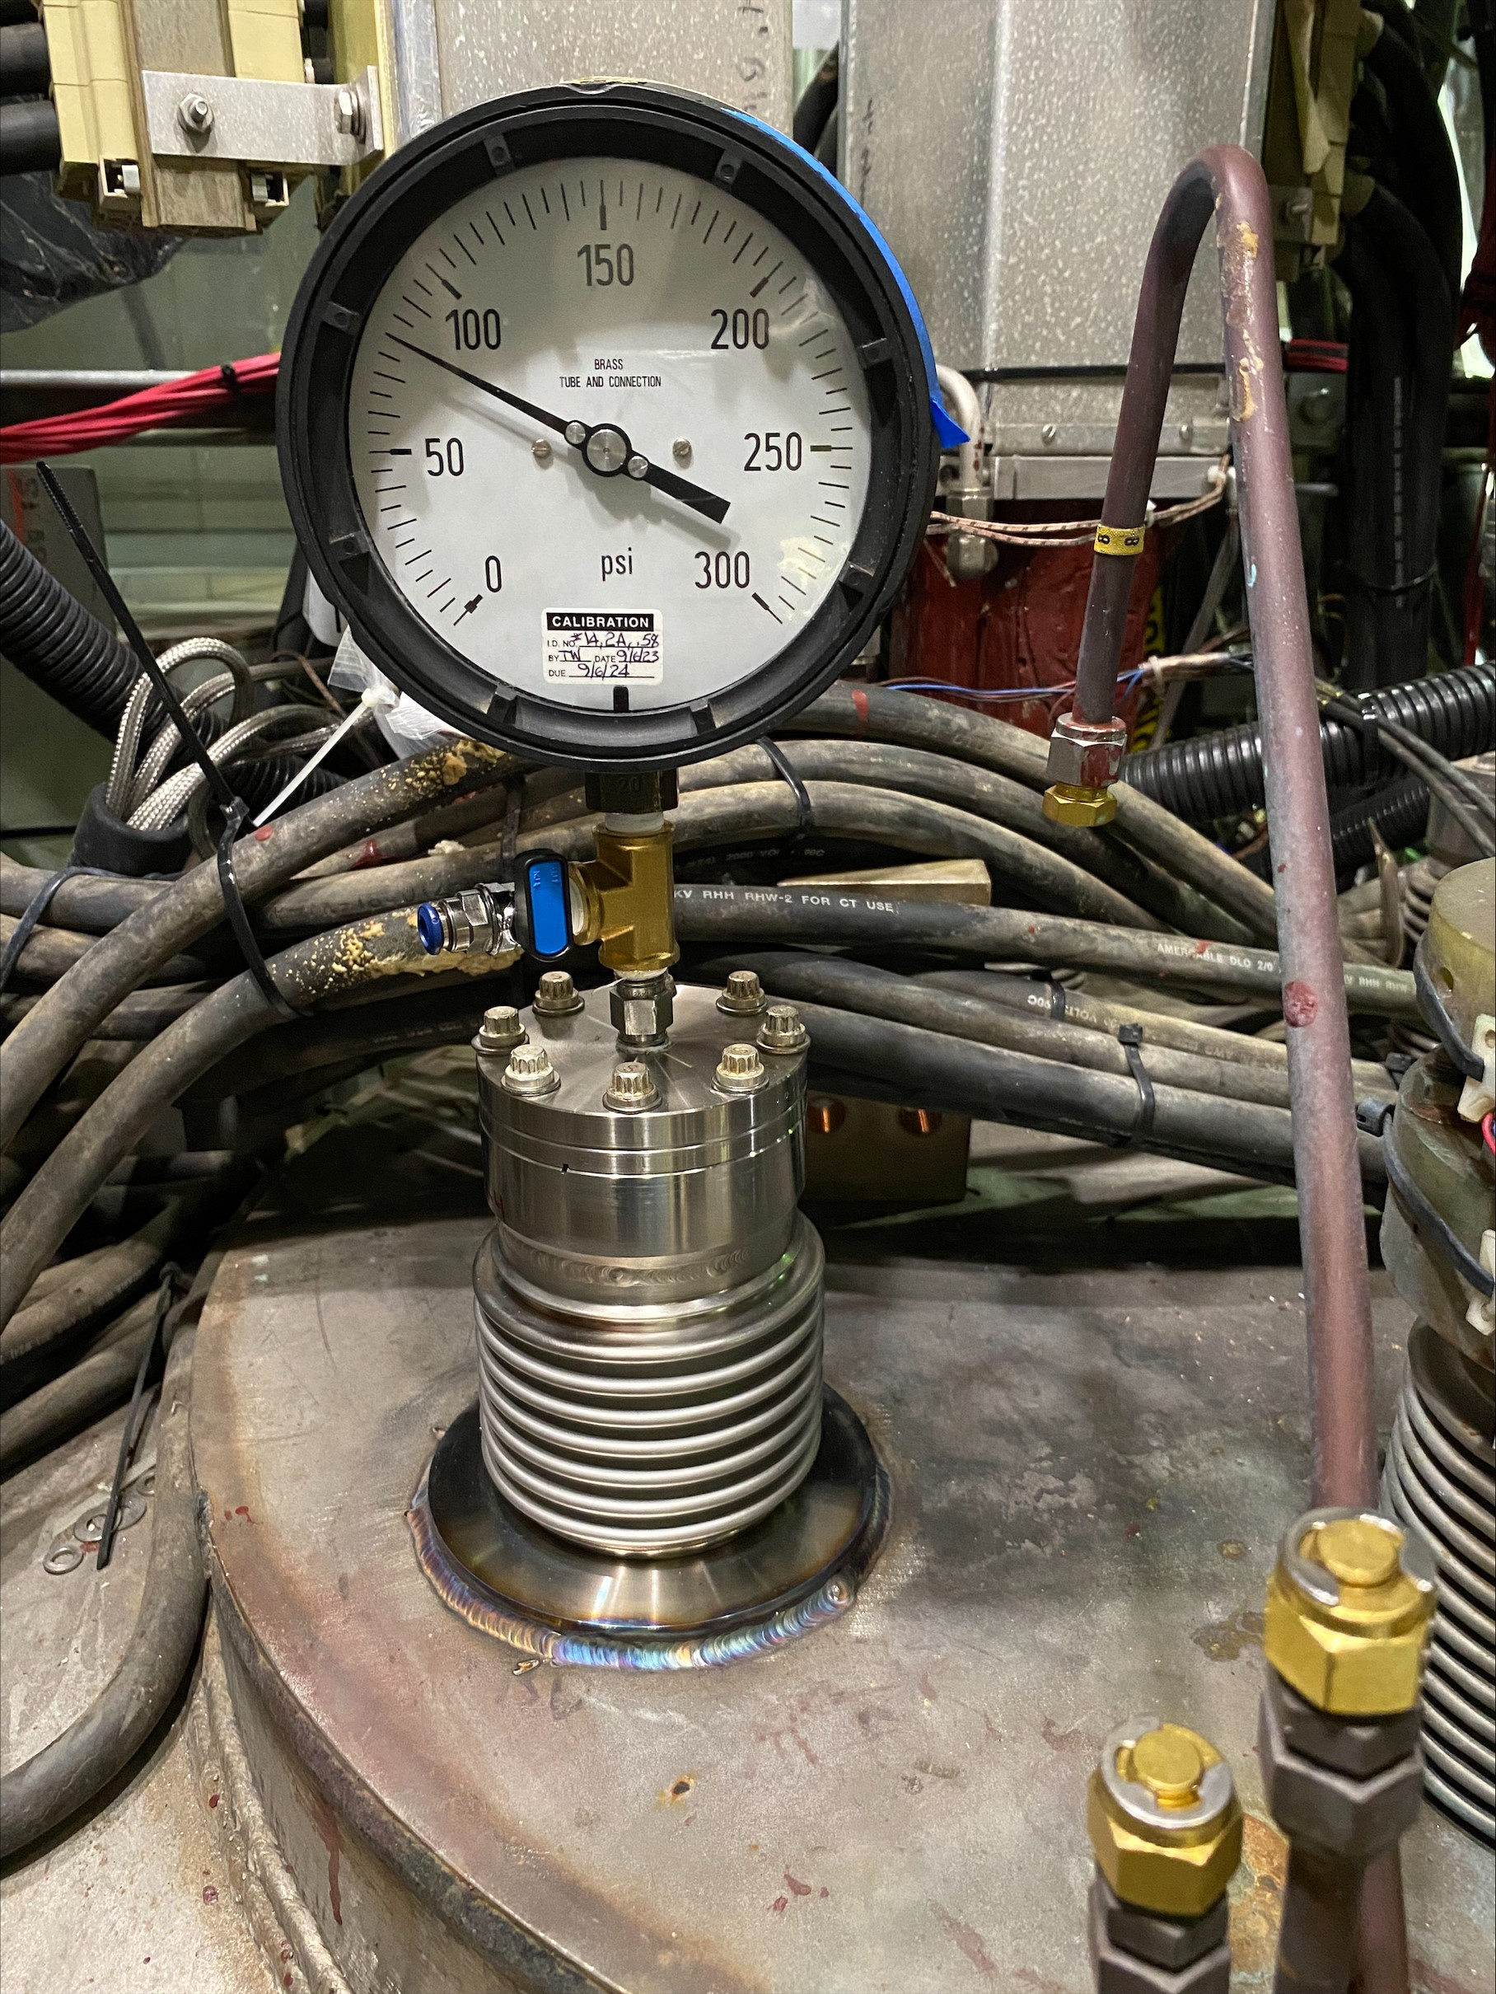
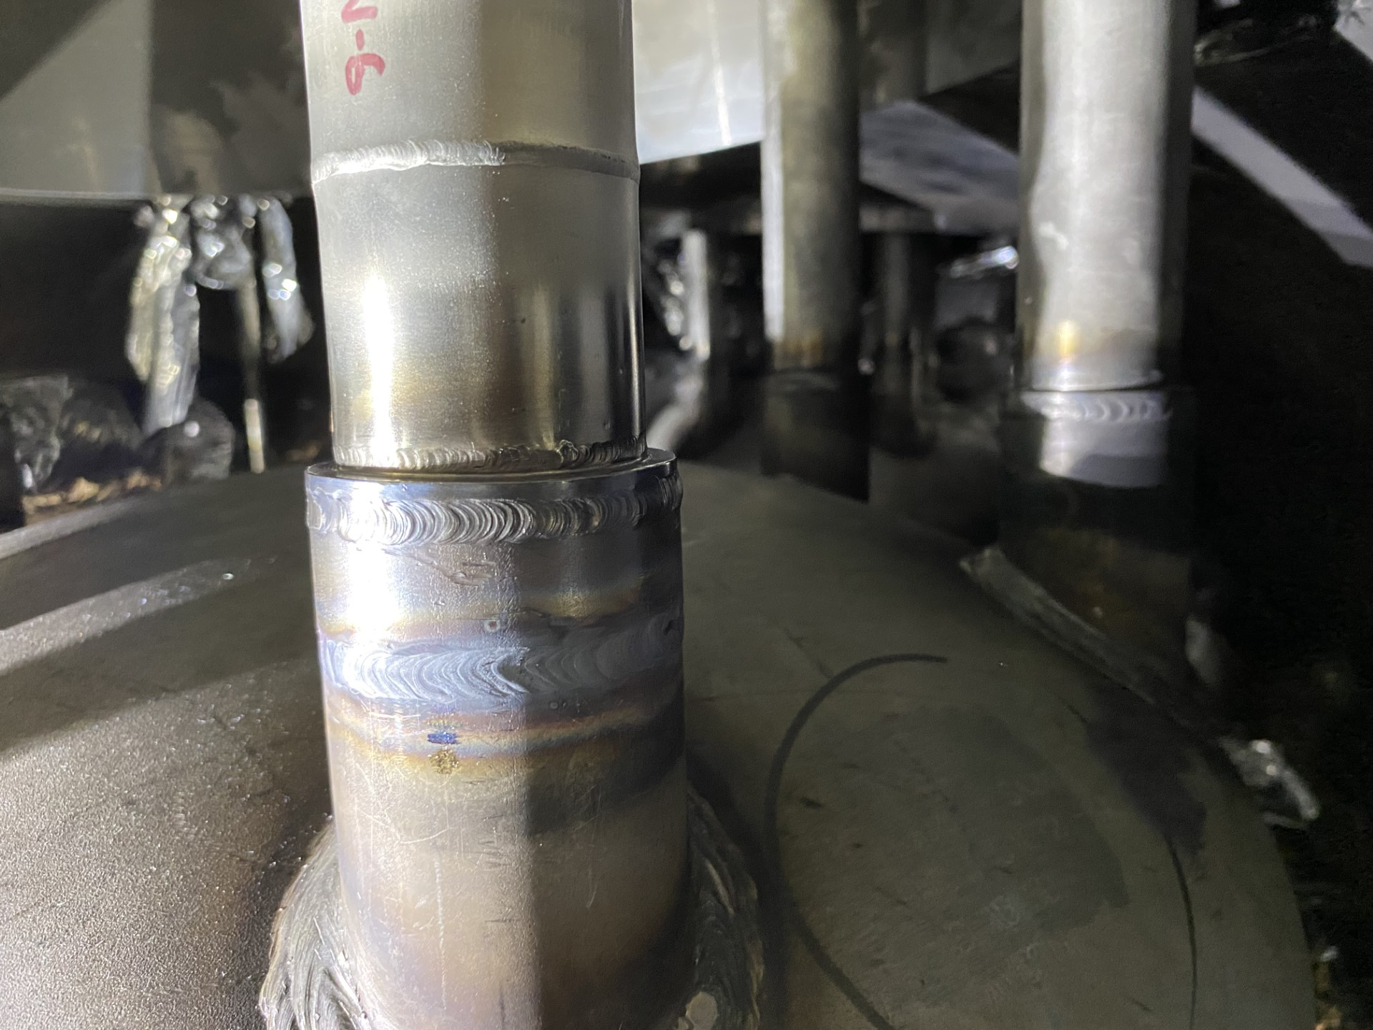
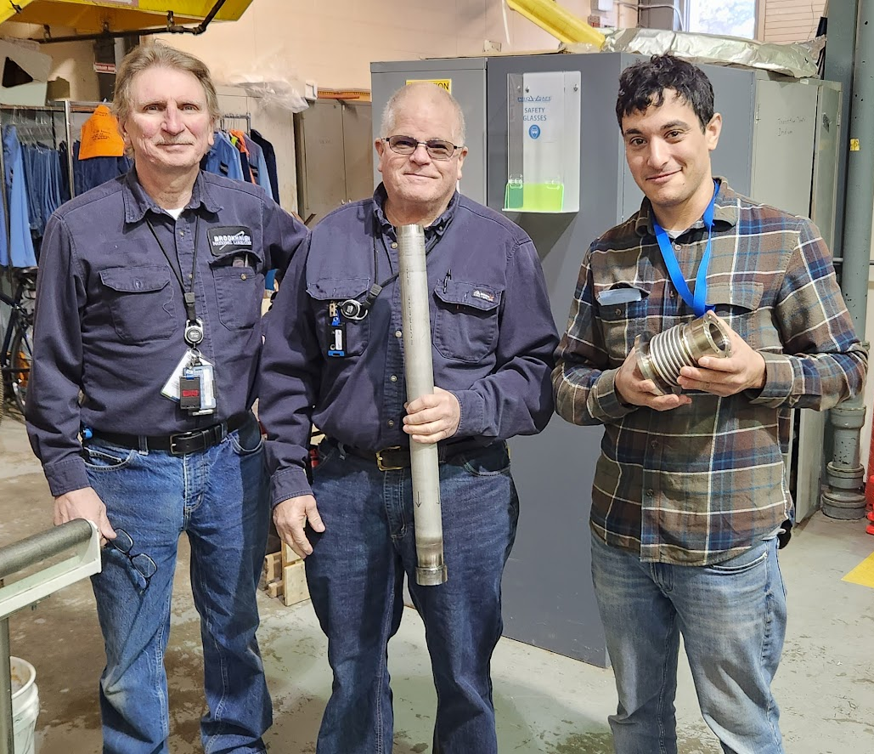
Lead pot “A” “TBD” feedthrough repair
Repair completed 11/18 with successful pressure test
Feedthrough tube welded to top of lead pot (interior)
Pressure test of the repaired feedthrough
The 1004B Blue Valve Box Entry and Repair Team
Tom Wozniak, Jeff Stewart, Nick Stivala

Slide 7
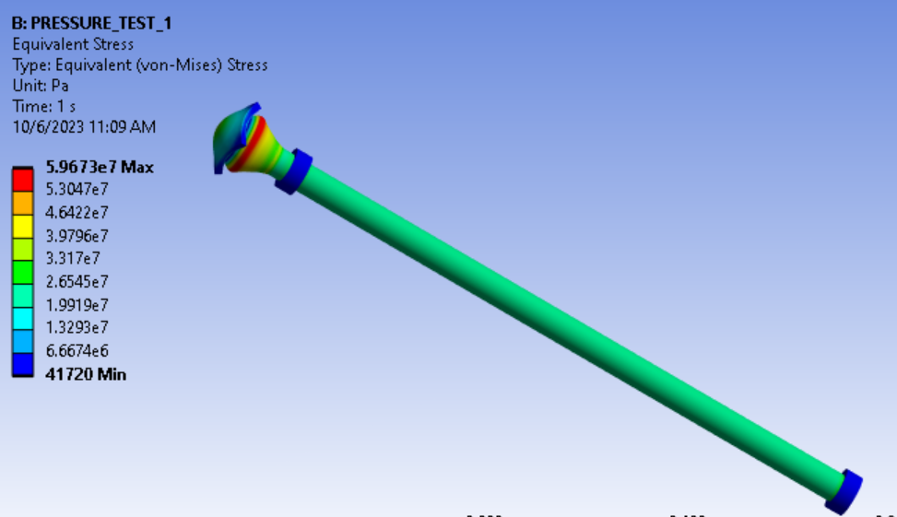
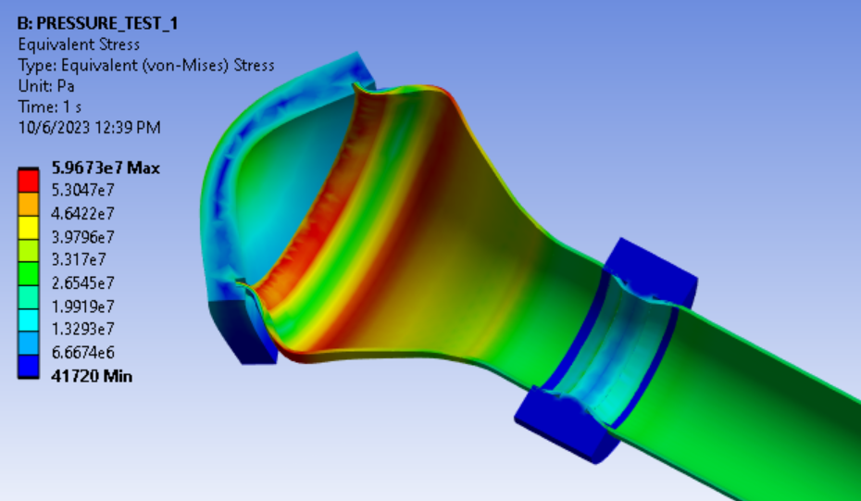
12X150 current lead and pressure test pipe FEA check
FEA at (A) 120 psi (8 atm) internal test pressure and at (B) 300 psi internal pressure
M-line typically operates at xxx psi
Stress check at 120 psi test pressure
Hoop stress thin walled tube = pd/2t = 120*2/2*.065 = 1846 psi
FEA model combined (von mises) stress = ~1800 psi
Allowable = 16,700 psi
300 psi → 5.97E7 Pa = 8.7 ksi
120 psi → 2.5E7 Pa = 3.7 ksi
300 psi → ~2.7E7 Pa = ~4 ksi
120 psi → ~1.2E7 Pa = ~1.8 ksi

Slide 8
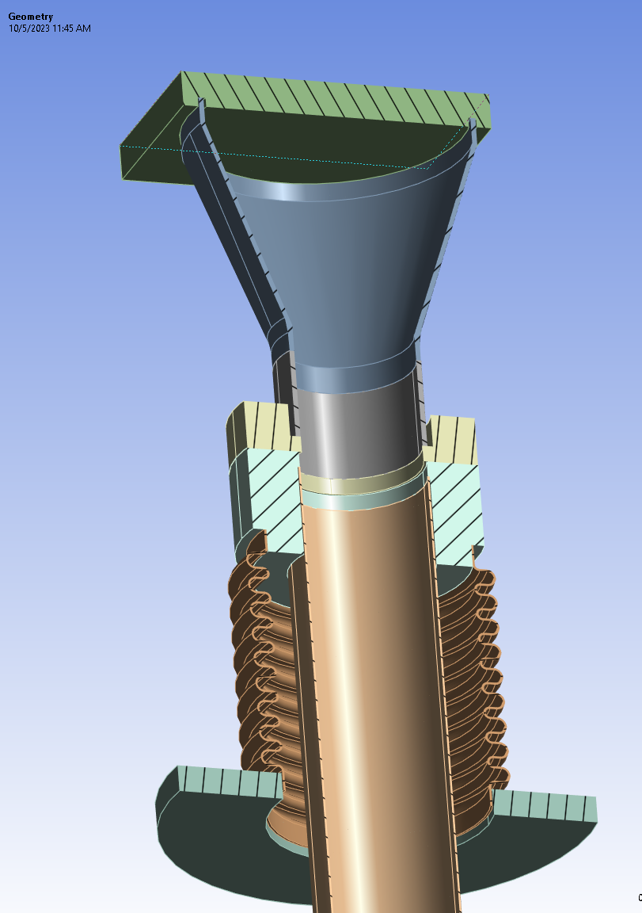
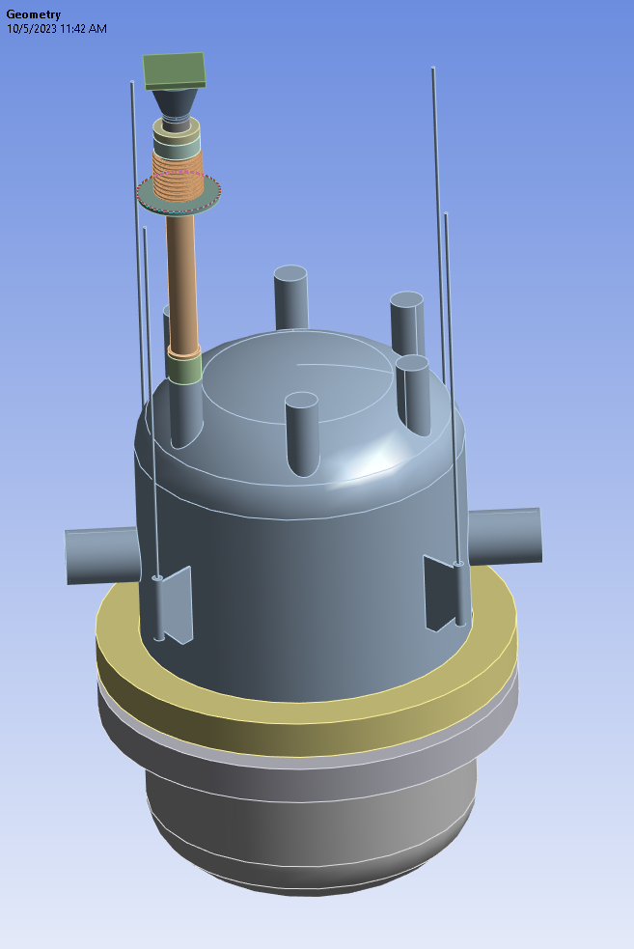
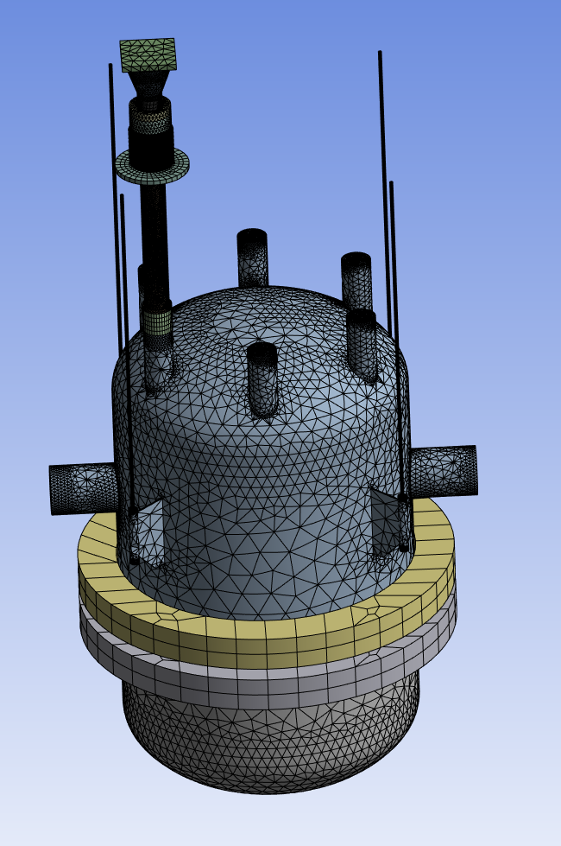
Lead pot feedthrough repair FEA check
FEA at (A) 120 psi (8 atm) internal test pressure and at (B) 300 psi internal pressure
Fixed b.c. at hangers
Refined mesh around feedthrough repair
New repair flange to weld bellows to outside of valve box
ruptured

Slide 9
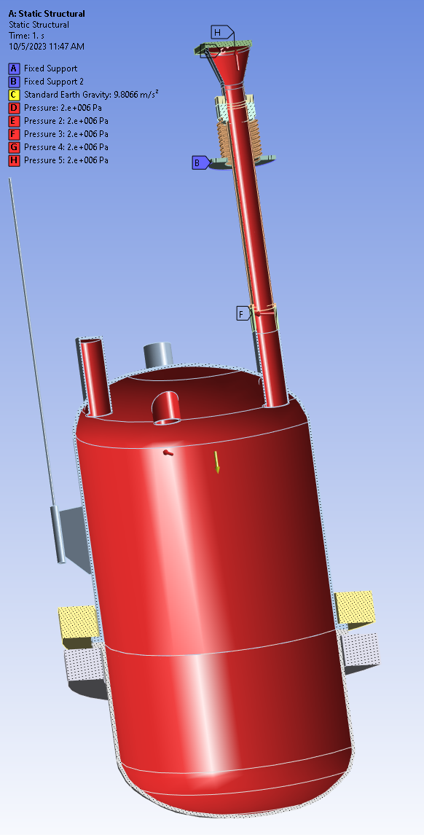
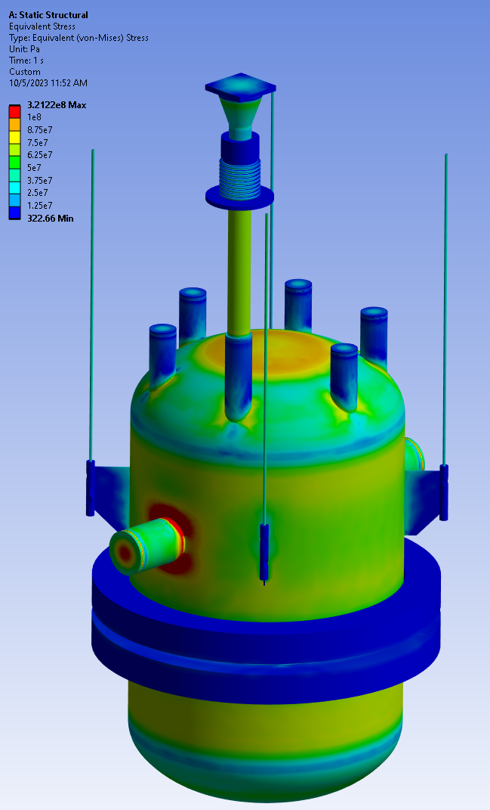
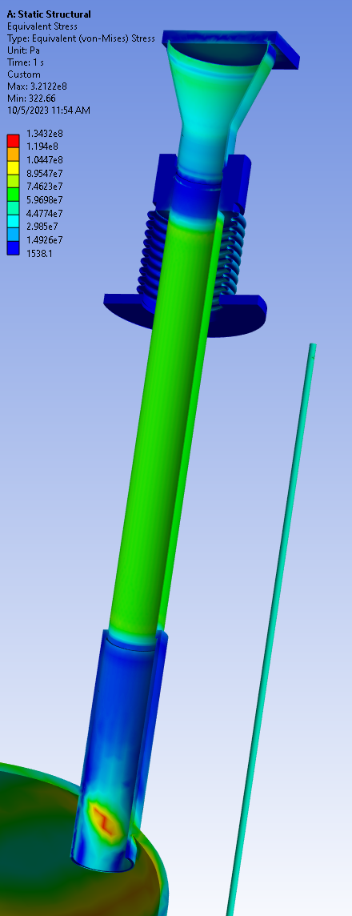
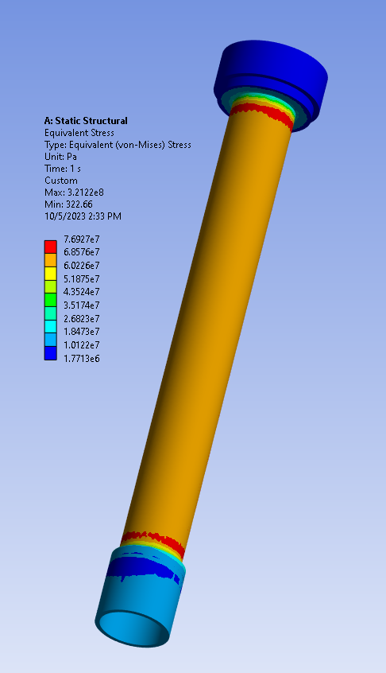
Lead pot feedthrough repair FEA check
FEA at (A) 120 psi (8 atm) internal test pressure and at (B) 300 psi internal pressure
Internal Pressure Applied = 300 psi = 2 MPa
VonMises Stress in tube = ~6E7 Pa = 8.7 ksi

Slide 10
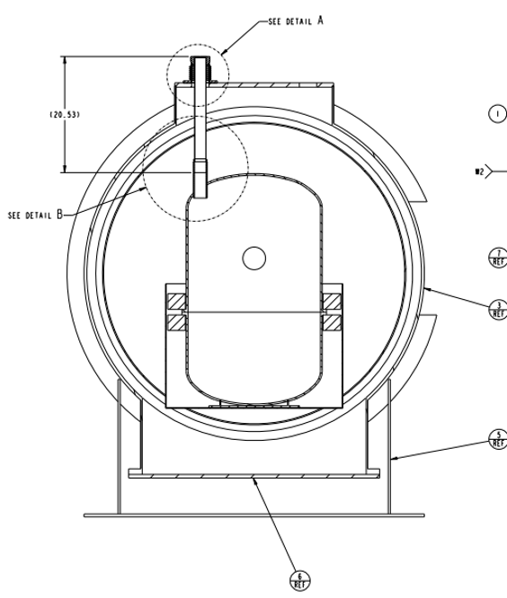
Manhole cover o-rings See talk on ODH analysis and ASE revision XXX
Xxx OD manhole cover Viton o-ring froze, cracked, and leaked due to bath of very cold helium gushing from ruptured feedthrough
We found XX cracks of about xx width in the o-ring
This failure mode was not part of original ODH modeling…neither was the ruptured bellows
Considered using silicone and we tested viton, buna-N and silicone dipped in LN2. All became brittle and cracked.
Installing new viton o-rings
For EIC, consider designing shroud or umbrella that diverts?
With ASE update and service building ODH systems joining RHIC credited controls, don’t need to upgrade.

Slide 11
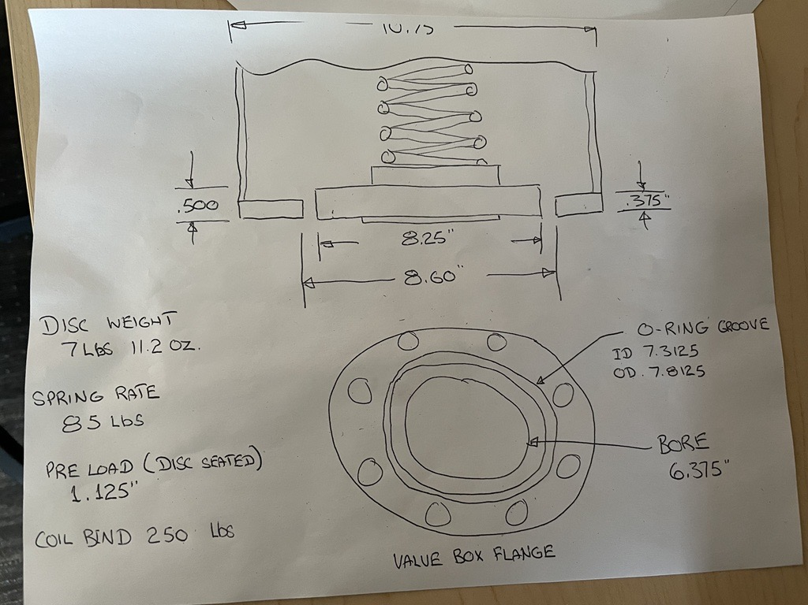
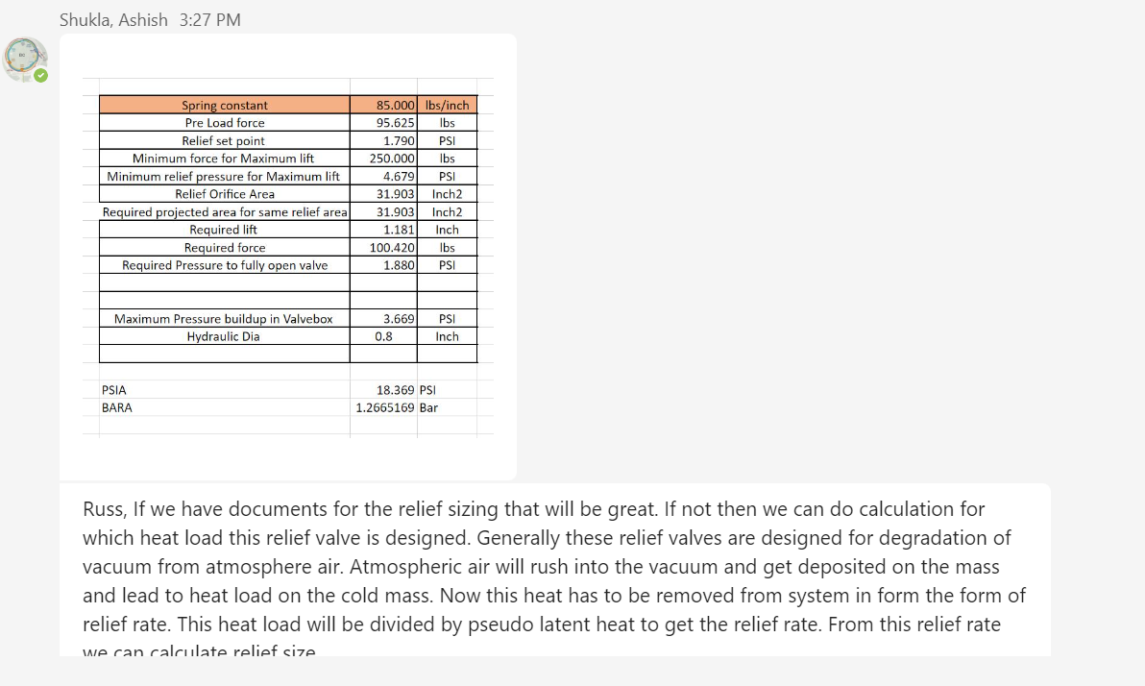
Valve box lift-plate relief valve
Dismantled and measured properties because we don’t have original design record

Slide 12
Other mechanical work and notes
After thorough visual search, no other damage found inside the valve box
Won’t know for sure until we can pressurize the complete M-line from 1004B to 4:00 DX
Cryostat relief valve and vent line
Cleaned out shredded MLI from pipe and outdoor grate
Verified and reset spring-loaded lift plate relief valve
MLI and thermal shield clean up and installation
Spare 12X150 electrical and mechanical testing
Vacuum leak check, 8 atm pressure test, Hi-Pot test
Only one working spare!
Ordering parts to build additional spares of current design
There is a team designing an improved current lead for EIC future
Safety → Work planning, LOTO and confined space entry
Strong partnership with ES&H teams keeps everyone safe and helps to keep the work moving forward smoothly
“Lucky” this happened now → Mechanical and electrical team from RHIC construction still working and able to share their experience and train people

Slide 13
1004B Blue Valve Box Repair
Repair Step | Status and notes as of 11/XX
Weld in new “TBD” feedthrough tube and bellows, pressure test | Complete
Insert, connect, and testing of spare 12X150 current lead | Start week after Thanksgiving Electrical team is also working on 4:00 DX splice joints Finish no later than 12/22
Internal and external electrical work and testing
Weld lead pots closed
M-line pressure test from 1004B to 4:00 | Key step. Need to wait for DX splice cans to be closed. Enables start of Cryo scrub.
Complete MLI and thermal shield installation, other housekeeping | Finish no later than 1/22/24
Re-set relief valve, close manhole covers, pump down

Slide 14
Backup material

Slide 15
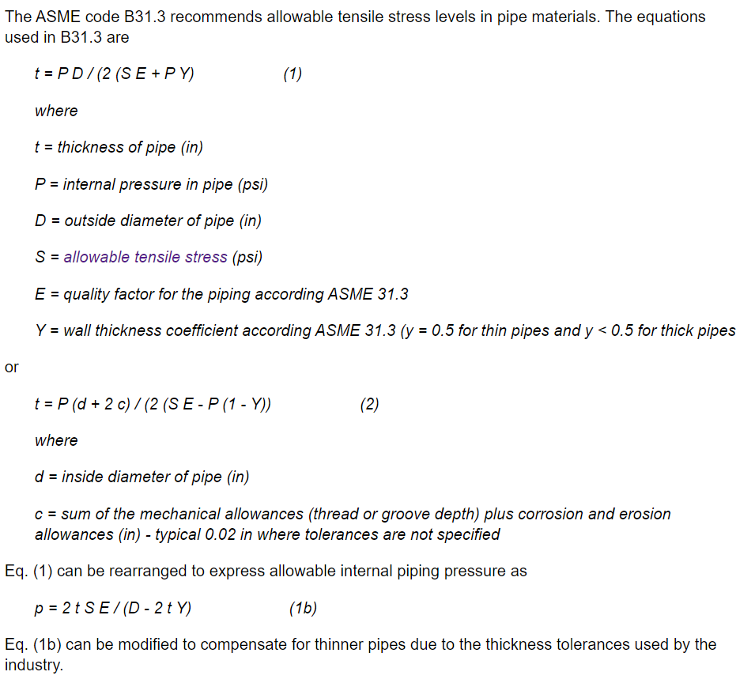
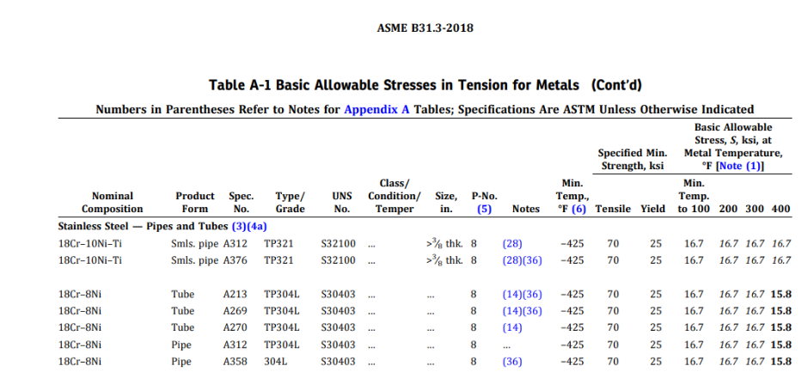

Slide 16
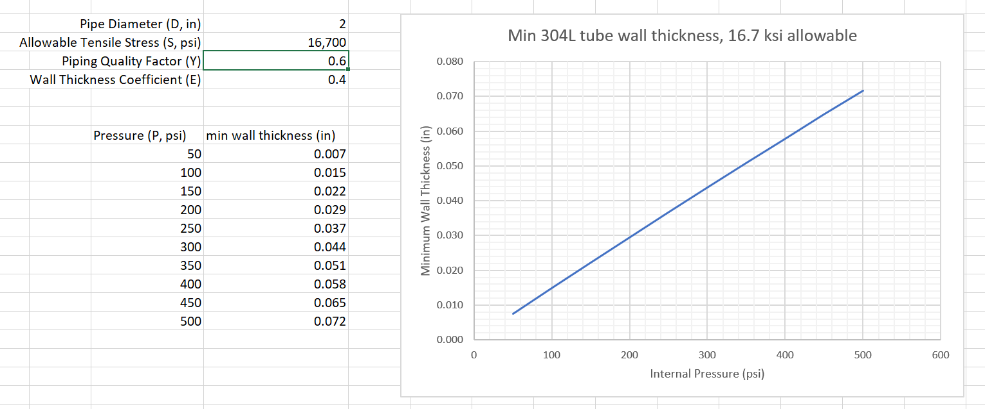
At the test pressure of 120 psi (8 atm), and using 16.7 ksi allowable, the minimum allowable 304L tube wall thickness is ~.018”
The test apparatus tube wall is .065”
The test apparatus tube wall is .028”
`
Pressure test apparatus tube wall thickness: .065”
Feedthrough repair tube wall thickness: .028”
8 atm current lead test pressure

Slide 17
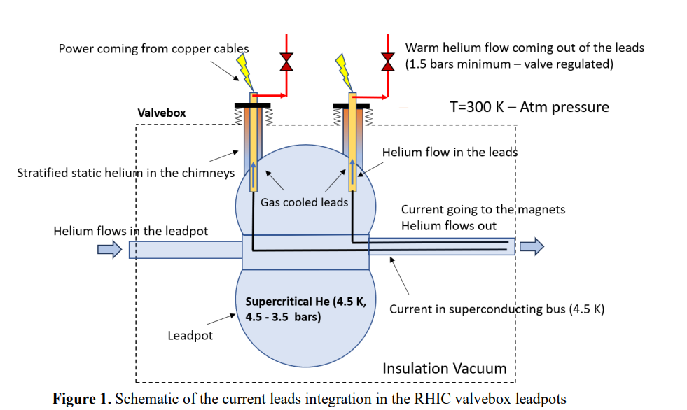
RHIC Valve Box Lead Pots and Gas-Cooled Current Leads
Schematic created by Frederic Micolon

Slide 18
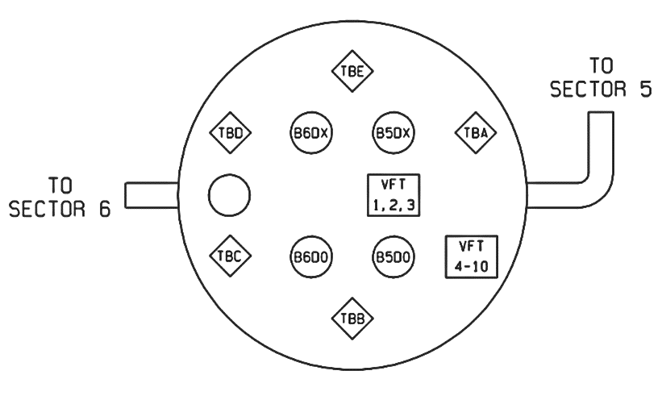
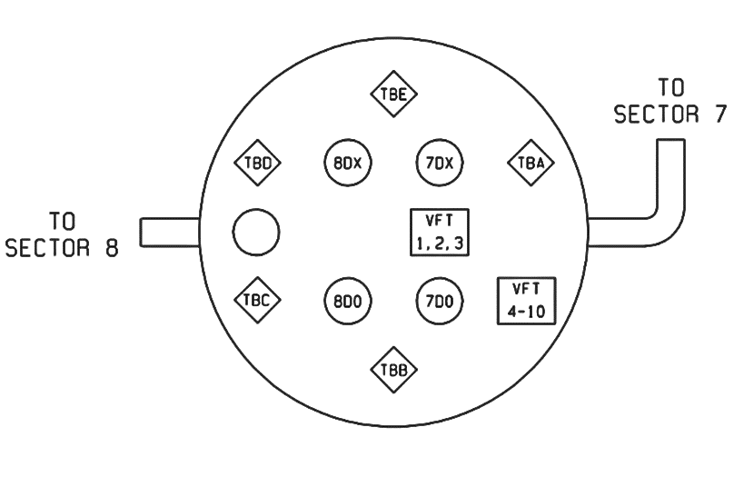
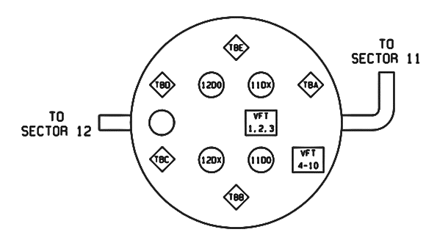
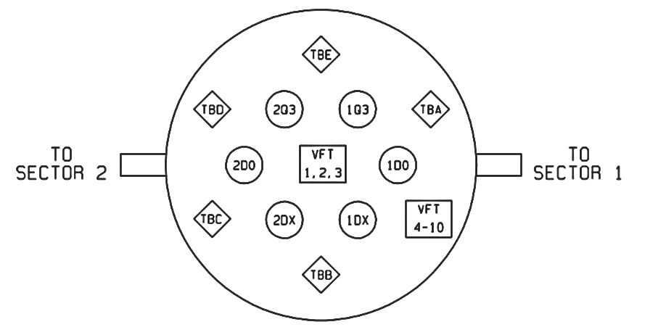
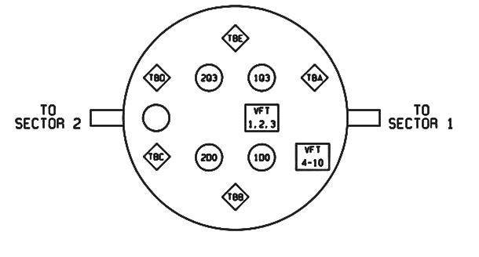
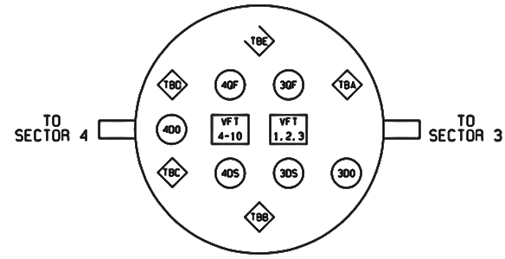
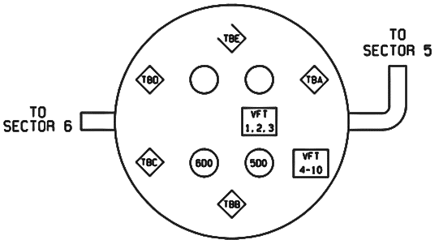
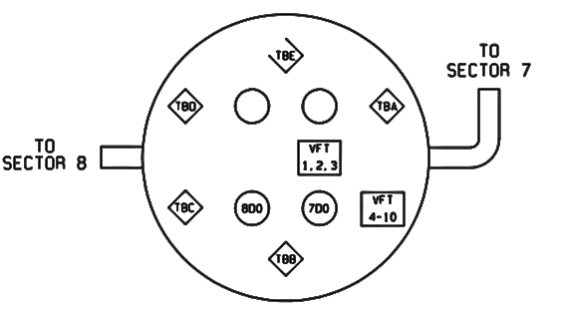
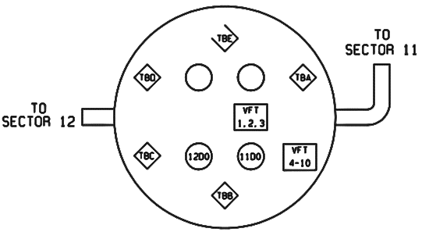
RHIC Valve Box Power Leads Map
TBX
= 12 x 150 amp
12D0
= XXXXXX
XXXX
XXXXX
= XXXXXX
 | 2:00 | 4:00 | 6:00 | 8:00 | 10:00 | 12:00
B
Y
A
A
A
A
A
B
B

Slide 19
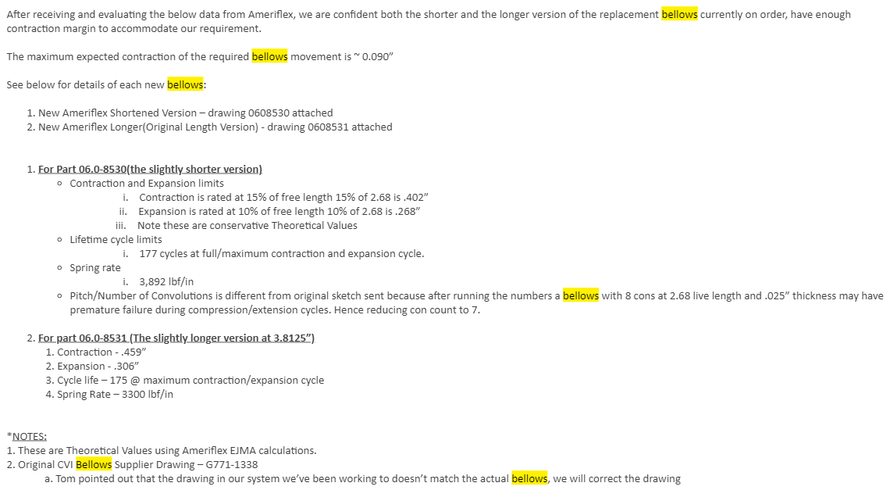
Bellows details: New repair bellows properties
Richard Muscolino

Slide 20
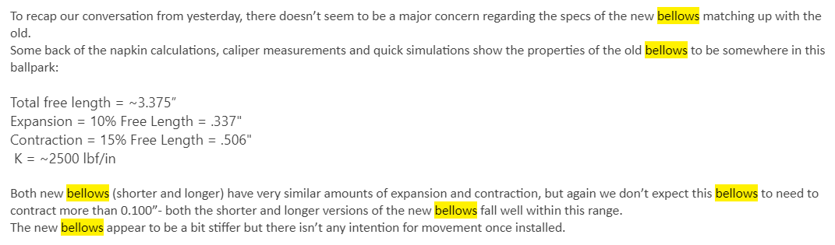
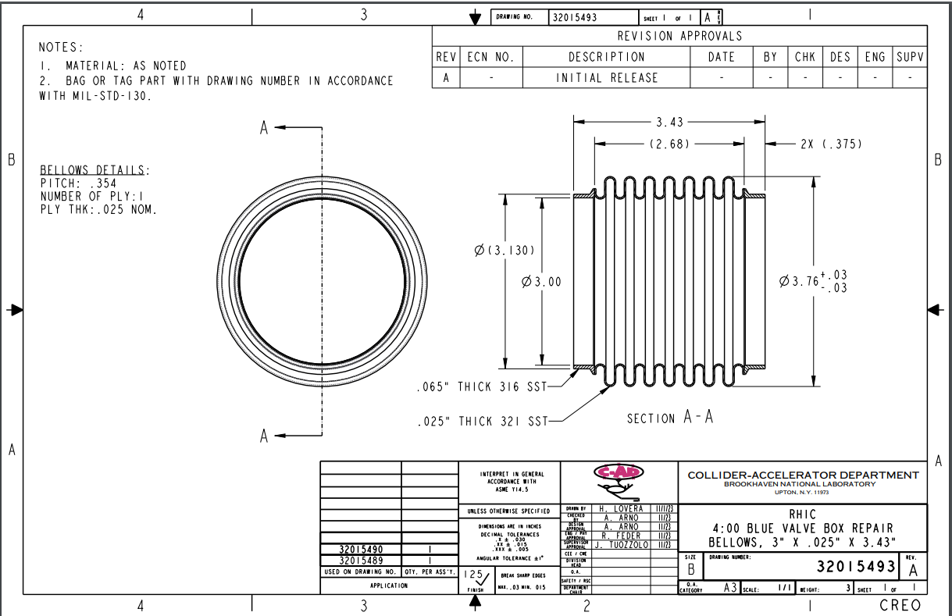
Bellows details: New repair bellows properties
Jonathon Greene

Slide 21
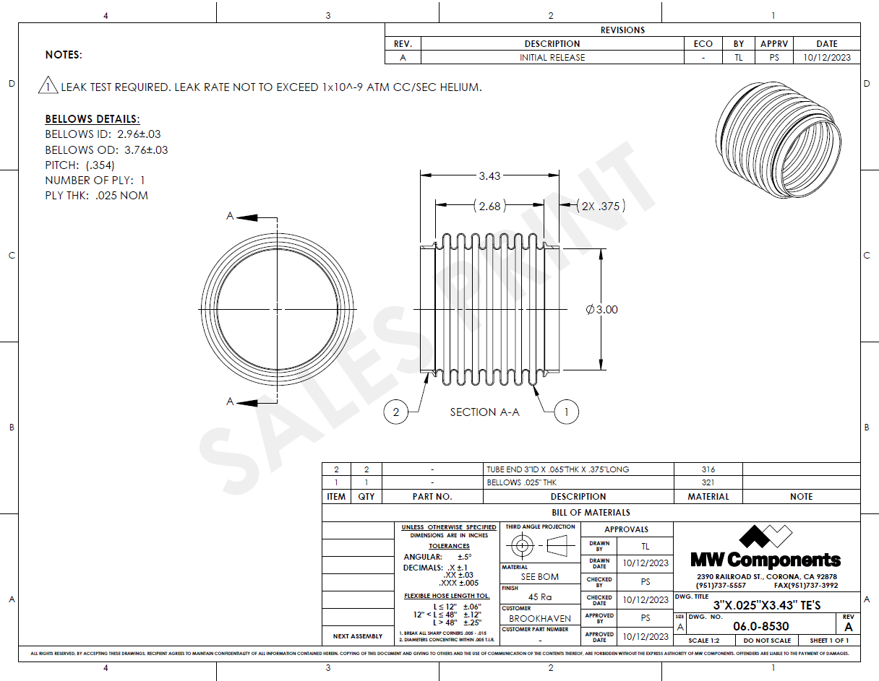
Bellows details: New repair bellows properties
Bellows drawings

