Slide 1
EICGENR&D2023_16: Development of Double-Sided Thin-Gap GEM-μRWELL for Tracking at the EIC
FY22 Progress Report & FY23 Proposal
EIC GENERIC R&D REVIEW MEETING
Kondo Gnanvo on behalf of Thin Gap MPGD Consortium
October 31, 2023

Slide 2
Outline

Slide 3
FY23 Progress Report

Slide 4
FY22 Progress Report – UVa

Slide 5
FY22 Progress Report – JLab

Slide 6
FY22 Progress Report - VU

Slide 7
FY22 Progress Report – Yale U.

Slide 8
FY23 Proposal

Slide 9
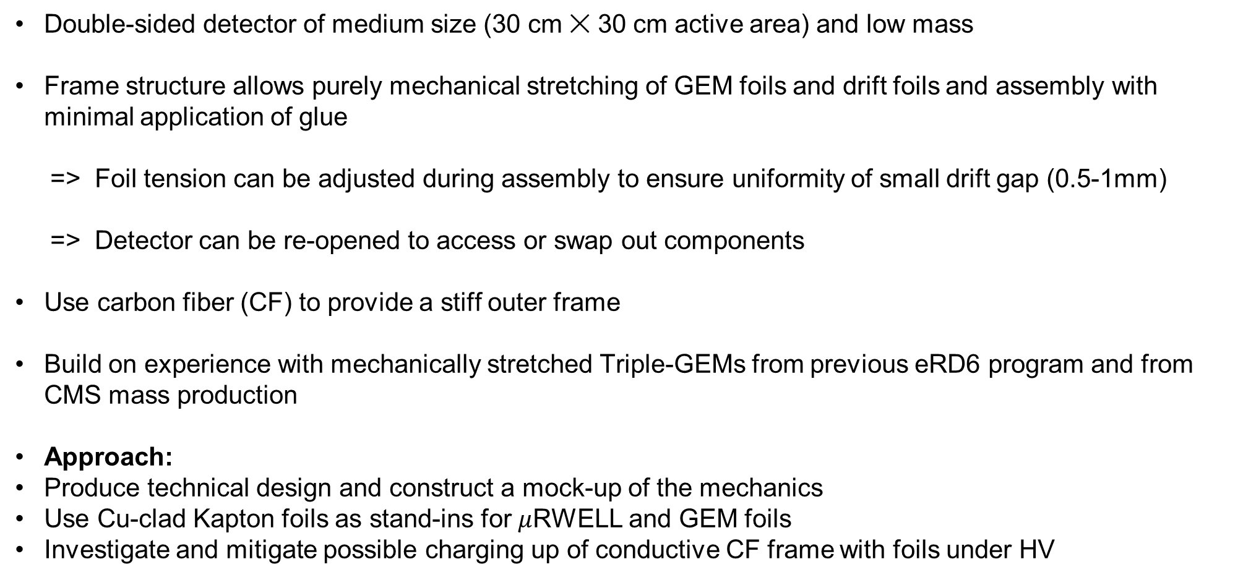
FY23 Proposal:
Mechanically Stretched Double Thin-Gap GEM-µRWELL Hybrid
Double-sided detector of medium size (30 cm ✕ 30 cm active area) and low mass
Frame structure allows purely mechanical stretching of GEM foils and drift foils and assembly with minimal application of glue
=> Foil tension can be adjusted during assembly to ensure uniformity of small drift gap (0.5-1mm)
=> Detector can be re-opened to access or swap out components
Use carbon fiber (CF) to provide a stiff outer frame
Build on experience with mechanically stretched Triple-GEMs from previous eRD6 program and from CMS mass production
Approach:
Produce technical design and construct a mock-up of the mechanics
Use Cu-clad Kapton foils as stand-ins for $μ$RWELL and GEM foils
Investigate and mitigate possible charging up of conductive CF frame with foils under HV

Slide 10
FY23 Proposal:
Mechanically Stretched Double Thin-Gap GEM-µRWELL Hybrid
Conceptual design
30 mm
300 mm
low-mass honeycomb backing
carbon fiber frame
O-ring
0.5 mm
μRWELL 1
0.5 mm
GEM 1
pull-out post
Drift cathode foil 1
stretching screw
15 mm
inner
frame
stack
5 mm
embedded nut
outer frame with O-rings
Drift cathode foil 2
Gas
port
GEM 2
μRWELL 2
Capacitive sharing readout strips
Not to scale !

Slide 11
FY23 Proposal – UVa & Vanderbilt

Slide 12
FY23 Proposal – Jefferson Lab

Slide 13
FY23 Proposal: Budget Request

Slide 14
Back up

