Slide 1
EICGENR&D2023_16: Development of Double-Sided Thin-Gap GEM-μRWELL for Tracking at the EIC
FY22 Progress Report & FY23 Proposal
EIC GENERIC R&D REVIEW MEETING
Kondo Gnanvo on behalf of Thin Gap MPGD Consortium
October 31, 2023

Slide 2
Outline

Slide 3
FY23 Progress Report

Slide 4
FY22 Progress Report – UVa

Slide 5
FY22 Progress Report – JLab

Slide 6
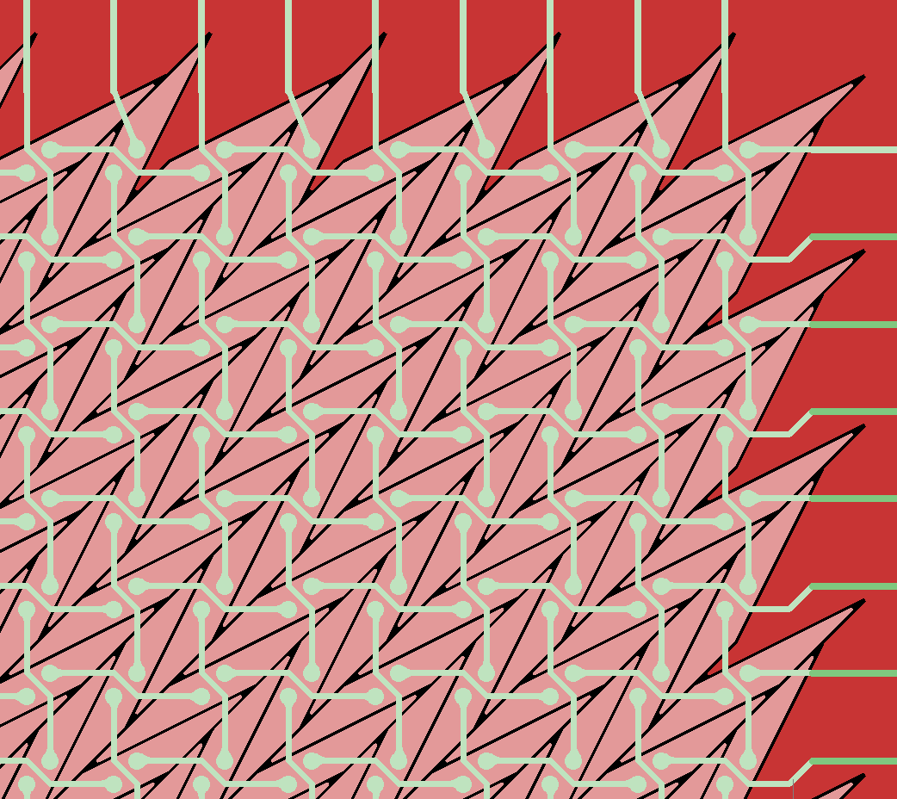
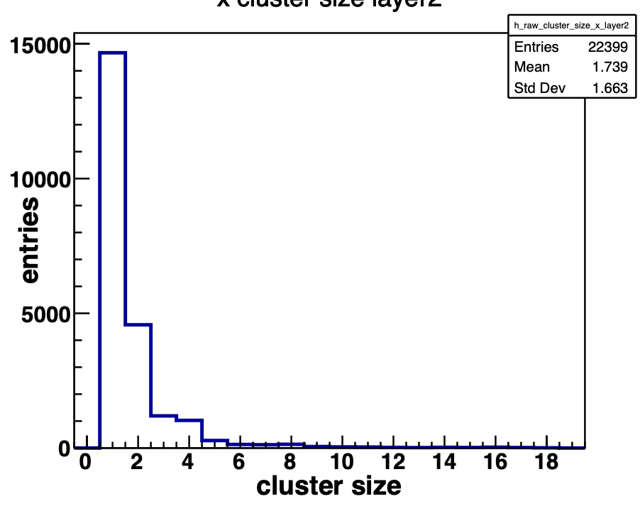
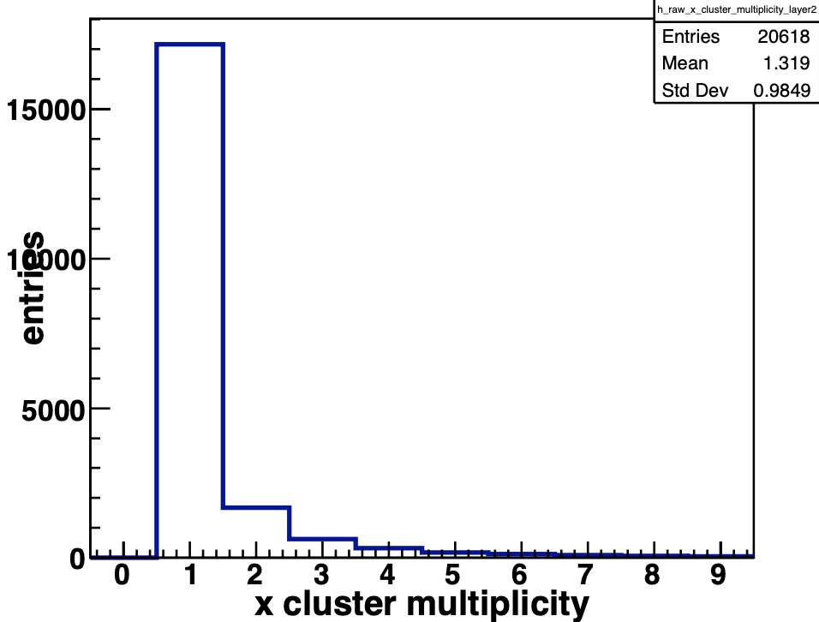
FY22 Progress Report - VU
Type of Prototypes | Specifications | Data taken (Fermilab test beam)
GEM +MMG | Active area = 10 cm x10 cm Drift gap = 1 mm Transfer gap = 1 mmm 2D chevron R/O with 1.6 mm pitch | ArCO2 gas (HV scan + track angle scan) KrCO2 gas (HV scan + track angle scan)
GEM + 𝜇Rwell | Active area = 10 cm x10 cm Drift gap = 1 mm Transfer gap = 0.5 mm 2D chevron R/O with 1.6 mm pitch | ArCO2 gas (HV scan + track angle scan) KrCO2 gas (HV scan + track angle scan)
𝜇Rwell | Active area = 10 cm x10 cm Drift gap = 1 mm 2D chevron R/O with 1.6 mm pitch | No data taken
          Only single strips are getting fired most of the time
          Challenging to decipher hot channel with real hit
          Ongoing analysis

Slide 7
FY22 Progress Report - VU

Slide 8
FY22 Progress Report – Yale U.

Slide 9
FY23 Proposal

Slide 10
FY23 Proposal - Florida Tech

Slide 11
FY23 Proposal – UVa & Vanderbilt

Slide 12
FY23 Proposal – Jefferson Lab

Slide 13
FY23 Proposal: Budget Request

Slide 14
Back up

