Slide 1
Introduction to DAMSA Experiment
HEP Seminar, BNL
March 21, 2024
Jaehoon Yu
Univ. of Texas, Arlington

Slide 2
What is DAMSA?
A very short baseline dark sector particle (DSP) search and discovery experiment at high intensity p beams
Stands for Dump produced Aboriginal Matter Search at an Accelerator (DAMSA)
  담사 (潭思) = 깊은생각 – Rumination or Reflection
    J. Yu et al., PRD 107, L031901 (2023)
Aims to discover DSP’s in the low mass regime at an accelerator ➔ E_{beam} below the pion threshold beneficial
  Originally developed for 600MeV proton beams at a nuclear rare isotope facility
  The 800MeV PIP-II and the ACE beams at Fermilab fit the bill
DAMSA can be at any accl. facility, including CERN

Slide 3
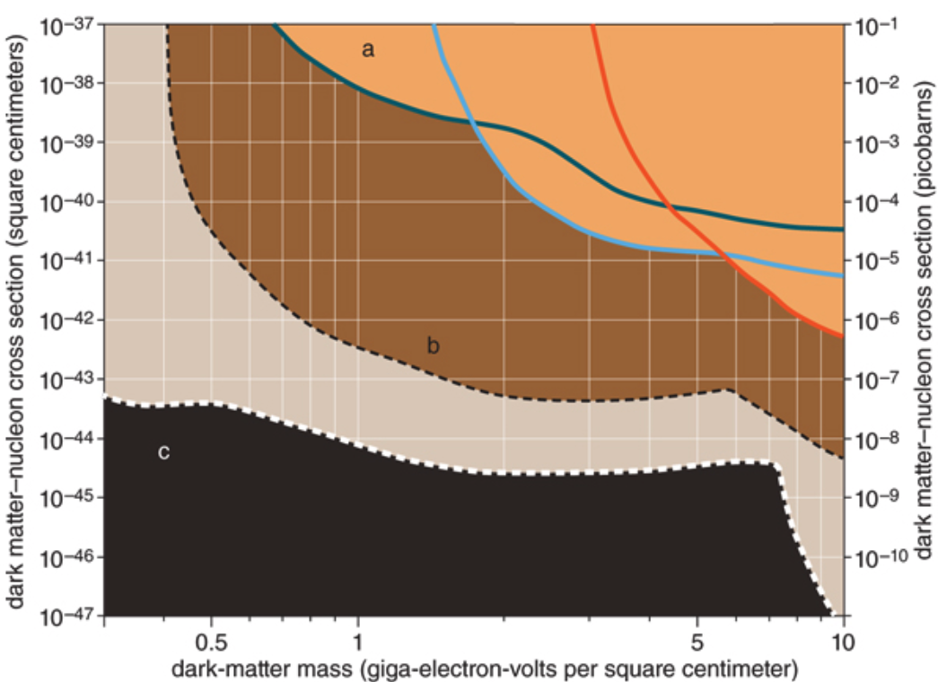
Physics Motivation For DSP
Direct searches have challenges in kinematic reach, leaving low mass range un-explored
Strategy:
  Search for dark sector particles in unexplored kinematic regime
  Make and discover DSPs in an accelerator
  Establish human infra on DM production & US leadership
No DM
Focus
here
Future: SuperCDMS SNOLAB
Solar Neutrino Background

Slide 4
Unique Opportunity on Dark Sector
Many DM search experiments in beams BUT
None of them at a super-short baseline (~1m)!
  Yes, it presents a huge challenge
This makes DAMSA unique!
Beam dump facility should be designed to take advantage of this uniqueness.
It is a small-size experiment with good physics case, an excellent opportunity to enhance the international collaborative research

Slide 5
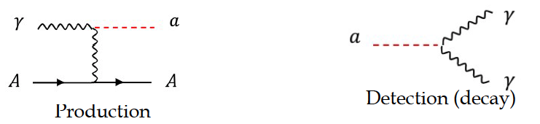
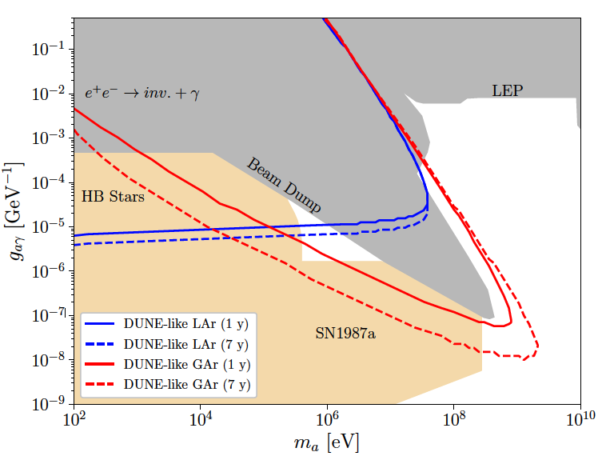
DAMSA Physics Strategy
Photons are the sources for dark sector particle production
  Use case: Search for Axion-like particles (ALP) in two-photon final state via the Primakoff process
What is the most peculiar feature of the DUNE sensitivity reach?
This edge limited (ceiling) by the distance from the source to the detector
D.Kim, Yu, et. al,
arxiv:2401.09529
  Brdar, Yu et al., PRL126, 201801 (2021)

Slide 6
DAMSA Physics Strategy
Photons are sources for dark sector particle production
  Use case: Search for Axion-like particles (ALP) in two-photon final state via the Primakoff process
Produce as many photons as possible in the dump
Capture as many ALPs as possible in as wide a mass range as possible
Mitigate the backgrounds from neutral particles, leveraging two EM particle final states
Place the detector very close to the beam
Note : ND-GAr only in DUNE Phase-II
Focus here
  Brdar, Yu et al., PRL126, 201801 (2021)

Slide 7
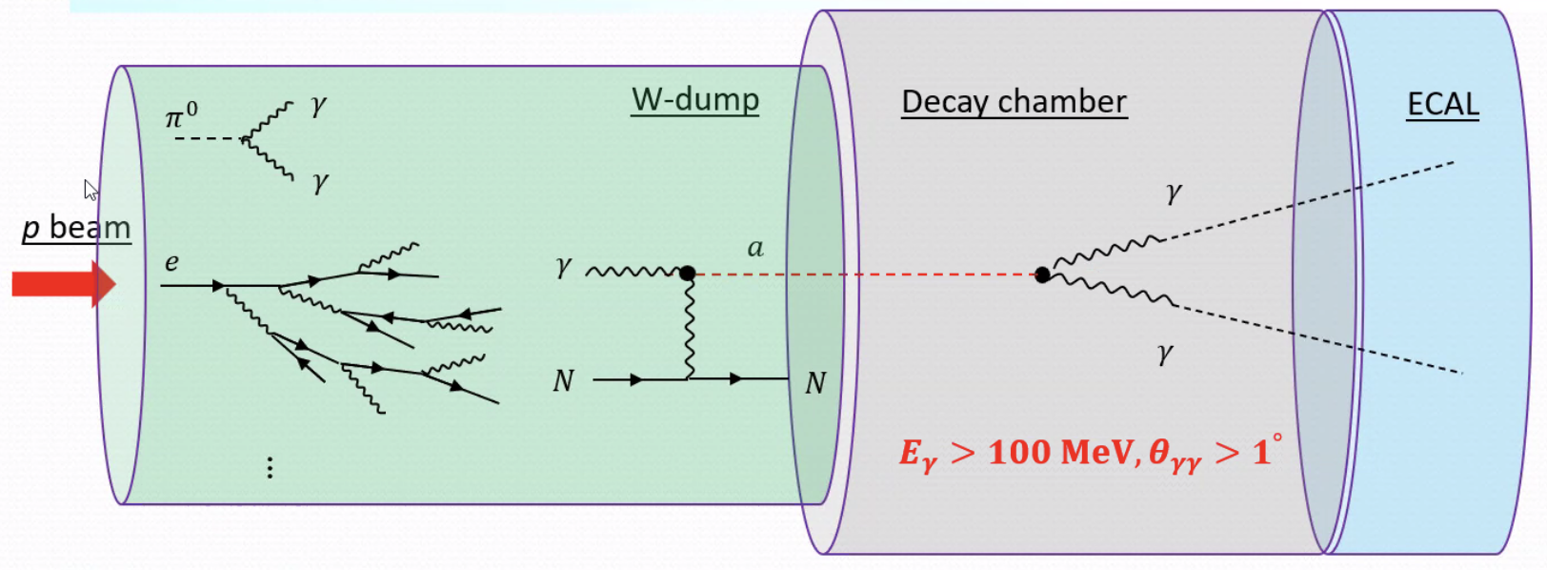
DAMSA Exp. Concept
Inject and absorb as many protons and produce as large number of γ in the dump as possible
Allow higher coupling ALP’s to decay in the vacuum w/ as small number of neutrons escaping the dump as possible
Place the detector as close to the dump as possible on axis to expand the mass reach to higher mass region

Slide 8





The three key elements
The bad
The ugly
The good
The beam
The dump
The detector

Slide 9
Accelerator Complex in the PIP-II Era
PIP-II (Proton Improvement Plan – II) provides
  New SRF LINAC for injection into Booster at 800MeV
  Booster cycle rates upgrade for increased proton beam intensity at 8GeV for 1.2MW beam power from main injector
PIP-II LINAC is the essential first element for DUNE
  Total proton current of 2mA ➔up to ~4x10²³ PoT/yr
  1 – 2% used for dnstream
PIP-II era begins in 2029, DUNE 2031
  Mu2e (8GeV)
  Fixed target, test beams (120 GeV)
  0.8 GeV beam available for other exp, such as beam dump experiments like DAMSA
TeV Field
B. Flauger

Slide 10
Physics Driven DAMSA Detector
Discover dark sector particles beyond ALP, such as
  Dark photon / ALP to e+e-
  Low mass dark matter, etc
Based on the signal and neutron background mitigation studies, using GEANT4 ➔ Detector assumptions
  Fine granularity for a superb shower position and angular resolutions for 2 EM particle vertex pointing & DCA precision better than 1cm in the vacuum decay volume
  Fast timing capability at sub-ns level (100ps or better) for two photon arrival time differences
  Capability of measuring up to 500 MeV photons with as fine a mass resolution as accomplishable

Slide 11
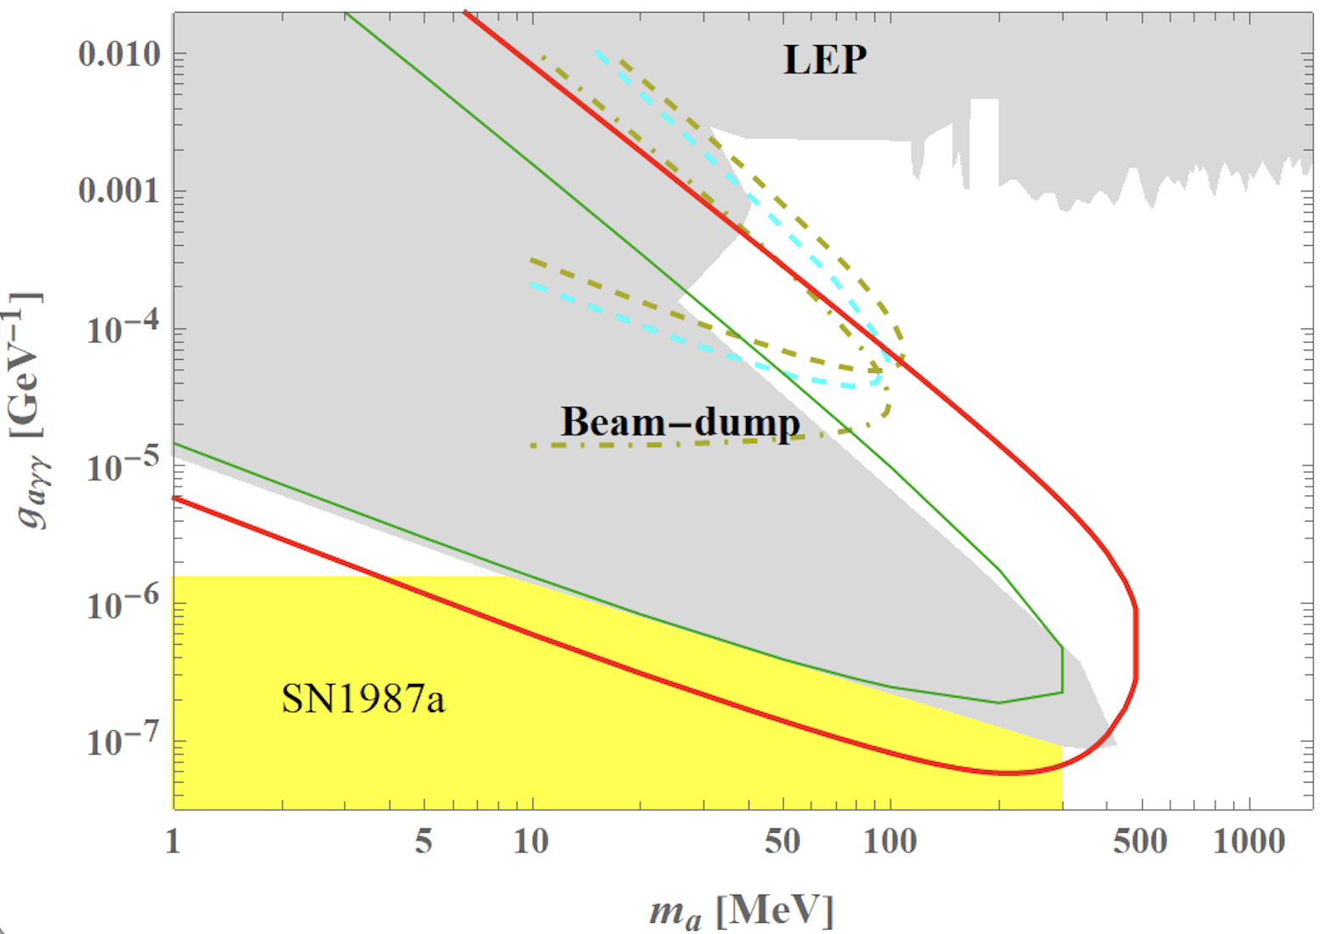
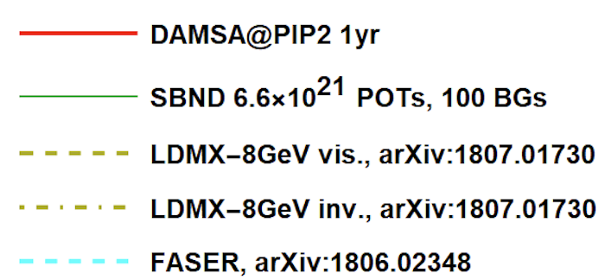
DAMSA Sensitivity – Running Experiments
Year 2031
Short lived! ➔ Capture decay products b4 det.
DAMSA Strength
Long lived! ➔ Capture decays in the detector

Slide 12
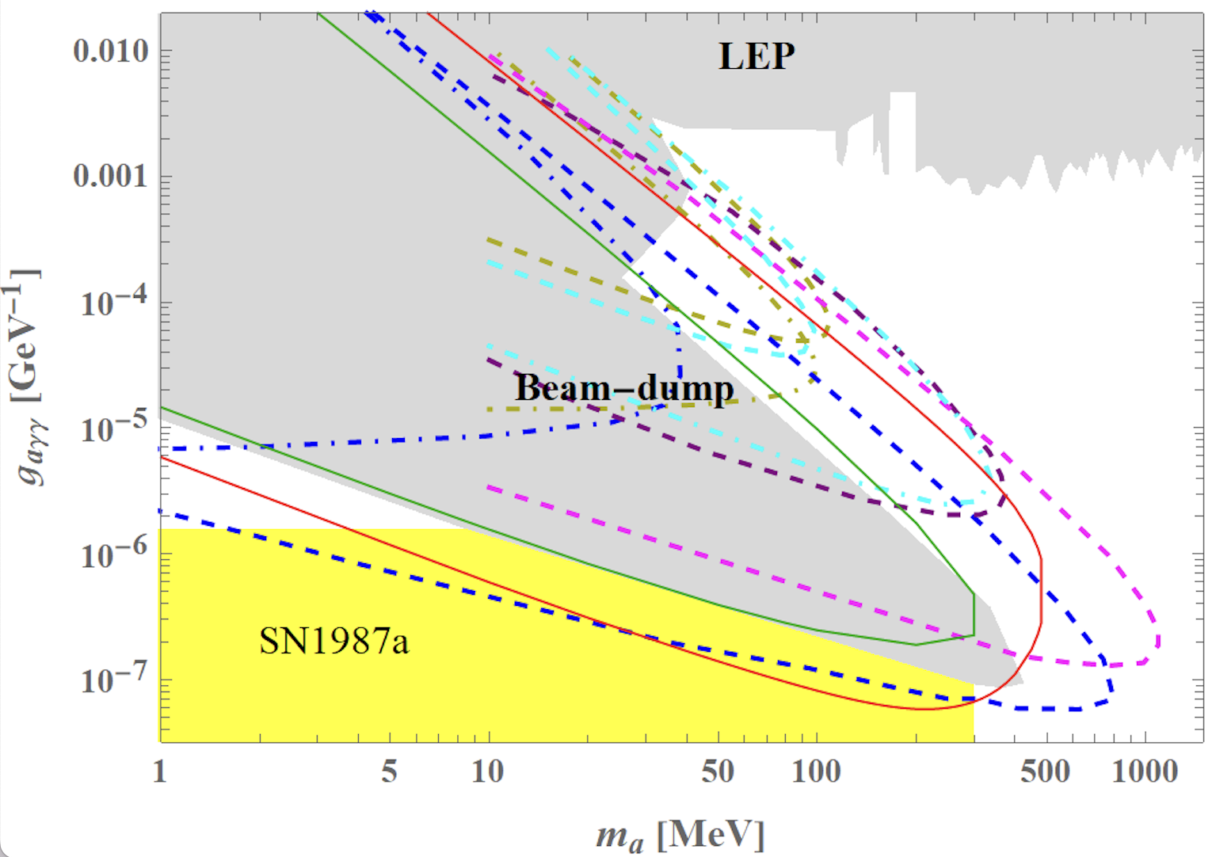
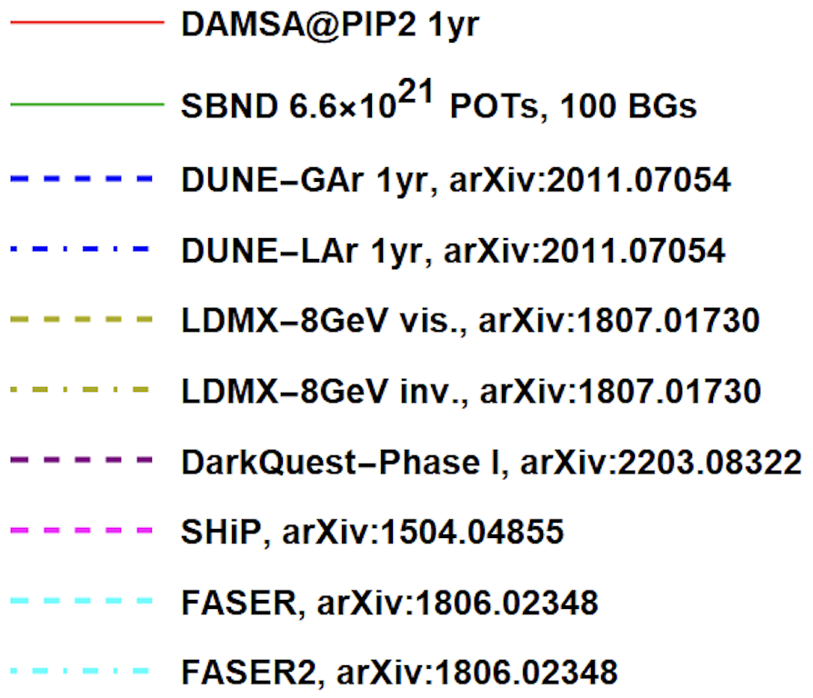
DAMSA Sensitivity – All Experiments

Slide 13
Detector Design Concept
2DST W-Scint
ECAL (~13 X₀)
Tail catcher
ECAL (~5 X₀)
Vacuum Decay Chamber
HD HG-ECAL - γ converter
(4 low X₀ layers ~3X₀)
6 layers of Si trk
Magnet

Slide 14
Where is the DAMSA experiment?
DAMSA has been introduced to the community throughout the past 2.5 years, more intensely in 2023
  Concept included in a few Snowmass2021 white papers
  Physics case study published on PRD107, L031901 (2023)
  Multiple presentations made at conferences, workshops and seminars in the U.S., SK and CERN in 2023
    Presented at a couple of P5 townhall meetings
  Met w/ Fermilab directorate in April, May, Aug, Sept. 2023 and Jan. 2024
DAMSA collaboration building ongoing but at a critical point
  Lead Investigators: J. Yu (UTA), J. Estrada (FNAL), UK Yang (SNU)
    10 US + 10 SK institutions on DAMSA
  Facility and experiment need to be defined
DAMSA can be a network of experiments at different facilities

Slide 15
The Little DAMSA
The question: Can we access the targeted parameter space with a dramatically smaller scale experiment (2401.09529)?
  Default: L_{dist}=1m, L_{vac}=10m, θ_{det}=0.5rad, N_{yr}=1yr
  Smaller scale: L_{dist}=1m, L_{vac}=1m, θ_{det}=0.05rad, N_{yr}=3mo

Slide 16
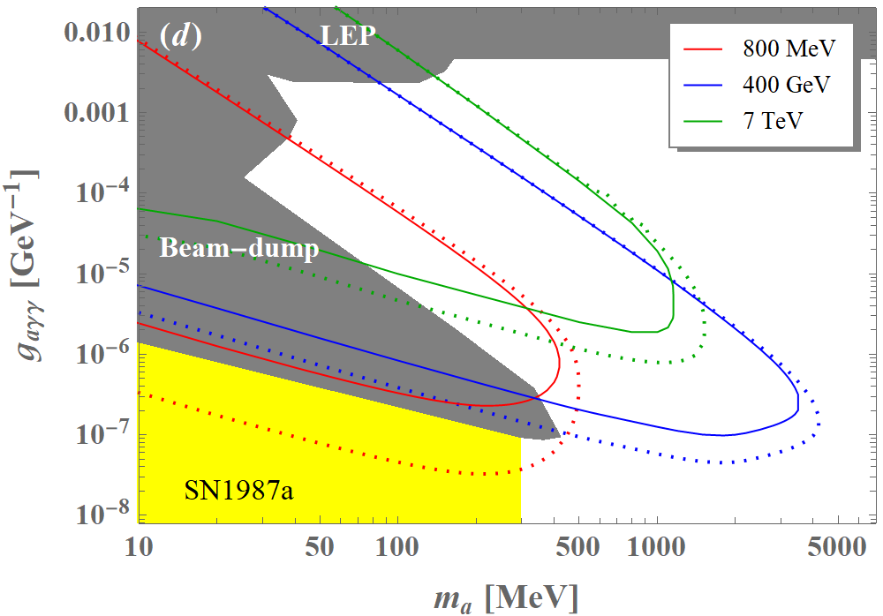
Small Scale DAMSA Sensitivity
Solid lines w/
Smaller dimensions
3mo data taking
D.Kim, Yu, et. al,
arxiv:2401.09529

Slide 17

The Little DAMSA That Could!
The question: Can we access the targeted parameter space with a dramatically smaller scale experiment (2401.09529)?
Further studied the combinations of the following cases
  Reduce the detector radius to 0.1m from 1.1m
  Reduce the vacuum chamber radius and length to 0.1m from 1m
  Reduce the W dump length to 0.5m (case 1) & 0.25m (case 2)
W Dump
L=0.5/0.25m
R=0.5m
Vacuum
L=0.1m,
R=0.1m
Proton
Detector
R=0.1m

Slide 18
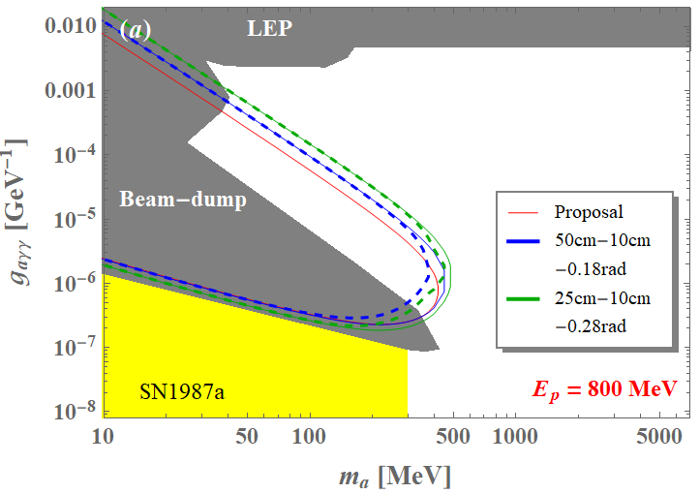
The Little DAMSA Sensitivity
3mo data taking
1m-1m-0.05rad

Slide 19
Why Pilot DAMSA?
Given the results of the Little DAMSA sensitivity study, it is possible for us to think about very small pilot detector
Primary issues to demonstrate
  Physics case feasibility
  Background handling
  Necessity for beam dump facility
Strategy for pilot
  Find a pathway to focus on physics case feasibility
    Need a facility that has as little neutron background from the dump as possible
  Focus on the fast-decaying particles with high coupling

Slide 20
The Little DAMSA Pilot Experiment!
Goal: Mount and complete a physics demonstrator in the next 2 yrs
Beam: electron 300MeV @ FAST@Fermilab ➔ greatly reduced neutron backgrounds, compared to proton beams
Target: 5cmx5cmx10cm W block (~28.5X₀)
Vacuum decay chamber : 10cm (r) x 30cm (L)
Detector: 6x10cmx10cm Si tracker + 12cmx12cmx44cm (24.5X₀) CsI ECal w/ each 1cm thick layer made of 12 – 1cmx1cmx12cm bars cut out from the existing 5cmx5cmx50cm crystals, each read out by 2 SiPM’s attached either end; two neighboring layers arranged perpendicular to each other
e
W
Detector array
Si trk: 0.1x0.1 m²
ECAL: 0.12x0.12x 0.44 m³
Vacuum
R=0.1m, L=0.3m

Slide 21
The DAMSA Pilot – the Experiment
Tungsten target, eliminating the need for a large dump
  Will we need cooling?
  Depends on the power of the electron beams needed
Vacuum cylinder: 10cm (r) x30cm (L)
  Are they any that is already in this size to borrow?
6 layers of 10cmx10cm Si tracker
A magnet of small aperture, short length
CsI ECAL: 12 – 1cmx1cmx12 cm bars per layer in 44 layers (23.8X₀)
  Can get ~80 small bars from one U.C. bar of 5x5x50cm³
    Total number of small bars needed: 528 ➔ 7 UC bars do the job
  Total number of SiPM’s needed: 12*2*44=1,056 SiPM’s
  Readout electronics?

Slide 22
Efforts on Little DAMSA Pilot – Experiment
Tungsten target:
  UMD has a 50cmx50cmx3mm W sheet
  Can we cut these to 5cmx5cmx3mm plate and organize them to 10cm length?
Si Tracker
  Can we have 6 layers of CMS – LGAD? SK colleagues?
Crystal ECAL
  UC (Wah) willing to provide up to 16 – 5x5x50cm³ undoped CsI crystal bars and test the small bars cut out, need SiPM
  ORNL colleagues willing to help with the initial crystal cutting for feasibility studies and identifying a company which can cut, polish and reflector wrap
  BNL’s help on this would be greatly appreciated!

Slide 23
Little DAMSA – Proposed Plan
Stage zero ➔ e-beam background demonstrator
  Measure the neutron and photon bck counts @e-beam
Stage one ➔ The a2γ demonstrator @ e-beam
  Build a demonstrator with only W target, vacuum decay chamber and CsI Ecal
  Publish the result, clearly showing the physics reach
Stage two ➔ The a2e demonstrator @ e-beam
  Upgrade the demonstrator with Si tracker and magnet
  Demonstrate the expanded physics coverage
Stage three ➔ The neutron bck demonstrator @ p-beams
  Move the demonstrator to a low power proton beams
  Demonstrate neutron background handling
Stage four ➔ The full scale @ p-beams
  Move the demonstrator to available proton beam facilities
  Perform search and discovery

Slide 24
DAMSA @ PIP-II Timeline
Project establish, Det. Design, Demo & prototyping
Experiment Construction
Experiment
Design studies, CDR & TDR, Tech. Publications
Sim, analysis, recon. software development,
Tech. publications
Commissioning & Data taking
Facility Design
Data analysis & Tech & Phys. publications
Facility Construction
Facility
Fermilab TF announced @ the PAC
Facility Commissioning
Seed Funds for design and prototyping
Construction
funds
Operations
funds
Yr 0 2024
Yr 1 2025
Yr 2 2026
Yr 3 2027
Yr 4 2028
Yr 5 2029
Yr 6 2030
Yr 7 2031

Slide 25
Potential Fermilab Experimental Facility
Proposed Name: F2D2
  Fermilab Facility for Dark matter Discovery
  Sited on part of the Tevatron field, out of any ACE plan
Requirements
  Basic assumption : multiple experiments operate simultaneously, mixture of on and off-axis
  Sufficient footprint per experiment
  Sufficient height of the hall w/ a large capacity crane coverage
  Sufficient overburden (>=40.m.w.e.)

Slide 26
Conclusions
DAMSA is a DSP search and discovery experiment
DAMSA has been making serious and steady progress
  Aim to be ready for PIP-II LINAC beam in 2029
  Perfect fit to ASTAE program in the recently released P5 report
  Planning on a series of demonstrators at a low E e-beam

Slide 27
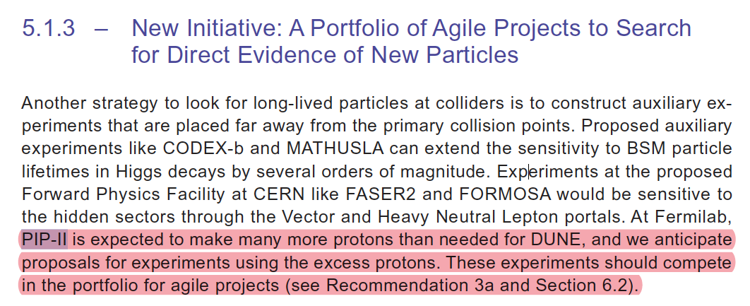
From the P5 Report – 1
Explicit recommendations on leveraging PIP-II LINAC and support for ASTAE program

Slide 28
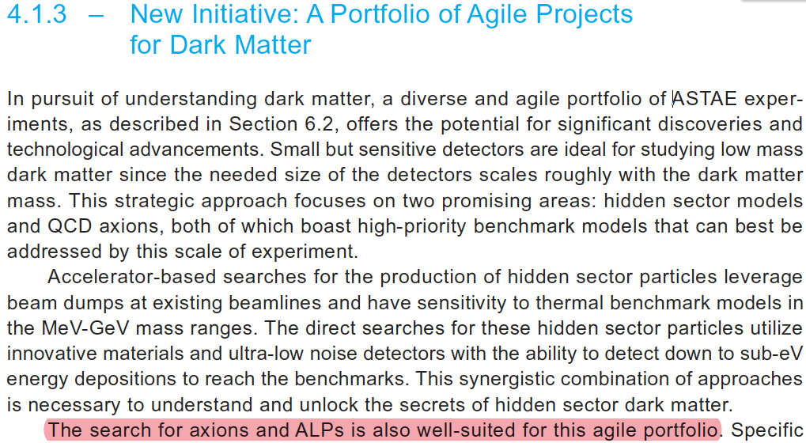
From the P5 Report – 2
Search for ALP well-suited for agile portfolio

Slide 29
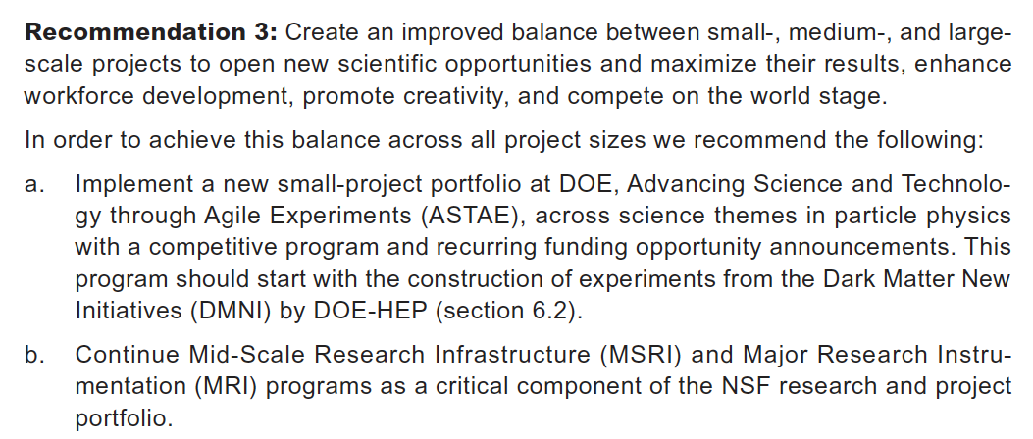
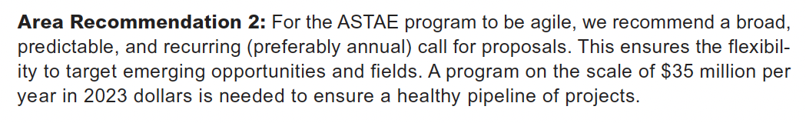
From the P5 Report – 3
ASTAE – Advancing Science and Technology through Agile Experiments – A portfolio of small-scale DOE experiments and funding
  Definition of Agile: timeline of 5 years and cost $5M – $25M

Slide 30
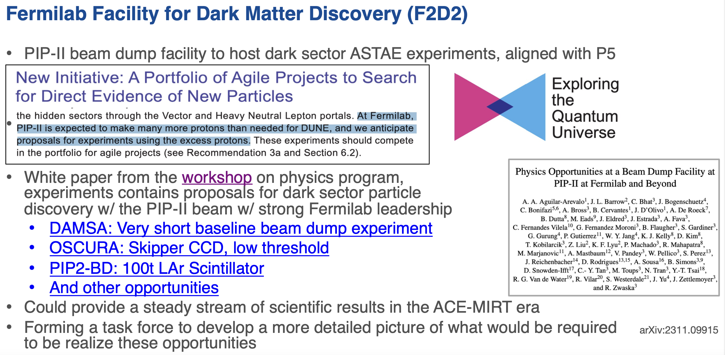
K. Buckett, PPD head
Fermilab PAC, 1/9/24

Slide 31
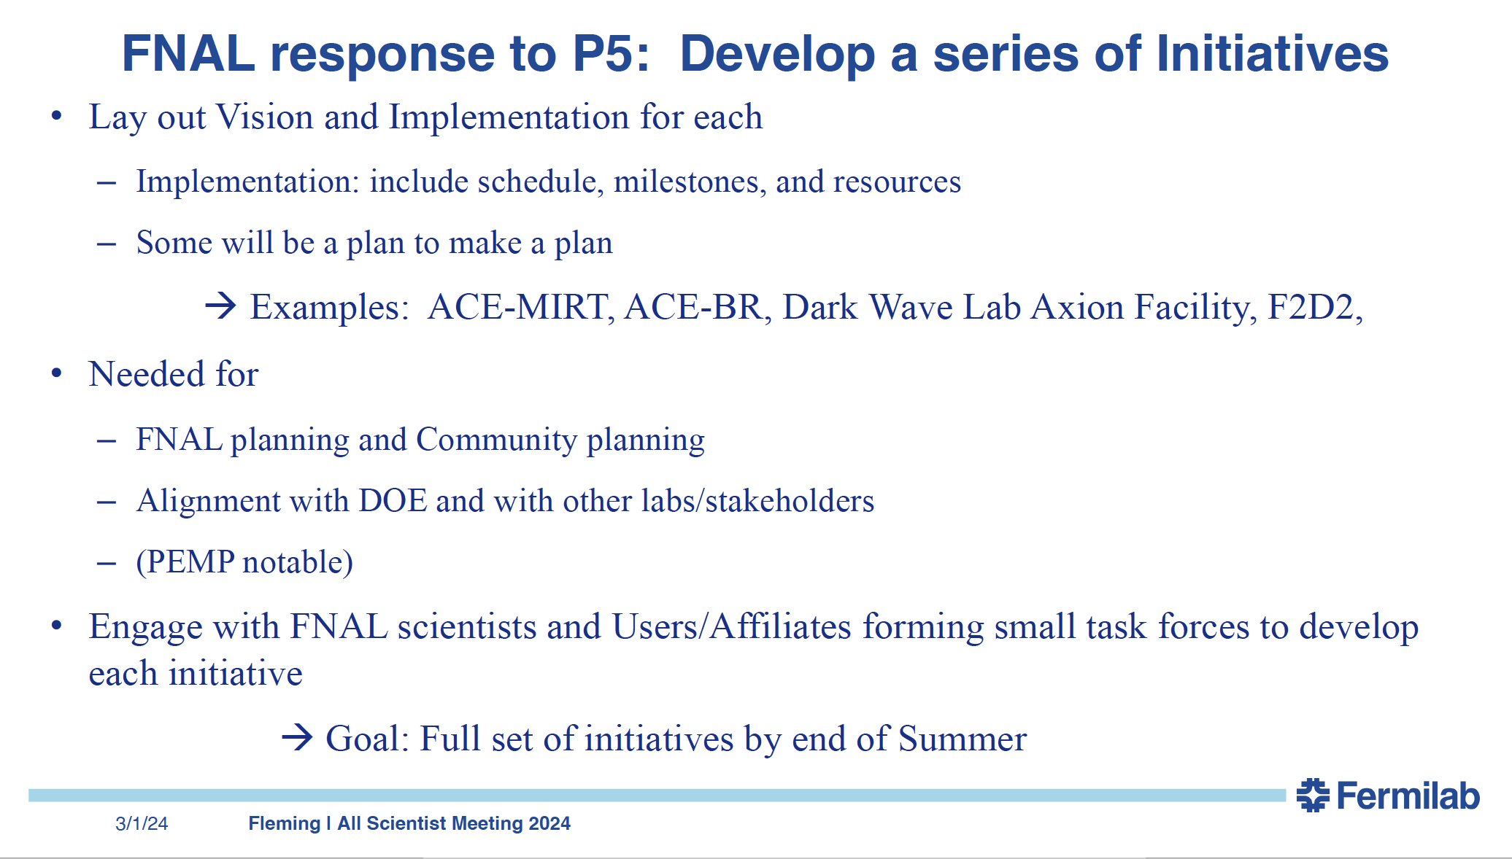
Fleming, CRO Fermilab ASC, 3/1/24
Performance Evaluation and Management Plan

Slide 32
Conclusions
DAMSA is a DSP search and discovery experiment
DAMSA has been making serious and steady progress
  Aim to be ready even for PIP-II LINAC beam in 2029
  Perfect fit to ASTAE program in the recently released P5 report
  Planning on a series of demonstrators at a low E e-beam
Collaboration building ongoing but still has room!
Fermilab forming a TF to define the facility
  Whitepaper released to the archive on PIP-II Beam Dump physics opportunities (2311.09915)
Demonstrator experiment is being developed
DAMSA presents an excellent opportunity for U.S. to take the leadership in DSP production and discovery at beams

