Slide 1
Extended EBIS (EEBIS) Commissioning & Status
E. Beebe
April 29-30, 2024
NACB 2024

Slide 2
Polarized ³He²⁺ source development is made in a collaboration between BNL and MIT
E. Beebe¹, G. Atoian¹, B. Coe¹, S. Ikeda¹, T. Kanesue¹, S. Kondrashev¹, R. Milner², M. Musgrave², M. Okamura¹, D. Raparia¹, T. Rodowicz¹, J. Ritter¹, B. Schoepfer¹,S. Trabocchi¹, A. Zelenski¹
¹Brookhaven National Laboratory, Upton, NY 11973, USA
²MIT, Cambridge, MA, USA

Slide 3
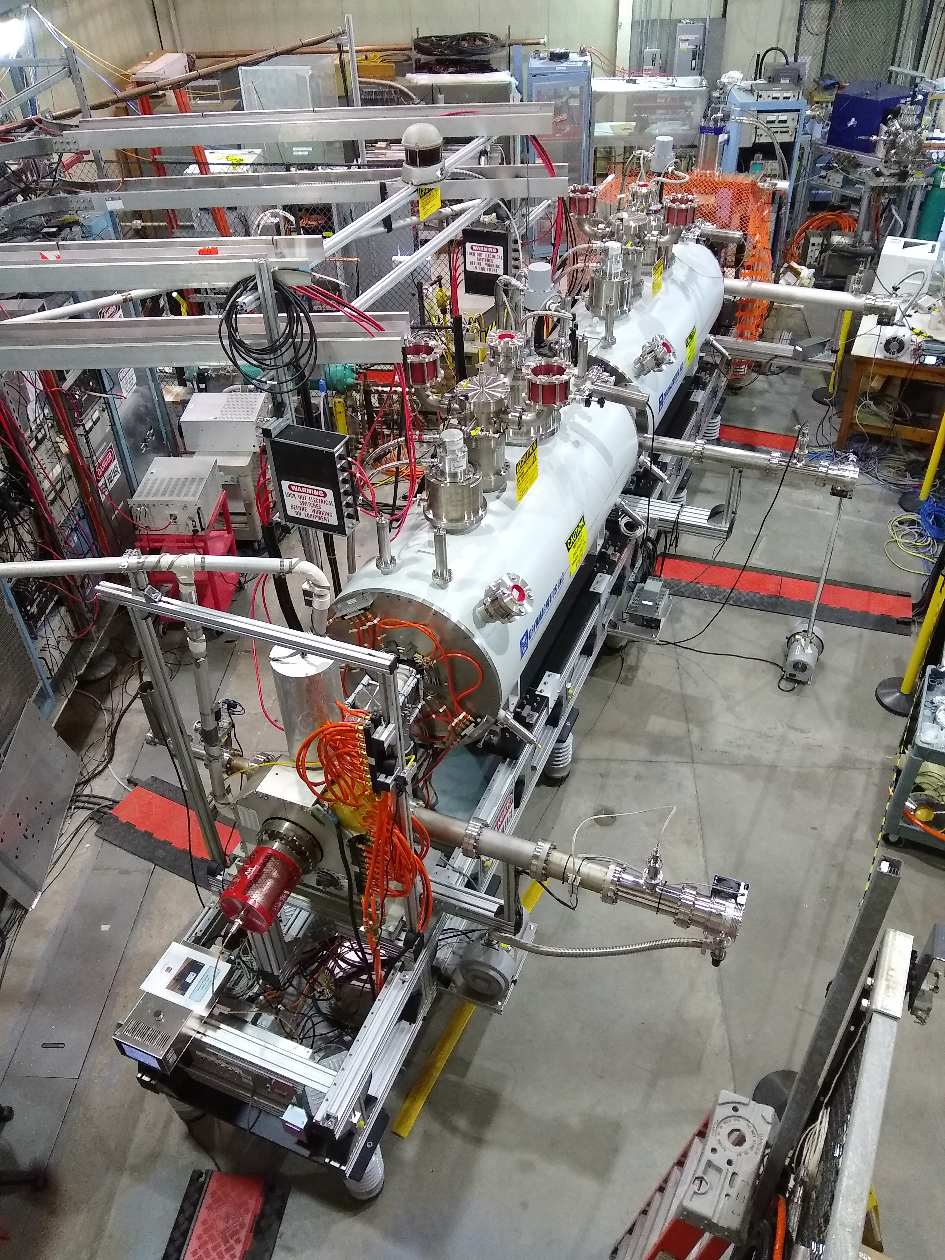
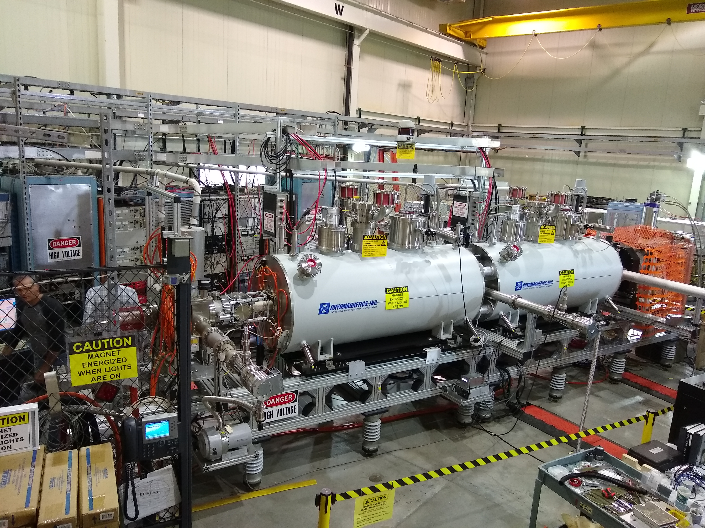
Extended EBIS during development in the EBIS test Lab

Slide 4
Extended EBIS Component Development and Operation in the Test Lab

Slide 5
The Extended EBIS Three trap System: (gas injection trap, short trap, long trap)
Two identical unshielded 5T superconducting solenoids are used for “Extended” EBIS
The upstream solenoid contains the new features for the efficient gas injection and eventual polarized 3He ion production:
gas injection / ionization cell at pressures up to 5x10⁻⁶ mb (2cm diameter, 40cm long)
“External drift tube” construction with differential pumping stages and custom pump out manifold to provide space for gas reservoir / high field polarization cell
An innovative pulsed valve operating on the Lorentz force mounted to the gas ionization cell drift tube via a compact insulator
Future installation: High field 3He polarization cell and purification system (tested in a separate solenoid)
The upstream solenoid also contains the “short trap”, a 95 cm long ionization region to provide additional intensity of highly charged ions over the single solenoid RhicEBIS system.
The downstream solenoid contains the “long trap”, a 178 cm long ionization region with good vacuum separation from the upstream module and electron collector.

Slide 6
Expected Extended EBIS intensities based on RhicEBIS performance
The extended EBIS uses the same electron beam launching and collection system system as RhicEBIS. The upgrade to provide (polarized) ³He²⁺ ions to RHIC and the future EIC results in increased intensities for other ion species:
Higher intensity of light ions can be produced from light gases using a highly efficient gas injection system rather than current RhicEBIS ion injection method.
Ion intensities of externally injected heavy ions benefit from the additional trap capacity provided by the short trap in the first solenoid.
Intensity Estimates for EBIS upgrade (at Extended EBIS exit)
He²⁺ ~ 2.5 - 5 x 10¹¹ ions/pulse
H⁺ ~5 – 10 x 10¹¹ ions/ pulse
Au³²⁺ ~2.6x10⁹ ions/pulse (1.4-1.5 times the RhicEBIS output)

Slide 7
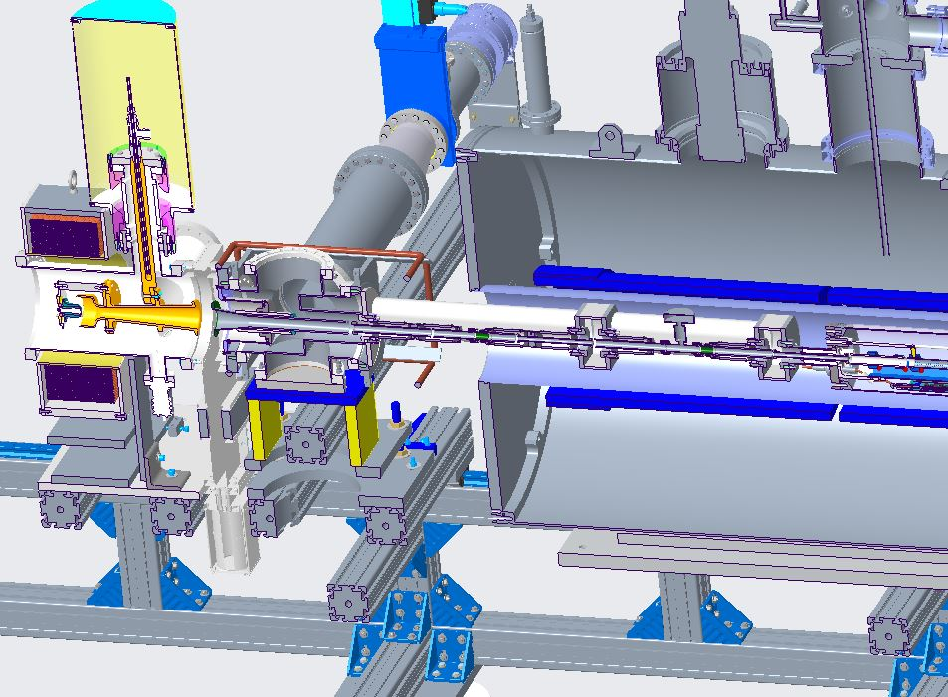
Gas Cell with pump out manifold and external drift tube connections

Slide 8
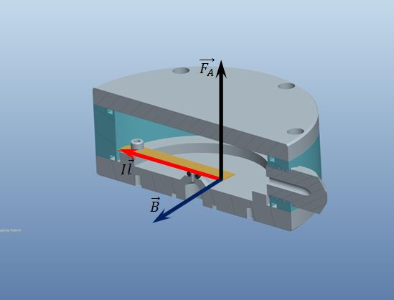
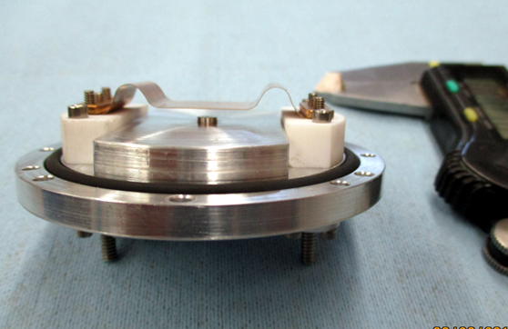
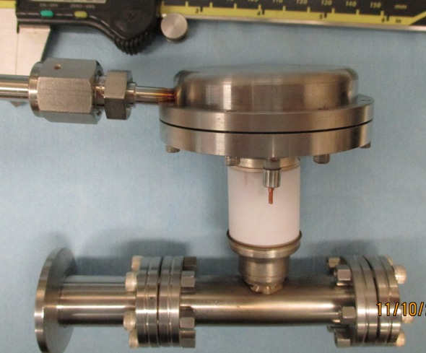
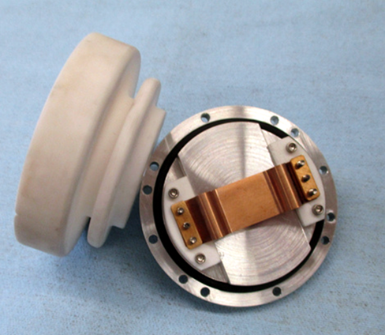
Fast Pulsing Gas Valve
“Electro-magnetic”, [IxB] valve operation principle
Lorentz (Laplace) force moves the flexible conducting plate in the high (~ 3-5 T) magnetic field.
For I=10 A, L=5 cm, F=2.5 N. Current pulse duration ~100-500 us
F
I
B
Pulsed valve for
Un-polarized gas
Injection to the EBIS

Slide 9
Extended EBIS Features
High-capacity NEGs + Turbo Pumping:
Provide high pumping speed where needed. Pulsed Hydrogen pumping speed measurement system developed to monitor NEG status.
Alignment during EBIS electron beam propagation:
HV cage is partitioned and HV connections are protected such that EBIS experts can enter the HV cage for initial mechanical magnetic alignment
New Electron Gun Cathode:
3M lower temperature oxide cathodes. improved reliability and lifetime, improved beam quality, domestically available, important for BNL and our other colleagues at ANL and FRIB
New Solid State Electron Collector Supply:
(Arrived too late for installation)
Expect less down time with faster reset time, collector voltage can be varied during a single species beam time as well as optimized for each species (future installation date to be decided).

Slide 10
Extended EBIS Installation at the Accelerator Location

Slide 11
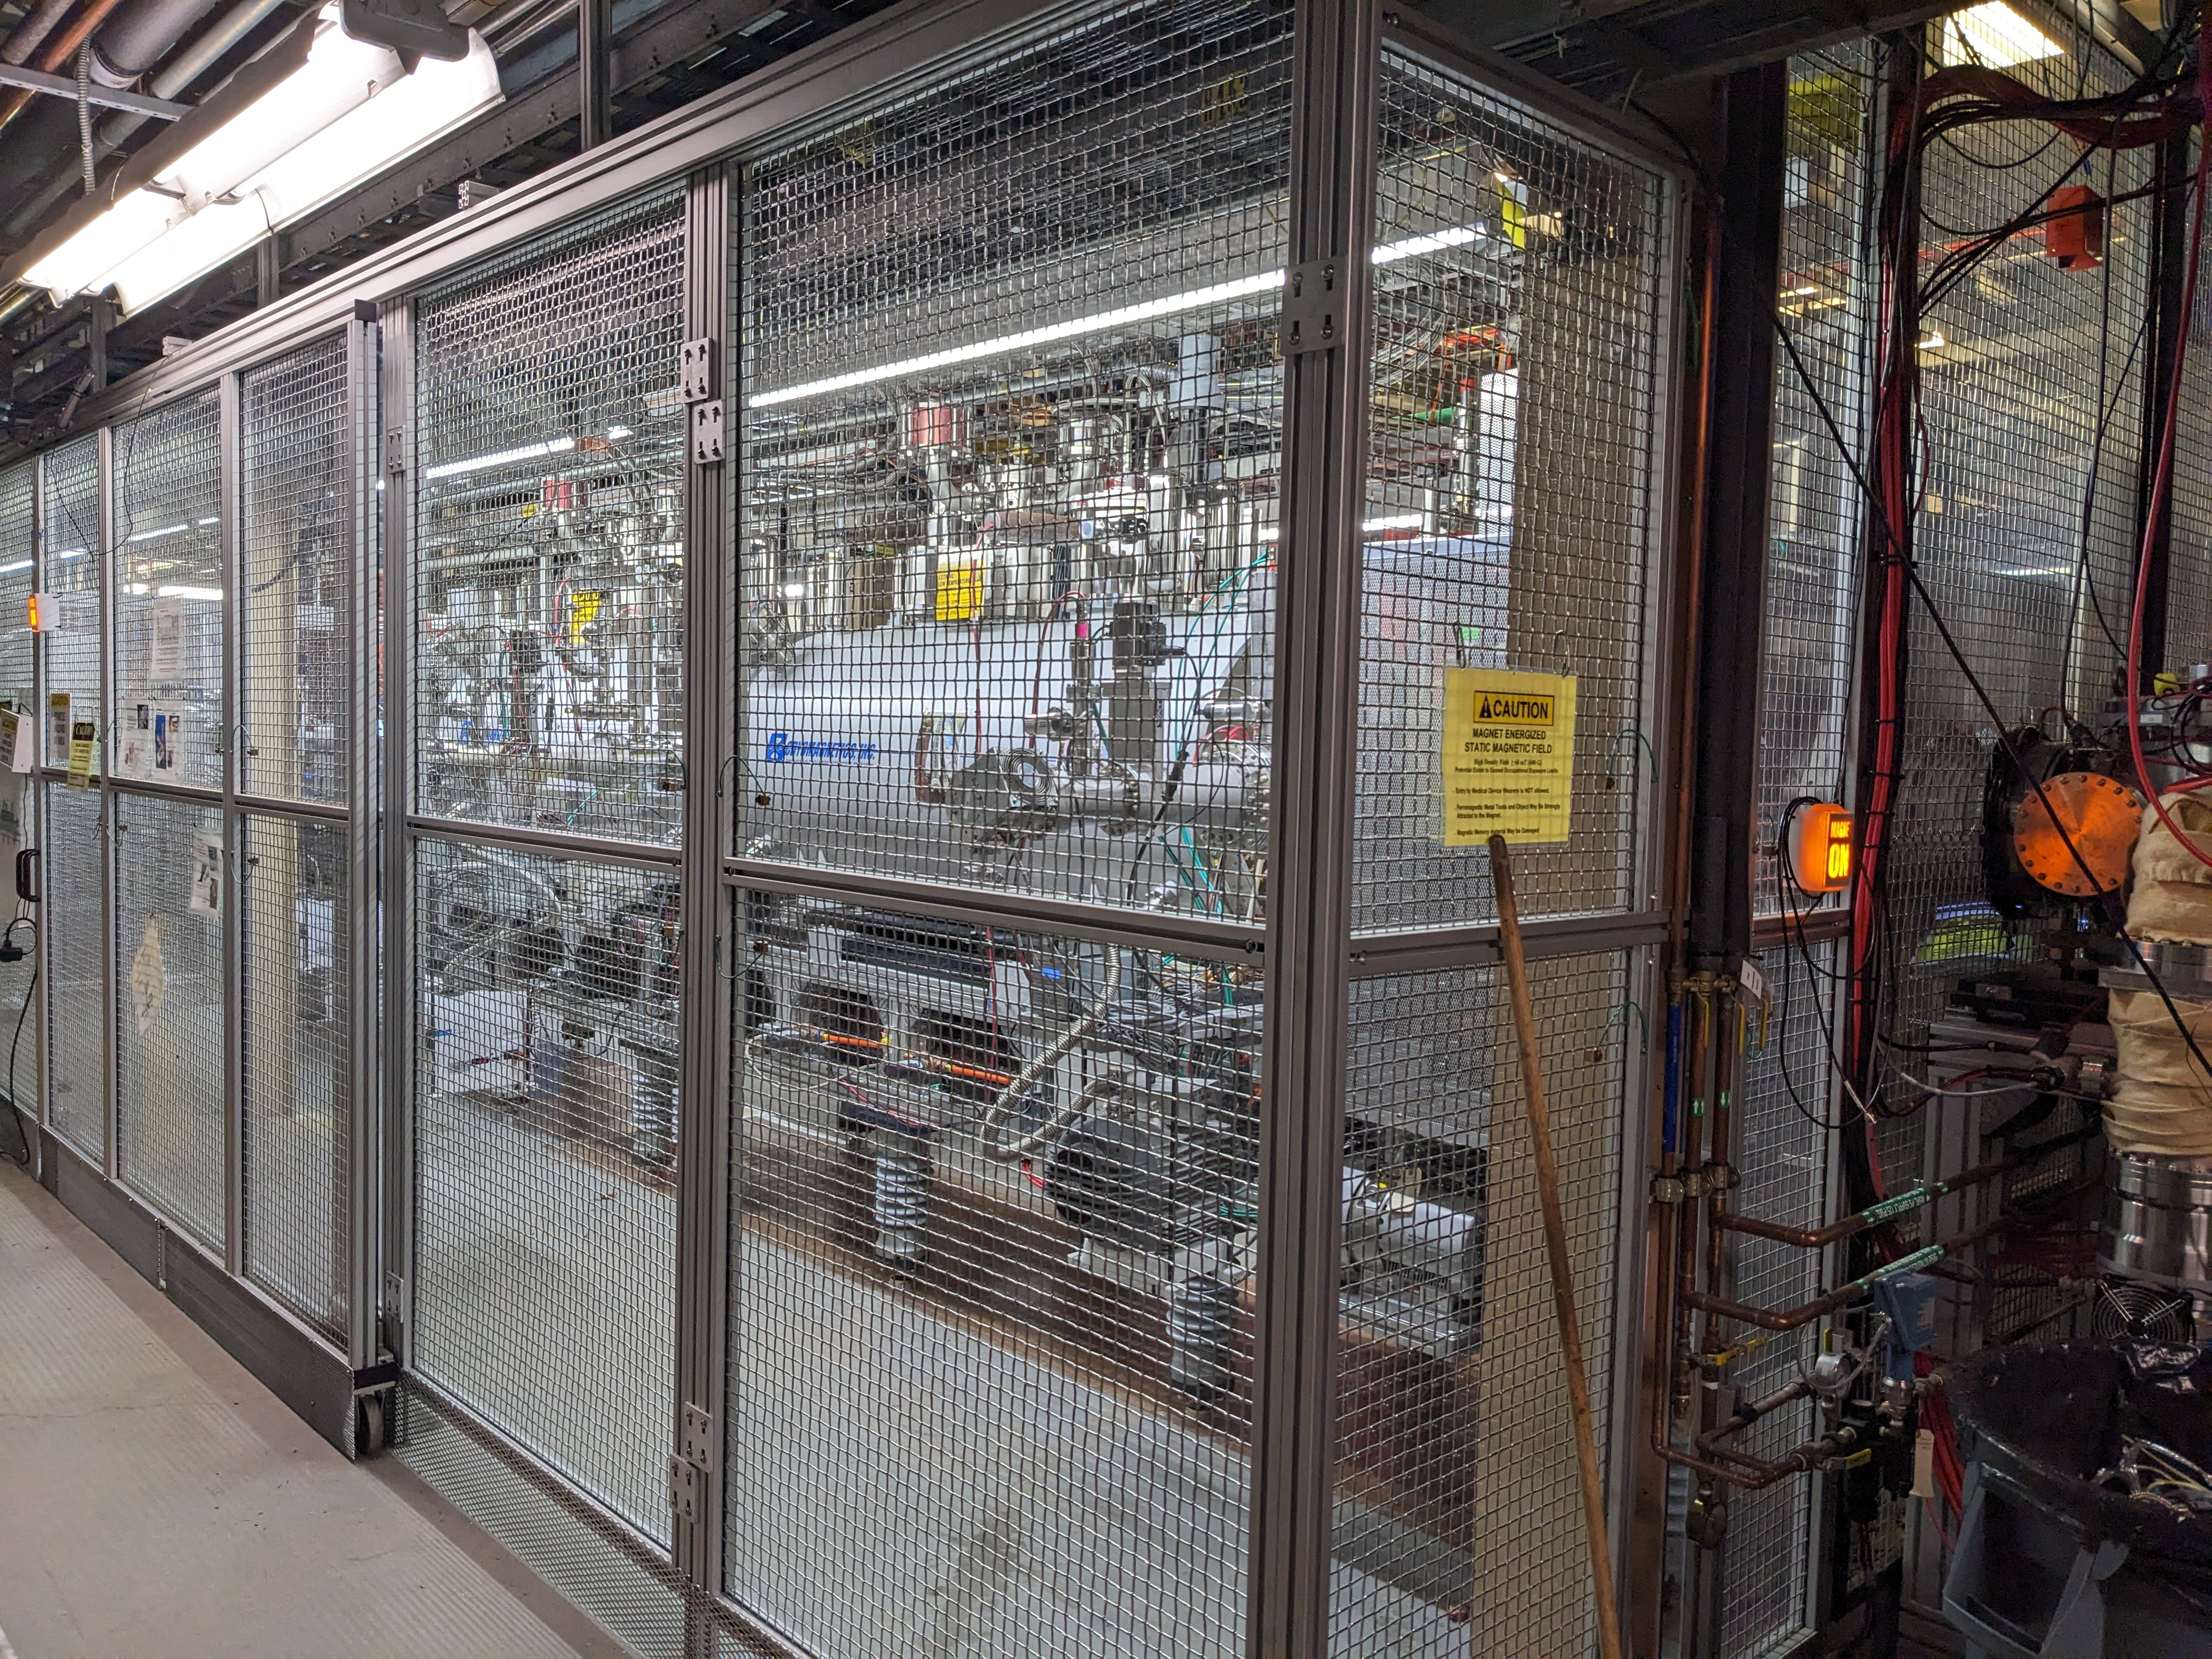
EEBIS – HV Cage

Slide 12
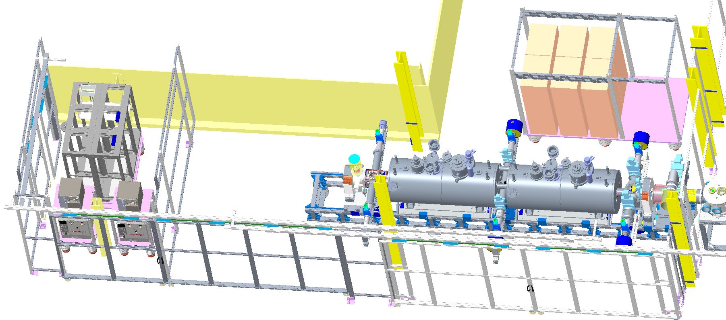
Extended EBIS Installation at Accelerator with High Voltage enclosure
Left: Electron collector supply
Middle: Extended EBIS with two Superconducting Solenoids
Right: Existing Ion injection and LEBT beamlines
Collector supply partition and EBIS shielded connections allows EBIS experts to enter the EBIS and power supply cage during electron beam aided source alignment and other operations not needing platform high voltage. (The entire cage is off limits during HV pulsing for ion injection from the laser ion source (LION) and ion extraction for beam propagation to the accelerator)

Slide 13
Present State of the EBIS source:
EEBIS startup went very quickly with He2+ beam being delivered to NSRL within 3 weeks of the initial electron beam at the accelerator location.
Very high charge state ions were delayed until a bakeout could be fit into the the busy NSRL schedule…but were produced immediately with the vacuum improvement once bakeout by the vacuum group was made.
Gas injection is working with He for NSRL.
Gas is ionized in the gas trap and transferred to the SHORT TRAP for fast extraction by the Behlke HV electronics.
Singly charged ion injection from LION into the EBIS LONG TRAP is working with both the Au rotating target for RHIC operations and the various targets Si, Fe, Bi, Ta, Ti, etc. in the xy target system. HCIS2 is operating for Ne+ injection and will be used for Kr+ and Xe+ injection.
Au32+ production for RHIC operations utilizes Au+ injection into both the SHORT and LONG TRAPS. Fast Behlke HV electronics provide 1+ ion capture, confinement and high charge state ion extraction from EEBIS.

Slide 14
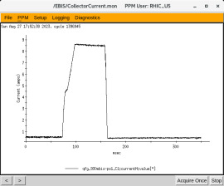
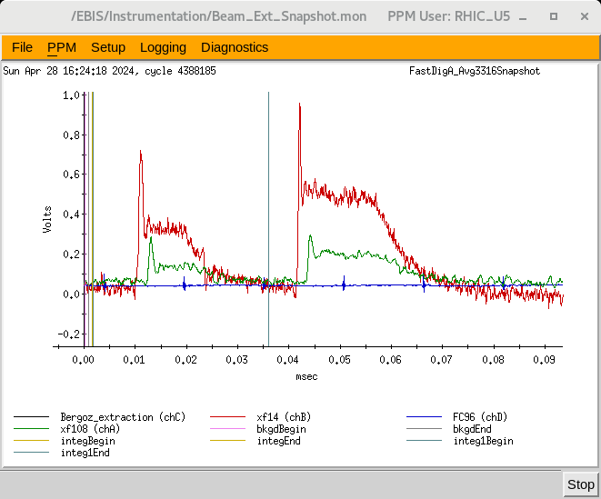
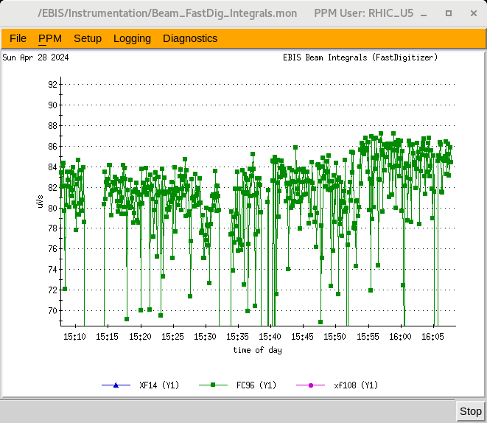
Measurements at EEBIS
8.1A electron beam
Conf2= 60ms wide (at peak value)
Red: xf14 signal
Green: xf108 signal
Blue: FC96 signal
(withdrawn during this snapshot).
Integral of series of FC96 waveforms

Slide 15
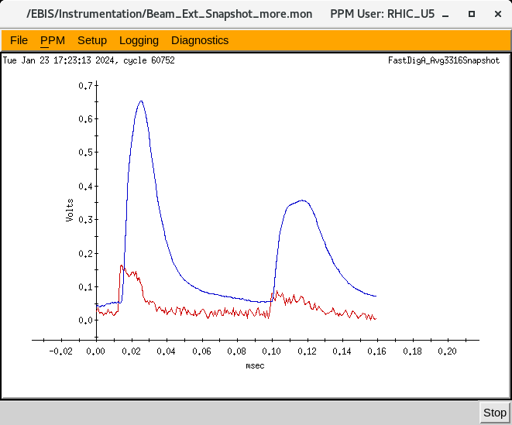
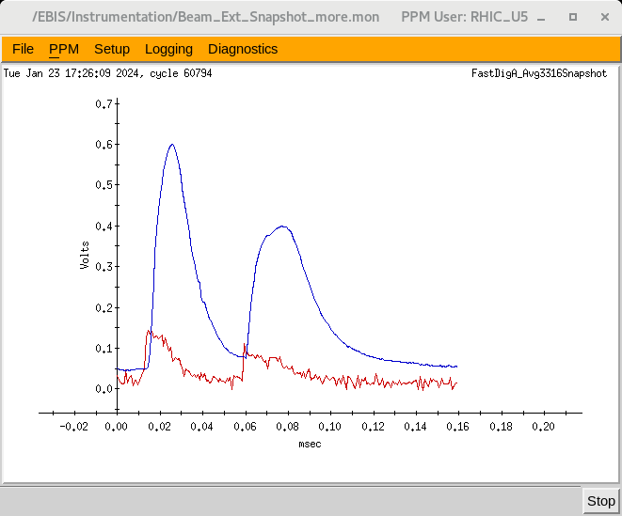
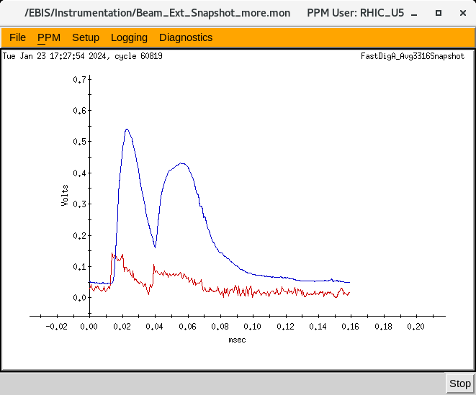
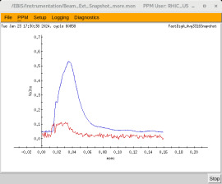
Short and Long Trap Ion Pulse Merging
Peak Separation ~90uS
Timing of the 20kV Behlke Switches is adjusted to extract ions towards the RFQ, first from the Short Trap, and then from the Long Trap.
The Short Trap is located upstream of the Long Trap, so short trap ions must not be impeded by the Long Trap potential barriers during the ion injection or extraction processes.
Intensity
Peak Separation
~30uS
TIME

Slide 16
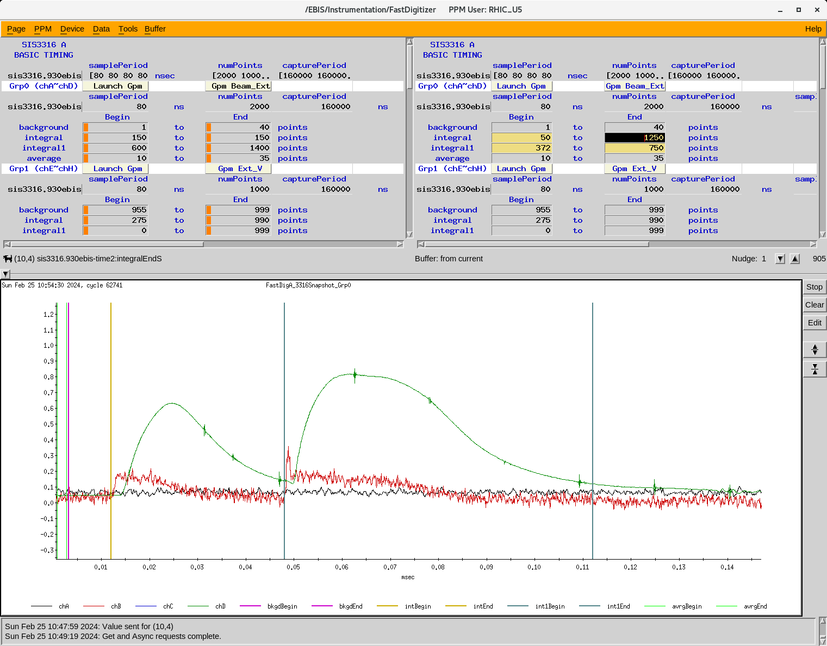
Integration Adjustment of Short and Long Trap Au32+ pulses

Slide 17
Commissioning Milestones (March-August 2023)
March 23 Initial Electron Beam off cathode 200-300mA 0.2Hz, 1-3mA
March 24 1A electron beam to collector after reversing Gun solenoid leads
(limited by drift tube power supply)
March 27-28 Magnetic Mechanical Alignment using electron beam
3A, 30ms e-beams no transverse magnetic steering used
6A, 0.4ms e-beam with some steering correction
March 29-30 First ions from Long Trap residual gas: 8nC, 3A e-beam, 5ms conf.
Helium Gas injection and RGA monitoring systems installed
March 31 Ion output vs Conf time for Gas, Short and Long Traps (Pressure probe)
Helium gas injection tests ( 3.5nC Helium ions from gas trap)
HV platform pulsing test to 500V (for ion beam transport to RFQ)
April 1-2 150C Bore vacuum system bakeout and NEG pump 550C activation
April 3-4 Three Behlke Switch Fast Capture and Extraction system debugged
4He Gas injection, He+ transfer to Long Trap, Ion extraction demonstrated
11nC total charge, at least 50% helium ions
April 8 He2+ propagation through RFQ and HEBT to FC96
April 10 He2+ set up in Booster from internal gas injection in EEBIS

Slide 18
April 11 Long Trap Behlke switches configured for 1+ ion capture by EBIS from LION
April 17 PPM control feature added for CAEN transverse magnetic steering
April 22 First NSRL operations with EEBIS ion beams He+,He2+, O5+, Si9+, C5+
beams from Extended EBIS were setup for use with NSRL GCR testing.
April 24 Ti13+ setup in booster for NSRL
April 27 Fe15+ setup in booster for NSRL
(This allowed Tandem to start RHIC operations with Au)
May NSRL operations
May 26 – June 12 EBIS High Temperature Bake by Vacuum Group
NEG Activation
Flange leak in collector transition found and eliminated
June 13 Pulsed H2 NEG pumping speed measurements
New cathode activation
June 14-17 Superconducting solenoid problems: multiple quenches and recovery
June 17-18 EEBIS Electron beam restart after vacuum improvement by baking, etc.
(4.1A ebeam)

Slide 19
June 19 -20 High Charge states Si11+, Nb23+, Ta38+ and Au32+ easily produced now. The EBIS vacuum is improved greatly after the bake and NEG activation.
June 22 Very high charge states Bi43+ and Au43+ developed
July 1 8A electron beam (1P/sc)
July 8 Au32+ 12P/sc (5.2A ebeam, 35uVs at FC96)
July 27 Au32+ improved distribution, 12P/sc intensity doesn’t change with rep. rate
Stable with most NSRL beams for several hours.
Aug 27 Au32+ Low voltage drift tube distribution with increased cathode bias.
8.3A electron beam achieved (1P/sc operation)
FC96 = 45 uVs with 6.5A ebeam not fully optimized
Oct 2 Short Trap Behlke Switch Partial Mechanical installation
Dec 05-06 4He2+ from EEBIS transported through chicane to FC96
16-18uVs obtained about 80-90% as obtained in the direct beamline.
Dec 22 Short trap Behlke Switch Fast Electronics Installation
Dec 29 Short Trap Behlke Switch High Voltage Testing Complete

Slide 20
Jan 6, 2024 First Highly charged ions after Short Trap installation (Si11+)
(Injected ions trapped and extracted using Long Trap only).
Jan 8-9 Re-start of NSRL setup with EEBIS Beams through ETB line to xf108
Transport of Si11+, Ti17+, Fe20+, Ag29+ Tb35+, Bi43+ from Long Trap
Jan 22 Au+ from LION captured in EEBIS Short Trap; Au32+ extracted
Jan 24 He gas injection with capture and extraction of He2+ from Short Trap
FC96 ~23uVs, XF108 ~2.1uVs (exceeded current Long Trap values)
April 19 Ne+ injected into EBIS from HCIS2; Ne8+ from EBIS used in Booster Ring
Xe27+
April 21 7.1A ebeam; Au32+ FC96 ~ 58uVs
April 27 HV tests with cold cathode (no ebeam): No Discharges Observed
April 28 Au32+ FC96 ~87uVs (1P/sc, 6.9A ebeam); 12P/sc 200ms FC96 ~70uVs

Slide 21
EEBIS Operation Status at the accelerator
1) Electron Beams up to 8.3A for Au32+ production
2) He gas injection, ion transfer to the short or long trap and 4He2+ extraction for NSRL operations
3) External ion injection of 1+ ions into the EBIS long trap with subsequent high charge state extraction to the RFQ, LINAC and Booster.
4) Two user operation on the same super cycle:
NSRL (Various very high charge state ions) + RHIC Au32+
5) Development of the RHIC 12P/sc Au32+ operation has been difficult due to vacuum deterioration in the gas injection region.
Adjustment of the potential distribution, cathode heating and source biasing has helped us reach the former RHIC EBIS parameters.
6) Matching of NSRL distributions to the RHIC Au32+ distribution provides better source stability.

Slide 22
Future Plans
Recently, Au32+ ion intensities measured are:
FC96 ~ 87uVs
xf108 ~ 3.9uVs (~1.1E9 Au32+ ions/pulse)
Work continues on RHIC Au32+ development with the goal of increasing the present output by 40 to 50 percent. This will be done by increasing the electron beam current to the 8-10A level and improving the injection and extraction efficiency
Future upgrades will include:
installation of the new electron collector supply
a high field 3He polarization setup in the bore of the first superconducting solenoid, a second gas injection valve and gas handing system, and a gas manifold for remote automatic gas switching.

Slide 23
Reference Material

Slide 24
Infrastructure Timeline (Reference material)
Infrastructure upgrades to the Extended EBIS installation site began just after July 4, 2022, after the end of NSRL operations. The site includes the previous RhicEBIS area plus an adjacent space previously cleared to accommodate the longer Extended EBIS and a new solid state electron collector power supply. Decommissioning of the RhicEBIS was the first task, as it was necessary to remove the ion source to be able to access other equipment and install a new overhead trays and power distribution system for the installation of Extended EBIS.
Aug. 1, 2022: RhicEBIS removed from installation area.
Collector Power supply removed and 200kVA Isolation/Rectifier Transformer removed.
200kVA 480VAC Isolation Transformer installed for powering new solid state collector supply.
Sep. 16, 2022: Extended EBIS Beam Tests completed in EBIS Test Laboratory
Sep. 26, 2022: Pumping Speed vacuum characterization on Extended EBIS
Superconducting magnetic fields ramped down and Extended EBIS disassembled for move to accelerator site.
Oct 11, 2022: Extended EBIS moved to accelerator installation location
Nov 2022 Extended EBIS vacuum system reassembled, mechanically aligned, under vacuums
Dec 2022 Electrical Infrastructure complete (except final collector supply installation)
Feb 23, 2023 Accelerator Systems Safety Review Committee (ASSRC) walkthrough of EEBIS. (All prestart items completed).
March 2023 Rack power supply, controls and vacuum controls completed …some small ongoing tasks remain
Solid state collector supply installation was expected during January 2023. This was delayed, depending on the ongoing acceptance testing. The old collector power supply was re-installed, taking considerable manpower and requiring an additional month to accomplish.

Slide 25
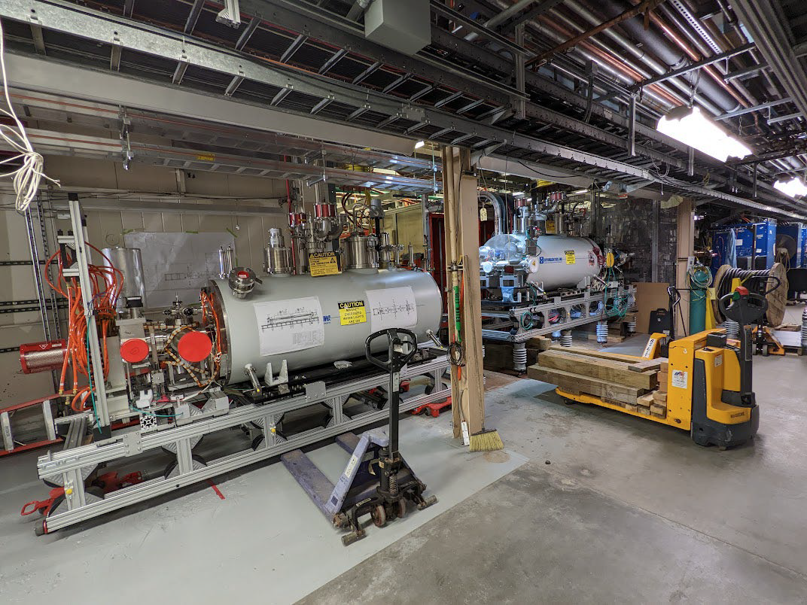
Upstream Section being installed (October 12, 2022)

Slide 26
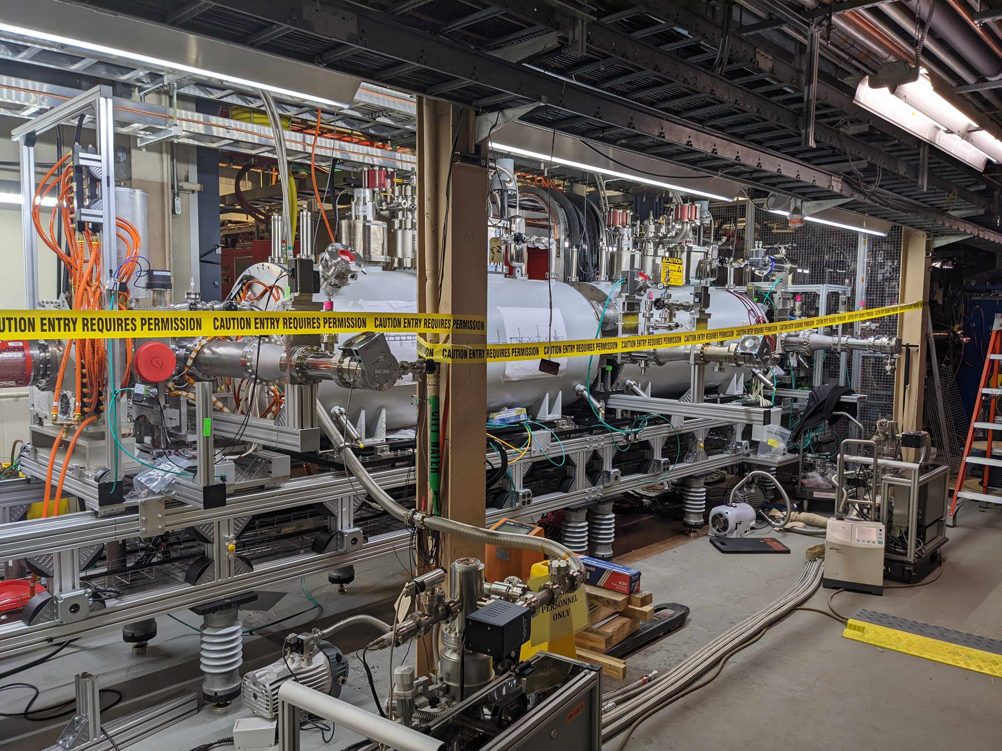
Extended EBIS Installation (December 8, 2022)

