Slide 1
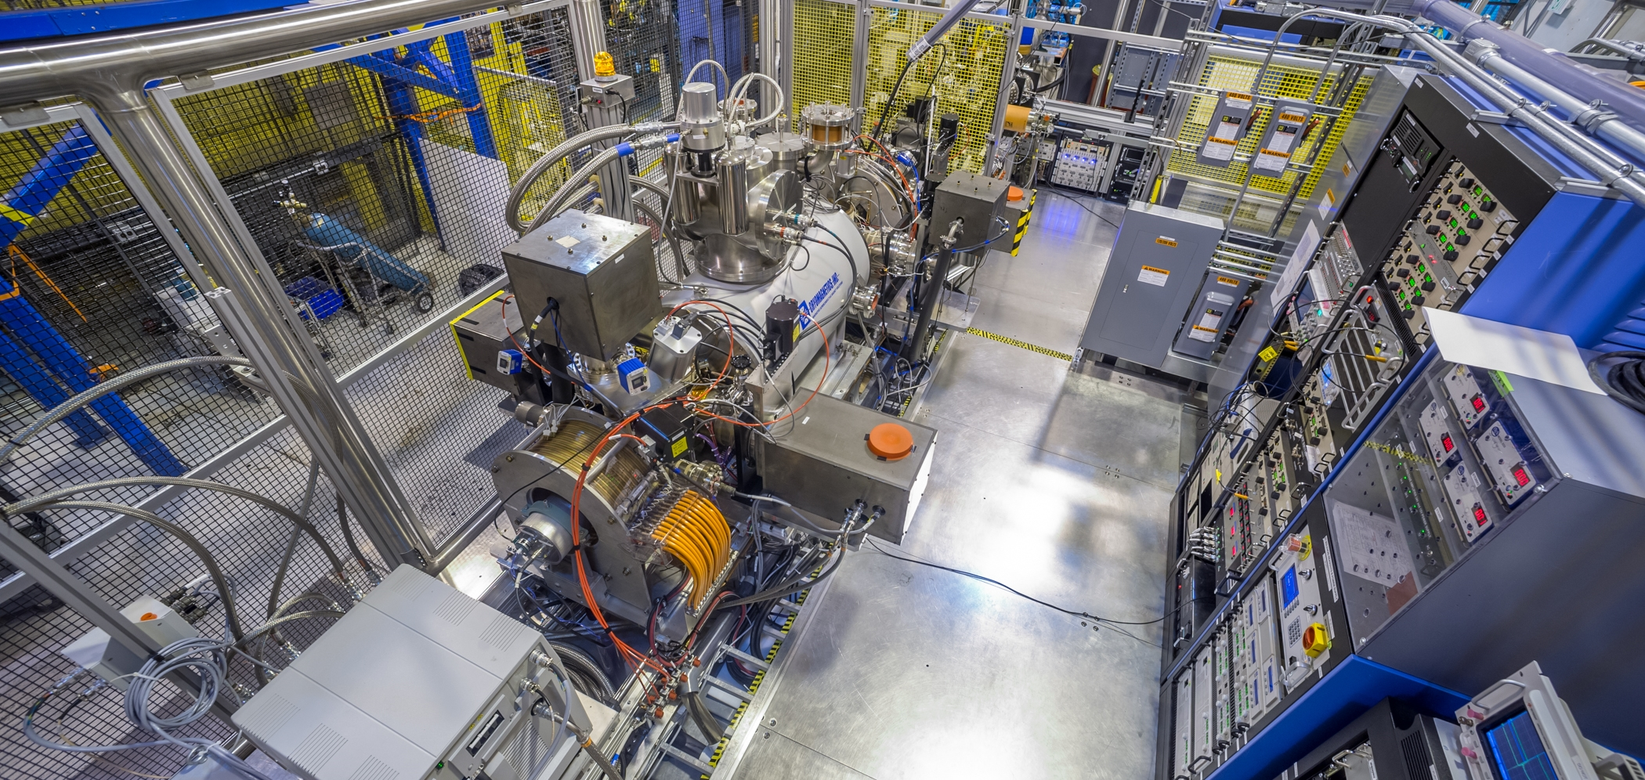
The ATLAS Electron Beam Ion Source and nuCARIBU
April 29, 2024
Richard vondrasek
NACB 2024
Brookhaven National Laboratory

Slide 2
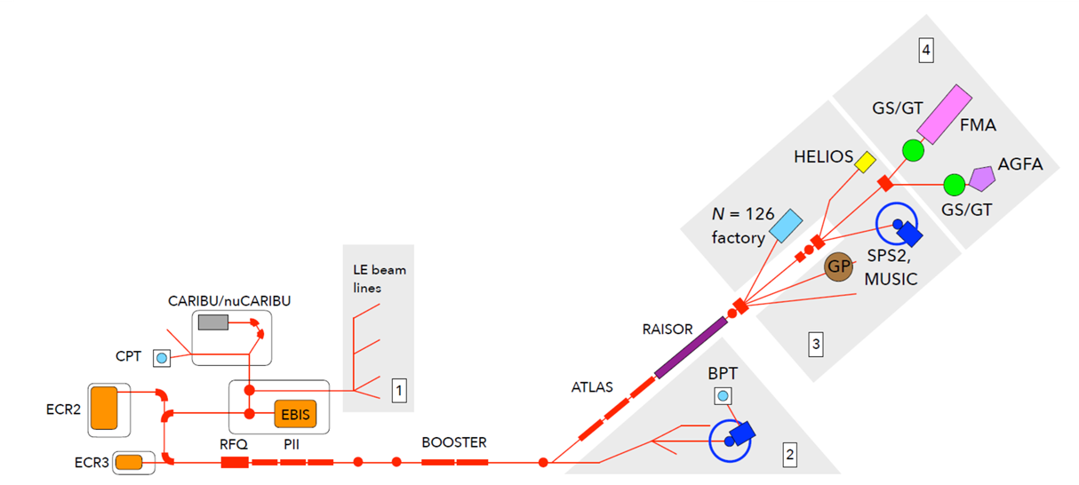
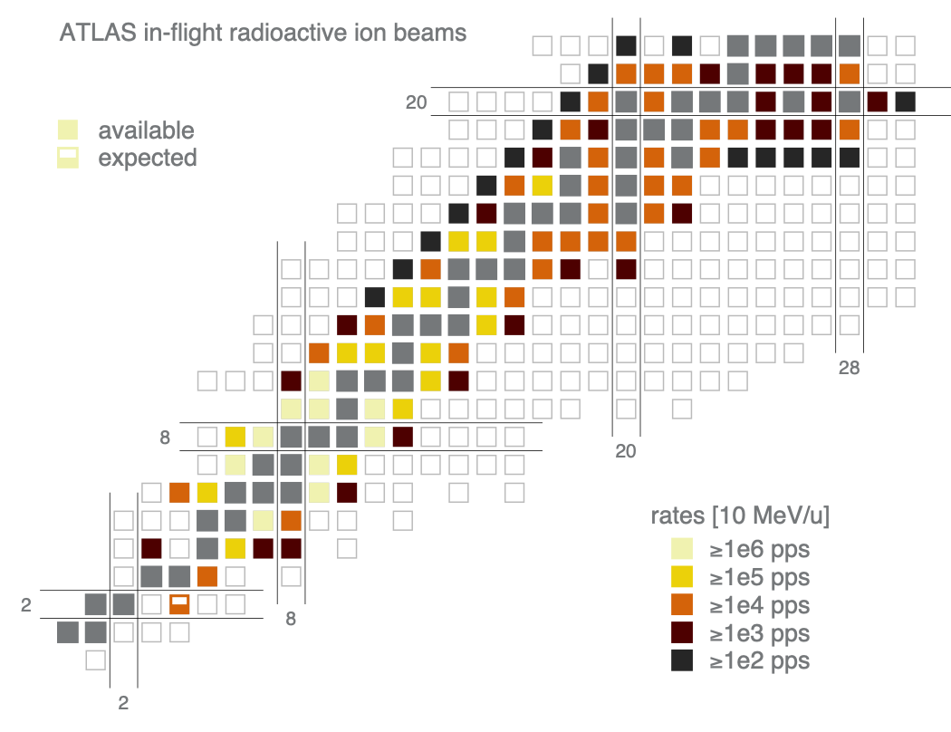
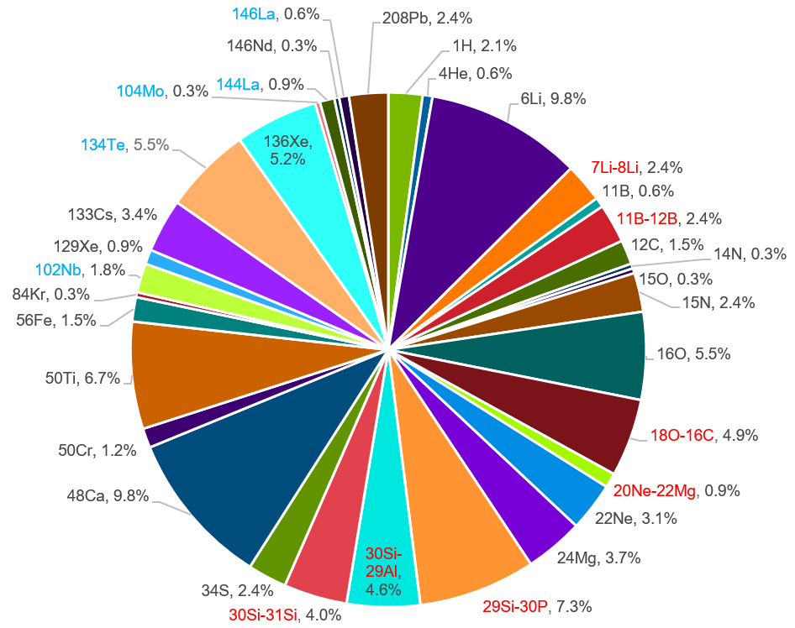
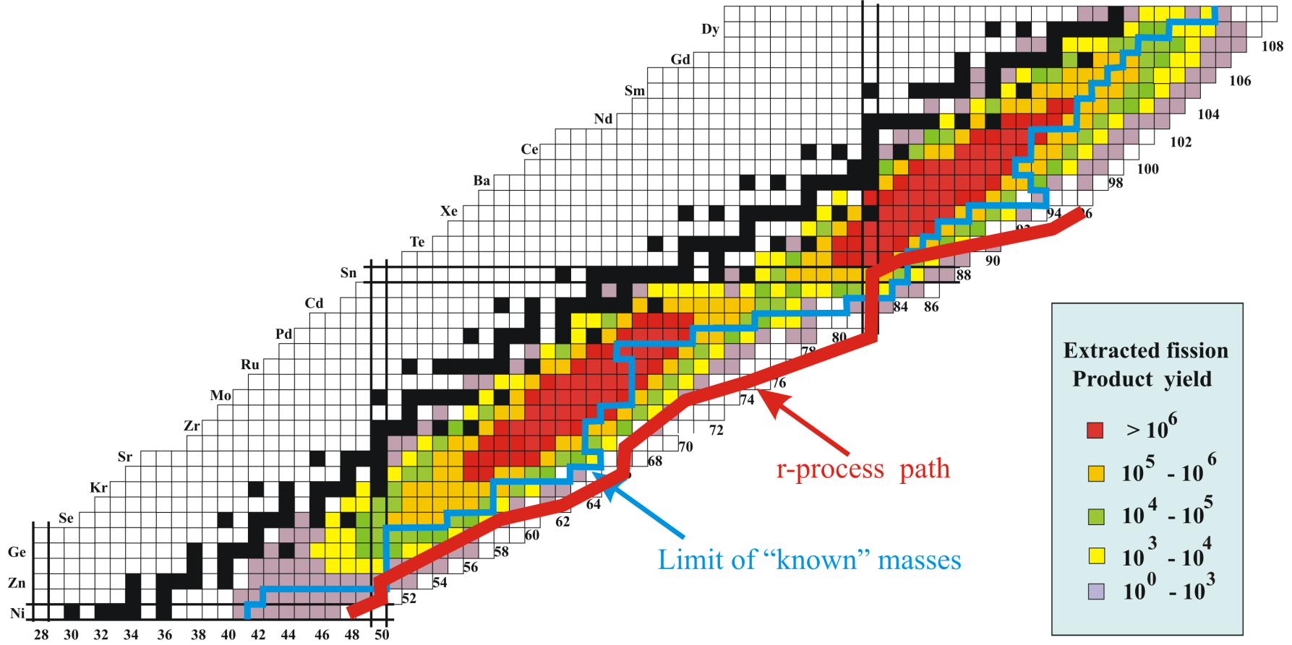
atlas
Argonne Tandem Linac Accelerator System
ATLAS is primarily a stable beam facility for nuclear physics
  Beam current typically <500 pnA, energy <20 MeV/u
Provide radioactive beams as well
  RAISOR - Light in-flight beams close to stability
  CARIBU - Heavy n-rich beams from Cf fission
Deliver ~6000 hours of accelerated beam each year
  Plus an additional 2000 hrs/yr of CARIBU stopped beam
  24 hours a day / 7 days a week / 93% availability (delivered vs. scheduled)
  300-400 users per year
2019
Stable – 61.7% (4545 hrs)
In-Flight (RAISOR) – 29.1% (2143 hrs)
Reaccelerated (CARIBU) – 9.2% (678 hrs)
Notes:
Accelerating gradient 60 MV (with G tank)

Slide 3
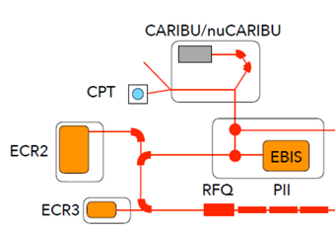
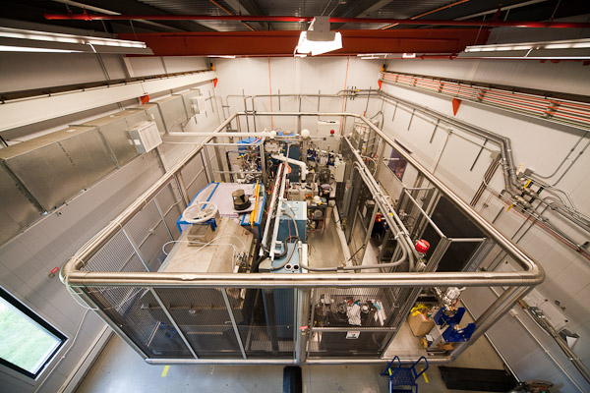
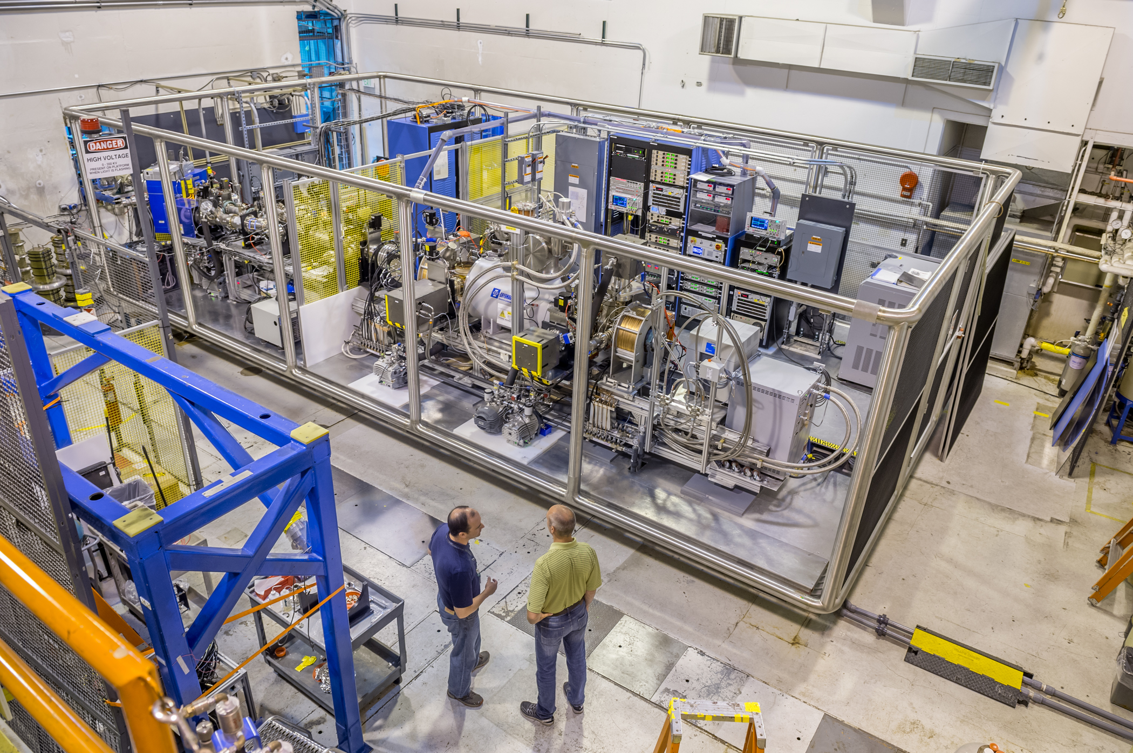
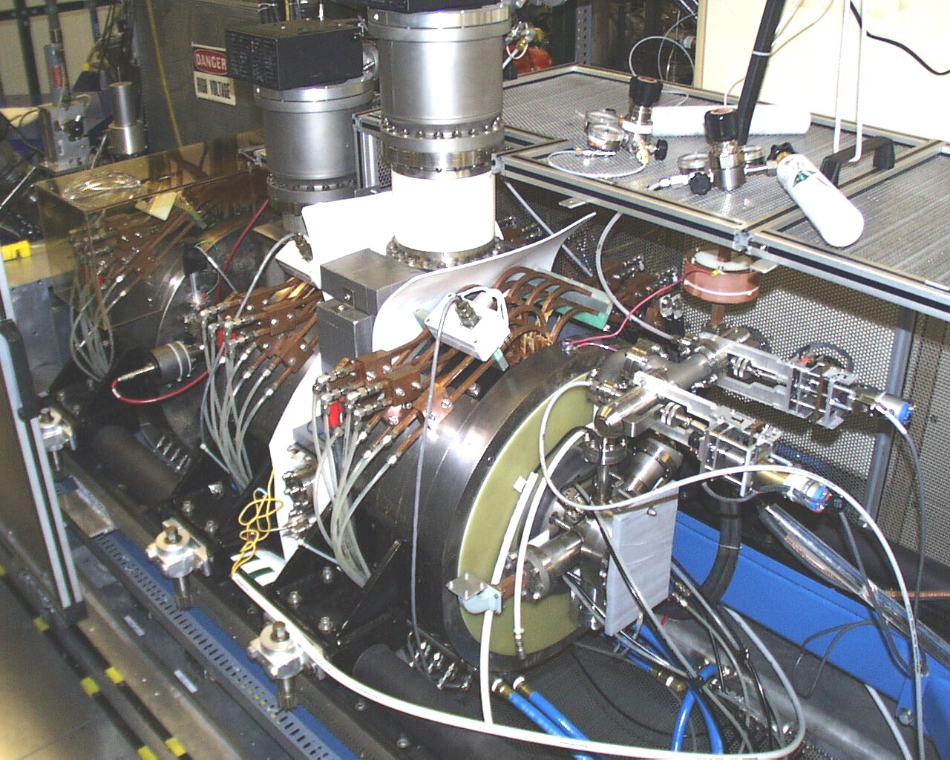
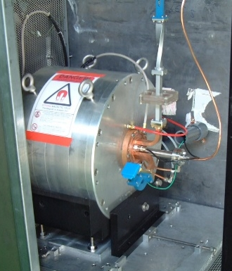
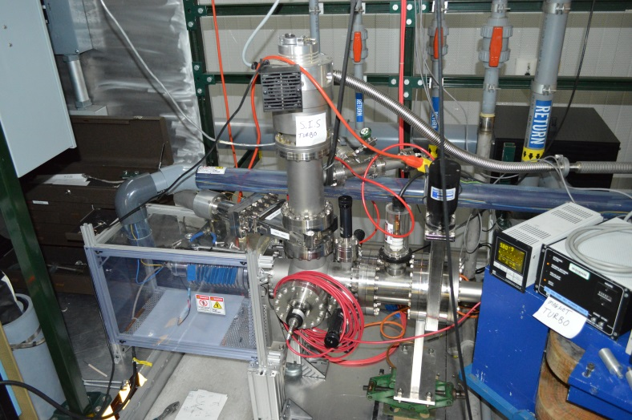
Atlas front end
CARIBU – n-rich beams
EBIS – charge breeder
ECR2 – stable beams
ECR3 – C-14, stable
Surface Ionization Source - lithium
Notes:
The ATLAS front end is a busy place.
CARIBU provides neutron-rich radioactive beams originating from a Cf-252 fission source thus allowing the entire system to be housed in a small addition at the front end of the accelerator.
Between 2008 and 2015 the 1+ beams fed into an ECR charge breeder.
In 2015, to combat the pervasive stable background we were seeing with the ECR-CB and which was limiting the experiments we could do with the device, we removed the ECR charge breeder and replaced it with an EBIS charge breeder.
Also at the front end we have two room temperature ECRs – a second generation ECR source and a permanent magnet source primarily used for C-14 beam production.

Slide 4
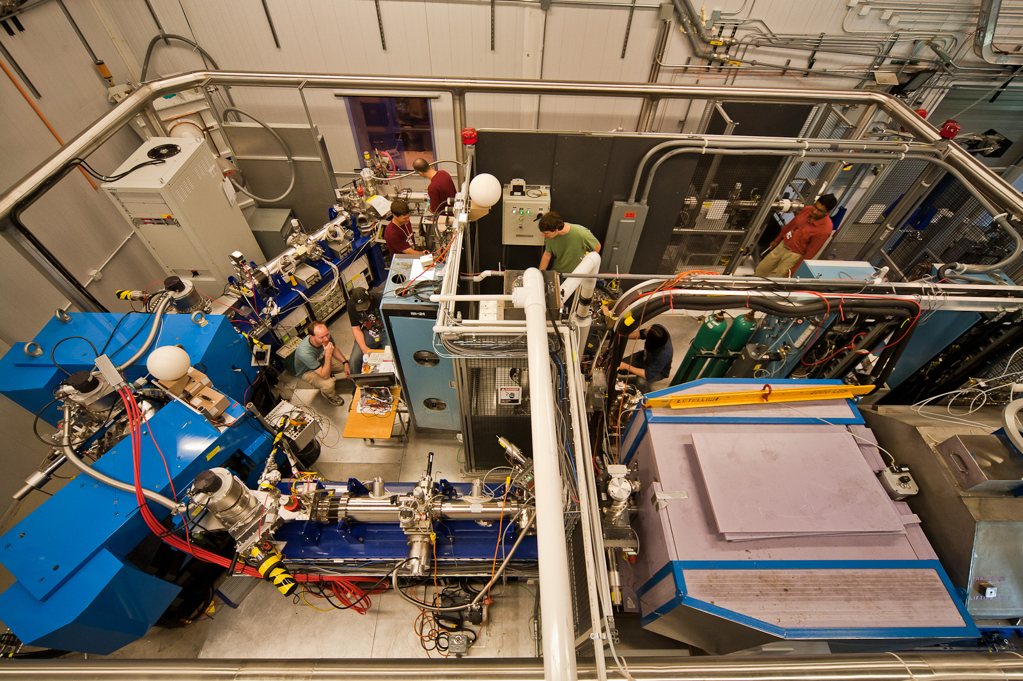
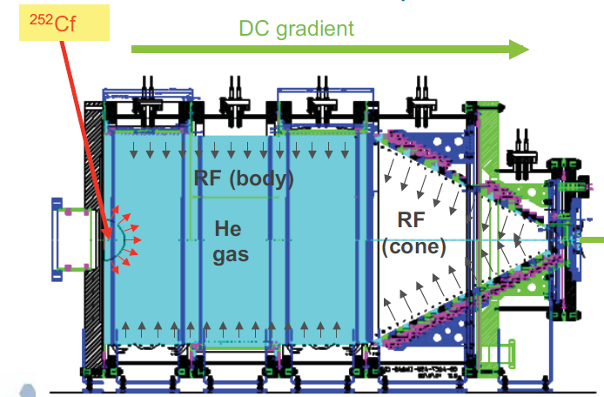
Caribu
Californium Rare Ion Breeder Upgrade (2008)
²⁵²Cf fission source provides radioactive species
  0.52 Ci source (installed May 2018)
  T_{1/2}=2.6 yrs
Thermalized in large volume helium gas catcher
  Energy spread - 1 eV
  Emittance – 3 π·mm·mrad
Extracted as 1+ or 2+ ions
Isobar separator - 1:20,000 resolution
RFQ cooler/buncher
MR-TOF
²⁵²Cf fission distribution
Notes:
For CARIBU, fission fragments from a heavily shielded Cf-252 source are thermalized in a large volume helium gas catcher and extracted as 1+ or 2+ ions.
Yields as high as 10^6 can be achieved under optimum conditions, but at the moment the source is quite old and is too thick resulting in self-shielding thus limiting us to the 10^4 regime.
The ions which are extracted have an energy spread of 1 eV and an emittance of 3 pii mm mrad.
The good properties of the extracted beam allow a mass resolution of 1:20000 with the isobar separator.
All of these components are housed on a 200 kV high voltage platform which is coupled to the charge breeder high voltage platform.
For efficient post-acceleration, the charge state needs to be raised, and for this we have the charge breeder.
It takes the 1+ beam, and in a fast and efficient manner, raises its charge state.
-----------------------------------------
Large volume - 50 cm diameter and 1.2 m length
UHV construction - stainless steel and ceramic
Helium gas with sub-ppb level impurity - operating pressure of 150 mbar
Radioactive ions transported by RF + DC + gas flow
Extraction in 2 RFQ sections with μRFQs for differential pumping
Mean extraction time is <10 msec with overall efficiency of 20%
Source at ~130 mCi now

Slide 5
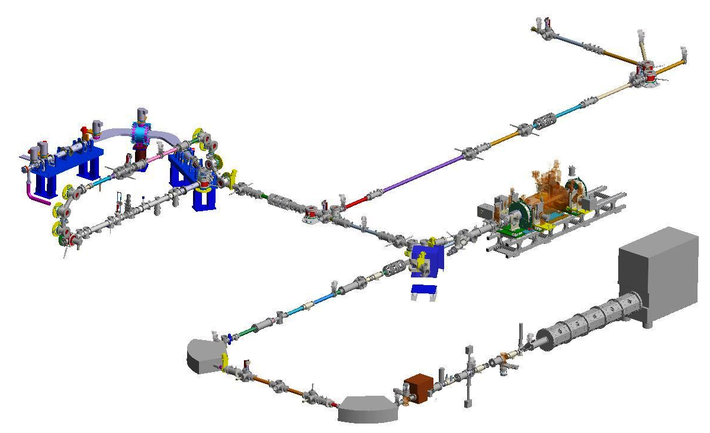
EBIS charge breeding cycle
CARIBU → EBIS → ACCELERATOR
Stopped beams experimental area
Isobar Separator
Resolution: 1:14,000
Transmission: 100%
Resolution: 1:20,000
Transmission: 60%
Elevator
Raises beam energy
2 kV → 25 kV
ECR-CB removed in 2015 and replaced with EBIS-CB
Pulsed breeding cycle
  Typically 10 Hz
Beam preparation required
RFQ Cooler/Buncher
MR-TOF
  Not required for EBIS operation
Elevator
  2 → 25 keV
Electrostatic switchyard
  Injection/extraction cycle
Electrostatic switchyard
EBIS
Breeding time: 50 ms
Frequency: 10 Hz
Total efficiency: 80%
Cf-252
MR-TOF
Capacity: 10⁴ ions/bunch
Resolution: 1:50,000 Transmission: 30-50%
Hold-up time: 15 ms
RFQ cooler/buncher
Capacity: 10⁵ ions/bunch Accumulation: 30-100 ms
Transmission: 70% (2+)
<70% for 1+
Pulse width: 2 µs
Dipole Magnets
Resolution: 1:400
Transmission: 100%
HIGH VOLTAGE PLATFORMS ARE NOT SHOWN IN THIS VIEW

Slide 6
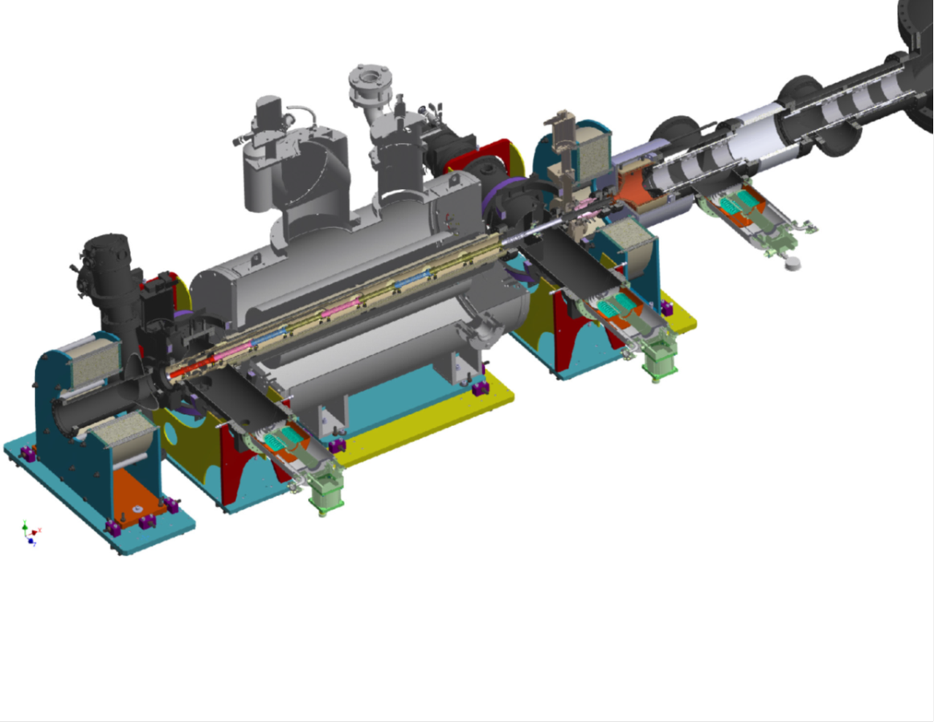
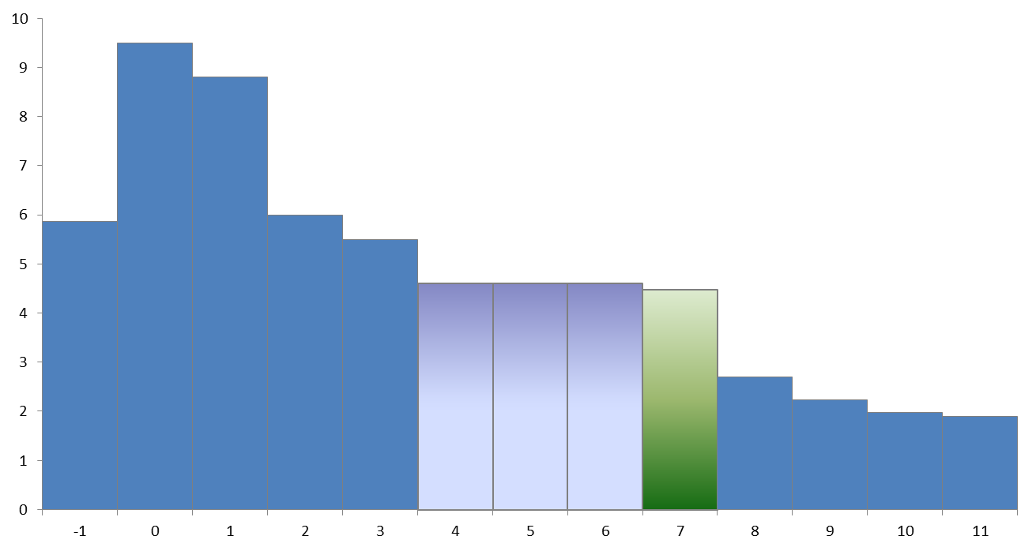
Ebis charge breeder
Collector
Electron beam dump
20 kW
EBIS Operating Parameters
Solenoid field | 5.5 T
Magnetic field on cathode | 0.15 T
Cathode diameter | 4.2 mm
Drift tube diameter | 20 mm
Electron voltage (gun / trap) | 10.4 / 6.3 keV
Electron current | 0.32 A
Effective electron current density in trap | 190 A/cm²
Trap length | 0.5 m
Charge capacity | 2.2x10¹⁰
Injection time | 50 µs
Repetition rate | 10 Hz
Duty cycle | 50 %
EBIS bias | 20 kV
Pressure | 1x10⁻¹⁰ torr
Electrostatic transport line
Injection/extraction cycle
Trap electrodes
Axial confinement
Solenoid coil
Electron beam compression
Anode
Electron beam extraction
Electron gun
2 Amp
Trap drift tubes
Voltage (kV)
Barrier drift tube
Drift tube number
Notes:
An EBIS is decidedly more complicated than an ECR source, but it has the advantage of very low beam contamination.
An electron beam is compressed by a high-field solenoid resulting in a high current density within the trap region.
The electrostatic potential of the electron beam itself serves as the radial trap, and a structure of 11 drift tube electrodes provides axial confinement.
We typically operate with a 10 Hz rep rate and a 50 % duty cycle.
For charge breeding, the barrier drift tube potential is lowered allowing the 1+ ions to enter the trap.
Before they complete a round trip, the barrier is re-established, and the ions are then ionized by the electron beam.
To empty the trap, one can either drop the barrier potential or raise the potential of the trap electrodes.
Dropping the barrier produces a ~10 us beam pulse whereas raising the trap allows this pulse to be extended.
The electron beam is then terminated, residual ions are flushed from the trap, and the process repeats.

Slide 7
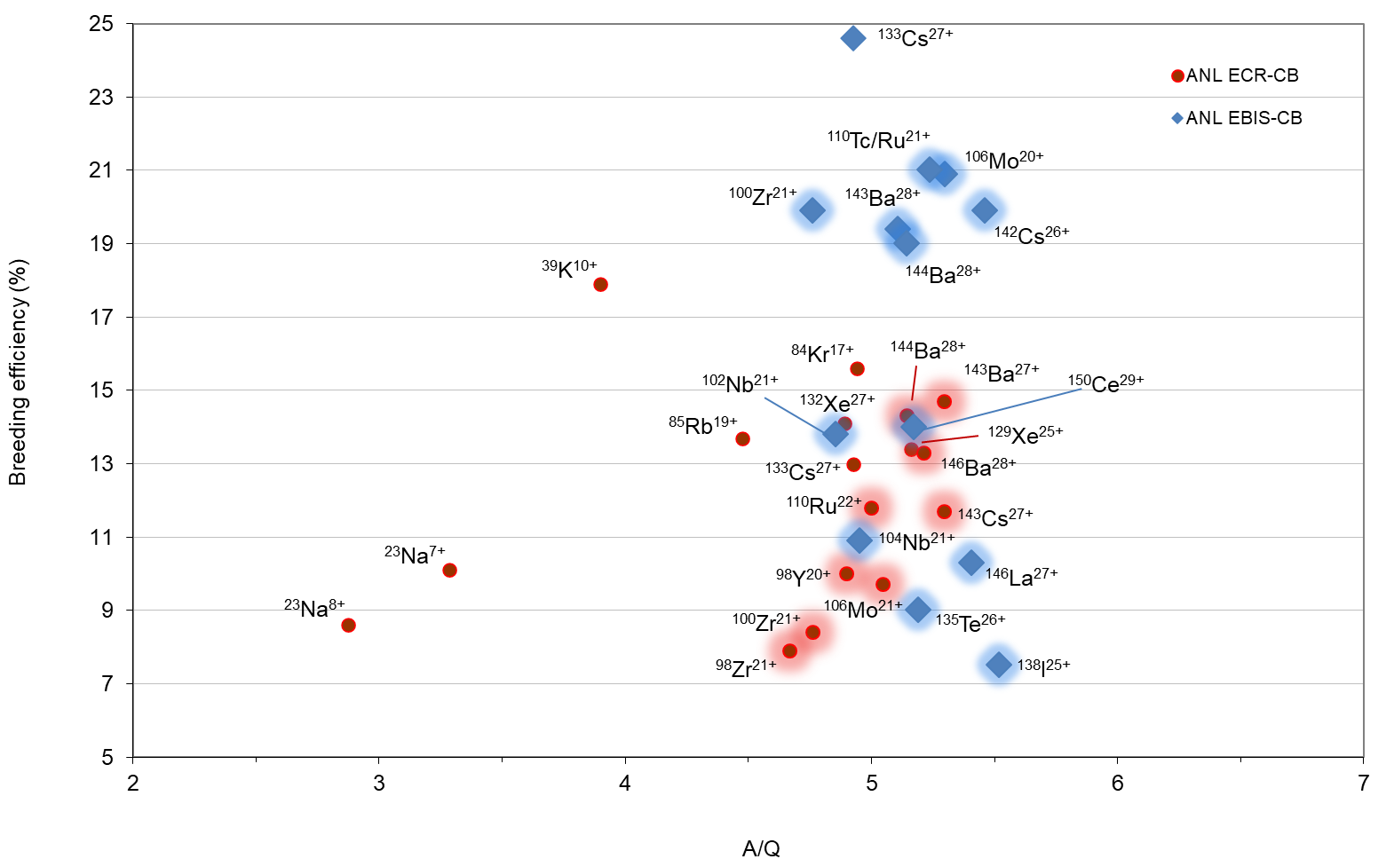
Charge breeding efficiency (ion source only)
1+ intensity into CB / single charge state intensity out
Notes:
The breeding efficiency of both devices is quite good.
The ECR has a high close to 15% for a RIB while the EBIS reaches 21%.
And one can see the significant increase in efficiency for beams such as 100Zr and 133Cs.

Slide 8
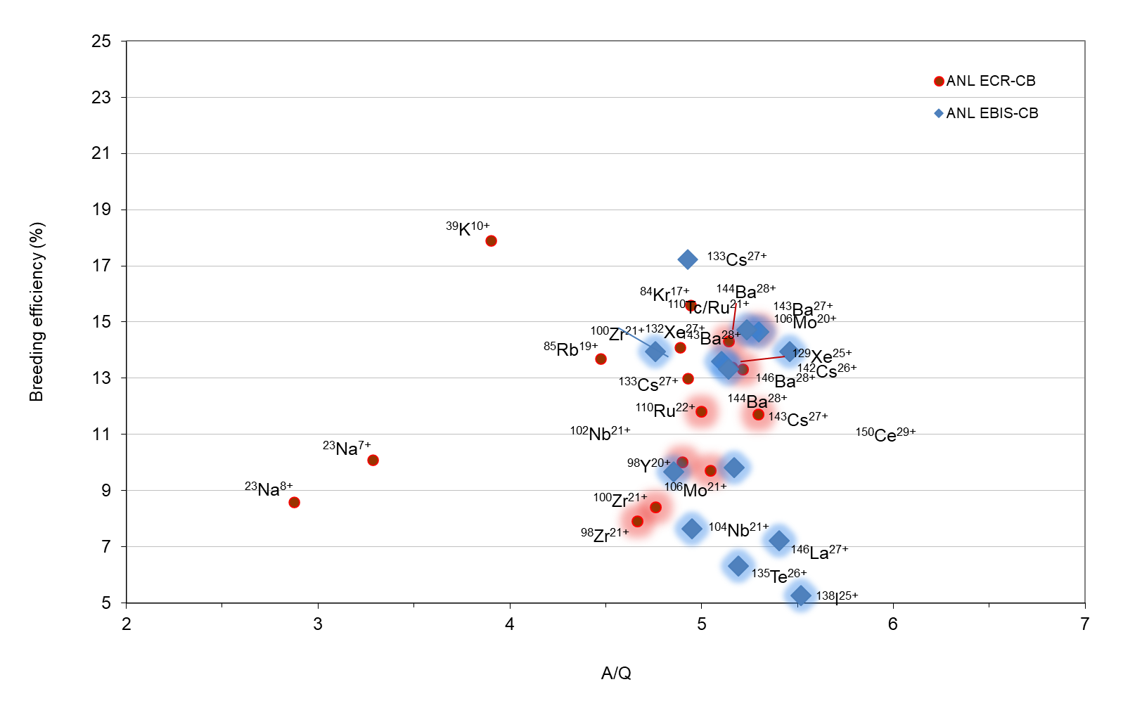
Charge breeding efficiency (system)
1+ intensity out of isobar / single charge state intensity out of CB
Notes:
Of course, this is simply the device efficiency, not the system efficiency.
If one takes into account the RF-Cooler/Buncher efficiency of 70%, the device efficiencies become more similar.

Slide 9
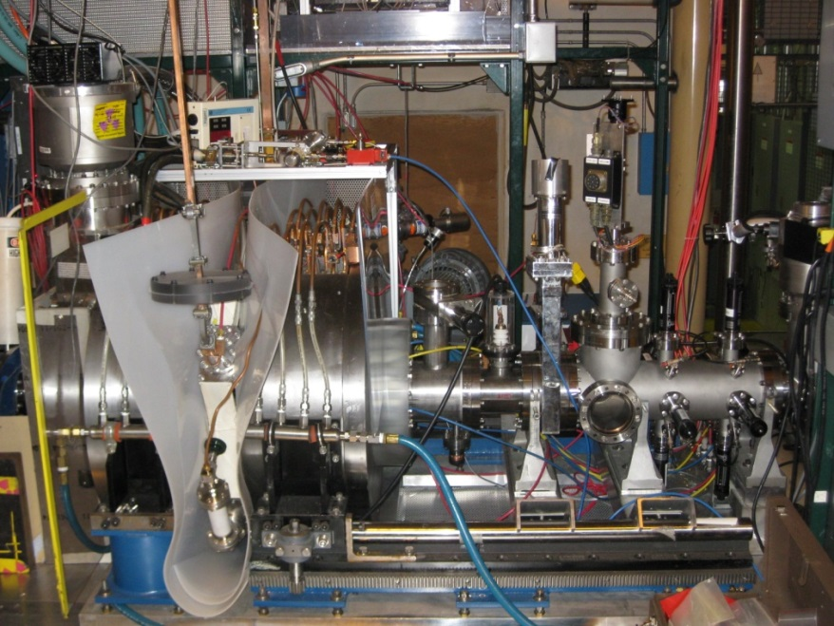
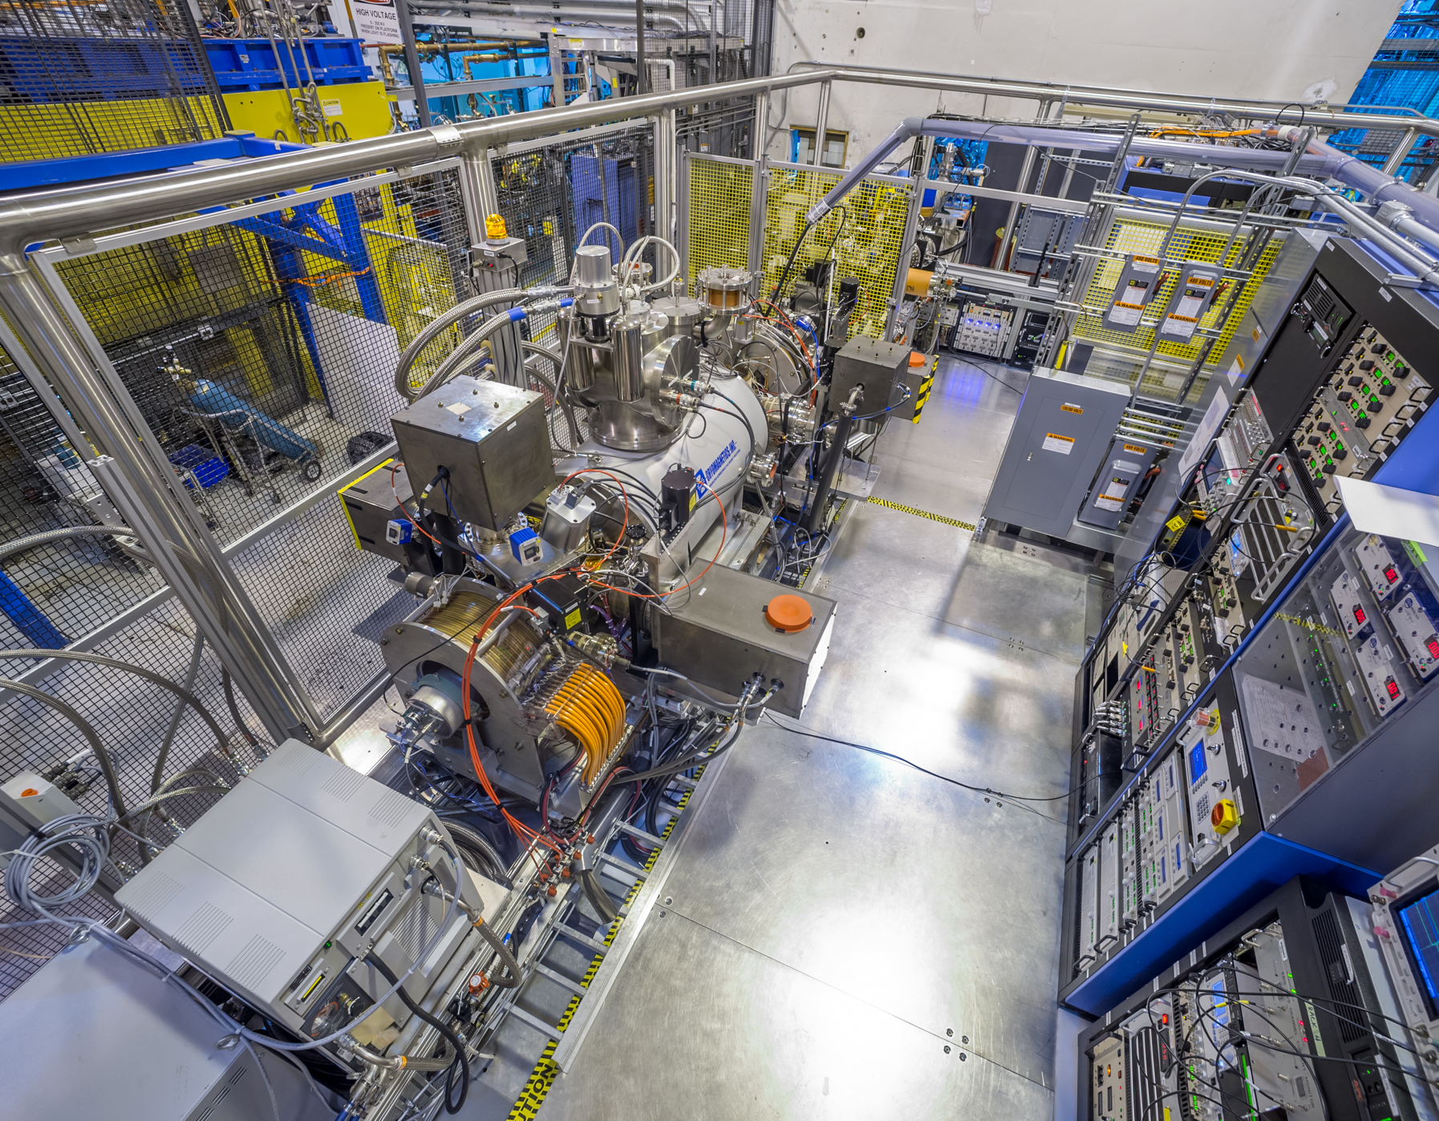
charge breeder comparison
ECR | ¹³³Cs²⁷⁺ | EBIS
≤ 13% | Device efficiency | ≤ 24%
≤ 13% | System efficiency | ≤ 17%
10-20 ms/q 390 ms | Breeding time | 1 ms/q 28 ms
< 3 % | RIB purity | > 90 %
2.5 – 5.5 | A/Q | 4.5 – 6
pμA (~10¹³ pps) | Maximum injected beam | pnA (~10¹⁰ pps)
CW (afterglow) | Mode of operation | Pulsed
3.6 x 5.2 m | Footprint | 10.7 x 5.8 m
Efficient
Compact
Simple
Slow
Dirty
Efficient
Clean
Fast
Large
Complicated
Notes:
Comparing the devices side by side, we see the similar efficiencies.
We also see that the ECR breeding time is 10 times longer than that of the EBIS.
The ECR can accept far more beam than the EBIS.
But the EBIS is far superior in terms of beam purity.
And of course the operational modes are different as is the space occupied by each device and its support systems.
Summing up the ECR we have …
And for the EBIS it is …

Slide 10
charge breeder maintenance
Failures and preventative measures
ECR
Failures
Klystron tube loss of power
HV cable breakdown
Preventative maintenance
Clean power supply fans
Change deionized cartridges
EBIS
SC solenoid insulating vacuum leak
Drift tube post breakdown
E-beam cathode loss of power
Behlke switch short
E-beam collector water-to-vacuum leak
Loss of water to SC solenoid compressor
Timing generator firmware corruption
E-beam melted anode
Clean power supply fans
Change deionized cartridges
Change compressor adsorber
Regen cryo and NEG pumps
Change cathode
SC solenoid compressor fluids and seals
Notes:
The charge breeder performance, as that of any ion source, is integral to the facility performance, and any failure will shutdown the facility.
We have been running the EBIS for about the same number of years as we did the ECR, and it has proven itself to be more delicate.
We perform preventative maintenance, but even the level required was significantly different.

Slide 11
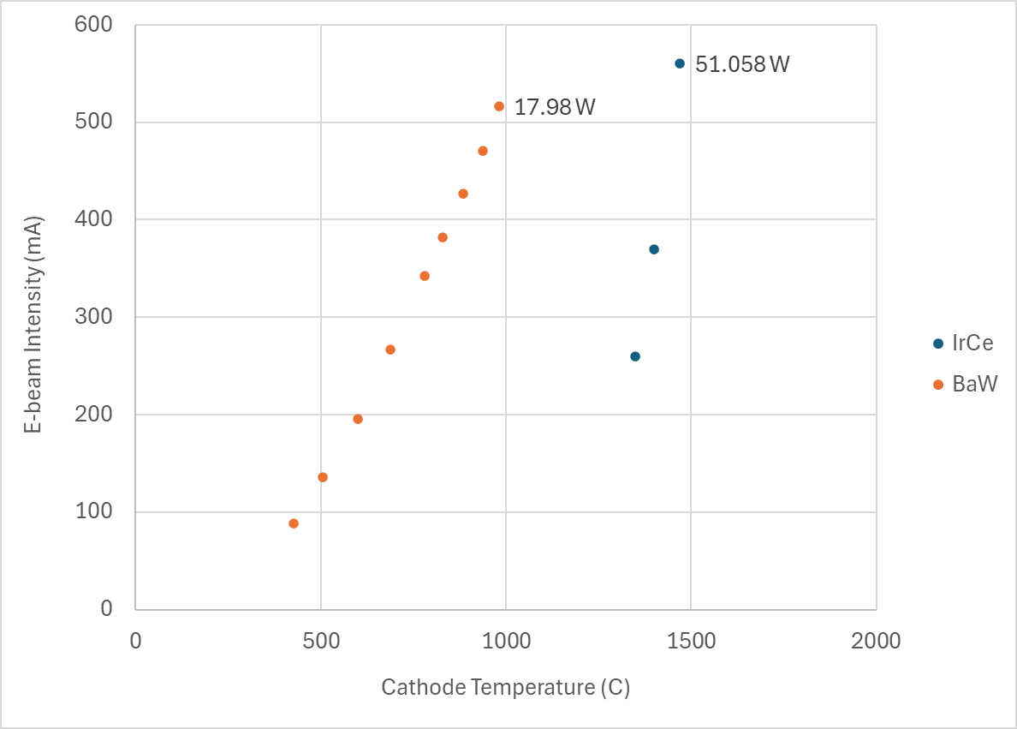
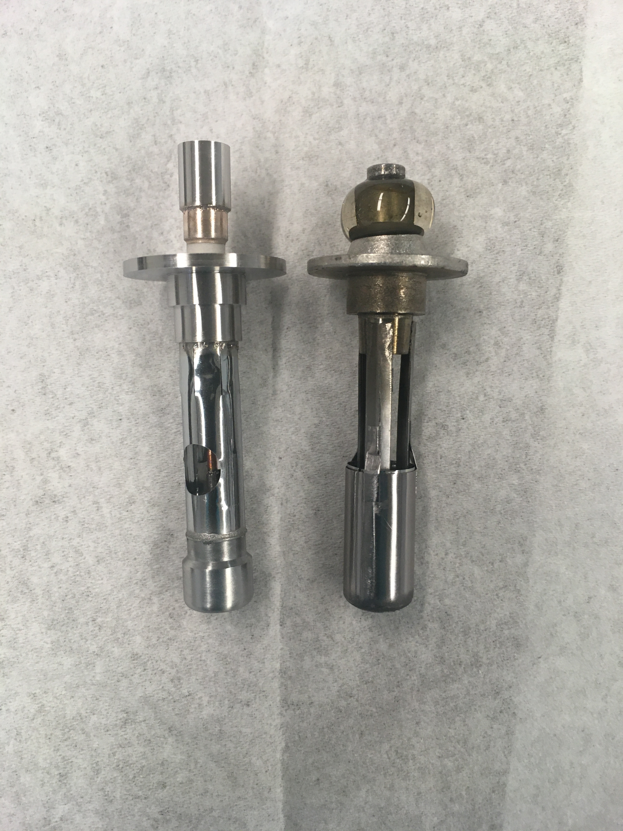
Ebis charge breeder
3M cathode
IrCe cathodes
  Were failing after ~5000 hours
  High power and high operating temperature
Ba/W dispenser cathodes
  No lifetime data as of yet
  Operate at lower temperatures
  Lower source operating pressures
  EBIS performance unaffected
IrCe
6.9E-10 torr
7.3E-10
1.1E-10 torr
5.8E-11
Ba/W
1.8E-10 torr
1.1E-10
IrCe: 5.3E-10 torr
Ba/W: 3.9E-10
57.8 mm

Slide 12
Ebis charge breeder
Closed shell breeding
EBIS Operating Parameters
Solenoid field | 5.5 T
Magnetic field on cathode | 0.14 T
Cathode diameter | 4.2 mm
Drift tube diameter | 20 mm
Electron energy (gun / trap) | 4.1 / 1.9 keV
Electron current | 0.17 A
Effective electron current density in trap | 180 A/cm²
Trap length | 0.5 m
Charge capacity | 2.4x10¹⁰
Injection time | 50 µs
Repetition rate | 10 Hz
Duty cycle | 78 %
EBIS bias | 20 kV
Pressure | 1x10⁻¹⁰ torr
16/6+
133/27+
16/4+
Most recent stable cesium results
Trying to hit right electron beam energy for 27+
  Have occasionally strayed into virtual cathode formation territory
133+: 10 epA, 133/27+: 76 epA
  Absolute efficiency: 28%
  Relative abundance: 43.6%

Slide 13
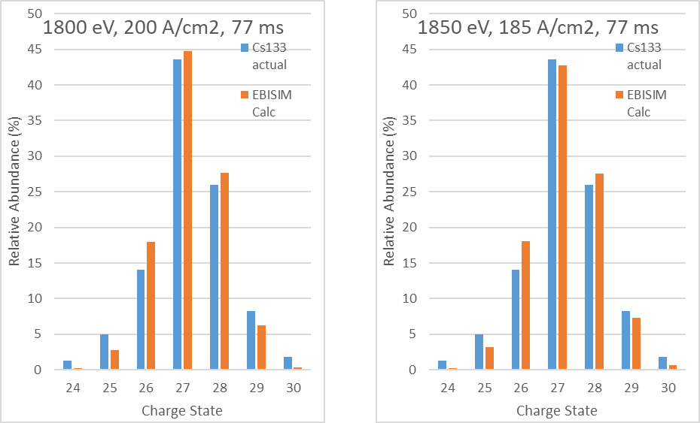
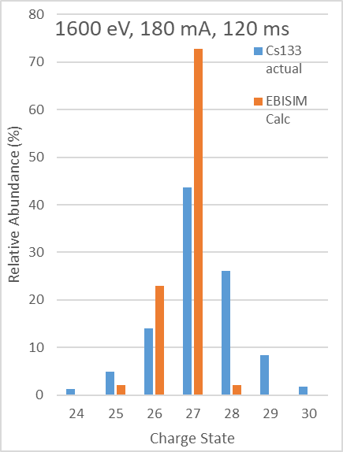
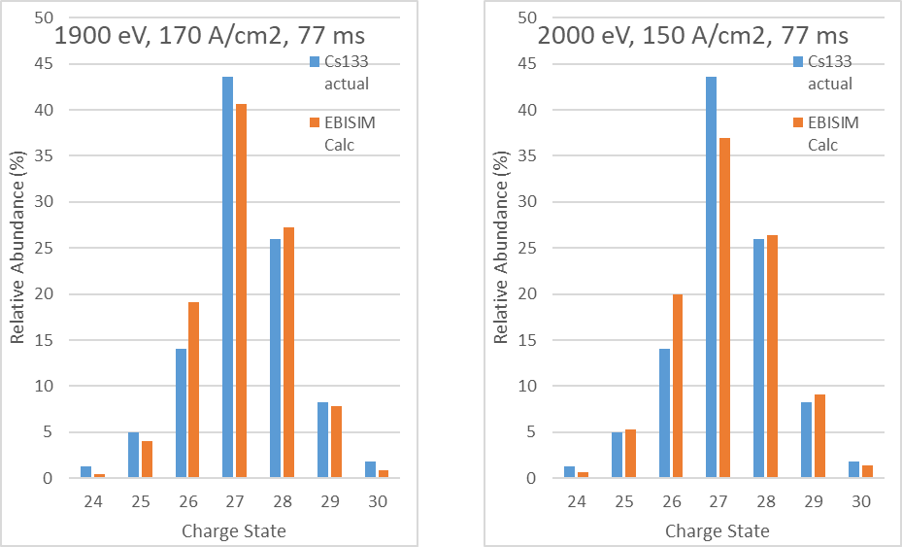
Ebis charge breeder
Closed shell breeding
Target settings
EBIS Operating Parameters
Solenoid field | 5.5 T
Magnetic field on cathode | 0.14 T
Cathode diameter | 4.2 mm
Drift tube diameter | 20 mm
Electron energy (gun / trap) | 4.1 / 1.9 keV
Electron current | 0.17 A
Effective electron current density in trap | 180 A/cm²
Trap length | 0.5 m
Charge capacity | 2.4x10¹⁰
Injection time | 50 µs
Repetition rate | 10 Hz
Duty cycle | 78 %
EBIS bias | 20 kV
Pressure | 1x10⁻¹⁰ torr
Achieved vs. calculated relative abundances for various electron energies and current densities
Simulations using ebisim dash (CERN)

Slide 14
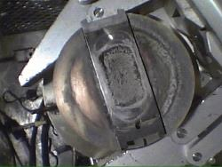
CARIBU issues
Mainly the 252Cf source
Source needs to be changed roughly every 3 years
Very challenging to obtain a good thin ²⁵²Cf source
The 1.7 Ci source, installed in May 2014, needed to be replaced in 2017
R&D at ORNL (2017)
  First of three plates was promising → 0.52 Ci with 40-50% release
  Next 3 attempts yielded no usable deposits
  Had to resume CARIBU research program, so installed single plate (May 2018)
  Current total yield: ~2 x 10⁷ fissions/sec
Proposed solution - nuCARIBU
  Neutron generator based source of fission fragments to obtain more reliable and higher intensity access to fission products

Slide 15
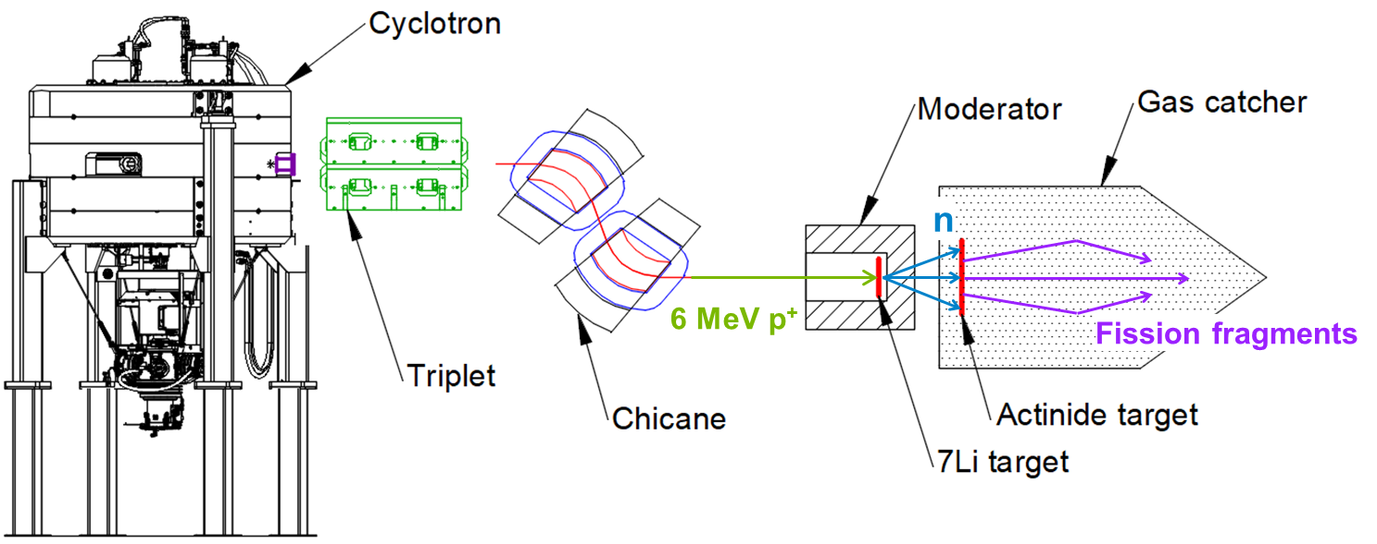
nuCARIBU overview
Neutron induced fission
Replace the ²⁵²Cf source and infrastructure with a neutron-induced fission system
  6 MeV, 0.5 mA proton cyclotron
  p-⁷Li reaction for neutron production
  Moderator
  Actinide target – ²³⁵U, ²³⁹Pu
Chicane provides room for cyclotron ion source and enables shielding at 180°

Slide 16
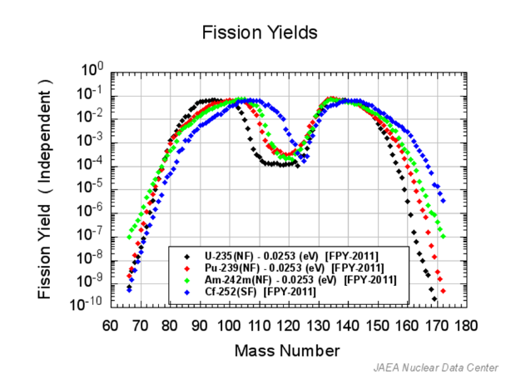
nuCARIBU goals
Significant gain
Consistency | Intensity | Reliability | Safety | Cost
A reproducible and controllable source of fission
Higher total yield
  ~1 x 10⁹ fissions/s from a thin ²³⁵U (5 mg/cm²) foil in the gas catcher
  (Current effective CARIBU rate ~2 x 10⁷ fissions/s)
Benefits
  Main source of radiation can be turned off, simplifying safety and maintenance
  Less expensive to operate in that it relies upon less lab resources – hot cells
  Opportunity to focus on different regions by choosing the best suited fission target
    ²³⁵U, ²³⁹Pu, ^{242m}Am
Significant loss

Slide 17
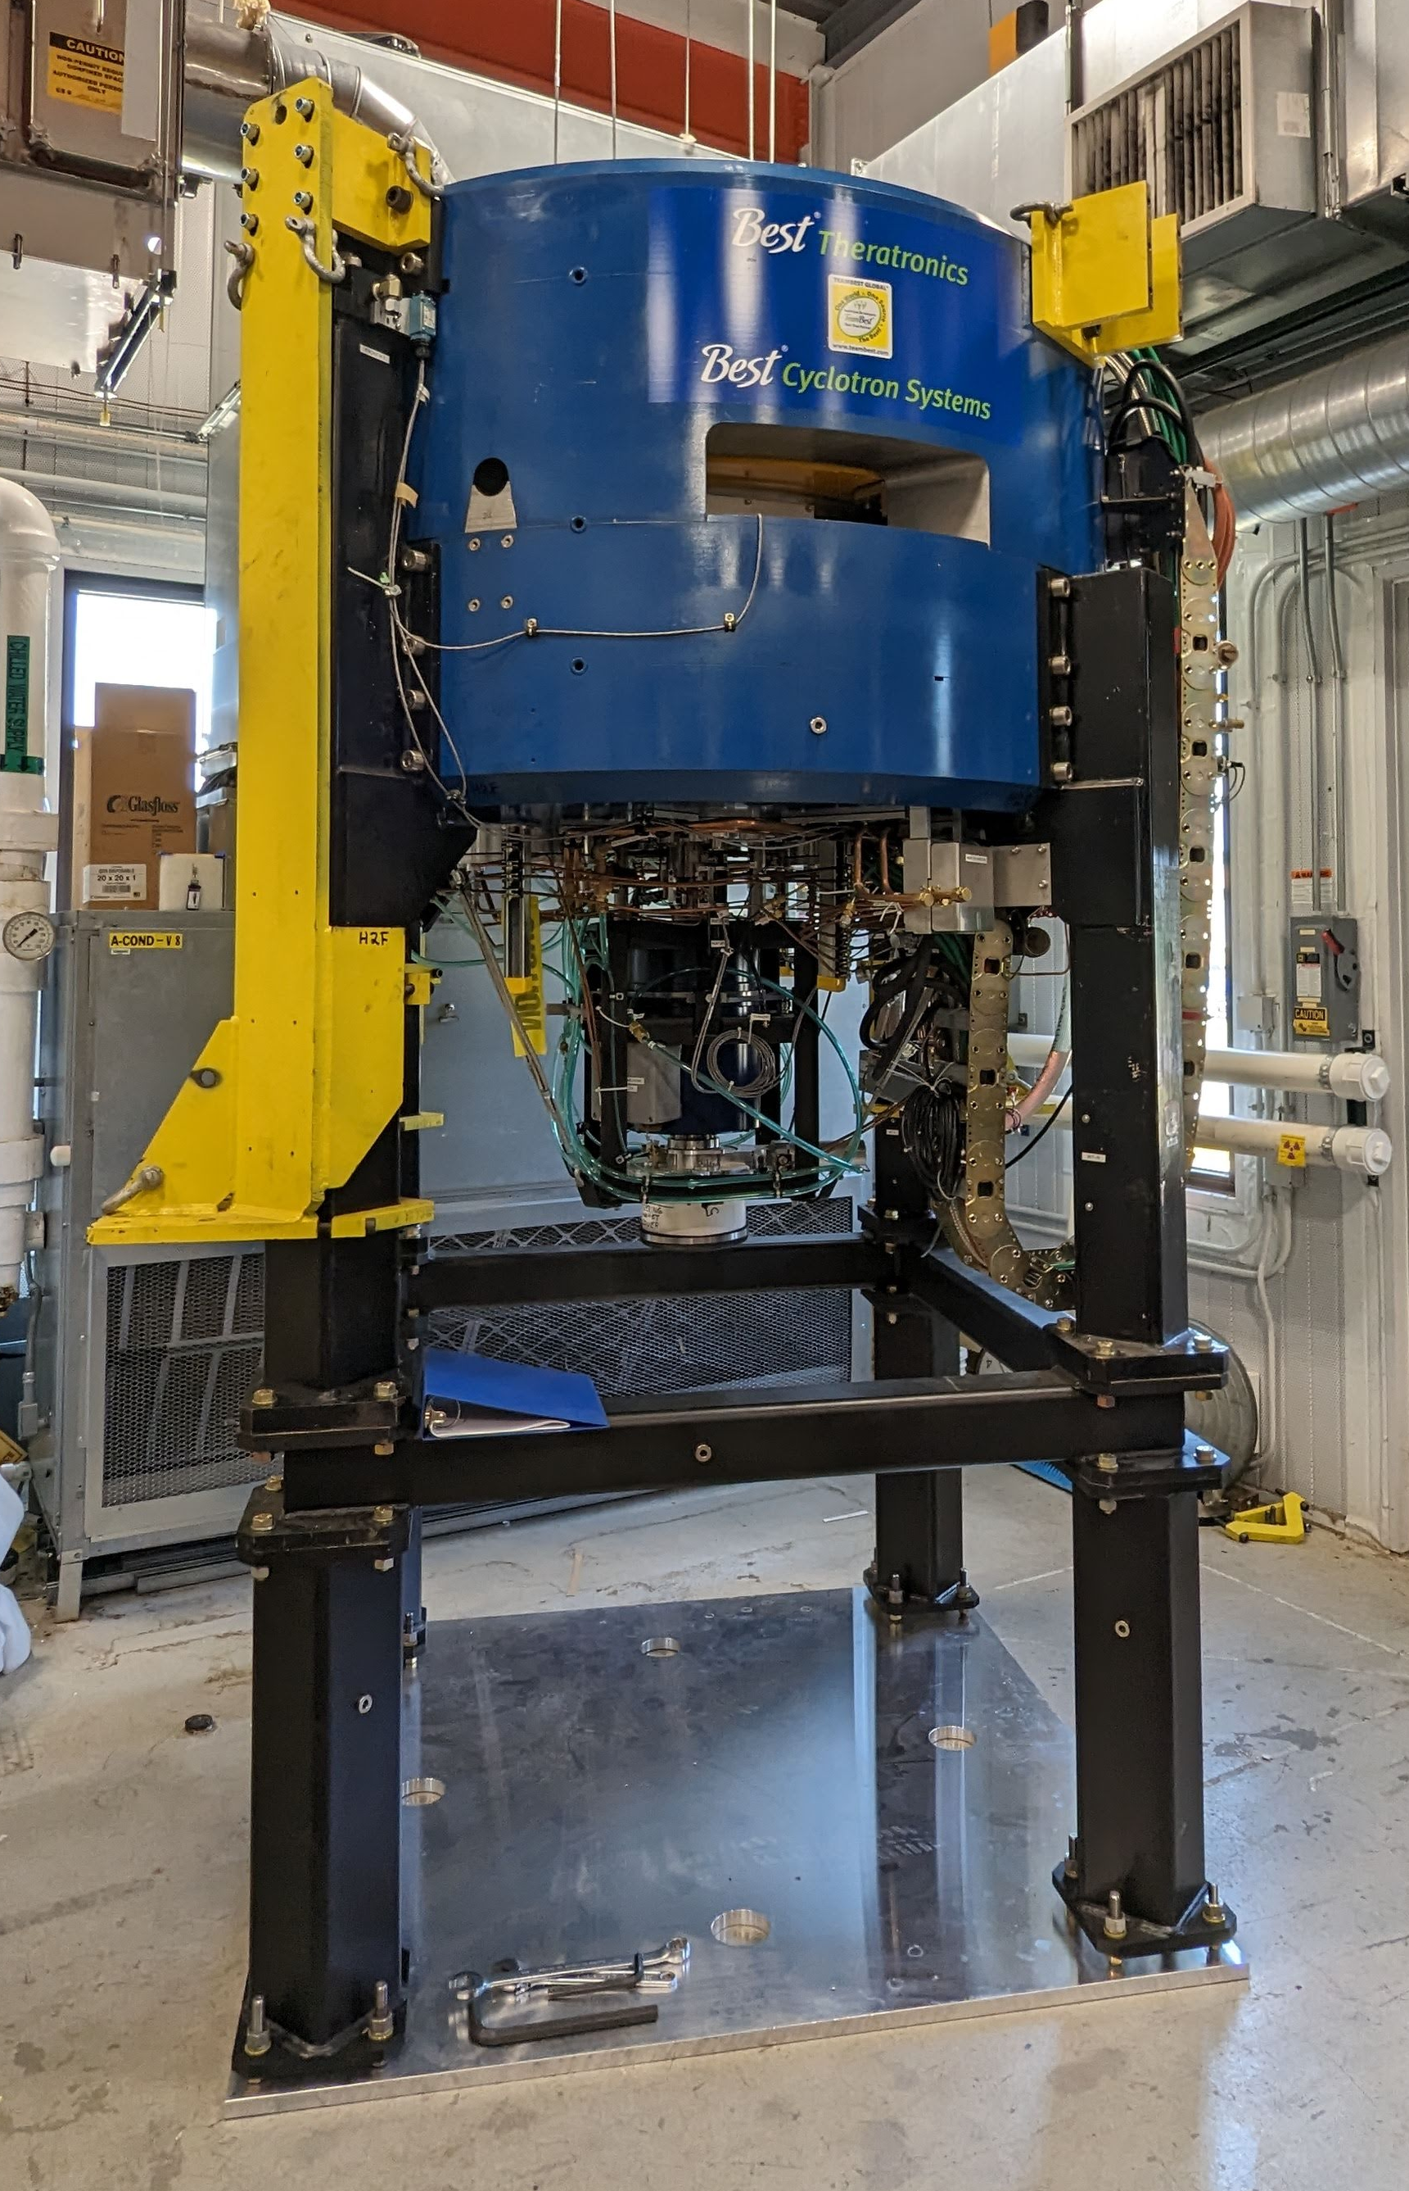
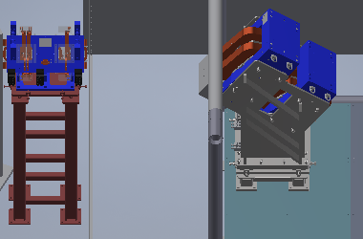
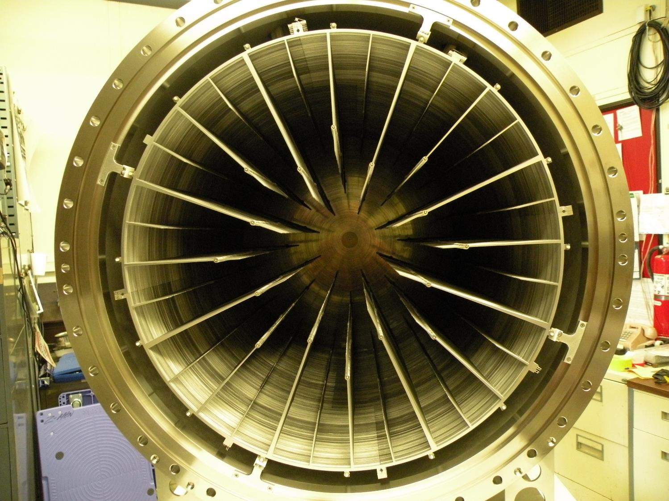
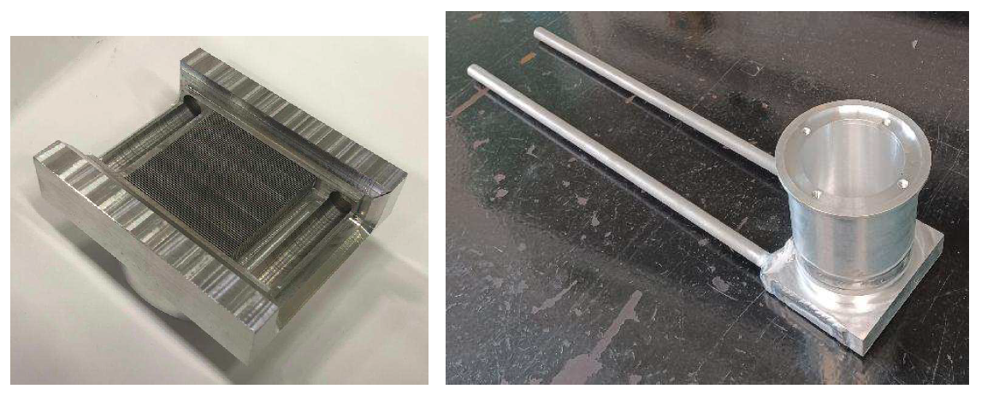
nuCARIBU scope
New equipment
  Proton cyclotron
  3kW ⁷Li target
  Fission target
  Moderator
  Shielding
  Transport
  Diagnostics
  Radiation interlocks
Facility modifications
  Utilities
  Gas catcher
  Documentation
Commissioning
Integrate the new equipment into ATLAS operations

Slide 18
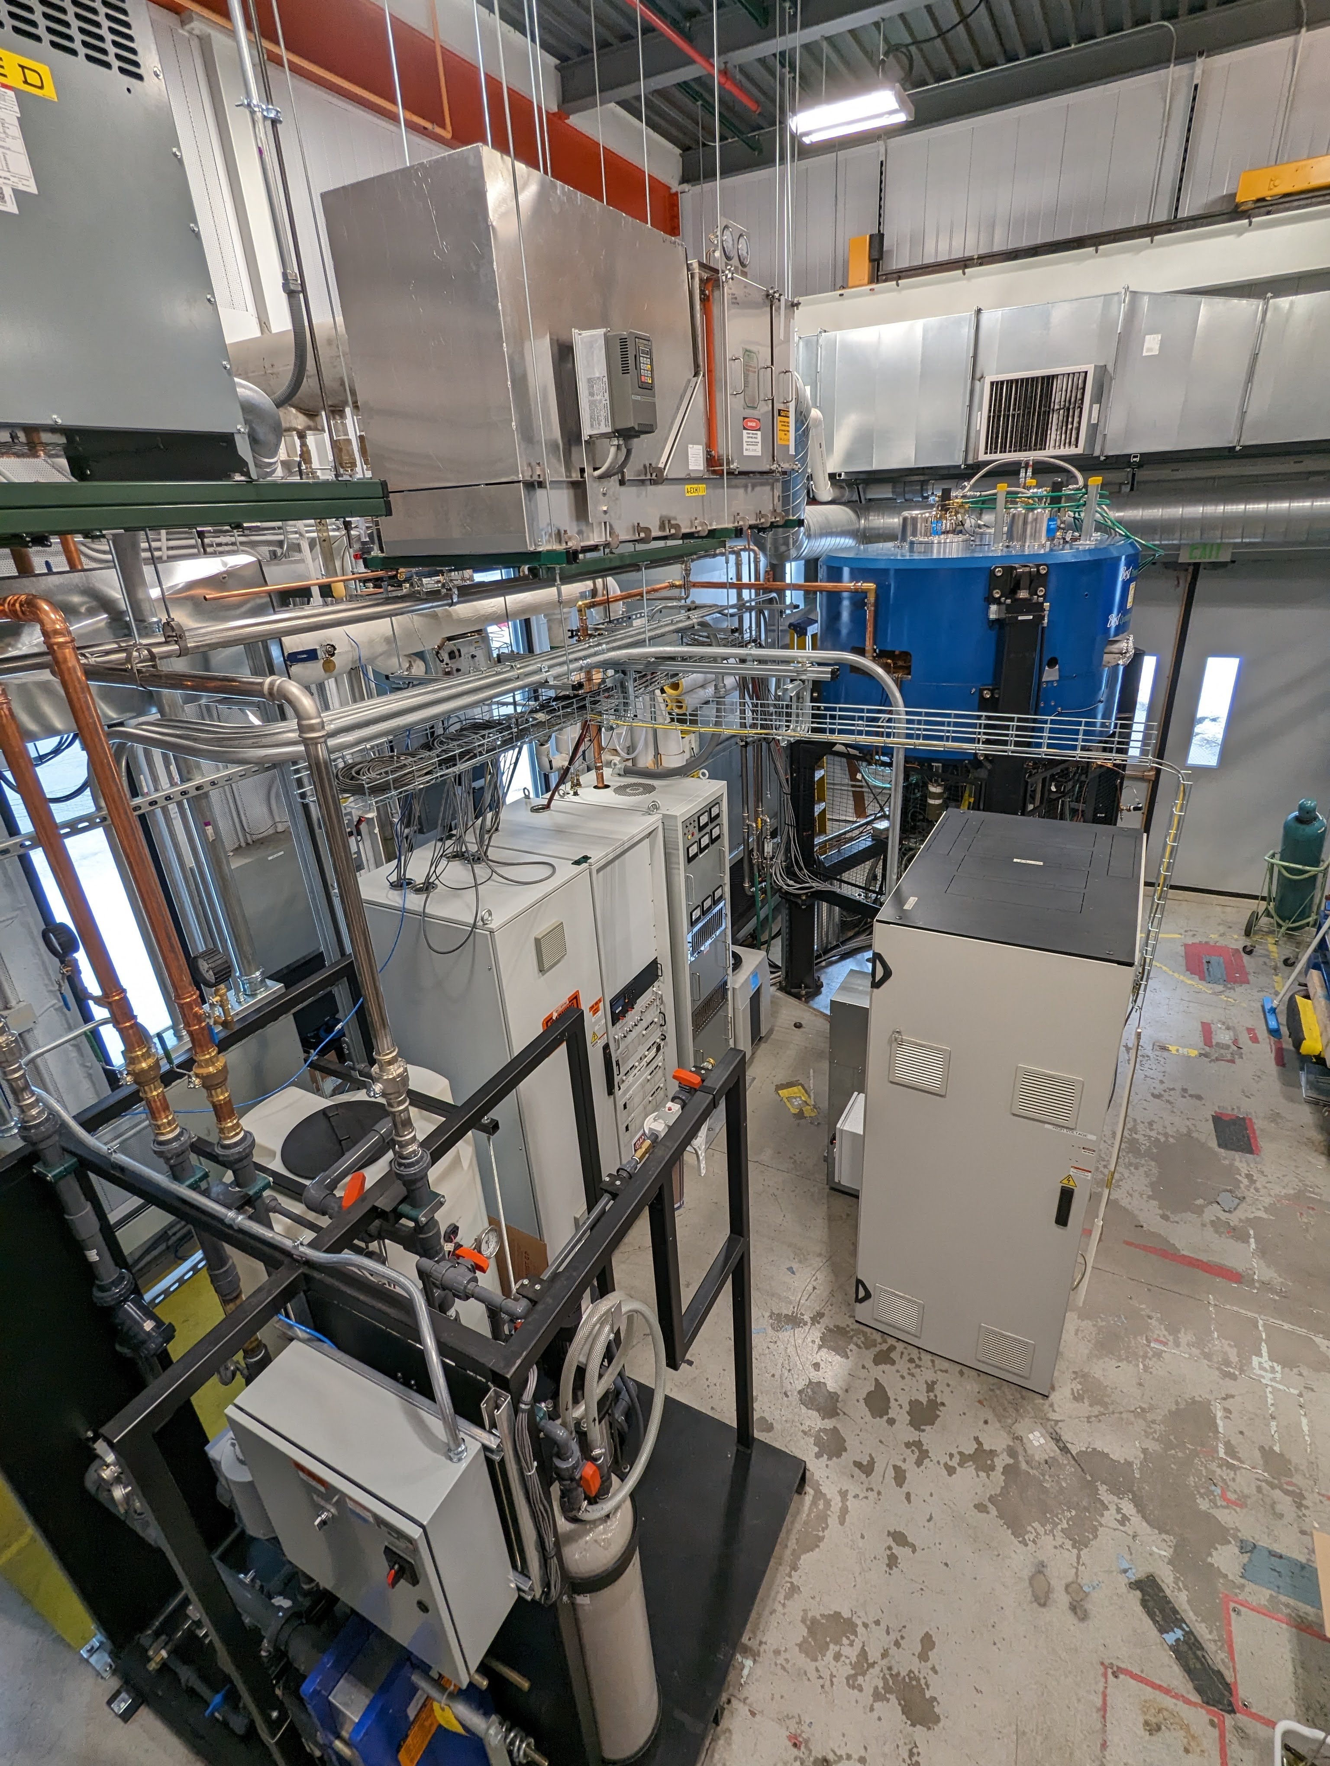
nuCARIBU status
Cyclotron in place in CARIBU
7Li target heat exchanger fabricated
Transport magnets (triplet and chicane) delivered
Radiation interlock PLC hardware due for delivery and majority of the software developed
Significant shielding simulations complete
Lots of reviews
Lots of paperwork
  Having to update/rewrite ATLAS SAD and ASE to reflect new installation

Slide 19
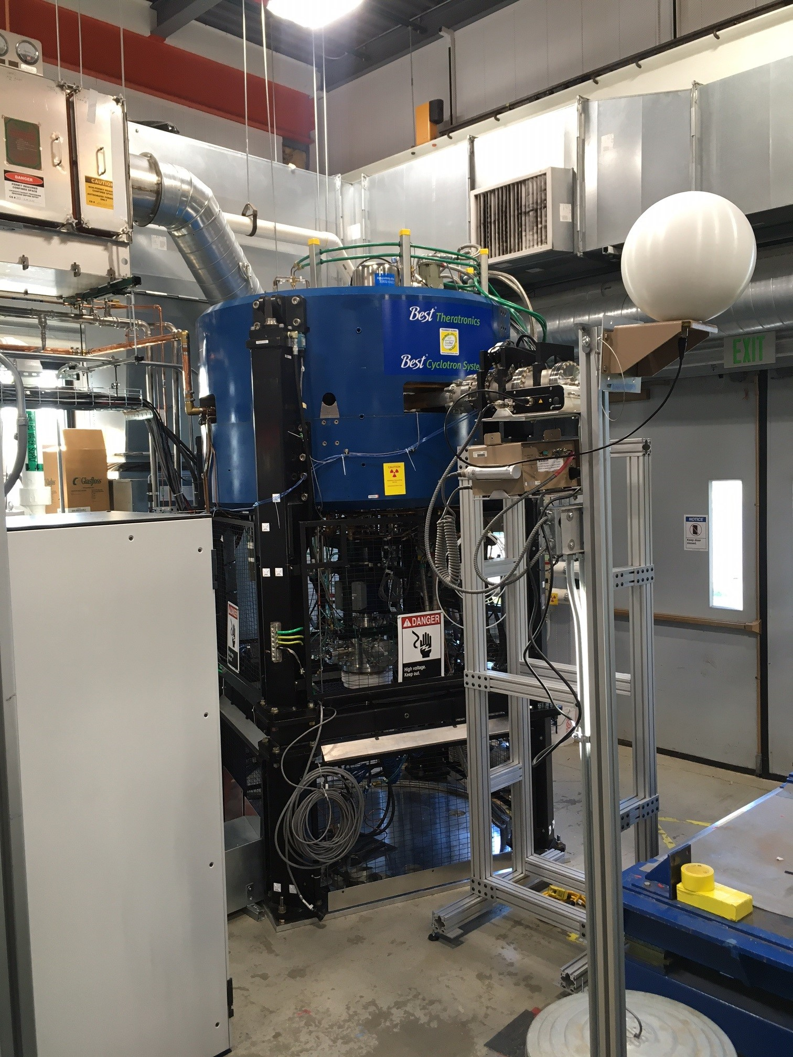
nuCARIBU commissioning
Major milestones
Install cyclotron
Connect cyclotron equipment – utilities, electrical racks, cabling, etc
Proton beam to beamstop at ion source exit
Protons to cyclotron Pop-up Probe at ~1 MeV orbit
Strip and extract 6 MeV beam directly into beam dump
Transport beam to CARIBU deck into beam dump
Evaluate p-⁷Li neutron production [KPP1]
Fission fragment production and selection [KPP2]

Slide 20
Atlas multi-user upgrade (amuu)

Slide 21
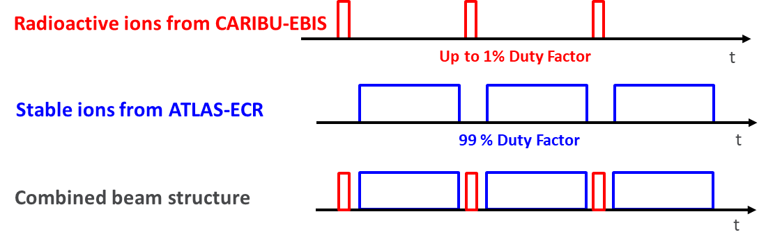
Multiuser upgrade
Making use of entire machine cycle
EBIS beam is typically 1 ms and 10 Hz repetition rate → 1 % DF
DC beam from ECR could be injected into ATLAS in the remaining 99% DF
nuCARIBU beam masses range from 80 to 170 with Z ranging from 30 to 70
ATLAS accelerates beams with A/q ratios ≤ 7
The useful range of A/q ratios for multi-user capability is 4 – 7
From previous years, ~40% of beams could have been run as multi-user

Slide 22
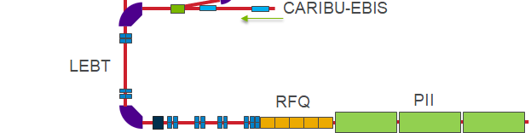
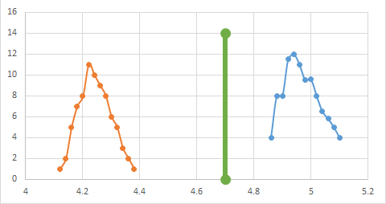

Multiuser upgrade
Demonstrated transport and acceleration of two species
¹³³Cs²⁷⁺ ¹³²Xe²⁷⁺
Slit scan
MCP
¹³²Xe²⁷⁺
¹³³Cs²⁷⁺
Both beams produced simultaneously by EBIS
Accelerated through RFQ, PII, and BOOSTER linacs with 70% total transmission
Acceptance for 7 ≥ A/q ≥ 4 is 3% for LEBT and 1% for RFQ/LINAC

Slide 23
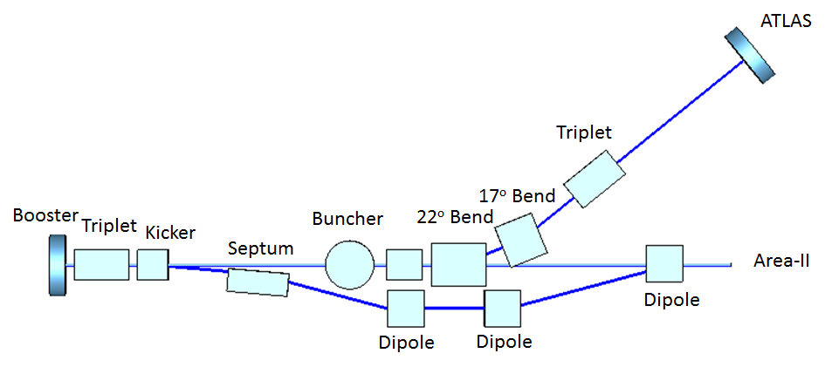
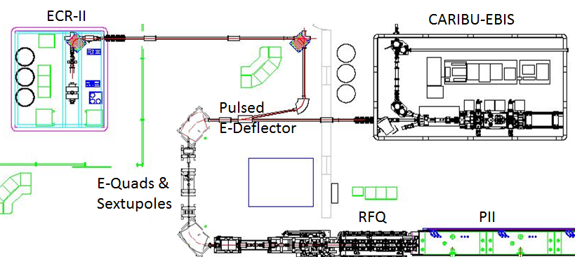
Multiuser upgrade
Scheme
Pulsed electrostatic deflector
2 electrostatic sextupoles
Compact triplet
Pulsed kicker-magnet ~ 5°
Septum-magnet ~ 10°
Kicker Requirements
Kick a 2.6 T.m beam by 5°-10° → 0.5 – 1.0 T field
Field rise/fall time of ~ 1 ms
Accommodate long and short pulses

Slide 24
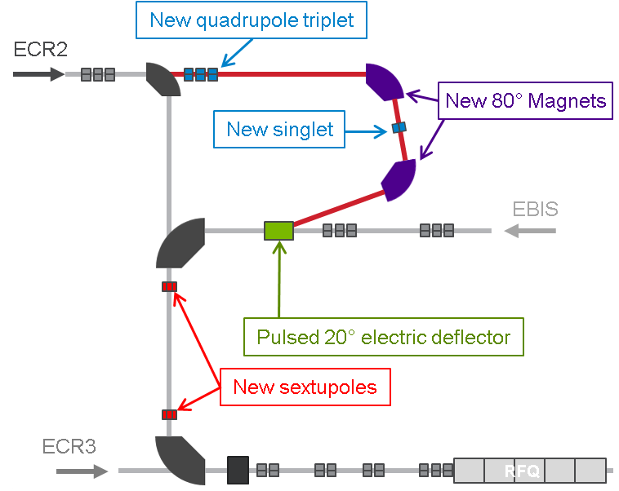
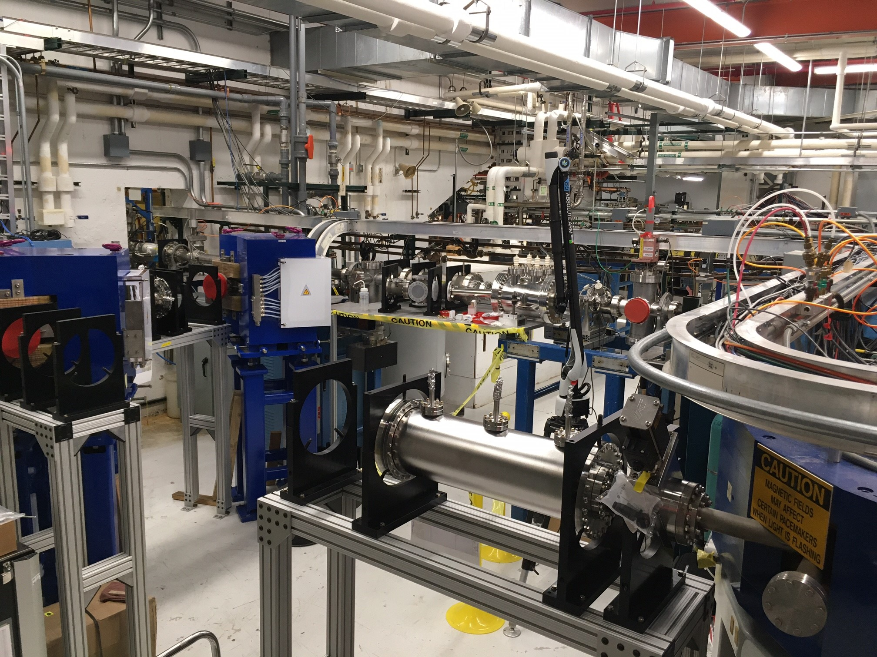
Multiuser upgrade
Status of front-end modifications
Modification of PII LEBT
  80 degree dipoles
  Pulsed electric deflector
  Sextupoles
  Triplet + singlet
  Vacuum equipment
  Chambers
  Diagnostics
  Controls
  Utilities

Slide 25
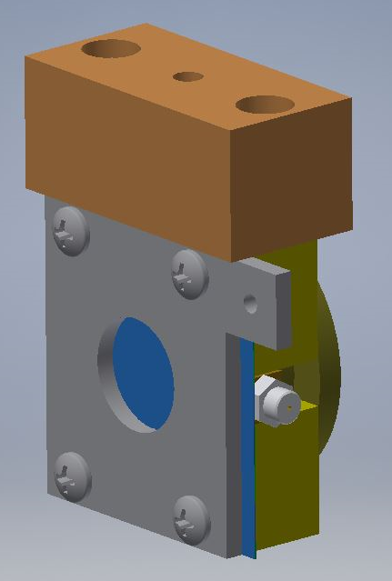
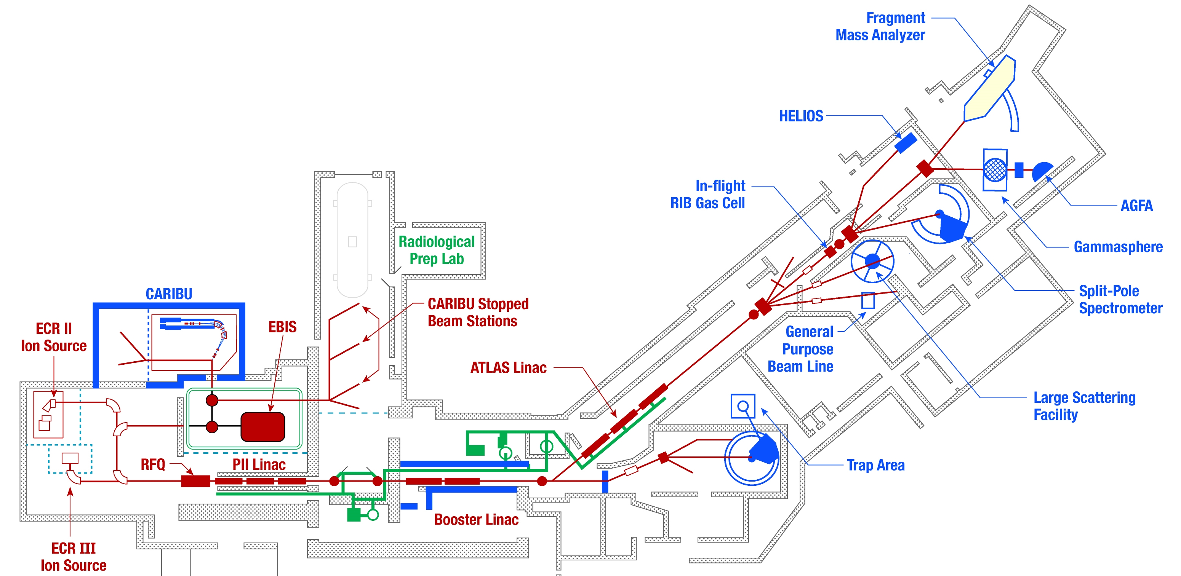
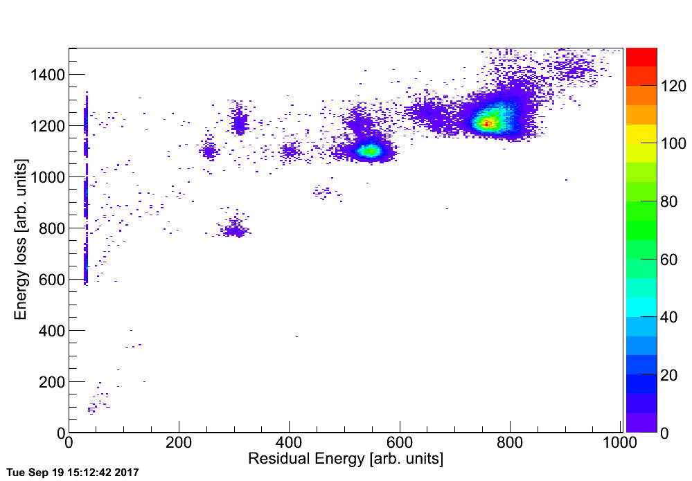
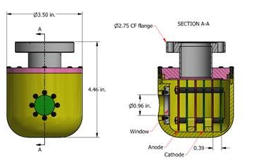
Rib detection
SBD
Multiple methods
SBD + IC
Faraday cup
  EBIS only
  >10 fA
Beta decay
  Aluminum implantation foil
  Silicon barrier detector
  Immune to contaminants
  Difficult with long half-lives
Gas ionization
  Only after post-acceleration
  Half-life not an issue
  10⁵ pps maximum
  3 Z resolution
  Compact
Microchannel plate
  Mainly at CARIBU
Silicon barrier
¹⁴²Ce²⁷⁺
¹²¹Sb²³⁺
¹⁴²Cs²⁷⁺
¹⁰⁰Mo¹⁹⁺
⁷⁹Br¹⁵⁺
80% RIB
Raw rate: 90 Hz
RIB ON
Ionization chamber
Notes:
Another practical aspect of operation is RIB beam detection, and for that we have several methods.
Faraday cups can be used with low intensity beams but only if the contamination level is low, such as with the EBIS.
Our primary system is aluminum foil covered silicon barrier detectors into which the radioactive species are implanted for beta decay detection.
All of the stations are identical, and we use them in the same manner one would faraday cups.
We also have versions which combine the faraday cup and beta detection capabilities.
More recently we have installed gas ionization chambers which do not have the half-life issue and have the benefit of Z identification.
We also have a few MCPs installed for energy and timing measurements.
The critical part is that you need these devices distributed throughout the entire beam path.
We initially had very few stations and relied upon our pilot beams and accelerator scaling, but something always goes wrong and you need diagnostics.
-----------------------------
Ortec TB-020-300-1000
300 mm^2 active area
1000 um depletion depth (1 mm)
14 keV beta resolution
Using a mix of MCPs and SBDs in CARIBU, EBIS, and LEBT areas
MCPs do not discriminate contaminant beam (post-EBIS)
SBDs are painful for long-lived species
At high energy rely upon SBD
Use experiment end station signal to optimize
Less Z resolution but primary purpose is to count ions
Intended to complement the existing diagnostics
In high energy sections only
Can be mounted on a 6” CF cross

Slide 26
Multiuser upgrade
Operational considerations
Tuning two beams
  One from ECR & one from nuCARIBU-EBIS
  Stable beam will be used for tuning all lines
    nuCARIBU beams require a guide beam
  nuCARIBU beam will be used to verify the tune to the designated target
Possible issues / restrictions
  Setting priorities
    Which experiment is primary
    Tasks for limited operations staff
  Two sources operating simultaneously
    Less time for beam development and maintenance
  Beam stripping can only take place after beam separation
Personnel issues
  More source personnel are on call more often
  Two beams on targets: requires two operators on duty

Slide 27
summary
EBIS is running well
  Will continue working on closed-shell breeding
nuCARIBU is taking up lots of time
  Ion source group is responsible for H⁻ source, cyclotron, and transport line
  CARIBU group handles lithium target, gas catcher, transport to EBIS deck
  Then beam gets handed back to ion source group for charge breeding and transport to linac
Multi-user will be challenging
At same time we are…
  Delivering 6000 hours of beam
  Developing new ion source techniques
  Upgrading ECR2 ion source

