Slide 1
Charge State Breeding at TRIUMF
Friedhelm Ames
NACB workshop
Brookhaven National Laboratory
April 28-29, 2024

Slide 2
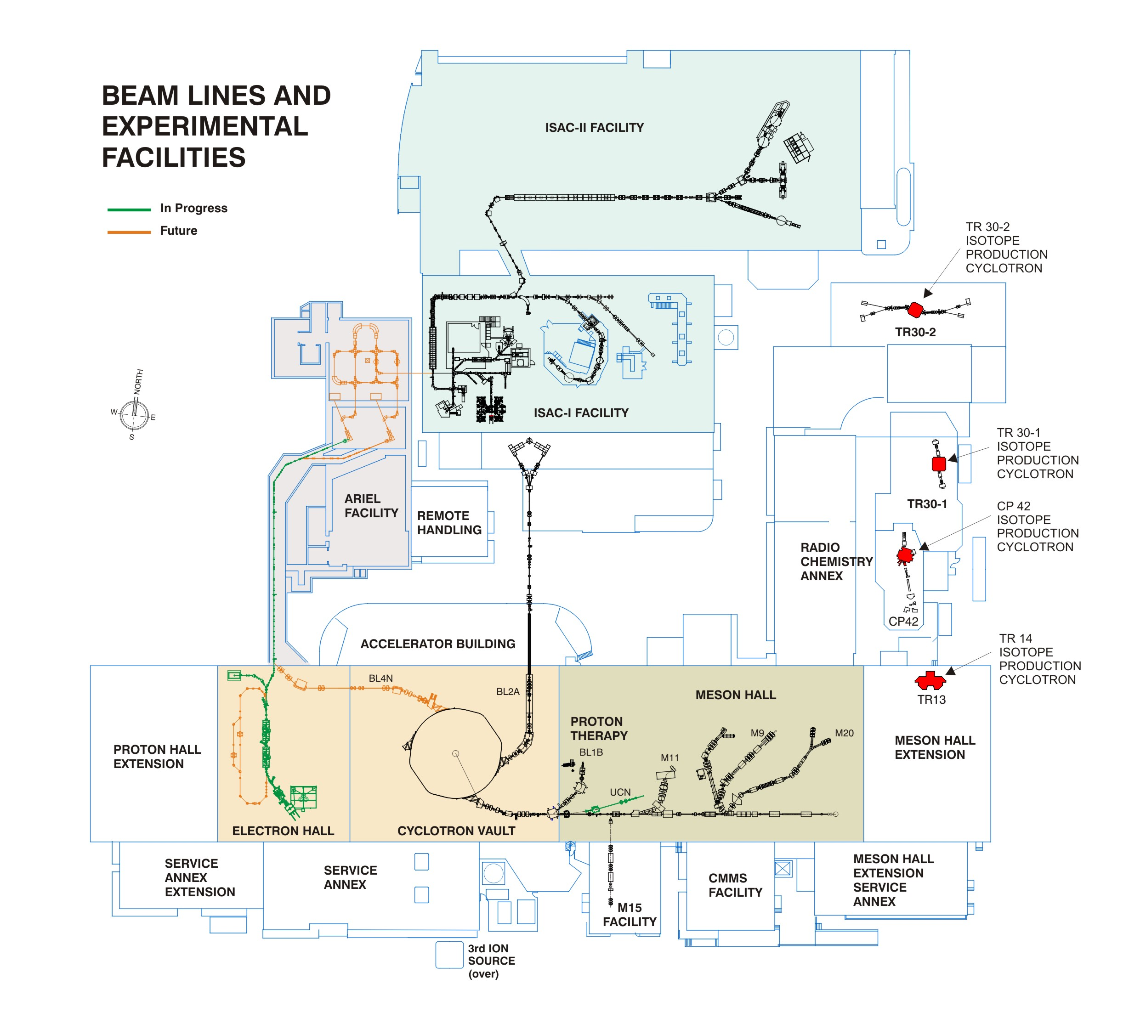
ISAC I and II
rare isotope beams up to 15 MeV/u
2 target stations for
up to 100 µA p beam @ 480 MeV
charge state breeding
CANREB
high resolution
mass separation
charge state breeding
4 cyclotrons 13-30 MeV
for medical isotope production
(BWTX)
ARIEL
e-linac 30 MeV 10 mA
e⁻ and p⁺ target station
for rare isotope
beam production
500 MeV H⁻ cyclotron
up to 4 simultaneously
extracted p⁺ beams
individually variable energy
up to 120 μ A per beam line
Beam line 1
µSR experiments
isotope production
ultra cold neutron source
p and n irradiation
(p therapy)

Slide 3
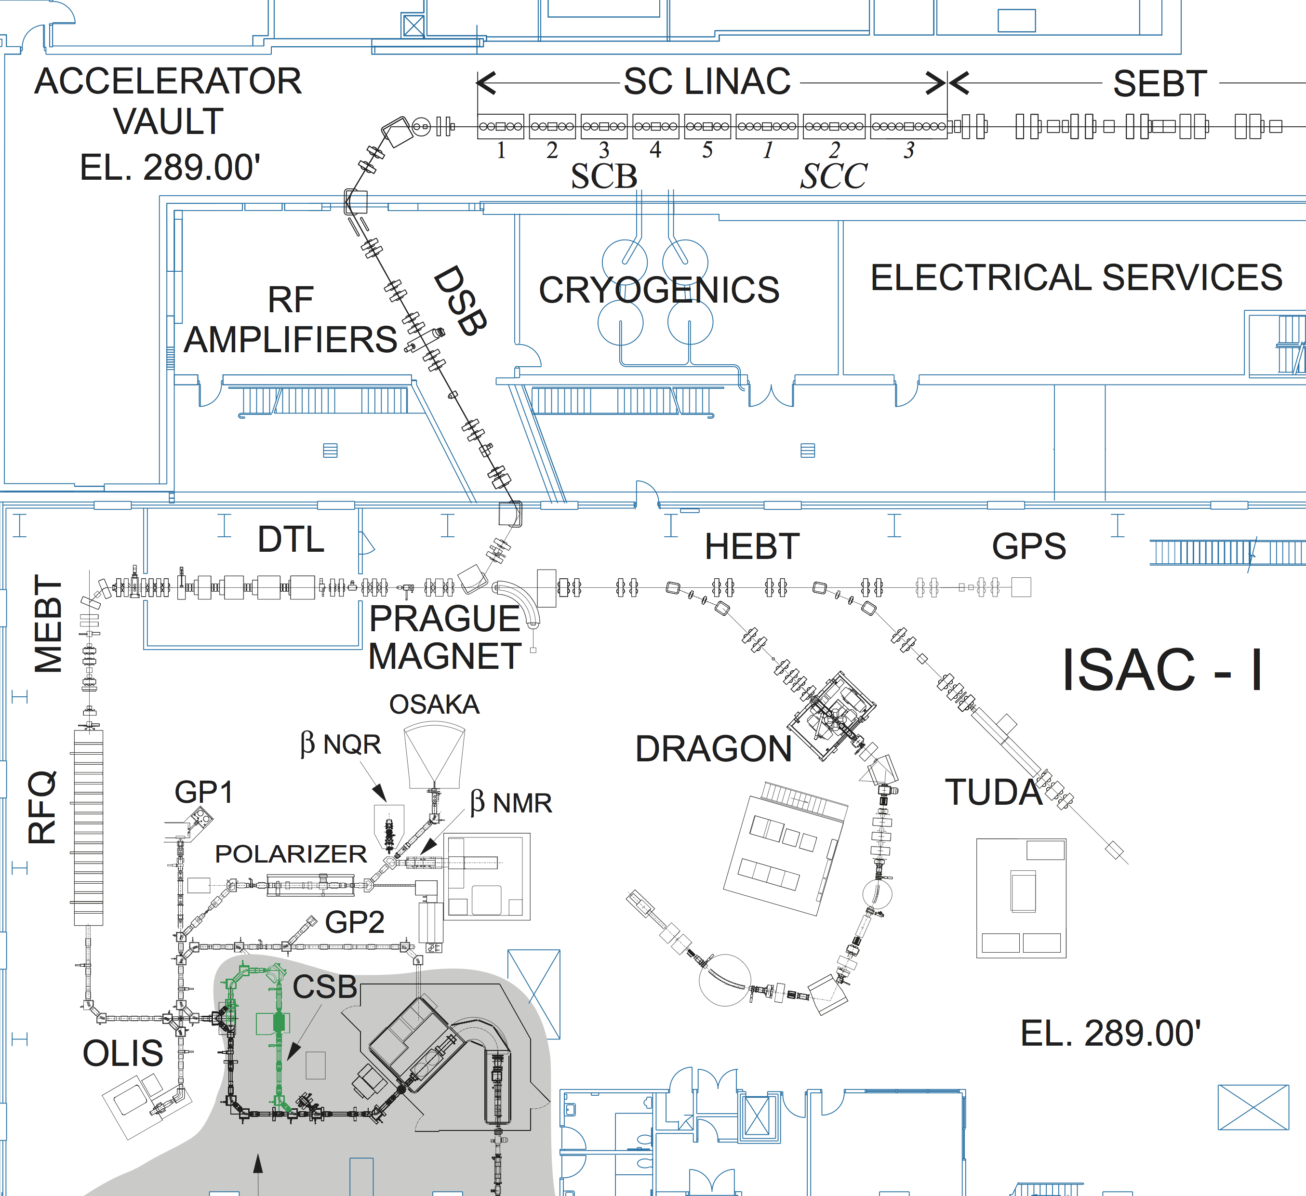
post acceleration
ISAC accelerator chain
RFQ: (radiofrequency quadrupole accelerator)
acceptance : A/q < 30 @ 2.04 keV/u
final energy: 150 keV/u
DTL: (drift tube linear accelerator)
acceptance A/q <7
final energy 1.5 MeV/u
superconducting LINAC:
acceptance A/q <7
final energy 15 MeV/u for A/q=3
A/q < 30 injection of 1+ ions, stripping after RFQ
A/q > 30 charge state breeding to A/q <7
stripping after DTL for higher energy or purification
From ARIEL
Charge state breeding needed for A/q >30

Slide 4
RIB operation
Up to 2017 (9 month /year)
Scheduled operation of ISAC 5000 hours/ year
Overhead and downtime 2000 hours/ year
Beam to experiments and development 3000 hours/ year
Typical duration of an experiment 2 days to 3 weeks (average ~1 week)
Ratio accelerated to non accelerated beams ~30%
Since 2018
~8 months per year reduced schedule for ARIEL installations
2020-22 further reduction due to COVID

Slide 5
Charge breeding systems at TRIUMF
For post acceleration:
ECRIS → Joseph A
EBIS → Brad S
For precision mass measurements:
EBIS → Fernando M
Requirements for post acceleration:
Mass <238
Charge: A/Q <7
Energy: 2.04 keV/u
Intensity: 1 – 10⁹ ions/s

Slide 6
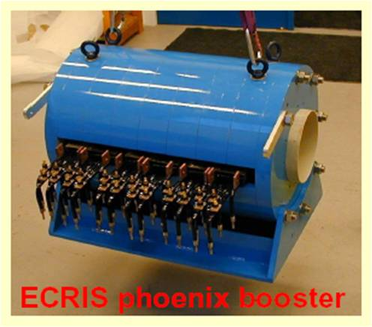
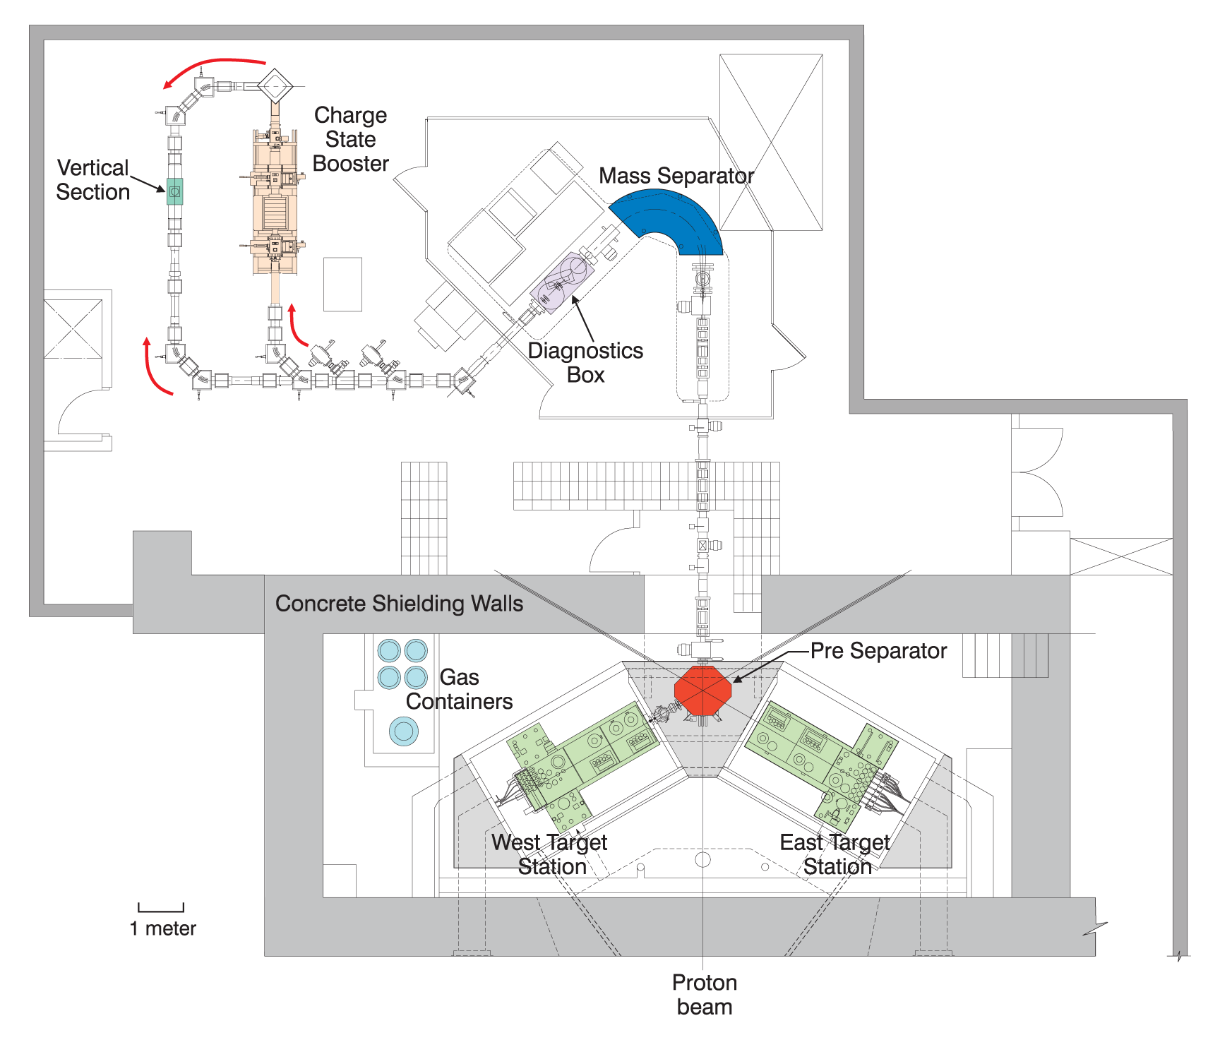
ECRIS charge state breeding
charge state breeding with an ECR ion source
At ISAC
14.5 GHz PHOENIX from Pantechnik
modified injection and extraction optics
Aluminum plasma chamber
One or two frequency operation
continuous beam operation
On-line operation since 2008

Slide 7
charge state breeding results
efficiency and charge state distribution
⁹⁴Sr
¹⁵⁸Er
¹³³Cs
²³⁸U
radioactive ions from on-line ion source
total efficiency >17%
stable ions from off-line and on-line ion source
total efficiency 35%

Slide 8
ECRIS background
background from residual gas and
plasma chamber materials
Material has been changed from stainless steel to aluminum
Use additional stripping at 1.5 MeV/u for purification from non isobaric background

Slide 9
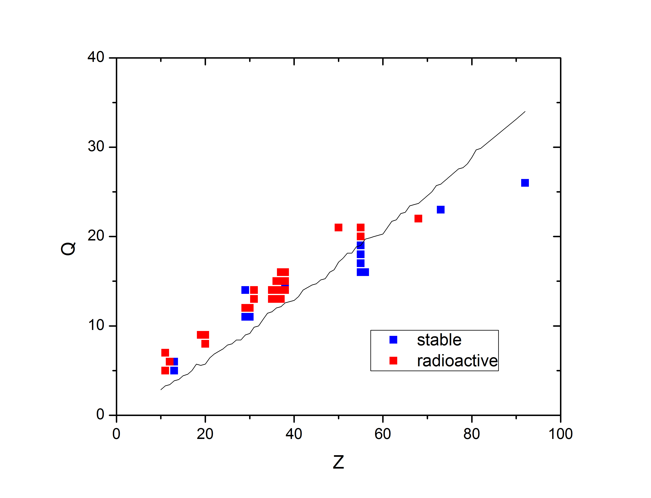
ECRIS charge states
Required for stable isotopes for A/Q < 7
Charge state with maximum intensity
(or used for experiment)
A/Q requirements can be fulfilled for elements with Z~< 60-70

Slide 10
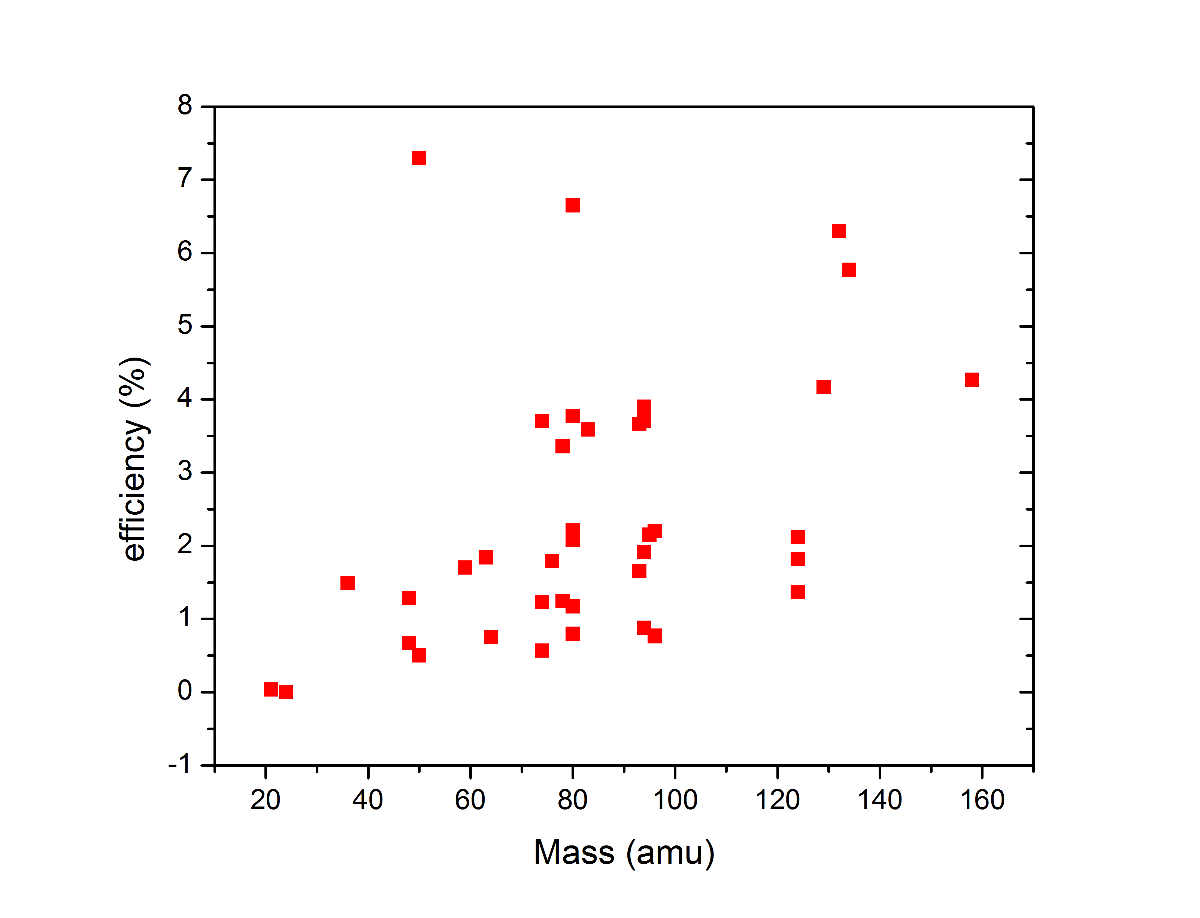
ECRIS efficiency
Radioactive isotopes
(used for experiment)

Slide 11
Summary ISAC :
More than 20 years radioactive beam delivery
More than 800 isotopes
Post-acceleration up to 15 MeV/u
ECR charge state breeder at ISAC operational since 2008
  isotopes from more than 15 elements have been charge bred so far
  range of ions charge bred for acceleration: ²¹Na – ¹⁶⁰Er
  efficiency 1-5%
  problems:
  high background
  long breeding time (~20 ms*q)
  Ongoing improvements to ECR charge breeder:
  implementing 2 frequency heating and improving injection/ extraction optics
  → higher efficiency, higher charge states, more stable operation

Slide 12
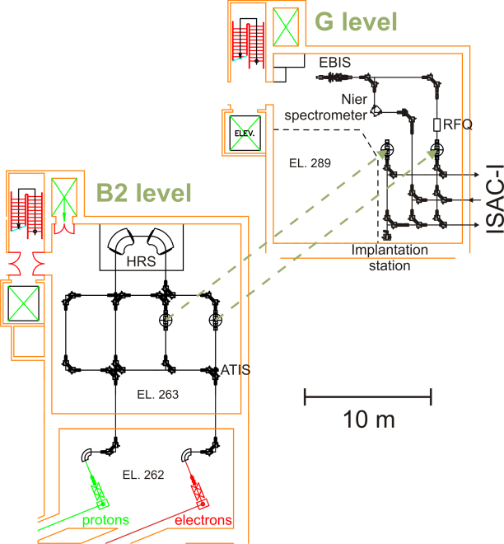
CANREB/ ARIEL rare isotopes beam lines
2 target stations
Up to 100 µA protons @ 480 MeV
Up to 3 mA electrons @ 30 MeV
High resolution mass separator M/ΔM = 20,000
EBIS charge state breeding
RFQ cooler buncher before injecting into EBIS
EBIS can also be used for beam from ISAC

Slide 13
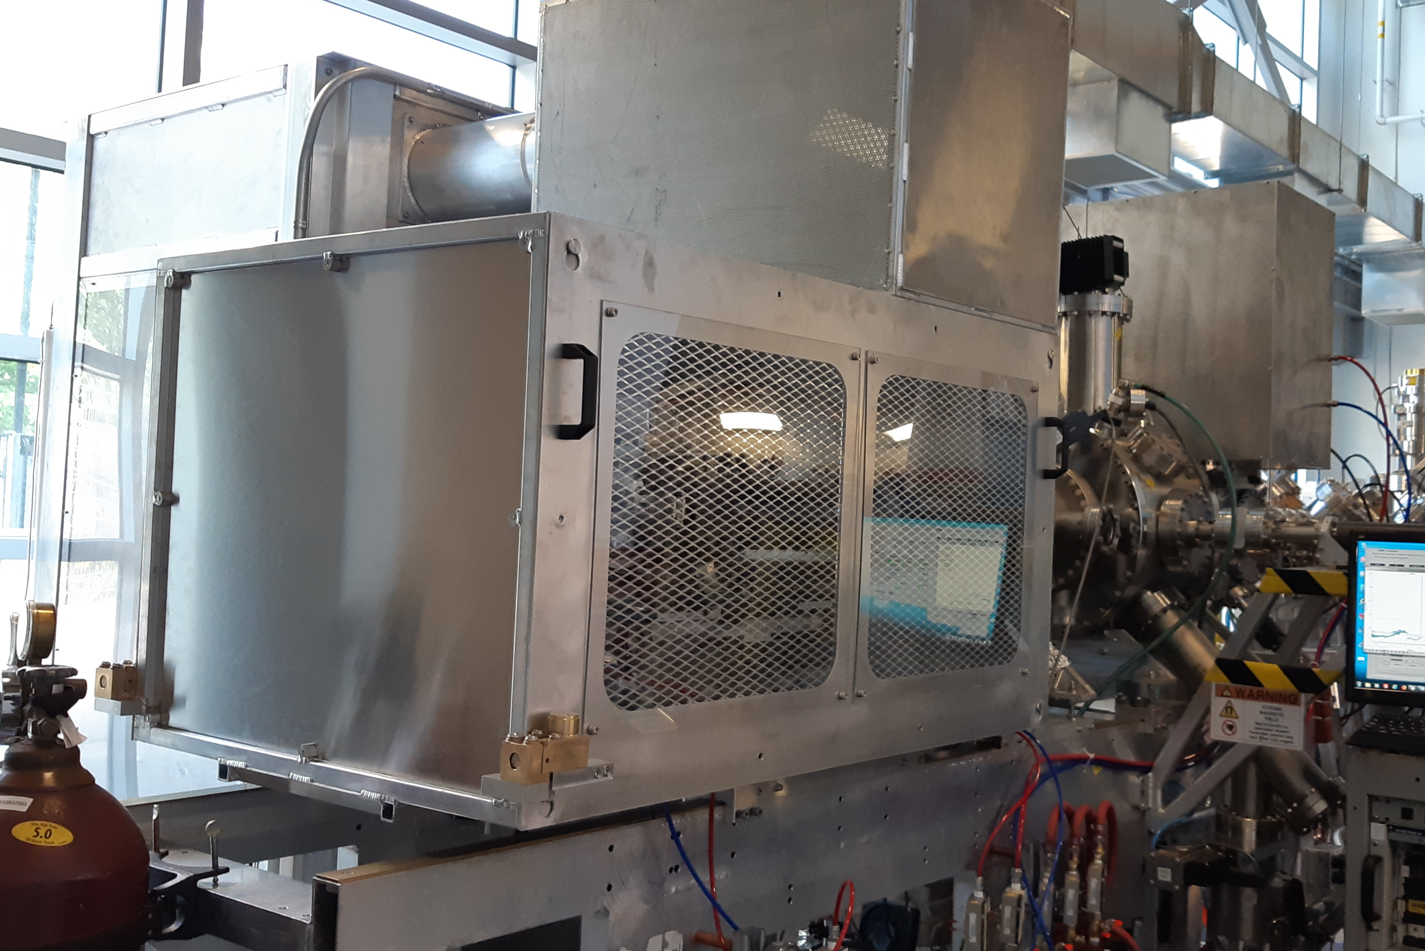
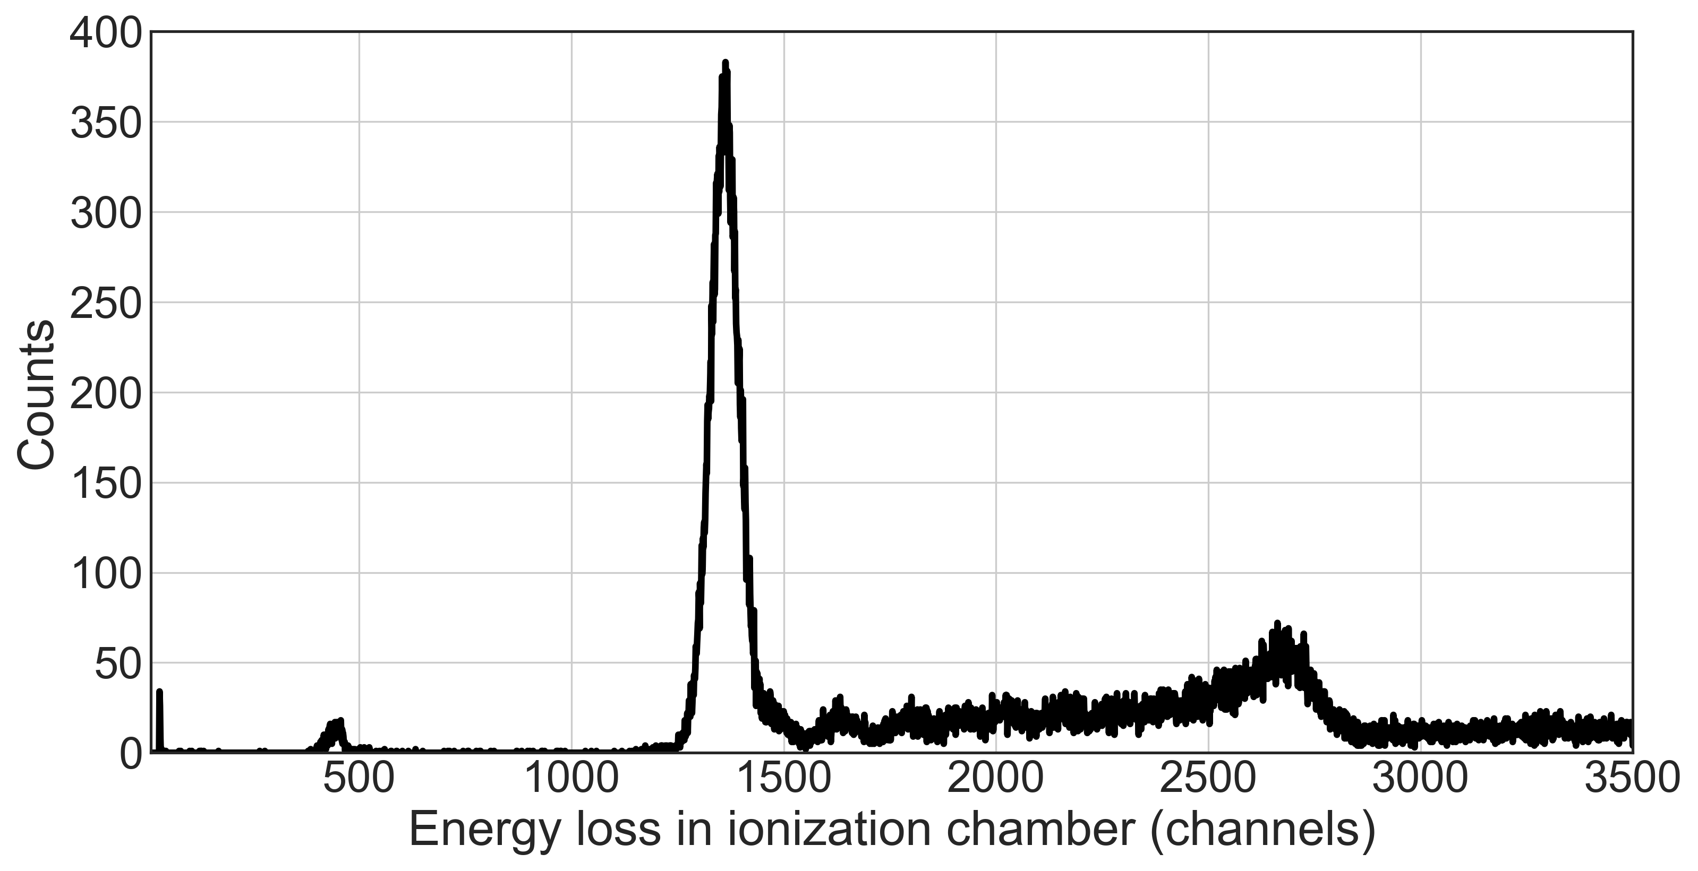
EBIS charge breeding status
EBIS delivered from MPIK Heidelberg 2019
Design values:
  Magnetic field up to 6T
  Electron beam current up to 500 mA
First tests done in 2020
Principle proof of operation with radioactive ions ⁵⁹Cu¹⁹⁺ and acceleration to ISAC II experiment
⁵⁹Cu
Problems with high voltage stability
partly resolved (maximum operation ~10 kV)
Electron gun maximum current limited to ~30 mA
  → new gun design under construction
Pile-up
Contaminant?

Slide 14
EBIS future developments
Pulse stretching first successful tests
Closed shell breeding requires higher electron beam current.
Will be done after new gun is implemented
M. Cavenaile

Slide 15
Future operation
ISAC + ARIEL beam delivery
Total hours to users: 9000 per year
3 simultaneous beams
  2 to low energy experiments
  1 accelerated beam
Fixed duration for one target (3 weeks)
Reduce overhead for beam tuning by
  implementing high level applications
  using ion optics model-based and AI based tuning
  automatic scaling and accelerator phasing

Slide 16




Thank you
Merci
www.triumf.ca
Follow us @TRIUMFLab

