Slide 1
Status of the CANREB EBIS at TRIUMF
Brad Schultz
Beam Delivery Physicist

Slide 2
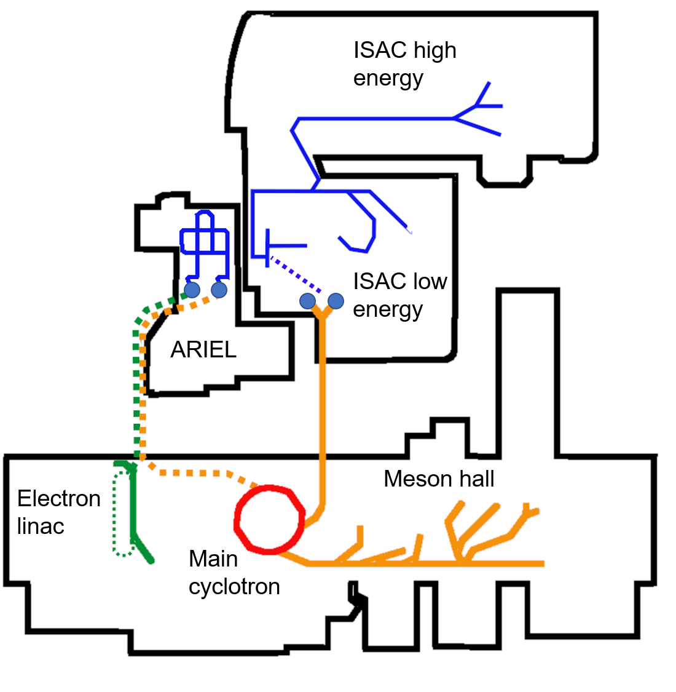
TRIUMF overview
TRIUMF is Canada’s particle accelerator center¹
Main cyclotron → Up to 520 MeV, 130 µA proton beams (max 100 µA to ISAC)
Rare isotope beam (RIB) production in ISAC
Two target stations (U, Ta, Si, Nb, Th, C)
Surface, laser, and plasma discharge sources
Direct transport to low-energy experiments (< 60 keV)
Transport to high-energy experiments requires post-acceleration
Post-acceleration in ISAC
Multi-stage linac (room-temp + SC)
Energy = 0.15 – 9.5 MeV/nucleon (A/q = 4)
Energy acceptance = 2.04 keV/nucleon
Highest energies and/or heaviest masses require charge breeding → ECRIS
Often requires second stripping in linac (reducing overall efficiency)
¹ ISAC and ARIEL: The TRIUMF Radioactive Beam Facilities and the Scientific Program ed J Dilling et al (Dordrecht: Springer)

Slide 3
ARIEL overview
Advanced Rare IsotopE Laboratory (ARIEL)
New targets for RIB production
Proton station → 480 MeV/100 µA (new beamline from cyclotron)
Electron station → electron driver + converter = photofission via gammas
Both stations can run in parallel with one ISAC target → up to 3 simultaneous RIB beams
Electron linac
Driver for photofission → Up to 10 mA @ 30 MeV = 300 kW on target
Future recirculation for increased energy or user facility (e.g. THz free electron laser)
CANadian Rare isotope facility with Electron Beam ion source (CANREB)
Next slide…

Slide 4
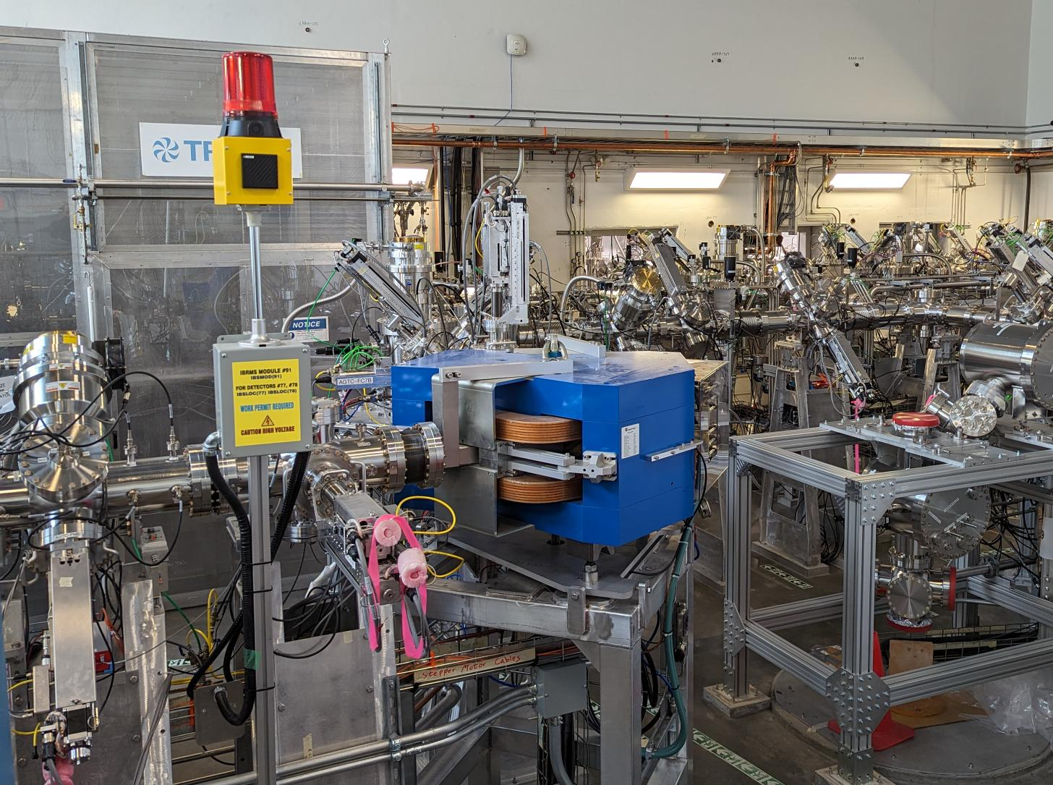
CANREB for post-acceleration
For post-acceleration of heavy masses (up to ~10 MeV/u) charge state breeding is required
ECRIS (Phoenix ECR) in ISAC has been operated for many years → Suffers from large background currents (due to residual gas pressure and plasma chamber sputtering) and limited maximum charge state
Electron beam ion source (EBIS)
Designed for UHV → Lower background rates (by up to several orders of magnitude)
Capable of higher charge states and efficiencies
Control of electron beam energy & confinement time → Special schemes, e.g. closed shell
CANREB EBIS built for charge state breeding in range 3 < A/q < 6
Also contains high-resolution separator (HRS) for isobaric purification of beams from ARIEL target stations (Δm/m ~ 1/20,000)

Slide 5
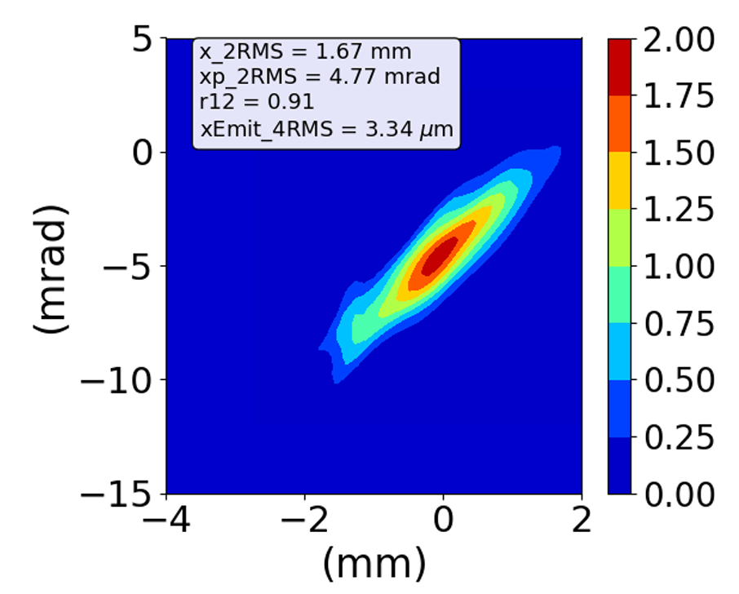
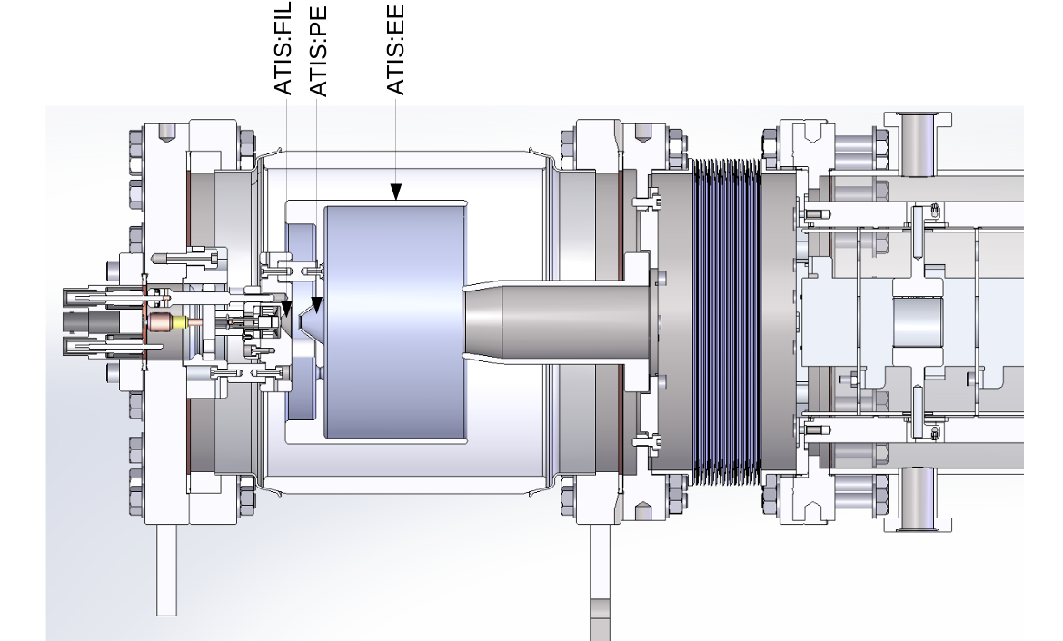
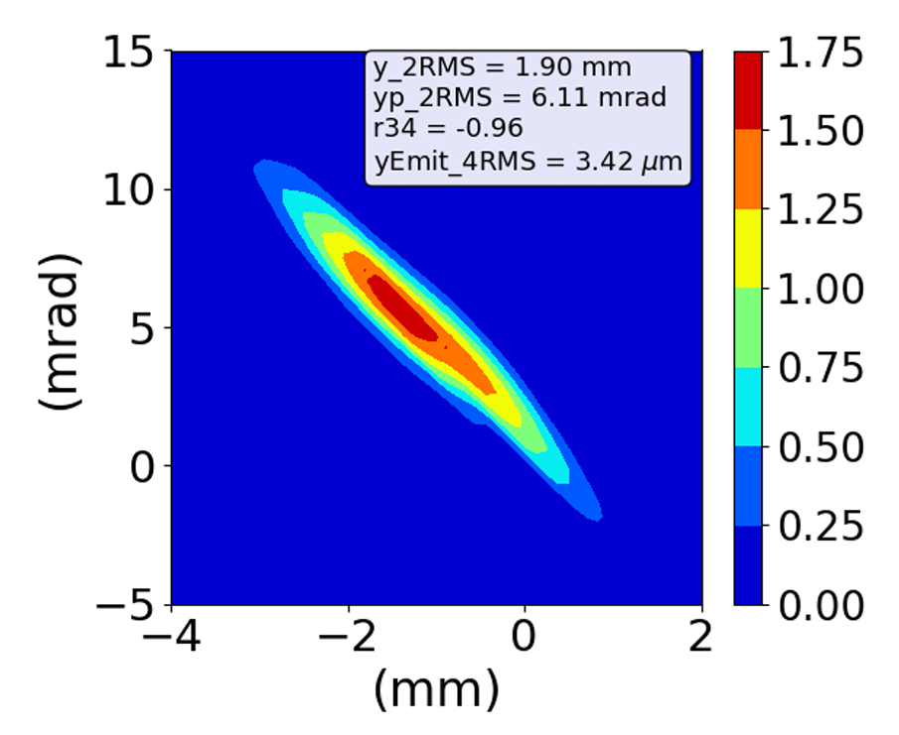
ATIS
ARIEL test ion source (ATIS) used for CANREB commissioning
Small surface ion source located in ARIEL-B2 level
Typically Rb or Cs, up to 60 keV / 20 nA

Slide 6
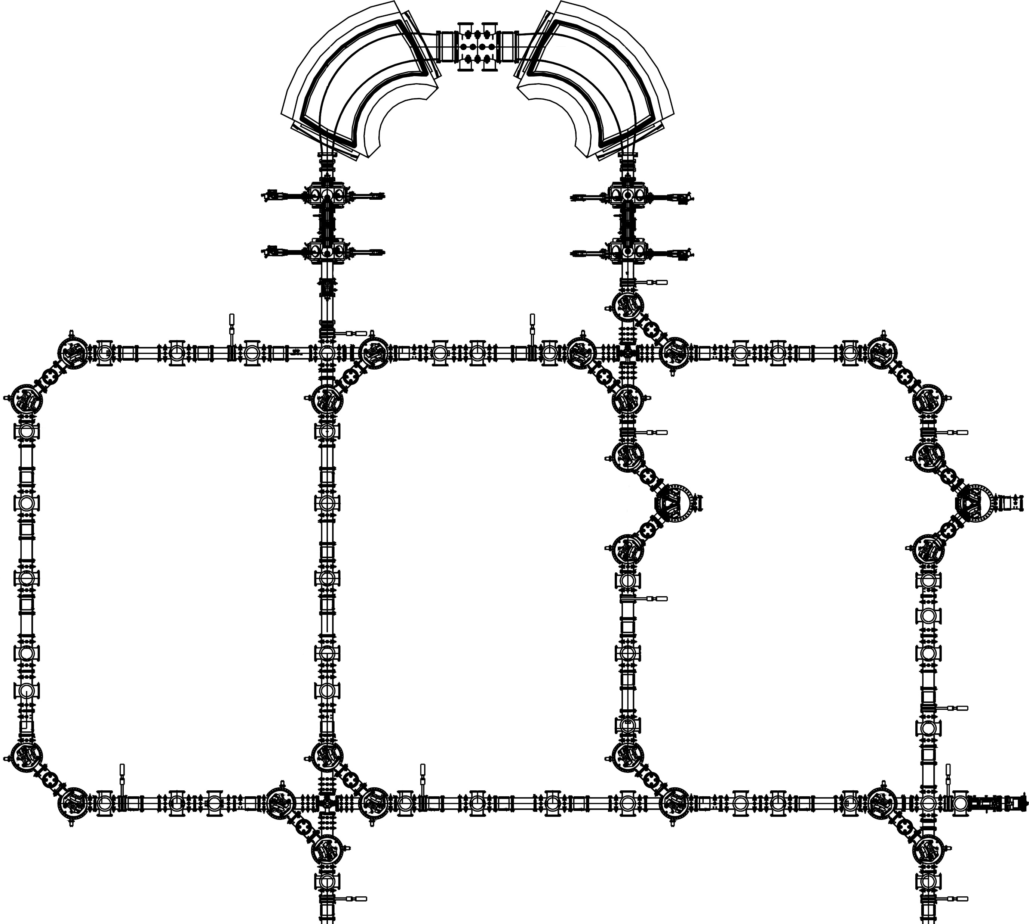
High resolution separator (HRS)
Dual 90° magnetic dipole separator, design Δm/m ~ 1/20,000
Multipole corrector (electrostatic) located between magnets to correct beam aberration
Can accept beam from either target proton or electron target station
HRS dipoles
Multipole corrector
West vertical beamline
East vertical beamline
ARIEL test ion source
ARIEL B2
ARIEL proton target
ARIEL electron target

Slide 7
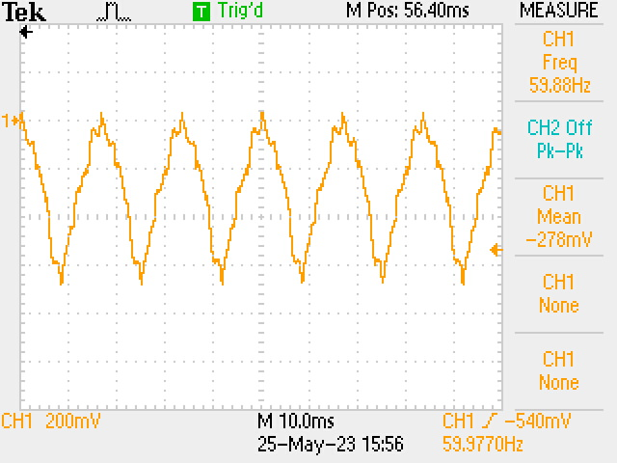
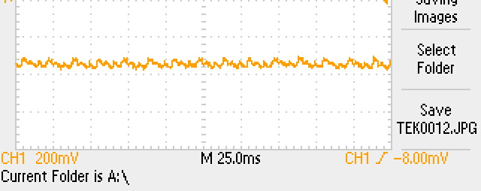
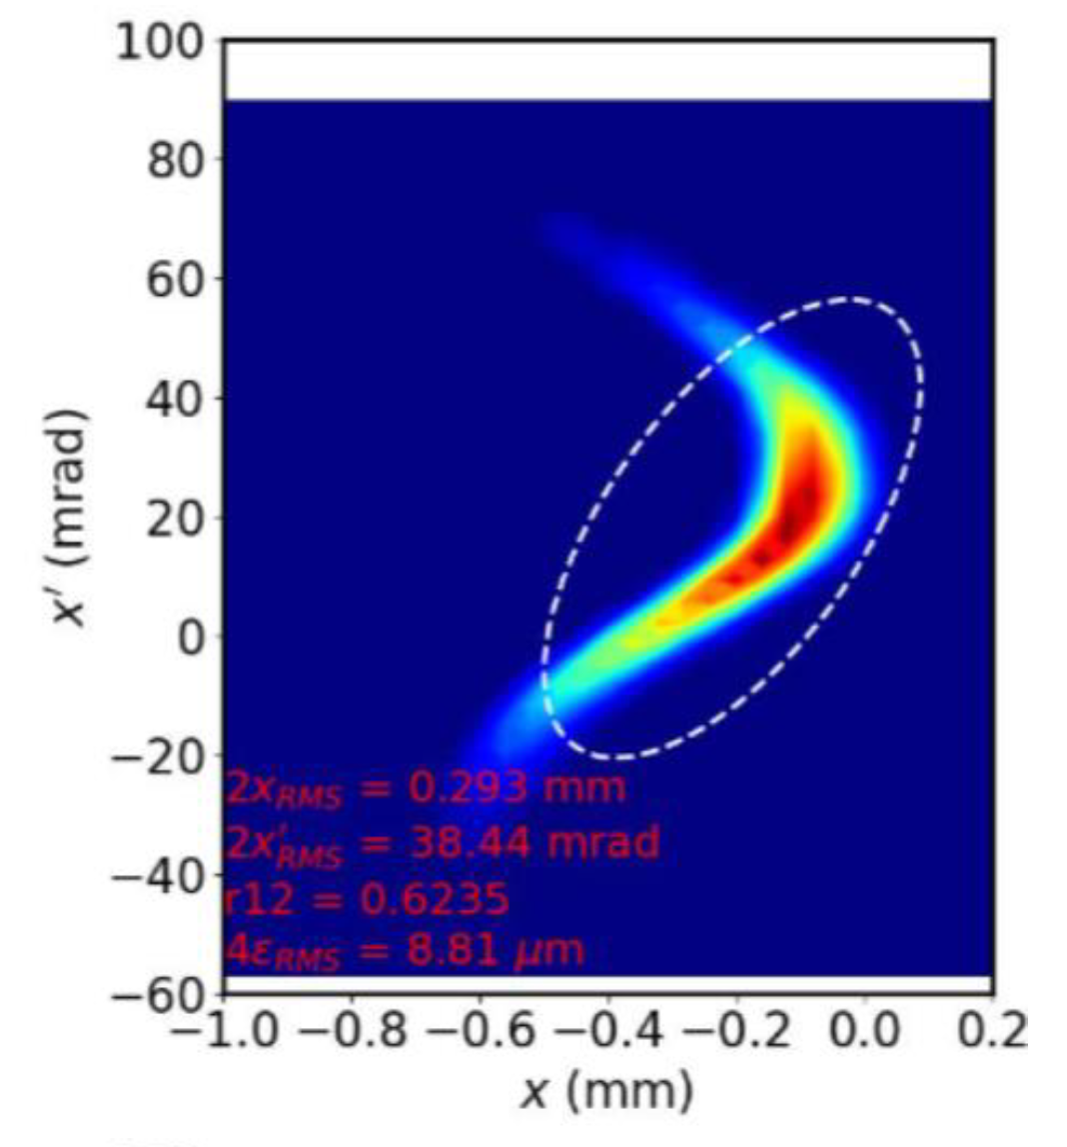
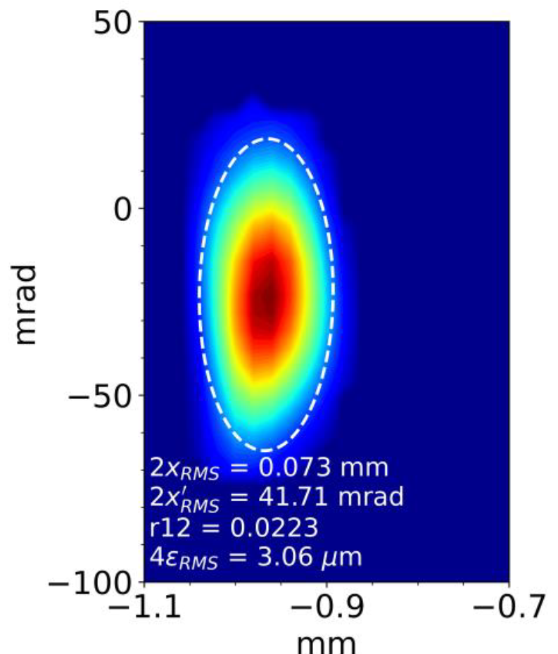
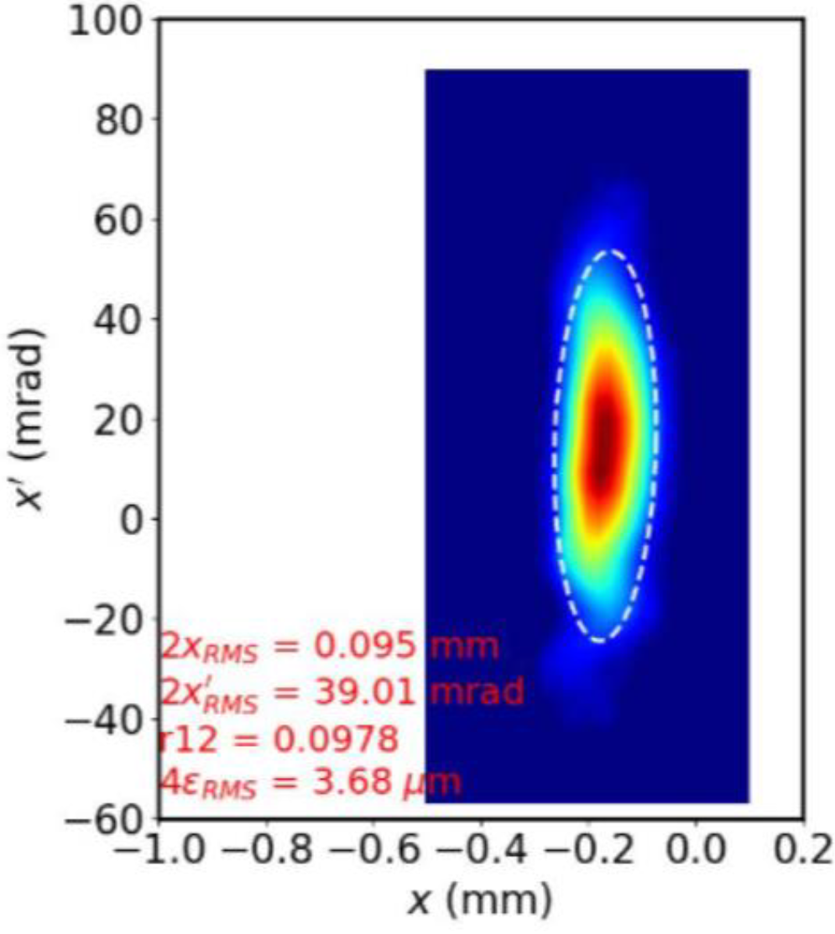
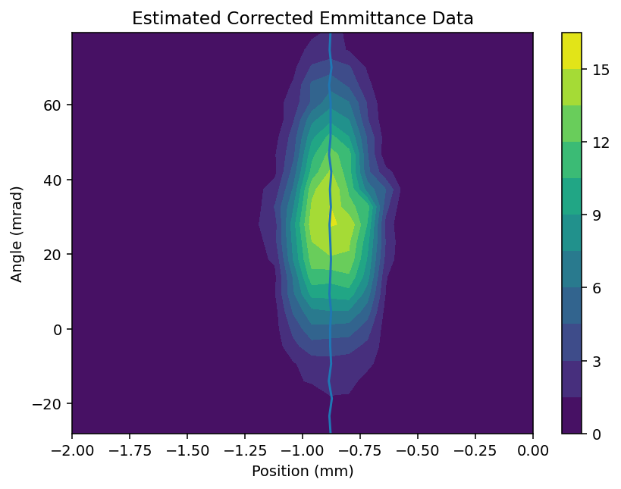
HRS commissioning
Commissioning still underway using ATIS beam
Currently demonstrated R ~ 13,000
High beam transport efficiency
Meets 3 µm emittance target
Requires compensation of a 60 Hz ripple on beam energy, resulting in emittance growth → Function generator installed and operational; growth factor of 2 – 3 less
FC current oscillation
FC current w/ modulation
Upstream
Downstream, uncorrected
Downstream, corrected

Slide 8
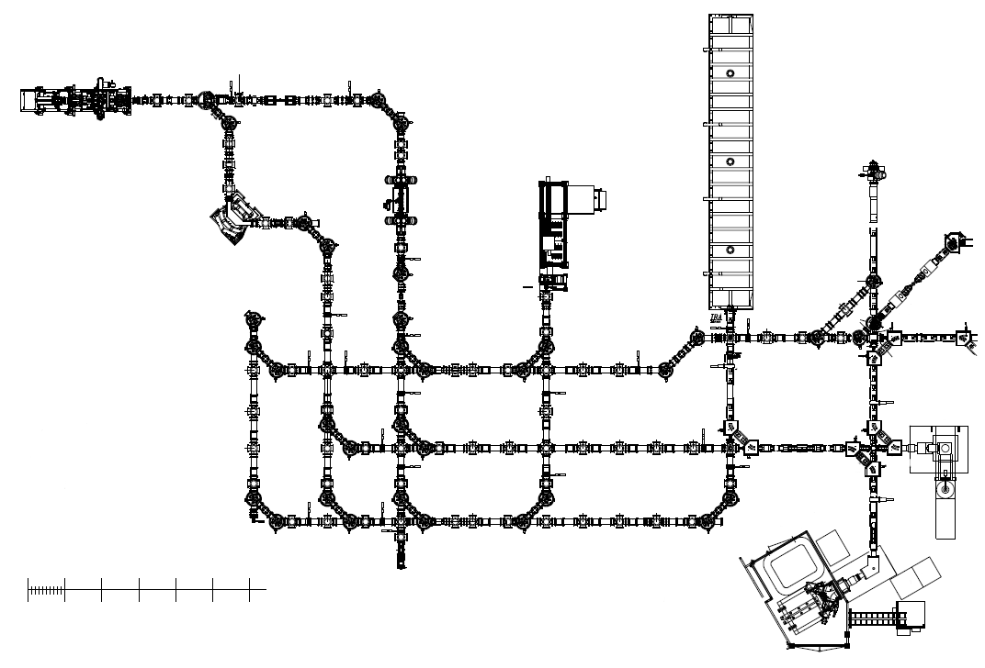
Radiofrequency Quadrupole cooler buncher (RFQ)
Cools & bunches beam
CANREB overview
ARIEL-G
Pulsed Drift Tube (PDT)
Matches beam energy for EBIS injection
Radio-Frequency Quadrupole
Post-acceleration of ions (A/q < 30)
ARIEL Yield Station (AYS)
Measured radioactive yield
Electron Beam Ion Source (EBIS)
Charge breeds beam (3 < A/q < 7)
Nier Spectrometer (NIS)
m/q separation of charge bred beams (R < 300)
ISAC-I
Beam in ISAC)
ISAC Yield Station
Measures radioactive yield
Beam out
Beam in (B2)
0
2
4
6
Scale (in meters)
Off-Line Ion Source (OLIS)
Stable ion beams

Slide 9
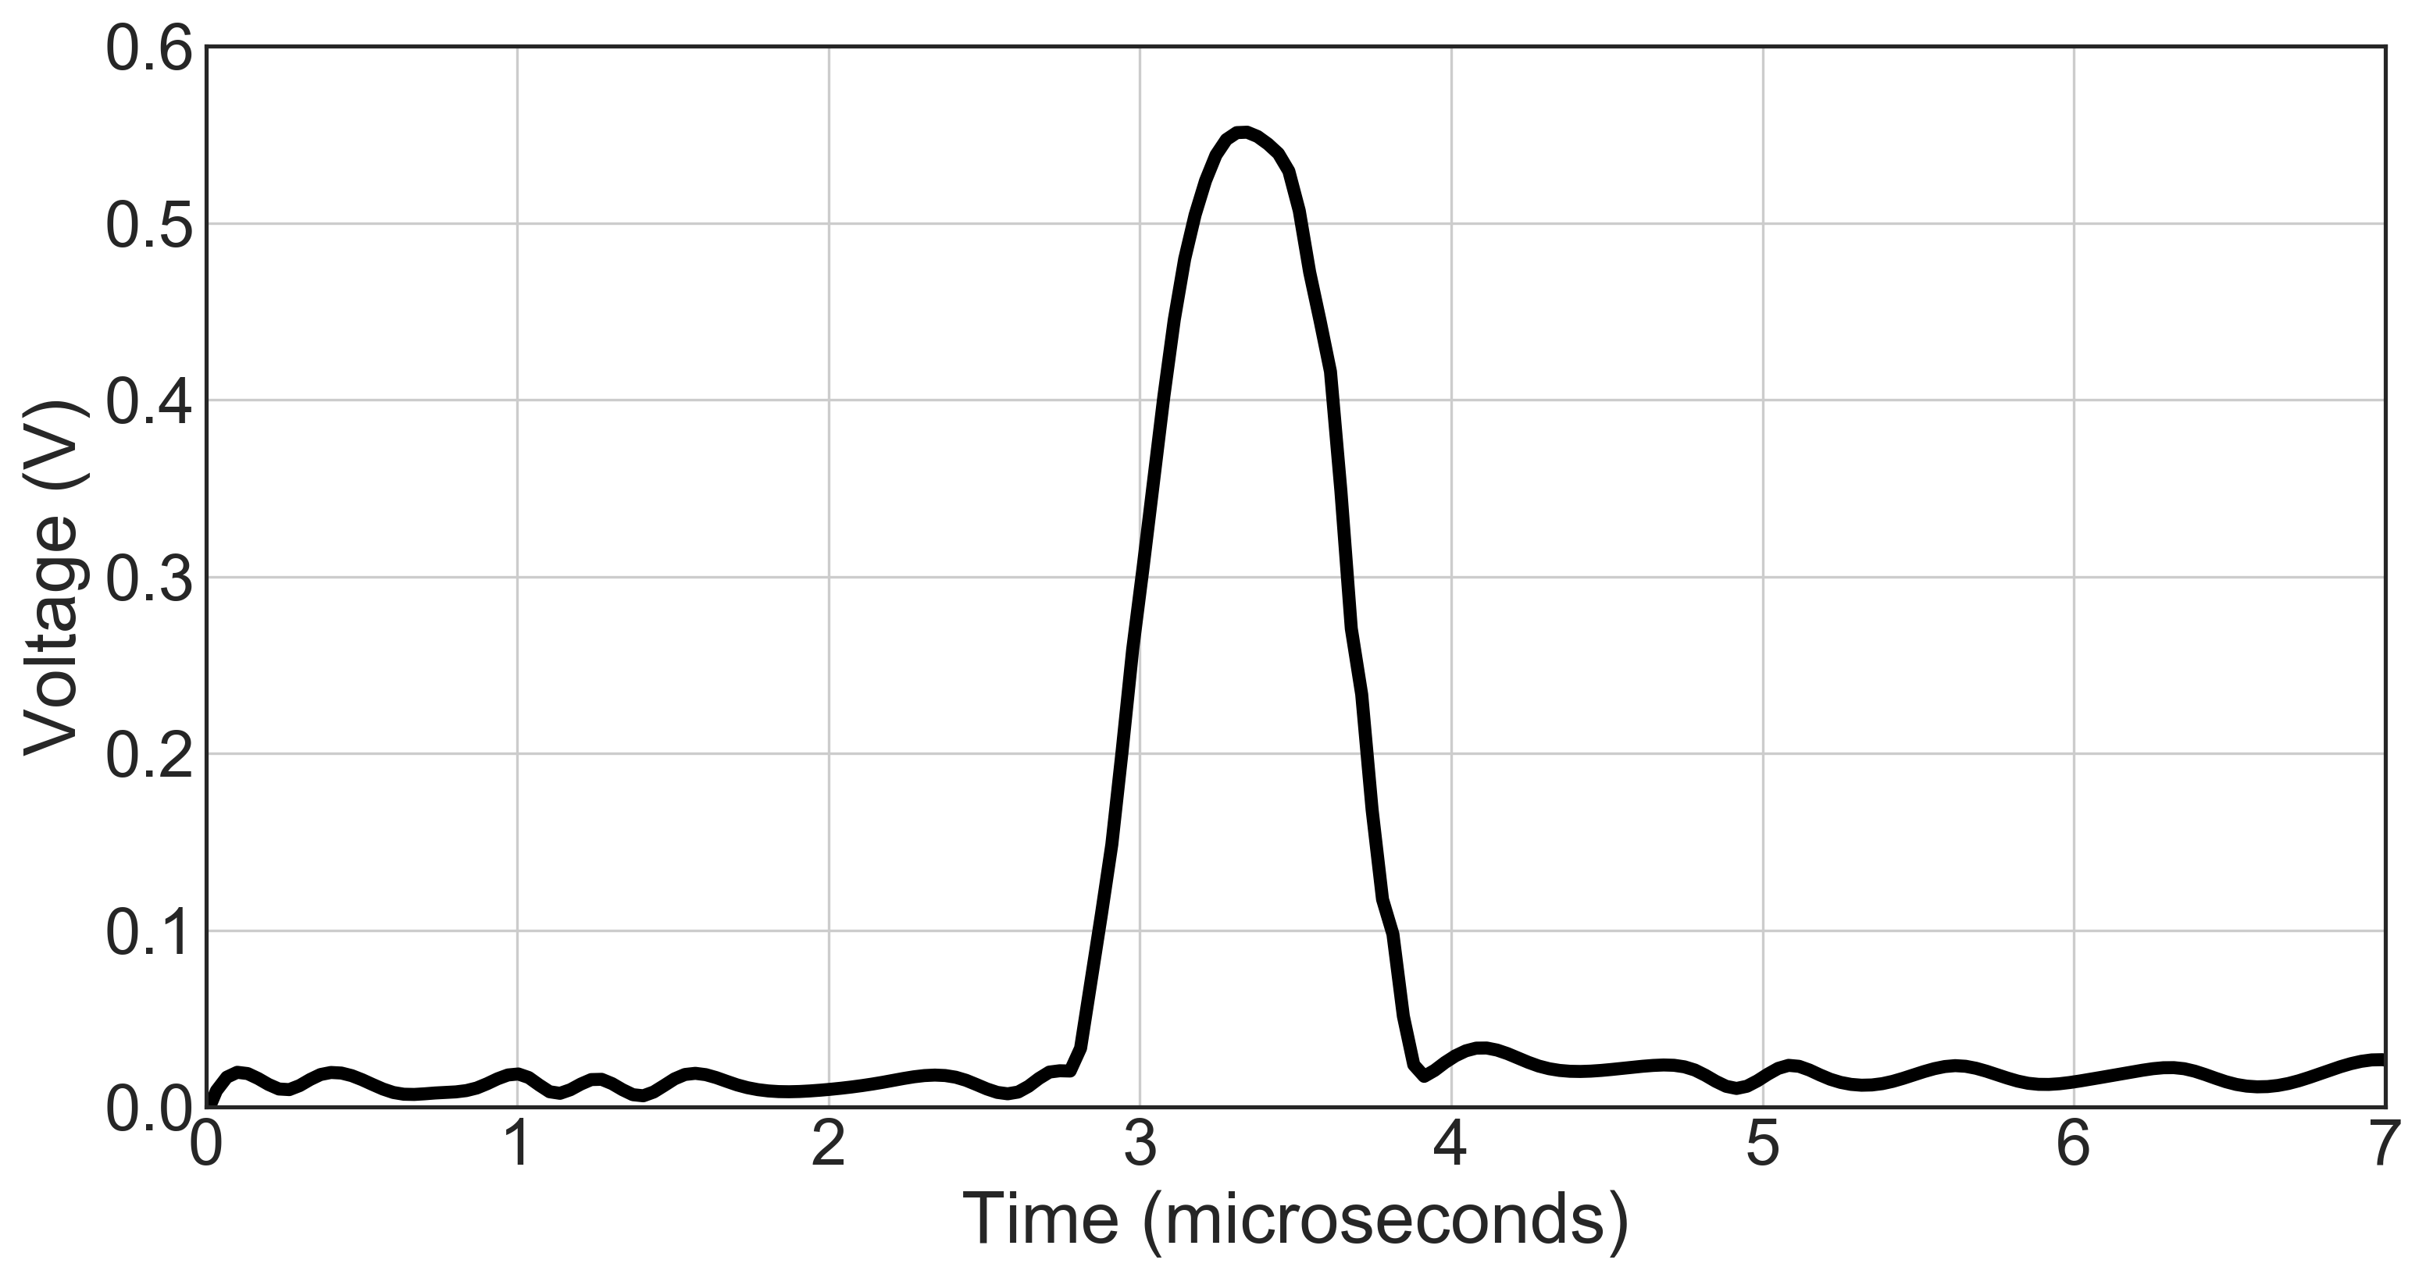
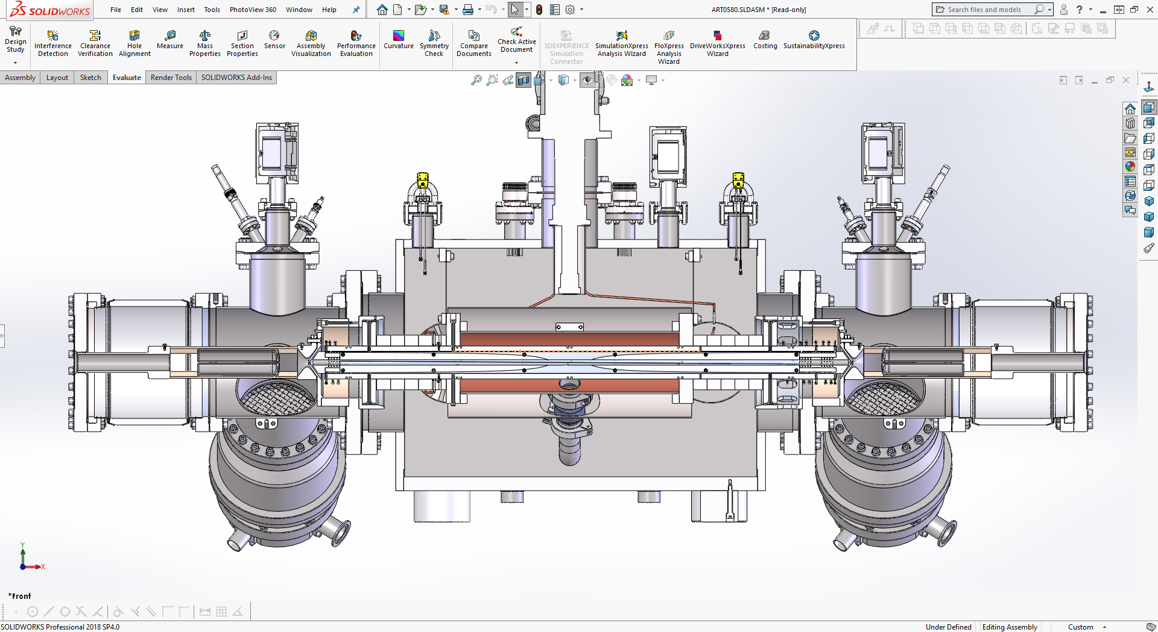
ARQB
ARIEL radiofrequency quadrupole cooler buncher (ARQB) used to cool and bunch beam from source (@ 100 Hz nominal)
Maximum injected energy = 60 keV
Maximum injected current ~few 100 pA
He buffer gas
RF = 3 MHz / 1 kV_{pp} (for heavier mass range)
High voltage platform
Fast Faraday cup, ~1 m downstream of RFQ
Extraction
region
Injection
region
For 30 keV, A > 60, I < 400 pA → Bunching efficiency > 90% (100 Hz rep rate)
A⁺ (bunched)
A⁺ (cont.)
Bunching region
Cooling region

Slide 10
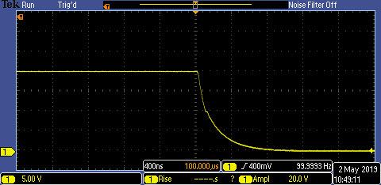
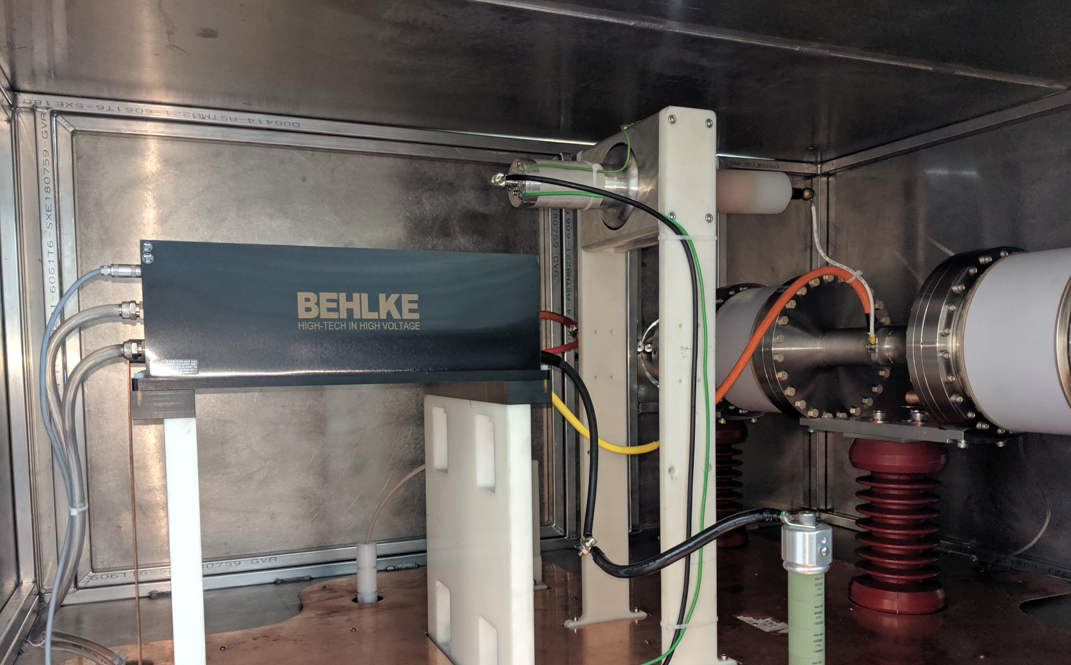
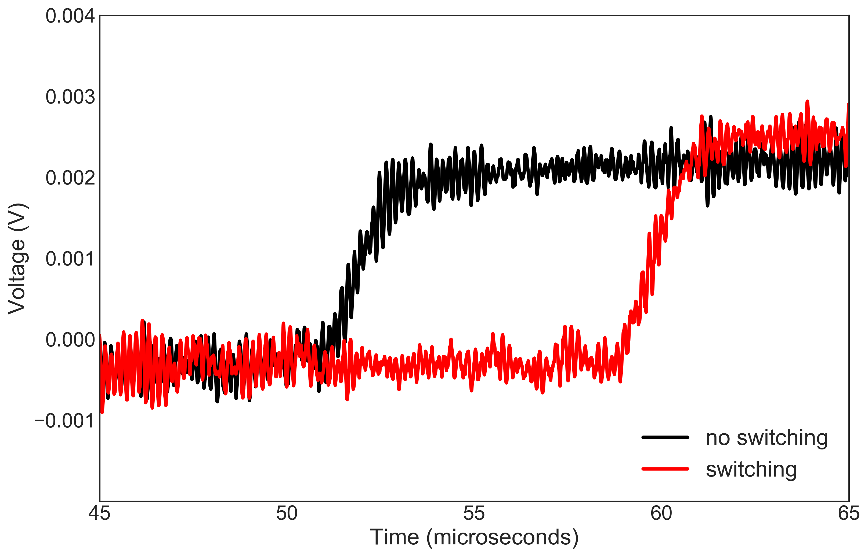
APDT
Reduces energy of bunched beam from ARQB to match into EBIS
Drift tube (700 mm long) biased using a liquid-cooled, 65 kV Behlke switch
Rise/fall time < 1 µs
HV switch
HV probe
Drift tube

Slide 11
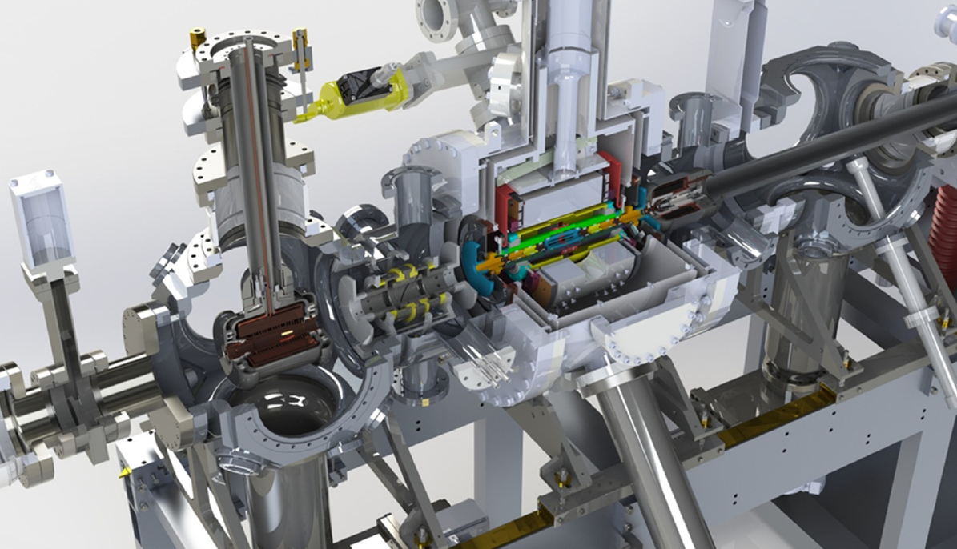
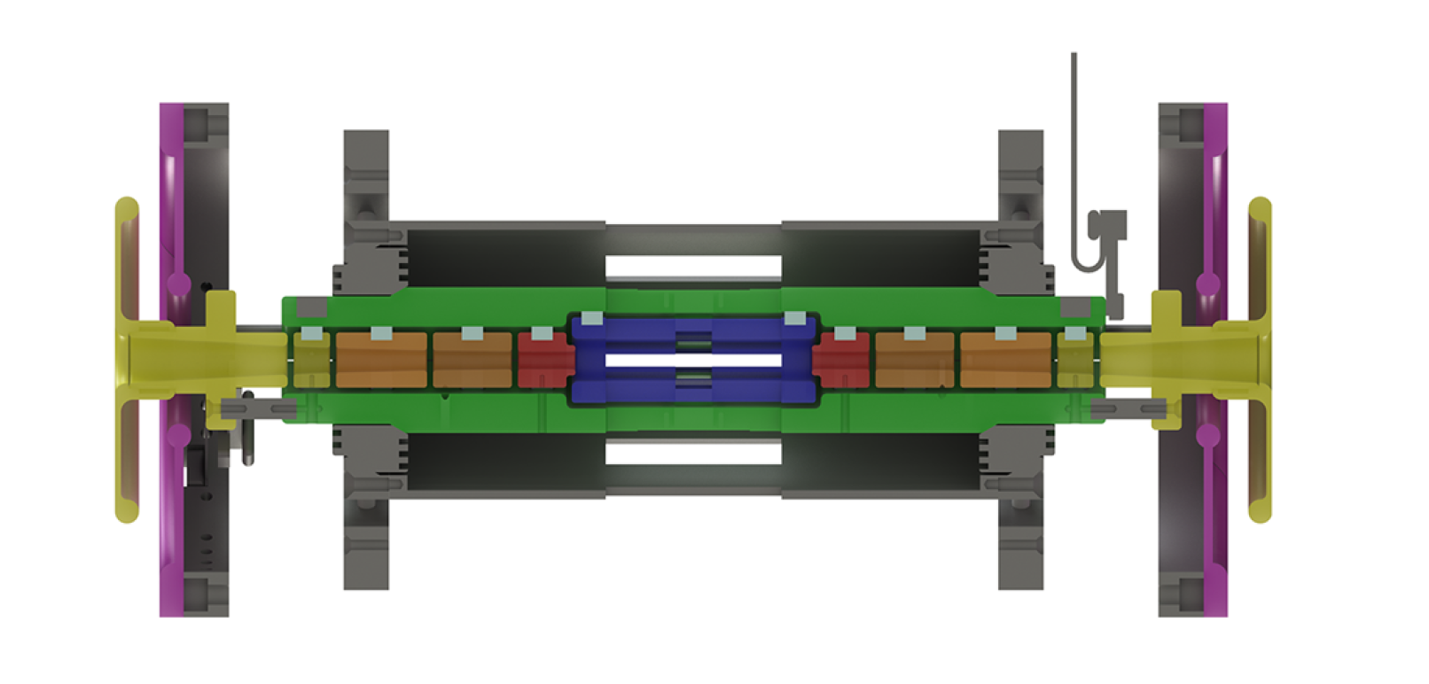
EBIS
Constructed at MPIK Heidelberg (group of J. Crespo¹)
Specifications:
Maximum B-field = 6 T (split-bore semi-Helmholtz)
Maximum injected beam energy ~ 10 keV, up to 10⁶ particles/bunch (@ 100 Hz)
Electron beam energy < 13 keV, current < 500 mA
Up to 10 ms charge breeding time @ 100 Hz
collector
Sikler lens
drift tubes
electron gun
80 mm
¹ Blessenohl M et al 2018 Rev. Sci. Instrum. 89 052401

Slide 12
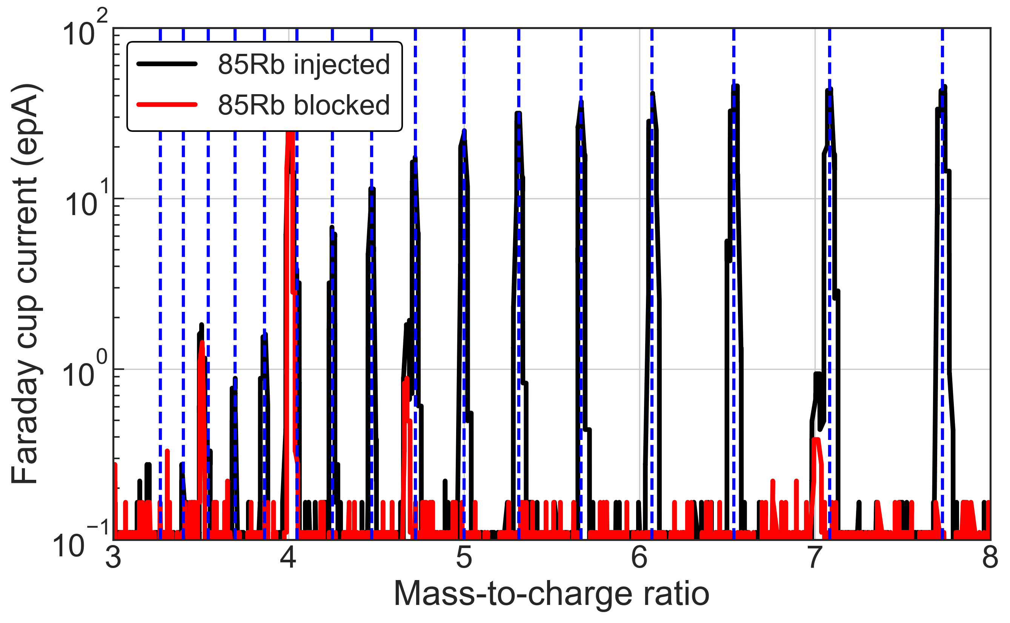
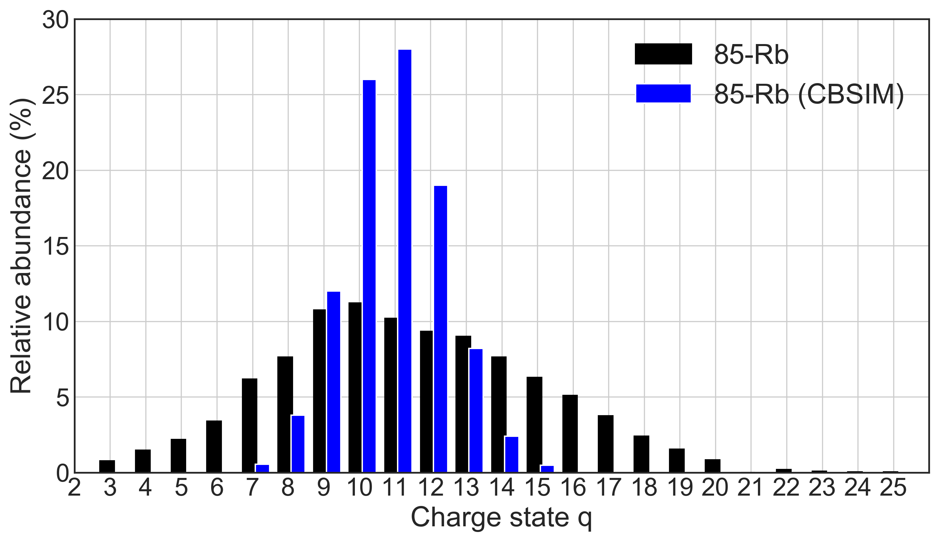
EBIS operation
Bulk of commissioning done with stable Rb/Cs from ATIS
Typical injected beam intensity < 300 pA
Performance:
Efficiency in center of charge state distribution (CSD) ~ 2%
CSDs are typically very broad and centered at low charge states → This (and efficiency) limited by low electron beam current (< 30 mA) and B-field (1 T)
25+
11+
CBSIM gives j ~ 50 A/cm², theory ~ 70 A/cm²
Peak of distribution ~ 11+, ~2% efficiency (200 pA injected)

Slide 13
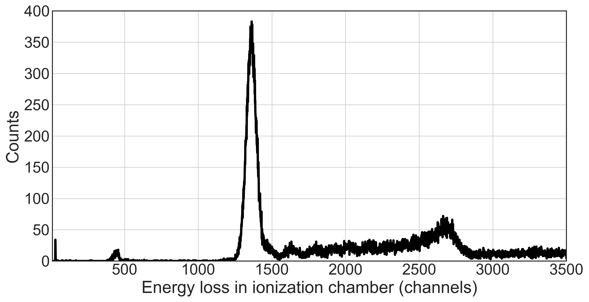
Charge bred RIB to ISAC-II
First delivery of charge bred RIB from CANREB to ISAC-II (IRIS)
⁵⁹Cu (t_{1/2} = 81.5 s) from ISAC target
~1% efficiency in q = 19+ charge state (A/q = 3.1), 7 ms charge breeding time (e-beam = 40 mA)
Beam sent to IRIS experiment in ISAC-II: ~300 pps @ 9.0 MeV/u
Relatively clean beam
Significant pile-up due to high instantaneous intensity → Requires implementation of pulse stretching during EBIS extraction (see M. Cavenaile)
Additional development required to characterize & optimize transport through linac (including charge exchange at high q)
⁵⁹Cu
Pile-up
Contaminant?
Courtesy of IRIS collaboration.

Slide 14
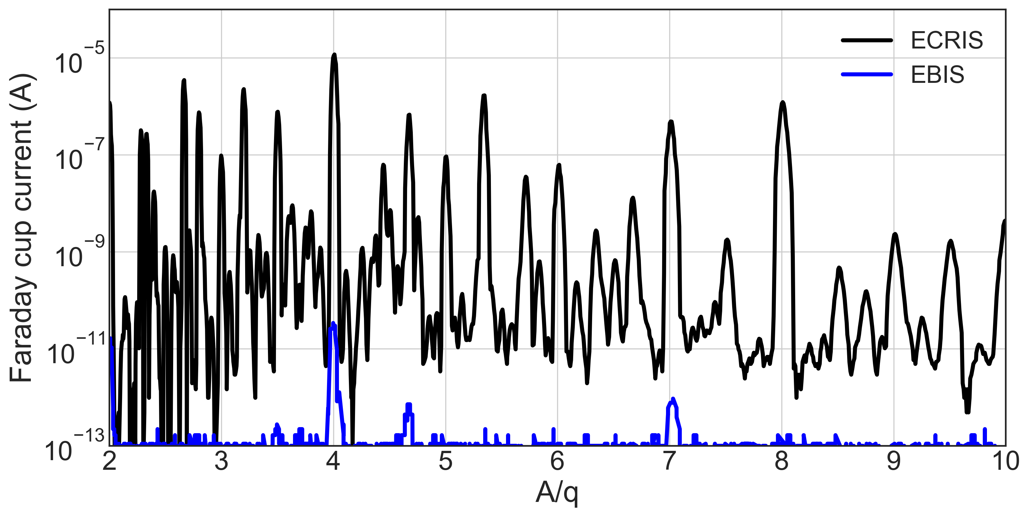
EBIS background
Typical background from EBIS (up to 30 mA e-beam current) < 1 epA for 3 < A/q < 7
Exception: A/q = 4 (He⁺) → Increased by gas diffusion from RFQ
EBIS cold-head recently replaced → Significant reduction in He+ background peak
Generally orders of magnitude less than typical background from ECRIS

Slide 15
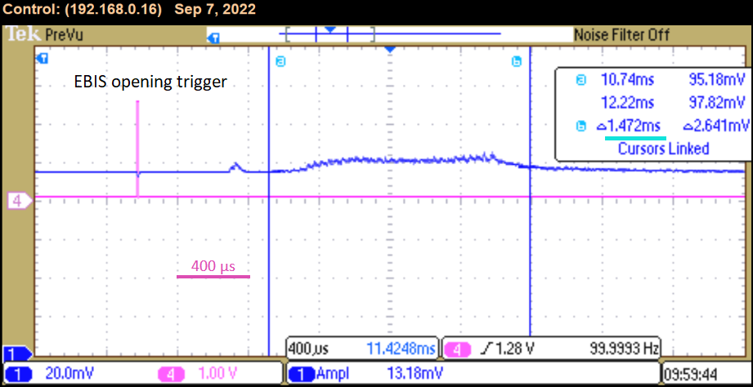
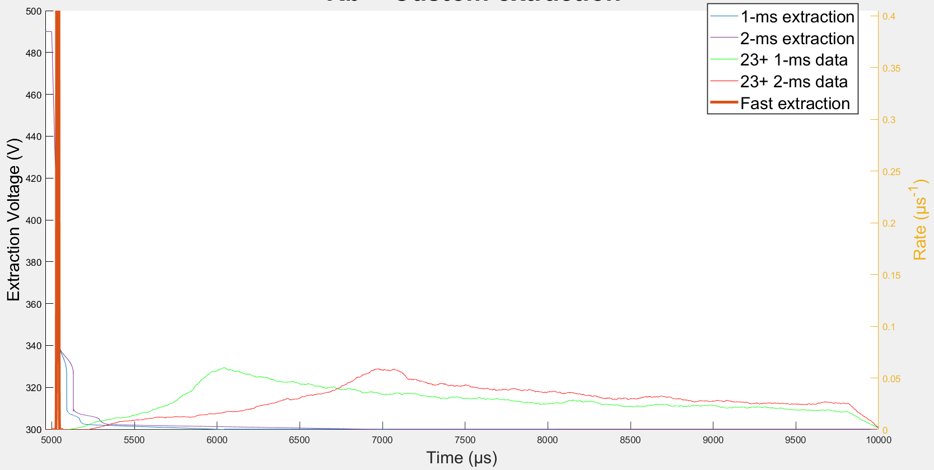
Stretching of extracted pulses
Proof-of-principle pulse stretching has been demonstrated
Pulses up to ~1 ms have been demonstrated using basic step function extraction
Custom extraction schemes based on energy distribution measurements have been investigated → Extracted pulses show very long tails even after trap should be fully open (additional trapping somewhere?)
⁸⁵Rb⁺²³
⁸⁵Rb⁺⁹
M. Cavenaile et al., Pulse stretching out of the CANREB EBIS, ICIS 2023 (In press).

Slide 16
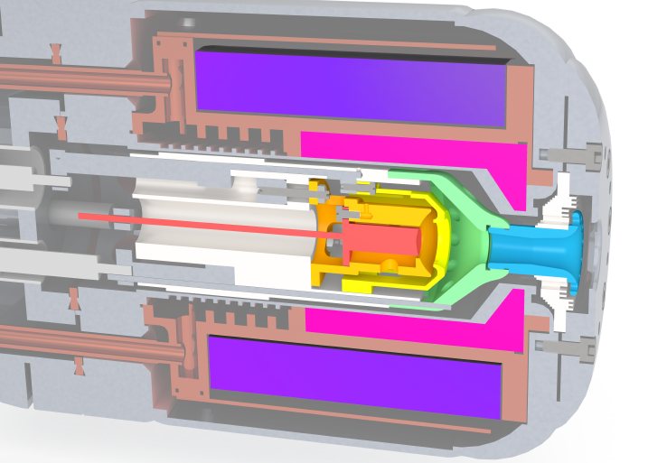
EBIS technical limitations
EBIS performance has been hindered by limitations in HV stability and e-gun current
HV
Full A/q range for post-acceleration (A/q <= 7) requires ~14 kV on EBIS drift tubes
Without B-field, this is achievable → With B > 0 T (as low as 1 T), HV limited to ~6 kV (when persistent bias discharge kicks in)
Goal is now stable operation at 10 kV (A/q = 5) which shouldn’t limit the ISAC science program
Electron gun
Many years ago, gun was tested up to 1 A (short) but has been degrading
During commissioning current was limited to < 50 mA
Trying to push extraction voltage results in massive spike in anode current which cannot be compensated
Emission is strongly B-field dependent (in a bad way)

Slide 17
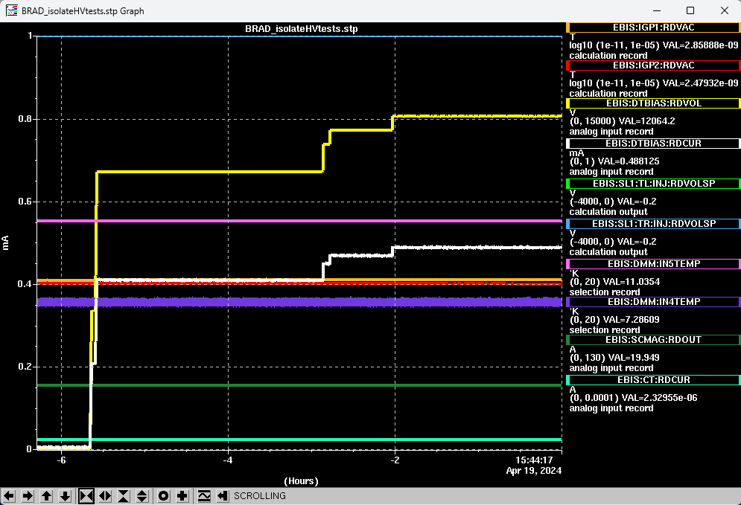
HV status
thermal
shield
Thermal (40 K) shields on both sides of trap were removed → Close proximity to trumpet electrode may be problematic
Situation has improved
At B = 1 T, stable operation up to at least 12 kV appears feasible
At B = 2/3 T, stable operation up to at least 10 kV appears feasible
Longer duration tests needs to be performed to determine limits of voltage and stability
Caveat: Removal of thermal shields has partially compromised cooling of 4 K components (including magnet), increasing base temperature by ~2 K → We can still operate, but in the long-term these should be redesigned and replaced
trumpet

Slide 18
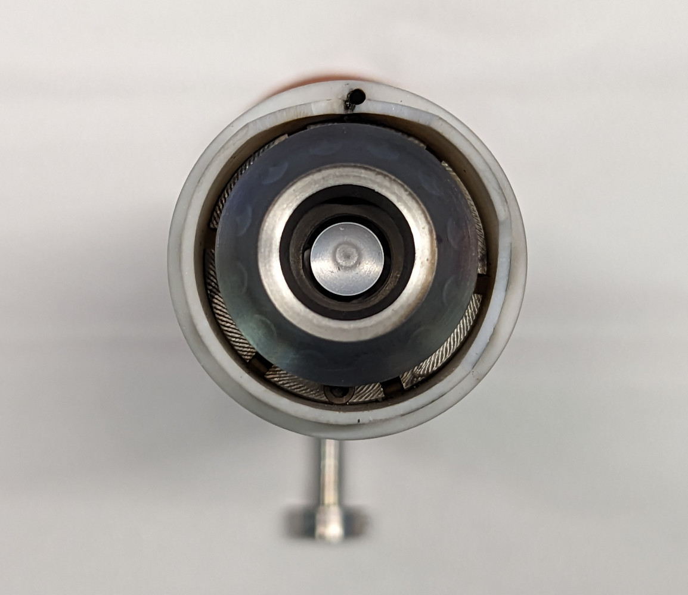
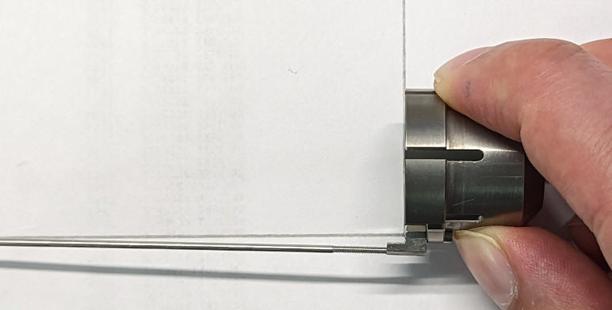
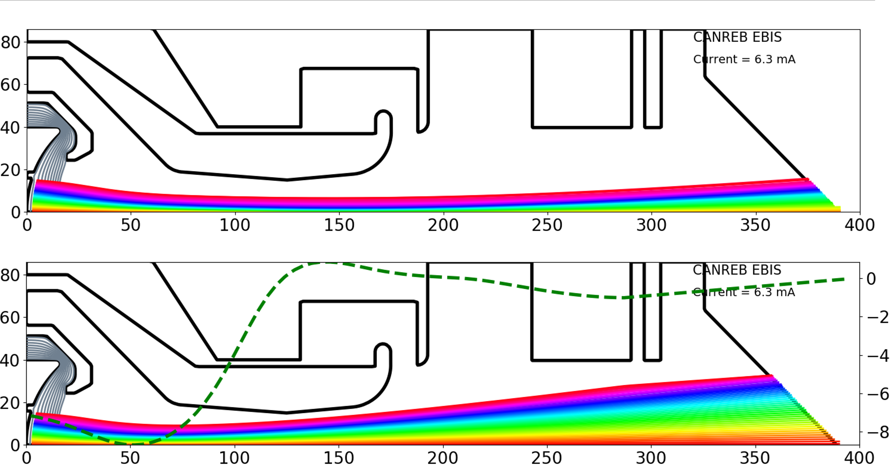
Electron gun
To diagnose issues, a temporary FC was installed directly in front of e-gun to separate emission from transmission through the magnet
Same issues were observed:
At currents greater than a few 10’s of mA, sudden increase in residual current on anode which cannot be controlled
Lots of beam striking collimator in front of FC, indicating beam is blowing up and/or off-axis
Possible issues: misalignment of focus electrode, residual magnetization of soft iron (up to ~10 G near cathode)
Conclusion: Reaching the required current with the current assembly appears unlikely, so we will move on with a new TITAN-designed gun

Slide 19
CANREB plans
Move forward with fabrication, assembly, and commissioning of new electron gun → Design is already complete (TITAN)
Machining will hopefully begin late Spring/early Summer
In parallel, continue with HV testing to pin down limits of stable operation
Fall/Winter 2024: Continue development and bring CANREB to an operational level

