Slide 1
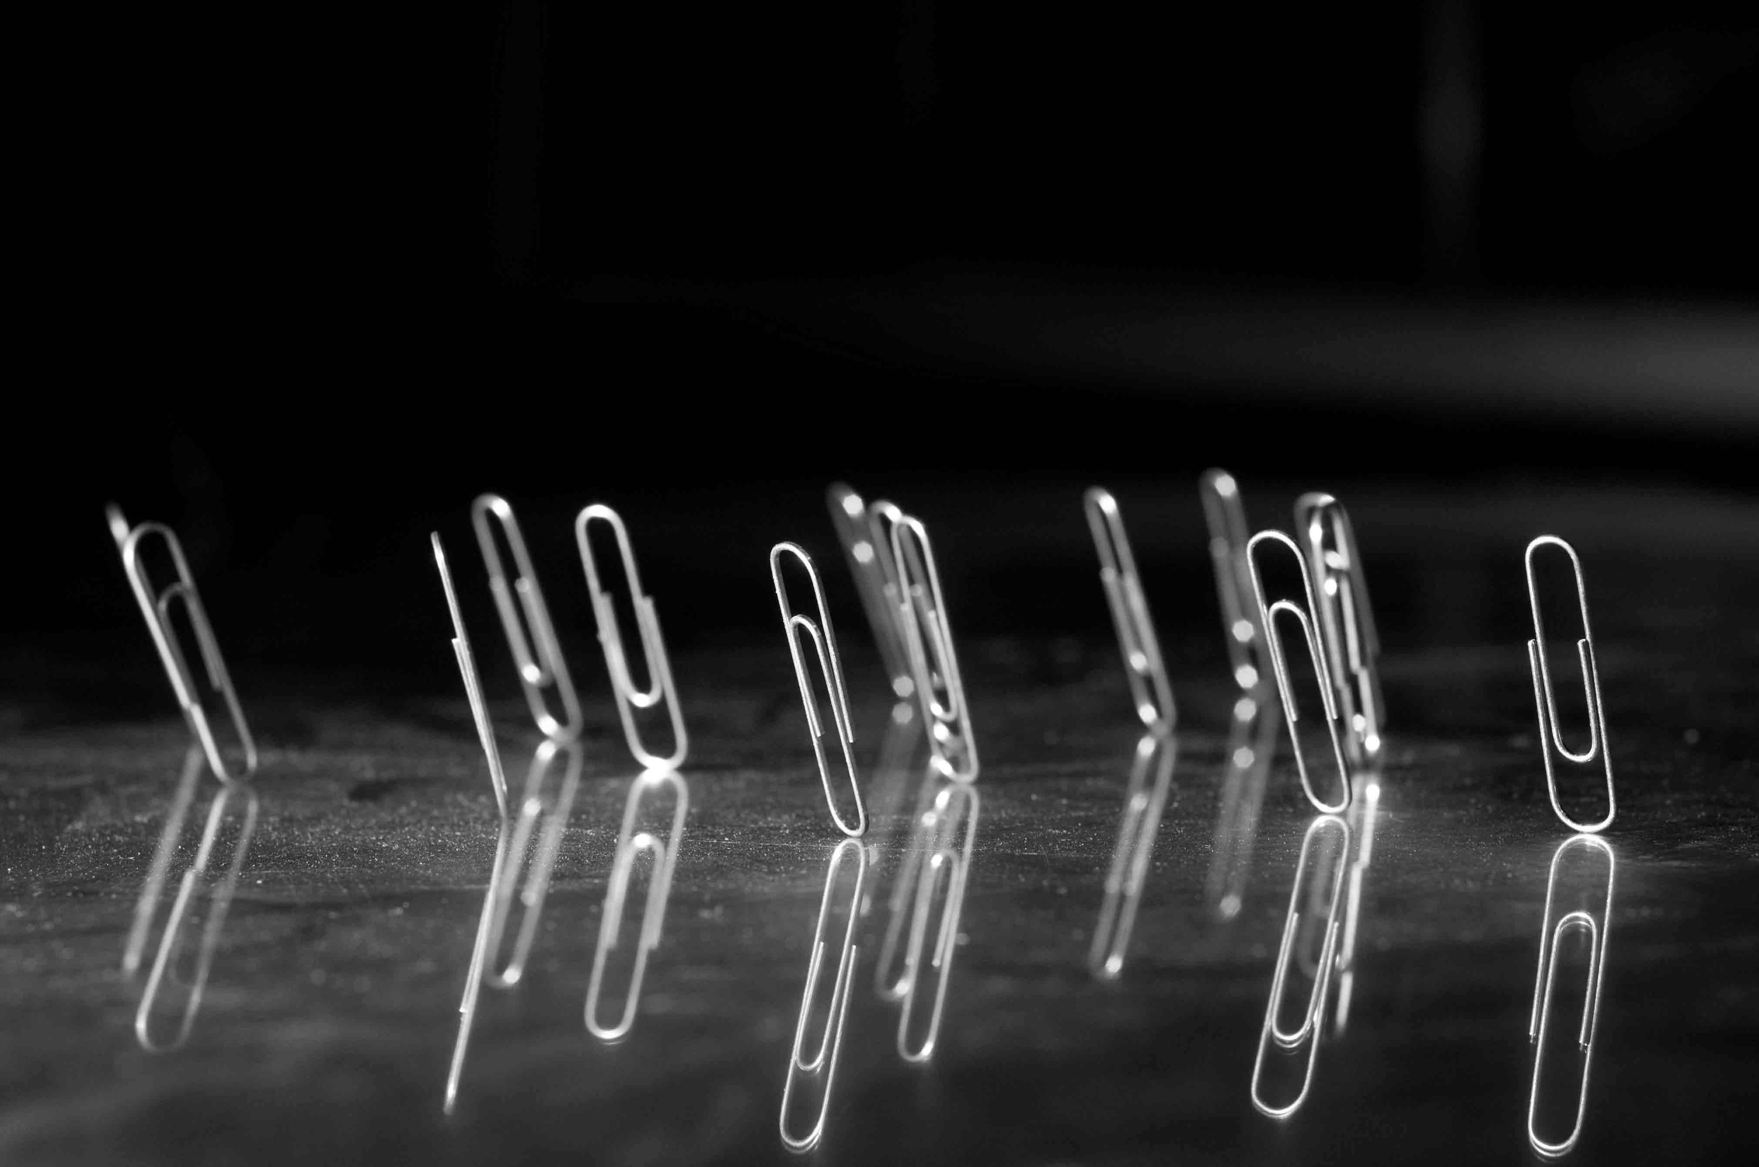
Status of the TRIUMF Electron Cyclotron Resonance Ion Source Charge State Booster
Joseph Adegun

Slide 2
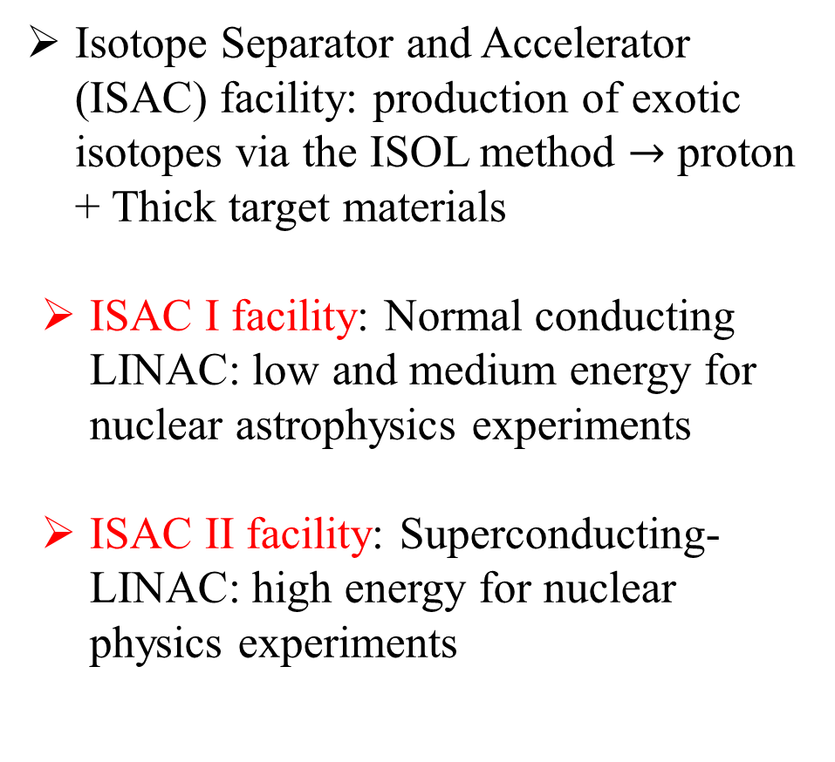
TRIUMF ISOL Facility Complex
ISAC-II
High energy
Isotope Separator and Accelerator (ISAC) facility: production of exotic isotopes via the ISOL method $→$ proton + Thick target materials
  ISAC I facility: Normal conducting LINAC: low and medium energy for nuclear astrophysics experiments
  ISAC II facility: Superconducting-LINAC: high energy for nuclear physics experiments
ISAC-I
Low and
medium
energy
500 MeV Cyclotron
Notes:
At TRIUMF, the cyclotron is the main beam driver that creates rare isotopes.
After the desired isotope has been selected, depending on the energy requirement for the experiment,
The isotope can be post-accelerated to medium using normal conducting LINAC in the ISAC I facility,
or to high energy using superconducting LINAC in the ISAC II facility

Slide 3
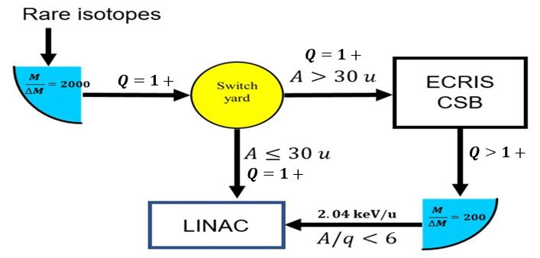

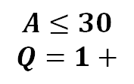
Charge Breeding: Required for $A>30$
Switch
Yard
$$A≤30$$
$$Q=1+$$
RFQ + DTL + SRF
Injection energy: 2.04 keV/u
Notes:
The first section of our LINAC was designed to accept isotopes at an initial energy of 2 keV
At TRIUMF, the Electron Cyclotron Resonance Ion Source is used to charge breed isotopes with atomic mass greater than 30 to match the injection energy of the LINAC.

Slide 4
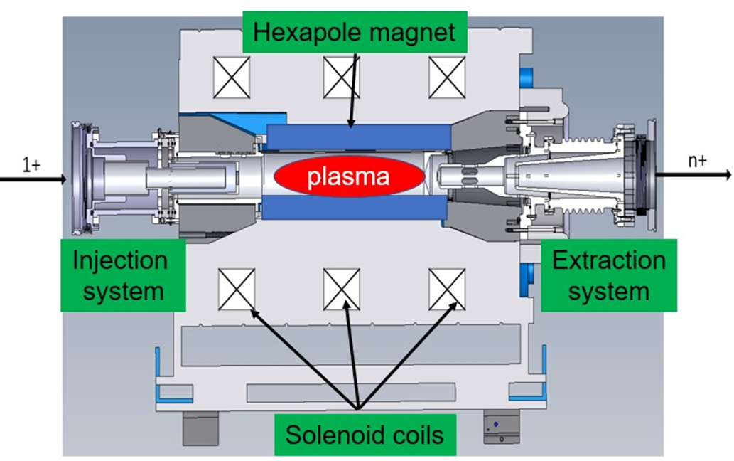
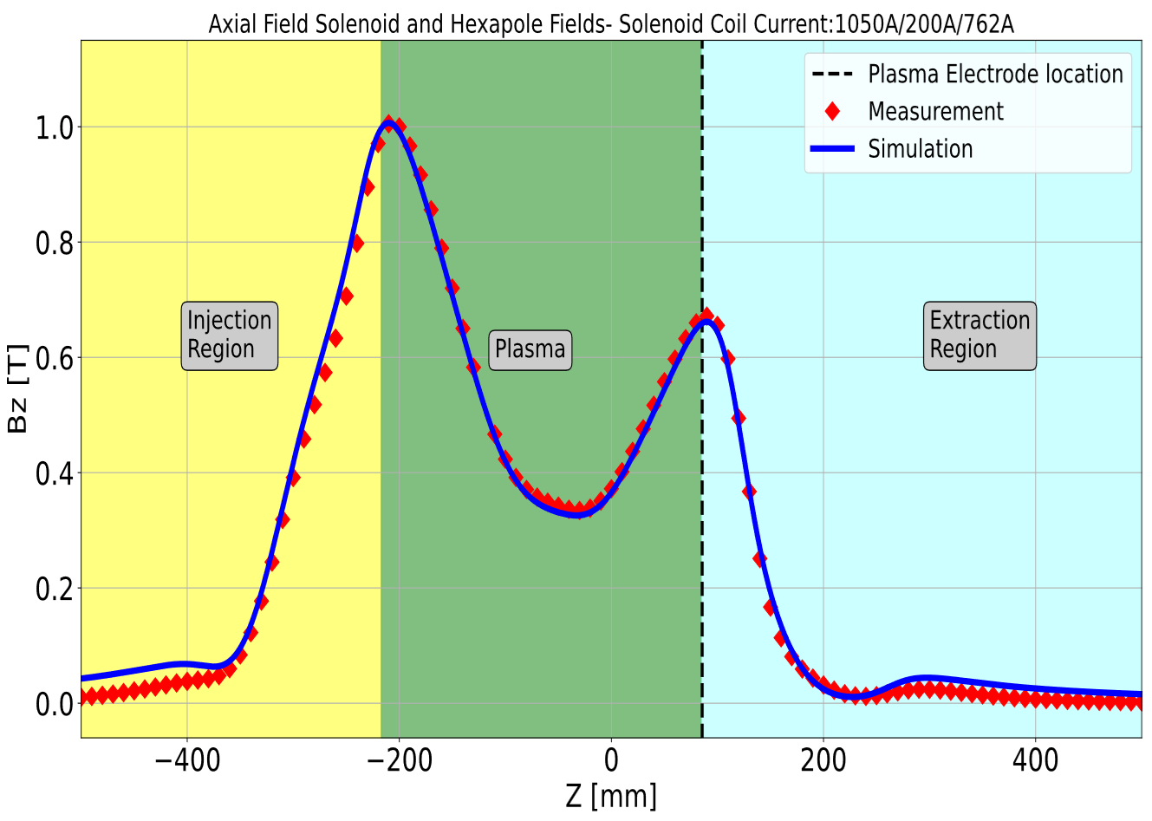
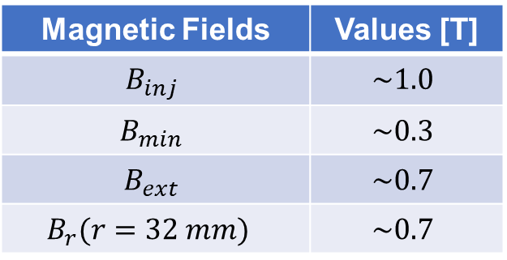
TRIUMF ECRIS Charge State Booster
Magnetic Fields | Values [T]
$$B_{inj}$$ | $$\sim 1.0$$
$$B_{min}$$ | $$\sim 0.3$$
$$B_{ext}$$ | $$\sim 0.7$$
$$B_{r}(r=32 mm)$$ | $$\sim 0.7$$
Notes:
Electron cyclotron resonance ion source uses electromagnetic waves and a magnetic field to create a plasma of high-energy electrons
Singly charged ions can then be injected into it and highly charged ions are created by electron-impact ionization
TRIUMF CSB uses room-temperature solenoids and permanent magnets to create axial and radial magnetic fields
Electromagnetic wave is launched radially into the source through the injection region at 14.5 GHz
The breeder is equipped with the three-electrode extraction system
The figure on the right compares the measured and simulated axial magnetic field distribution of the source
To get the best out of the breeder,

Slide 5
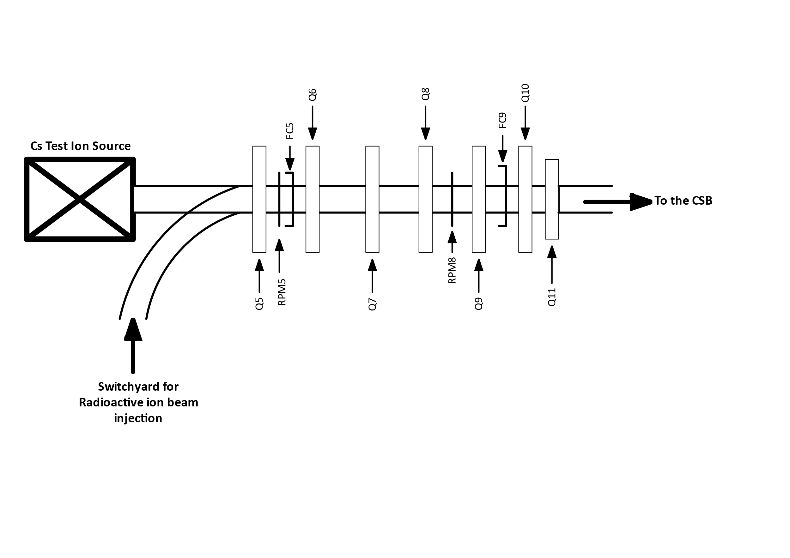

Schematic of the injection and extraction optics of the TRIUMF CSB
Injection Optics
CSB
Extraction optics
Nier-type spectrometer
Notes:
Achromatic system - Nier-type spectrometer – the energy dispersion of the magnetic dipole is compensated by the energy dispersion of the electrostatic benders.
The achromatic system helps to filter out impurities extracted from the CSB.
Chromatic aberration is when particles of different energies have slightly different trajectories when passing through a magnetic field.
Electrostatic benders are preferred over sextupoles for chromatic aberration correction because they are suitable for a wider energy range, making them more versatile than sextupole magnets.
Mass dispersions are different for the two bends. The do not cancel.
Magnetic solenoids are not used in low-energy beamlines because of high power requirements

Slide 6
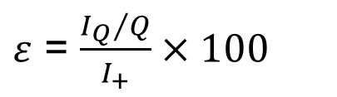
Efficiency: ECR Ion Source Charge State Booster Figure Of Merit
Injection system
$ε$ = $\frac{{I_{Q}}/Q}{I_{+}}×100$
Plasma condition
rf, B-field, support gas
Injection optics
Extraction system
Extraction optics
Notes:
It is important to also optimize the extraction system to prevent emittance growth of the extracted HCIs
Injection and extraction optics need to be optimized to preserve the integrity of the ion beam.

Slide 7
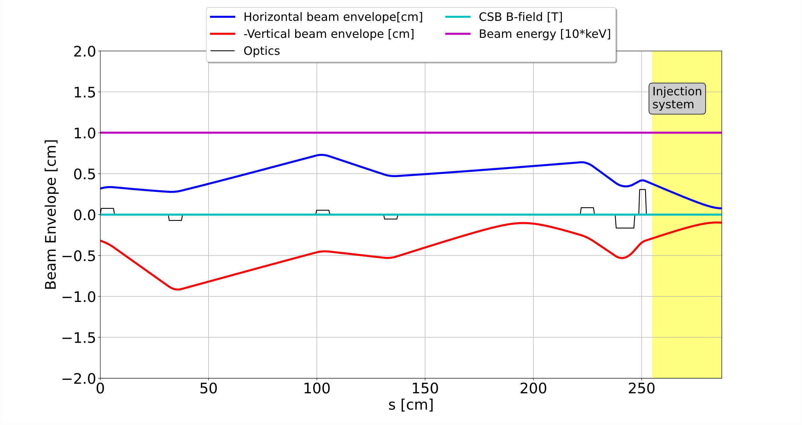
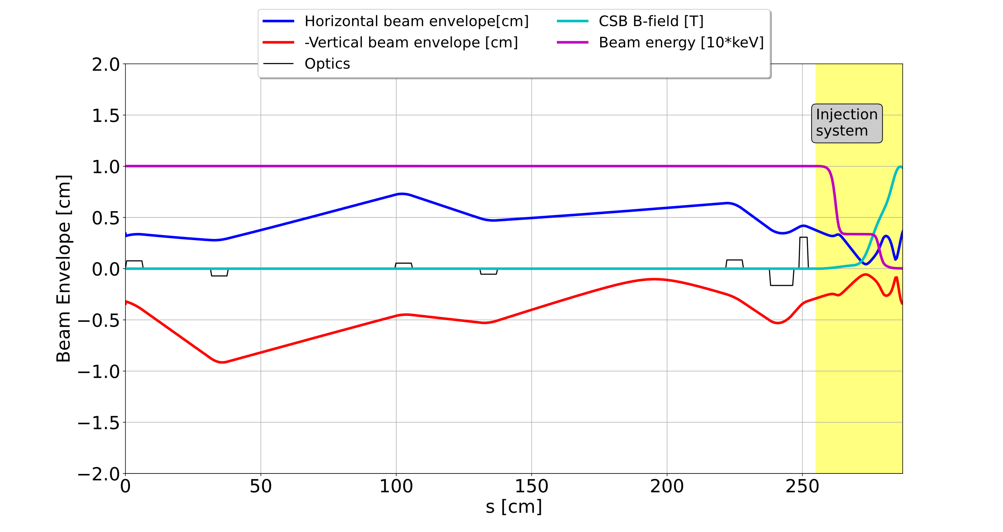
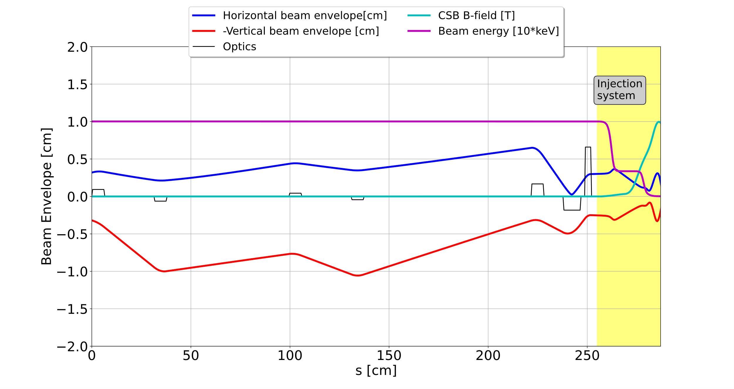



Optimization of the CSB Injection optics in TRANSOPTR
TRANSOPTR is a beam envelope code. It uses only first-order optics
$$B_{inj}=E_{inj}=0$$
$$B_{inj}≠0,E_{inj}≠0$$
Beam envelope of ¹³³Cs⁺
$$B_{inj}≠0,E_{inj}≠0$$
Envelope optimized with B and E-fields ON
Notes:
This is the first time that the injection optics has been optimized by considering the magnetic and electric fields.

Slide 8
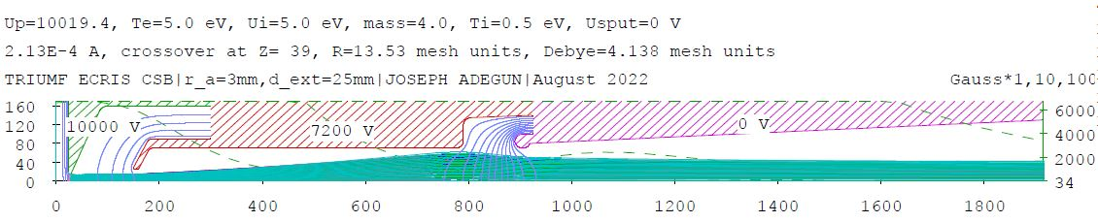
Optimization of the Extraction System in IGUN
Beam rotation, $θ^{′}→$ Magnetic field – Large Emittance
Magnetic Field
[Gauss]
Extracted ion Beam
Vertical and Horizontal axes are in mesh units: 1mesh unit = 0.2 mm
Notes:
In the ECR ion source, the magnetic field has been identified as the main cause of large emittance because of the beam rotation induced by the field in the extraction region.
However, the magnetic field’s effect can be minimized by setting the extraction field to the optimum value.
It also causes different focal points for the ion masses and charge states in the extracted beam
Simulated most intense residual ions (H,C,N O), support gas, He and Cs24+
The electric field for beam formation is created between the plasma electrode and the puller electrode
The electric field affects the beam divergence of the extracted ions depending on the shape of plasma meniscus
The case where the plasma meniscus is flat, the divergence is optimum, emittance is smallest
In reality, the gap is not fixed during CSB operation, the length of the gap varies depending on the magnitude of the extraction field and the ion density
For ion extraction from the ECR plasma, optimized extraction field is achieved only when the plasma density balances the space charge density.
I systematically optimized the CSB extraction system to identify the optimized extraction field.
The shape of the plasma boundary depends on the Extraction E-field
Convex: – ion beam forms with a large angle
Planar: – ion beam forms with optimum angle
Concave: – ion beam forms with an over-focused angle
On this slide, I would like to talk about the optimization process of the CSB extraction system in IGUN. The extraction system consists of the
The whole extraction system is installed in the strong magnetic field of the CSB
If the extraction field is low, the shape of the plasma boundary is Convex meniscus producing large Emittance (extraction gap smaller than the designed)
If the extraction field is moderate, plasma boundary aligns with the extraction aperture, and the shape of the plasma boundary is Planar meniscus – lowest emittance (designed gap)
If the extraction field is high, the shape of the plasma boundary is Concave meniscus producing also large emittance (Extraction gap longer than the designed)
The parameters that influence the beam emittance are categorized as:
Ion temperature
Extraction gap
Extraction aperture
Magnetic field
Pierce geometry minimize aberrations in the extraction system.
Ui is the ion directed energy – initial energy of the plasma

Slide 9
Effect of Extraction Field on Plasma Meniscus
Convex
meniscus
Concave
meniscus
Planar
Meniscus

Slide 10
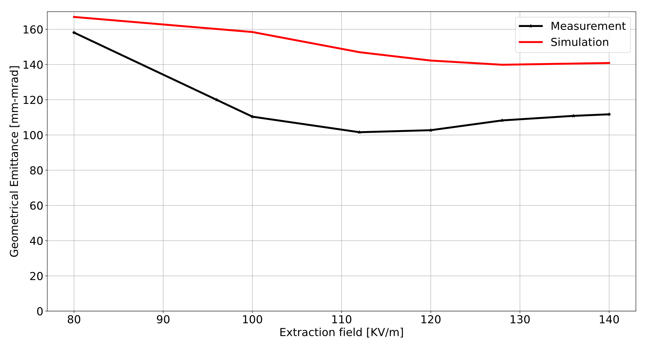
Total Emittance of the CSB: Measurement vs IGUN Simulation
 | Optimized Emittance [mm-mrad] | Extraction field [kV/m]
Simulation | 139.8 | 128.0
Measurement | 101.6 | 112.0
Total current collimated by the quads after the extraction system
Notes:
Acceptance of the quad is not measured because each mass in the beam has a different focal length because of the magnetic field.
This is the plot of the results of the IGUN simulation compared with the total emittance of the CSB.
The extraction field was varied between 80 and 140 kv/m. Emittance from IGUN simulation is plotted in red and the measured emittance of the CSB using the QST is plotted in black.
The trend of the plots indicates that as the extraction field is varied, the total emittance of the CSB is changed as shown in the plot.
The disagreement between the measurement and IGUN simulation is because the total extracted current from the CSB was collimated by the quadrupole in front of the CSB extraction system, removing a fraction of the low-mass ions that significantly contribute to the large emittance of the CSB included in the IGUN simulation.
So, only a fraction of the total current was present at the location where the total emittance was measured.
From the measurement, the Lowest emittance of 101.6 mm-mrad was found at 112 Kv/m
The beam rotation due to the decreasing magnetic field of the ECRIS becomes the dominating contribution to the ion beam emittance when $B∗r≥0.5\sqrt{kT}\sqrt{A/Q}$
CSB Bias to 10 kV
100 % beam Emittance = 5$ε_{1rms}$ Waterbag distribution
86 % beam Emittance = 4$ε_{1rms}$
When you add up all currents you should see Child-Langmuir. If it deviates then there are losses in the extraction system, which we cannot detect.

Slide 11
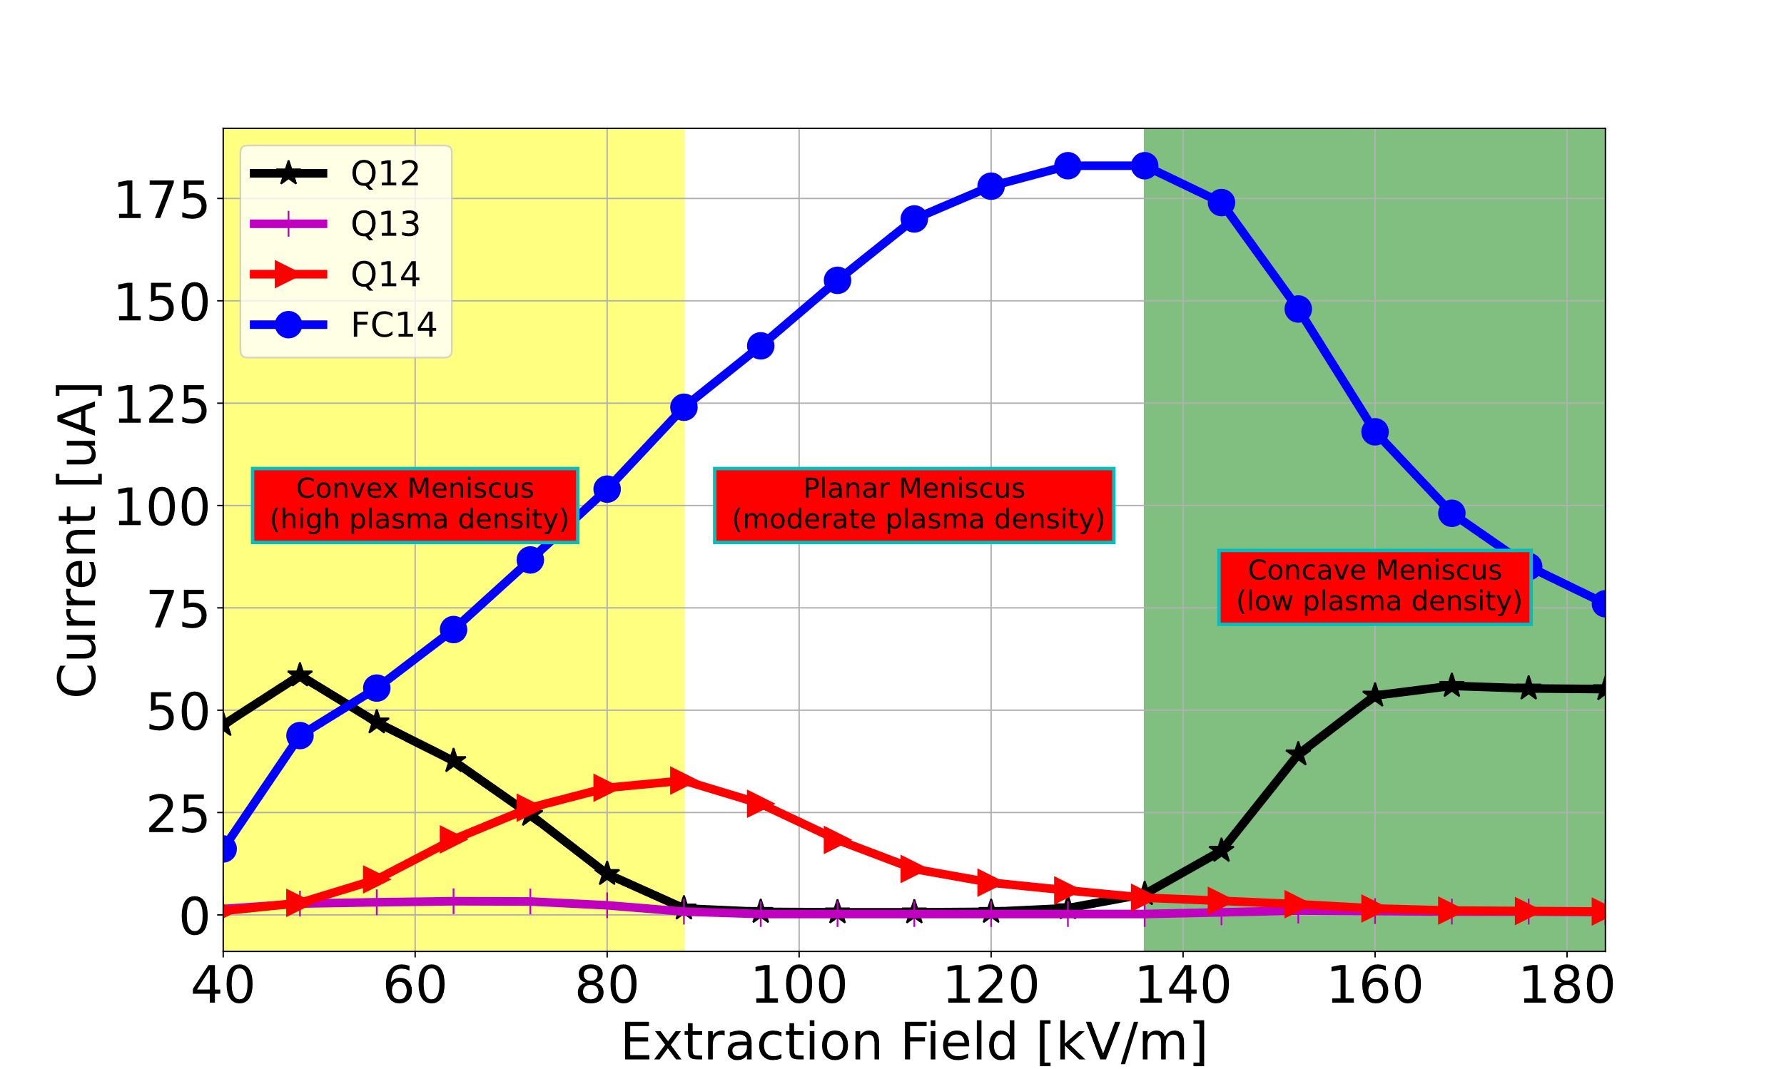
Total Extracted Current vs Extraction field

Slide 12
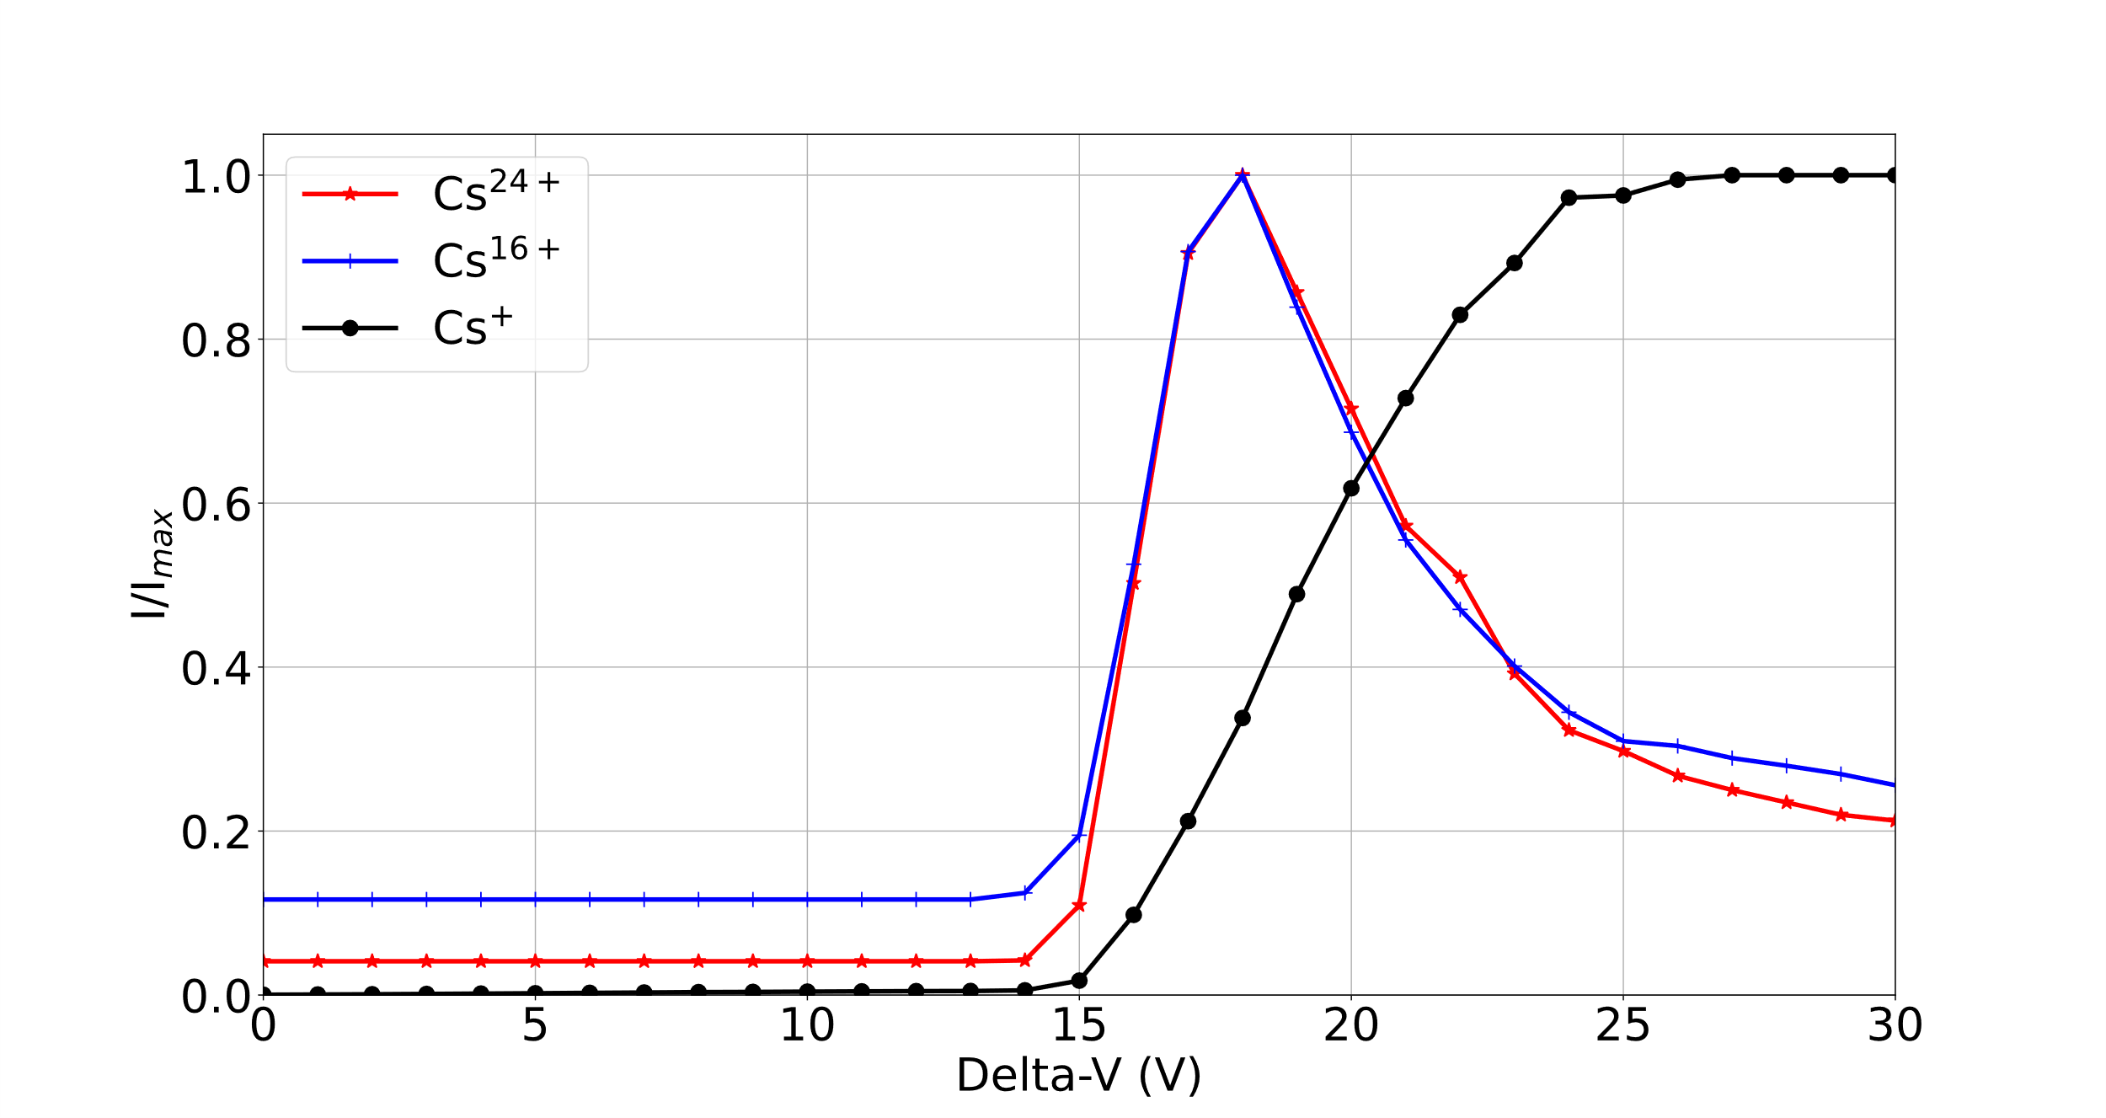

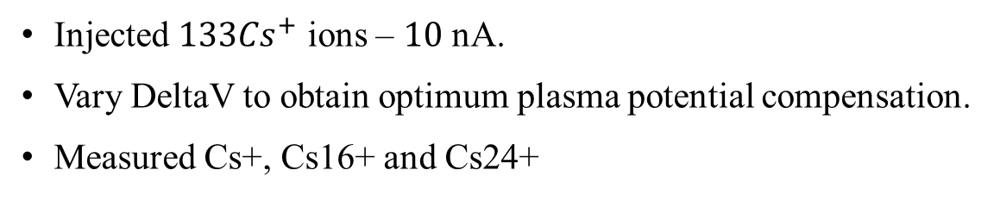
Variation of DeltaV: Plasma Potential Measurement
Injected ${133Cs}^{+}$ ions – $10$ nA.
Vary DeltaV to obtain optimum plasma potential compensation.
Measured Cs+, Cs16+ and Cs24+
Plasma potential seems to be in order of $17 V$
Notes:
At the plasma edge, some electrons have sufficient energy to escape the magnetic confinement leaving the plasma positively charged.
The potential that the plasma acquire in this process is called the plasma potential, and it affects both the injection and extraction of ions from the charge state booster.
I measured the plasma potential by varying deltaV which is the difference between the bias voltage of the test ion source and bias voltage of the CSB between 0 and 30 V
The CTIS bias voltage (DeltaV) can be increased up $500 V$ above the CSB bias voltage to compensate for the plasma potential
$$DeltaV= {CTIS}_{bias}−{CSB}_{bias}$$
Low-energy electrons are found mainly at the plasma edge – Highly collisional and not perfectly confined
The CTIS bias voltage can be increased up $500 V$ above the CSB voltage to compensate for the plasma potential.
Plasma potential is as a result of non-neutrality at the edge of the plasma due to the loss of low energy and highly collisional electrons.
Plasma potential depends solely on electron temperature $V_{p}=\frac{2.84T_{e}}{e}$ - It is only valid at the plasma edge, assuming neutrality at the plasma center.

Slide 13
Implementation of two-frequency heating

Slide 14
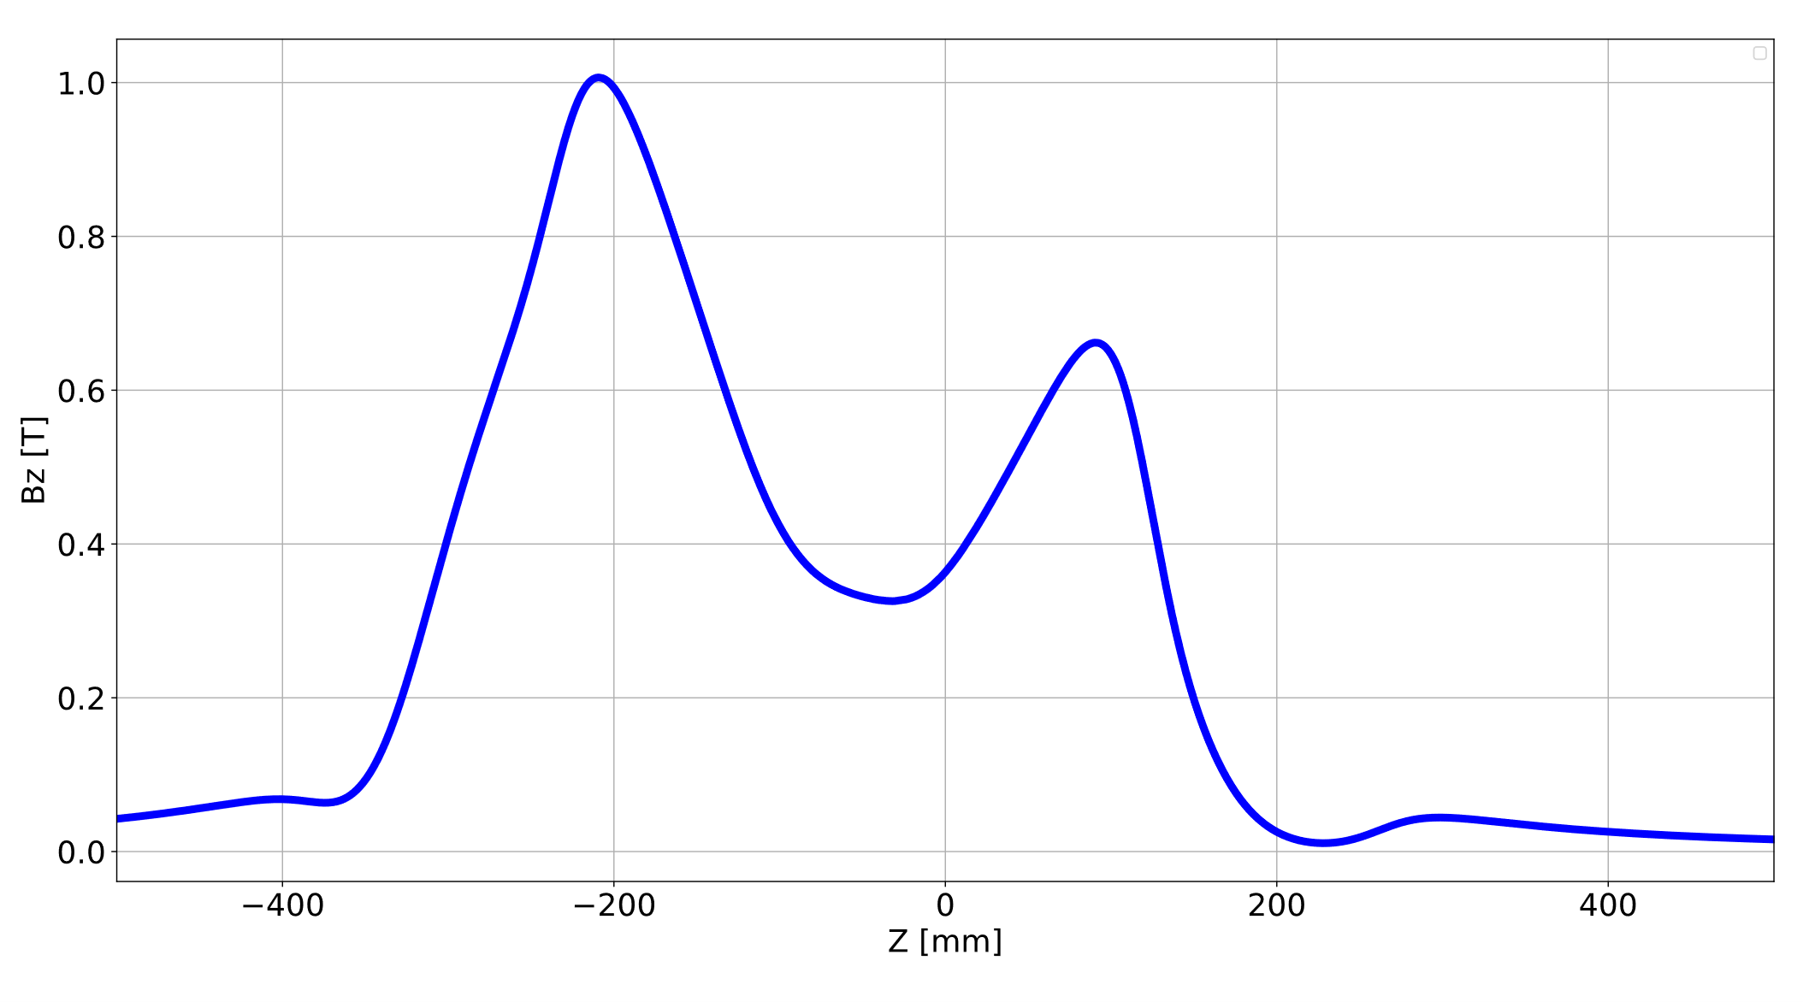



Two-frequency heating of the ECR plasma
$$f_{rf1}$$
Electron heating: One Frequency = One resonance surface
$$f_{rf1}≠f_{rf2}$$
$$f_{rf2}$$
More heating for the electrons:
two distinct frequencies = two resonance surfaces
Notes:
In an ECR plasma, only electrons get heated, because they are lighter than the ions.
Electrons undergo resonant heating when an EM wave is applied.
For instance, if we apply an EM wave of 14.5 GHz, Bz = 0.52 T will create an electron cyclotron frequency that equals the rf frequency. When this happens, the plasma electrons absorb the radio frequency power at that resonant zone.
If we add another frequency, two resonant zones are created, and more electrons get heated.
Two-frequency heating creates additional resonance zones for electron heating
Reason for implementing TFHT
-it is known to stabilize the plasma
-Increase the intensity of HCIs
-Pushes the charge state distribution to higher charge states

Slide 15
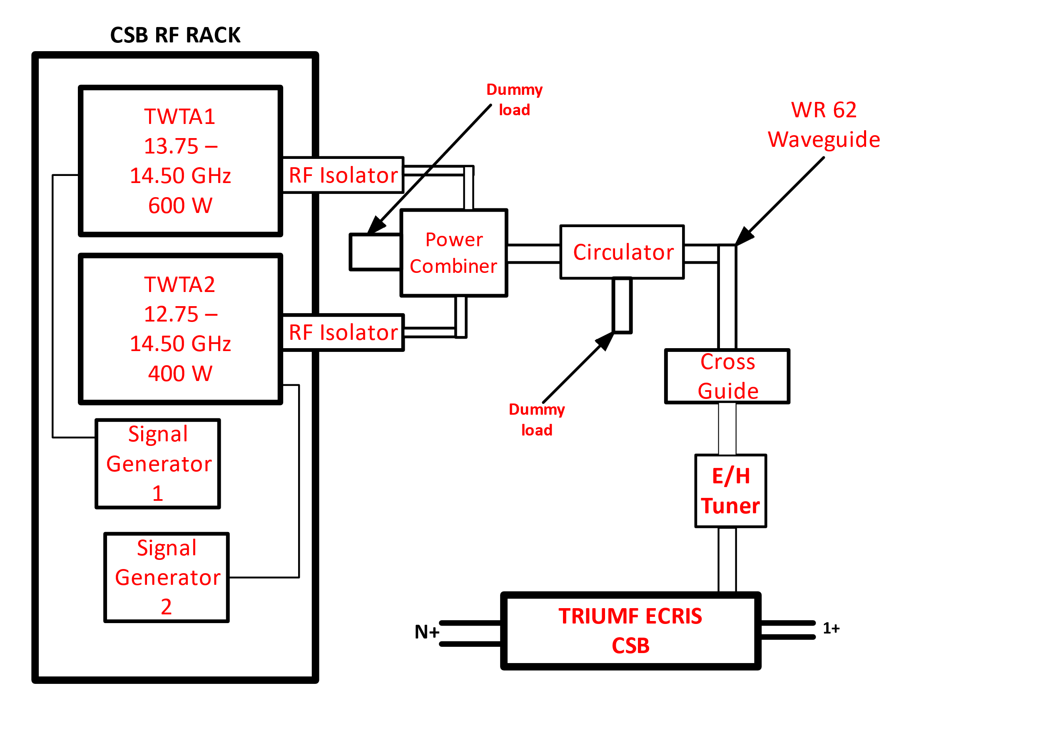
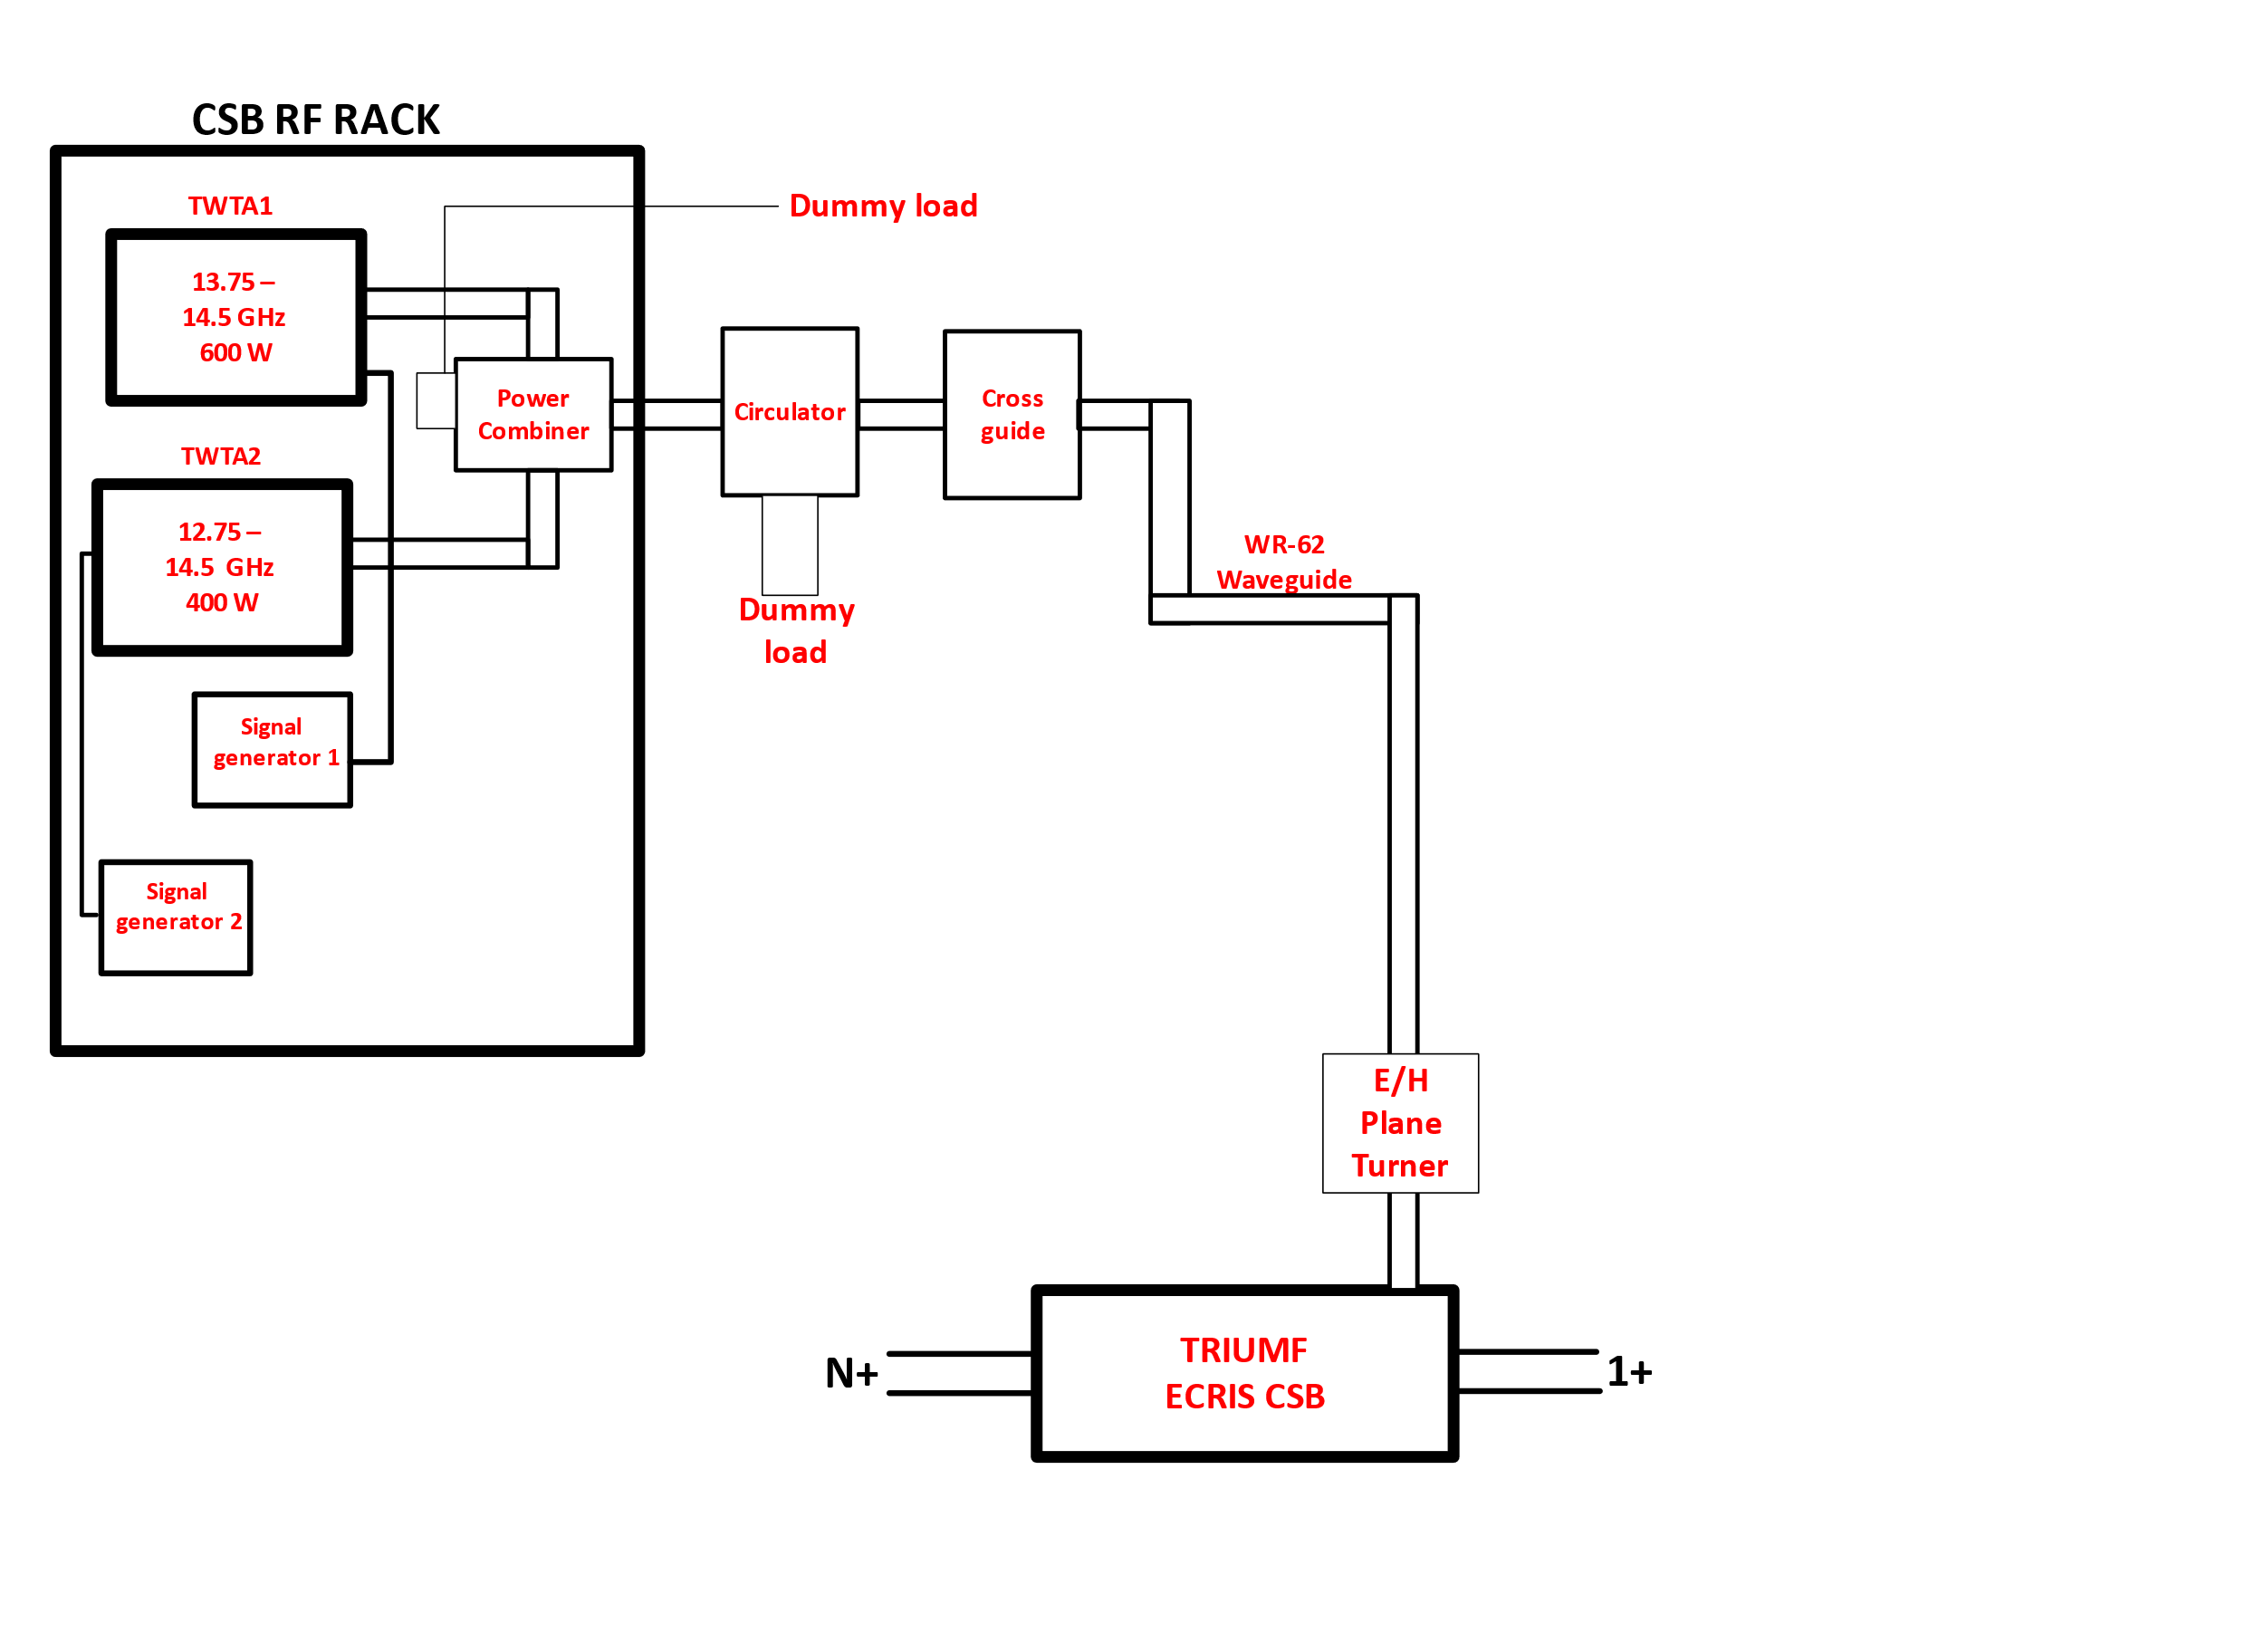
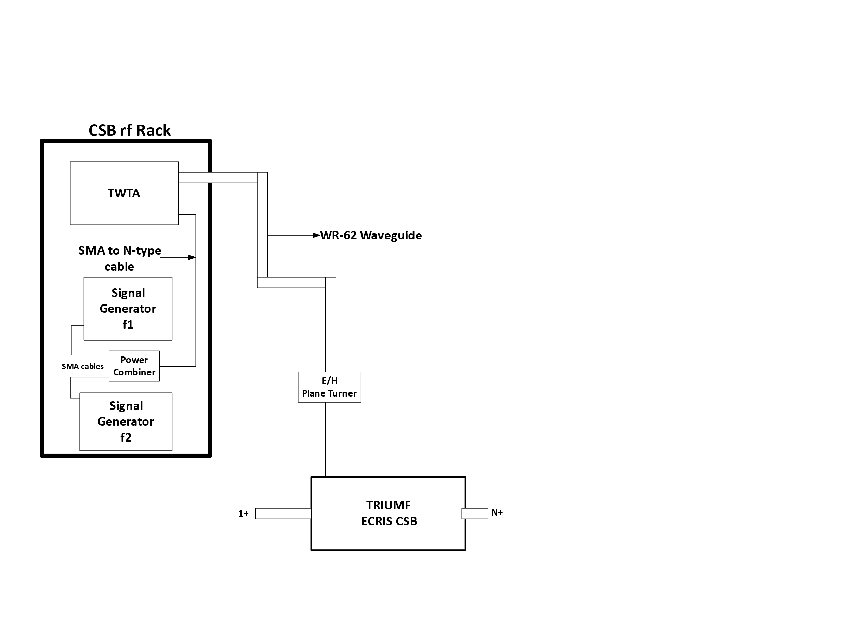
Implementation of Two-Frequency heating on the TRIUMF ECRIS CSB
First approach
Setup based on R. Racz et al, 2018.
J. Adegun et al, ICIS21
8 – 18 GHz
400 W
Notes:
Conventionally, the technique is implemented using two separate waveguides, but TRIUMF CSB was not designed to accommodate…
The main components of the TFHT are

Slide 16
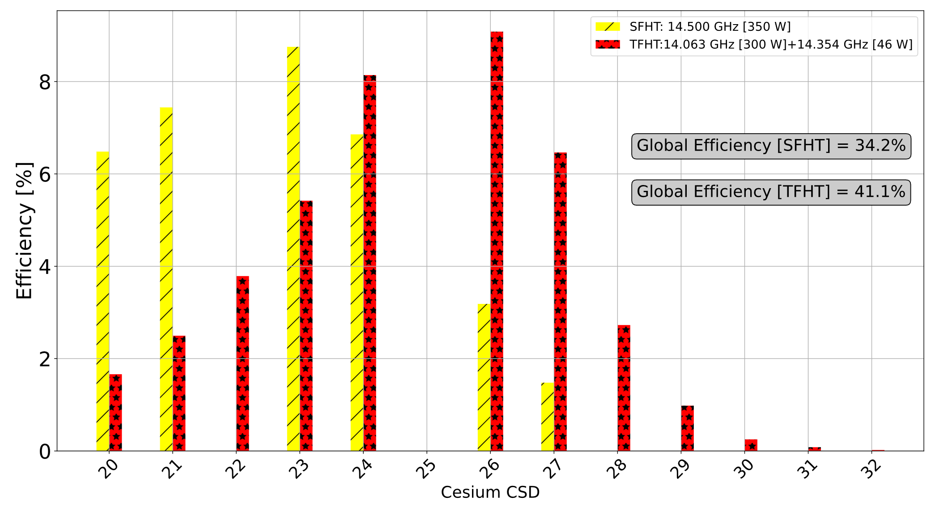
Efficiency of the Charge State Booster: SFHT vs. TFHT
Notes:
By comparing the two heating techniques, the TFH of the plasma increases the electron energy, plasma density and ion confinement time, leading to the maximum efficiency increasing from 8.5 % at SFHT for Cs²³⁺ to 9.1 % at TFHT for Cs^{26+.}
The maximum charge that can be produced shifted from 28+ to 32+
Global efficiency shifted from 34.2 % to 41.1 %
Ionization energy for 133Cs27+ = 916.1 eV
Ionization energy for 133Cs32+ = 1936 eV
Cs+ - 10 nA, 4RMS Emittance = 8.78 mm-mrad
The shifting of the peak of the Cesium charge state distribution to higher charge states as shown on this plot is a result of the TFH of the plasma.
The TFH of the plasma increases the electron energy, plasma density and ion confinement time, leading to the production of higher charge states.
The CSB efficiency is compared for different heating modes and plasma configuration
About 79 % increase in global efficiency under TFHT compared to SFHT
Global Efficiency interpolating the missing CS
SFHT1 – 46 %: C22+ = 7.8 % and Cs25+ = 4.9 %
SFH2 – 39 %: Cs25+ = 3.4 %
SFHT3 – 25 %: Cs25+ = 1.3 %
TFHT – 50 %: Cs25+ = 8.6 %
Higher charge states contribute more to the global efficiency
Electron energy, plasma density and ion confinement time increased with the two-frequency heating of the plasma resulting in the production of higher charge states

Slide 17
Effect of unwanted dipole field on beam injection
1+
1+
With the magnetic field at the injection switched ON, but plasma switched OFF, injected singly charged ions were not extracted.
Notes:
But assuming we are not interested in charge breeding and just want to shoot singly charged ions through, that is, if I inject a 1+ beam through this side, I should be able to extract the beam on this side.

Slide 18
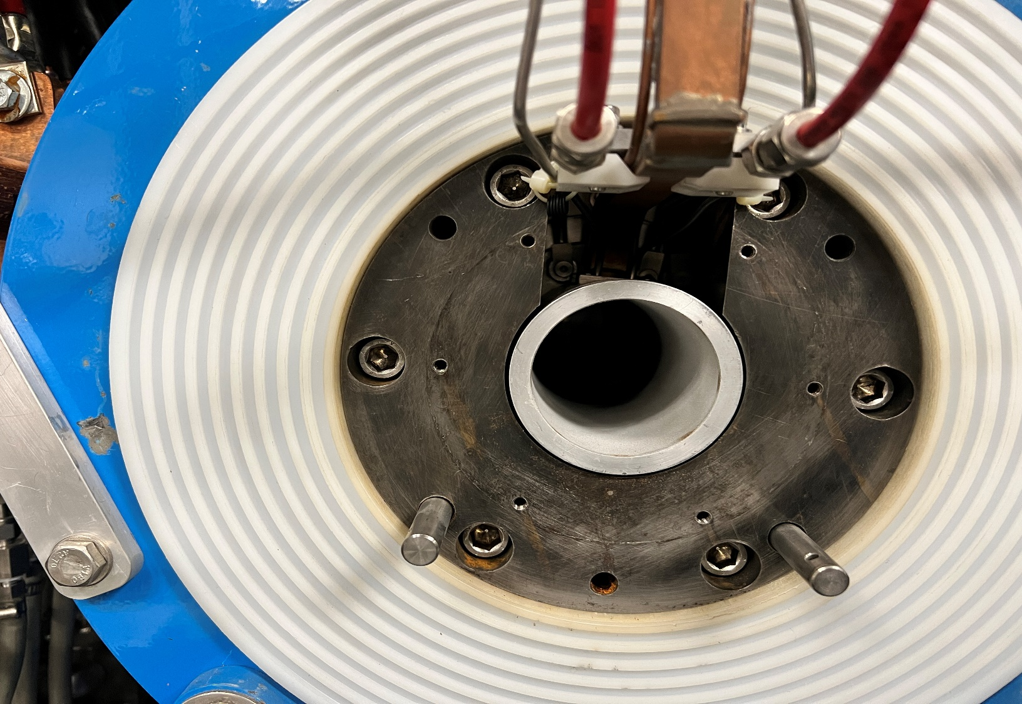
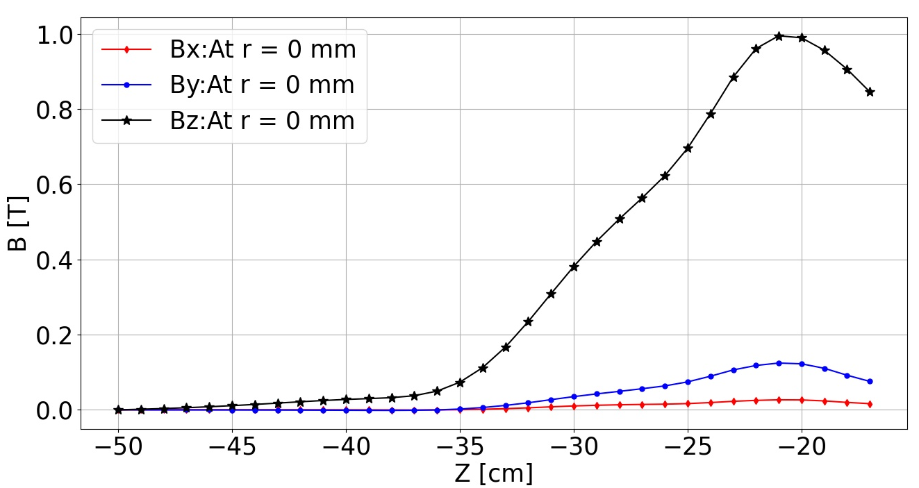
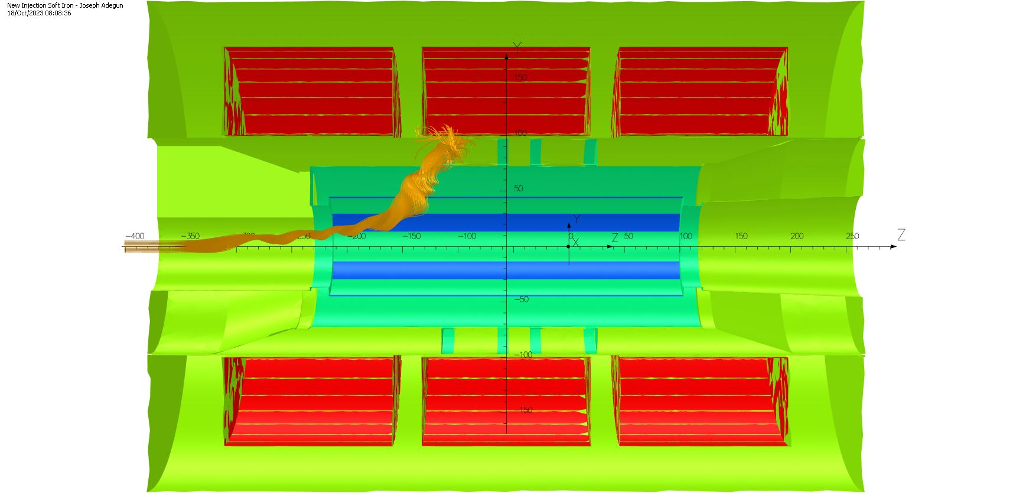
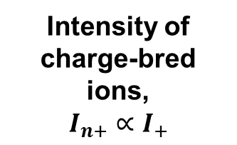
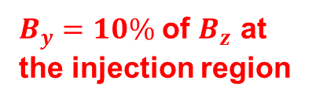
Effect of the wide gap in the iron Plug
B-field in the injection region of the TRIUMF CSB
$B_{y}=10\%$ of $B_{z}$ at the injection region
If singly charged ions are lost during injection, then nothing to charge breed – efficiency is lower
Intensity of charge-bred ions,
$$I_{n+}∝I_{+}$$
Notes:
But that is not the case with our CSB.
When injecting a 1+ beam without plasma while the magnetic field is active, the ions undergo deflection during the injection process, resulting in their loss before reaching the plasma. This affects the efficiency of charge-bred ions.
The deflection is because of a magnetic field component perpendicular to the direction of travel of the ions.
The field created by the gap in the injection soft iron of the CSB. The gap was made to feed through the waveguide and other components into the plasma chamber.
This is the motivation for the design of a new injection soft iron.

Slide 19
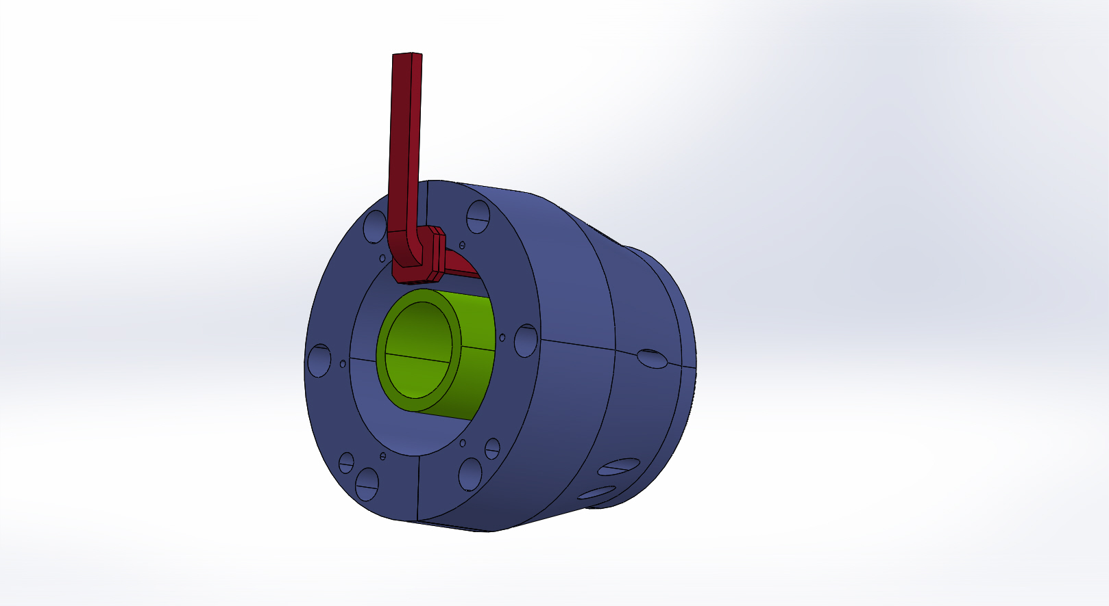
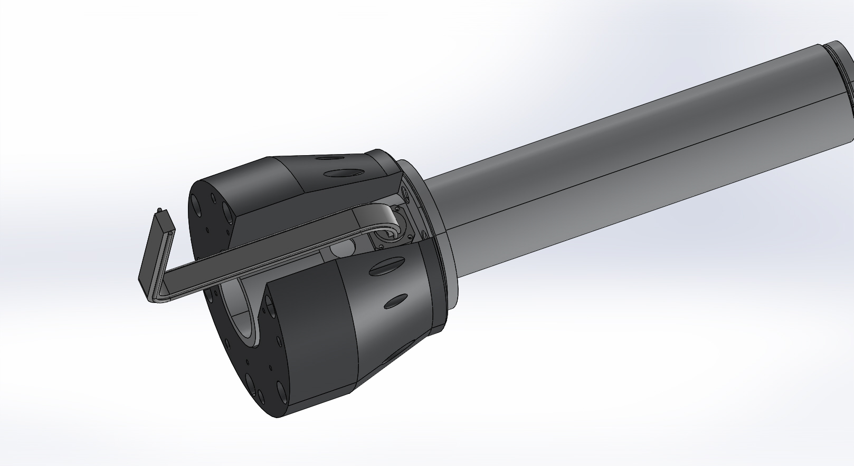
Comparison between Geometries with waveguide
New Iron plug
Existing iron plug
Notes:
Here is the soft iron with waveguide

Slide 20
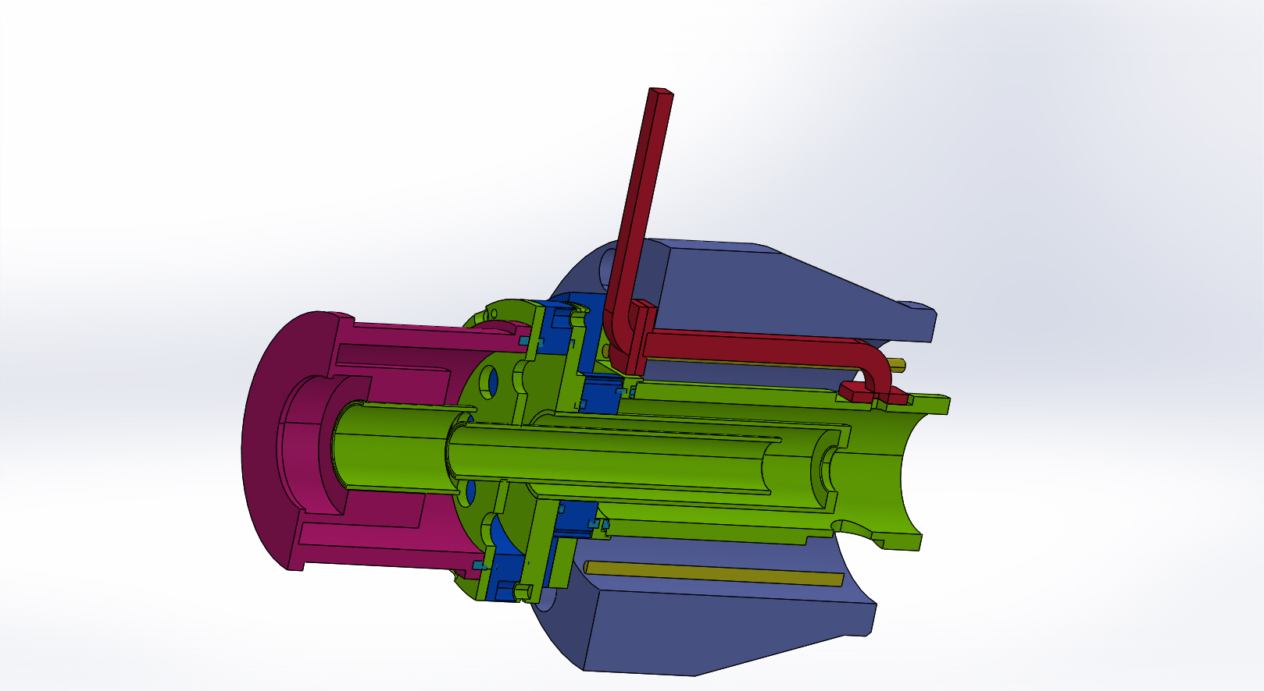
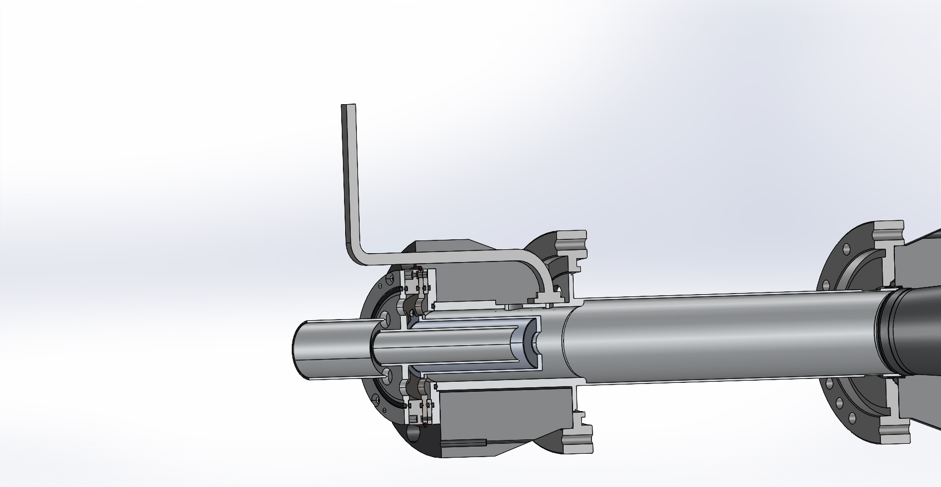
Comparison between existing and current with Flanges
New design
Existing
Notes:
Here is a cut-away view of the soft iron
During the redesign, the support gas window was repositioned.

Slide 21
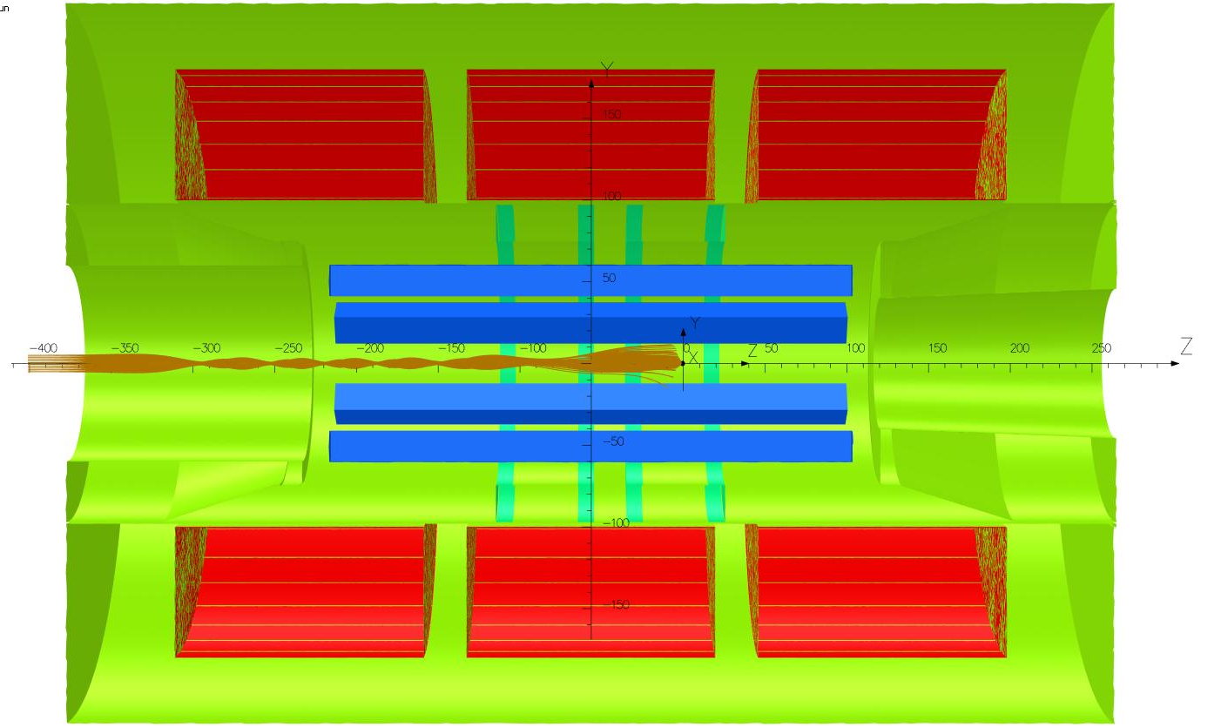
Comparison of particle trajectories
Existing Soft Iron
New soft iron
Notes:
With the new design, injected ions are no longer deflected

Slide 22
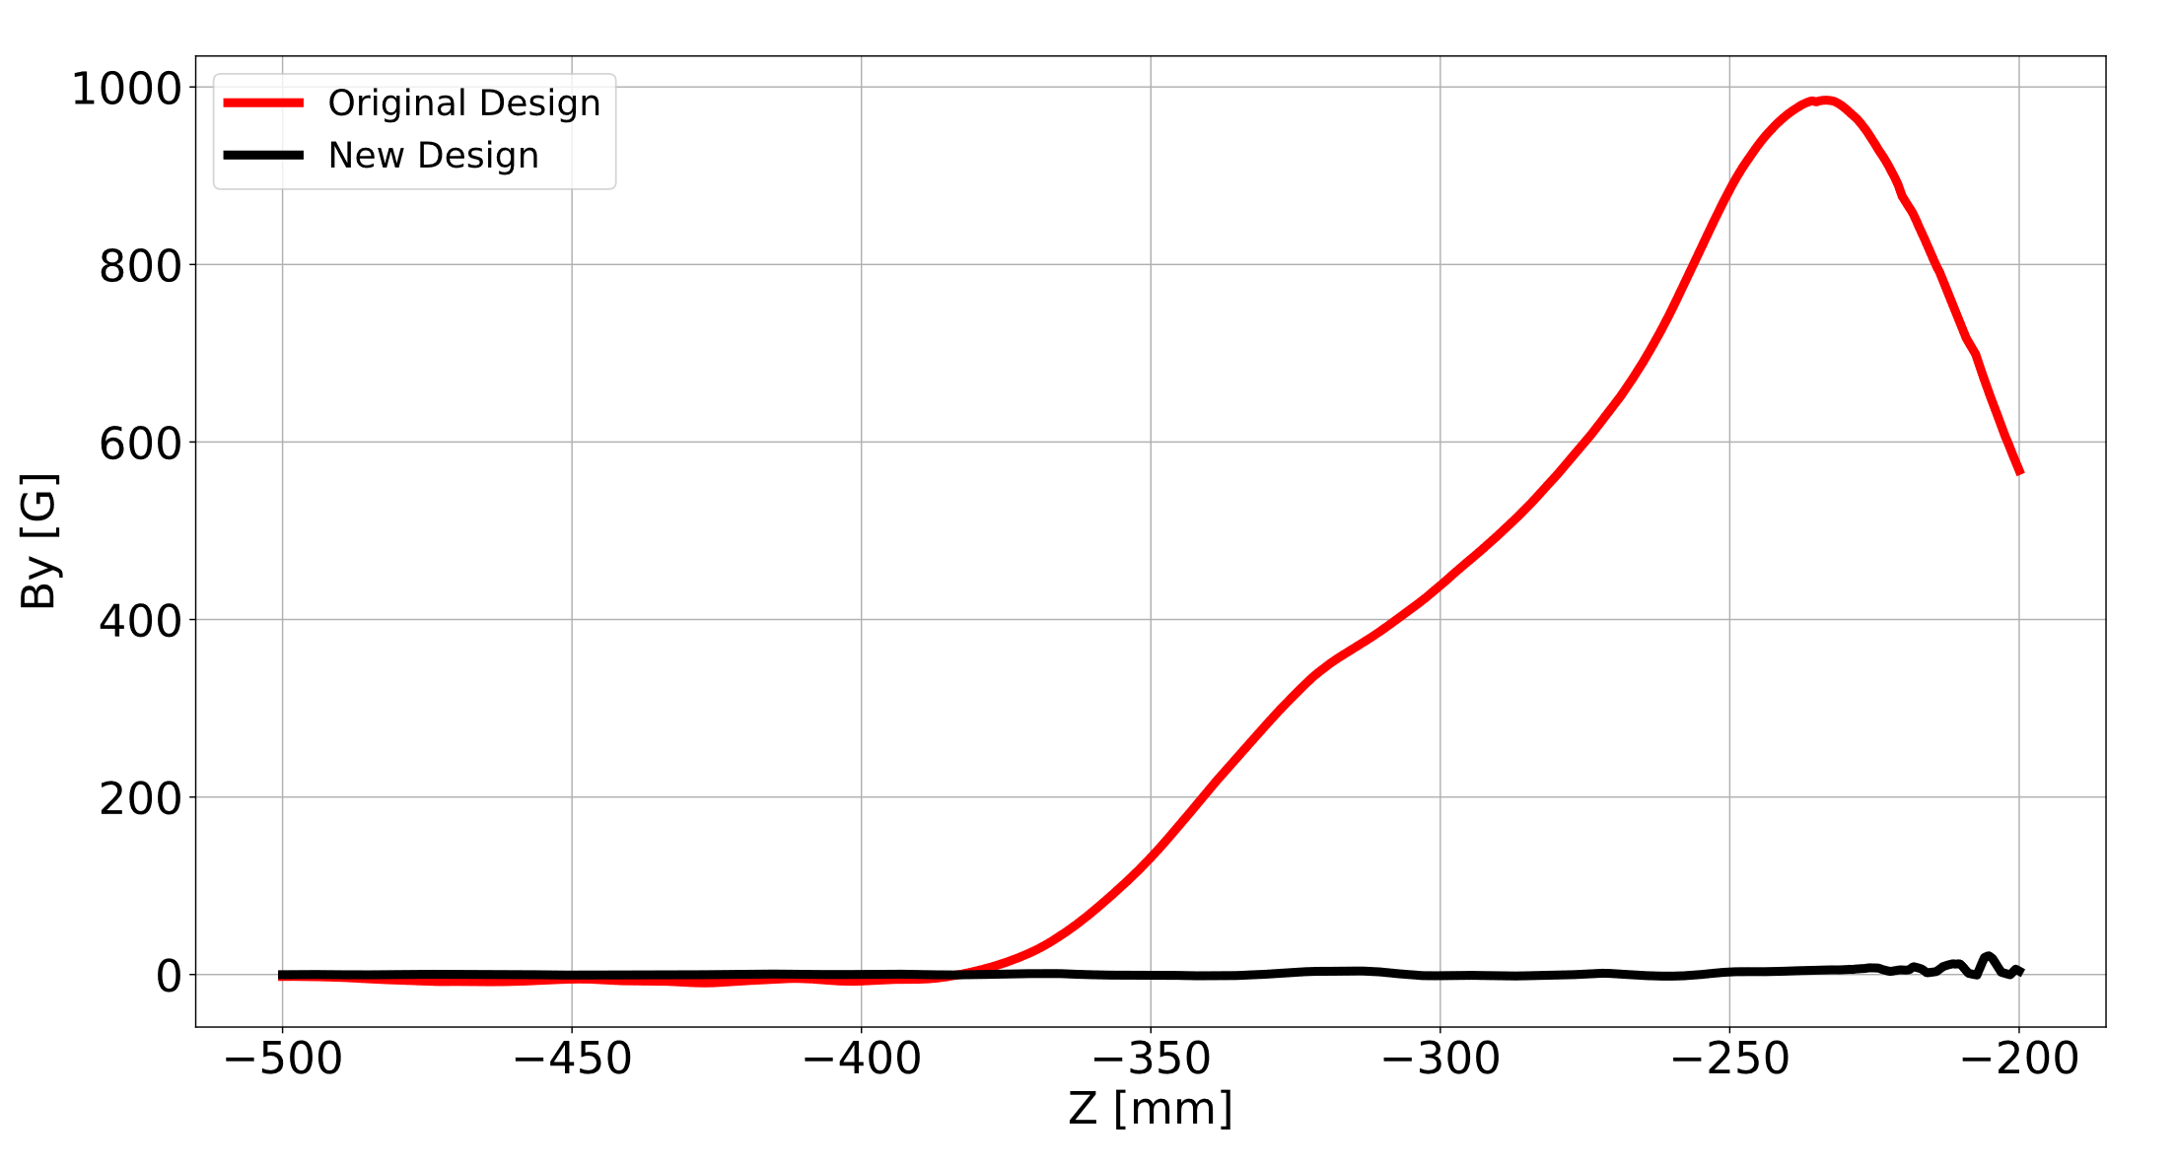
Comparison of Magnetic field at the injection region
Notes:
I simulated the magnetic field distribution of the CSB with the newly designed soft iron and compared the result with measured fields.
I also plotted the Bx and By components.
With the inner diameter increased, the strength of the field decreases at the injection region. Also, the slopes of the fields are also different
Meanwhile, higher magnetic field is required at the injection region for better confinement.
However, the magnetic field can be increased without saturating the iron.
With the current setup, at 1050 A, we can achieve 1 T but with the new design, simulation showed that we will need more than 1100 A to achieve 1 T. The current power supply is up to 1300 A, so that is possible.

Slide 23
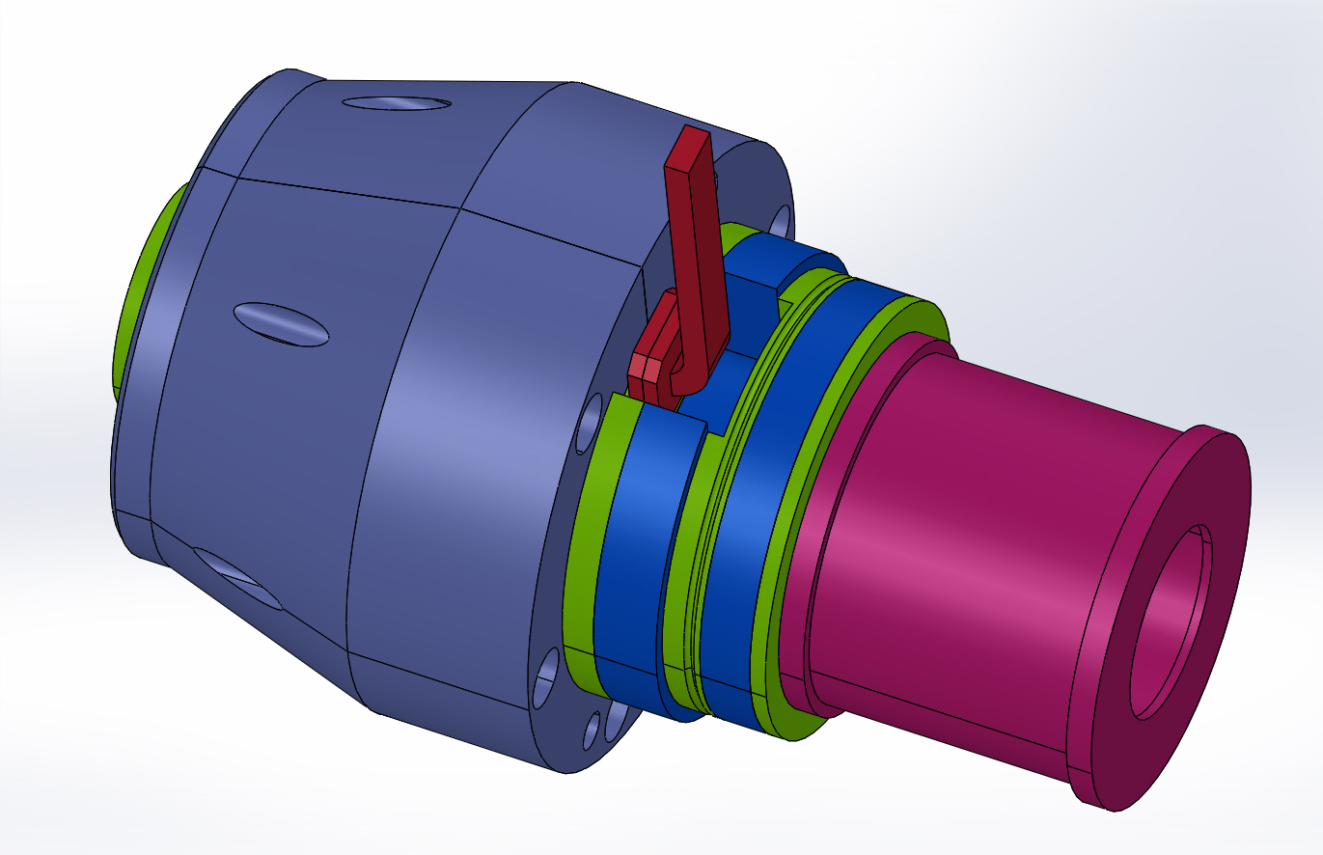
Final design
The iron plug is being manufactured and expected to be delivered next year for installation
Notes:
The redesign of the soft iron create a domino effect.
With the new design, it will be difficult to assemble/disassemble the CSB, so Friedhelm suggested that I should slice the soft iron vertically into two equal halves.

Slide 24
Summary
At TRIUMF, the Electron Cyclotron Resonance Ion Source is used to charge breed isotopes with atomic mass greater than 30 to match the injection energy of the LINAC.
Recently, a two-frequency heating technique was implemented on the CSB using a single waveguide, contributing to its increased efficiency.
There is a gap in the injection soft iron of the CSB, creating a magnetic field that deflects ions towards the chamber wall. A plan to replace the iron has been established.

Slide 25
Thank you

Slide 26
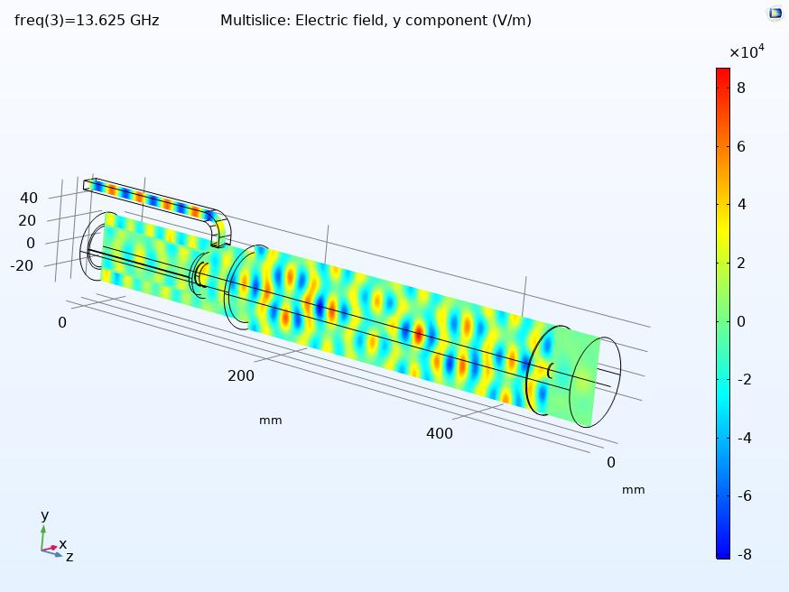
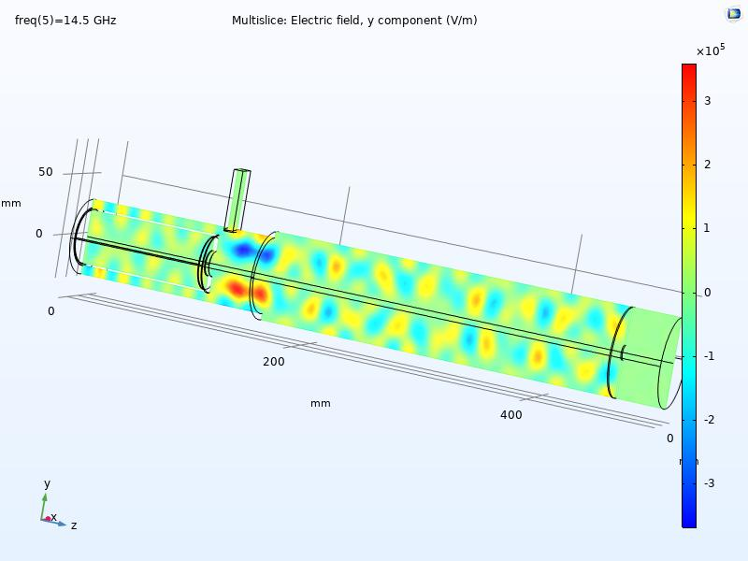
Comparison between the excited modes in New and existing plasma chamber I
New Plasma Chamber
Existing Plasma chamber
Notes:
Since the location of the waveguide window is changed, it was crucial to verify whether the modified setup of the plasma chamber can still effectively excite the required electromagnetic wave mode within the desired frequency range for plasma heating.
So, I used COMSOL to model the chamber, allowing me to calculate the excited modes

Slide 27
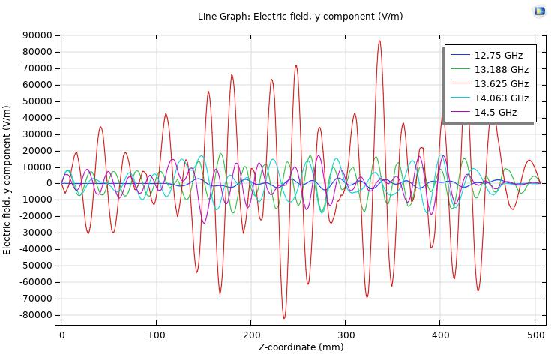
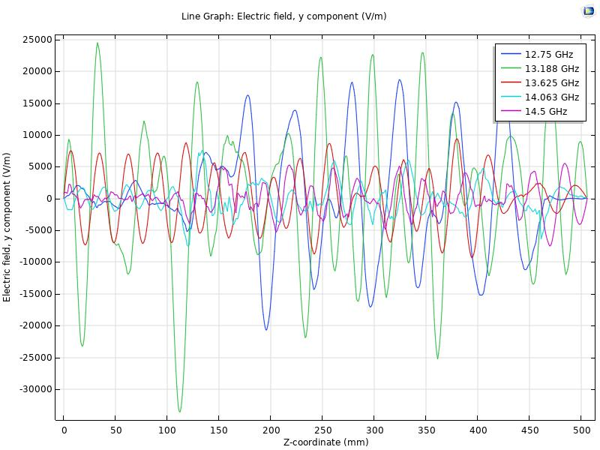
Comparison between the excited modes in New and existing plasma chamber II
Redesigned Plasma Chamber
Existing Plasma Chamber
Simulation shows that, without plasma, the frequency of the dominant mode for the existing plasma cavity is 13.188 GHz
Frequency of the dominant mode is 13.625 GHz for the new design without plasma
Notes:
Here is the plot of the modes along the axis of the chamber. I varied the frequency of the EM waves between 12.75 and 14.5 GHz for both the existing and new chamber

Slide 28
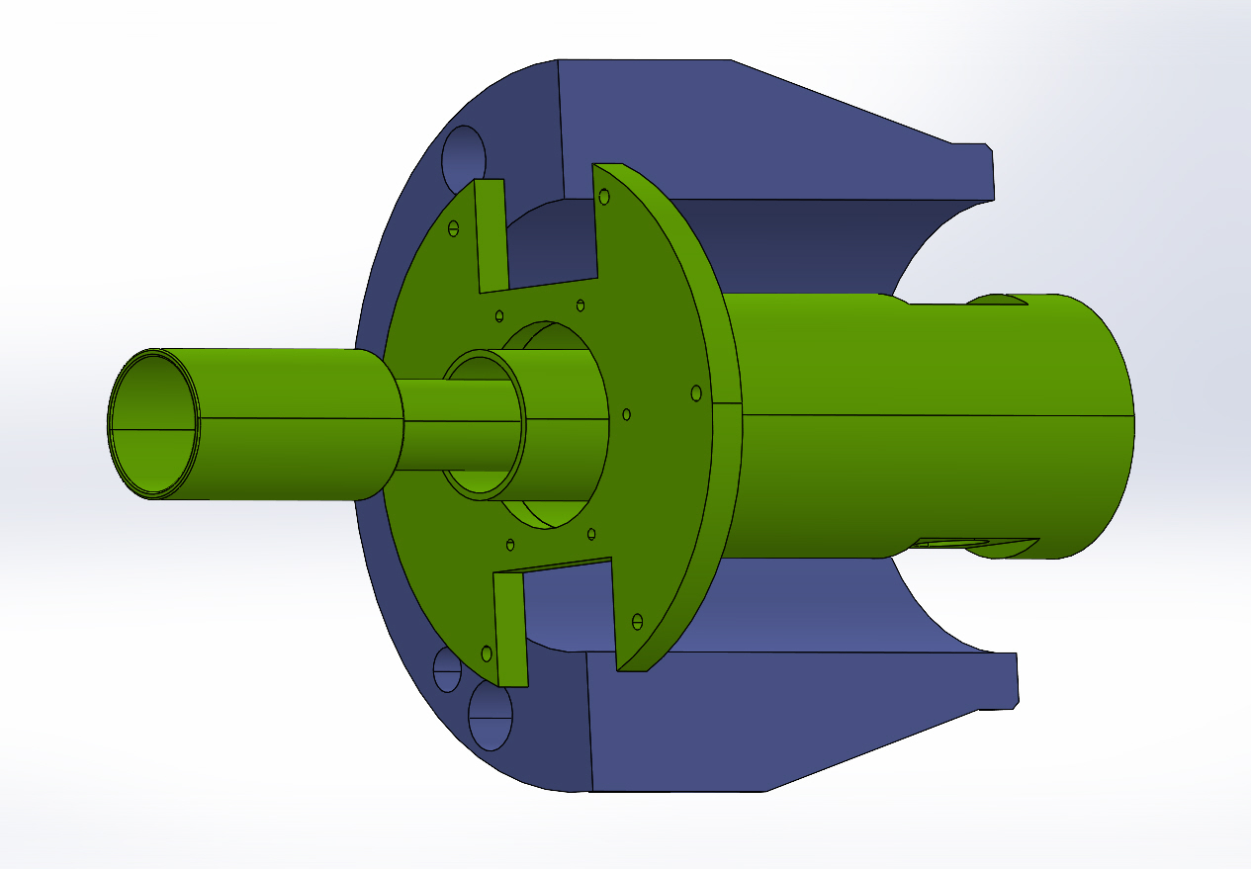
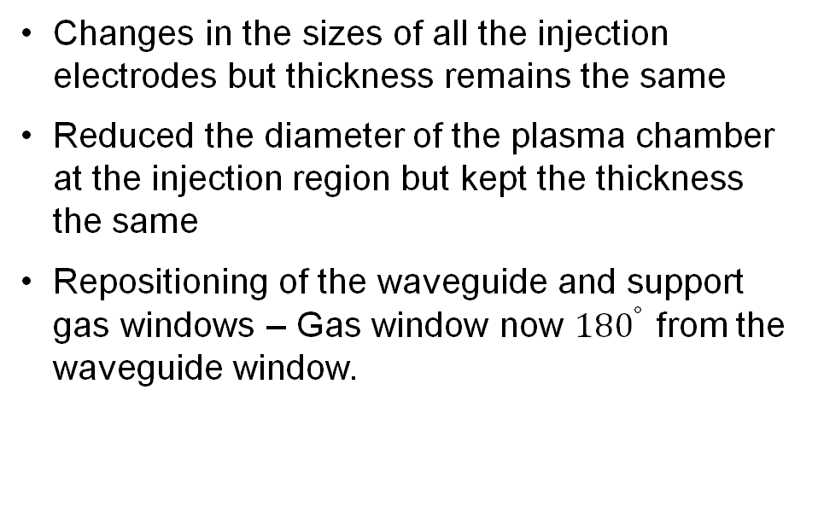
Changes to Injection electrodes and plasma chamber
Changes in the sizes of all the injection electrodes but thickness remains the same
Reduced the diameter of the plasma chamber at the injection region but kept the thickness the same
Repositioning of the waveguide and support gas windows – Gas window now ${180}^{°}$ from the waveguide window.
Notes:
To achieve the new design, I had to make modifications to both the injection electrodes and the plasma chamber.
I also used the opportunity to reposition the buffer gas window.

Slide 29
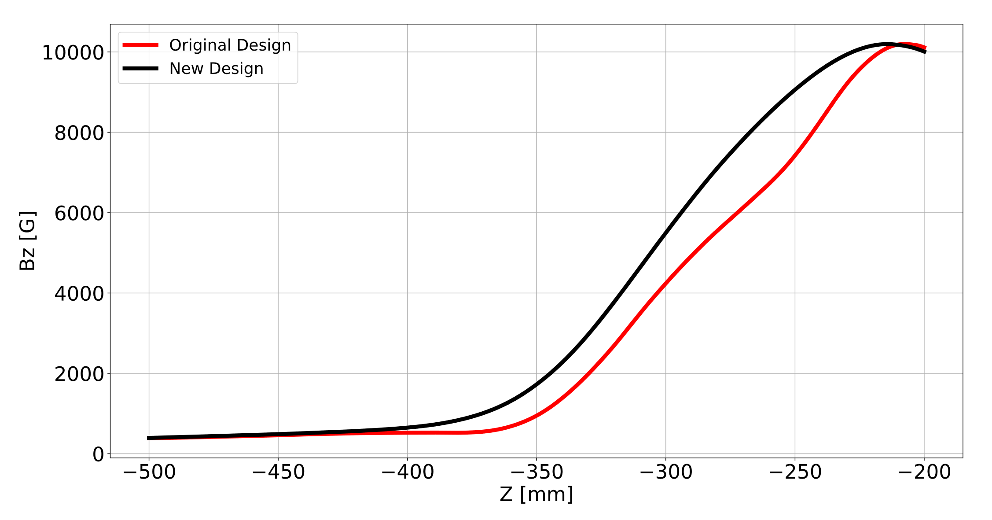
Comparison of Magnetic field at the injection region
Notes:
I simulated the magnetic field distribution of the CSB with the newly designed soft iron and compared the result with measured fields.
I also plotted the Bx and By components.
With the inner diameter increased, the strength of the field decreases at the injection region. Also, the slopes of the fields are also different
Meanwhile, higher magnetic field is required at the injection region for better confinement.
However, the magnetic field can be increased without saturating the iron.
With the current setup, at 1050 A, we can achieve 1 T but with the new design, simulation showed that we will need more than 1100 A to achieve 1 T. The current power supply is up to 1300 A, so that is possible.

Slide 30
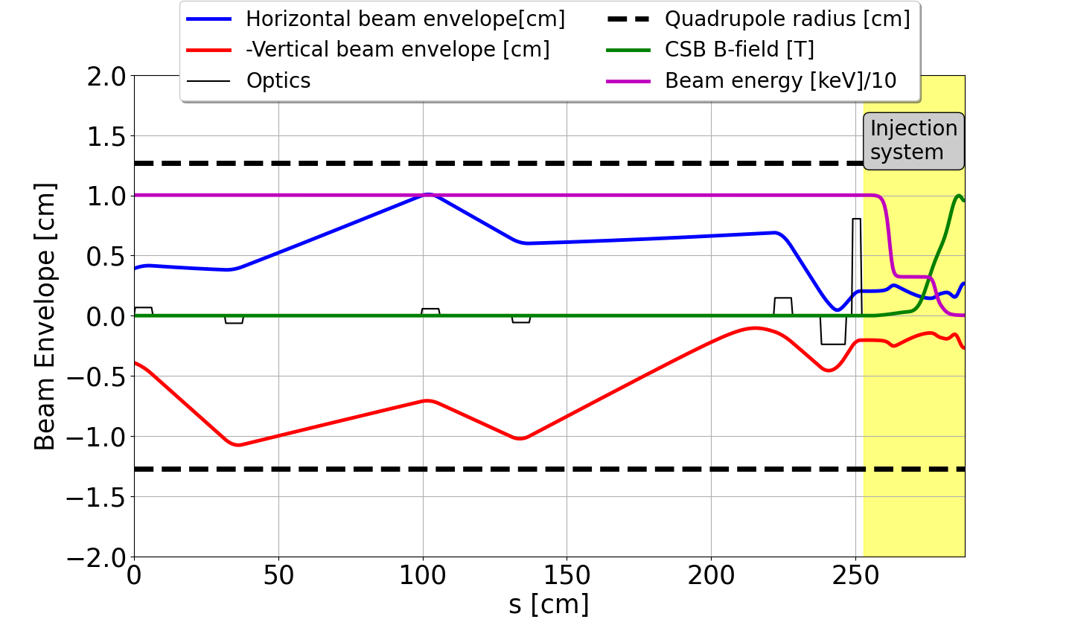
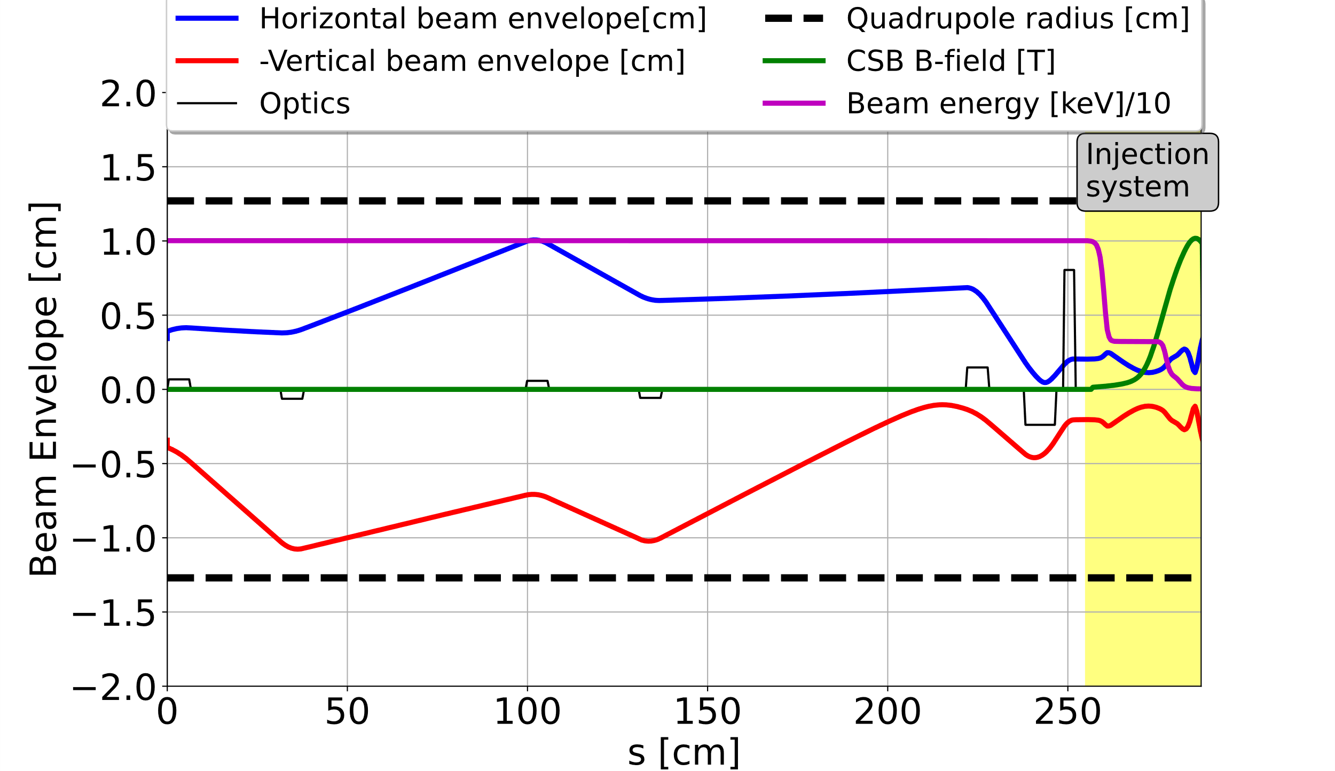
Comparison of Beam Envelopes
New E and B-fields
Existing E and B-fields
Notes:
With the introduction of the new soft iron and injection system, it was necessary to verify the compatibility of the injection optics considering the differences in the B and E-fields.
I optimized the optics with the current configuration, and I used optimized tune for the new E and B-fields.
This analysis guarantees that the system remains adaptable, despite the changes in the magnetic and electric fields introduced by the new design.

Slide 31
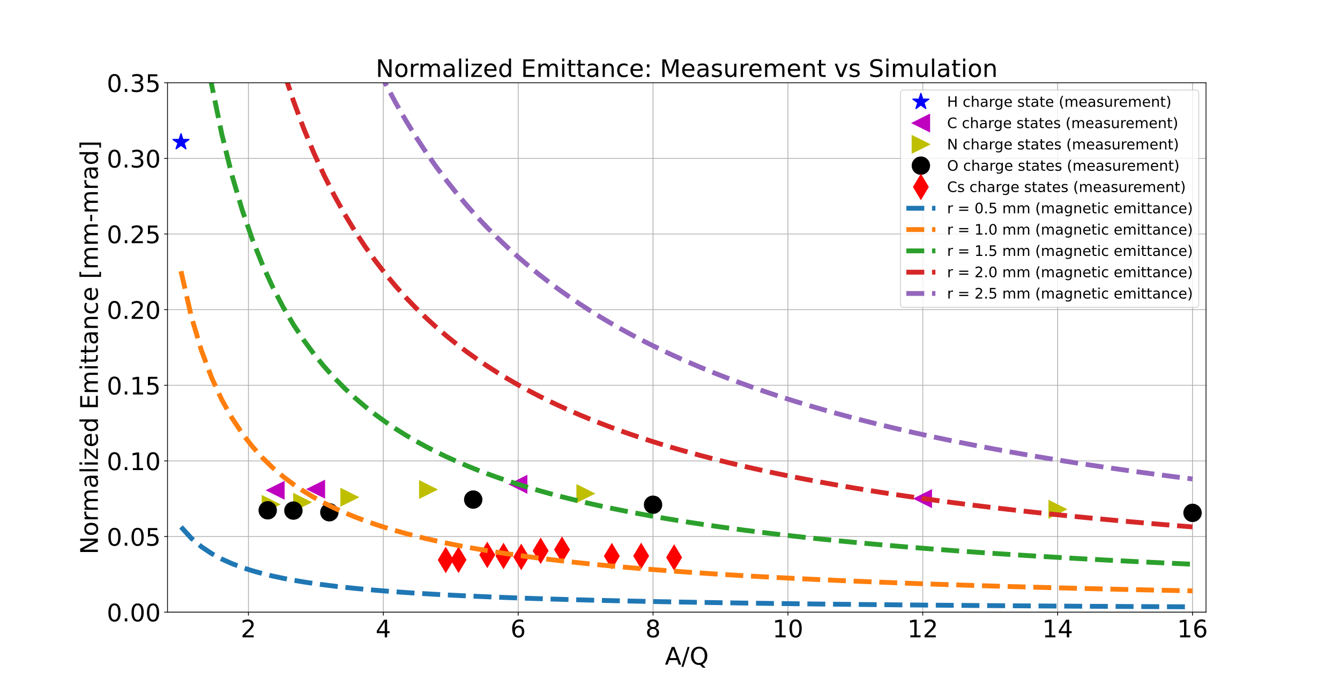

Normalized 4RMS-Emittance of Cs Charge State and Residual ions
$$ε_{mag}=0.16\frac{B_{0}r^{2}}{A/Q}$$
$$B_{0}=0.7 T$$
Ion-ion cooling effect (and magnetic field) from the ion extraction are responsible for spatial emittance distribution
Notes:
I also measured the Normalized Emittance of Cs charge states between 16 and 27 and residual ions from H,C,N and O. I also compared the measurements with the Magnetic Emittance calculation for plasma aperture radius between 0.5 mm and 2.5 mm to estimate the radius where the ions are extracted from the plasma.
It was observed that Hydrogen, the lightest of the ions, has the highest normalized emittance and Cs, the heaviest ions, has the lowest normalized emittance.
From the magnetic emittance calculation, I estimated that the residual ions were extracted from the radius between 1 mm and 2.5 mm while Cs charge states were extracted between 0.5 mm and 1.5 mm .
The cooling of the highly-charged heavy ions by the low-charged light ions is responsible for the spatial emittance distribution.
ion-ion cooling effect in which low-charged lighter ions are repelled to the plasma edge, and highly-charged heavier ions are attracted to the plasma center, and the magnetic field from the ion extraction are responsible for the spatial emittance distribution.

Slide 32
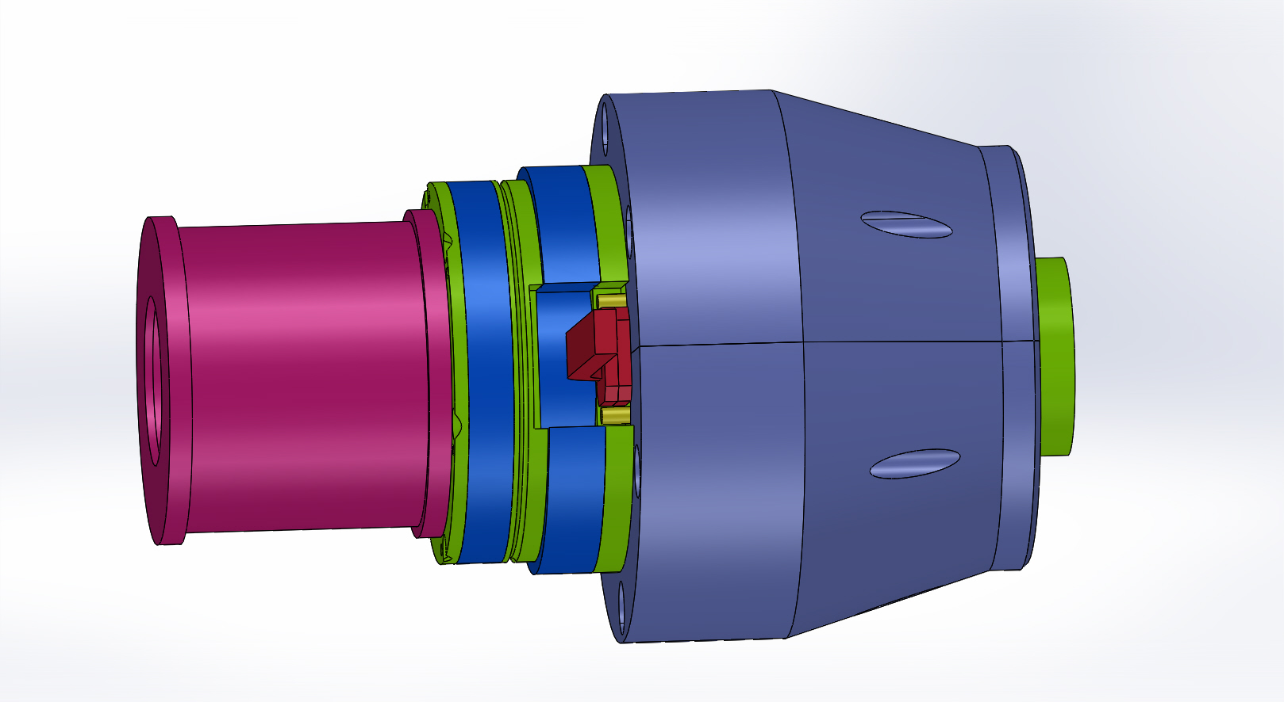
Final design II
All the flanges, HV insulators and O-rings are required to be changed
Notes:
Furthermore, the dimension of all the flanges, insulators and O-rings will be changed to match the new design.

Slide 33
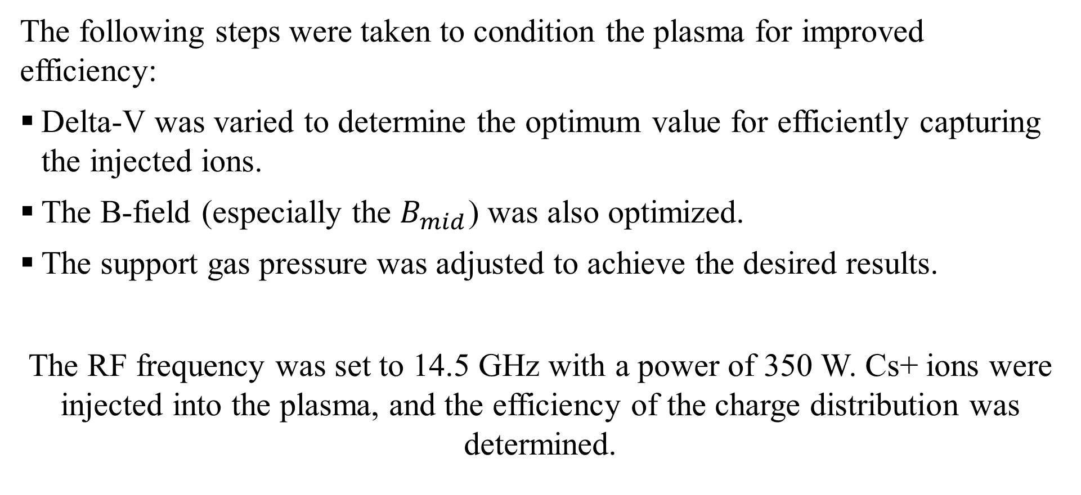
Plasma conditioning
The following steps were taken to condition the plasma for improved efficiency:
Delta-V was varied to determine the optimum value for efficiently capturing the injected ions.
The B-field (especially the $B_{mid}$) was also optimized.
The support gas pressure was adjusted to achieve the desired results.
The RF frequency was set to 14.5 GHz with a power of 350 W. Cs+ ions were injected into the plasma, and the efficiency of the charge distribution was determined.

Slide 34
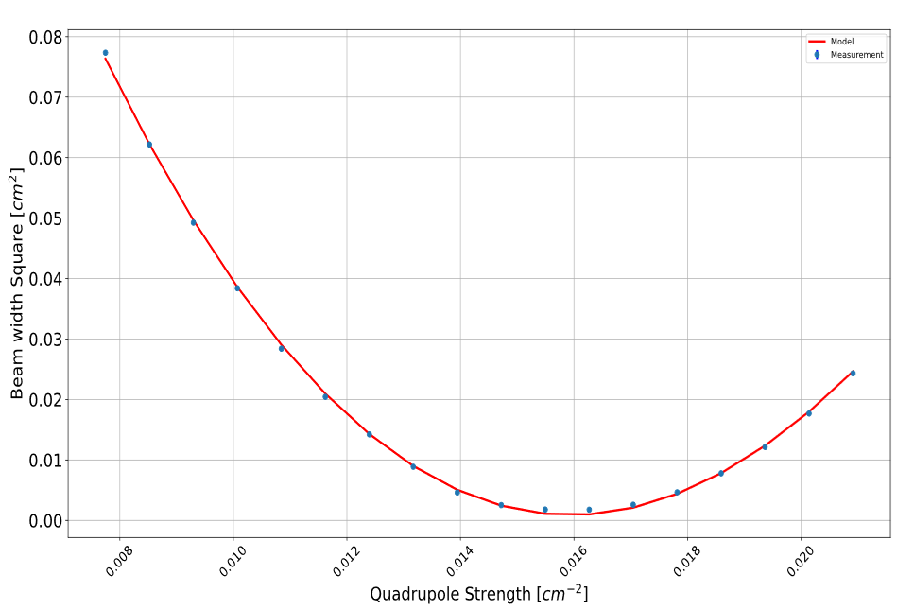
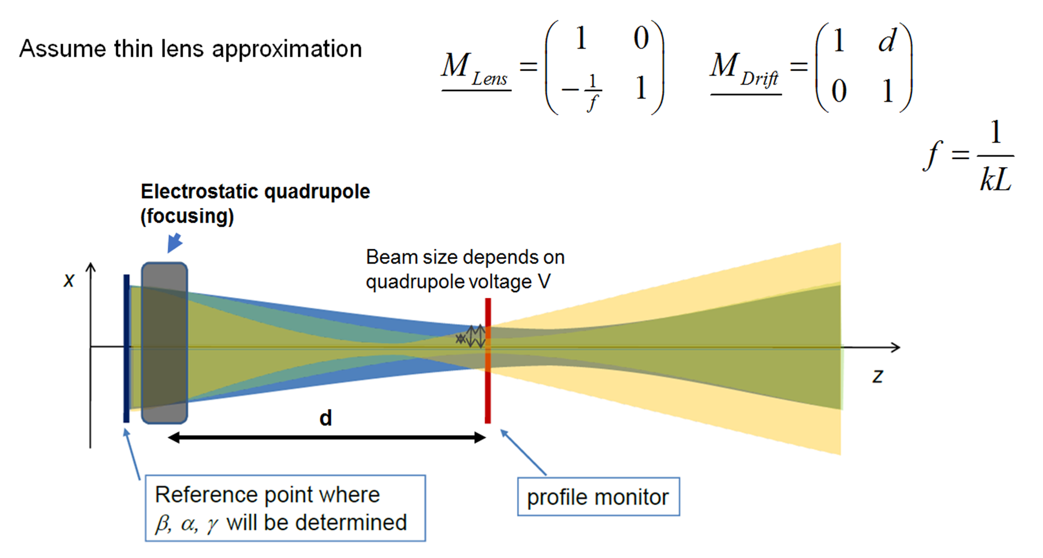
Quadrupole Scan Technique for Emittance Measurement
Limited space to install conventional Emittance meter
QST is more flexible in terms of using the existing quadrupole optics
Point where emittance is determined
Python code was developed to automatically scan the quad and process the mathematics involves in the Emittance measurement
Notes:
I would like to summarize the alternative method that I developed for the emittance measurement of the CSB
The method is called the QST.
The technique involves scanning a quadrupole’s range of strengths and measuring the corresponding beam distribution on a profile monitor at a given drift length.
A parabolic curve is produced by plotting the standard deviation of the distribution against the quadrupole strength.
The beam matrix is extracted and used to determine the beam emittance.
Conventional Emittance meters are not installed because of limited spaces around the CSB
The space charge effect is proportional to the beam intensity being transported, and it produces a defocusing outward electric field that spreads the beam radially.
Space charge effect is canceled out at high velocity due to the magnetic effect.
In beam transport, space charge can be compensated for by collision with neutral atoms.
$f_{e}$ is the charge neutralization factor – the charge has opposite sign to the beam
Elements of the sigma matrix are the moments of the particle distribution being measured.
The moments provide information about the shape, size, and orientation of the distribution.
If matrix M is simplectic (determinant = 1), the volume of the phase space is constant during transport)
With the Two-Extraction system, electrons that are generated within the beam channel are accelerated towards the plasma and may change the CSD in the emission region.
Thin lens:- the length of the quad is small compared to its focal length ($l≪f$) or ($f≫l$)
Two-Extraction System with an Einzel lens - Not as flexible as TRIUMF Three-Extraction System.

Slide 35
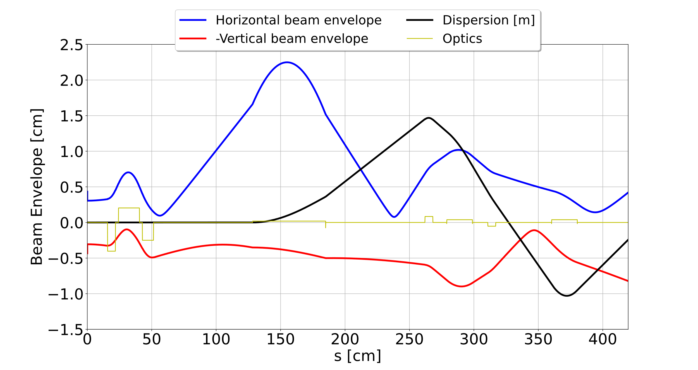


Nier-Type Spectrometer Feature of the Extraction Optics
Dispersed beam
Zero dispersion beam
Beam envelope of ${133Cs}^{24+}$

Slide 36

Overall Optimization of the CSB under Single frequency heating Regime

Slide 37
Comparison of the TRIUMF PHOENIX Booster with the LPSC Booster
Parameter | TRIUMF | LPSC*
133Cs26+ Efficiency | 9.1 % | 14.1 %
Global Efficiency | 41 % | 91.8 %
Support Gas | He | He
B_inj | ~1.0 T | 1.56 T
B_min | ~0.3 T | 0.47 T
B_ext | ~0.7 T | 0.84 T
Power | 346 W | 670 W
Frequency Heating | TFHT | unknowns
* J Angot et al 2022 J. Phys.: Conf. Ser. 2244 012063
Notes:
There are three Phoenix boosters currently in operation
One at TRIUMF
One at GANIL, France (no access to the efficiency)
And One at LPSC, Grenoble, France

Slide 38


Iron plug: New design vs current design
New design
Original design
Inner diameter = 40 mm
Inner diameter = 60 mm
Notes:
To eliminate this issue, I designed a new soft iron without a gap but with a larger inner diameter to feedthrough the waveguide
The design has been reviewed and the iron is currently being manufactured.

