Slide 1
Recent Developments in Highly Charged Ion Studies at TITAN to Explore Frontiers in Atomic and Nuclear Decay Spectrometry
Fernando Maldonado on behalf of the TITAN collaboration
maldonado@triumf.ca

Slide 2
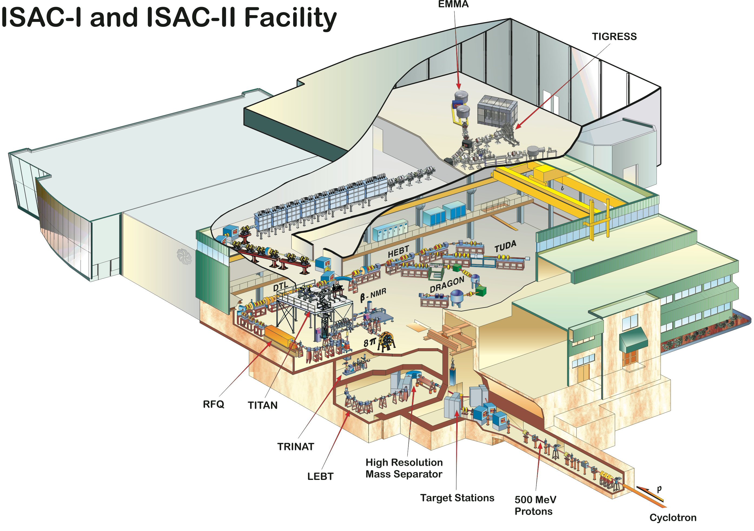
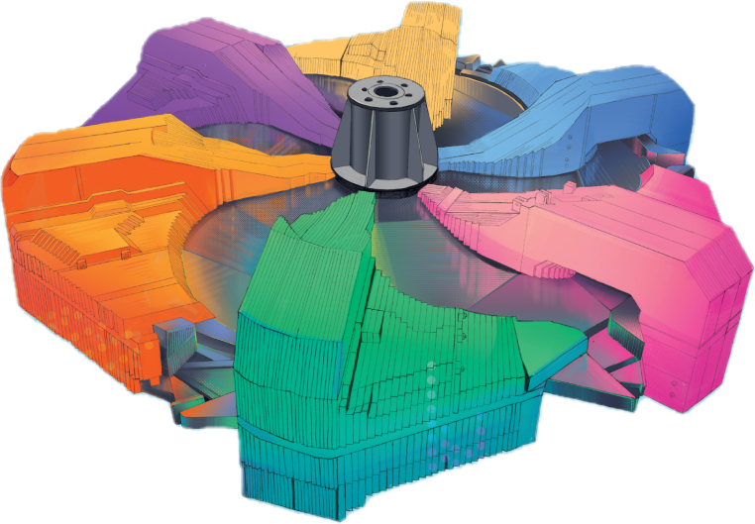
TRIUMF ISAC facility for Radioactive Ion Beam Production
TITAN
ISAC facility provides singly charged ions from an ISOL target.
p⁺

Slide 3
TRIUMF Ion Trap for Atomic and Nuclear Science (TITAN)
Measures the mass of short-lived isotopes with high precision
Nuclear structure, astrophysical reaction paths, and fundamental symmetries.
Reveals fingerprints of nuclear structure, provides input data to nucleosythesis simulations.
Cools and bunches the beam, send to MRTOF for mass spectrometry or isobaric cleaning.
Send to EBIT and charge breed and either store the ions or …
Deliver to MPET for frequency-determined mass measurement.

Slide 4
The Electron Beam Ion Trap (EBIT)
 | Max electron current (mA) | Max electron beam energy (keV) | Max magnetic field (T)
Original design (2010) | 5000 | 70 | 6
HV upgrade (2019) |  | 67 | 6
New electron gun (ongoing) | 5000 | 66 | 6

Slide 5
The Electron Beam Ion Trap (EBIT)
JPCS 2244 (2022) 012075
 | Max electron current (mA) | Max electron beam energy (keV) | Max magnetic field (T)
Original design (2010) | 5000 | 70 | 6
HV upgrade (2019) |  | 67 | 6
New electron gun (ongoing) | 5000 | 66 | 6

Slide 6
New electron gun status update
Issues procuring molybdenum.
Issues finding someone to work with molybdenum.
All parts ready and waiting on machine shop time for welding the bucking coil.
Now planning when is best to install, but likely by end of 2024.

Slide 7
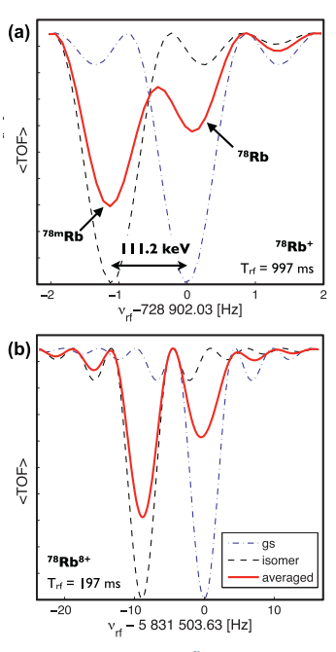
The TITAN EBIT
Has boosted the precision of Penning trap-based mass measurements.
Enables the study of forbidden or highly suppressed nuclear decays as a function of electron population.
Helps pursuing absolute nuclear charge radii determinations of heavy radioactive species.
Supports pursuing ionization of radioactive molecules for fundamental symmetries tests
PHYSICAL REVIEW C85, 044311 (2012)

Slide 8
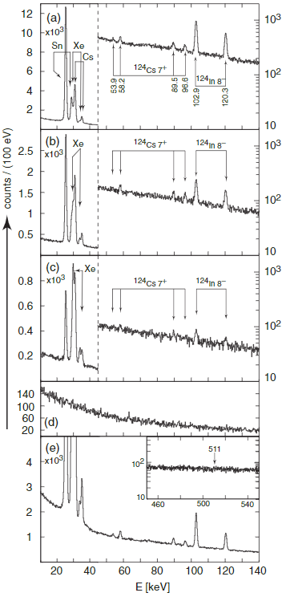
The TITAN EBIT
Has boosted the precision of Penning trap-based mass measurements
Enables the study of forbidden or highly suppressed nuclear decays as a function of electron population.
Helps pursuing absolute nuclear charge radii determinations of heavy radioactive species.
Supports pursuing ionization of radioactive molecules for fundamental symmetries tests
PRL113,082502 (2014)

Slide 9
The TITAN EBIT
Has boosted the precision of Penning trap-based mass measurements
Enables the study of forbidden or highly suppressed nuclear decays as a function of electron population.
Helps pursuing absolute nuclear charge radii determinations of heavy radioactive species.
Supports pursuing ionization of radioactive molecules for fundamental symmetries tests

Slide 10
Goals
Overhaul the HCI program to probe the origins of the universe, its evolution, and fundamental interactions.
Advance nuclear and in-trap nuclear experiments by characterizing and upgrading the EBIT and auxiliary services.
Develop a body of knowledge for operating and troubleshooting the EBIT, with present and forthcoming electron gun.
Determine precisely the electron beam radius and energy for the experimental resonant processes of interest.

Slide 11
TITAN’s spectroscopy arm with highly charged ions, e.g.,
“On the nuclear charge radii of Fr and Ra isotopes measured by extreme-ultraviolet spectroscopy of Na-like ion”.
Important for test of fundamental symmetries and permanent eEDM.
“Nuclear two-photon emission unveiled through suppression of first-order decay processes”.
Helps with the determination of equation of state of nuclear matter.
“Controlled Stimulation of Nuclear Excitation via Electron Capture”.
May play a role in nucleosynthesis.
Potential application for nuclear batteries.

Slide 12
Electron beam characteristic for past and future experiments
Experiment | Electron current (mA) | Electron Energy (keV) | Charged state
Mass measurements | 70, 85, 200, 400* | 1.5, 1.9, 2.2, 5 | ⁷¹Ga²¹⁺,⁷¹Ge²²⁺, ⁷⁸Rb⁸⁺,¹²⁴Cs^{26+ – 32+}
EUV |  | 35 | ²¹¹Fr⁷⁶⁺,²²⁵Ra⁷⁷⁺ (Na-like)
Radmol |  | <0.1 | ²²⁹PaF³⁺,²²⁷ThF³⁺,²³⁸UO³⁺
2-γ | >3000 | 60 | ⁹⁸Rb³⁶⁺ or ⁹⁸Sr³⁷⁺ (bare atoms)
NEEC | ≥500 | 7.10 | ^{129m}Sb⁴¹⁺ (Ne-like)
The Highly Charged Ions (HCIs) crucial for the past TITAN achievements were created using the EBIT electron gun operating considerably below design specifications.

Slide 13
New scope requires answers
Perveance
Electron current – Energy dependence.
Breeding time
Desired charge state before decaying.
Electron current
Increased photon events, shorter breeding time.
Dielectric recombination lines
True energy, energy spread, electron beam radius.
Electron Energy
HV infrastructure guarantees maximum energy.
Radmol
Low energy to not destroy molecules.
Mass measurements, 2-γ
Radionuclides with 100 ms lifetime require shorter breeding times.
NEEC
More electrons increase the events due to low cross sections.
NEEC
Only the accurate energy triggers the resonant process.
NEEC, 2-γ, EUV
Higher energy to remove most electrons down to bare.

Slide 14
Results

Slide 15
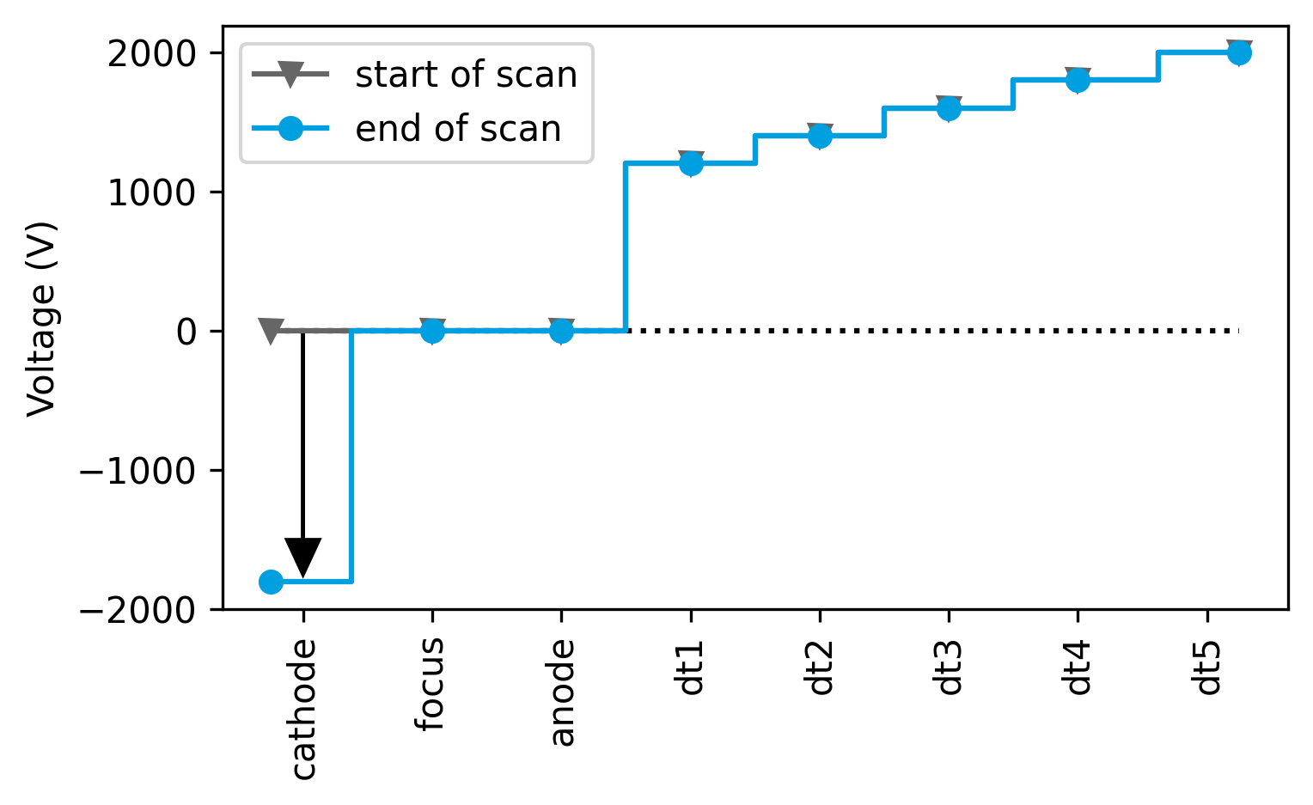
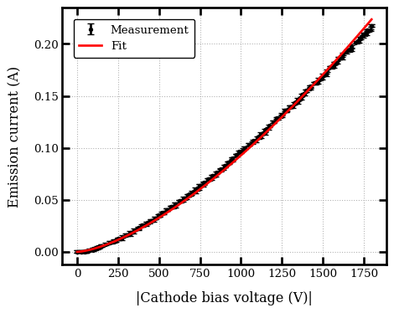
Perveance measurements
$$P=2.4×{10}^{−6} \text{A}{\text{V}}^{−3/2}$$
Scanning cathode bias without floating the gun.
Thermal limitation at around 200 mA, so to reach higher currents we needed to heat more.

Slide 16
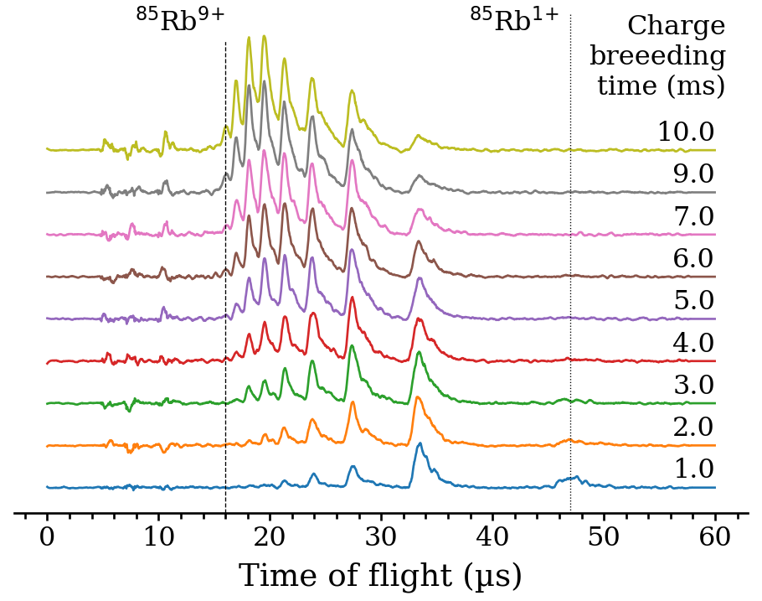
Charge breeding time
⁸⁵Rb¹⁺ injected into the trap and bred for several breeding times.
Longer breeding times translate to higher charged states.
HCI spectra as measured on a multichannel plate.

Slide 17
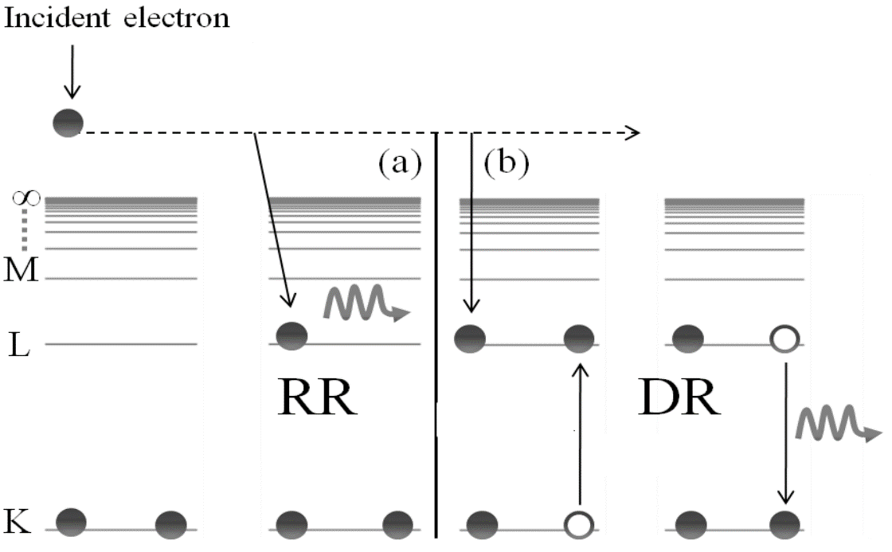
X-ray spectroscopy of recombination processes in argon
Radiative recombination and Dielectronic recombination
DR resonant process permits knowing true electron energy
(a) radiative recombination and (b) dielectronic recombination in He-like ions.
Taken from Ali, S, Electron - Ion Recombination Data for Plasma Applications: Results from Electron Beam Ion Trap and Ion Storage Ring, PhD thesis (2012).
X-ray spectra measured with a ULEGe detector. Uncorrected energy = $e∙{∆V}_{gun−trap}.$

Slide 18
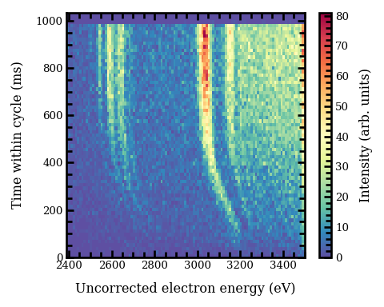
X-ray spectroscopy of recombination processes in argon
Transient X-ray signal helps determine electron beam radius
Energy shift between known DR energy and X-ray signal at $t=0$attributed to pure electron beam space charge effects.
With known electron current, one can compute the radius*
Between 70-150 µm
*following Rev. Sci. Instrum. 89, 052401 (2018)

Slide 19
Injected neutral argon seems to impart a time dependency to the energy shift
Not enough Ar injection:
Charge imbalance due to lack of ions and some ions still being created while the trap is open.
Sufficient Ar injection:
Charge state compensation reaches steady state.
Excessive Ar injection:
No x-ray investigation but have seen effects on electron emission current.
Interplay between trap depth, neutral load→ion load →space-charge compensation

Slide 20
Pushing the EBIT to the (our) extremes, e.g., beyond previous experimental requirements
Checked reliability power supplies
Stabilized electron emission current with PID software
Conditioned high voltage after operational hiatus
50 mA at 38 keV
500 mA at 7.1 keV

Slide 21
“Controlled Stimulation of Nuclear Excitation via Electron Capture”

Slide 22
NEEC process
NEEC is the time reversed process of internal conversion.
A highly charged ion captures a free electron into one of the atomic vacancies.
New nuclear excited state populates but depletes emitting signature X- or γ- rays.
Energy transfer process is possible if resonant conditions are met.
Ringuette J, 2022 Towards Nuclear Excitation Via Electron Capture In An Electron Beam Ion Trap, Ph.D. thesis Colorado School of Mines.

Slide 23
What makes NEEC interesting: Almost nine orders of magnitude difference in cross section
Experiment (Nature 554, 216–218 (2018)).
Use of solid target required complex modelling on electron energy due collisions in the material.
Theory (PRL 99,172502 (2007)).
Independent experiment (PRL 122, 212501 (2019))
Disputes previous experiment results.

Slide 24
Why at the TITAN EBIT
Clean environment reduces uncertainty and provides control of the electron energy.
The isomer of interest, 129mSb41+, has been detected before at the MR-TOF.
While sitting at the resonant energy,
We either observe NEEC via isomer depletion or,
We establish an upper limit for the cross section
Relies on in-depth characterization of our electron beam current density and energy.

Slide 25
Electron beam energy determination for NEEC
L-K
NEEC stimulation energy
Fit argon KLL and scale electron energy
Fit argon RR with known binding energy.
Are the fit consistent? So far yes
Argon RR to monitor during experiment
Other DRs to monitor, maybe Mo?
KLN
KLM
Argon DRs
KLL
I_{e} = 200 mA
∆V_{trap}= 200 V

Slide 26
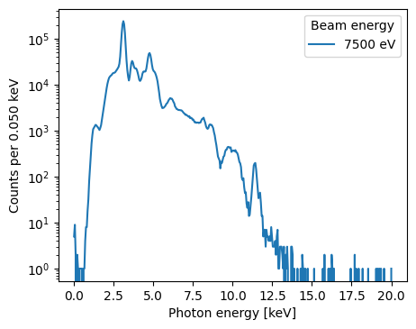
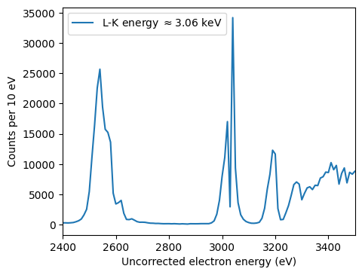
Promising results
argon KLL-DR
argon K-RR
Fit RR with known binding energy
Fit DR with known energy
Estimated energy differs between methods ≈ 100 eV and corresponds to dE/E ≈1.5%.

Slide 27
Challenges and Limitations:
Valid extrapolation at all conditions?
DR closer to the resonant energy on something else that is gaseous or sold as a hot ion source.
RR on noble gases such as Kr (binding energy?)
Sufficient gas injection for energy determination during online run
And maybe for evaporative cooling to achieve higher charge states.

Slide 28
Back to the generals

Slide 29
Back to the generals
Accepted experimental proposals require pushing the currently installed electron gun
First time operating EBIT at 500 mA.
A nearly completed new electron gun will ease operations
Will make use of the prior knowledge for proper characterization.
First time using x-ray spectroscopy as a diagnostic tool.
Installation foreseen end of the year.
Helps pursuing the new spectroscopy arm of TITAN

Slide 30
Last year we develop a lot of new knowledge within the group, and we are satisfied with the EBIT performance, but
Need to confidently obtain the energy and beam radius calibrations required for NEEC experiment
Validate energy extrapolations
Use isobaric cleaning for purer isomer beam
By exploiting the TITAN multi-reflection time of flight mass spectrometer
Install and commission new electron gun
Repeat characterization ☺

Slide 31
Outstanding inquiries to the experts
Required numerical collisional radiative models if we plan to use Kr for energy estimation.
Defined operations at our “extreme” conditions for two days.
Operational knowledge for an experiment while guaranteeing precise knowledge of our electron beam energy and radius.

Slide 32
Summary
TITAN pursuing high-precision nuclear spectroscopy with the EBIT.
Electron gun operating at 500 mA and 7.1 keV but more is needed for future experiments.
Confident in our methodology but require to finalize the measurements to provide solid numbers for electron beam radius and energy.
Collaboration through visits/meetings or numerical models for DR/RR are valuable.
Thanks to all the TITAN collaboration, especially the EBIT team and AA Kwiatkowski

Slide 33
Thanks!
maldonado@triumf.ca

Slide 34
Back up slides

Slide 35
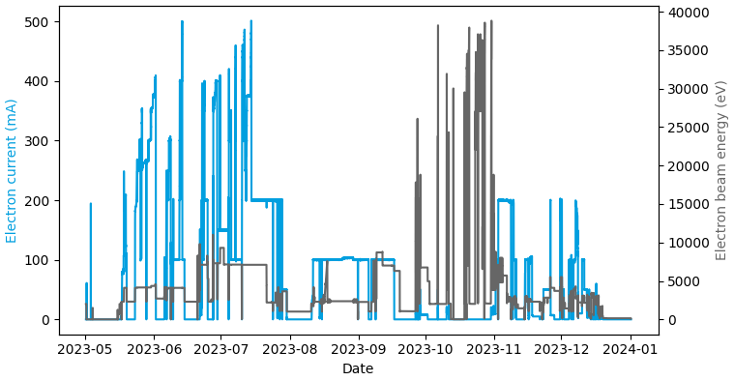
Historical data showing the different goals pursued
NEEC
2-gamma
Pushing the EBIT to the extremes, or at least beyond previous experimental requirements
radmol
X-ray spectroscopy
500 mA at 7.1 keV
50 mA at 38 keV

Slide 37
Same group came up with other calculation 20x larger: PHYSICAL REVIEW C 108, L031302 (2023

Slide 38
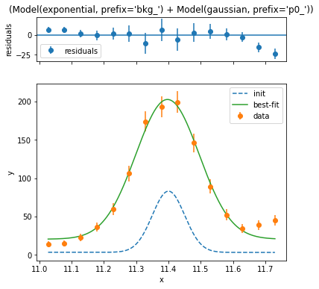
Fit RR with known binding energy
Space charge shift = 223 eV
RR estimation -> 2454 eV
DR observed at 2545 eV

Slide 39
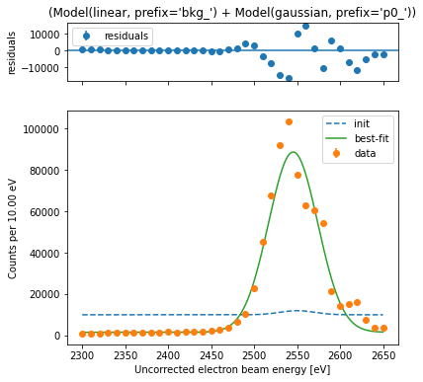
Fit DR and extrapolate energy
Space charge shift = 245 eV
DR estimation -> 2454 eV
RR extrapolation 7316 eV
RR observed at 7276 eV

Slide 42
CBSIM: 7keV, 500 mA to Ne-like ^{129m}Sb⁴¹⁺
The population loss is counteracted by the fact we will not switch energy during the experiment

