Slide 1
Review preparation:
ES&H and QA
Yulia Furletova
November 6, 2023

Slide 2
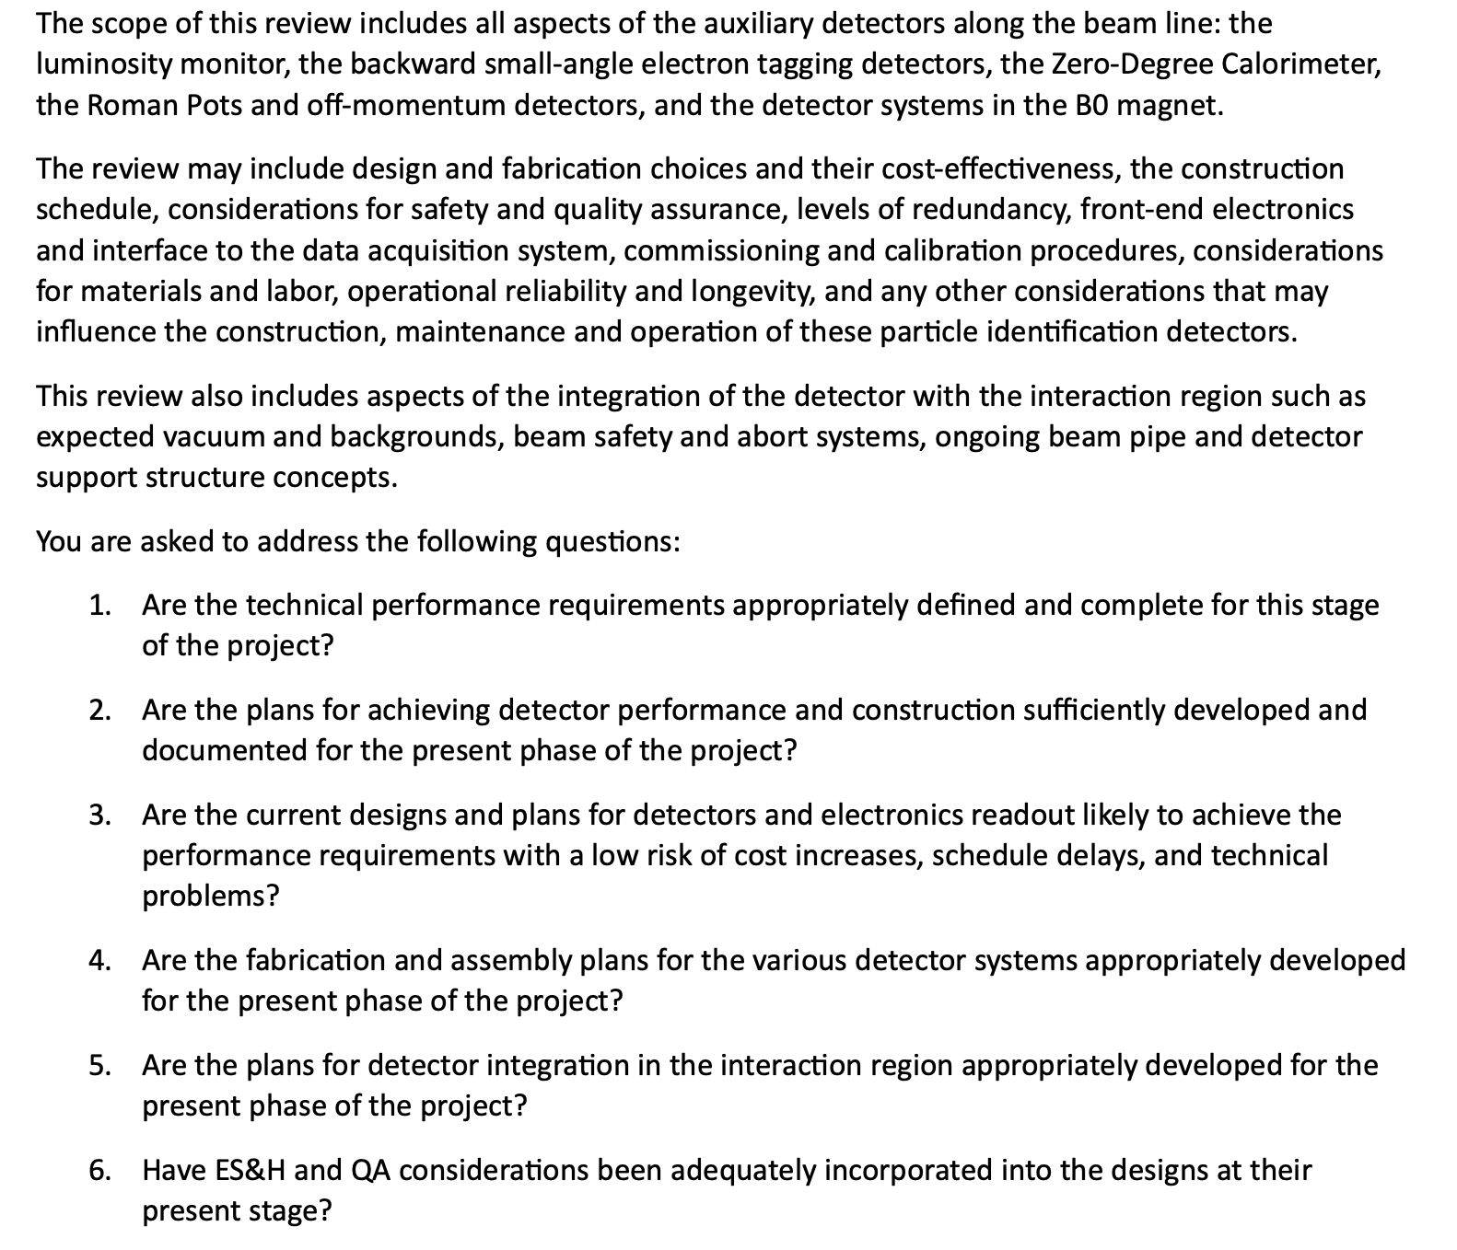
January FF/FB
Review
Preliminary charge questions:

Slide 3
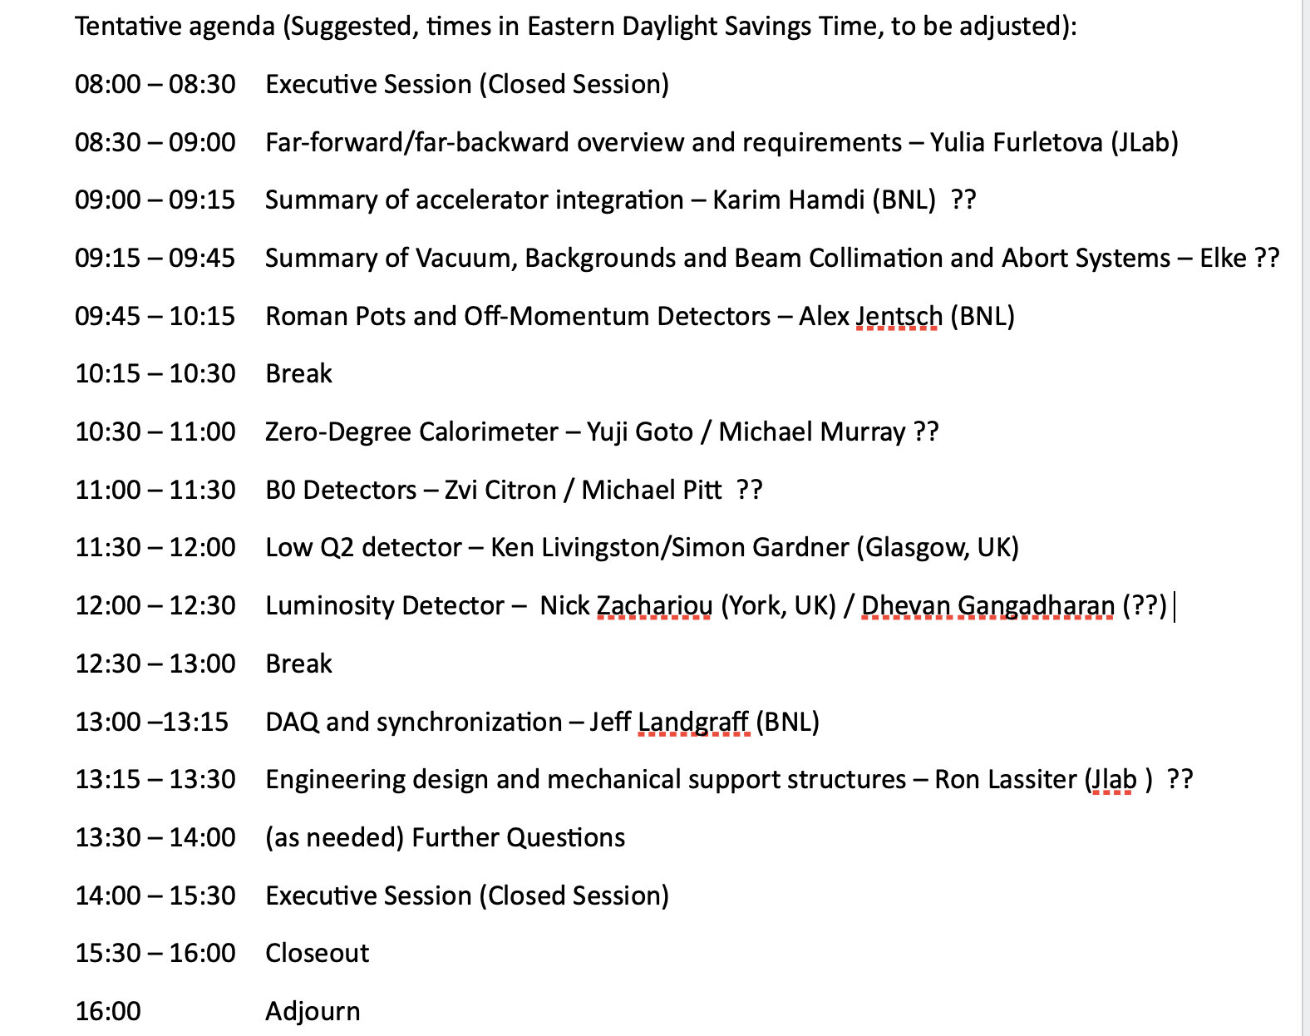
Preliminary Agenda

Slide 4
Environment, safety, and health (ES&H) and quality
Charge 4
During the engineering design phase:
include production of mockups and engineering test articles to insure the proper functionality and quality.
During the production, testing and operation:
We will be using the appropriate ES&H and Radiation Safety measures as dictated by the participating universities and labs. All personnel working within the labs have to have the appropriate training to ensure adherence to these safety protocols.
Full production chain tests are planned for each sub-system.
For operation with HV and Cooling: we will ensure that these are mechanically secure and not a trip hazard, have proper warning signs and follow the lab procedures for electrical safety.
Operation near the beam-pipe and vacuum:
we will require that anyone working near the far-forward/backward detectors to wears ear protection, and will post signage to that effect.

Slide 5
ES&H (part 1)
Hazards and how to handle:
Flammable:
total amount of material, storage, extinguishing system
Heavy lifting/stability:
total weight, transportation, stability, mechanical security
Electrical:
HV/LV, current, operation procedure, signs and labels , cabling ( standard HV modules, standard cables, etc )
Light -sensitive ( in the box, special key to open)

Slide 6
ES&H ( part 2)
Hazards and how to handle:
Operation near vacuum ( or in the vacuum)
to wear ear protection
Magnets: Operation inside or near magnets
ODH
marking space or setup a fence ( how many gauss??) : pacemakers, etc.
Radiation ( operation in the tunnel)

Slide 7
Separate ES&H ( Operation manual) for :
production/tests/ transportation
assembly/ installation
running experiment.

Slide 8
Quality assurance and quality control
During the production:
Manual on production and testing
check-lists
detailed spread-sheets with numbers and QA parameters, etc.
Test beams ( full chain production test and DAQ)
Transportation procedure
Assembly and installation procedure ( alignment, DAQ test )

