Slide 1
The JUNO distributed computing infrastructure
Giuseppe Andronico

Slide 2
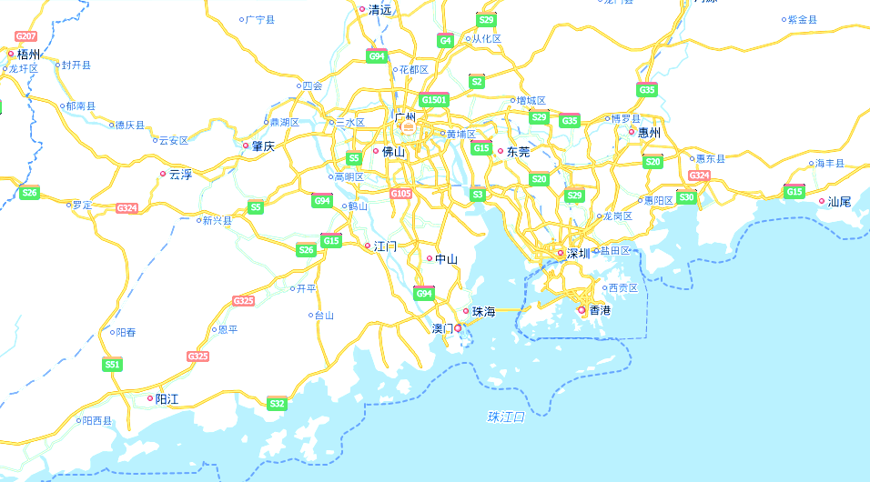
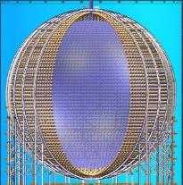
Location of JUNO and JUNO-TAO
74 Institutes, 17 Countries, about 750 people
20 kton LS detector
700 m underground
Guang Zhou
Daya Bay
Hong Kong
JUNO
53 km
53 km
TAO
Taishan NPP
Yangjiang | Taishan
17.4 GW | 9.2 + 9.2 GW
Yangjiang NPP
Notes:
The 6th Yangjiang reactor core started commercial operation on July 24, 2019.
The 2nd Taishan core started generating power this June.
All six 2.9GW cores in Yangjiang and two 4.6 GW cores in Taishan are in operation now.

Slide 3
Neutrino Physics with JUNO
Mass Hierarchy w/ reactor: 3-4σ in 6 years
Precision w/ reactor: sin²θ₁₂, Δm²₂₁, Δm²₃₁ to <1%
Supernova Burst: 5k events + Neutral current
Diffuse SN Background: Discovery potential
Geo-neutrino: Determine Geo-physics model
Proton Decay: Best in K channel
Solar
Atmospheric
Sterile
Neutrino from Dark Matter
Exotic searches
JUNO Yellow book J. Phys. G 43, 030401 (2016)

Slide 4
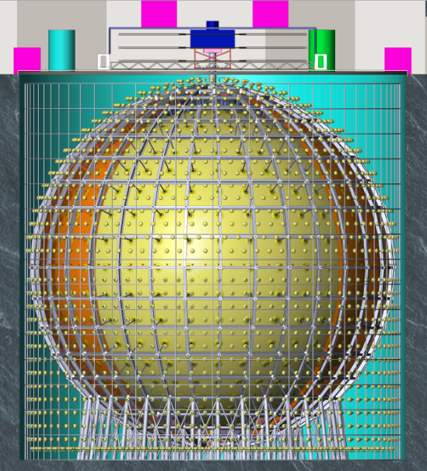
JUNO Detector
Calibration
Top Tracker
Filling/Overflow
Central detector
SS latticed shell
Acrylic Sphere:
ID: 35.4m
Thickness:120mm
SSLS:
ID: 40.1m
OD: 41.1m
Water pool
ID: 43.5m
Height: 44m
Water Depth:43.5m
Acrylic sphere
(20 kt LS)
Acrylic sphere : ID35.4m
18000 20” PMT
25000 3’’ PMT
Pool Depth: 44m
Stainless steel latticed shell: ID40.1m
Water Cherenkov
~2000 20’’ PMT
Pool ID:43.5m

Slide 5
Computing model: data
Data type and volume
Raw data
upper limit 2PB/year
Calibration data
0.6 PB/year
Rec data
order of 200TB/year
Sim data
order of 100TB/year
Analysis data
order of TB/year
Total resources requirements
Storage
upper limit 3PB disk/year
Computing
12000 CPU cores

Slide 6
Base design

Slide 7
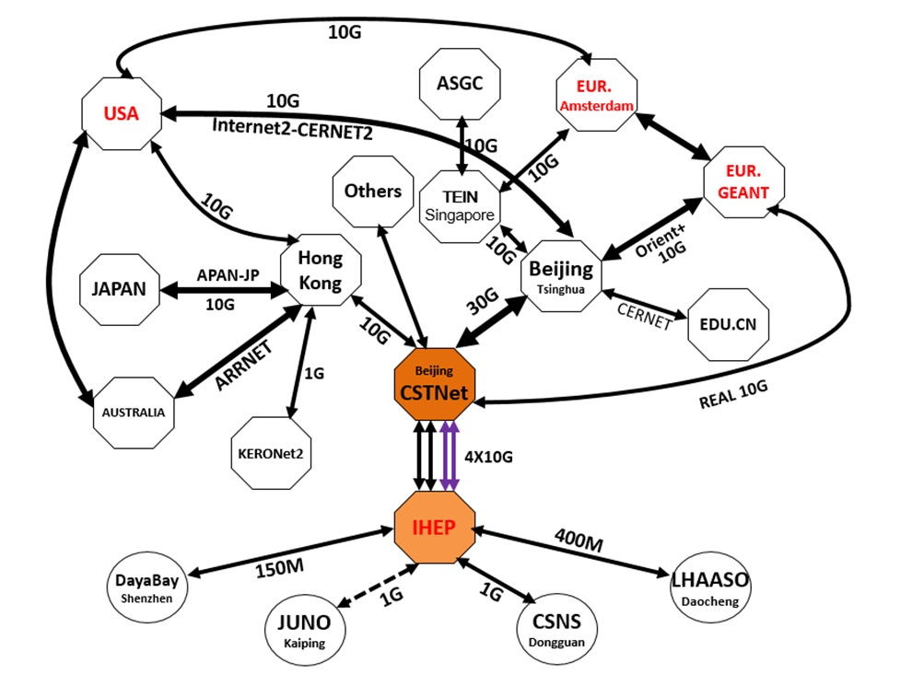
Network in China
REAL 10G
NEW 100G

Slide 8
Global Networks for JUNO
ORIENTplus 10Gbs
Real 10G
INTERNET2
GEANT
TEIN3
100Gb

Slide 9
Mail policies
Use DIRAC as DCI core service
Experience at IHEP and in most of the data centres
Join LHCONE
Virtual lan built on interconnected NRENs
Keep JUNO DCI in sync with WLCG
Data centres are T1 in WLCG
Funding agencies are familiar with WLCG standards

Slide 10
Conclusions
JUNO needs a distributed computing infrastructure (DCI)
DCI already designed and under deployment and testing, by means of an intens international collaboration
Key components are the global research and education networks

Slide 11
Thank you!!!
Any question?

