Slide 1
Operations and Operations Support
Peter Ingrassia

Slide 2
Operations and Operations Support
“Operations” groups include
Main Control Room Group,
Operations (Maintenance) Support, and
“CA” Support.
Additional Operations groups not included;
Cryogenics,
AGS Main Magnet Power Supply,
Tandem Van de Graff, and
Health Physics.

Slide 3
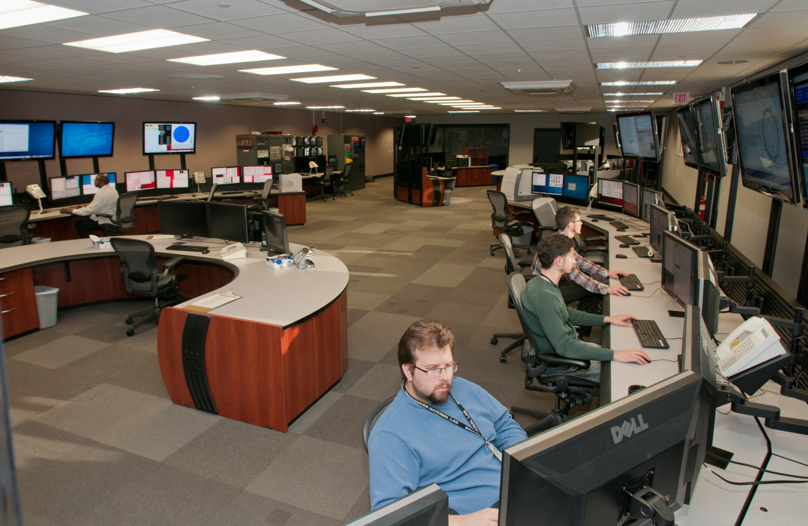
The Main Control Room

Slide 4
Main Control Room Group
Roles and Responsibilities
Primary Focus – Safe and Efficient Operation following DOE Conduct of Operations.
Simultaneously Operates the LINAC, BOOSTER, NSRL, AGS, & the RHIC. Also supports operation of the BLIP and the EBIS.
Troubleshoot accelerator performance problems.
Restore accelerators to operation after maintenance or shutdown periods.
Maintain Accelerator Safety Envelope.
Support Accelerator Physicists – both on and off shift.
Support of other C-AD groups off shift e.g. mechanical design, new equipment testing, Controls/software support, Rf systems, Pre-Injectors.
Liaison with experiments and C-AD Staff.
Emergency Response when on shift.
Make up
17 FTE’s (1 PhD, 4 MS, 12 BS) – full complement of operators => 23 FTE’s
17 professional staff, (does not include one manager).
7 operators – 5 “open seats” at the end of Run13.
6 Shift Supervisors --
3 Accelerator Specialists – accelerator wizards!
1 Deputy Group Leader

Slide 5
Main Control Room Group
Off shift responsibilities – examples of work in progress
Rf simulations for RCMS – D. Maffei.
Modify RHIC Injection model to include MADX; Solar particle simulator (model booster extraction bumps) – M. Lafky
Controls Software support including sequencer; Beam Based Alignment – I. Blackler
Cryogenic controls (operator/machine interface) – B. Van Kuik
LASER Ion Source controls integration /Synoptic Displays – N. Kling
Maintenance of operations procedures – C. Naylor
Mechanical Design RHIC low energy electron cooling – B. Martin
Mechanical Design & Installation, AGS internal sweep gate – W. Jackson
Instrumentation Group – R. Smith
AGS Jump quad timing, data mining for AGS Physics GL – R. Tuccio
Controls group – write code to decode RHIC event link – S. Perez
AP – coding to improve operator interface to Zgoubi simulation software – C. Harper
Controls group – code for baud rate generator & UART for VME trouble shooting – Y. Zhang

Slide 6
Operations (Maintenance) Support
Roles and Responsibilities
Primary Focus – Accelerator Availability.
Prioritizes, Schedules, and Coordinates bi-weekly maintenance.
Coordinate and Schedule annual “summer” shutdown.
Maintenance -- repair -- installation
Assists in planning work and insures all work is planned.
Coordinate installation and testing of new equipment during accelerator operating periods as well as shutdown periods.
Liaison with Laboratory support groups e.g. “F&O” (Facilities and Operations).
Liaison with C-AD Support Groups e.g. Experimental Support and Facilities Division.
Make up
3 FTE’s
1 professional, two technical staff.

Slide 7
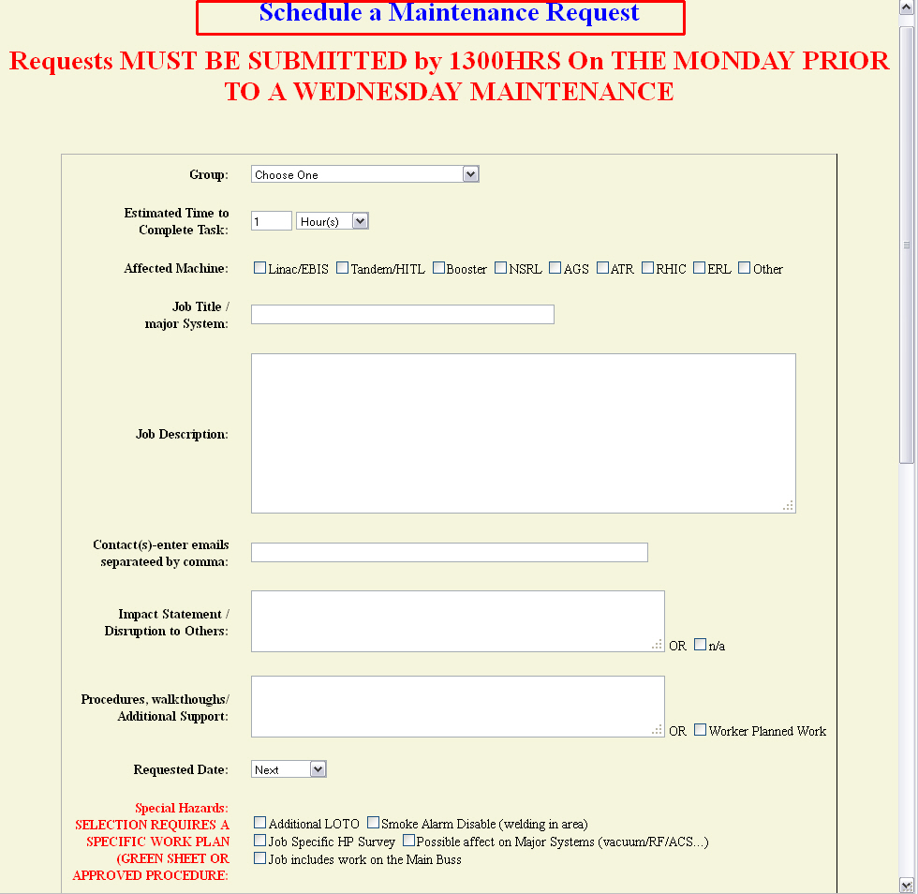
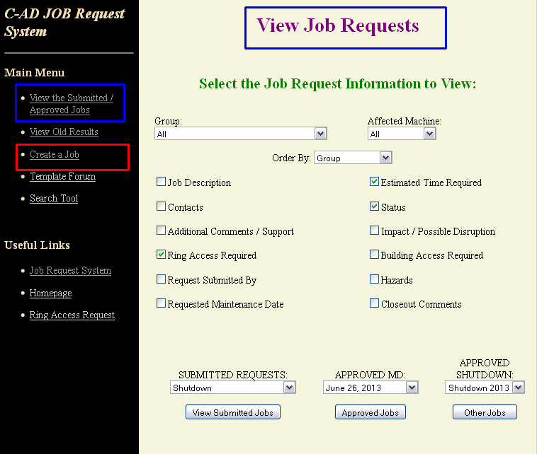
Maintenance Management – “Job Request System” Preventative Maintenance Corrective Maintenance / Repair, Modification Equipment Installation

Slide 8
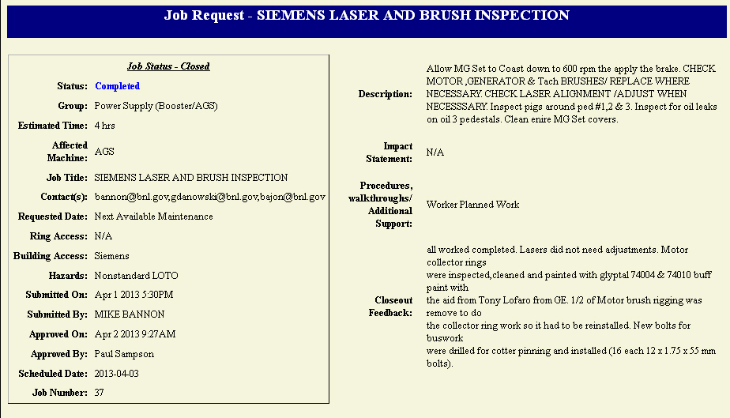
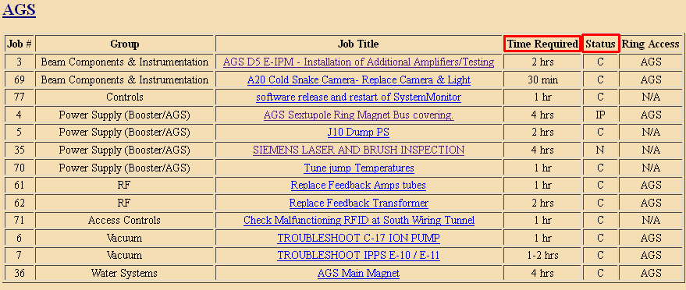
“Maintenance Management”– continued
Captures 5 core functions of DOE Integrated Safety Management, -- DOE P 450.4
Define Scope of Work
Analyze Hazards
Develop/Implement Controls
Perform Work
Feedback/Improvement
Maintenance Periods
Predictable
Jobs Prioritized
Time estimates publicized
Mechanism to handle “emergent jobs”
Links to other groups work plans e.g. MAXIMO for IFM
Lessons Learned (closeout)

Slide 9
“Collider Accelerator Support” (CAS)
Roles and Responsibilities
Primary Focus – C-AD “first line of defense” in the event of equipment failure or emergency response.
Technical expertise with high voltage pulsed power; Rf; DC power supplies; controls; and cooling water systems
Provides year-round (24/7) monitoring of C-AD complex .
On shift presence increases (from 1 to 2) during RHIC operating periods.
Make rounds – check equipment operation and security (locked doors)
Implements electrical safe access (LOTO) for Booster and AGS
Provides technical and operational support during accelerator operation.
Provides technical support during maintenance and shutdown periods.
e.g. modify power supplies
Liaison with Laboratory support groups e.g. “F&O” (Facilities and Operations).
Liaison with C-AD Support Groups e.g. Experimental Support and Facilities Division.
Make up
8 FTE’s – all experienced technicians
Eight technical staff.

Slide 10
Availability Run08 - Run13 (DOE 80% Metric)

Slide 11
Mean Time Analysis: MTBF (all systems from AGS start)

Slide 12
Run 13 System Failure > 1 hr (all systems from AGS start)

Slide 13
RHIC Power Supply Failure as % of Operating Hours

Slide 14
Rf Systems Failure as % of Operating Hours

Slide 15
RHIC Experiment Failure as % of Operating Hours

Slide 16
Human Error as % of Operating Hours

