Slide 1
Accelerator Physics
Mike Blaskiewicz

Slide 2
Accelerator Physics

Slide 3
Accelerator Physics and Physics Support
Physics support from Accelerator Physics Group, Physics Support Group and Stochastic Cooling Group
AP group is responsible for conceptual design, specification, and commissioning of accelerators and components
AP group proposes improvements and works with other groups to achieve the goals.
Does lattice calculations for the three synchrotrons
Vets the lattices for power supply compatibility and does particle tracking to test dynamic aperture and behavior with beam-beam force
Does spin tracking, which utilizes NERSC
Serves to monitor and reduce the coupling impedance.
Takes and analyzes large amounts of orbit, tune and loss data during operations and dedicated machine experiments.
Provides operations with run coordinators and shift leaders.
Lead efforts in collimation, beam based alignment, ramp optimization, online models, store optimization, optics measurement ….

Slide 4
Accelerator Physics and Physics Support (cont’d)
The Stochastic Cooling Group is an outgrowth of the RF Group.
Responsible for designing, building and operating our six stochastic cooling systems.
With ARRA funding, the group also included physicists supporting electron lens.
The Physics Support Group provides the interface between experiments, liaison engineers, and the accelerator complex.
Scope starts with the proposals through approval installation and running
The PS group has in house expertise in magnet design contributing to experimental magnets, the ERL, the iRCMS, and spin flipper.
The PS group has expertise in radiation shielding and soil activation calculations and beam line optics design.
In collaboration with the Spin Physics group, the PS group is involved with the construction, operation and maintenance of the AGS and RHIC polarimeters.
Working on upgraded data acquisition with the C-AD Controls Group
Working with Charles University, Prague to upgrade the silicon detectors for the jet target.
Group members are members of the various experiments

Slide 5
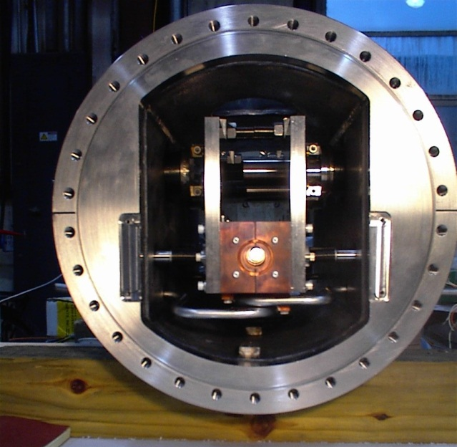
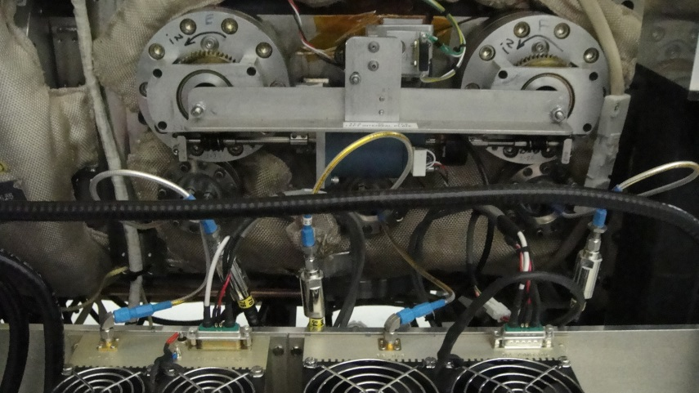
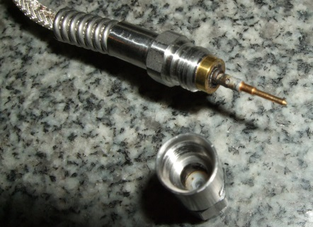
Stochastic Cooling Upgrades Motivation
Reliability of kickers
Longitudinal kickers are made from retrofitted kicker tanks from Tevatron
Problems have occurred
Motion mechanism
Stuck bearings in vacuum
Stepper motors/encoders (“slip detected” error)
Reproducibility of cavity resonant frequencies
Vacuum leaks
Water cooling line, and bellows
Rf vacuum feedthrus
Thermocouple vacuum feedthrus
Coax cable over heating
Power amplifier failures

Slide 6
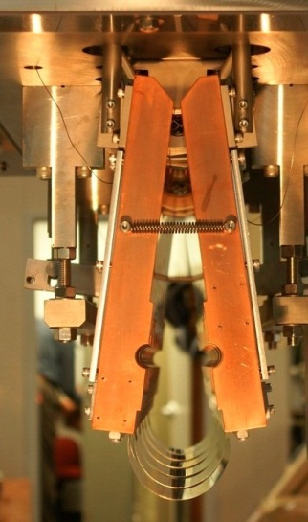
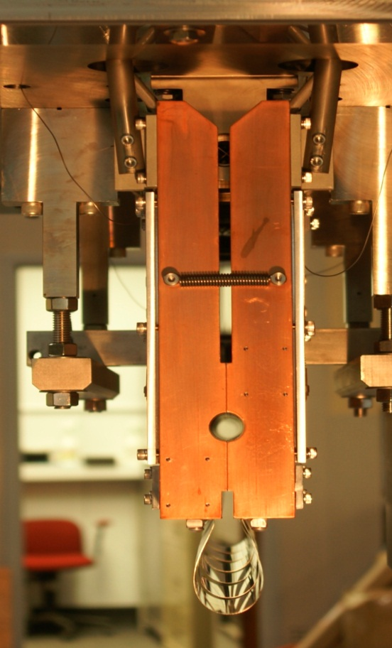
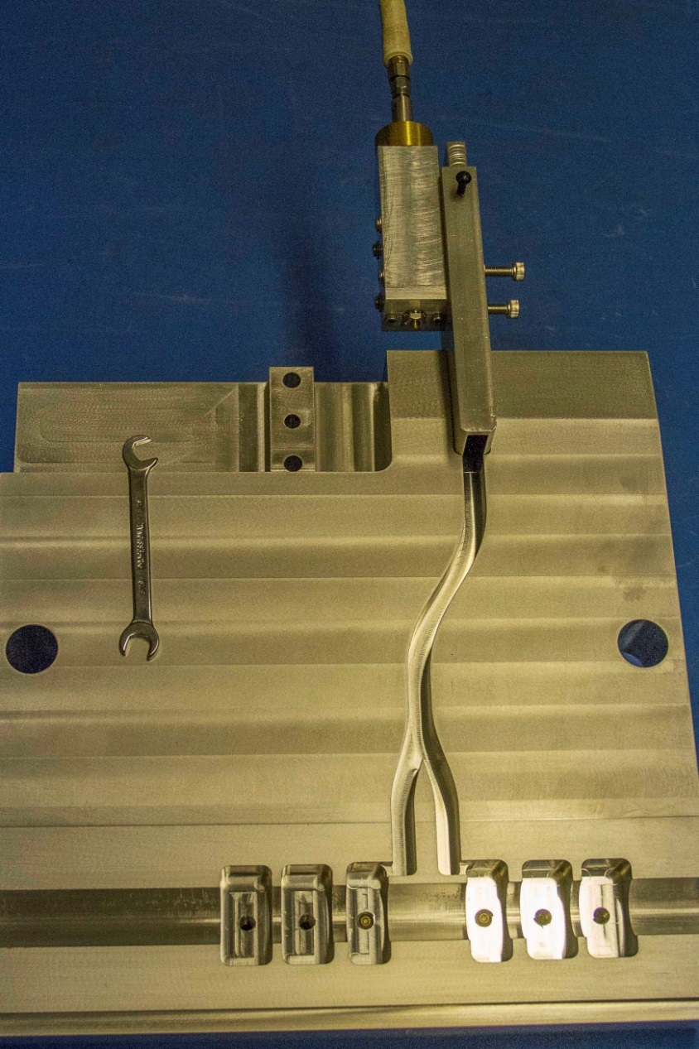
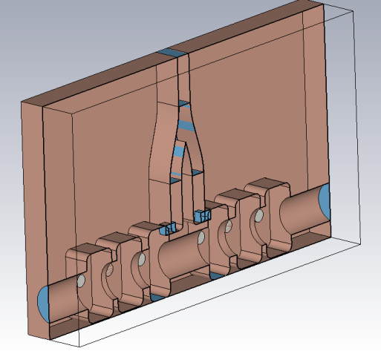
Six-Cell Cavity Kickers
6-cell cavities, higher R/Q (don’t have to shoehorn into Tevatron tanks)
No bearings in vacuum
Scissors type motion for opening cavities
Used for vertical and horizontal kickers
Binary motion mechanism (open or closed)
Flexi-hinge (no sliding surfaces)
No springs (more below)
Waveguide power feeds (no coax cables in vacuum)
Use all existing power amplifiers and low-level electronics

Slide 7
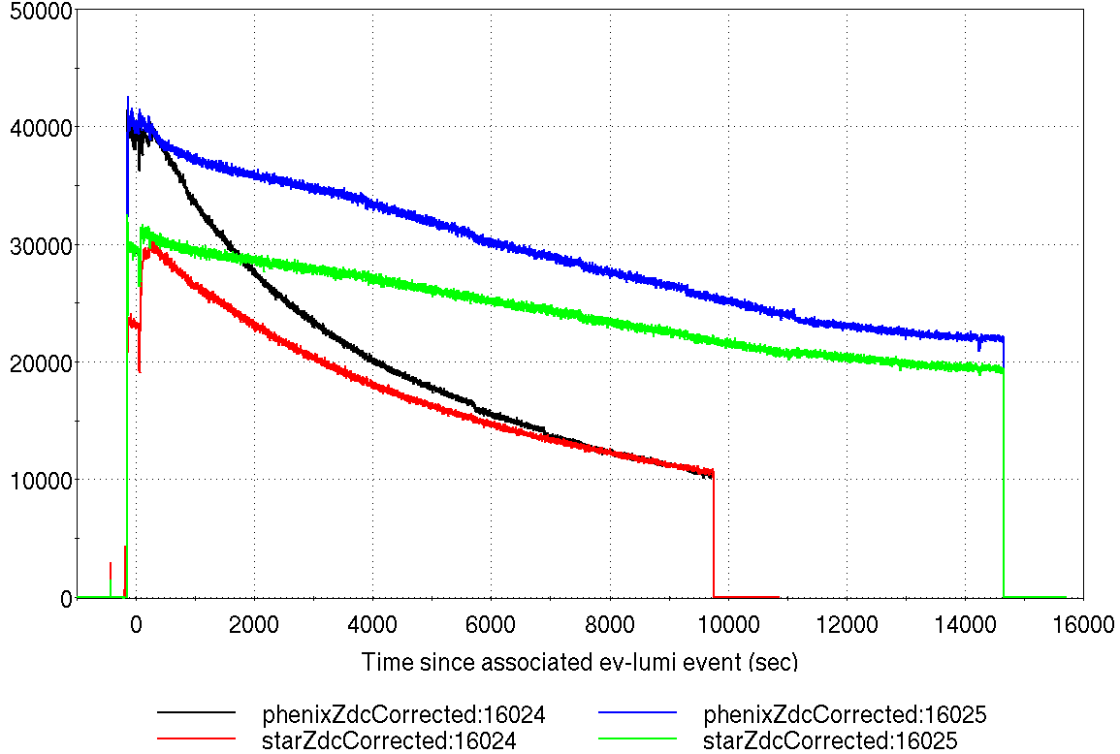
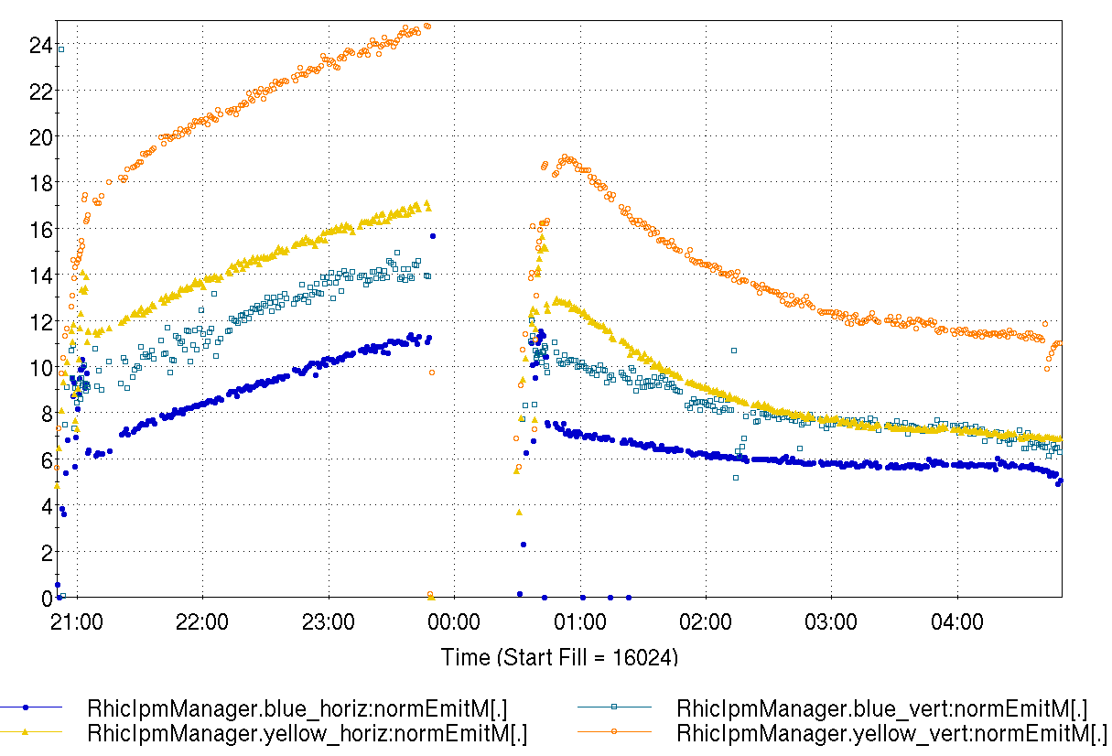
Stochastic Cooling Run 11 Summary
Cooling worked
3 main problems mentioned at retreat last year were not problems this year
Vacuum leaks
Motion stuck
Cross talk between blue/yellow vertical
Luminosity (ZDC)
Emittance (IPM)
cooling on
cooling off
cooling off
cooling on
All fixed

Slide 8
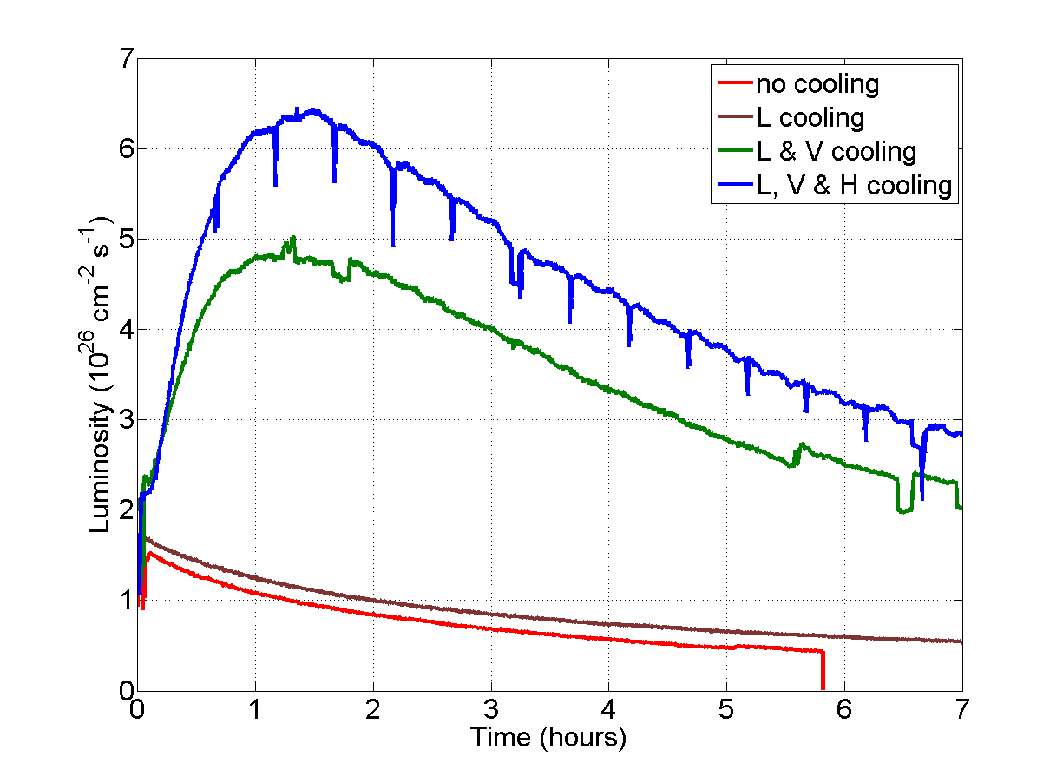
U-U Results

Slide 9
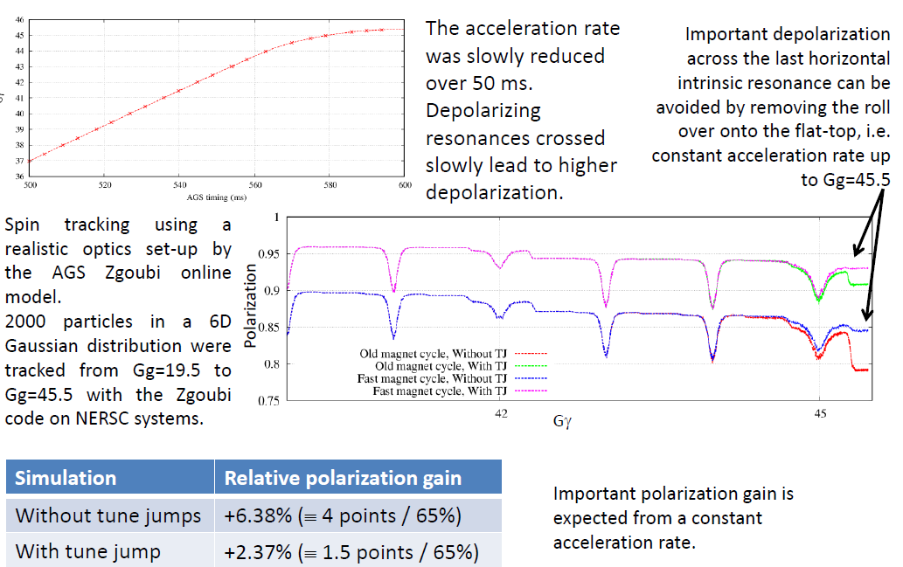
AGS Main Magnet roll over onto flat top (simulation)

Slide 10
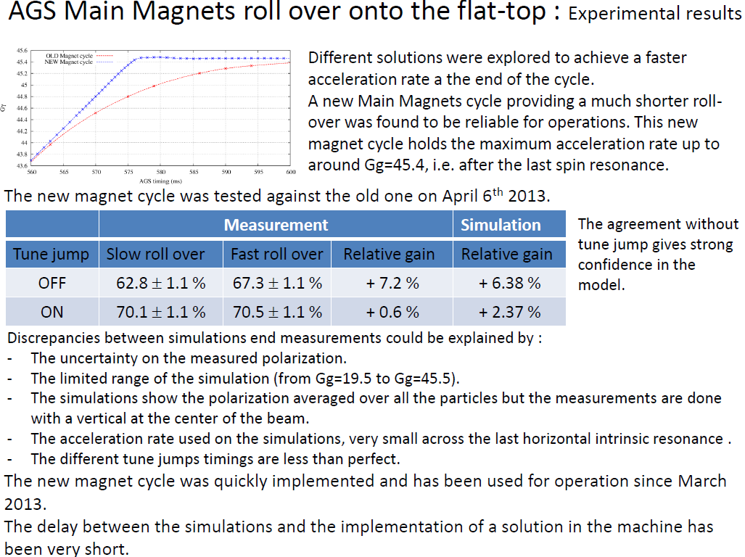
AGS Main Magnet roll over onto flat top (experiment)

Slide 11
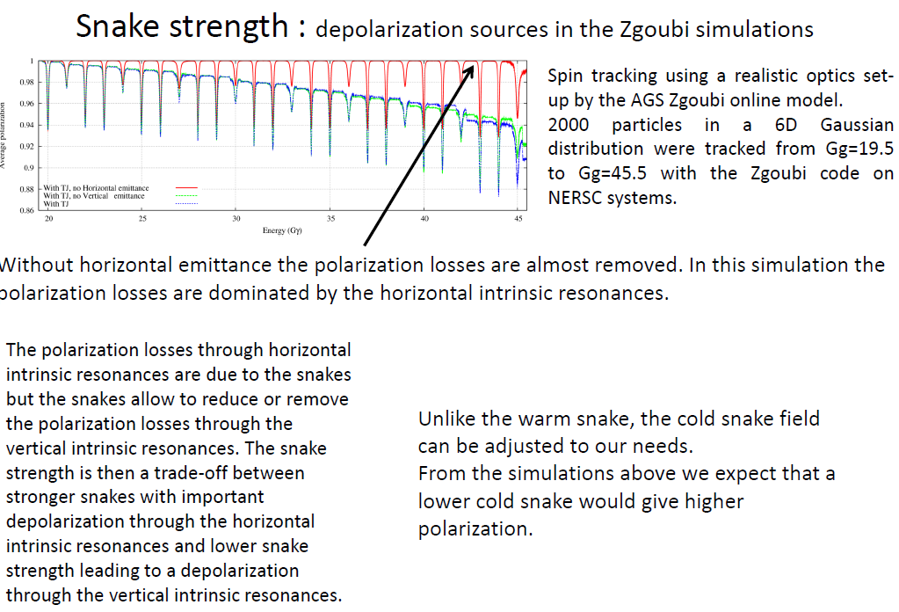
Snake strength: depolarization sources

Slide 12

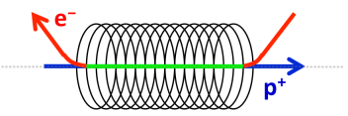
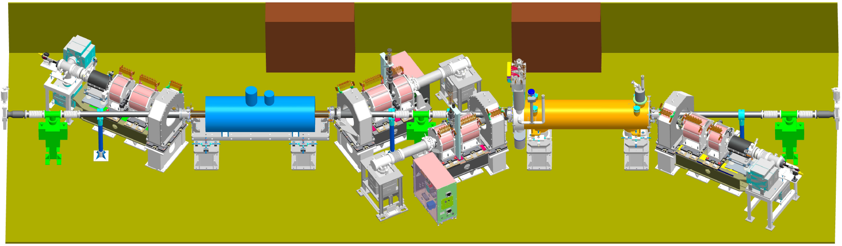
RHIC Electron Lens Commissioning
Xiaofeng Gu
Z. Altinbas, M. Anerella, D. Bruno, M. Costanzo, W.C. Dawson, A.K. Drees, W. Fischer, B. M. Frak, D.M. Gassner, K. Hamdi, J. Hock, L.T. Hoff, A.K. Jain, J. Jamilkowski, R. Lambiase, Y. Luo, M. Mapes, A. Marone, R. Michnoff, T. Miller, M. Minty, C. Montag, S. Nemesure, W. Ng, D. Phillips, A.I. Pikin, S.R. Plate, P. J. Rosas, J. Sandberg, P. Sampson, L. Snydstrup, Y. Tan, R. Than, C.W. Theisen, P. Thieberger, J. Tuozzolo, P. Wanderer, and W. Zhang
26 July 2013, Brookhaven National Lab.

Slide 13
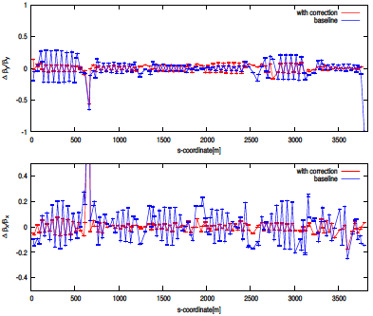
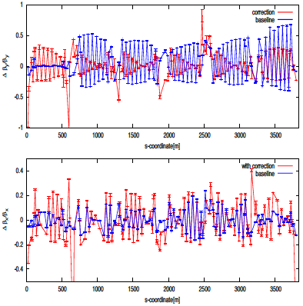
Highlights from APEX-12
Optics Correction: Bai, GRD, Joe, Simon
SBST was successfully implemented during APEX
Blue pp @ 255 GeV
Yellow Au @ 100 GeV

Slide 14
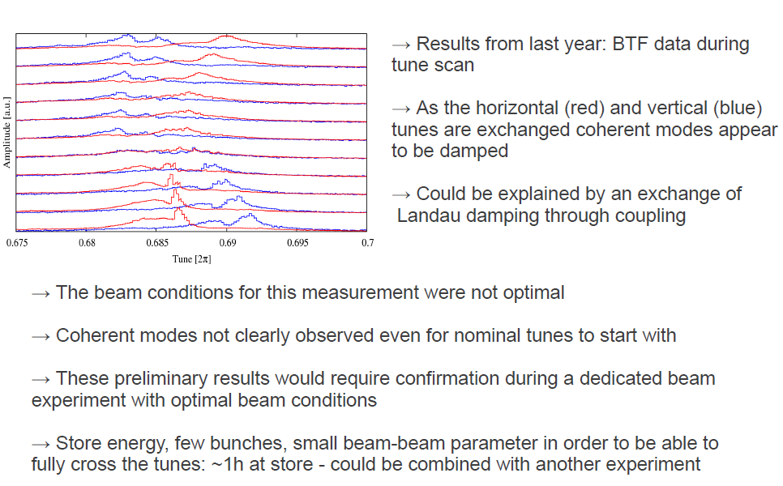
Coupling and beam-beam

Slide 15
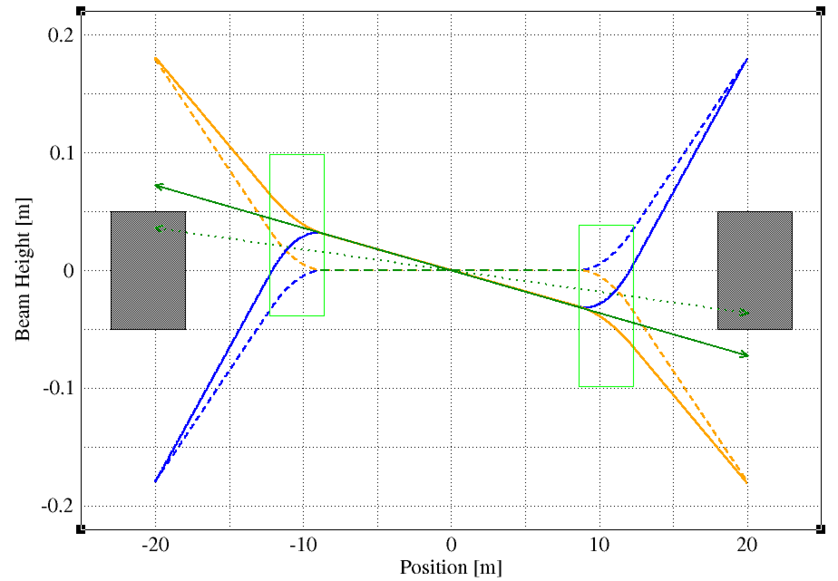
Machine changes
DX magnets need to move.
Divergence angle of neutrons is about +-1mrad, which has a spread in x of about +-2cm around the beam trajectory → need to move ZDCs
Au
p
≥2cm
neutron
DX
ZDC
ZDC
DX
neutron
p
Au

Slide 16
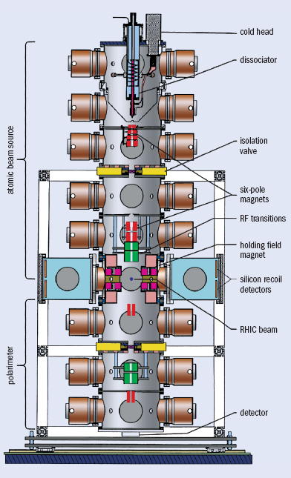
H-jet polarimeter
The H-jet polarimeter’s three major parts: polarized Atomic Beam source (ABS), scattering chamber, and Breit-Rabi polarimeter.
The polarimeter axis is vertical, recoil protons detected in the horizontal plane.
The common vacuum system comprises identical chambers, provides nine stages of differential pumping each at 2000 l/s
Flip jet polarization every 300 sec
The Jet beam is 6 mm FWHM sees the full beam polarization profile
Highest intensity so far. Measures the absolute beam polarization
Operations / maintenance are carried out by C-AD. Data analysis by the Spin Physics Group

Slide 17
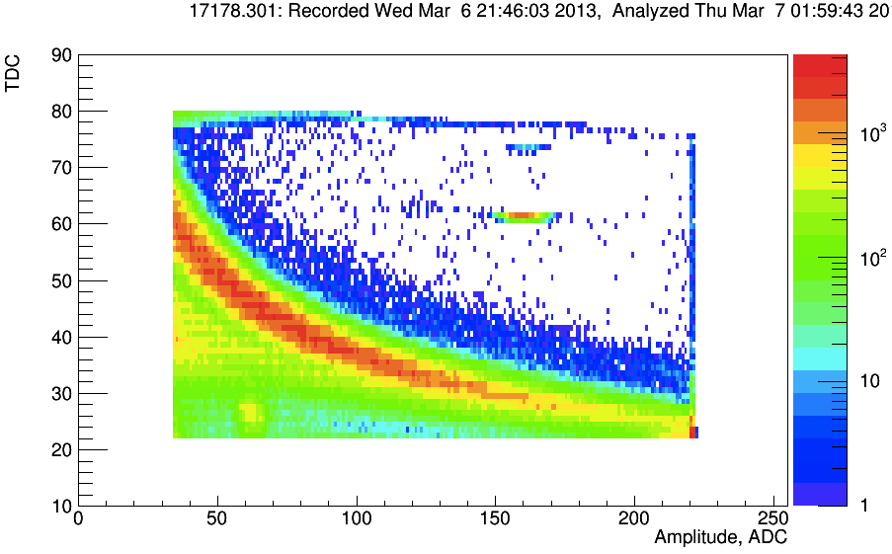
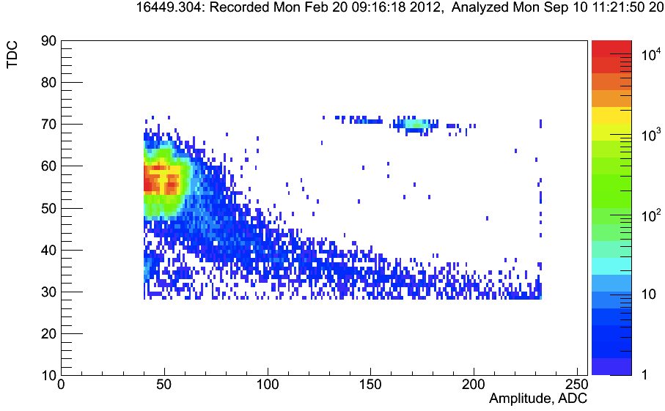
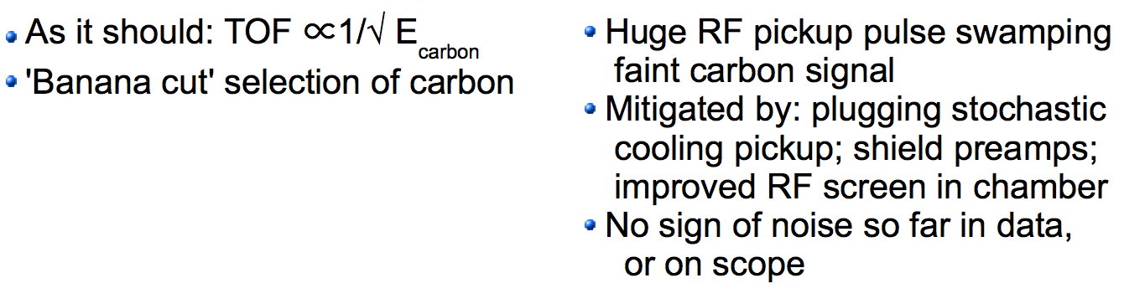
RHIC Polarimeter RF noise problem fixed

Slide 18
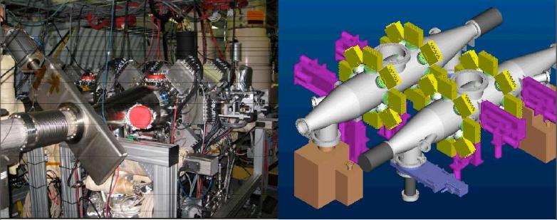
RHIC Polarimeters Layout
Two polarimeters in each RHIC beam (redundancy)
After tests in the AGS replaced charge sensitive amplifiers with fast current sensitive amplifiers
Target holders 6 (V) 6 (H) in each polarimeter
Simultaneous H and V pol. Profiles
Original Si are 2mm strips but we installed 1mm BNL detectors with orientation along and perpendicular to beam direction
Multiplexing to reduce cost. Readout with WFD no dead time.
Polarimeters operations is a collaboration between C-AD and Spin Physics Group

Slide 19
Accelerator Physics and Physics Support
Physics support for the RHIC Program is provided by the Accelerator Physics Group
which resides C-AD’s Accelerator Division and the Physics Support Group which resides
in C-AD’s Experimental Support and Facilities Division. Additional physics support is
provided by the Stochastic Cooling Group.
The Accelerator Physics Group, headed by Mike Blaskiewicz, is responsible for the
conceptual design, specification, and commissioning of the department's accelerators
and constituent components. In addition, AP Group members are deeply involved in the
creation of controls software and in operations support. The group is responsible for
proposing improvements in the various accelerators and to work with other groups within C
AD to make the improvements a reality. Specific activities include lattice calculations for the
Booster, AGS and RHIC. The lattices are vetted for power supply compatibility and then
subject to particle tracking and other analysis techniques to insure they will work as planned.
This includes spin tracking which is quite computer intensive and has been parallelized to run
on the NERSC cluster. The group is responsible for vetting new devices before insertion into
the accelerator so that the machine impedance remains acceptable. We take large amounts of
orbit, tune and other machine data both during operations and dedicated experiments. These
data are analyzed to optimize operations parameters and occasionally to introduce new
systems. In operations, AP group members lead the effort in beam collimation, beam based
alignment, ramp optimization, accelerator online models, optimization of store conditions
including optics measurements and corrections, operation of both AGS and RHIC polarimetry
and the evaluation and development of new programs such as polarized He-3 and asymmetric
collisions of protons with heavy ions.

Slide 20
Accelerator Physics and Physics Support (cont’d)
The Stochastic Cooling Group, led by Mike Brennan, is an outgrowth of the RF Group created to design,
build and operate six stochastic cooling systems for enhancing the integrated luminosity of heavy ion
collisions at 100GeV/n in RHIC. The cooling system has more than doubled integrated luminosity for gold
beams and led to a five-fold improvement in integrated luminosity for uranium.
The Physics Support Group, headed by Yousef Makdisi, provides the interface between the Physics
experiments and the assigned liaison engineers and the accelerator complex (Booster (NSRL), AGS and
RHIC). Their scope of work covers the proposal stage through the approval process, installation, running
schedule, and eventually D&D. The group possesses the in-house expertise for external beam line optics
design and installation and magnet designs for variety of needs throughout the complex (Experiment
magnets, the ERL, IRCMS, Spin Flipper…etc). The group also supports radiation shielding and soil
activation analyses through complex computer simulations. Liaison physicists along with Liaison engineers
are involved in Experimental Safety Reviews of experimental detector installations. Members of the group
are involved in the Spin Flipper effort.
In collaboration with the Spin Physics group in the Physics department, the Physics Support Group is also
involved in the construction, day to day operations, maintenance, and analysis of the RHIC and AGS
polarimeters. Currently the group, in collaboration with the C-AD Controls group, is involved in an R&D
effort to upgrade the polarimetry data acquisition systems to utilize better supported computer systems. An
upgrade of the Polarized Jet target silicon detectors through an MOU with Charles University, Prague is in
progress, and an effort to evaluate a recently designed JLAB WafeForm Digitizer system towards an
upgrade of our 12 year old system.
In order to better serve the physics community and keep abreast of experimental nuclear physics
techniques, members of the group may also collaborate on physics experiments (current involvement at
STAR, PP2PP @ STAR, PHENIX, and AnDY)
In total, C-AD provides physics support for RHIC of approximately 22 FTE’s annually.

