Slide 1
Cryogenic Systems
Roberto Than

Slide 2
Cryogenic Systems

Slide 3
Staff [25]
Engineering / Operations: 8
  Operations Engineering: Group Leader + Operation Engineer
  Mechanical/Cryogenics: 3
  Electrical/Instrumentation/Controls/SCADA: 3. Group Leader +2
Technicians + Supervisors 14 + 3
  Mechanical Technicians + Plant Operators + Supervisors
    Supervisor for Mech Techs
    3 Senior Techs
      Deputy Supervisor. Cryogen/Spares/Maintenance schedule/Equipment
      Turbine / Valve Tech / Machinist
      Compressor Tech
    5 Mech Techs
    5 Plant Operators / Mech Techs
  Instrumentation, Electronics & Controls:
    Supervisor +for electrical techs
    2 E/I Technicians

Slide 4
Technician Group
Cryogenic/ Mechanical/ Operations
  Operations support
    24/7 Shift during run
    to handle any interruption in operations due to power dips, equipment failure, and to maintain/trouble shoot/replace any instrumentation, valves, and other equipment when necessary to prevent the plant from going down.
  Maintenance & repair support
    Equipment maintenance
    Calibration
  New project support
    Piping installation
    Equipment installation
Instrumentation & Controls, Electrical
  Operations support
    Calibration
    Trouble shooting & Replacement
  Maintenance & repair support
    Maintenance
    Repairs
    Calibration
  New project support
    Rack builds
    Cable installation
    Instrumentation installation

Slide 5
Engineering
Cryogenic/ Mechanical/ Operations
  Operations support
    Supervision
    Operating Procedures
    Process Control changes
    Plant/System operation trouble shooting
    Work planning
  Maintenance & repair support
    Procurement of spares and parts
    Modifications
  New project support
    Cryo process /Thermal
    Mechanical
    Equipment procurement support
Instrumentation & Controls, Electrical
  Operations support
    Trouble shooting and repair
  Maintenance & repair support
    Spares
    Repair
    Upgrades
  New project support
    Control Logic Programming
    DCS database updating
    Human Machine Interface Development

Slide 6
Cryo Instrumentation & Controls, Electrical
RHIC Tunnel complex: 42 Racks
Service building: 23 Racks
Main Cryoplant Area: 10 Racks
I/O’s: ~3000’s
Main Supervisory logic running on redundant Compaq Alphas servers
  Original 1980’ s legacy DCS running on upgraded hardware, Compaq Alpha servers on DEC-VMS OS
  All PLCs communicate via main supervisory
HMI: Upgraded to Modern HMI/SCADA: Indusoft Co. [2003-2009]
  Thin Clients: Redundant main HMI servers
  Several direct clients to Alphas
RHIC tunnel & Service blg’s PLC’s: Square D Symax [1996]
Main cryoplant PLCs upgraded to: RTP Corp. [2002-2004]
Database tag count ~14,000

Slide 7
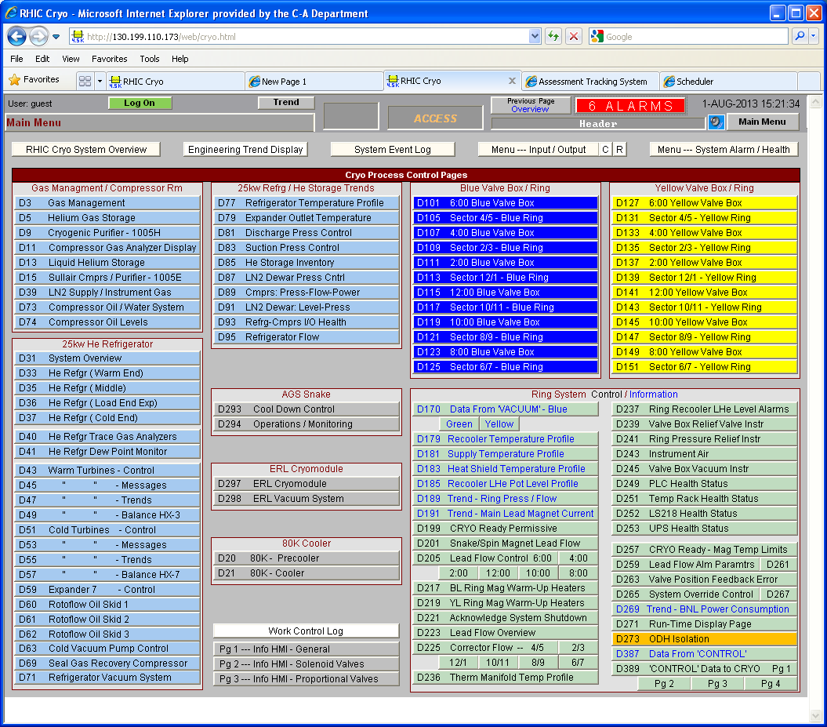
Cryo: Human Machine Interface HMI

Slide 8
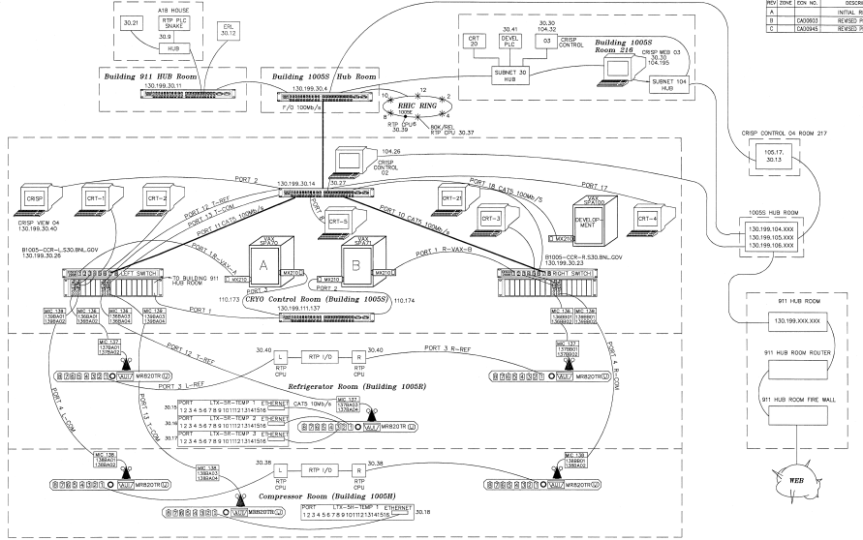
Cryo Controls Networking

Slide 9
Cryogenic System Loading
Original Design
1980’s CBA Cryo plant
Compressor Flow: 4300 g/s
Installed Comp: 17 MW
Carnot Work:
Carnot efficiency: ~ 25%
2.6K Load
Cold compressors
~ 100 g/s liquefaction
50K Shield: 55 kW
Present RHIC Operation
Compressor Flow: 1750 g/s
Compressor Power: 5 MW
4.5K Refrigeration Load: 8000 W
Liquefaction: 42 g/s
45K- 80K shield: 25,000 W
Carnot efficiency: ~ 20%
7 expander stages
    6 recycle
    1 expander in JT loop

Slide 10
Cryogenic System
RHIC System
Compressor System
LN2 Storage Compressor bldg
4.5K Coldbox System
Forced Convection Ambient heaters
Gas Storage
Liquid Helium Storage
LN2 Storage for Liquid Helium Storage
80K cooler
Cryo Distribution and Valve boxes
Main magnets Lead Flow Controls
Correctors Lead Flows
Instrument Air
Controls & Instrumentation
Cooling Tower 7
AGS
  Cold Snake Cryocoolers / LN2 Precool
Projects
  ODH warning isolation
  Electron Lens SC Solenoid
  56MHz Storage SC Cavity
  Coherent electron Cooling
  Energy Recovery Linac, ERL
  Cryoplant ERL
  SRF Vertical Test Facilities
Assistance
  Bldg 930 LINAC LN2 Dewar upgrade
  SMD Magnet Division
  NSLS / NSLS-II
  BNL LN2 bulk storage dewars at other test facilities
  Physics / ISD
  High Field MRI

Slide 11
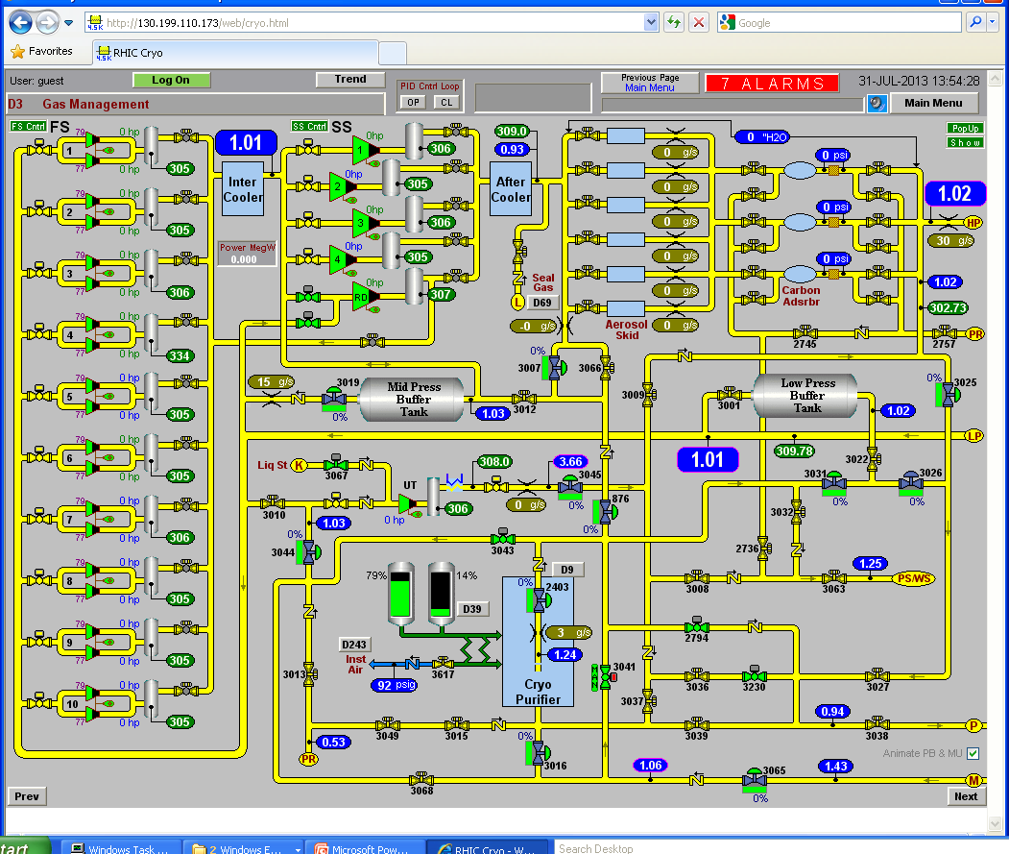
Compressor System

Slide 12
Compressor System 1005H
20 x First Stage Compressors: Howden 321/1.65. 600 HP motor. 235 g/s. + Oil cooler HX
5 x Second Stage Compressors: Howden 321/1.65, 2200 HP. 940 g/s. + Oil cooler HX
Central Intercooler/After cooler Heat exchangers after each compression stage
Oil Coalescers (20 vessels)
Oil vapor removal Charcoal Beds (3 vessel)
Utility Compressor: Howden 255/1.65, 600 HP, 80 g/s
250 g/s Purifier Coldbox system
Oil processing skid
Instrument Air compressor
Maintenance
  Compressor Bearings
  Motor/Compressor Alignments
  Oil Filter cleaning
  Water filter cleaning
  MCC cleaning
  Valves & actuators
  Instrumentation
  Oil change and processing
  Relief devices inspection/recertification
  Charcoal replacement

Slide 13
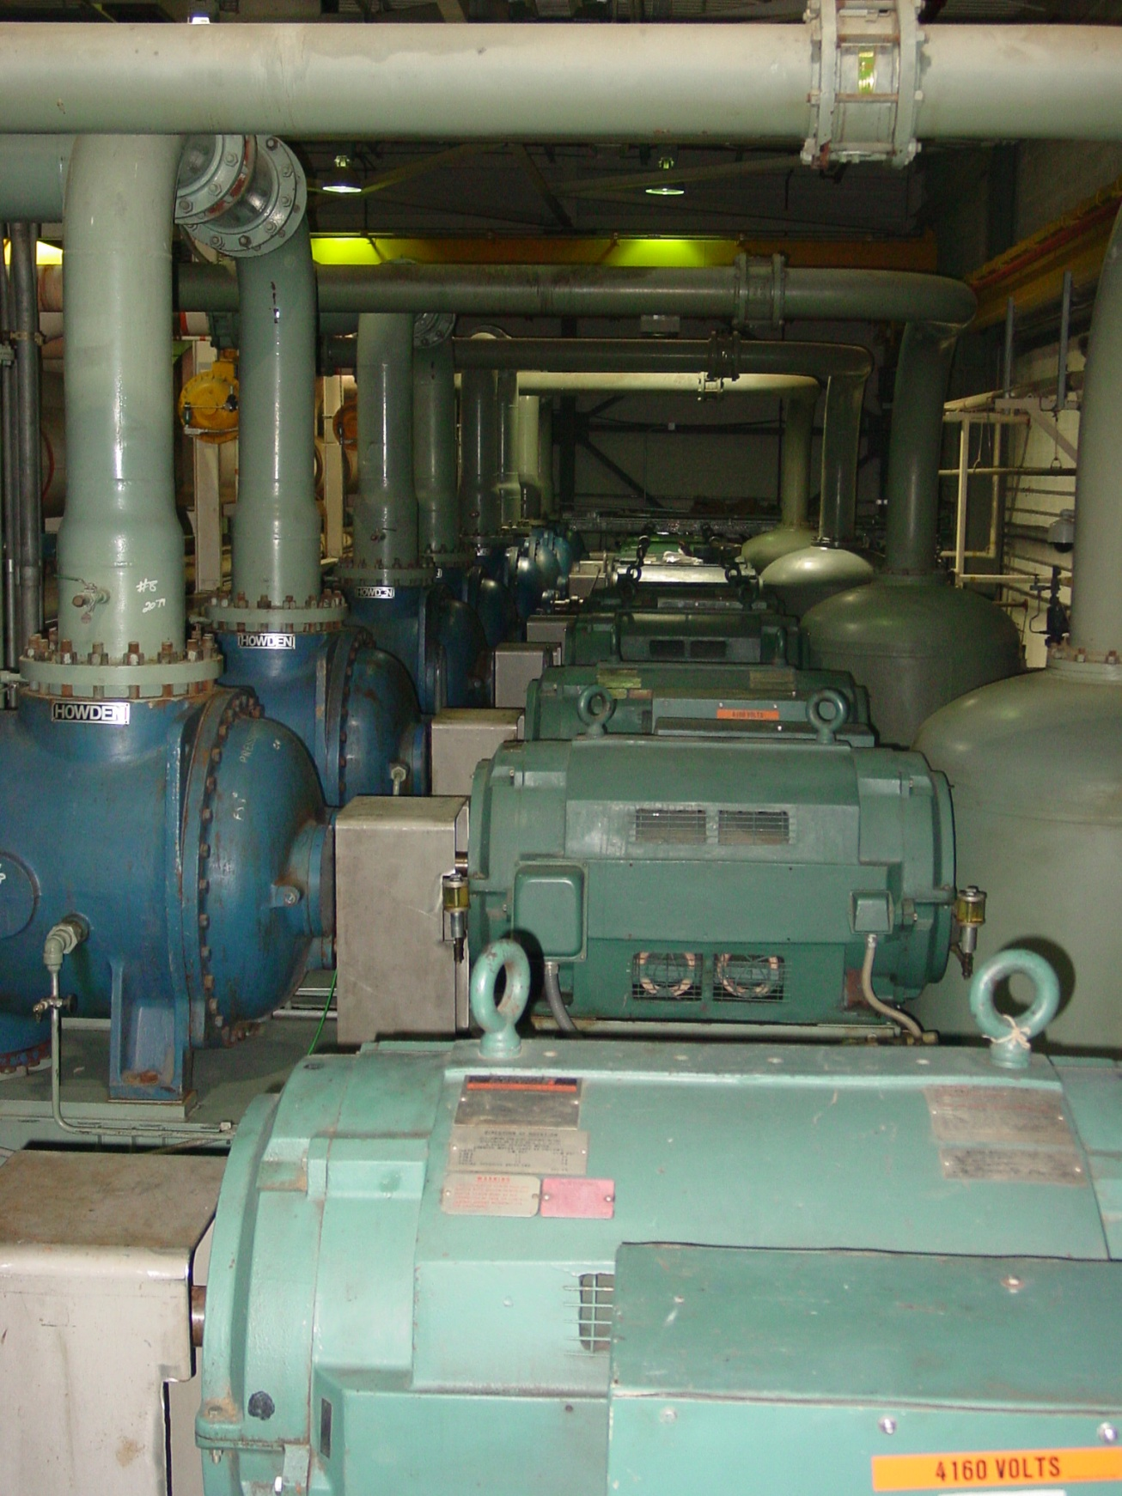
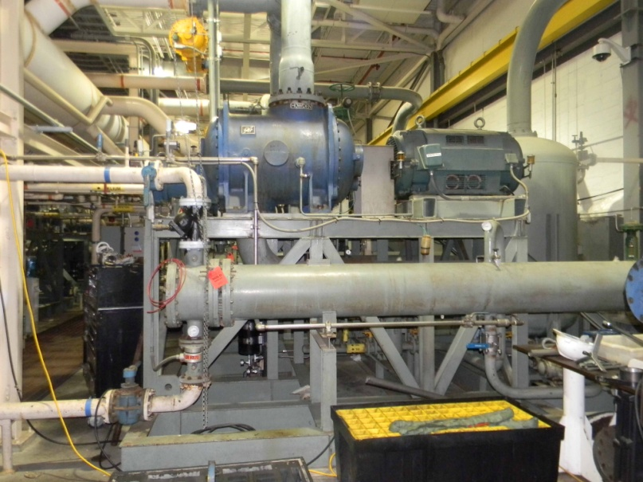
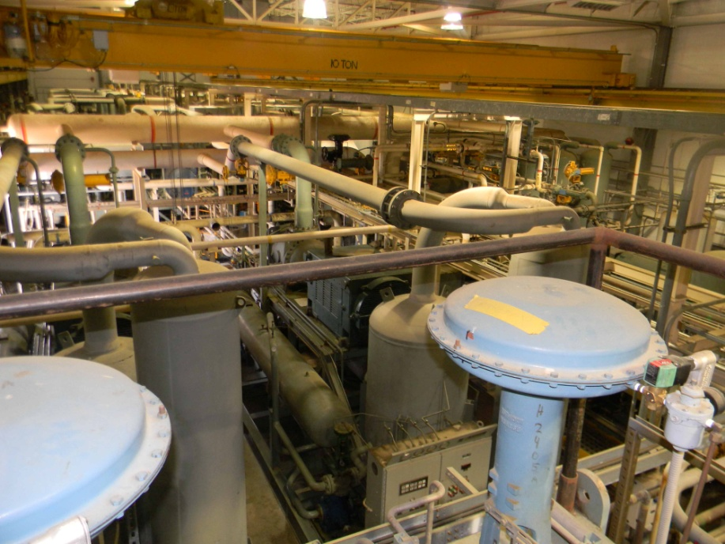
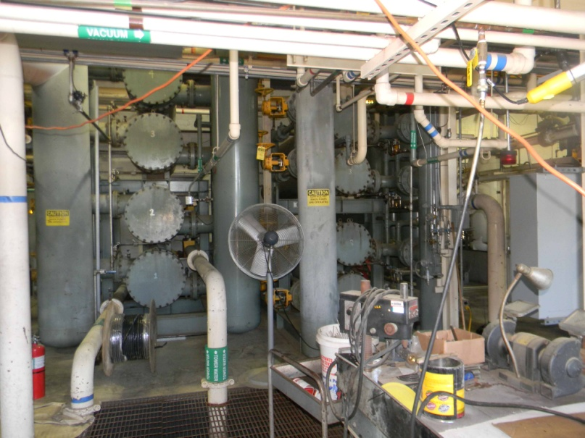
Compressor System 1005H
First Stage Compressor skid
First Stage Compressor Row
Intercoolers/ Aftercoolers
2nd Stage
Compressor skid

Slide 14
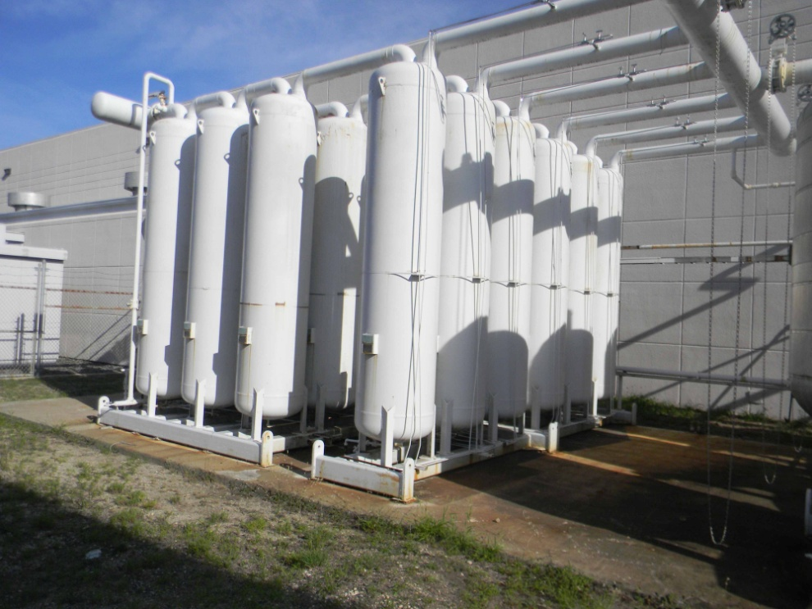
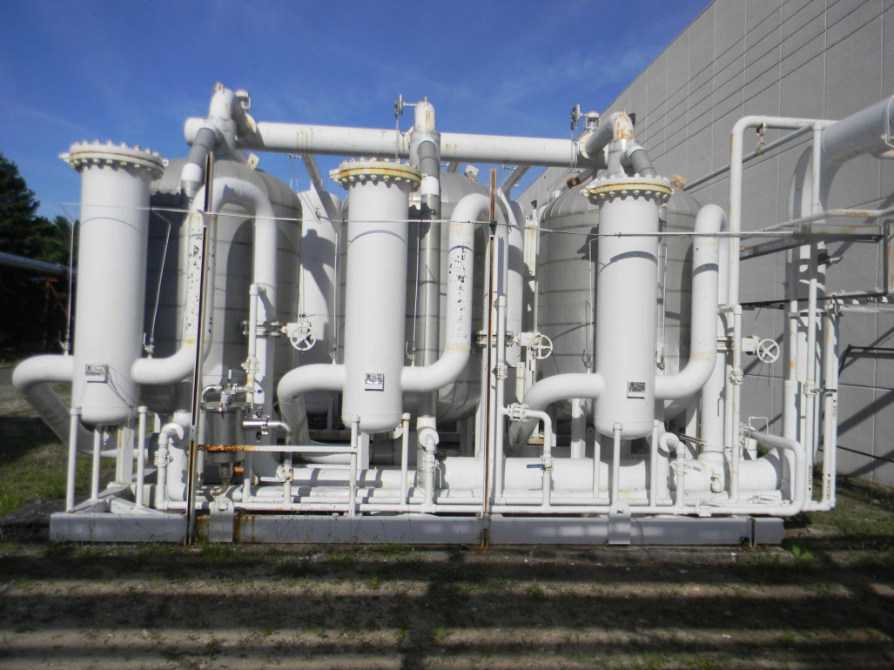
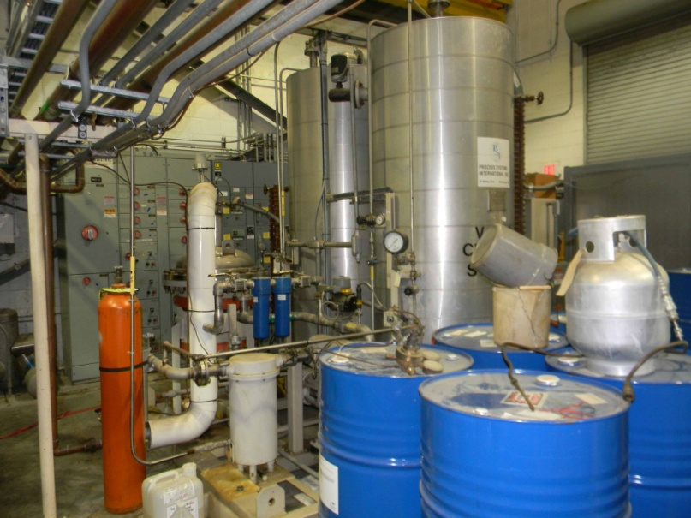
Compressor System 1005H: Oil removal
Oil Mist Removal
  4 Stages Coalescers
  5 parallel banks
  Vapor removal
  3 parallel charcoal beds
  6 ft diameter
  Oil Vapor Removal
  3 parallel charcoal beds
  6 ft diameter parallel banks
Coalescers
Charcoal Beds
Oil Processing System

Slide 15
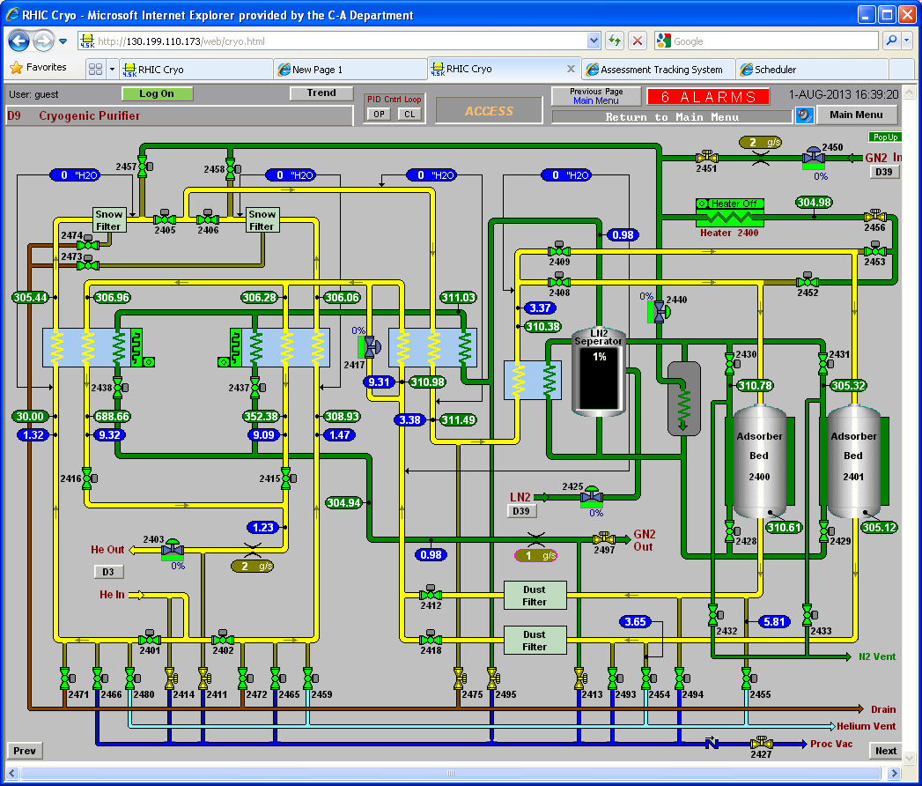
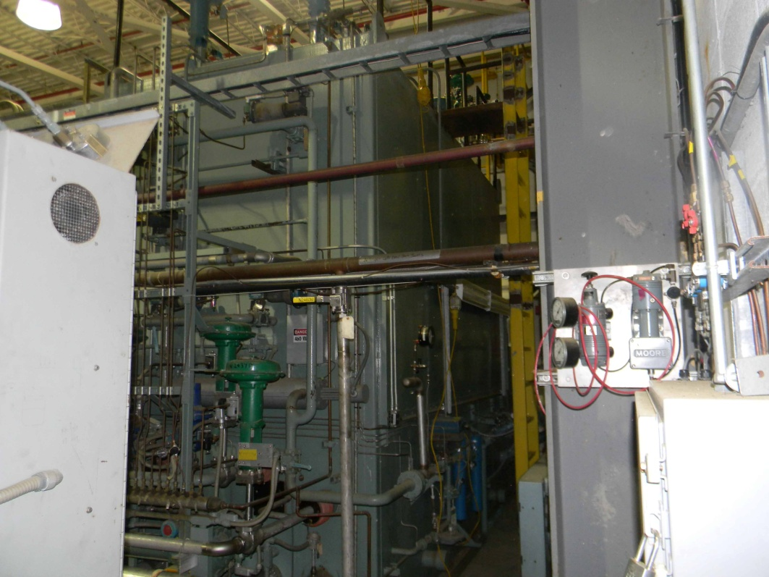
Compressor System: Purifier
250 g/s
Dual freeze out heat-exchanger
Dual charcoal bed
Regen gas heater
LN2 cooled
Maintenance
  Regeneration
  Valves
  Instruments
  Relief Devices

Slide 16
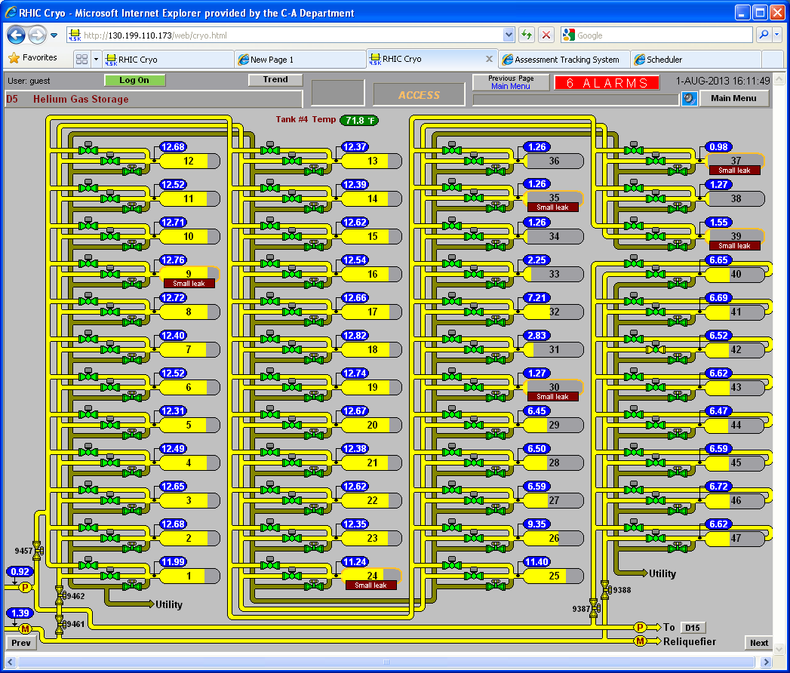
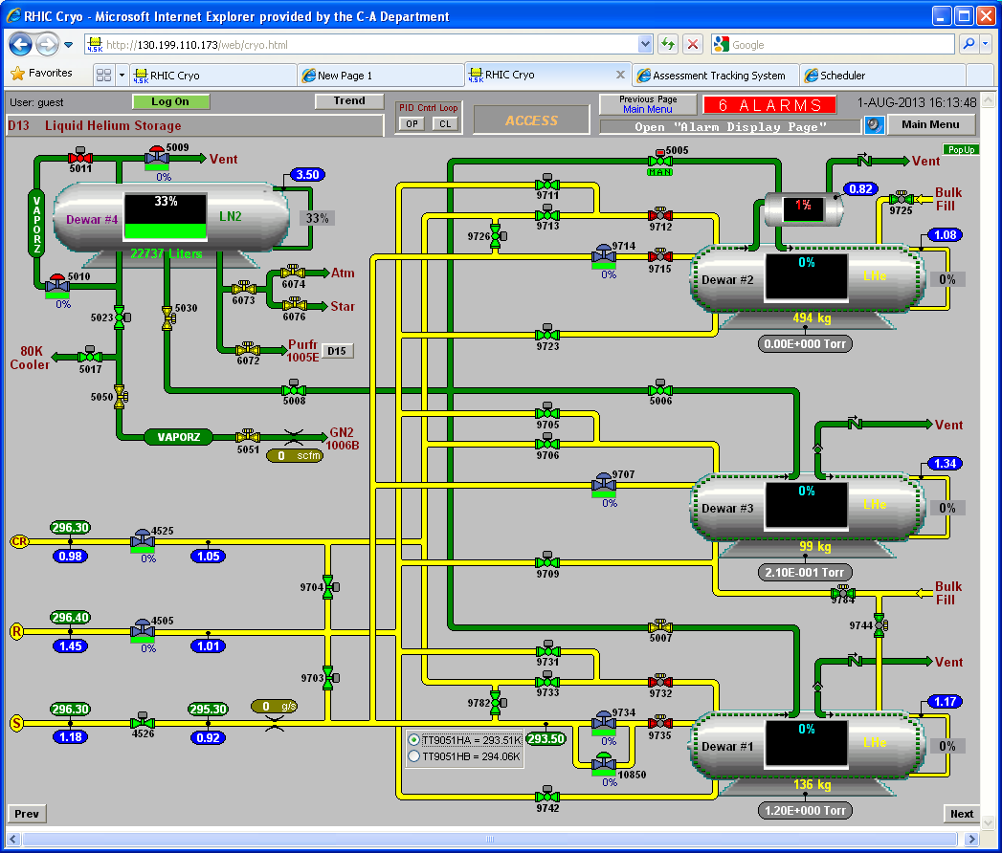
Helium Inventory: Gas & Liquid Storage
47 Gas Tanks
~ 30,000 Liquid Gallons equivalent
3 x 10,000 Gallons Liquid Dewar
20,000 Gallons LN2 dewar
Maintenance
  Valves
  Relief Devices
  Insulating vacuum
Operational Requirement: 48,000 Gallons Liquid helium

Slide 17
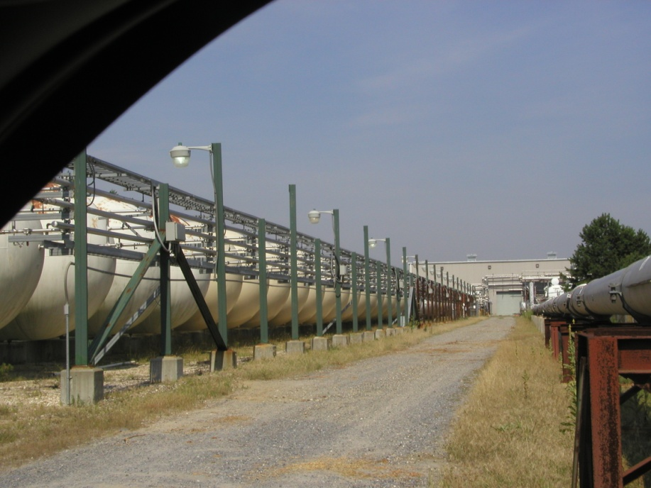
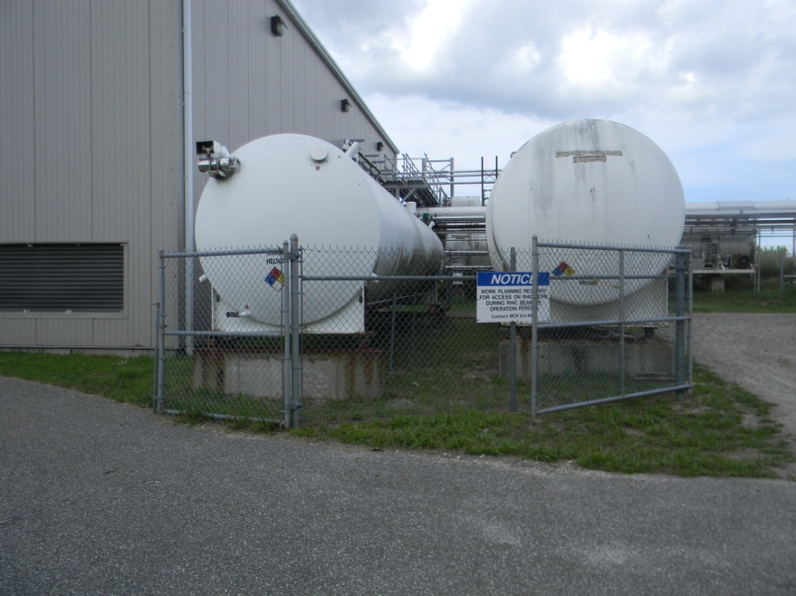
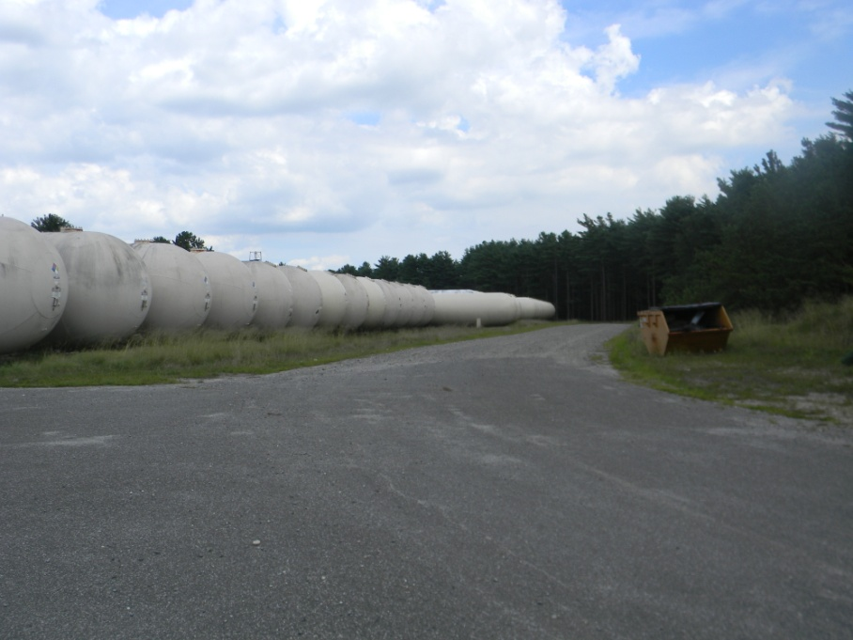
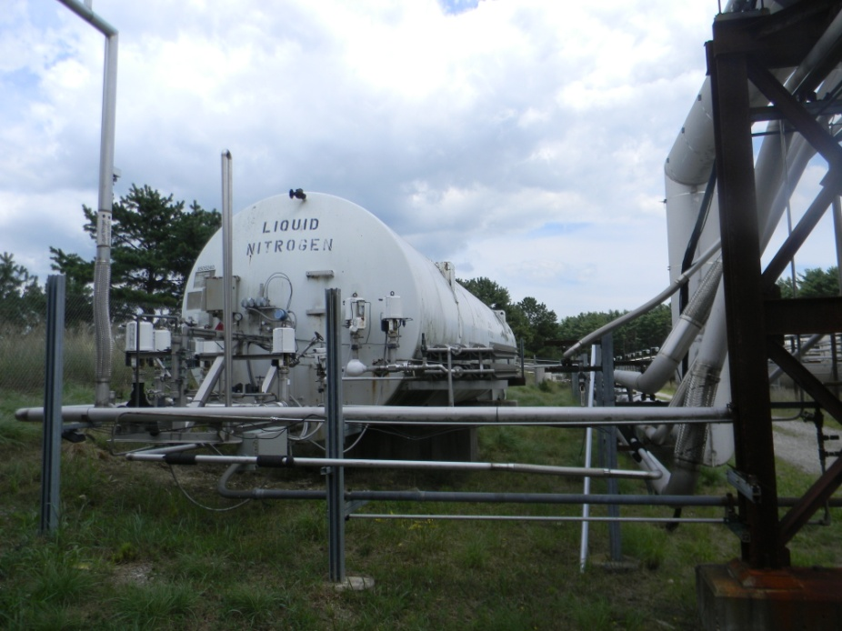
Helium Inventory: Gas & Liquid Storage
Liquid Helium Dewars
Tank Farm
Liquid N2 Dewar

Slide 18
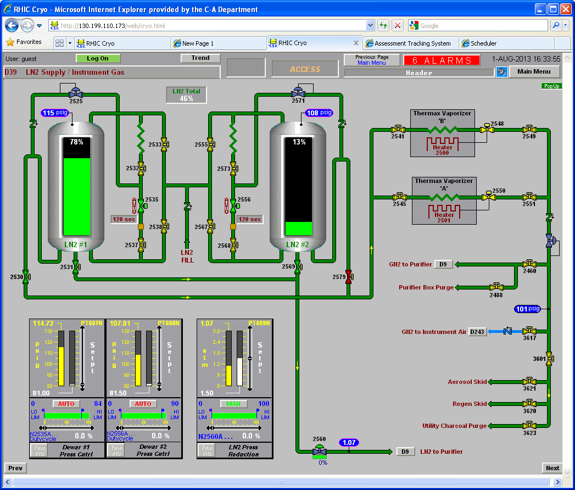
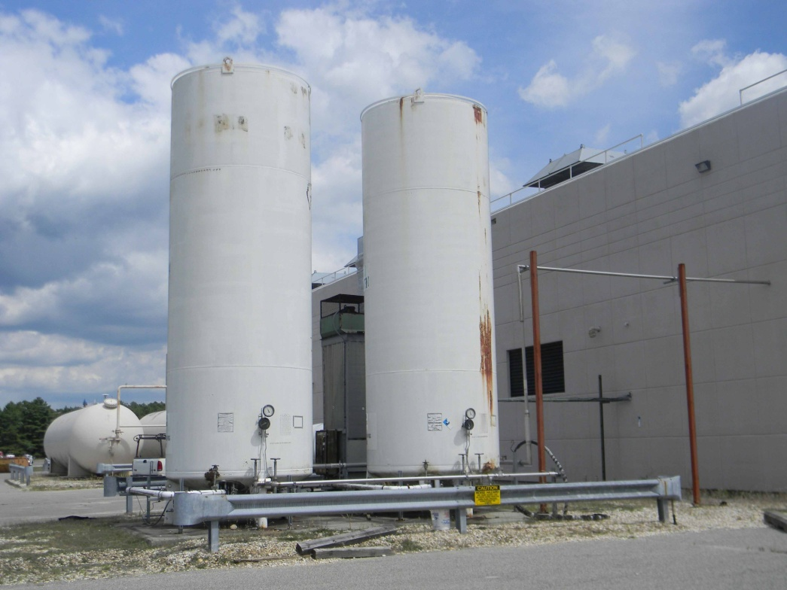
LN2 Supply @ 1005H
Twin 6000 Gallons LN2 towers
Gas generation for regeneration
Liquid delivery to Purifier
Maintenance
  Valves
  Relief Devices
  Insulating vacuum
  Defrosting of coils
Liquid N2 Dewars

Slide 19
4.5K Coldbox System
5 Cold boxes with Valves
Dual 65K charcoal adsorbers
Regeneration skid
12 Roto-flow oil bearing turbines + oil skids
Seal gas compressor
1 Gas bearing turbine system
Forced convection ambient vaporizers
Insulating vacuum system
Maintenance
  Valve calibration / actuators
  Relief devices inspection/recertification
  Turbine Oil Filter cleaning
  Turbine labyrinth seal maintenance
  Insulating vacuum pumps
  Instrumentation
  Regeneration

Slide 20
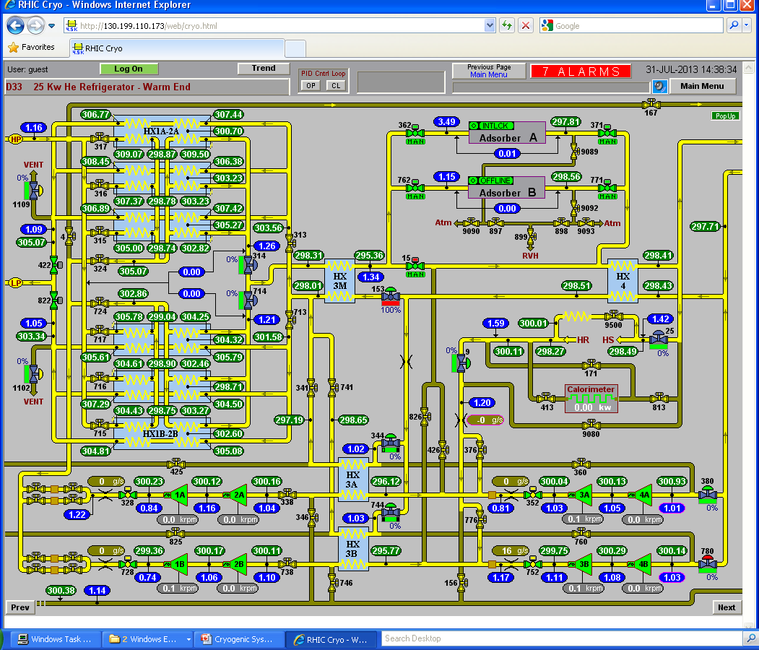
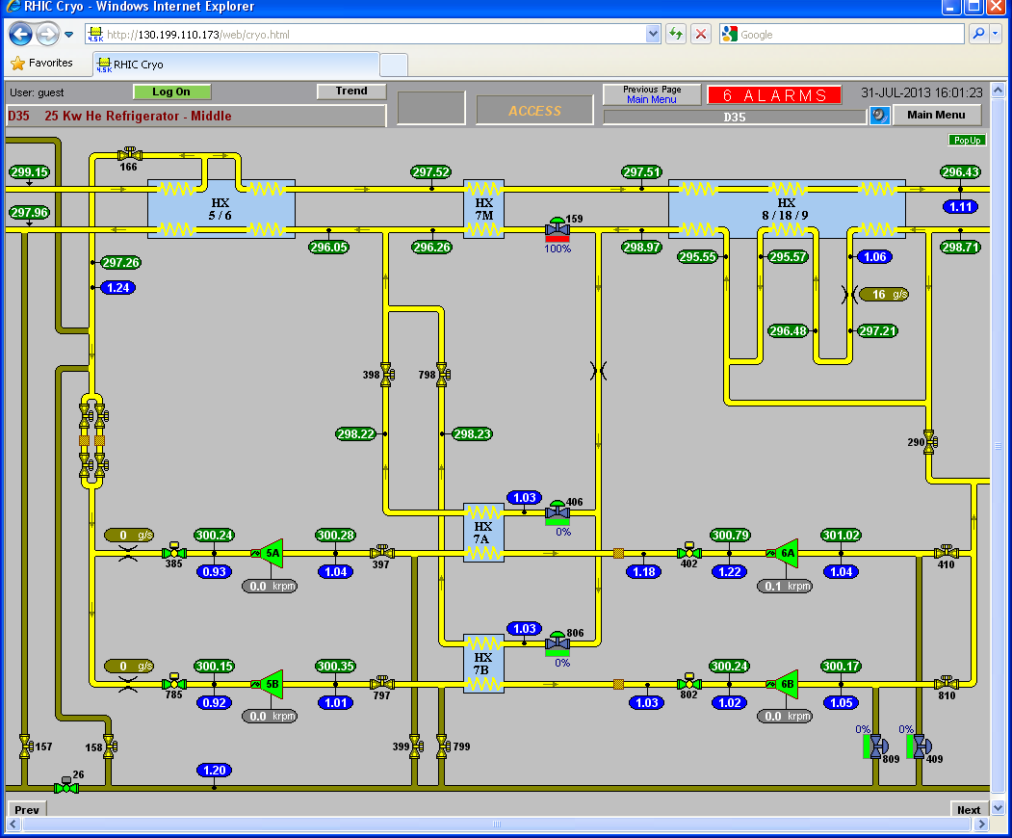
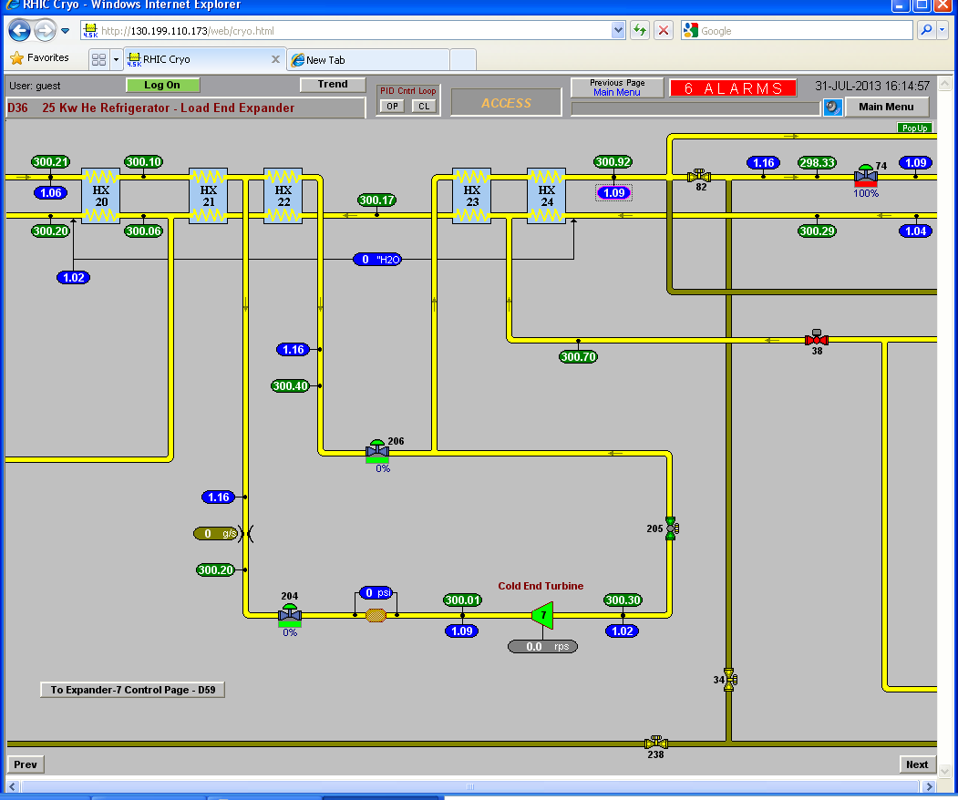
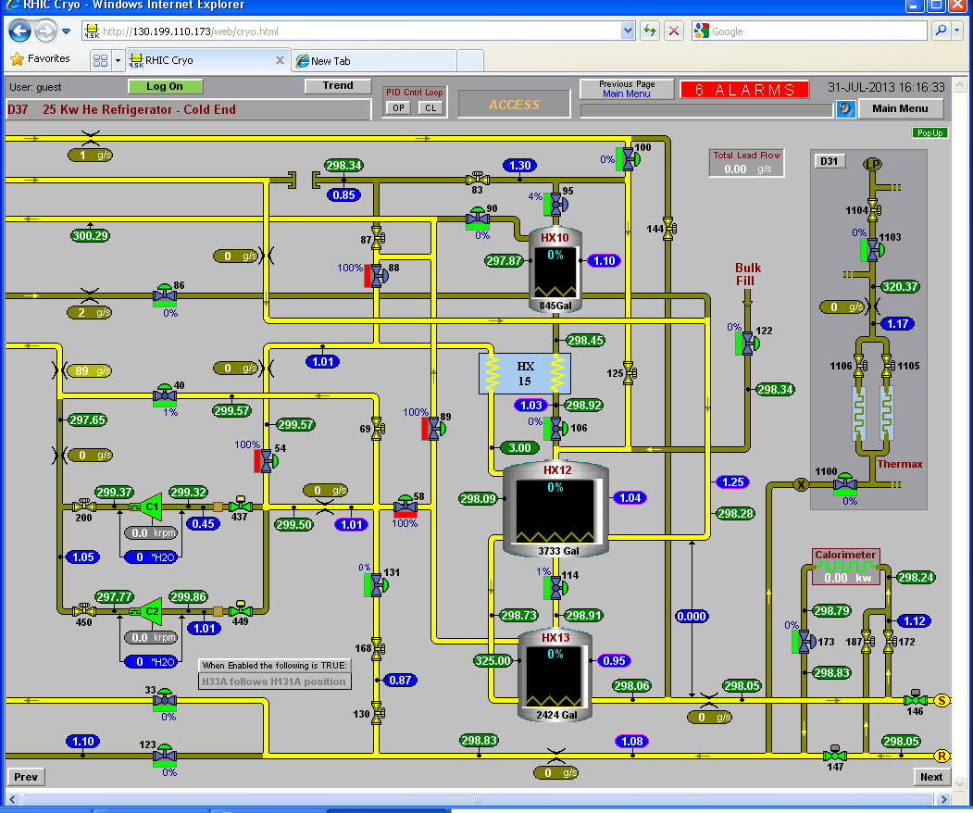
4.5K Coldbox System

Slide 21
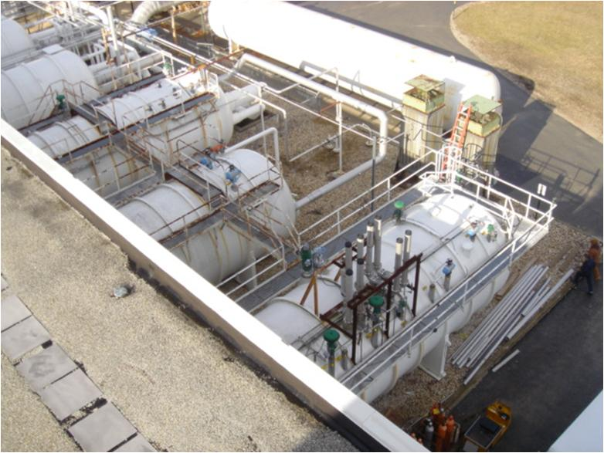
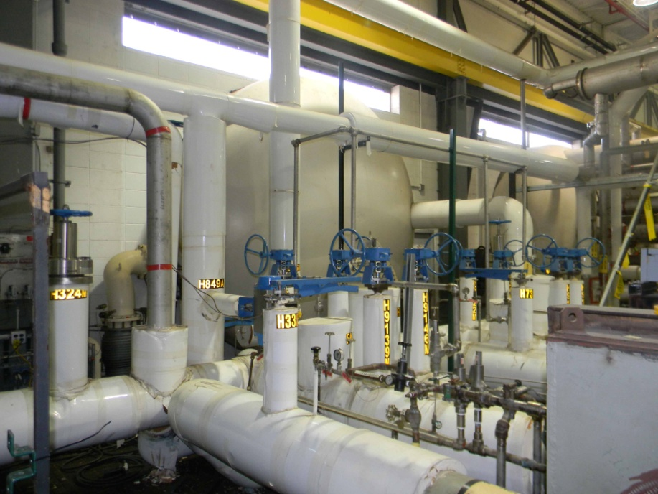
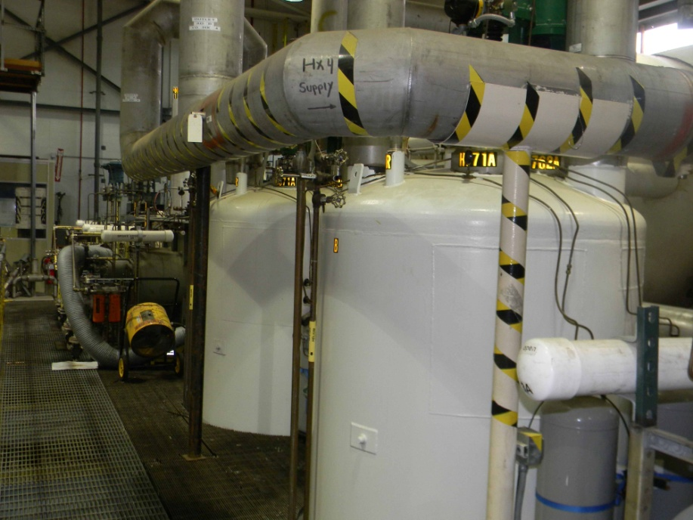
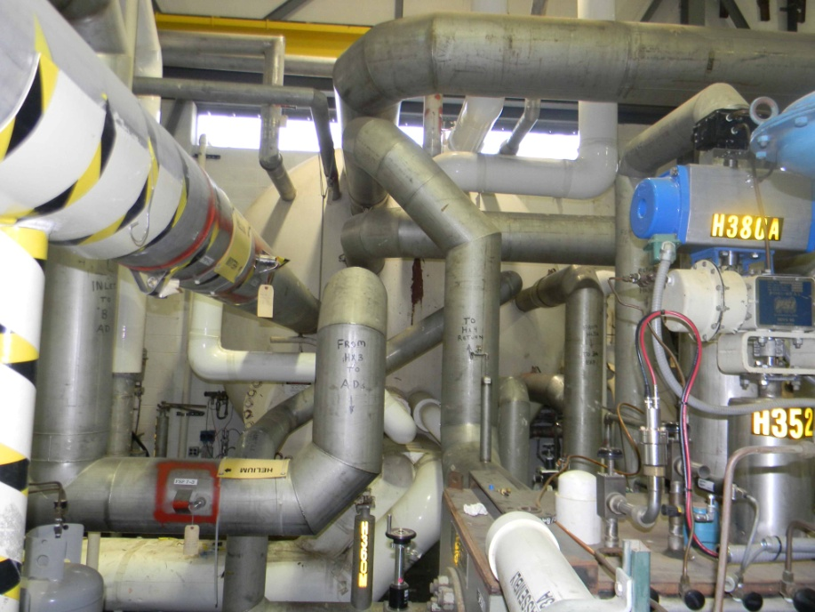
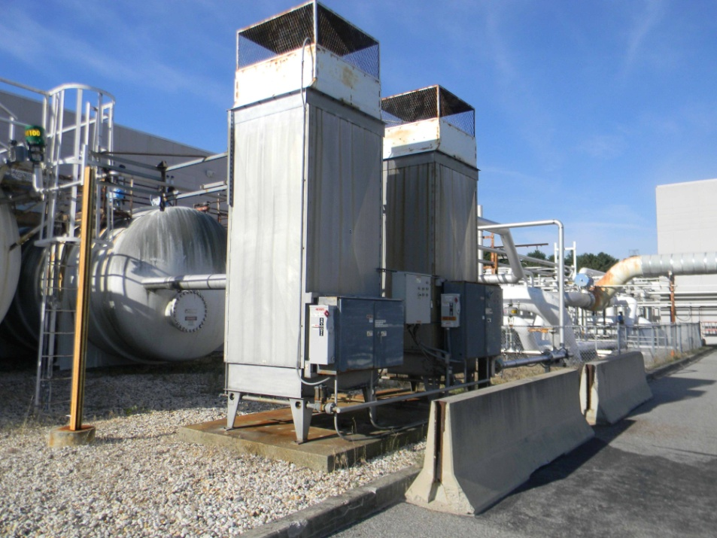
4.5K Coldbox System
Cold 3 120K-65K
ColdBoxes, last Coldbox 5
Forced Convection
Ambient vaporizers
65K Charcoal
Adsorption Beds
Cold Box 4 65-5K

Slide 22
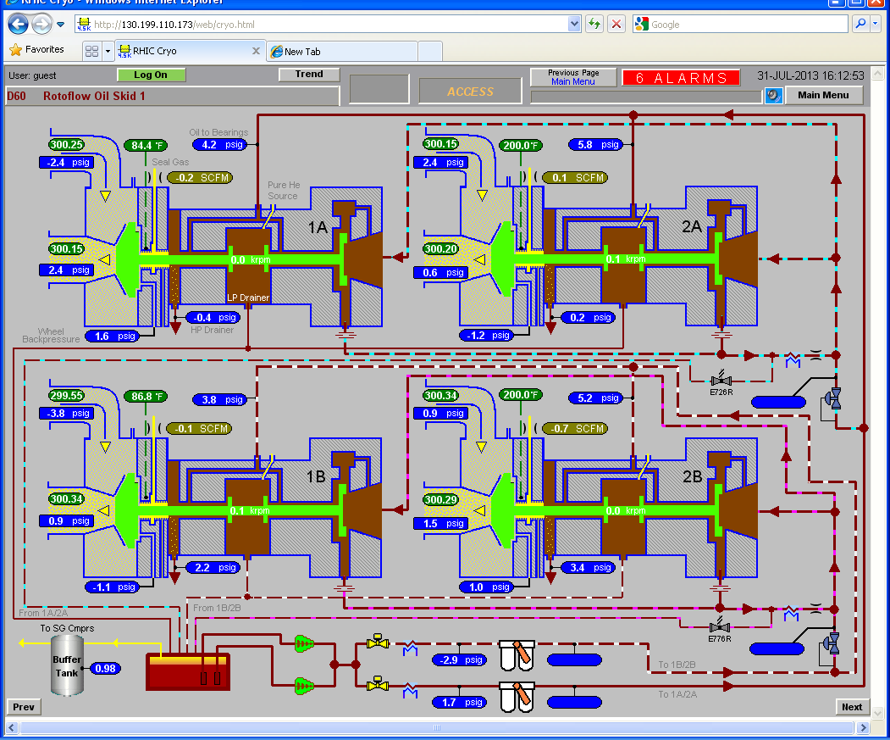
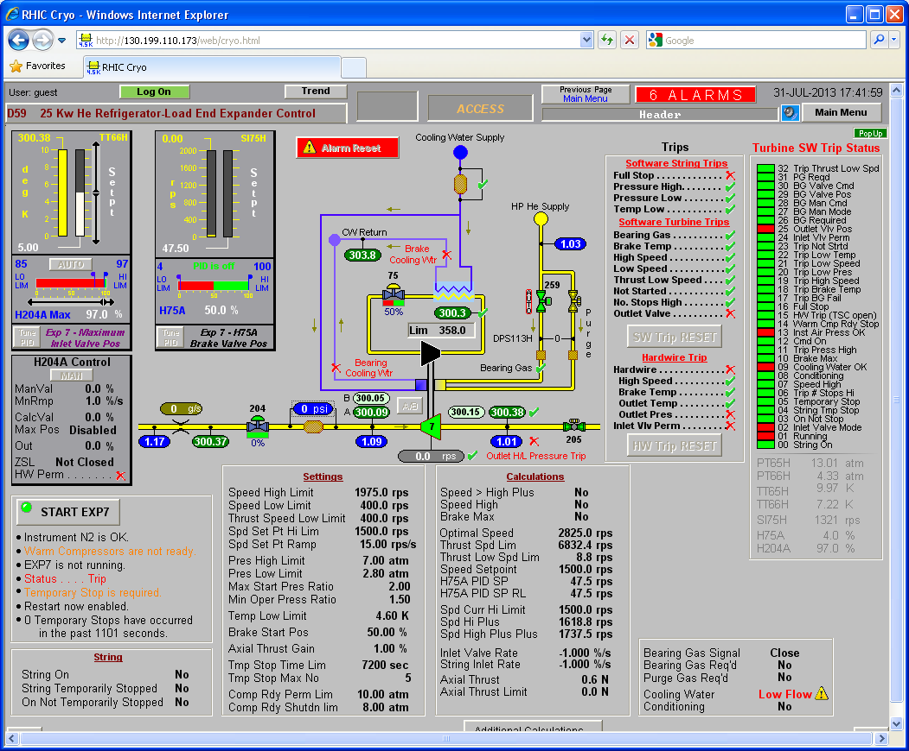
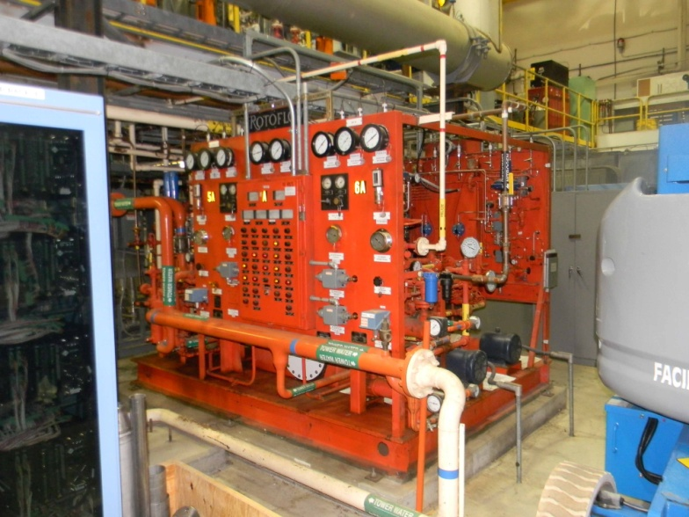
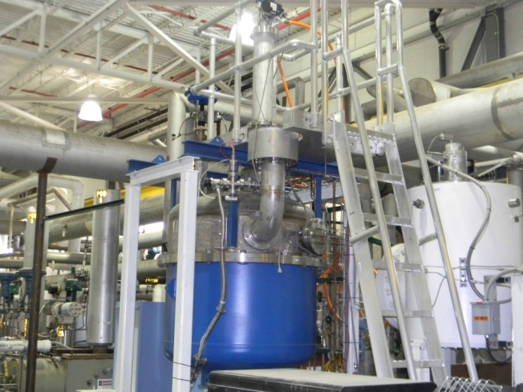
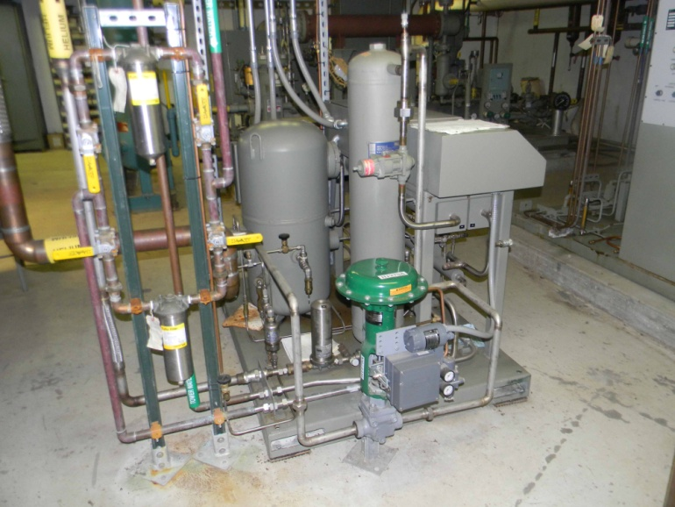
T1 thru T6 Oil bearing expander + T7 Gas Bearing
Rotoflow expander
Oil skid
Gas Bearing Expander
Seal Gas Compresssor

Slide 23
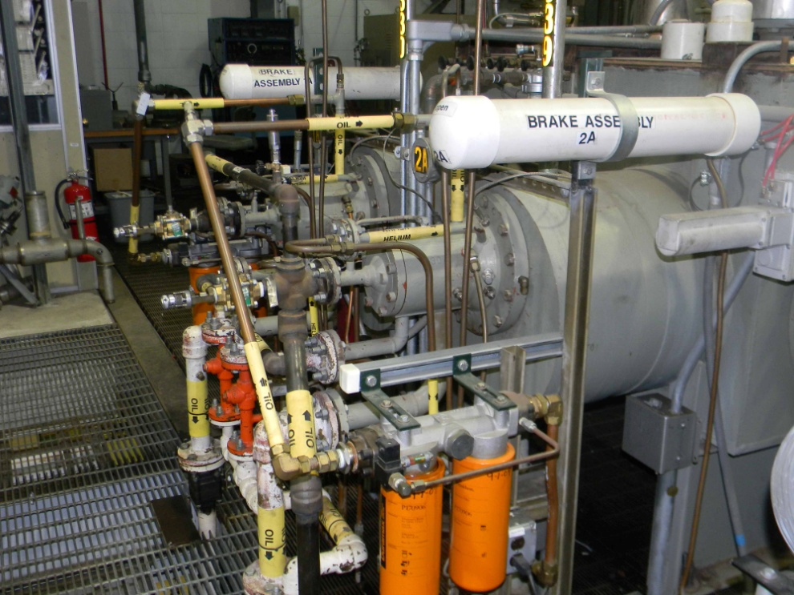
Expanders
Oil bearing Expanders T1-T6 A/B
  Oil bearing
  Oil brake loop, fixed resistance
  Variable inlet vanes
  Oil Skid
    Oil Pump
    Seal gas
    Oil cooler Heat exchangers
    Oil sump
    Valves
    Instrumentation
    Reliefs
  Inspection
    Labyrinth seals
    Bearing surface
Gas bearing Expander T7
  Dynamic helium gas bearing
  Fixed inlet vanes
  Variable gas brake loop
  Brake Heat exchanger
  Control valves
  Cooling water
  Expander Inlet Filter

Slide 24
Distribution & Valve Boxes
12 Valve Boxes
  Nominal 30 cryogenic valves
  Reliefs
  Lead Pot Volume for power leads
  Recooler
  Instrumentation
Lead flow interface and lead flow controllers
Relief devices
Ring Vacuum Jacketed Piping
  Between Sextants & Bldgs
Ring to Refrigerator Vacuum Jacketed Piping
  Between Plant & Ring
Sextant
  Recoolers
  Cryogenic Fill valves
  Instrumentation
Maintenance
  Valve calibration / actuators
  Relief devices inspection/recertification
  Lead flow controllers
  Instrumentation
  Vacuum pump-out ports
  Leak check

Slide 25
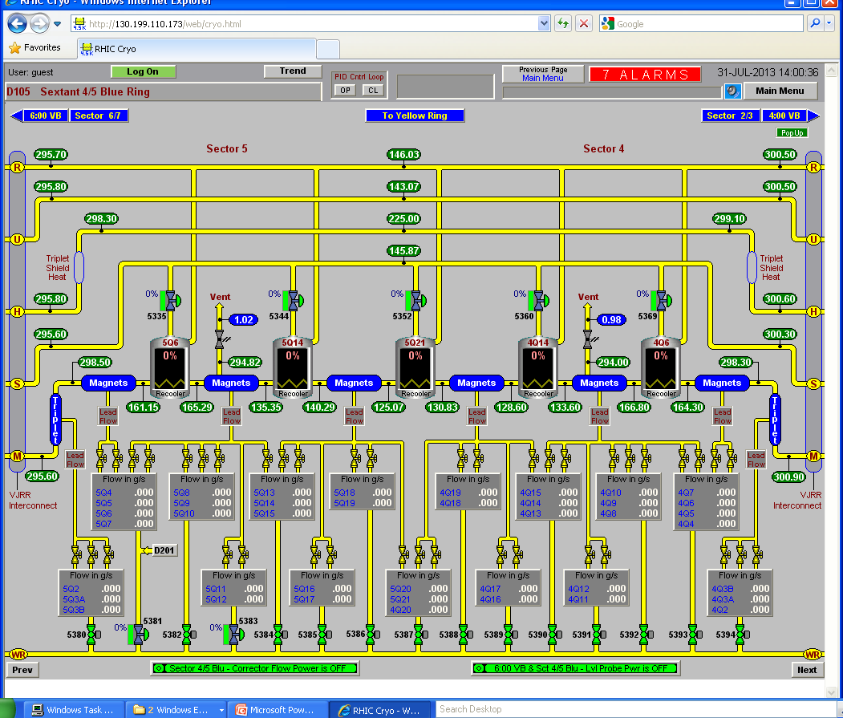
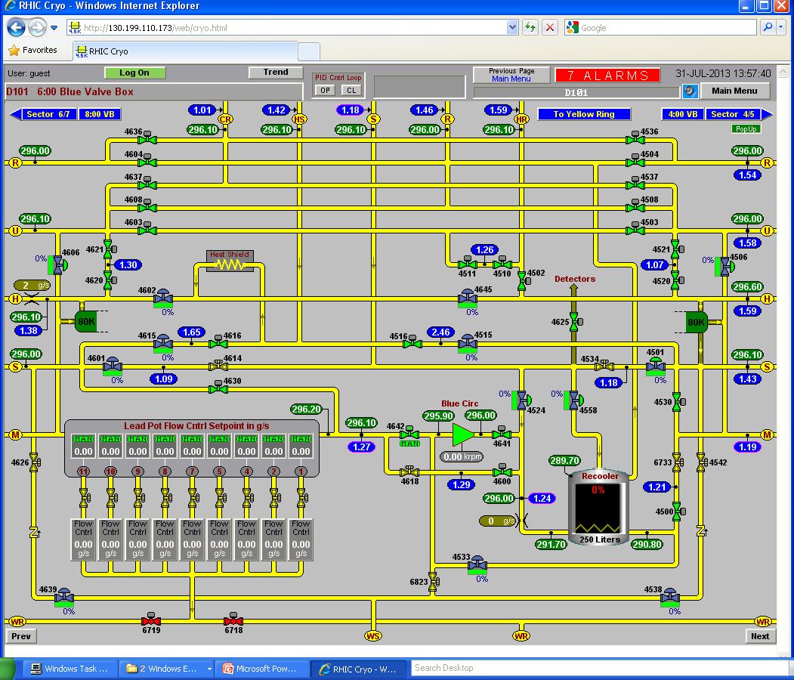
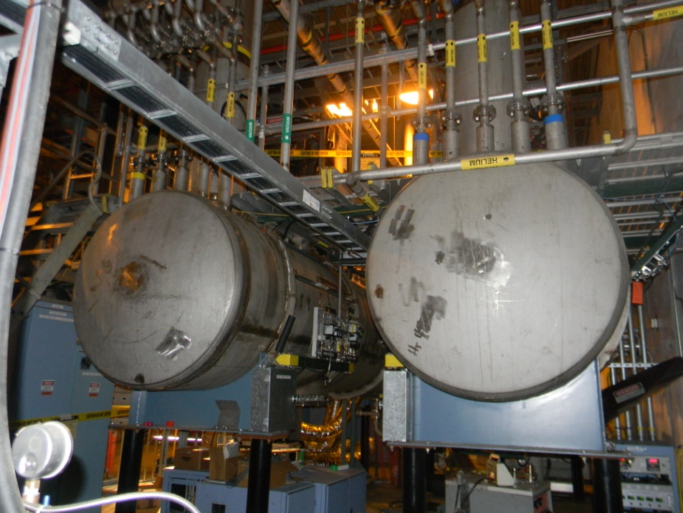
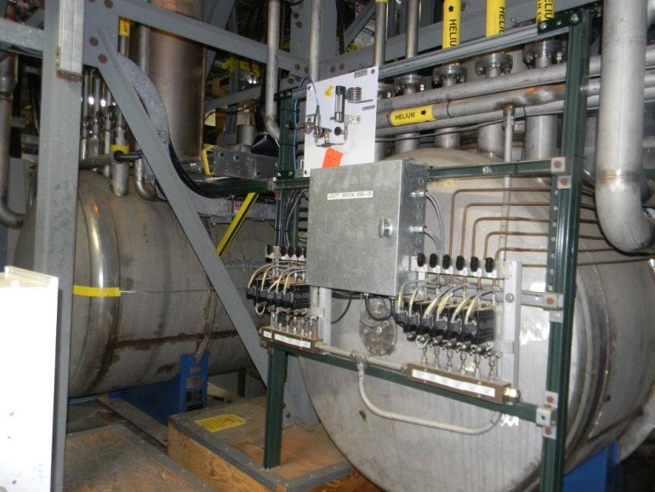
Distribution & Valve Boxes

Slide 26
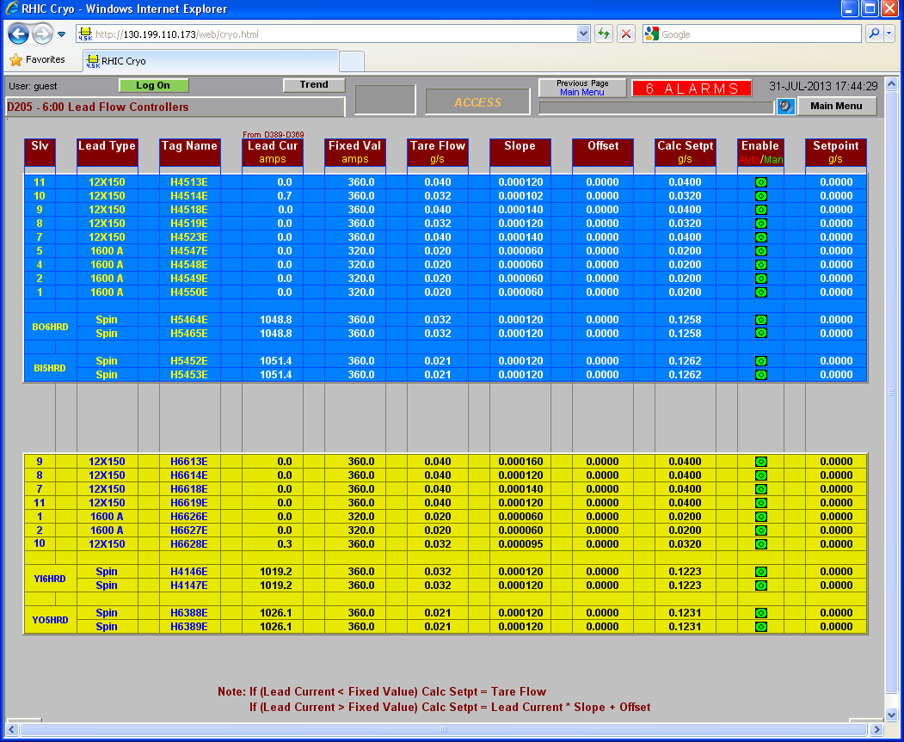
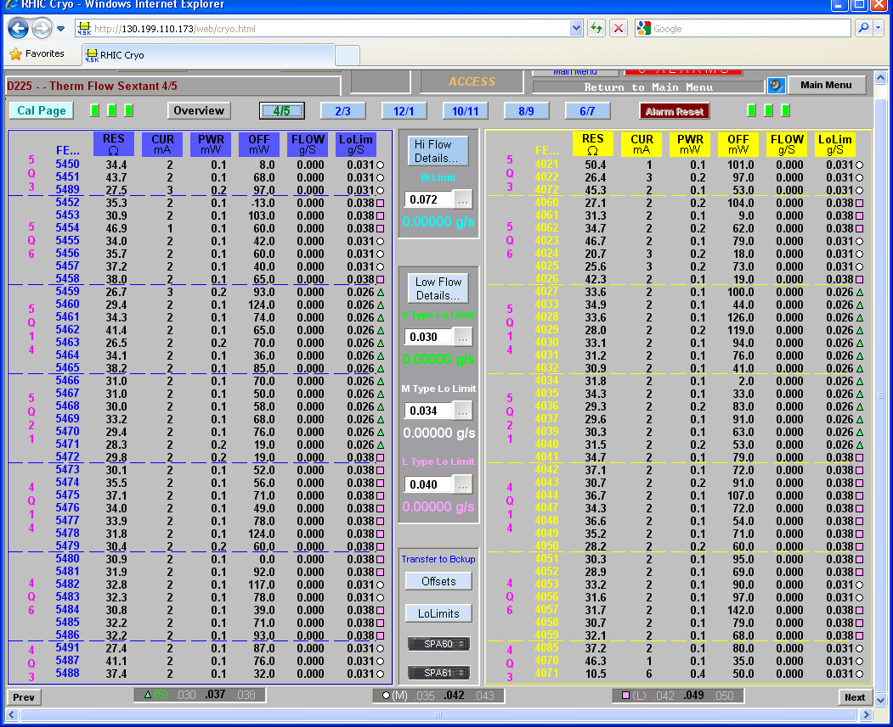
Lead flow + Correctors Flow controllers
High current leads:
144 thermal mass flow controllers.
Ramp with current
480 corrector flows thermistors flow meters,
Pre-set needle valve
Calibration at start of run as required
Quench Link Interlock

Slide 27
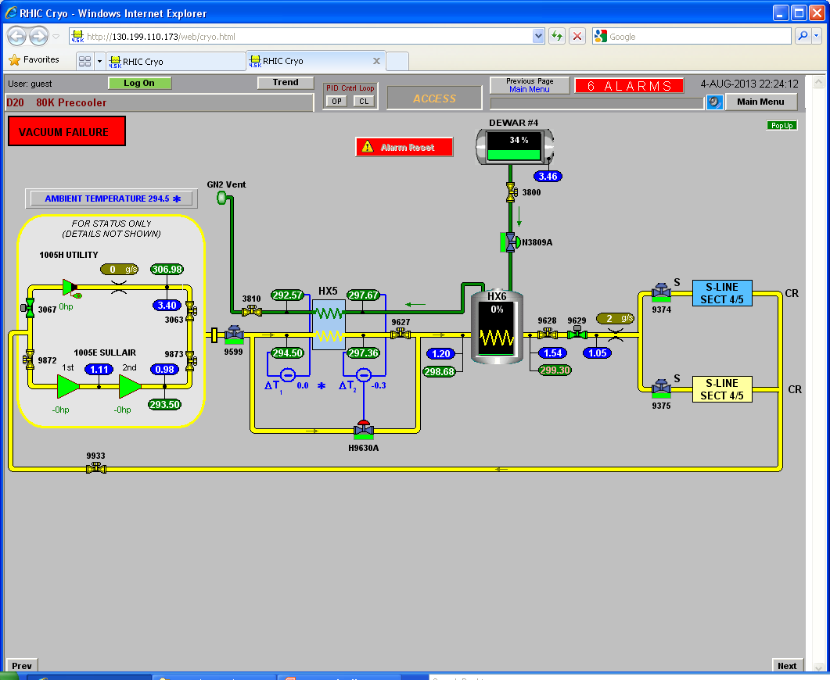
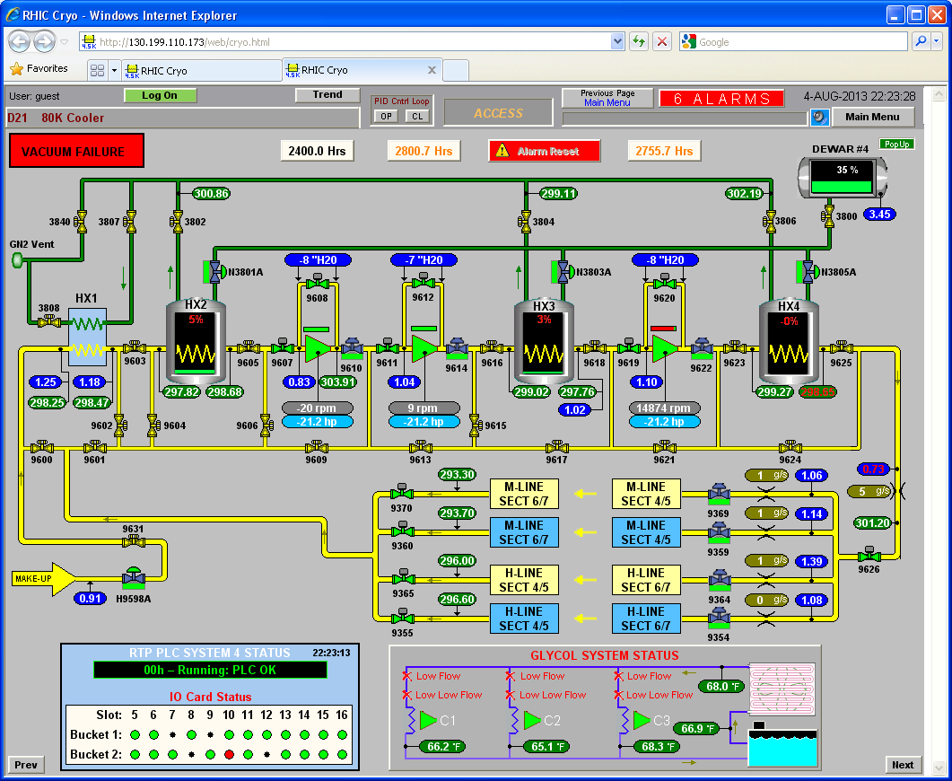
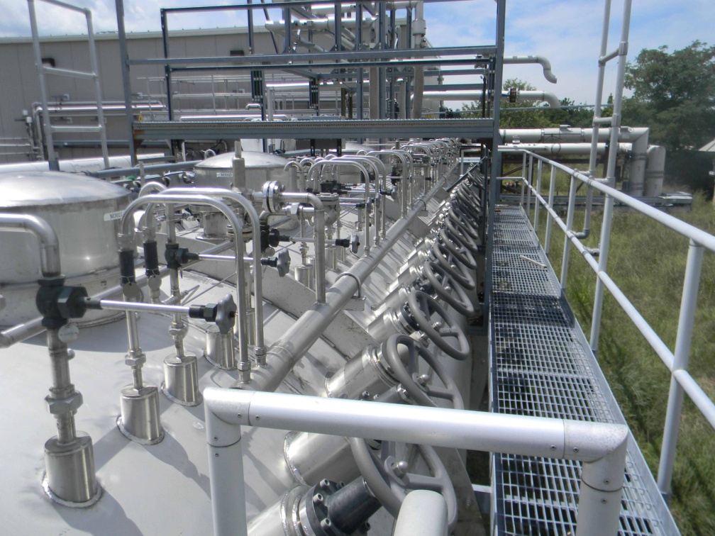
80K Cooler
LN2 cooled
80K cooldown supply for Collider cooldown
80K helium circulation loop
Centrifugal Barber-Nichols circulators
LN2 recoolers

Slide 28
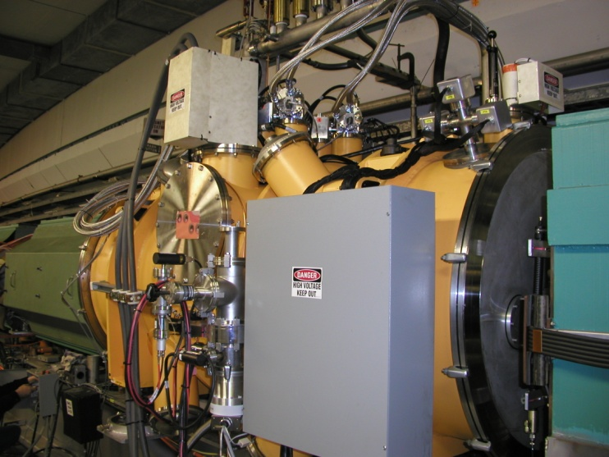
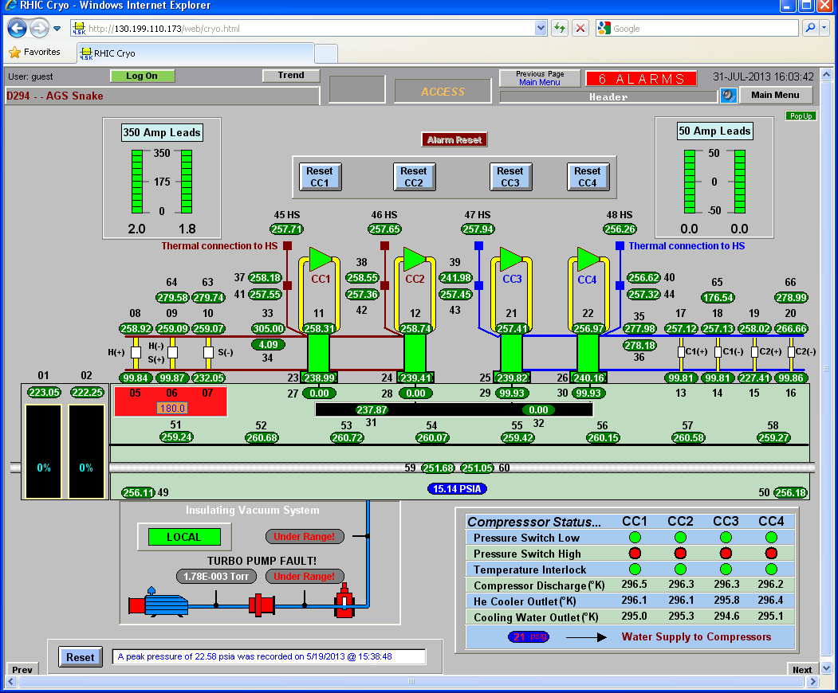
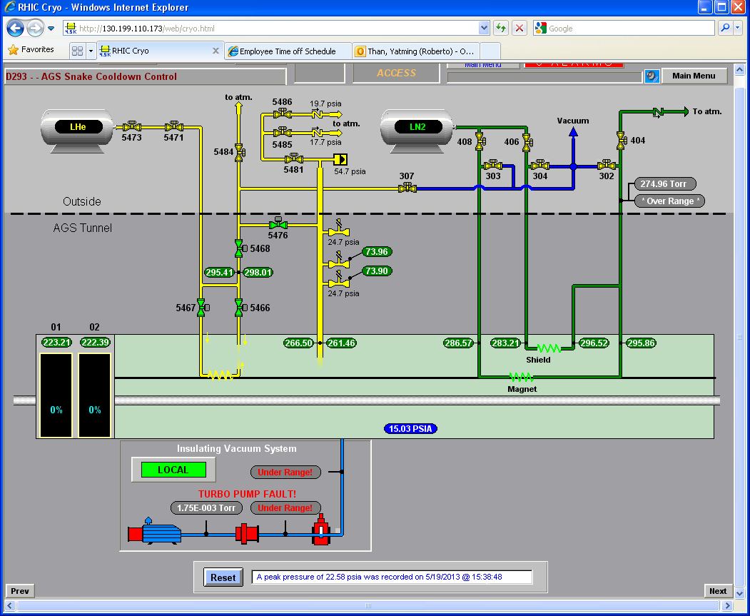
AGS Cold Snake
4 Cryocooler system: Coldhead & Compressor
LN2 precooling circuit
Instrumentation and Controls

Slide 29
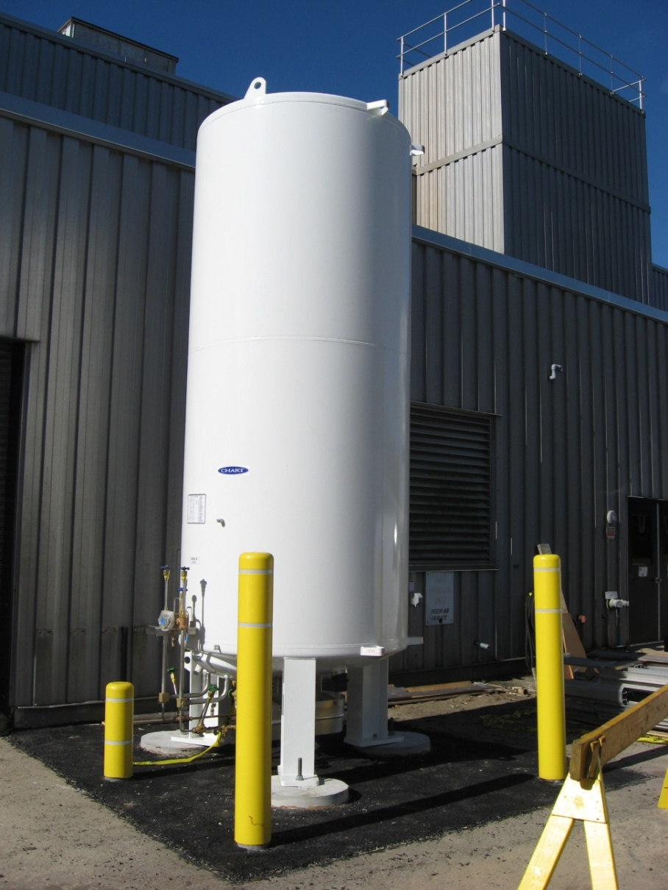
Bldg 930 LINAC LN2 Dewar Upgrade
Specification
Procurement
1500 Gallon Dewar
Ambient vaporizer
Installation of external piping
Reliefs

Slide 30
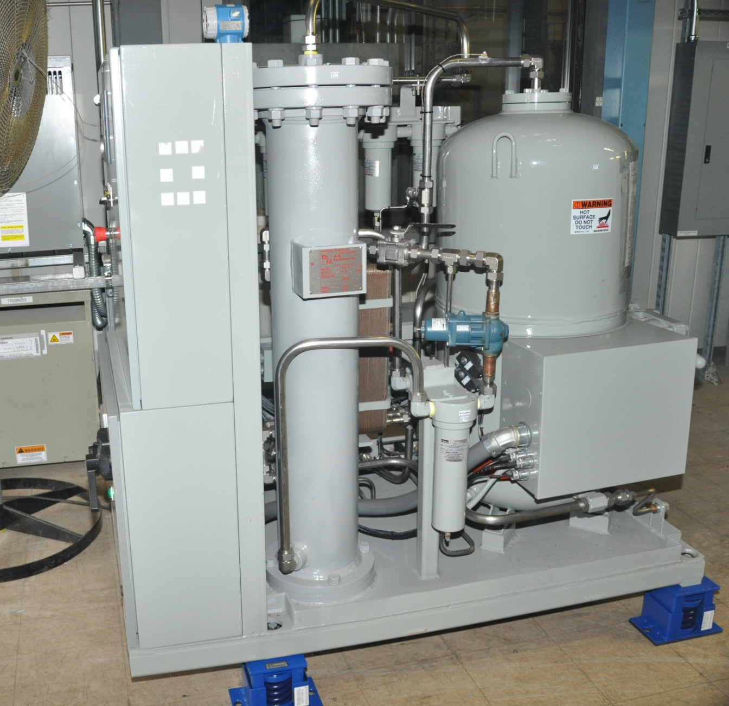
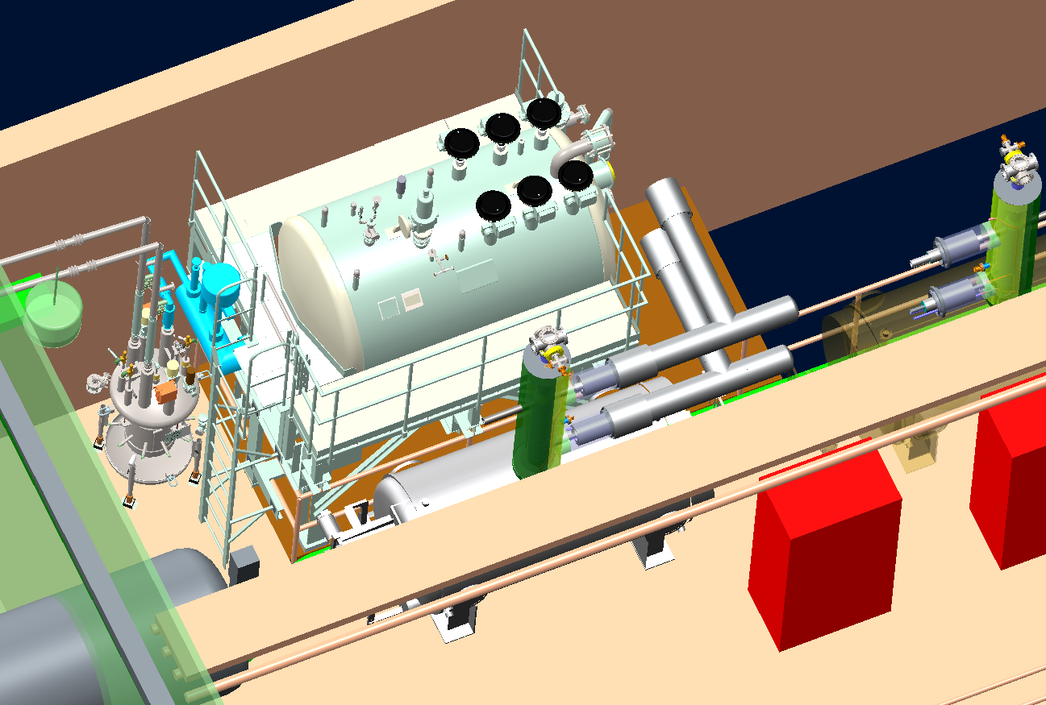
56MHz SRF Cryogenic System
56 MHz cavity Cryostat
4.5 Condenser Cryostat
RHIC Interface separator
Vacuum Jacketed piping system
Small helium compressor
Warm Piping

Slide 31
Cryogenics for E-lens SC Solenoids
4.5K Operation
Liquid helium Supply Tap from RHIC M line
Transfer line to solenoids
Return line to RHIC WR header
Relief discharge header
Provision for testing during shutdown with dewars

Slide 32
Cryogenics for E-lens:Tunnel View

Slide 33

Coherent Electron Cooling Experiment

Slide 34


CeC: 112 MHz Gun Cavity & Condenser Cryostat
Condenser Cryostat Supply system
112 MHz electron Gun

Slide 35

Coherent Electron Cooling Experiment

