Slide 1
Instrumentation
Michiko Minty

Slide 2
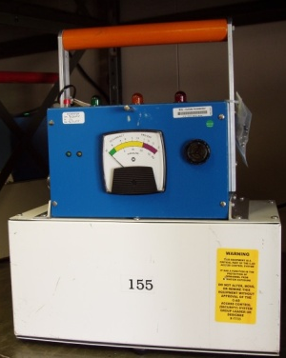
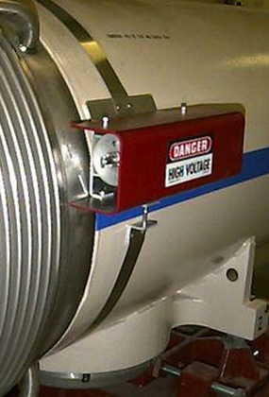
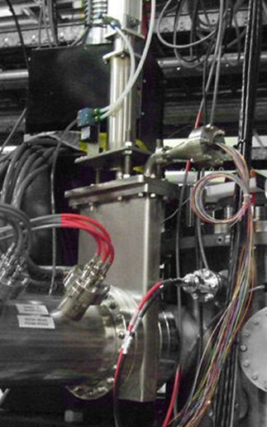
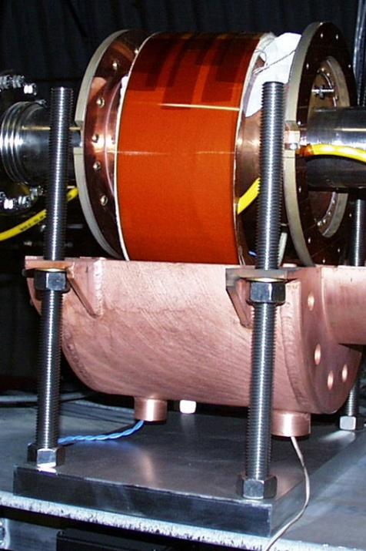
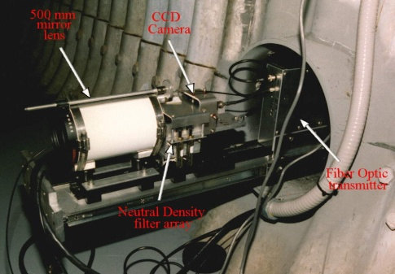
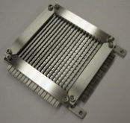
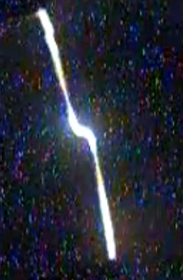
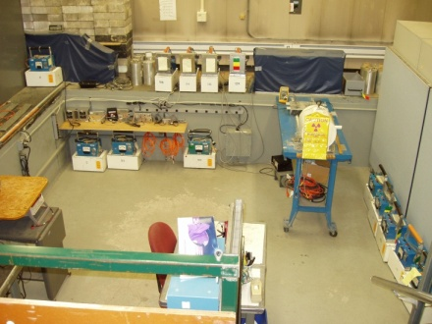
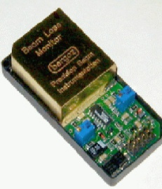
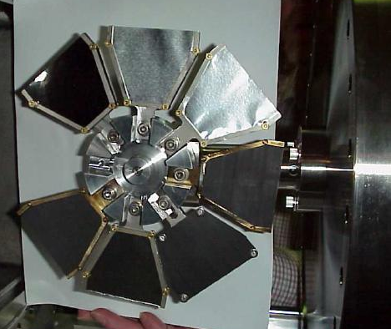
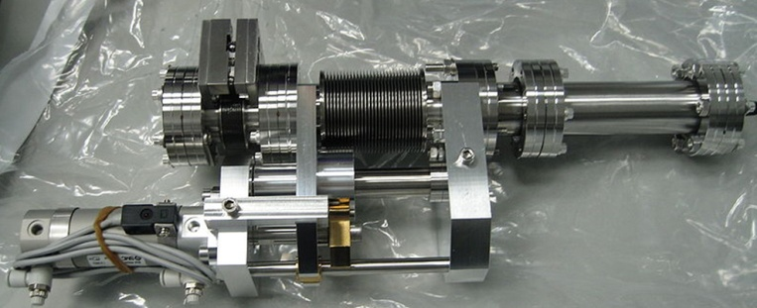
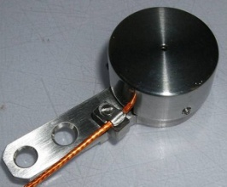
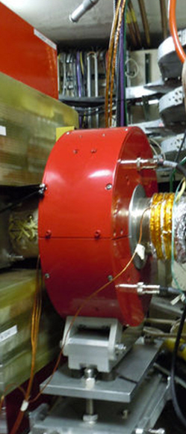
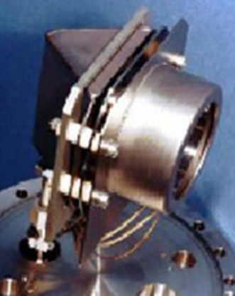
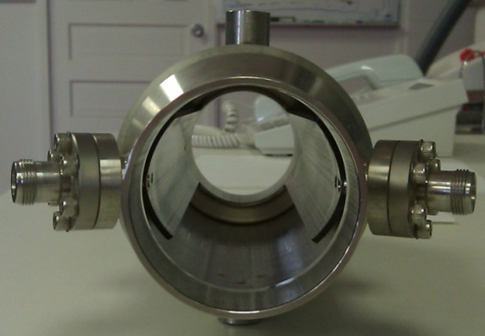
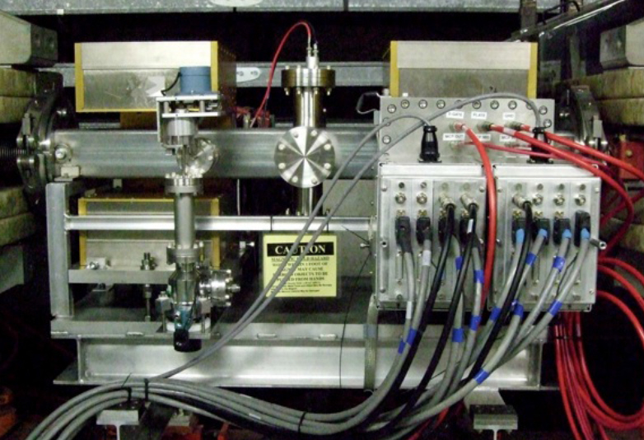
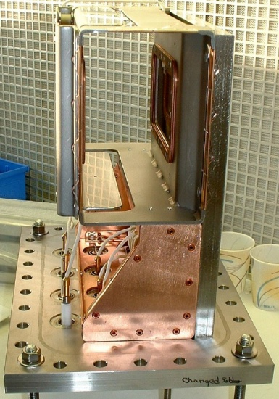
Instrumentation Systems - C-AD conventional diagnostics
19 scintillators
> 125 chipmunks
video imaging
>750 ionization
systems
chambers
18 wire arrays
9 wall current
>60 pin
monitors
diode
monitors
chipmunk calibration pit
pin hole detector
6 stripping foil assemblies
pepperpot
7 ionization
profile
monitors
680 BPMs
(>920 planes)
23 current
7 Faraday cups
transformers
diverse suite of diagnostics - each with distinct characteristics, qualities, and components

Slide 3
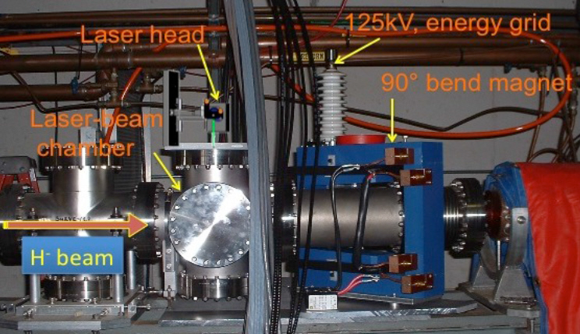
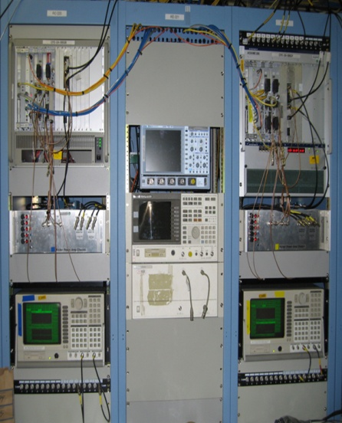
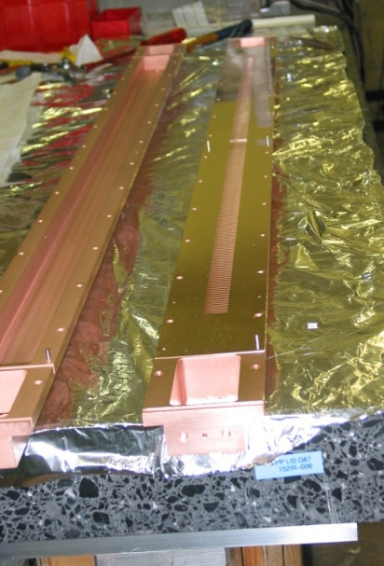
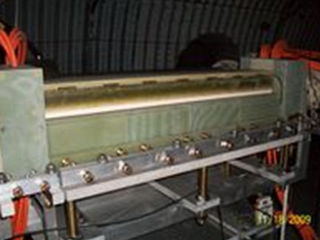
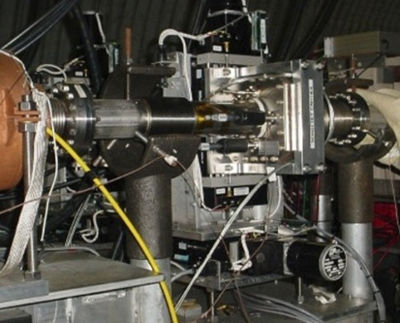
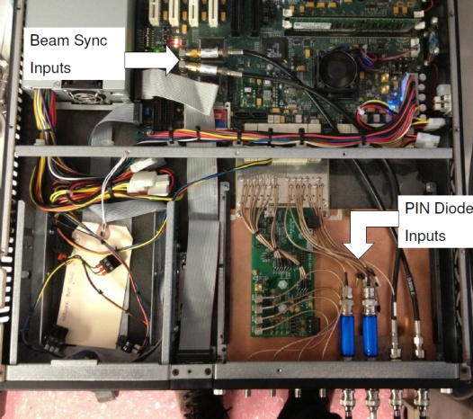
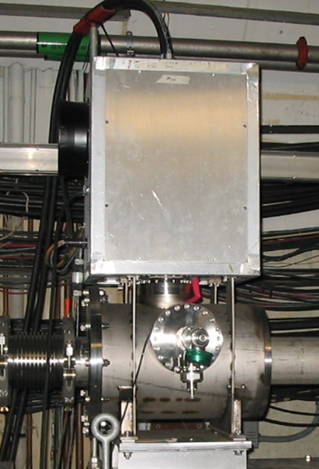
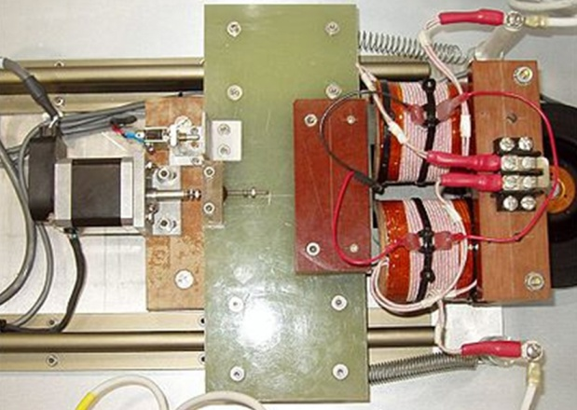
Instrumentation Systems - C-AD specialty diagnostics
LINAC laser
RHIC travelling wave
RHIC BBQ / BTF
profile monitor
RHIC spin flipper
RHIC HF Schottky
RHIC bunch-by-bunch
beam loss
position
coherence
luminosity
AGS tune meter
and damper
unique diagnostics

Slide 4
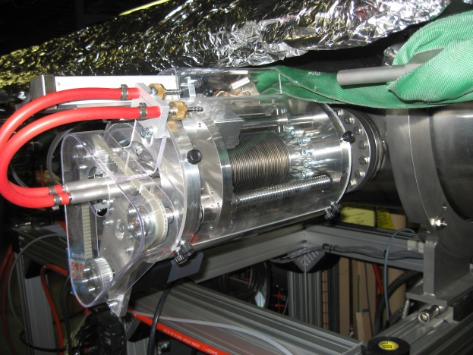
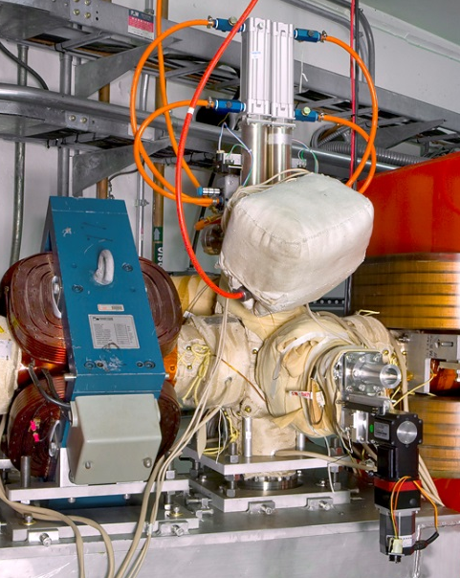
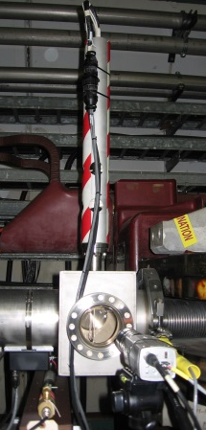
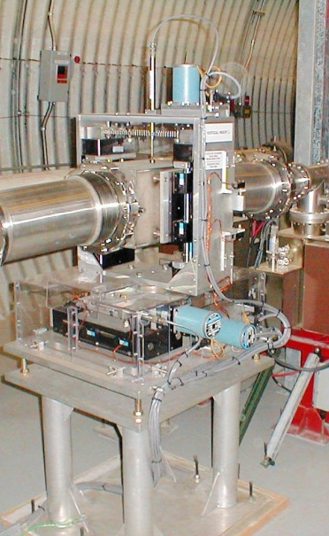
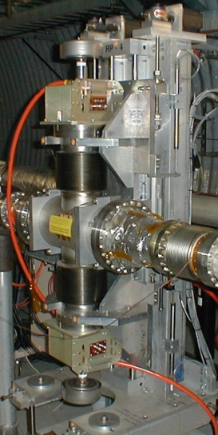
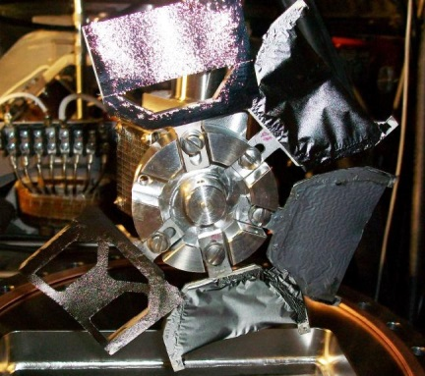
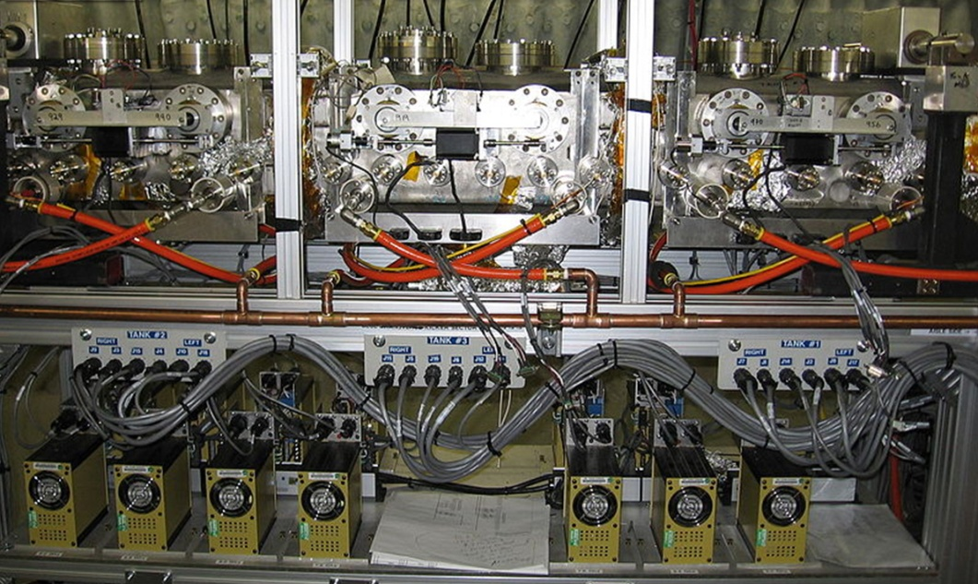
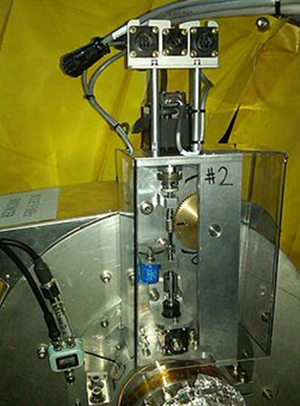
Instrumentation Systems - C-AD Motion Control
>300 axis of motion including steppers, AC and DC motors, pneumatic, piezo, linear servo and solenoids
EBIS RFQ tuner
EBIS Harp & Collimator
AGS jump target
RHIC Collimator
RHIC roman pot
Booster
stripping foil
RHIC stochastic cooling longitudinal kicker
RHIC RF
operations-critical, diverse

Slide 5
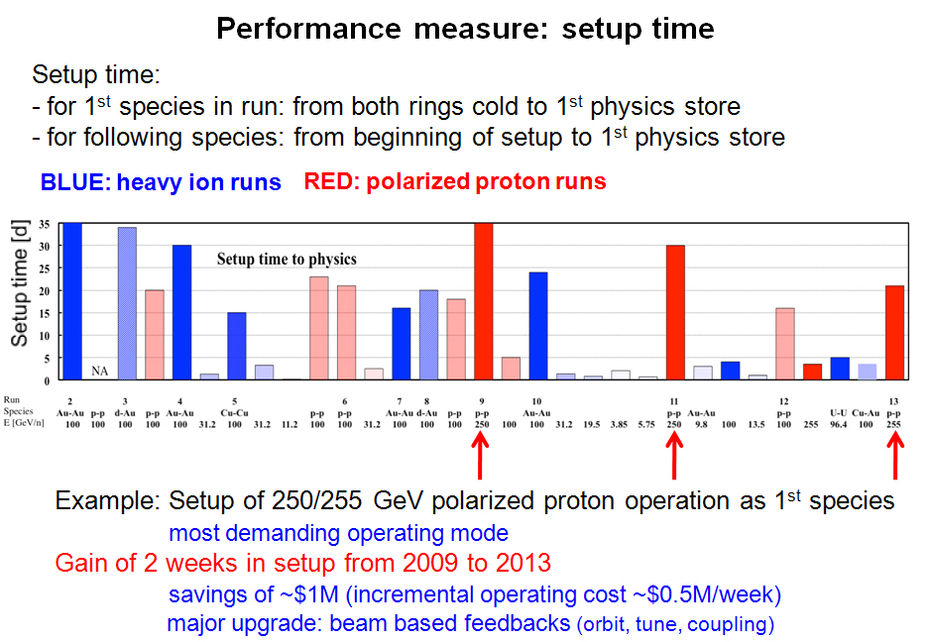
Instrumentation Systems: beam-based feedback
from W. Fischer “outlook on Run-14 and beyond”, RHIC Retreat closeout (07/31/13):

Slide 6
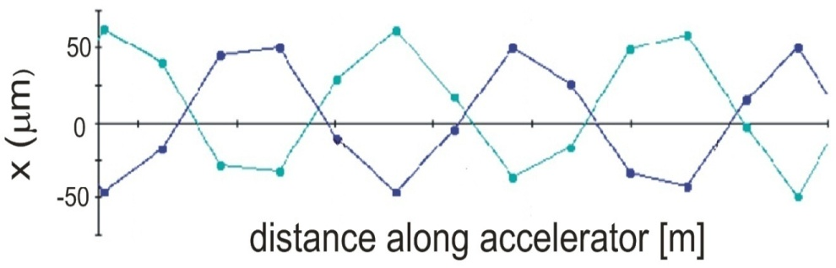
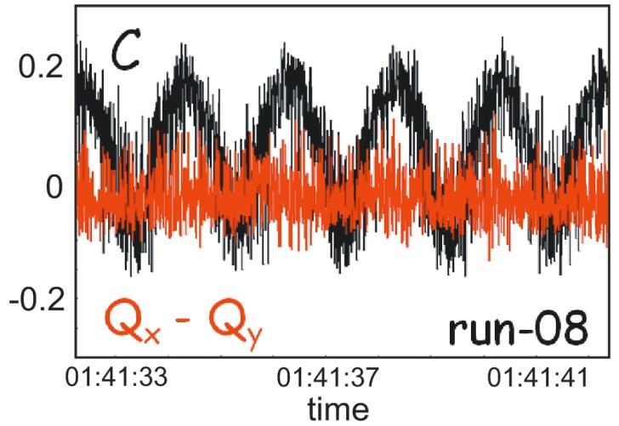
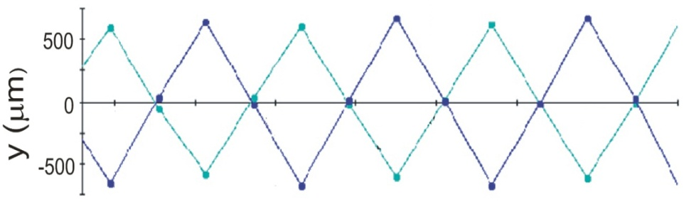
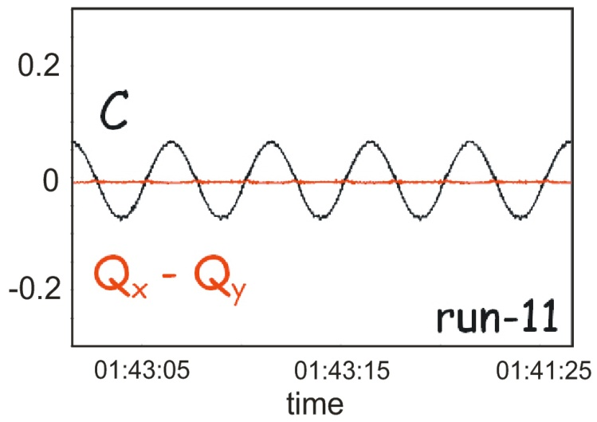
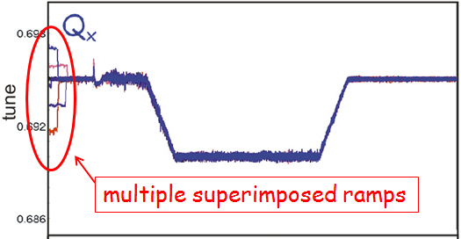
Instrumentation Systems: measurement precision
orbits
coupling
400 m
resolution < 5 um (~ 15 um for turn-by-turn)
tunes
resolution ~ 1E-3
resolution ~ 1E-6
improved resolution allowed for beam-based feedback control of critical parameters

Slide 7
Instrumentation Systems - beam-based feedback history
type of
feedback
proof of
principle
application
during all ramp
developments
application to
all ramps before
declaring physics
fully
operational
application
for all ramps
tune/coupling
2006
2009
2010
2011
> 2011
orbit
2010
2011
2011
2011
> 2011
xmean
2011
2011
2011
2011
> 2011
10 Hz
2010, prototype
2011, full systems
2012
2012
2012
2012
tunes corrected and stable to ~ 1E-3 factor 100 improvement
coupling ….. ~ 1E-2 …. 10
orbits ….. ~ 20 um .…. 50
energy ….. ~ 1E-6
Precision measurement and control of the beam’s parameters have resulted in improved
operational efficiency (~ 1 week/running period), in highly reproducible operating conditions
and in improved performance (i.e. higher polarization)

Slide 8
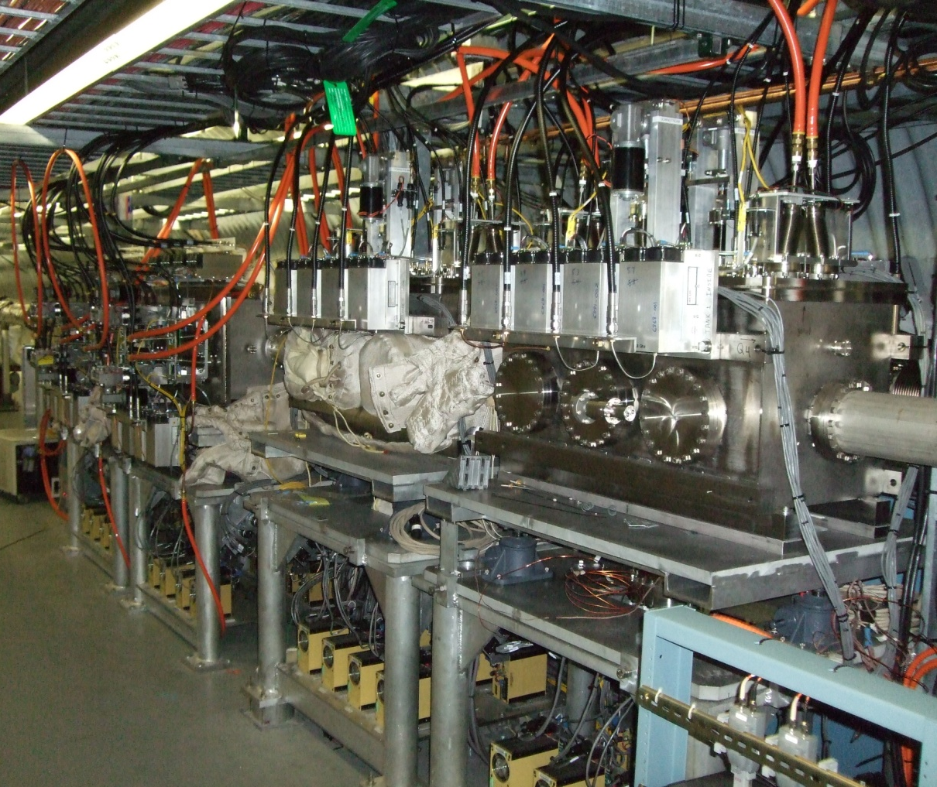
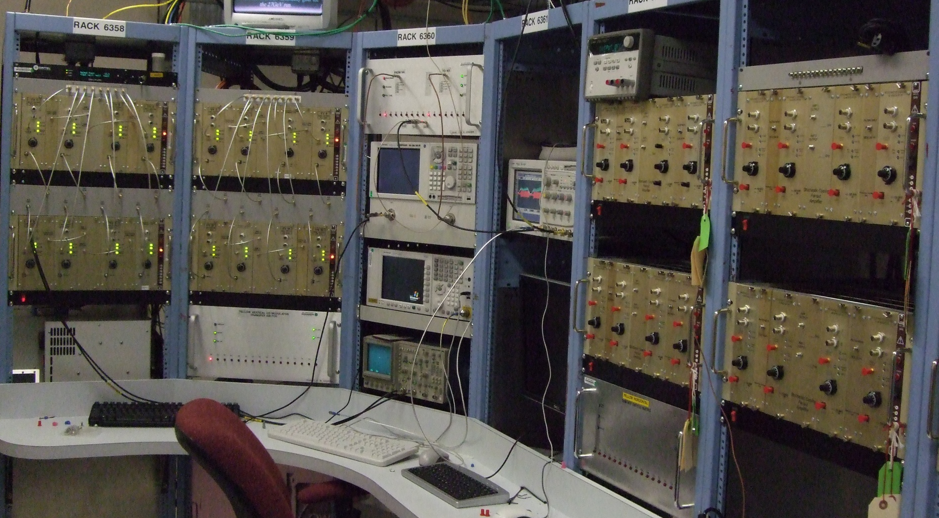
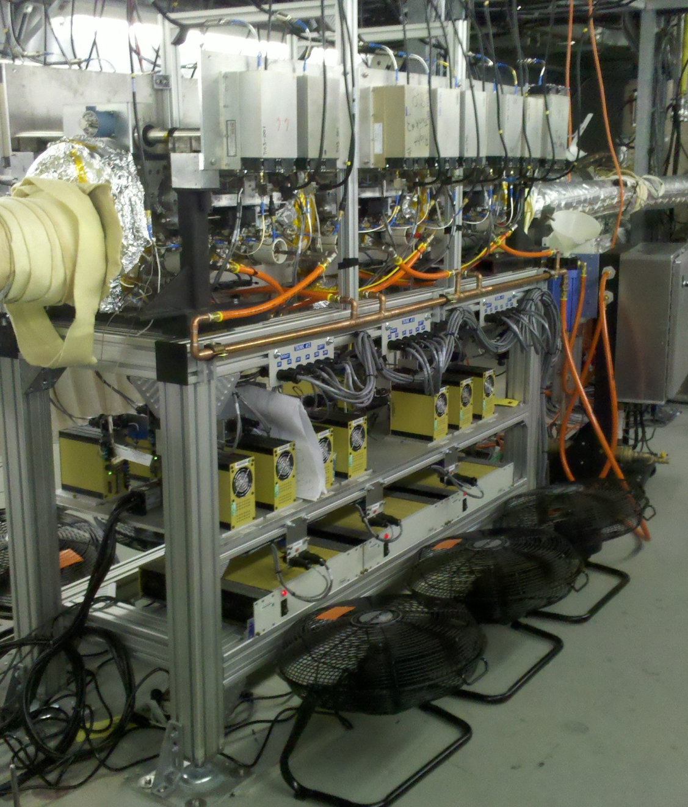
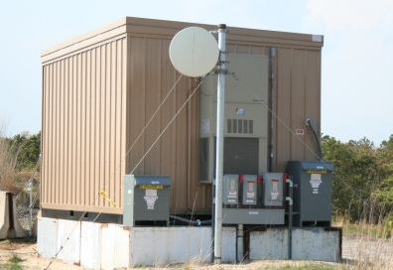
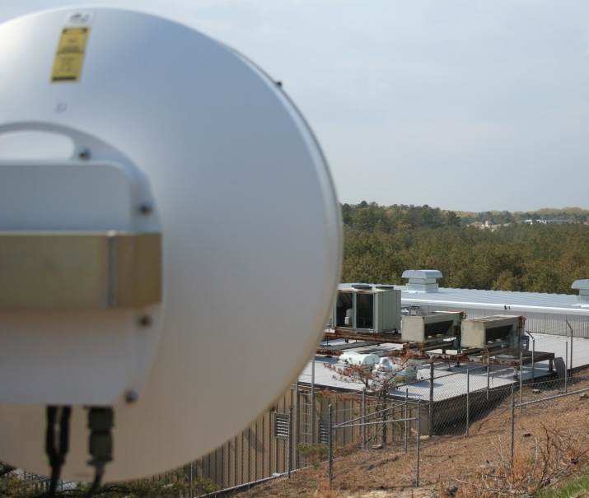
Instrumentation Systems – stochastic cooling
operational responsibility transferred to our group in 2010
Fanout
Amp (x4)
EDFA
(optical amp)
NA switch
Filter (x8)
Network
Analyzer
Spectrum
Analyzer
I/Q (x16)
BTF switch
Blue Horizontal & Vertical Kicker Installation
Yellow Vertical & Horizontal LLRF Electronics
Blue Longitudinal Kicker Installation
Yellow Longitudinal Microwave Link

Slide 9
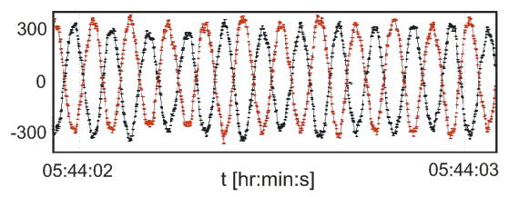
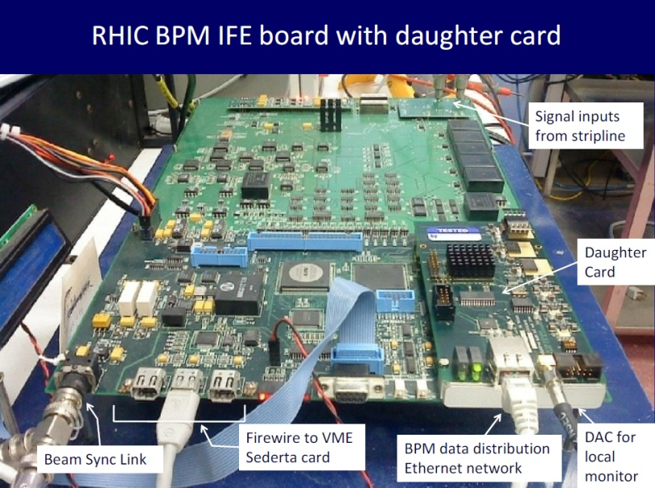
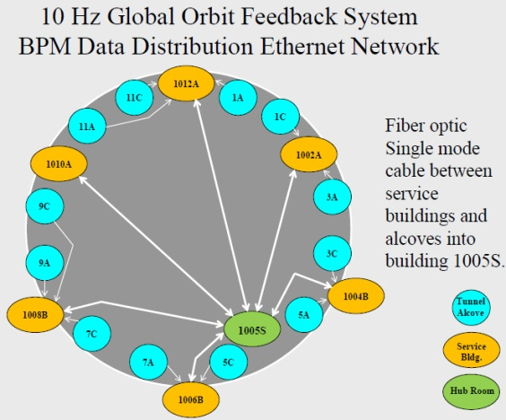
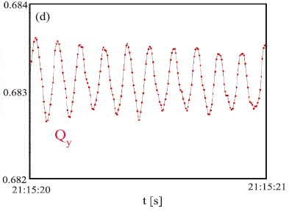
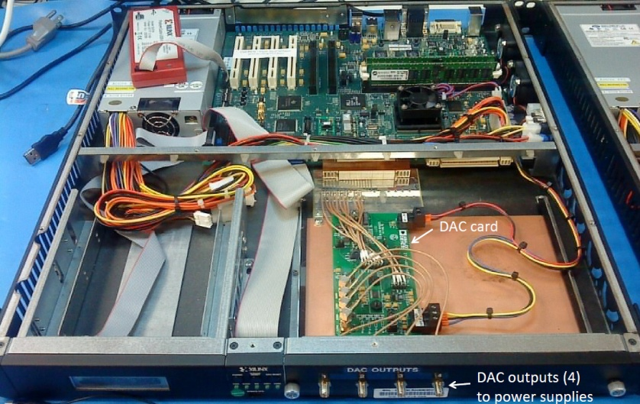
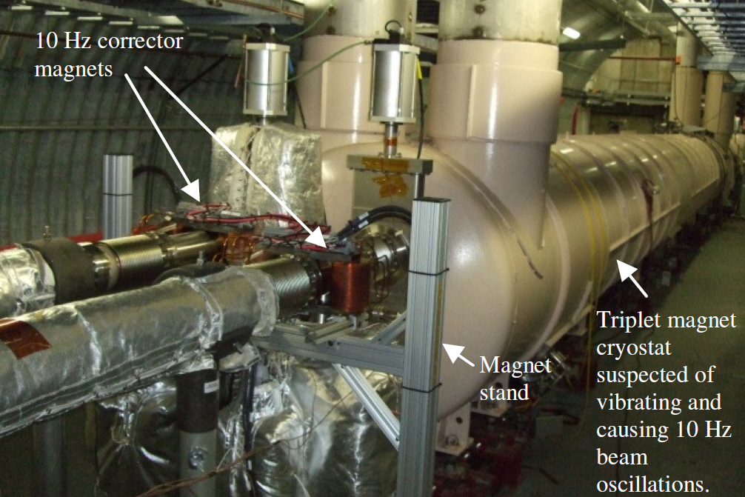


Instrumentation Systems – 10 Hz feedback
front-to-end design (with support from other groups)
72 new BPM daughter cards
dedicated fiber optic network with
position
(μm)
high speed Gigabit Ethernet for
data delivery at 10 kHz
tune
run-9
time (1s full scale)
6 Xilinx ML-510 (FPGA) with new DACs
24 new corrector dipoles
Luminosity at
STAR and PHENIX
ON
OFF
time

Slide 10










Instrumentation Systems – Electron Lenses
Instrumentation Systems – Electron Lens
imaged cathode
strongback after assembly after transport
YAG and pinhole profiles
scrapers and pinhole
instrument holder
particle studio and spice simulations for E-Lens BPM
backscatter detector
BPM
collector

Slide 11






Instrumentation Systems – high level applications
(Based on new methods for automated data acquisition using also feedback to ensure good conditions and reproducibility)
9 o’clock snake
ONLINE ORBIT FIT - reveals model imperfections
COUPLING CORRECTION - local and global methods independent
Blue Ring horizontal
Blue Ring vertical
beta functions (m)
Time during acceleration (s)
RAMP OPTICS MEASUREMENTS
OPTICS CORRECTION
developments of beam control apps leveraging off of improved instrumental resolution

Slide 12
Instrumentation
FY2010 FY2011 FY2012 FY2013

