Slide 1
Mechanical Systems
Joe Tuozzolo

Slide 2
Mechanical Engineering and Design 18036
Mechanical Engineering and Design Support
RHIC Technical Support Group (shared with SRF Group).
High level thermal, stress, magnetic, and fluid calculations using ANSYS (w/CFX), MECHANICA, and FLUENT computer.
Detailed component and mechanical systems design.
Fabrication and component procurement support: specifications, build to print, sow, project engineering, and scheduling.
Detailed modeling and fabrication drawings using Pro-E and AutoCAD inventor 3D.
Design and calculation Control Center upgraded to Windchill for approved drawings, engineering calculations, design reviews, QA, ASME welding, and approvals for use.
Equipment engineering liaison repair and upgrades.

Slide 3
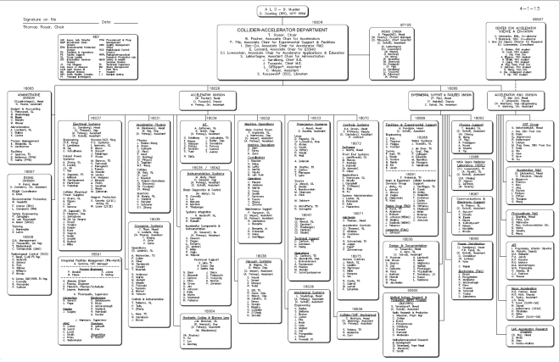
Mechanical Engineering and Design 18036 33+ staff (15+ Matrixed out to other projects/accounts)
Mechanical Engineering: 12 Engineers + Supervisor
Design and Documentation: 18 Design/Drafters (9 Mechanical) + Supervisor + 2 DCC
Collider/SRF Mechanical: 3 Technicians + Supervisor
Chief Mechanical Engineer

Slide 4
Mechanical Engineering and Design 18036
4 Supervisors (1 added 2011), 2 Documentation Control (1 added 2012)
Major Projects - Engineering and Design Support:
eLens: 2011/2012: C-AD 2.5 + AM 2.5
56 MHz: C-AD 3 + VTF: .75
EBIS: C-AD 3 (Commissioning, additions, EBIS spare solenoid)
RHIC 2013 Projects: AGS IPM’s, Siemens Mechanical Support, RHIC transverse damper, RHIC Kicker Magnets, RHIC Compressor Maintenance, DX Magnet Move, LINAC Laser Ion Source
RHIC 2012 Projects: RHIC ODH analysis/relief modifications, 9 MHz Cavity Upgrade, RHIC IPM’s, Siemens Mechanical Support, AGS Jump Targets, RHIC Cryogenic Compressors, RHIC Beam Dump Analysis, AGS ACS upgrade

Slide 5
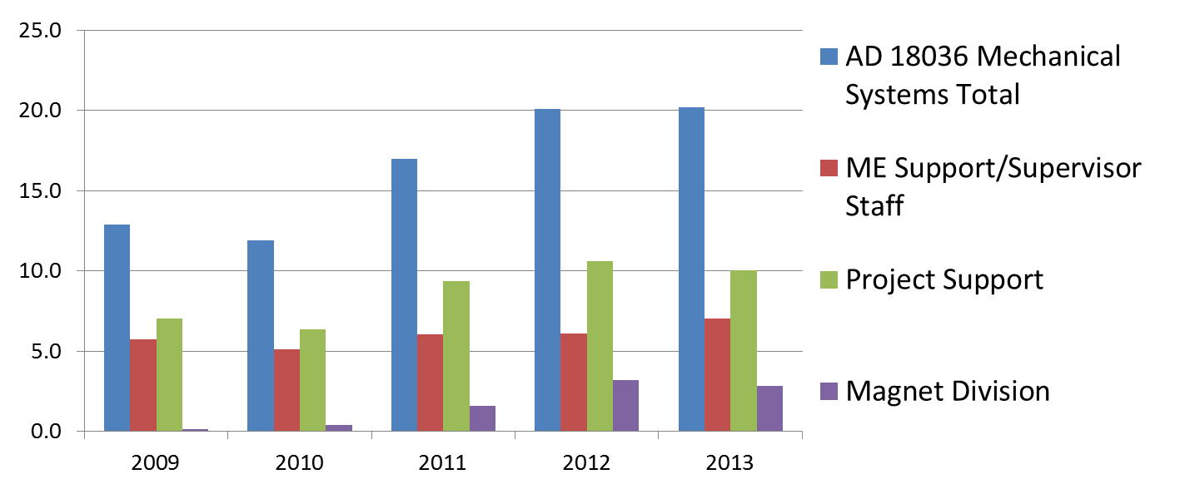
Mechanical Engineering and Design 18036
Overall year by year broken out by:
Mechanical Engineering Group Supervisors and DCC Staff
RHIC Accelerator Systems project support other than those supported by specific project accounts.
Magnet Division project support charged to 18036
FTE’s

Slide 6
Mechanical Systems

Slide 7
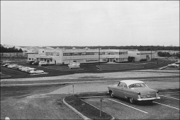

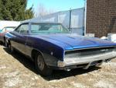





RHIC Facilities Commission Dates (lots of maintenance, repair, and upgrade work, following slides)
AGS (1960)
AGS Power Supply Upgrade (1970)
200 MeV Linac (1970)
AGS Upgrade & Booster (1986-1991)
AGS to RHIC Transfer Line (1968 – 1999)
RHIC He Refrigerator (1980)
RHIC (2000)

Slide 8
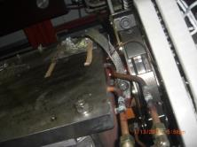
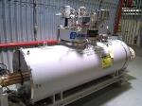
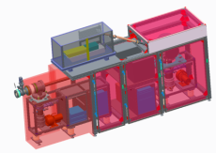
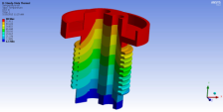
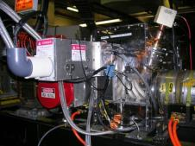
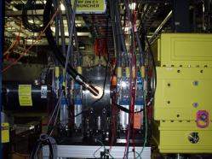
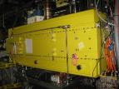
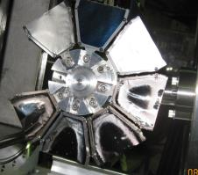
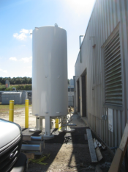
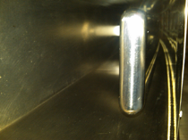
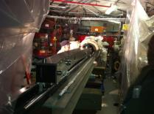
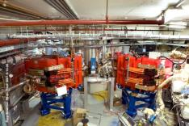
LINAC and Booster
LINAC/EBIS
New Laser Profile Monitor for BLIP
Source and LEBT/MEBT upgrade programs
Booster Foil Changer
LN2 supply system upgrade
Booster
Modifications and Installation for EBIS
HI Inflector modification
Extraction septum repair

Slide 9
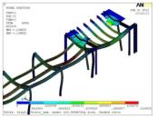
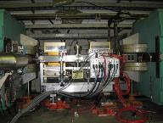
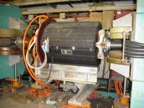
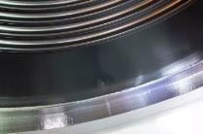
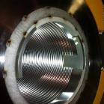
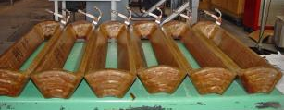

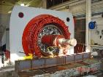
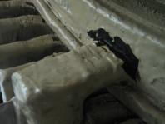
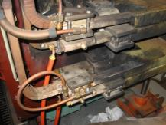
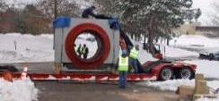
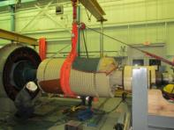

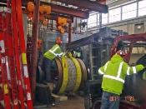
AGS
Last major upgrades to vacuum system, injection system, and RF occurred 1988 to 1992.
Siemens (1970) and Westinghouse (1960) PS require constant maintenance – Siemens slip ring repair/Westinghouse motor maintenance.
Au beam vacuum chamber drill
New sextupole coils and magnet repair
Upgrade AGS IPM’s.

Slide 10

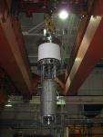
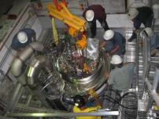
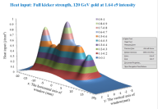
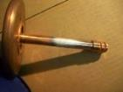
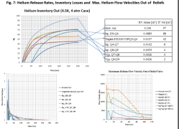
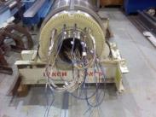
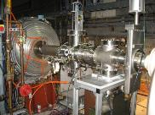
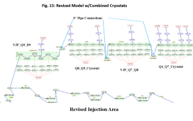
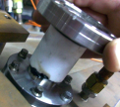
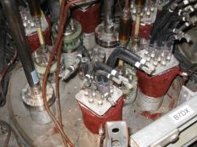
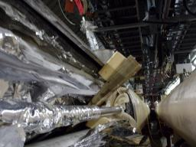
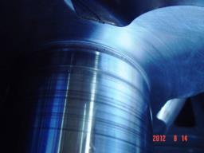
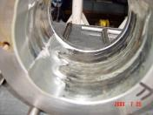
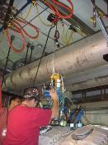
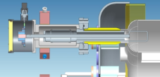
RHIC
Valve box lead feedthroughs repairs
RHIC ODH recalculations and remediation
eLens support
56 MHz support + Vertical Test Facility
RHIC Beam Dump & Kicker
Yellow Snake Magnet Repair
RF Utility Crane
Triplet vibration magnets.

Slide 11
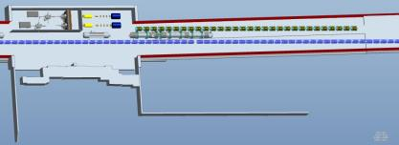
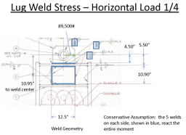
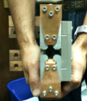
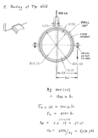

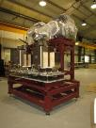
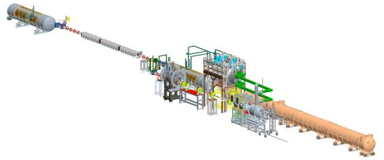
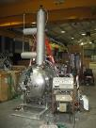







R&D support
CeC PoP
ERL
eRHIC

