Slide 1
Pre-Injectors
Jim Alessi

Slide 2
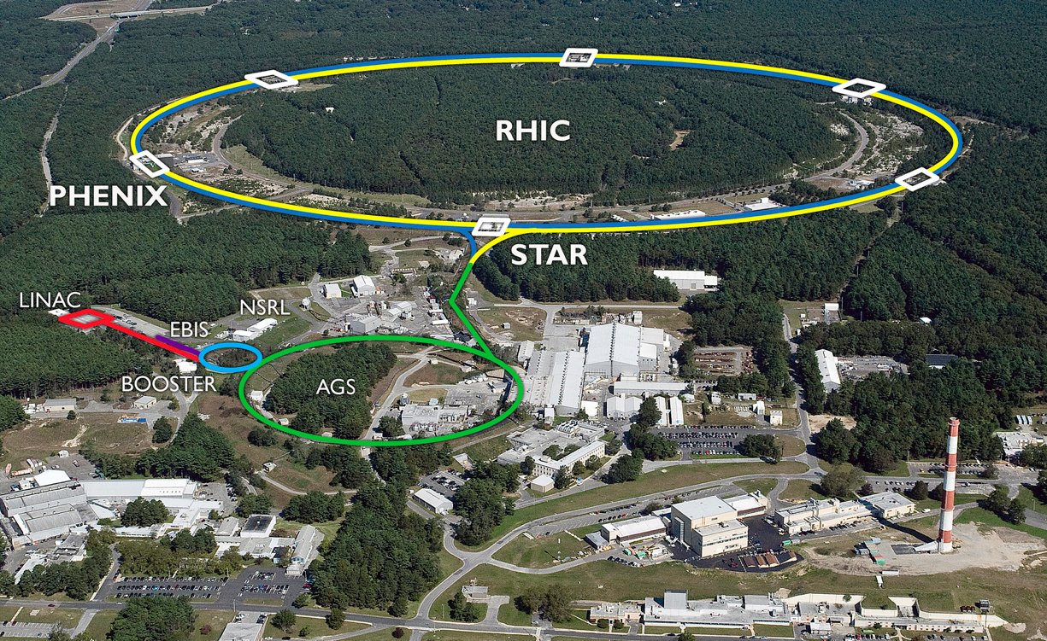
Preinjectors –ion sources and initial acceleration for all beams used for RHIC, BLIP, and NSRL

Slide 3
Preinjector Systems
200 MeV H- Linac
  Polarized H- for RHIC
    200 MeV; mA’s
  H- for Brookhaven Linac Isotope Producer (BLIP)
    66-200 MeV; >40 mA peak, up to 130 μA average
EBIS Preinjector
  Helium to Uranium ions for RHIC and NASA Space Radiation Laboratory (NSRL)
  1 second switching between species for simultaneous operation
Two 14 MV Tandem Van de Graaff’s
  No longer used for RHIC
  Outside user program for electronics testing, micropore filter production (medical/biological), etc.
Other
  RHIC Polarimeter support
  Laser Ion Source
    1+ for EBIS and high charge state for medical applications, etc.
  EBIS-related R&D
    Polarized He-3 for RHIC
    Improved electron gun (CERN collaboration)
    Charge breeder (ANL collaboration)
    eLen – electron gun & collector design; component testing on Test EBIS
  Plasma-related applications
    Plasma windows, plasma lenses, in-situ copper coating of RHIC beampipe, etc.

Slide 4
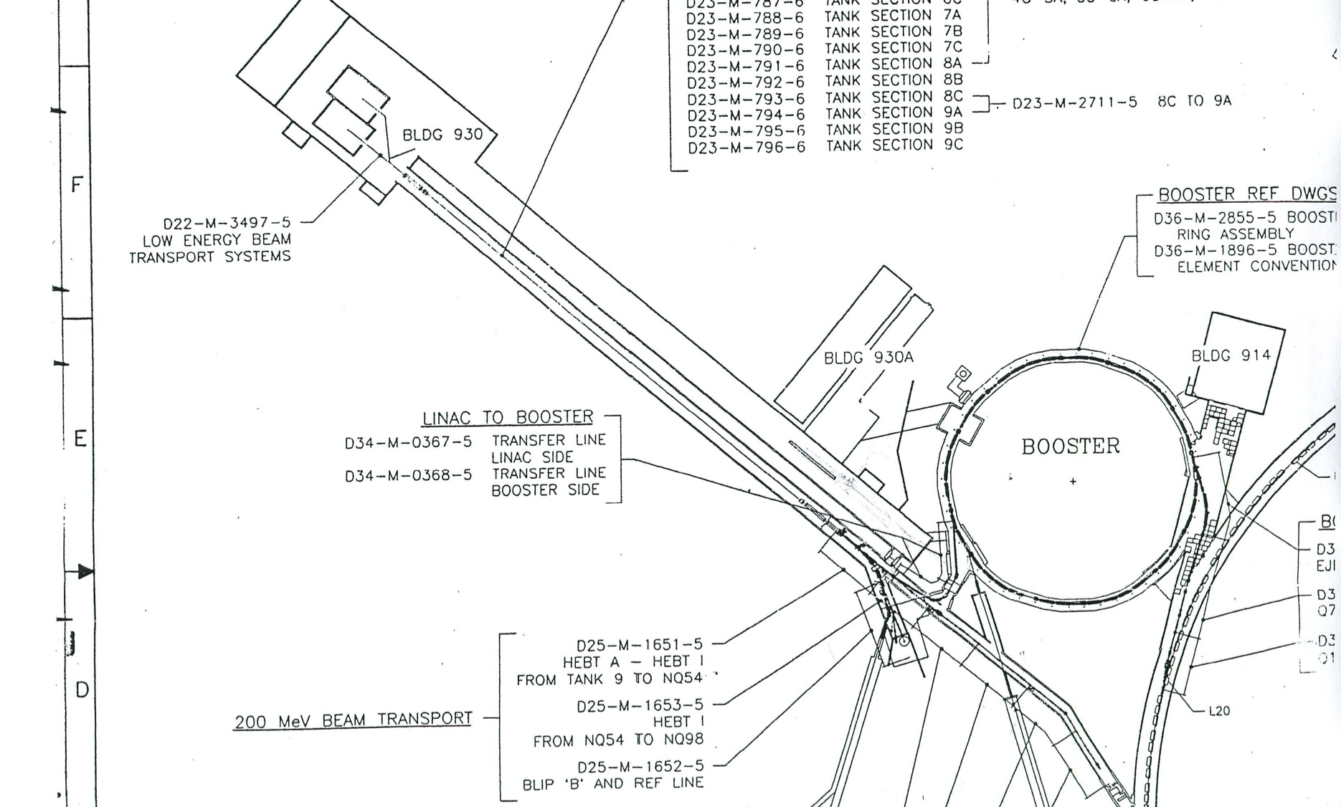
Sources, accelerators, and transport lines included:
H- and Polarized H- sources
RFQ and buncher
EBIS, 1+ sources, RFQ, IH Linac, 3 bunchers, heavy ion transfer to Booster
200 MeV linac, 475’, 9 rf cavities & rf systems, 286 drift tubes & quads, 143 quad ps’s
H- transfer line to Booster
H- transfer line to BLIP
~300’ transfer line; polarimeter, energy measurement
Nature of preinjectors – always the first things on and the last things off

Slide 5
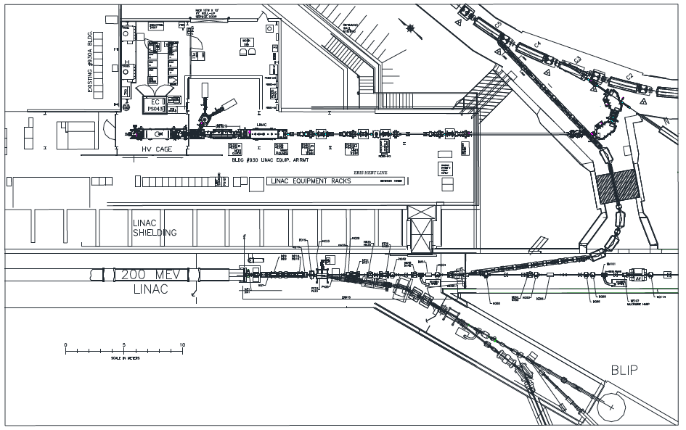
Booster
EBIS
LINAC
Transport to polarimeter
BLIP

Slide 6
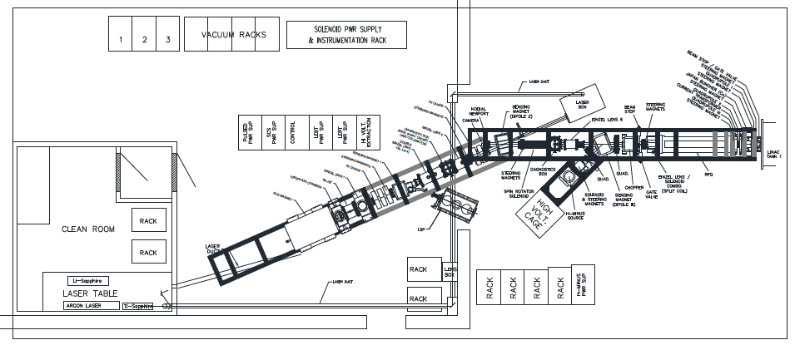
Front end of 200 MeV Linac
RFQ
Magnetron H- source
Polarized H- source

Slide 7
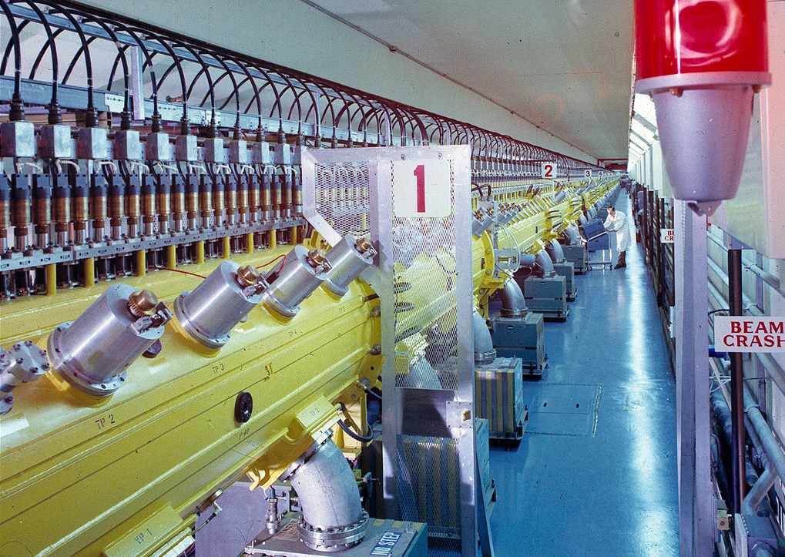
200 MeV Linac – 9 cavities, 150 m long, 286 drift tubes/quads

Slide 8
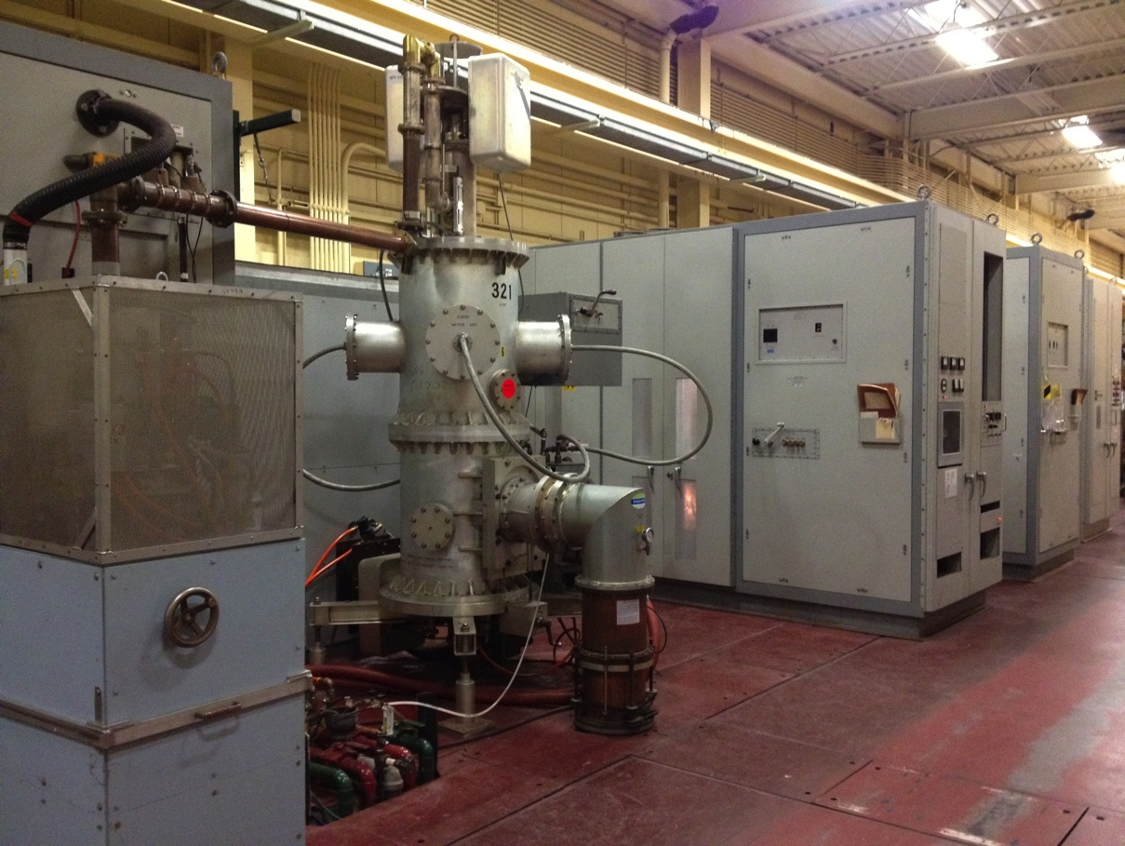
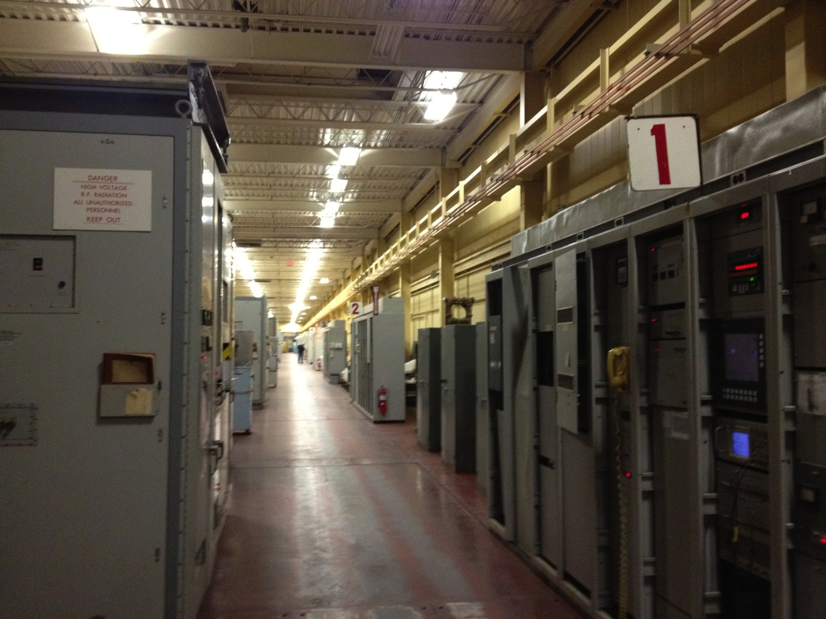
Linac rf systems (9) – 200 MHz, 5 MW peak power

Slide 9
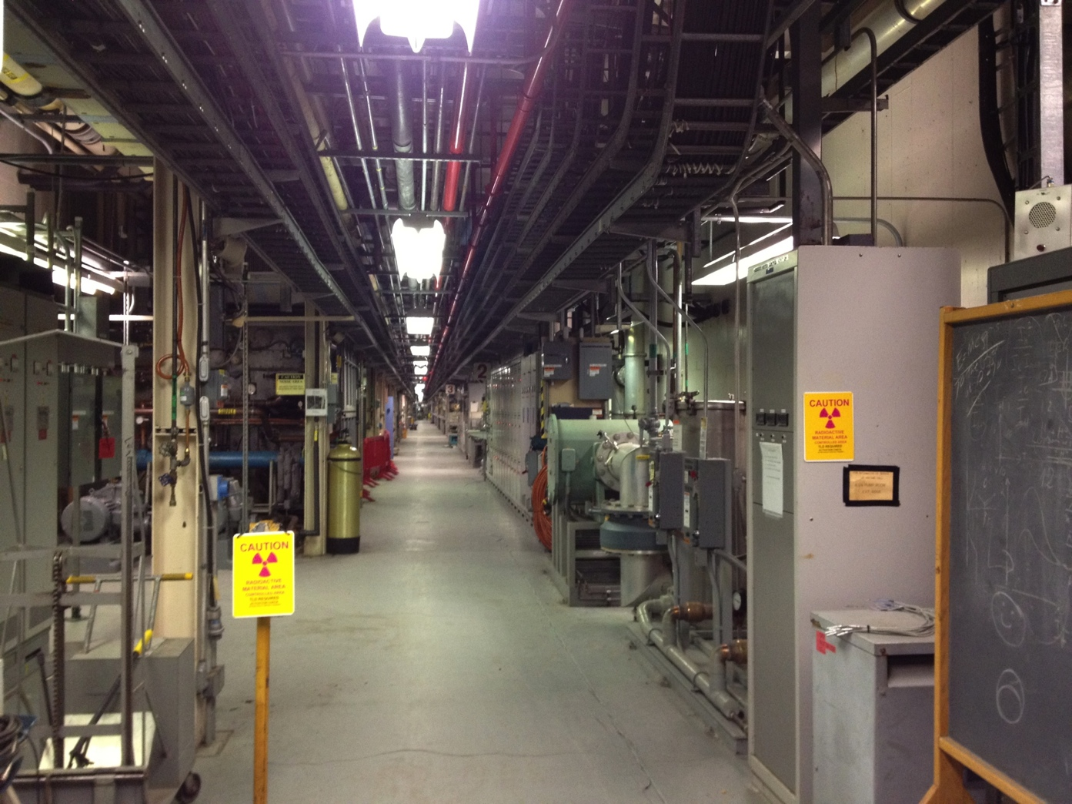
Lower equipment bay – tank drift tube pulsed quad ps’s, vacuum systems, transport line magnet ps’s, water systems, high power coax splitters, etc.

Slide 10
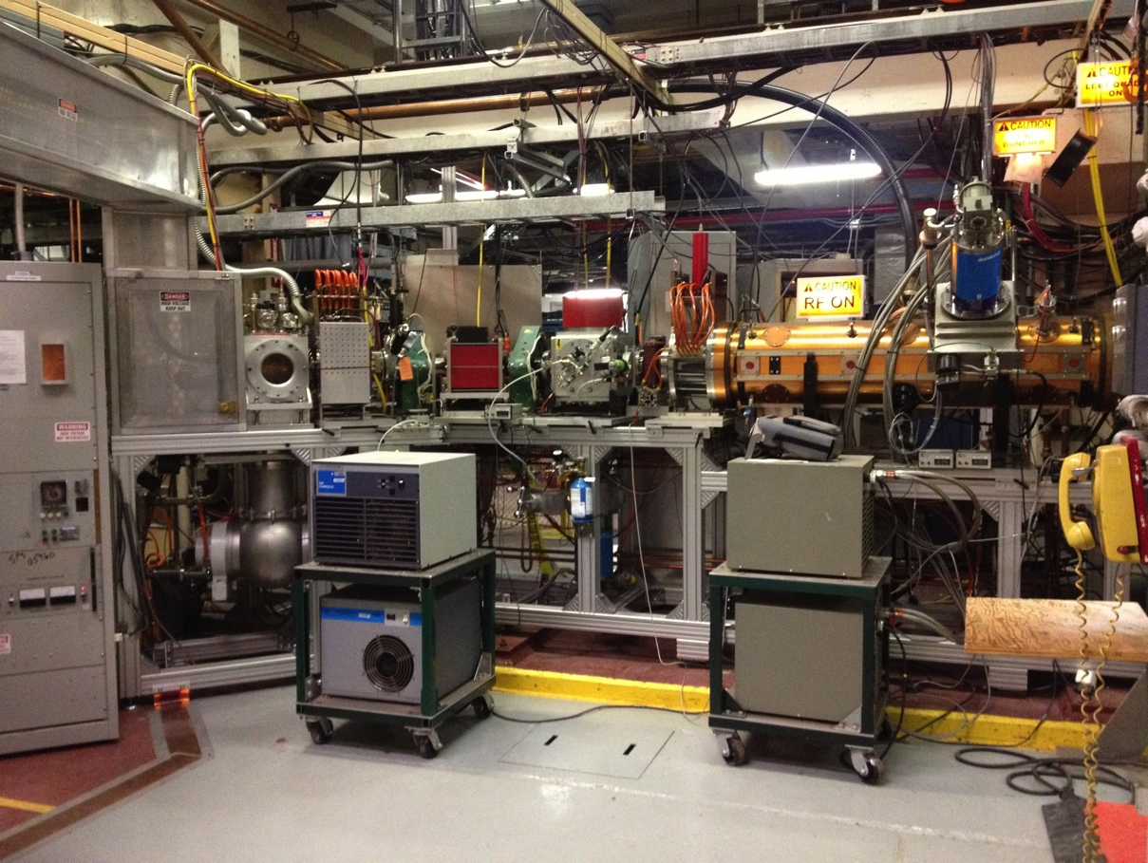
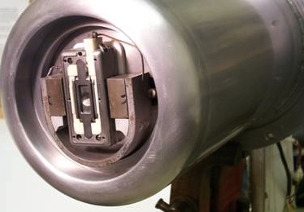
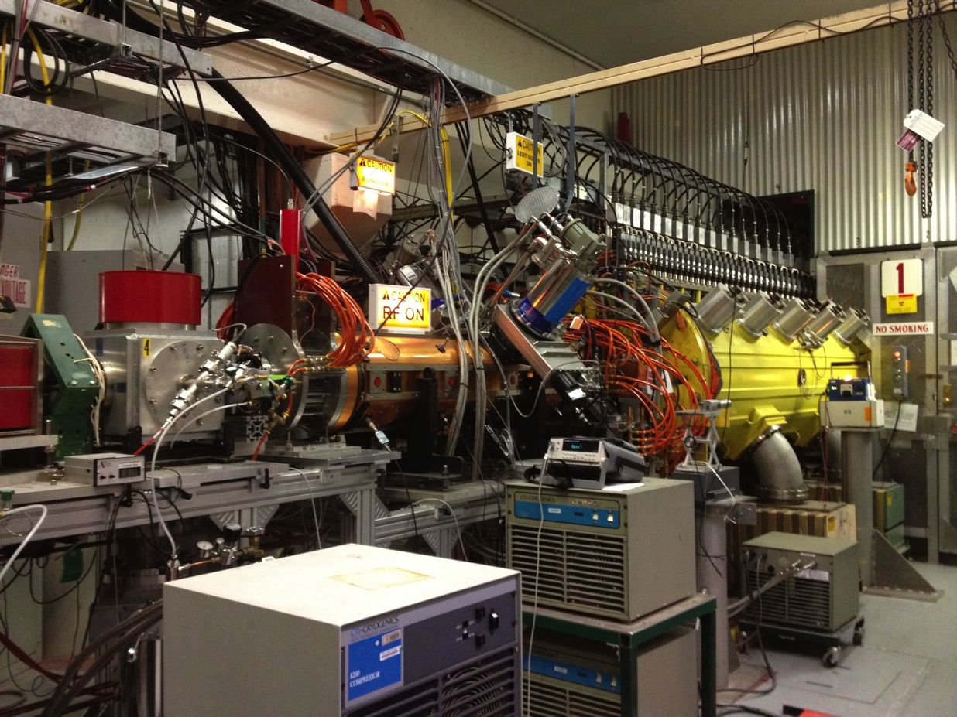
H- ion source, ~80 mA peak, 600 us, 6.66 Hz
Chopper, RFQ, and buncher cavity

Slide 11
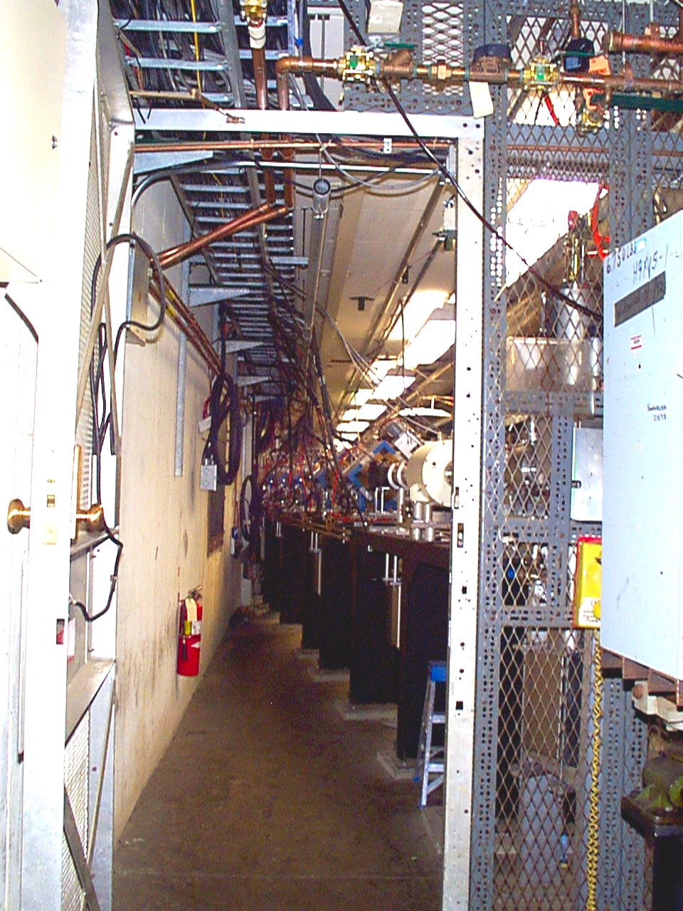
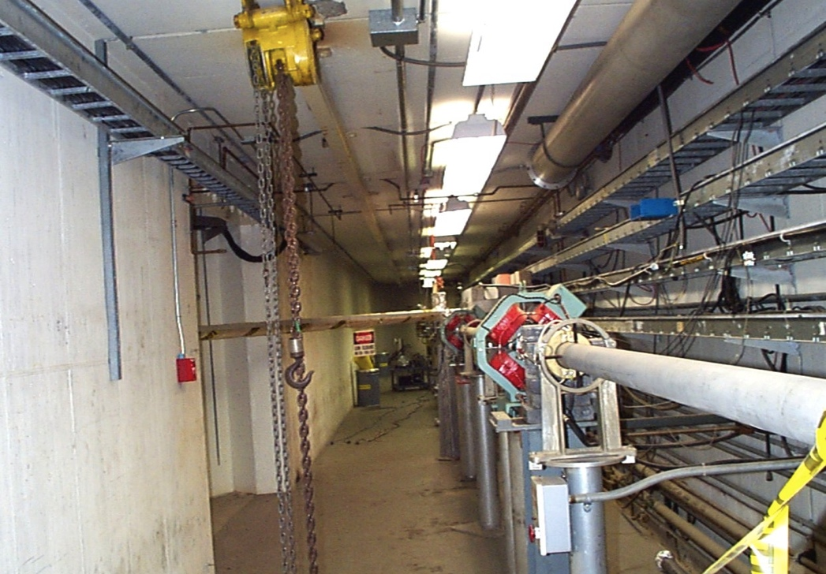
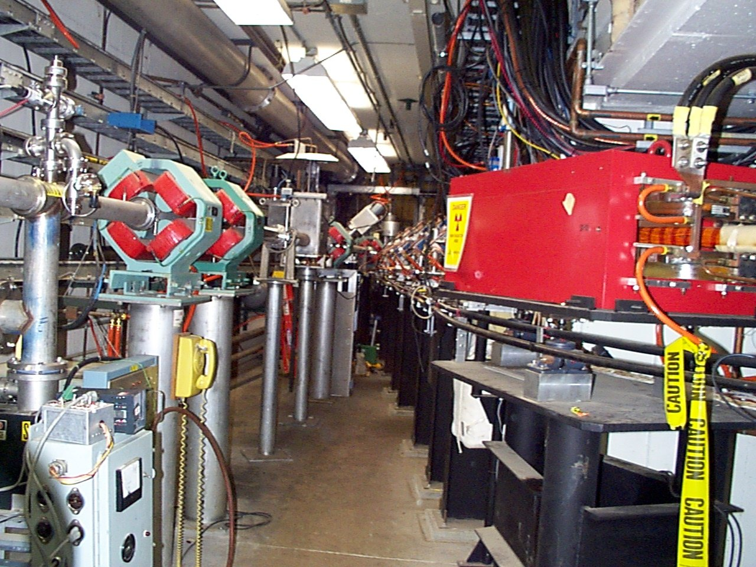
200 MeV transport lines to Booster, polarimeter, and BLIP

Slide 12
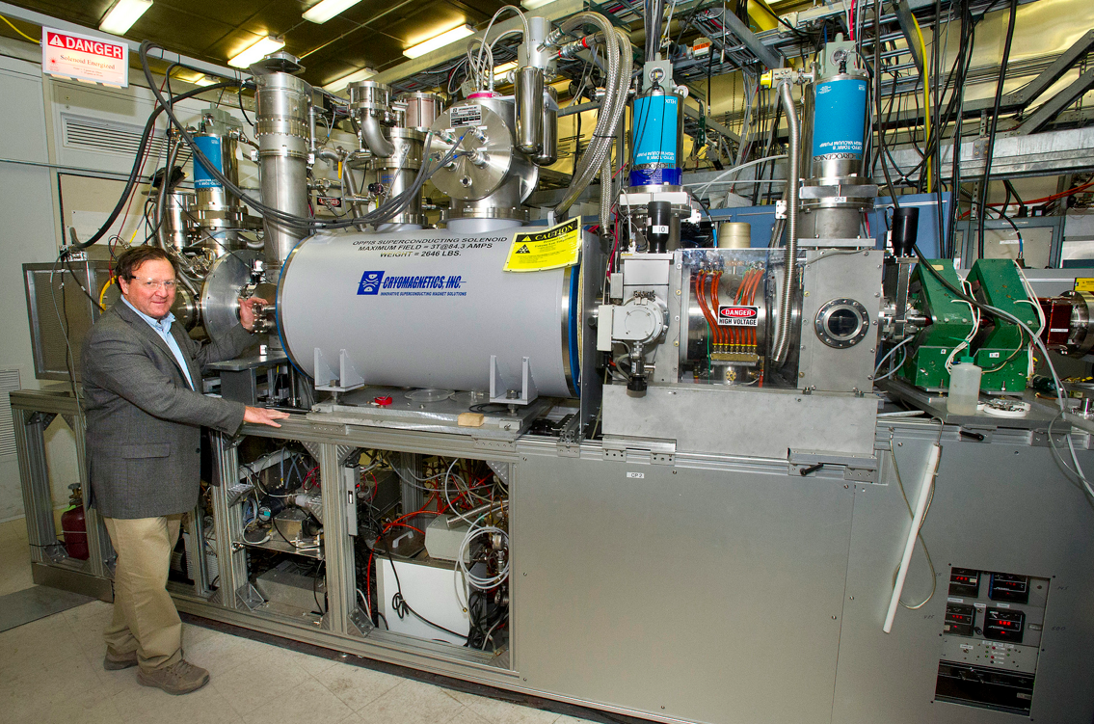
Highest intensity polarized H- source in world
5A proton source
3T SC solenoid
Cr:LiSAF laser & probe laser
H neutralizer
He ionizer
Polarized Rb neutralizer
Na ionizer
Sona transition
HV extraction
Low energy polarimeter
The source is comprised of many complex systems:

Slide 13
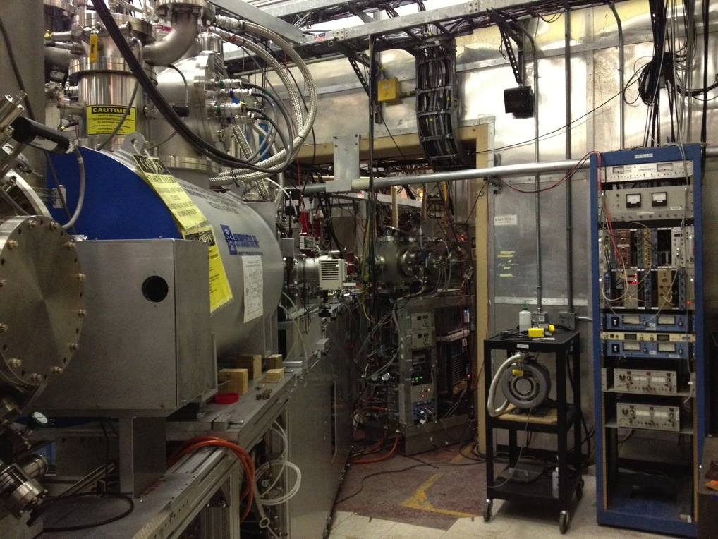
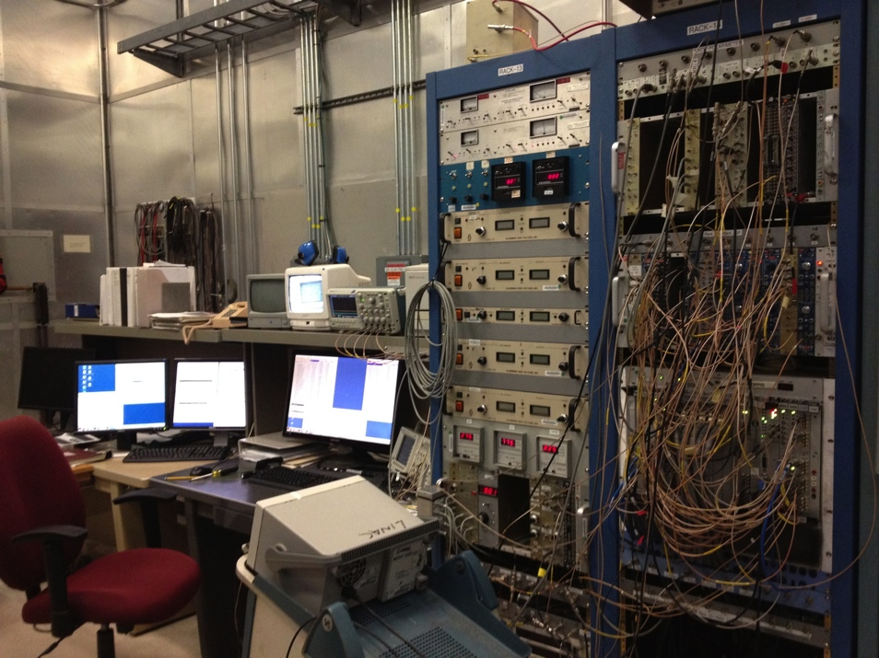
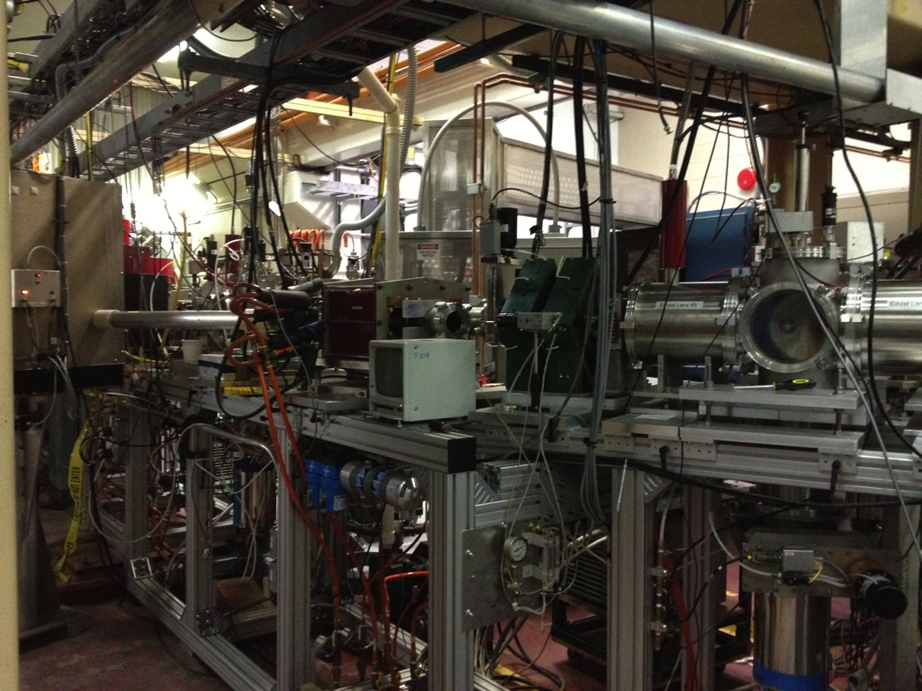
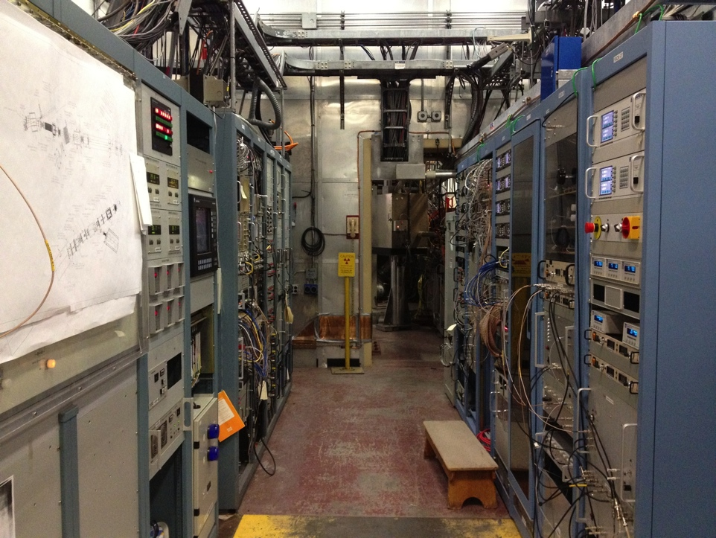
All parts of the polarized H- source
Controls, polarimetry
Source & polarimeter
Source ps’s
Transport, spin precession

Slide 14
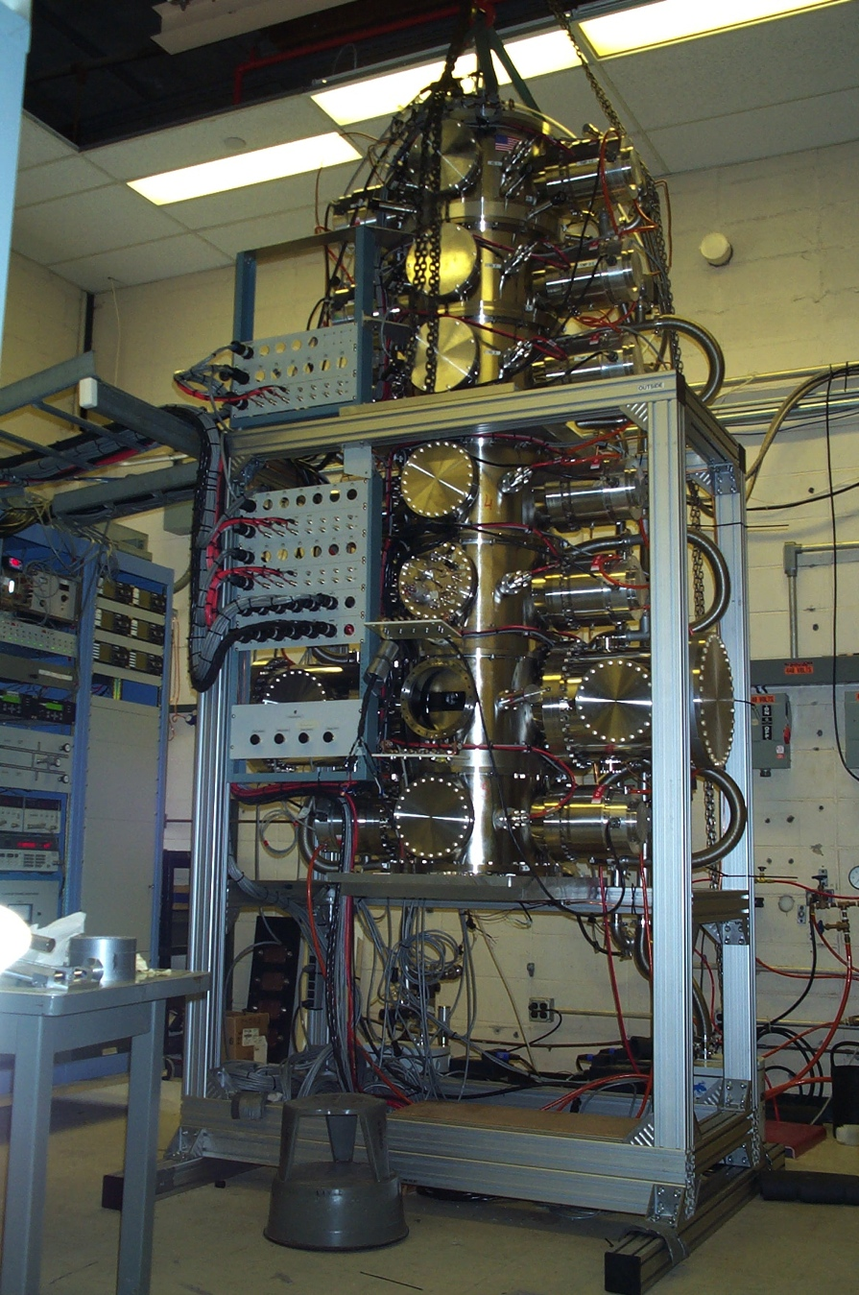
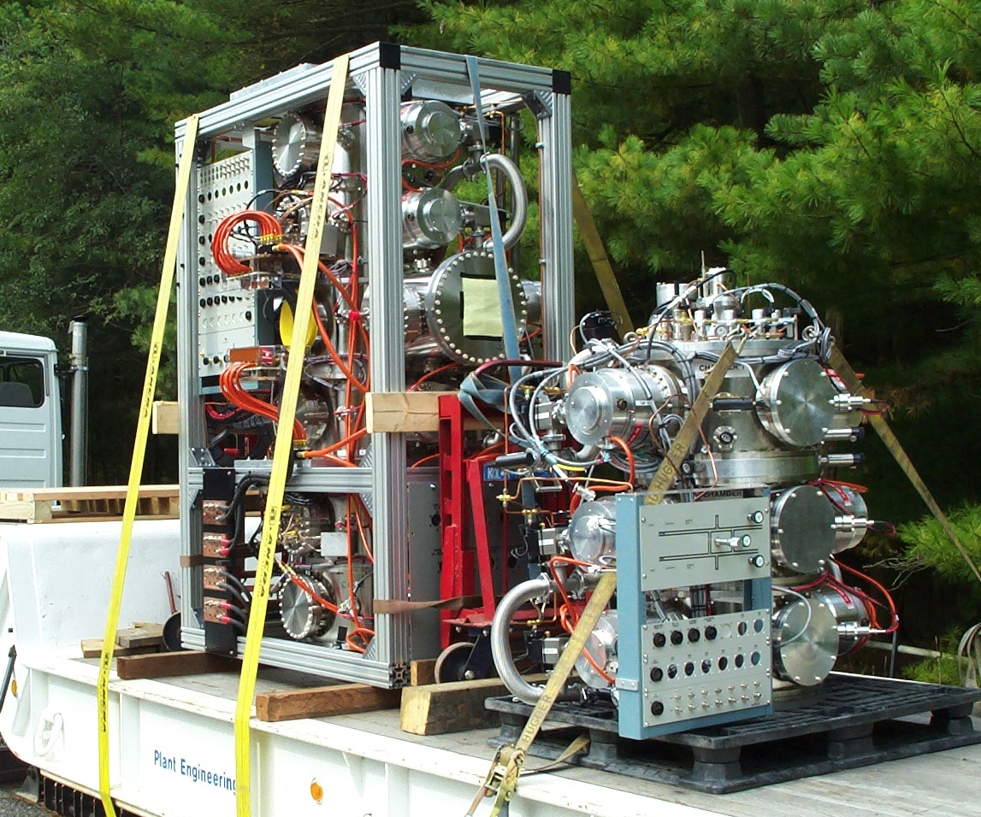
Polarized gas jet – before installation in RHIC
(group provides primary support for operation & maintenance)
Atomic H beam, sextupoles, 21 turbos
Also, for RHIC CNI polarimeter, group makes ~300 targets/year, 25mm long, 50 nanometer thick, 10 microns wide; mounted individually on frames

Slide 15
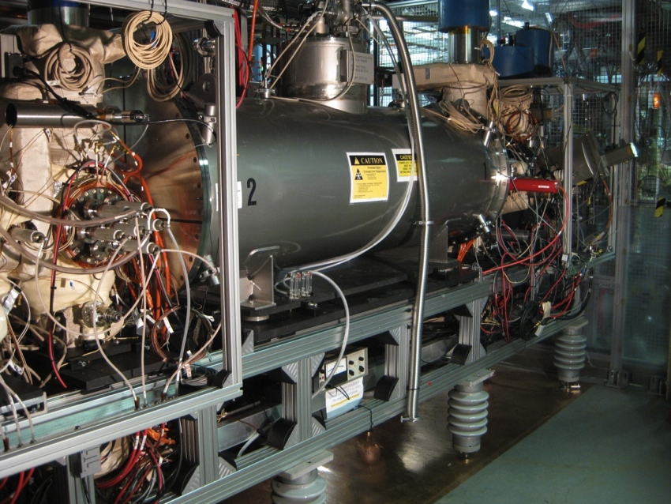
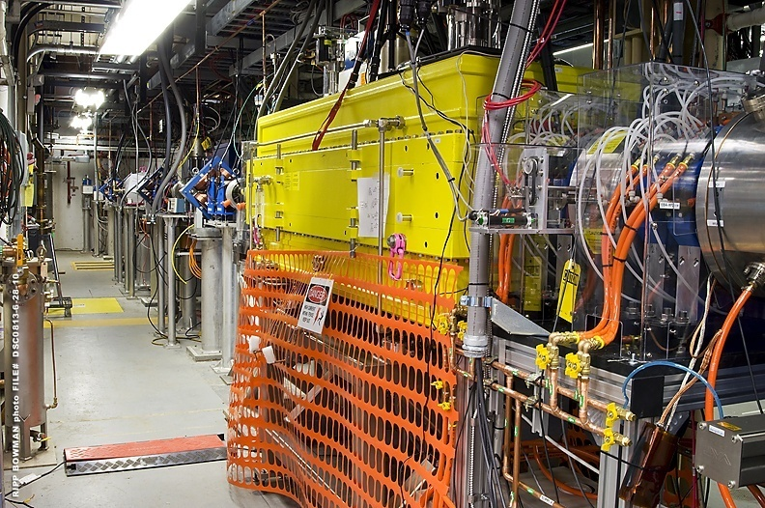
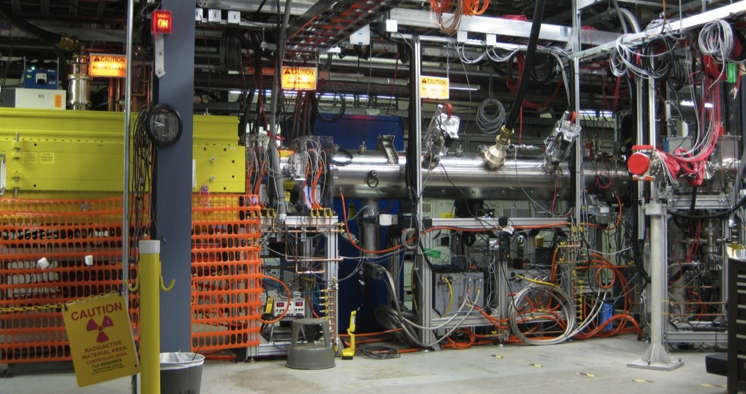
EBIS Preinjector – high charge state heavy ions
³He to U (15 species run to date)
All heavy ions for RHIC and NSRL
BOOSTER
DIPOLES
EBIS
RFQ
LINAC
BEAM TRANSPORT LINE
Acceleration to 2 MeV/u for injection into Booster

Slide 16
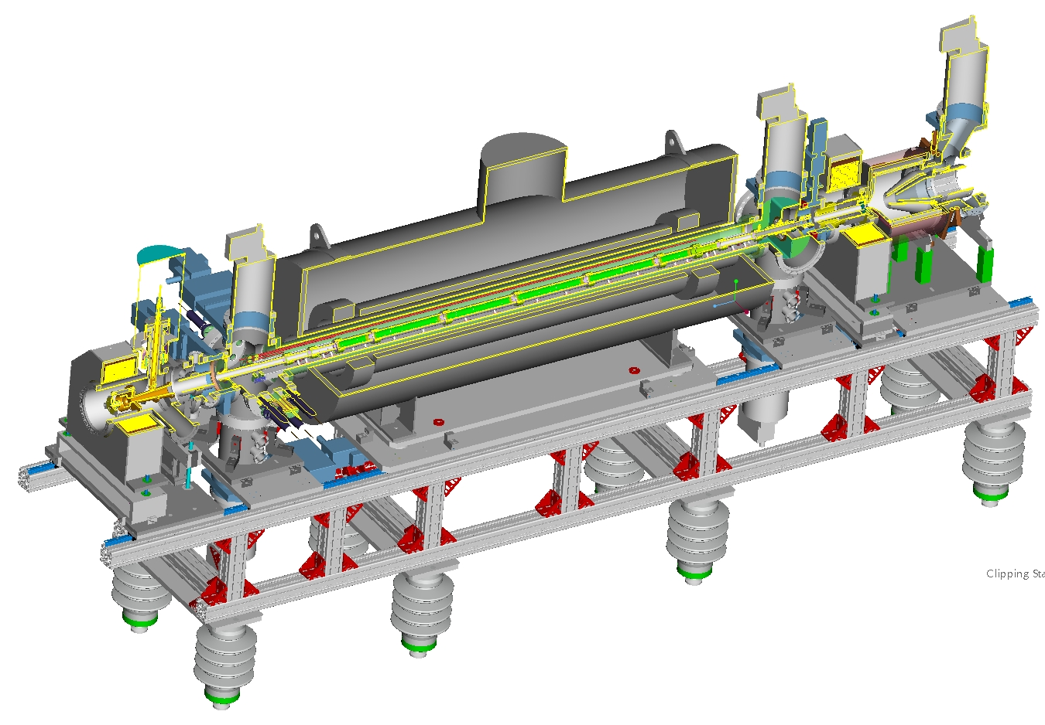

Highest intensity EBIS in the world
Electron Collector
Superconducting Solenoid (5 T)
Drift Tube Structure (P<10⁻¹⁰ Torr)
E-Gun
(10 A)
Source includes 10A electron gun & collector
5T SC solenoid
Ultrahigh vacuum system
2 ion sources for 1+ ion injection

Slide 17
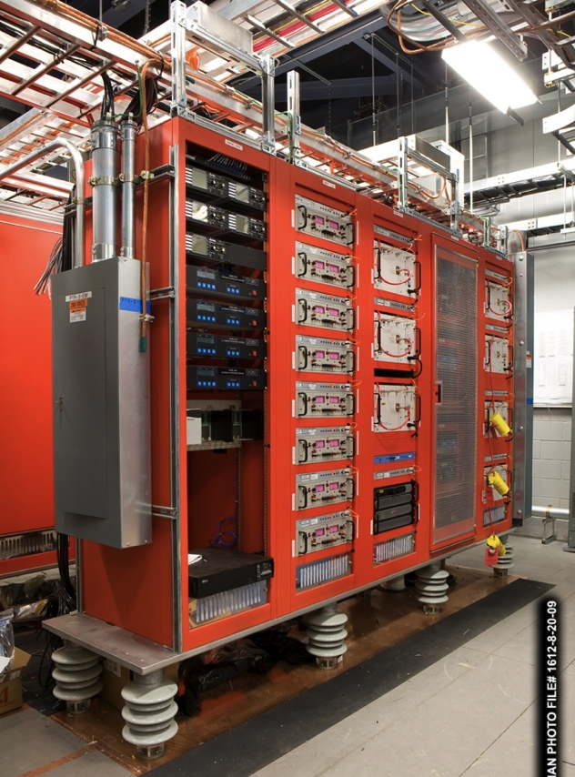
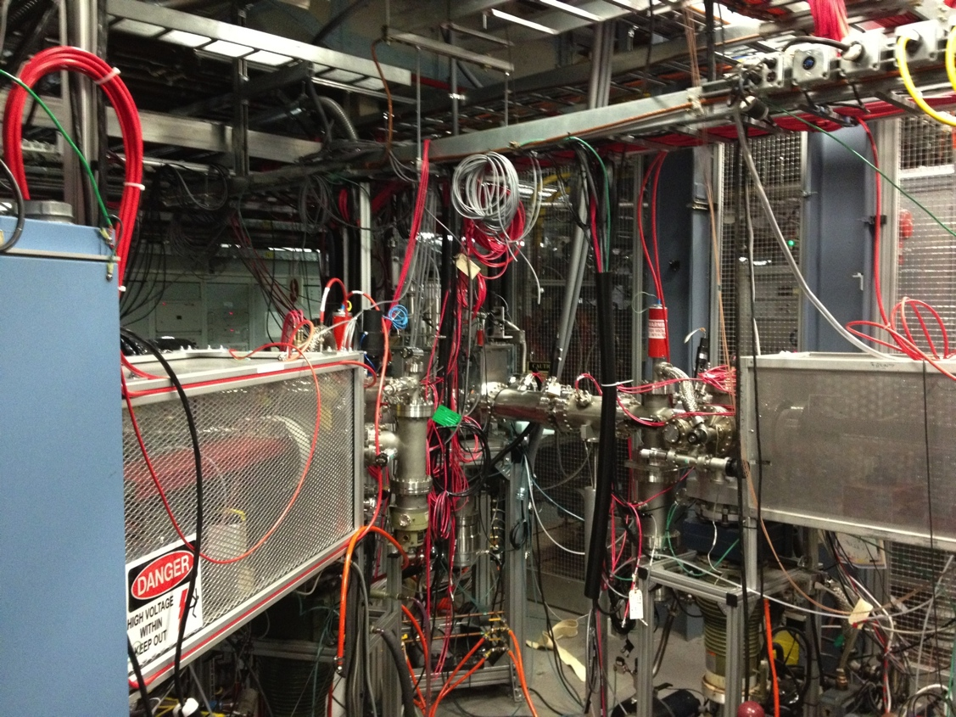
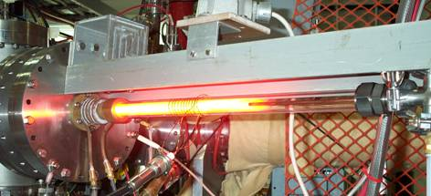
EBIS source PS’s
15A, 15 kV ps between the electron gun and electron collector
Two 150 kV, 200 kVA isolation transformers
100 kV platform pulser – 200µs risetime, 500 µs flattop
40 kV, 20 mA gun anode ps
Ten 20 kV, 20 mA (100 mA burst) drift tube ps’s
2 room temperature solenoids and 8 steering ps’s (electron beam)
Two 1+ heavy ion sources to produce desired species

Slide 18
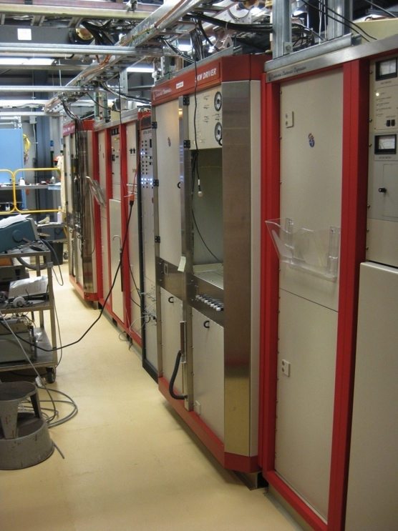
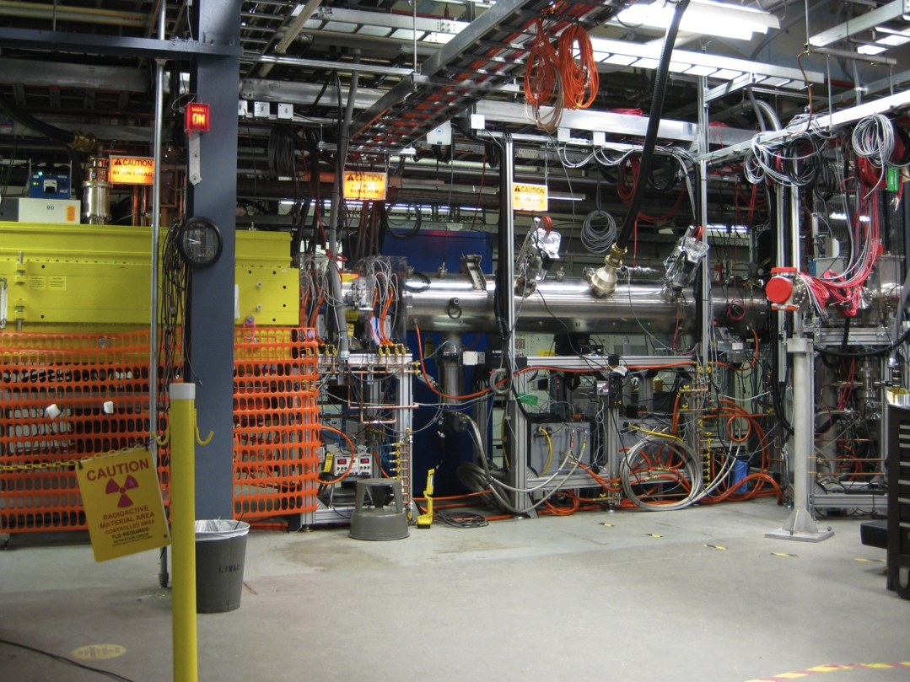
EBIS - Heavy ion accelerators and transport lines
2 x 300 kW and 3 & 10 kW rf systems
RFQ, MEBT, and Linac
Linac and EBIS-to-Booster transport

Slide 19
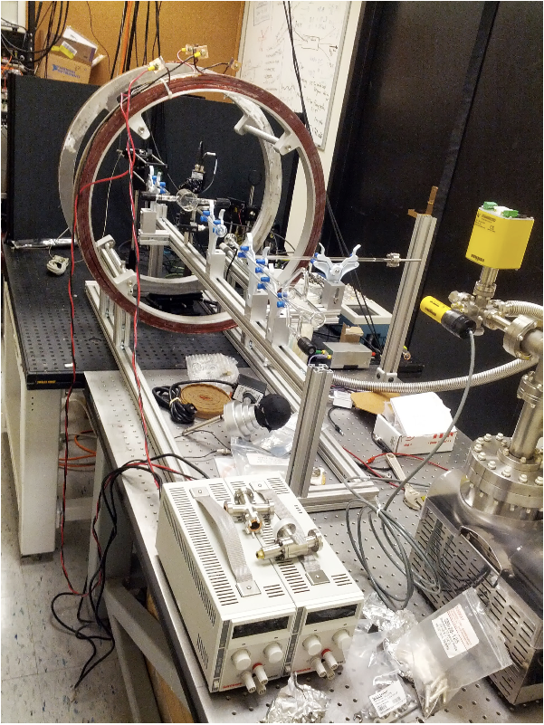
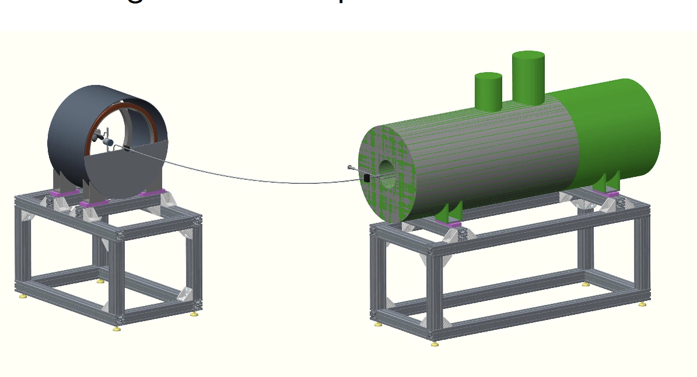
Polarized helium-3 source for RHIC using EBIS ionizer
Collaboration with MIT (R. Milner, J. Maxwell, C. Epstein)
Polarized He-3 gas cell - preparations at MIT
Will be brought to BNL this fall and tested on EBIS spare solenoid for possible depolarization during injection into trap field

Slide 20
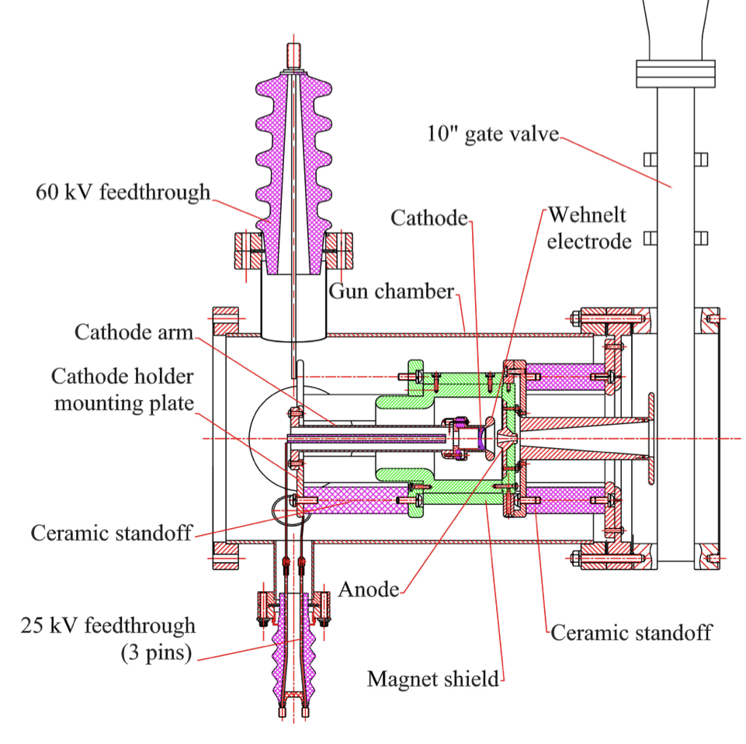
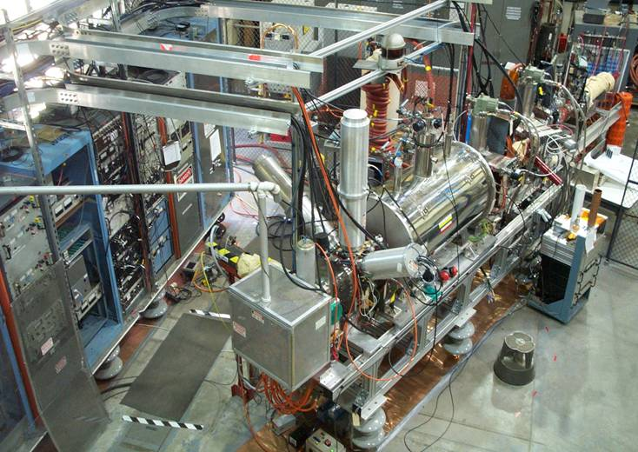
Improved EBIS electron gun – designed by BNL EBIS scientist, built in collaboration with CERN, and is now being prepared for testing on BNL Test EBIS
Could produce 10 times higher current density in the trap, resulting in 10-times shorter confinement times, and therefore shorter electron beam pulses
  could improve charge state distribution, vacuum, emittance

Slide 21
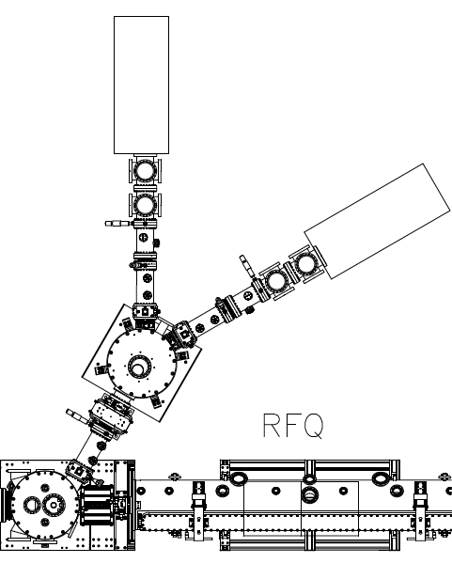
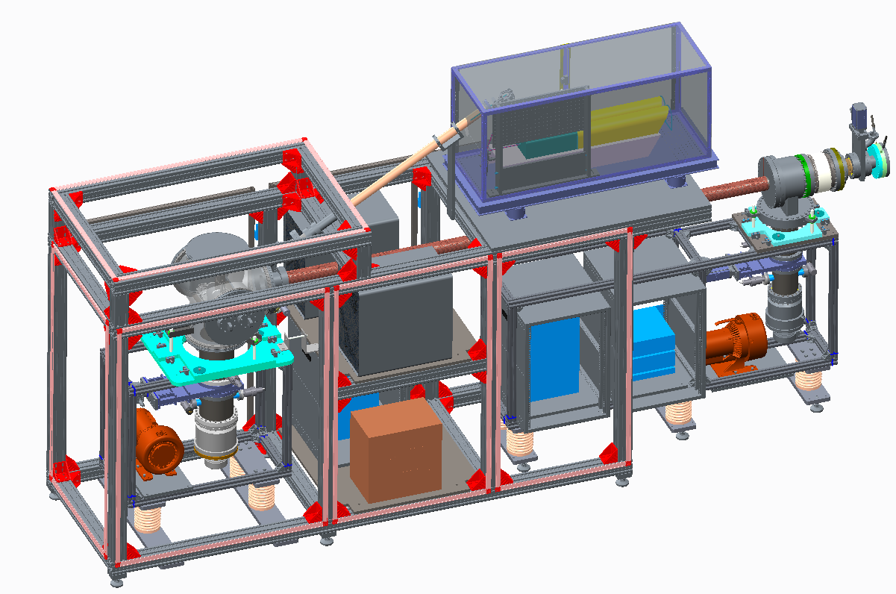
Laser Ion Source for improved flexibility when running multiple species from EBIS
1+ injection into EBIS
NASA funded – will be installed on EBIS this fall
40 kV Break
55 kV Break
40 kV Station Insulator
Ground Potential
40kV

Slide 22
Rough breakdown of manpower
H- source, LEBT, MEBT, linac, rf systems, quads, transport lines, diagnostics, vacuum ~6
Polarized H- source, linac polarimeters, RHIC polarimeters & targets ~3
EBIS source, 1+ sources, heavy ion RFQ, Linac, transfer lines, ps’s, etc. ~4
Laser source; EBIS developments; other R&D for RHIC ~3
ME, EE, machinist, secretary, group leader, floating techs ~6-7
(support for all of above)
Misc. support (other groups) ~1-2
TOTAL ~24
Procurements:
Largest is rf tubes for 200 MeV linac - ~1.1 M$/year
Otherwise, typically ps repairs/replacements, vacuum pump repairs/replacements, etc.

Slide 23
Pre-Injectors
Reduction in labor primarily due to switch from Tandem to EBIS preinjector

