Slide 1
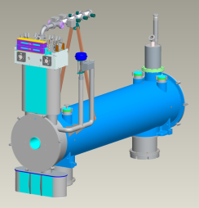
Superconducting Magnet Support
Peter Wanderer
Superconducting e-Lens Solenoid Magnet

Slide 2
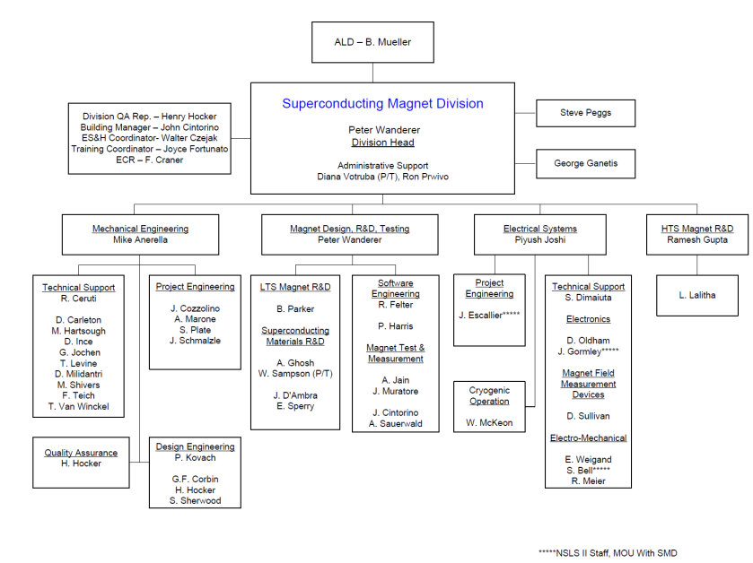
Superconducting Magnet Division Organization
~ 40 FTE’s

Slide 3
Superconducting Magnet Division RHIC Accomplishments
RHIC arc magnet R&D, design, construction and test
RHIC insertion magnet R&D, design, construction and test
RHIC polarized proton snake and spin rotator design, construction and test
AGS Cold Snake design, construction and test
e-Lens sc solenoid design, construction and test
eRHIC next?

Slide 4
Superconducting Magnet Support
The primary activity in support of RHIC during FY10 – FY13 has been the construction of two superconducting magnet systems for the electron lenses
Other activities include:
magnet testing (pulsed quad, AC dipole, RHIC arc dipole and quad at low field, small aperture R&D dipole for eRHIC, EBIS quadrupole)
magnetic design (IR magnet for eRHIC)
magnet construction (solenoid for ERL wound with high temperature superconductor)
magnetic field calculations (sextupole in RHIC dipoles at low field).

Slide 5
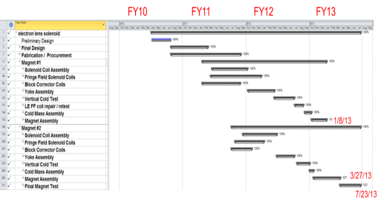
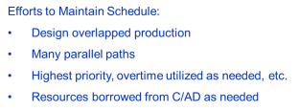
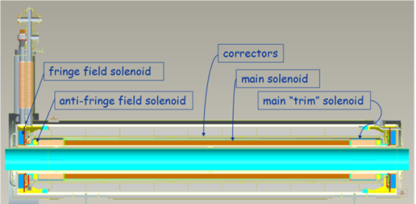
Principle Activity, FY10-FY13 Superconducting e-Lens Solenoid Magnets (2)
6 x 10 ⁻³ field uniformity from 1T to 6T
± 50 microns field axis straightness over ± 1050 mm from 1T to 6T
Goal - 6.6 Tesla minimum field (110% of max. operating field)
Official minimum requirement – “A minimum field of 5 T in the superconducting solenoid as measured in a vertical test”
No Prototype
Assembly
Assembly
Test
17 separate circuits:
1 2.5m main solenoid, Ø200 mm ID
2 fringe field solenoids
2 anti-fringe field solenoids
5 0.5m vertical correctors
5 0.5m horizontal correctors
1 2.5m vertical corrector
1 2.5m horizontal corrector

Slide 6
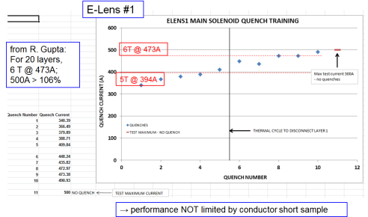
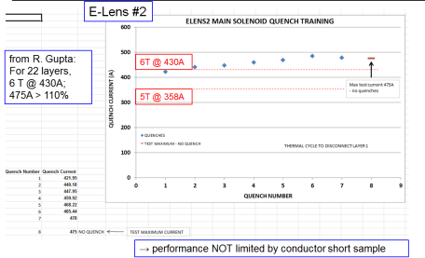
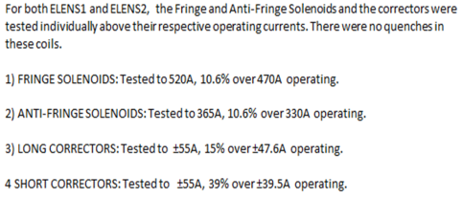
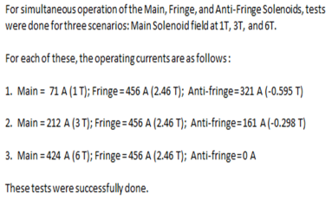
Successful e-Lens Solenoid 4K vertical dewar quench tests

Slide 7
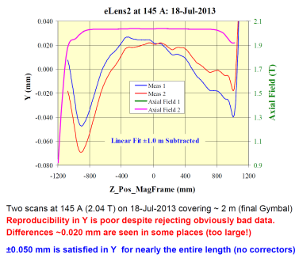
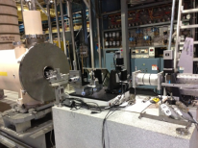
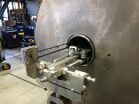
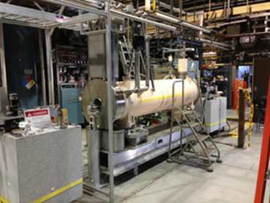
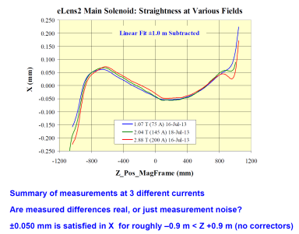
Successful e-Lens Solenoid Horizontal 4K Straightness Test, Magnet #2
UNCORRECTED STRAIGHTNESS CLOSE TO DESIGN SPECS!
Laser source
“needle-and-mirror”
Superconducting e-Lens Solenoid Magnet #2 in test

Slide 8
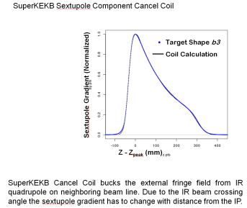
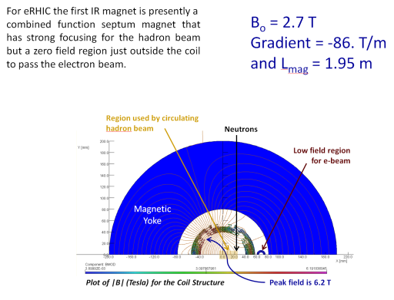
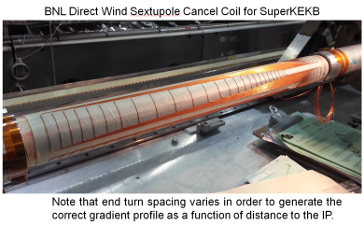
eRHIC – “direct wind” combined function IR coils
“The latest “shovel ready” concept gets rid of the Crab Cavities (and therefore the crossing angle) for an initial 10 GeV stage and this has me scrambling to come up with a viable solution. I am taking full advantage of our HERA-II, BEPC-II, JPARC, Alpha, ILC, and Super-KEKB experience (and some wild new ideas) to make this work - all our previous work is “eRHIC related.”” – Brett Parker
SMD has greatest expertise for this work worldwide
The KEK cancel coil work has provided the conceptual basis for an eRHIC IR magnet design

Slide 9
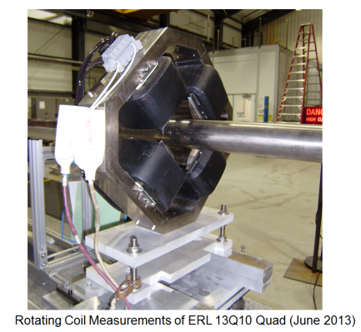
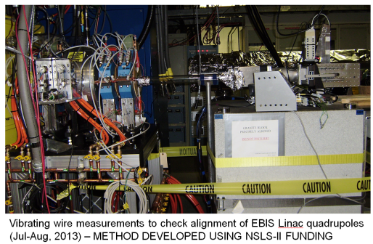
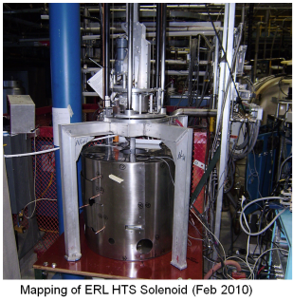
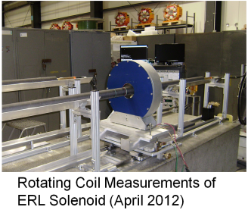
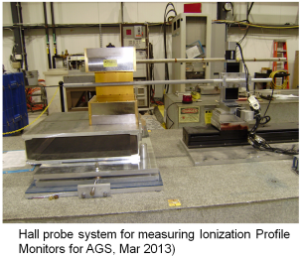
Magnet Testing & Measurement

