Slide 1
Accelerator R&D
Ilan Ben-Zvi, breakout session

Slide 2
Accelerator R&D
R&D efforts are at ~5% of the total operating budget, which enables us to carry out our mission as set by the NP Long Range Plan and EICAC recommendation, in concurrence with ONP.
FTE’s are capped at 10 scientific and 15 non-scientific, bare minimum for our mission.

Slide 3
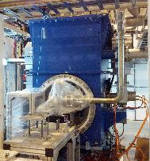
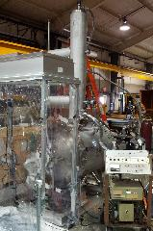
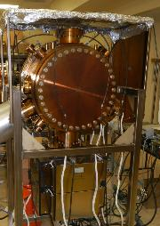
Our main projects
eRHIC physics and design: Design of a complex large collider
Energy Recovery Linac R&D: A complete, state-of-the-art accelerator
Coherent electron Cooling: A complete accelerator and a novel hadron cooling system, interfaced with RHIC
Funneling high-current polarized electron source aimed at 50 mA

Slide 4
Superconducting RF SRF cavities are part of the R&D ERL, CeC PoP and LEReC projects; future electron-ion colliders will extensively utilize SRF technology; in addition, we are developing a 56 MHz storage cavity to improve luminosity in RHIC (C-AD AIP) and a 400 MHz compact quarter wave crab cavity for the LHC luminosity upgrade (LARP).

Slide 5

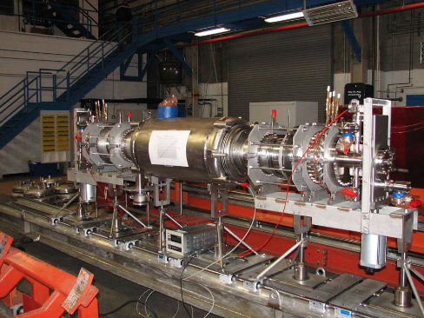
704 MHz SRF for ERL
704 MHz cavity optimized for HOM damping.
The five-cell cavity and cryomodule were fabricated by AES.
The cavity demonstrated excellent performance in vertical tests. The cryomodule has been tested and is ready for beam.
The two FPCs were conditioned
Gun cavity commissioned to 2 MV.
Testing with a copper cathode in August.
High quantum efficiency multi-alkali photocathode in September.

Slide 6
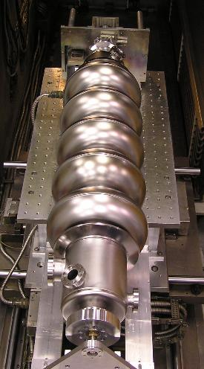

SRF for CeC PoP
112 MHZ Gun cryomodule was successfully tested at Niowave in February 2013. 0.92 MV reached, limited by radiation shielding.
The gun is at BNL. We plan to condition it to 2 MV and test with photocathodes later this year.
5-cell SRF cavity at 704 MHz designed for high-current applications such as eRHIC.
Vertical testing this year.
Will be used in CeC.

Slide 7
eRHIC Design We are doing medium-range R&D on an Electron Ion Collider concept based on an Energy Recovery Linac (ERL). This original approach is characterized by a high luminosity and high degree of polarization. LHeC adopted this method. Cost effectiveness is achieved by using the RHIC ion accelerator, an in-tunnel design and multiple passes through the linac.

Slide 8
eRHIC
5 – 30 GeV electron beam accelerated with Energy Recovery Linac (ERL) inside existing RHIC tunnel collides with existing 250 GeV polarized protons and 100 GeV/n HI RHIC beams
Single pass allows for large collision disruption of electron bunch, giving high luminosity (~ 10³⁴ cm⁻² s⁻¹), and full electron polarization transparency
Accelerator R&D for highest luminosity:
High current (50 mA) pol. electron gun
Multi-pass high average current ERL
Coherent electron cooling of hadron beam
Initially: 5-10 GeV electron beam
Box area corresponds to the initial version

Slide 9
Technical design development
Successful technical review of eRHIC design was done in Aug. 2011
Preliminary technical design of major accelerator components and systems (magnets, vacuum chamber, power supplies, cryo, controls ….) has been developed
Cost optimization for the first stage of eRHIC has been done (the number, location and length of the linacs; the number of recirculation passes). The cost estimate now stands at ~$550M (Phase I).
Presently we are looking into 10 GeV electron energy and cost /luminosity trade-offs.
Possible design solutions which may further decrease the cost:
First stage NS-FFAG design or vertical FFAG design, possibly with permanent magnets
Alternative Interaction region design

Slide 10
Recent eRHIC Accelerator Design Advances
Hadron lattice functions for symmetric IR design
Space charge compensation device to greatly improve the machine luminosity at lower CME range
Symmetric interaction region design which simplifies achieving low β* and good dynamic aperture for hadrons
Further evaluation of surface roughness effect and related beam energy loss and spread.
A FFAG lattice capable of the transport of multiple energy electron beams has been derived
Measured surface roughness of extruded Al pipe

Slide 11
ERL The R&D ERL is aimed at testing ERL issues for eRHIC and other projects, such as Coherent electron Cooling of RHIC. The current objective of 300 mA is set by what is required by eRHIC cavities. The ERL incorporates originally developed state-of-the-art SRF laser-photocathode electron gun and a high-current, heavily damped acceleration cavity, the first such designed and built for ERL service.

Slide 12
ERL status
The 704 MHz elliptical half-cell SRF gun was successfully cooled down last fall then set of cold emission tests (CET) are performed until voltage in cavity reached 2 MV January 2013 without cathode.
The cathode transport cart assembled and successfully attached to SRF gun.
Improved of HTS solenoid cooling system has been designed and installation is underway.
Next step will be repeat set of the SRF Gun cold emission test with copper cathode scheduled for July 2013.
In the same time the HTS solenoid will be powered up and tested in the first time.
After that of the SRF gun commissioning will be testing its operation with a high quantum efficiency multi-alkali photocathode.
Nearly all components of the ERL are in house, many already installed.
Some ERL beam extraction line has been received (Beam dump, Quadrupole) other components are under final review.

Slide 13
Recent and future ERL target dates
5-cell cryomodule to Bldg. 912 October 2008
Start cold-emission tests March 2009
Gun cavity start processing January 2010
External Review Committee February 2010
HTSS delivered for assembly July 2010
Gun cavity string delivered April 2011
Gun cryomodule delivered April 2012
Sub-systems connections to gun October 2012
Gun commissioning start November 2012
Gun cathode insert multipactor/CET studies July 2013
First beam test multi-alkaline cathode August 2013
System integration & checkout Mid 2014
ERL all Systems testing start Late 2014

Slide 14
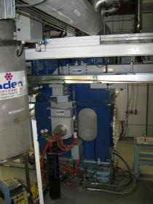
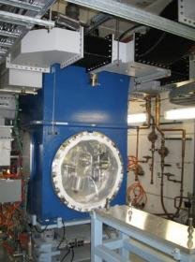
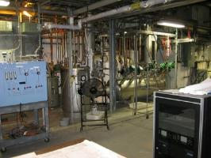
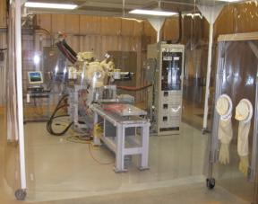
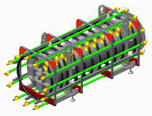
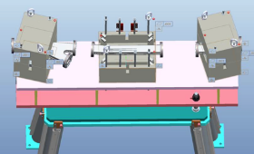
ERL cavity string, gun and ERL cave
ERL e-Gun: Cryogenic and RF Connections
The gun cavity (without Cathode)
tested to 23.5 MV/m, (2MeV electron energy) with a dynamic load of <7 Watts. Tests with cathode to be done in July.
ERL Cryogenics System
Beam dump with beam loss monitors grid around
Cathode Deposition System
Extraction chicane magnets

Slide 15
POLARIZED GUN We are doing R&D, funded primarily by LDRD, to develop a high-current (50 mA), high-polarization electron gun for eRHIC. The principle we are aiming to prove is funneling multiple independent beams from 20 cathodes. External review was carried out in 2012.

Slide 16
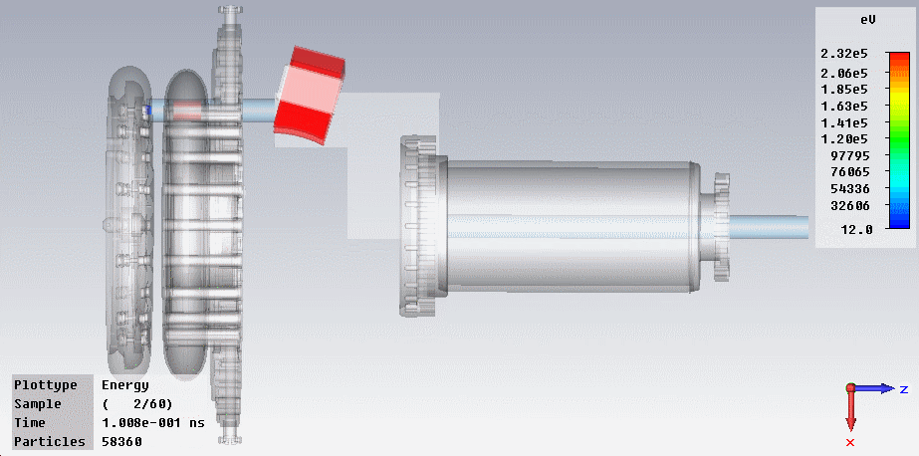
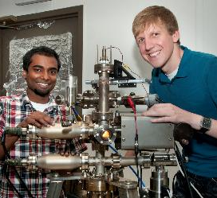
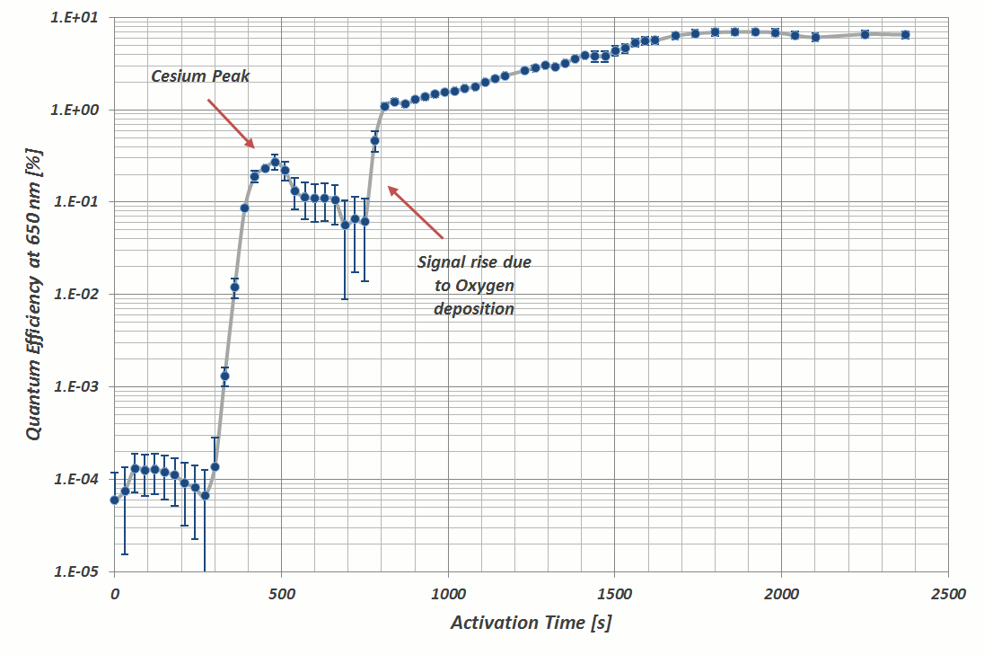
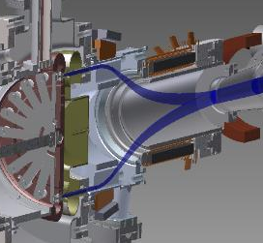
Beam motion by 3-D Particle In Cell code with space-charge
Low 10⁻¹² Torr (gauge limit), excellent QE

Slide 17

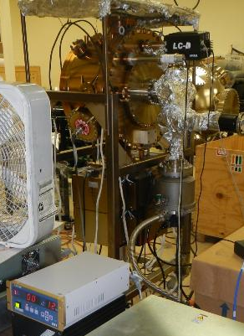
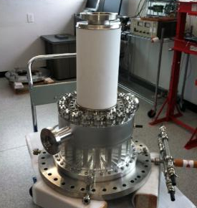
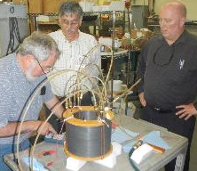
Main Vacuum chamber prepared for system integration.
Front and side views of the Gatling gun vessel
Front of Gatling Gun Chamber.
Recent testing has confirmed that the main gun vessel can achieve to mid to low 10⁻¹² Torr prerequisite vacuum level for e-beam operation

Slide 18
COHERENT ELECTRON COOLING The CeC is a novel technique to cool stored ion beam which combines the best features of stochastic cooling and electron cooling. Such an effective cooling technique can be used to cool RHIC proton beams at full energy, and is a must for any version of EIC. External review was carried out in 2012.

Slide 19
Progress in 2013
Finished modifications of the 112 MHz SRF gun. During test at Niowave reached 0.92 MV accelerating voltage limited by the radiation shielding at Niowave.
Placed contract for the helical wiggler.
Continued developing of the simulation package.
Procurement of drive laser, solenoids and trim magnets is close to completion
Started area preparation for installation
The cathode launching system was built, but damaged during shipment. Repairs will be done under particulate free conditions.
704 MHz accelerating cavity fabricated.
Started procurement of diagnostics.
Fundamental power coupler is manufactured at SBU
Started installation of the cryogenic and RF systems
Started work on the control system.

Slide 20
Work Plan
4Q FY13 – 1Q FY14 install the first phase of the experiment (low energy part including gun, laser, bunching cavities, beam transport and diagnostics)
2-3Q FY14 Commissioning gun and low energy system, injector characterization
3-4Q FY14, 1Q FY15 install balance of the equipment (703 MHz accelerator cavity, FEL system, beam transport, high power beam dump, diagnostics
2-3Q FY15 Commissioning of the CeC PoP systems, first cooling experiments
FY16 Cooling experiments

Slide 21
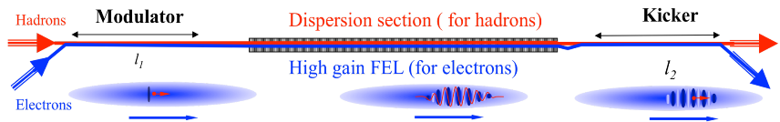
Economical Version of CeC
In the modulator and kicker sections the electrons have the same speed as ions (γ_{e}=γ_{Au}).
In the FEL section the electrons are slower then ions but group velocity of the density modulation is equal or higher to the ions velocity (setting limitations on the wiggler parameter).
The ions experience ballistic motion with dispersion D=L_{FEL}/γ²
Parameter | Units | Value
Ion’s Energy | GeV/u | 40
R.M.S. normalized emittance | mm mrad | 2.5
R.M.S bunch length | ns | 5
R.M.S. momentum spread |  | 3.5×10⁻⁴
Repetition rate | kHz | 78.3
Parameter | Units | Value
Electron Energy | MeV | 21.8
R.M.S. normalized emittance | mm mrad | < 5
Peak current in FEL | A | 60-100
R.M.S. momentum spread |  | < 1.0×10⁻³
Charge per bunch | nC | 1-5

Slide 22
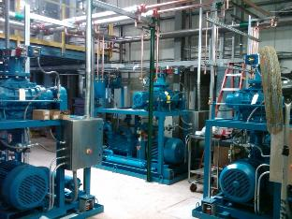
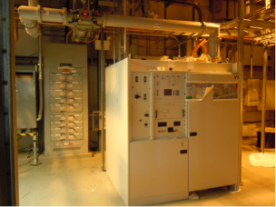
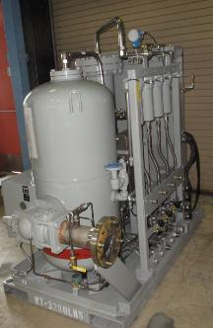
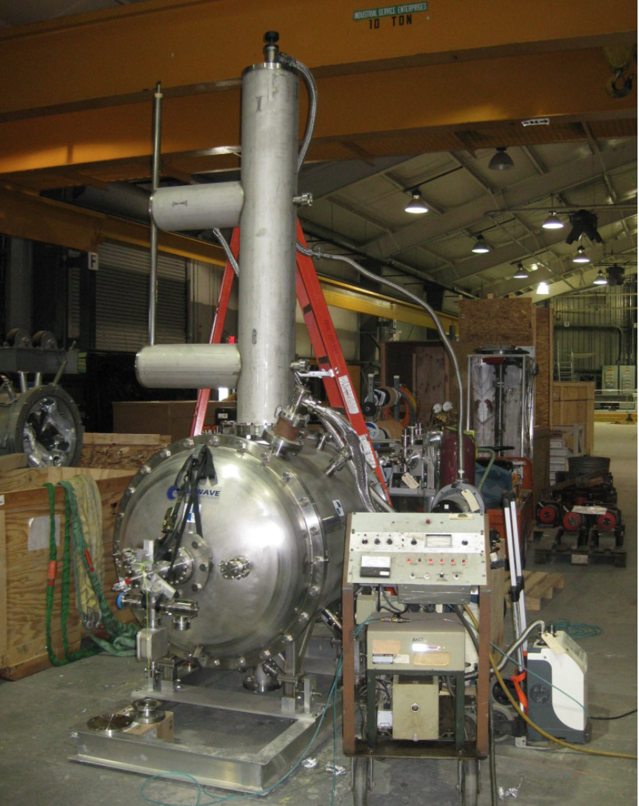
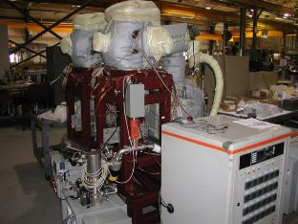
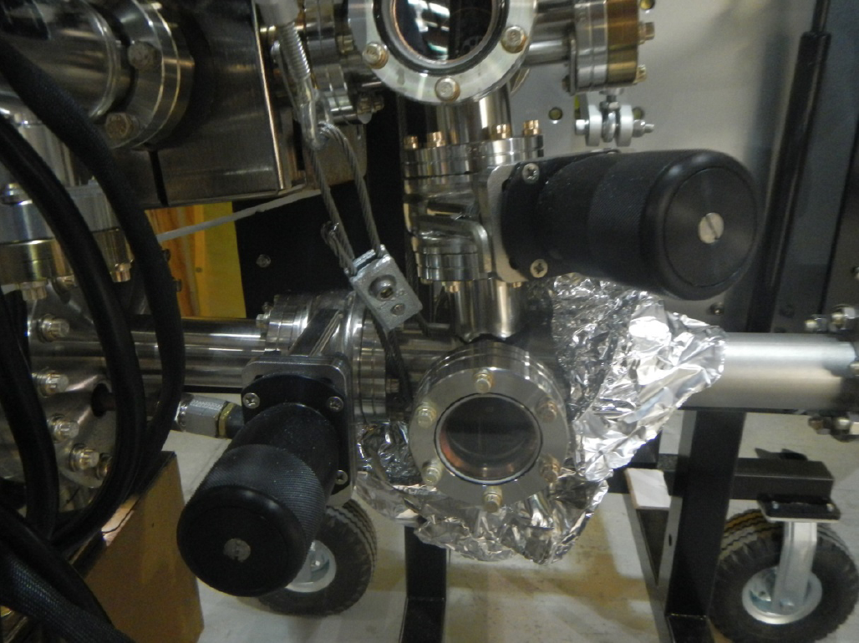
Many components at hand

Slide 23
Backup

Slide 24
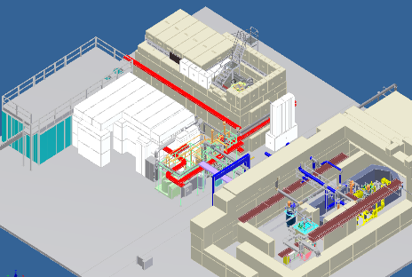
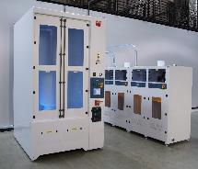
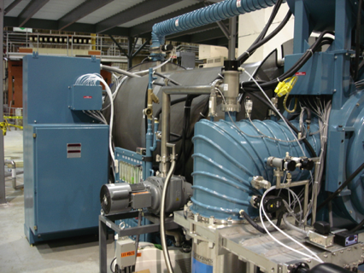
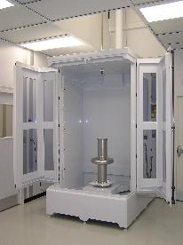
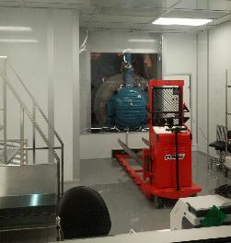
SRF facilities
BCP @ AES
800°C vacuum oven for cavity baking
Large Vertical Test Facility
Clean room
ERL
High pressure rinsing @ AES
Clean room
Small VTF
ERL / VTF cryogenic system
With most of the SRF-related infrastructure (joint BNL/AES BCP and HPR facility; Small VTF Block House; 800°C vacuum oven; Mezzanine clean room; ERL/VTF cryogenic system) operational and some (Large VTF; horizontal test area; cryomodule assembly area) coming up soon, we have a complement of SRF facilities to do various basic SRF tests from 56 MHz to 1300 MHz.

Slide 25
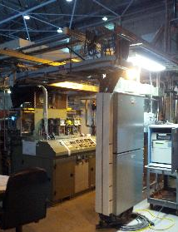
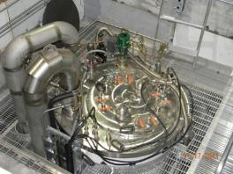
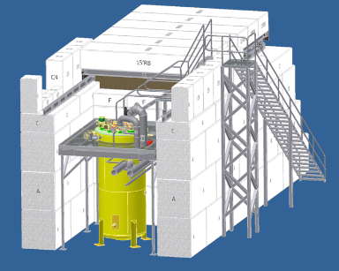
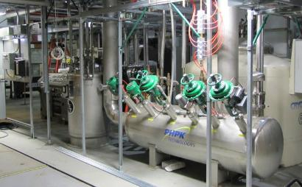
SRF test facilities in building 912 (cont’d)
VTF dewar top plate
360 W 4 K refrigerator.
A liquid ring pump for 2 K operation,
capable of handling a 100 watt heat load.
1000 gallon LHe storage dewar.
38,000 gallon helium gas storage tank.
ERL / VTF cryogenic system
Vertical Test Facility

Slide 26
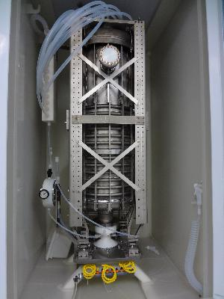
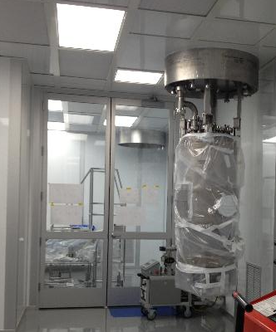
56 MHz cavity preparation for acceptance testing at LVTF
Cavity in BCP cabinet at AES
Cavity in Class 10,000 cleanroom at BNL
The cavity has undergone processing standard for SRF cavities: BCP etch, vacuum bake at 600°C for 10 hrs, light BCP etch, HPR, assembly in the Class 100 cleanroom. Its first acceptance test at C-AD’s LVTF will be performed in July.

Slide 27
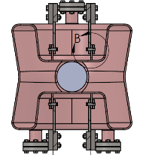
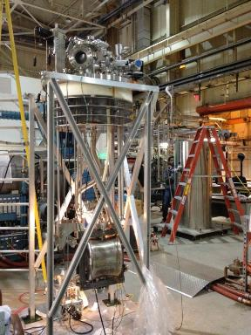
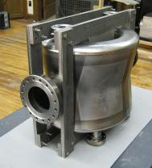
Compact double QW crab cavity for LHC luminosity upgrade
A compact double quarter wave crab cavity was proposed and designed at BNL.
A proof-of-principle cavity has been fabricated and processed at Niowave; 600°C vacuum bake – at BNL.
The first vertical test at C-AD’s SVTF in June. The second test is planned for late summer after re-processing.
Funded by LARP.
Cavity insert and testing dewar
Frequency | 400 MHz
Deflecting Voltage | 3.0 MV
R_{t} /Q (Fund. Mode) | 400 Ohm
G | 88.3 Ohm
R_{BCS} (2 K) | 1 nOhm
R_{BCS} (4.5 K) | 62.3 nOm
R_{res} | 10 nOhm
Q₀ (2 K) | 8.0×10⁹
Q₀ (4.5 K) | 1.2×10⁹
P_{RF} | 2.8 W
Dynamic liquefaction load | 0.13 g/s

Slide 28
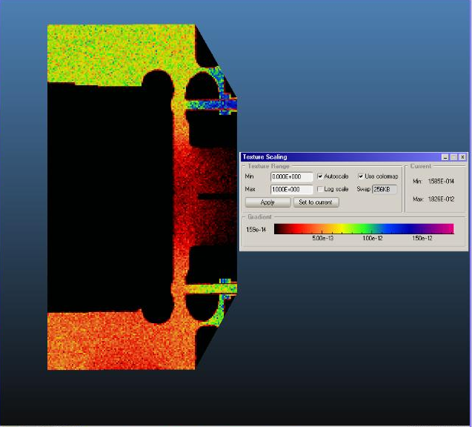
Vacuum profile in Polarized gun for eRHIC
Cathode side
Vacuum distribution study
Inter Cathode-anode NEG pump is designed to have a capacity of 3000 l/s (H2)
Additional 8000l/s
NEG capacity to be added to the main chamber.
torr
Anode side
pump

Slide 29

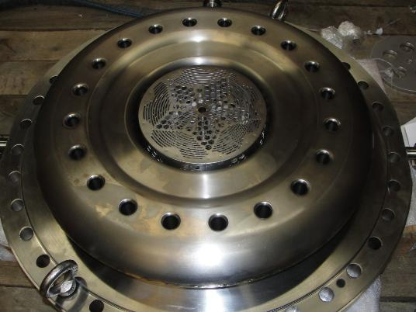
The Gatling Gun Anode Assembly
A NEG pump chamber custom designed by SAES has been integrated into the Gatling Gun’s Anode assembly for high voltage design evaluation tests

Slide 30
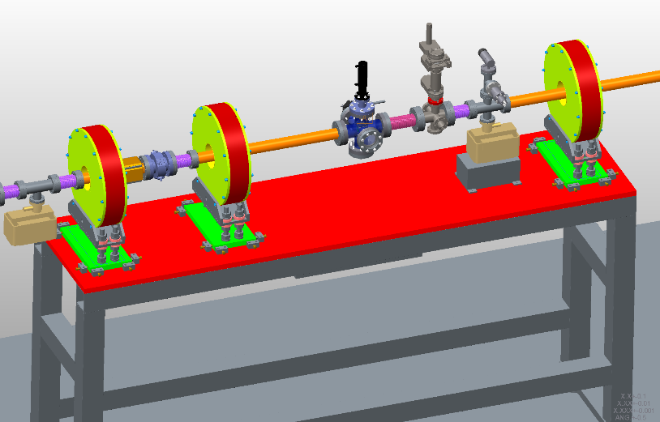
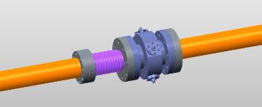
CeC PoP Instrumentation
BPM assemblies are being built by MPF
Pepper-pot and beam profile monitors are under design
Integrated current transformer is under procurement
We planning to use Libera BPM processors from ERL

