Slide 1
Accelerator R&D
Ilan Ben-Zvi

Slide 2
In this presentation:
Describe the Accelerator R&D Division which carries out mid-term R&D
Detail and explain the mid-term accelerator R&D
Make a case for the relevance of our work to operations
Describe how we carry out our mission
Discuss our efforts in terms of money, personnel and work objectives
Show briefly our main R&D projects

Slide 3
The ARDD of the Collider-Accelerator Department
The Accelerator R&D Division (ARDD) of C-AD engages in medium-term R&D related to the mission of ONP and provides expertise and support to short term accelerator R&D.
The ARDD is the site of a unique combination of expertise and facilities:
Electron cooling of unique nature, such as the Coherent electron Cooling and bunched-beam electron cooling for cooling Low Energy RHIC.
Superconducting RF for highly specialized applications such as high-current ERL, storage ring applications and SRF electron guns.
Laser photocathodes, polarized and high QE non-polarized.
The ARDD has a HEP funded component (LARP, ATF, Muon Accelerator), which benefits the ONP program, e.g. crab cavities, and vice versa – the HEP program benefits from the capabilities within NP.
The expertise and intellectual interchange with HEP units greatly enhances the capabilities of the ARDD.

Slide 4
Why we do mid-term Accelerator R&D
From the 2007 NSAC Long-Range Plan:
Realization of an EIC will require advancements in accelerator science and technology, and detector research and development.
The nuclear science community has recognized the importance of this future facility and makes the following recommendation:
We recommend the allocation of resources to develop accelerator and detector technology necessary to lay the foundation for a polarized electron-ion Collider. The EIC would explore the new QCD frontier of strong color fields in nuclei and precisely image the gluons in the proton.
What medium term Accelerator R&D do we do?

Slide 5
From the EICAC Report on Accelerator R&D Priorities
(C-AD is carrying out this research based on these recommendations)
eRHIC highest priority:
High current (e.g. 50 mA) polarized electron gun
Demonstration of high energy – high current ERL
Beam-Beam simulations for EIC
Polarized 3He production and acceleration
Coherent electron cooling
eRHIC high priority:
Compact loop magnets
Development of eRHIC-type SRF cavities
eRHIC medium Priority:
Crab cavities (funded by HEP in LARP group)
Complex
projects!

Slide 6
The Relevance of Accelerator R&D to Operations
The development of new ideas, often in unexpected direction
Example: Bunched beam stochastic cooling of RHIC, leading to the RHIC II era 5 years ahead of schedule and at 1/7 of the cost: Tremendous impact on operations!
Resident expertise enables new improvements.
Example: 56 MHz cavity AIP for RHIC luminosity improvement, based on SRF expertise.
Example: Low Energy RHIC Bunched Beam Electron Cooling, based on expertise in electron cooling, SRF, electron guns and photocathodes.
R&D efforts are at ~5% of the total operating budget, which enables us to carry out our mission as set by the NP Long Range Plan and EICAC recommendation, in concurrence with ONP.

Slide 7
Organization of ARDD Synergy of NP - HEP groups
Collider-Accelerator Department
Thomas Roser
Accelerator R&D Division
Ilan Ben-Zvi
Superconducting RF Group
Sergey Belomestnykh
Accelerator R&D Group
Vladimir Litvinenko
Photocathode Group
John Skaritka
NP
HEP (BES)
LARP Group
Qiong Wu
Muon Accelerator Group
Robert Palmer
Accelerator Test Facility
Igor Pogorelsky
NP mid-term Projects:
eRHIC physics and design
Energy Recovery Linac
Coherent Electron Cooling, including superconducting linac
Gatling Gun

Slide 8
How do we plan and manage the R&D
We derive our directions from recommendations of appropriate committees and management.
We plan the research and track progress through internal meetings.
We subject the plans and results to review committees.
We implement the recommendations of the reviews.
We publish papers in scientific journals.
We communicate our results in workshops and conferences and derive conclusions to guide our projects.

Slide 9
Project reviews
An internal review of the cost of an intermediate design of eRHIC was made in October 2009.
The ERL was reviewed on February 2010 by an external committee.
Technical review of eRHIC design was done in August 2011by an external committee.
DOE Review of C-AD Accelerator R&D, December 12-14, 2011
Gatling-Gun (GG)-project review was performed on June 28-29 2012 by an external committee.
The Coherent electron Cooling project was reviewed in December 2012 by an external committee.
C-AD Machine Advisory Committee reviews:
June 2005 - eRHIC, the status of the R&D.
January 2006 – High-energy electron cooling of RHIC and appropriateness of the R&D program (experimentally the ERL)
February 2008 - High-energy electron cooling of RHIC and the ERL.
March 2009 – eRHIC, ERL
October 2012 – The ERL

Slide 10
Next Generation Facility (Mid-Term R&D)
Next generation R&D effort about 5% of RHIC Operations funding.

Slide 11
Evolution of Accelerator R&D support (all in FTE)
 | FY 2010 | FY 2011 | FY 2012 | FY 2013(P)
Total (MGTAD+PROF+TECH) | 10.50 | 11.50 | 16.67 | 15.17
Total (Scientific) | 10.60 | 9.72 | 8.00 | 10.46
Total Scientific and non-scientific) | 21.10 | 21.22 | 24.67 | 25.64
(P)-Projected

Slide 12
R&D goals

Slide 13
eRHIC physics and design
5 – 30 GeV electron beam accelerated with Energy Recovery Linac (ERL) inside existing RHIC tunnel collides with existing 250 GeV polarized protons and 100 GeV/n HI RHIC beams
Single pass allows for large collision disruption of electron bunch, giving high luminosity (~ 10³⁴ cm⁻² s⁻¹), and full electron polarization transparency
Accelerator R&D for highest luminosity:
High current (50 mA) pol. electron gun
Multi-pass high average current ERL
Coherent electron cooling of hadron beam
Initially: 5-10 GeV electron beam
Box area corresponds to the initial version

Slide 14
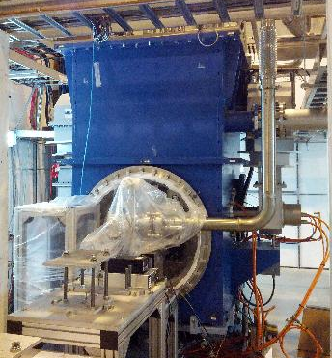
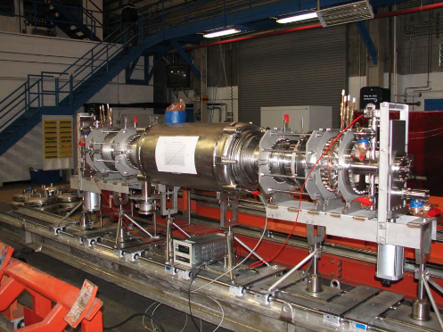
Energy Recovery Linac (ERL)
The R&D ERL is aimed at testing ERL issues for eRHIC and related projects, such as Coherent electron Cooling of RHIC. The current of 300 mA is required by eRHIC cavities.
The ERL incorporates originally developed state-of-the-art SRF laser-photocathode electron gun and a high-current, heavily damped acceleration cavity, the first such designed and built for ERL service.

Slide 15
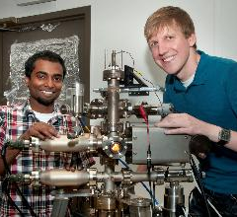
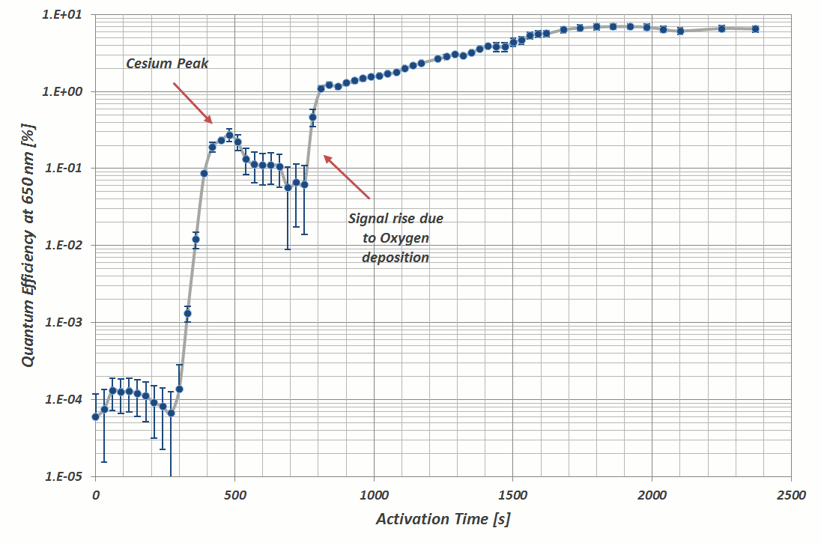
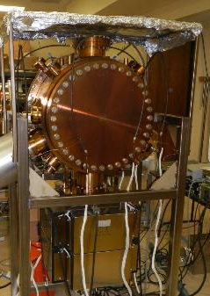
POLARIZED GUN
We are doing R&D, funded primarily by LDRD, to develop a high-current (50 mA), high-polarization electron gun for eRHIC.
The principle we are aiming to prove is funneling multiple independent beams from 20 cathodes.
External review was carried out in 2012.

Slide 16
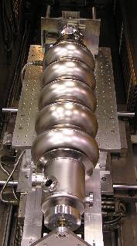
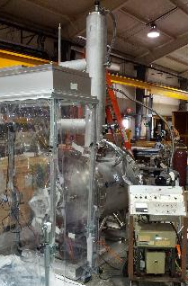
COHERENT ELECTRON COOLING
The CeC is a novel technique to cool stored ion beam which combines the best features of stochastic cooling and electron cooling. Such an effective cooling technique can be used to cool RHIC proton beams at full energy, and is a must for any version of EIC.
Competitive ONP R&D funding for CeC (M&S only, k$):
FY11 FY12 FY13 FY14 FY15 FY16 1488 1280 1410 1727 370 272

Slide 17
Summary Accelerator R&D
We follow a strategic plan.
We carry out R&D called by NSAC long range plan.
Our research is guided by high level committees.
The ARDD provides ideas and expertise that improve operations and enable upgrades.
ARDD staff support operations and AIP projects.
We work safely.
Our mid-term R&D is done with a minimal, approximately capped level of resources.
Our projects are planned.
Our projects are reviewed by external committees by choice.

Slide 18
Backup slides

Slide 19
We operate with a strategic plan
The June 28-30, 2010 review had the following recommendation:
“Prepare a strategic plan for the accelerator R&D division, which describes activities of the division, durations of tasks and goals, in the context of the overall RHIC strategic plan. Submit a preliminary plan to the Office of Nuclear Physics by January 31, 2011.”
A strategic plan was was submitted.
Mission Statement
The mission of the Accelerator R&D Division at the Collider-Accelerator Department is to develop and improve the suite of particle / heavy ion accelerators used to carry out the program of accelerator-based experiments at BNL; and to design and construct new accelerator facilities in support of the BNL and national missions. The Division participates in operations and provides a venue for Accelerator Division staff to participate in R&D. The division performs all these functions in an environmentally responsible and safe manner under a rigorous conduct of operations approach.

