Slide 1
Electrical Systems
Jon Sandberg

Slide 2
Electrical Systems
Electrical Systems Group
(J. Sandberg)
Collider Electrical P.S.
(D. Bruno)
(3 Engineers, 0.5 TS, 12 Technicians
Pulsed Power
(W. Zhang)
(3 Engineers, 0.5 TS, 4 Technicians
Power Distribution
(P.K. Feng)
(2 Engineers , 1 TS)
(R. Lambiase, W. Ng,
C. Schultheiss)
Booster/AGS Ring PS
(I. Marneris)
(3 Engineers, 1 TS, 11 Techs)

Slide 3
Electrical Systems
The personnel in these groups support the operation, development and upgrades of all C-AD systems. Recent additions including:
          EBIS -184 power supplies
            E Lens-72 power supplies
            OPPIS-PLC controls
Active participation in the Electrical Equipment Inspection Program (EEI)
Active participation in the Electric Materials and Equipment Installation Inspection Program (EMII)
Legacy equipment programs such as removal of obsolete cabling (cable pulling crew) and power distribution equipment
Training for Safety Awareness and use of proper PPE
Concerns and Mitigation of Arc Flash Hazards

Slide 4
Electrical Systems
Collider Electrical Power Supply Group (CEPS)
~1045 power supplies ranging from 50 Amp bipolar correction supplies to the RHIC Main Dipole and Quadrupole PS’s (5,500 A, 200 V, & 5,500 A, 90 V))
These power supplies can be divided into 15 different types
Superconducting quench detection and protection systems
          309 quench protection assemblies
          36 quench detection systems
          288 crowbar assemblies
          24 DX heater assemblies
Tuning of the quench detection system when significant changes to the operating cycles are
Electrical Testing of the Magnets before and after each Operating Cycle
Major contributor to eLens including the new phase shifting power supply systems (PS and QPA’s). When completed they will be responsible for 34 new power supplies for eLens
To increase system reliability major rebuilds of many hundreds of power supplies has been undertaken successfully over the last decade and a semi-automatic test facility has been built
Maintenance requirements for such a large number of PS is very labor intensive. Changing fans which are near the end of life can take two technicians many months during shutdown periods.

Slide 5
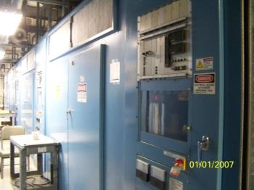
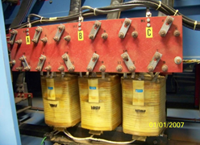
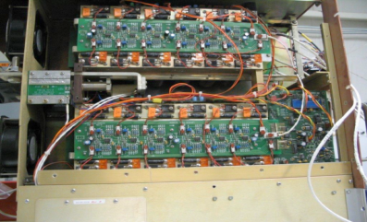
Electrical Systems
Collider Electrical Power Supply Group (CEPS)
RHIC MMPS
+/- 300 Corrector

Slide 6
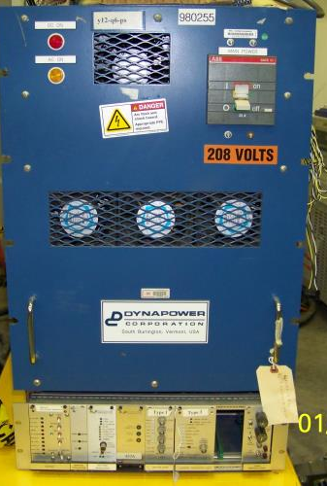
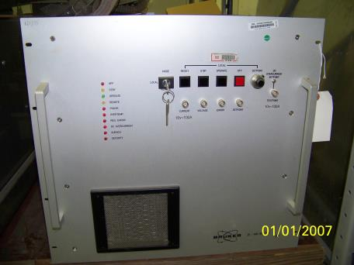
Electrical Systems
Collider Electrical Power Supply Group (CEPS)
100 A
450 A, 20 V

Slide 7
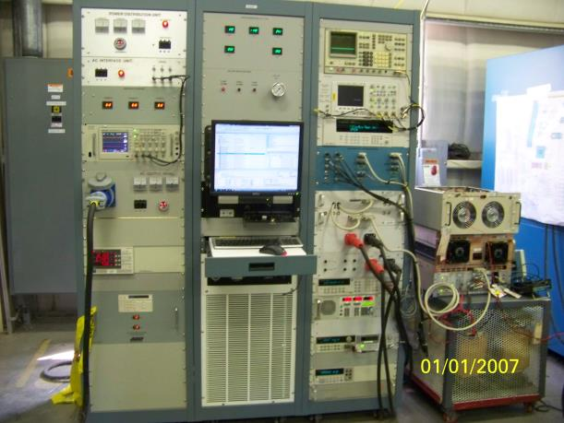
Electrical Systems
Collider Electrical Power Supply Group (CEPS)
RHIC MMPS
Automatic Test Stand

Slide 8
Electrical Systems
Booster/AGS Ring Power Supply Group (BARPS)
350 power supplies ranging from 1000 Watt correctors to the 95 MVA AGS main magnet power supply (and associated transformers (8ea) and switchgear)
Four quadrant switch mode supplies (+/- 125 V, +/- 700 A)
Two Quadrant switch mode supplies (+/- 200 V, 1000 A)
SCR supplies (+/- 9,500 V, 5,500 A, AMMPS)
The operation and maintenance of two multi MVA motor generator sets
The Booster main magnet power supply 6,000 V, 6,000 A and associated transformers (30 ea) and switchgear
Electrical testing of the AGS and Booster ring magnets
Maintenance and operations of 79 uninterruptable power supplies
Major contributions to the EBIS (collector supply 15,000 V, 15A), the OPPIS (PLC based control system) and eLense (when complete 44 PS) projects
STAR (1000 V, 5000A) and PHENIX ( 200 V, 3000A) high power PS

Slide 9
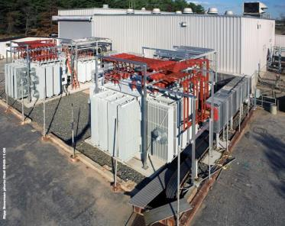
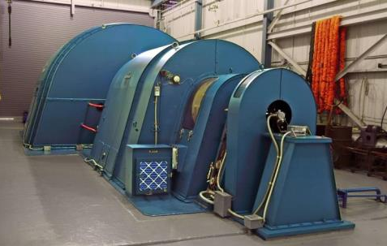
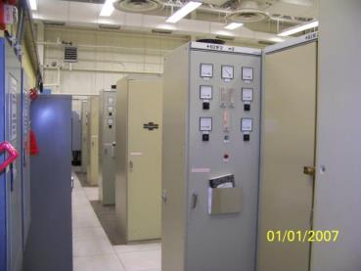
Electrical Systems
Booster/AGS Ring Power Supply Group (BARPS)
AGS MMPS --Transformers, Rectifier Assemblies, and MG Set

Slide 10
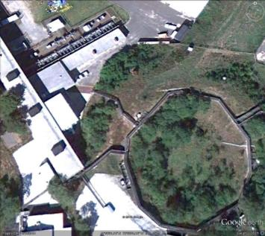
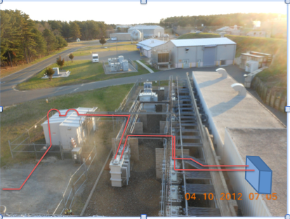
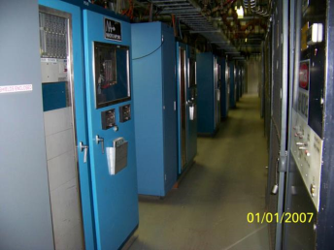
Electrical Systems
Booster/AGS Ring Power Supply Group (BARPS)
Booster MMPS-- Rectifiers, Transformers, and switchgear house

Slide 11
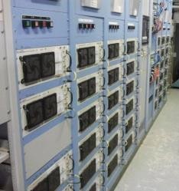
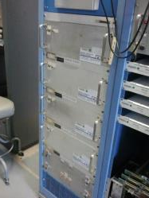
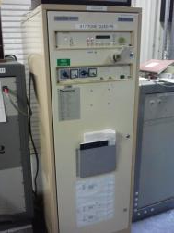
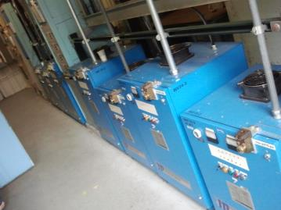
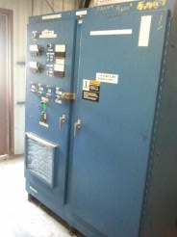
Electrical Systems
Booster/AGS Ring Power Supply Group (BARPS)
AGS Correctors
Booster Corrector
Tune Quad PS
BTA PS
J10 Dump Bump

Slide 12
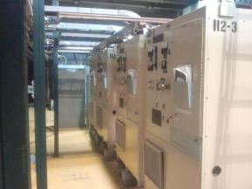
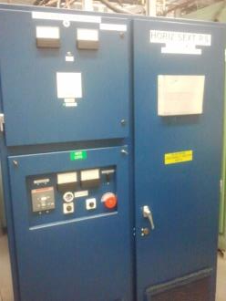
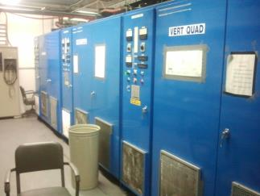
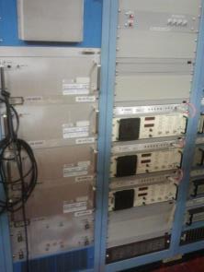
Electrical Systems
Booster/AGS Ring Power Supply Group (BARPS)
BTA PS
Sext PS
ETB PS
Multipole Room PS’s

Slide 13
Electrical Systems
Pulsed Power Systems Group (PPS)
65 Pulsed power system throughout C-AD
20 systems in the Booster
23 systems in the AGS
20 systems in RHIC
2 in EBIS
Booster Injection kicker 90 V, 1000 A (function 1ms-1.5 ms)
Booster extraction kicker 35,000V, 1,200 A (2,300 ns trapezoidal waveform)
AGS L20 injection septum 350 V, 12,000 A (2 ms, ½ sine waveform)
AGS extraction kickers 35,000 V, 2000 A (360 ns, ½ sine waveform)
RHIC Injection kickers 32,000 V, 1,260 A (160 ns trapezoidal waveform)
RHIC Abort kicker 28,000 V, 21,000 A (22 us irregular waveform)
Cost and delivery of thyratrons is becoming a significant problem. A recent quote for the abort kicker thyratrons is now ~ $40 K. Solid state solution must be found.
4 PS for eLens

Slide 14
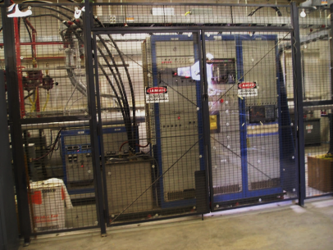
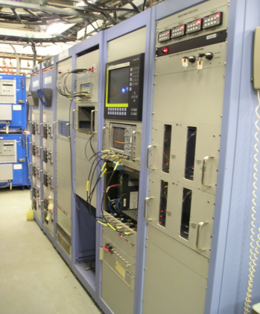
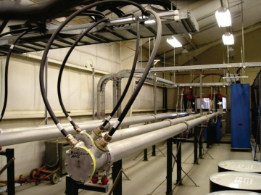
Electrical Systems
Pulsed Power Systems Group (PPS)
RHIC Injection Kicker PS--Controls, Charging Supply and Blumlein pulse generator

Slide 15
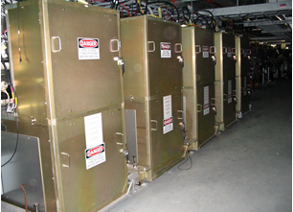
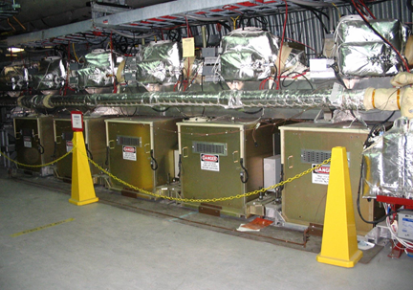
Electrical Systems
Pulsed Power Systems Group (PPS)
RHIC Abort kicker modulators

Slide 16
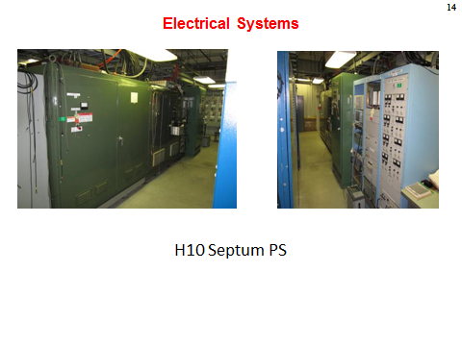
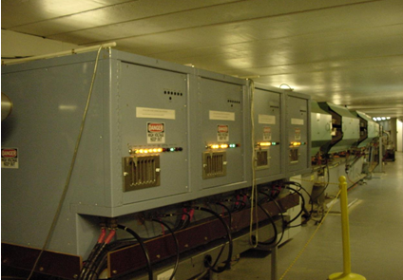
Electrical Systems
Pulsed Power Systems Group (PPS)
H10 PS
G10 Modulators

Slide 17
Electrical Systems
Power Distribution Group
Maintains, Operates, Designs, and Installation of 120/208 V, 480 V, 4160 V, and some limited number of 13.8 kV experimental power distribution systems.
C-AD uses approximately 56 % of the Laboratory power (31 MW)
C-AD utilizes 59 unit substations (13.8 kV / 480 V)
There are two 10 MVA 13.8 kV/ 4,160 V substations which supply power to 26 compressor motors for the RHIC cryogenic system
There are ~8,000 switch and panel boards at C-AD as well as 30,000 molded case circuit breakers
There are 11 diesel generators which supply 2400 kW of emergency power to the complex.
The C-AD Power Distribution Group takes care of low voltage systems (<600 V) for:
          Lighting Systems
          Variable Frequency Drives
          Motor Soft Start Systems
          Automatic transfer switches
          Ground fault detection systems
          Transformers
          Panel boards
          Motor Control Centers (MCC’s)

Slide 18
Electrical Systems
Power Distribution Group
Responsible for 49, 480 V MCC’s. There is an ongoing effort to replace older MCC’s
In 2006 the C-AD floating Delta system was converted to a high resistance grounded system. Since then remote ground fault detection and monitoring systems have been implemented on 51 substations.
RHIC has 2000 lighting fixtures and 800 lamps and 300 ballasts must be replace annually.
This group has been responsible for 106 work orders (wo’s) so far in 2013, 294 wo’s in 2012, 409 wo’s in 2011, and 336 wo’s in 2010
Replacement of High incident energy switchgear and relays. Since 2006:
        Over 93 beaker settings have been reviewed and optimized
        Soft start circuitry has been added to the STAR main power supply
        45 new solid state trip units have been installed
        New remotely operated switchgear has been installed at 1005 H
        ~ 6000 pieces of equipment have received arc flash labels
        The condition of aging and over-dutied equipment has been brought to forefront and resource are regularly allocated to remediate these conditions

Slide 19
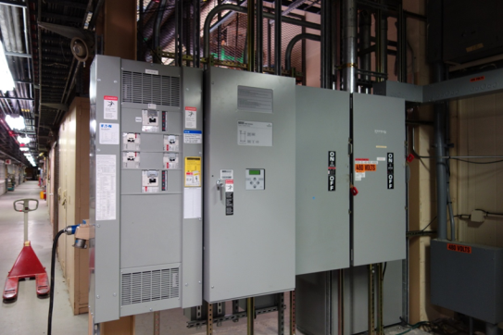
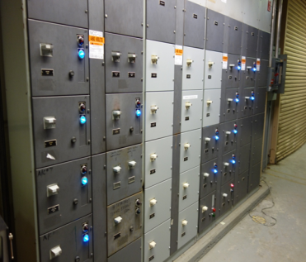
Electrical Systems
Power Distribution Group
New Transfer switch and load center at Linac reduces arc flash hazard
New Buckets in Linac MCC

Slide 20
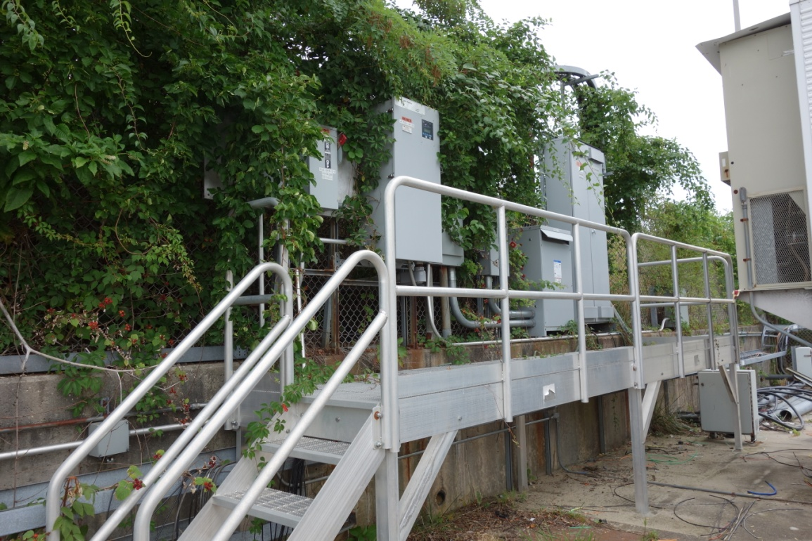
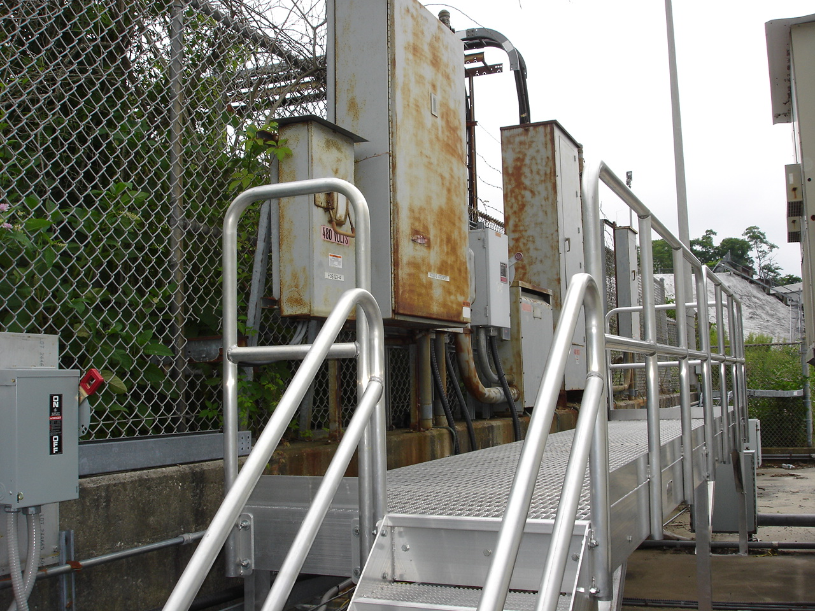
Electrical Systems
Power Distribution Group
Replaced Last Year
Before replacement
Load Center Replacement

Slide 21
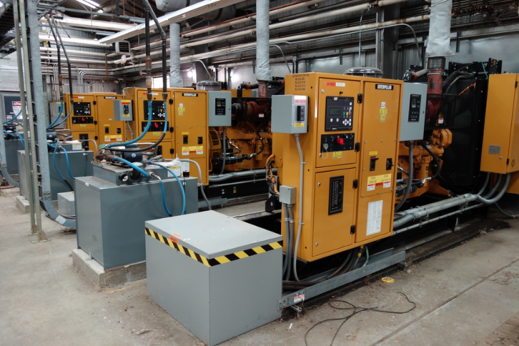
Electrical Systems
Power Distribution Group
New
912A Emergency Generators

Slide 22
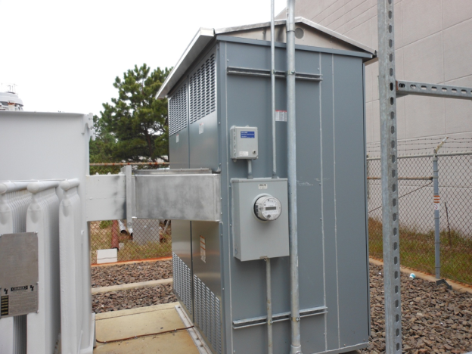
Electrical Systems
Power Distribution Group
1005h, 480 V Main Switchgear replacement now remotely operated

Slide 23
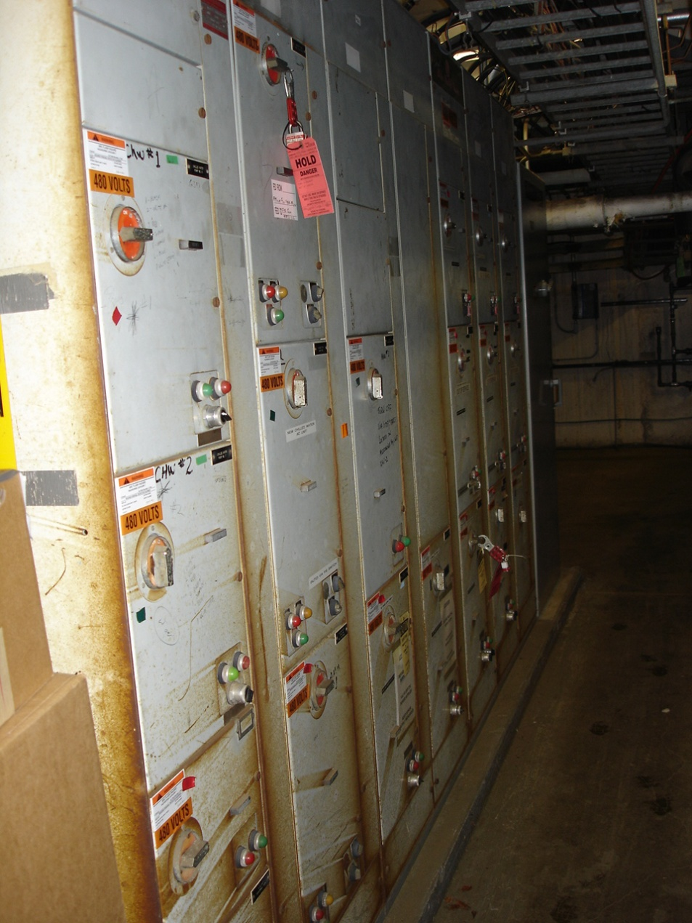
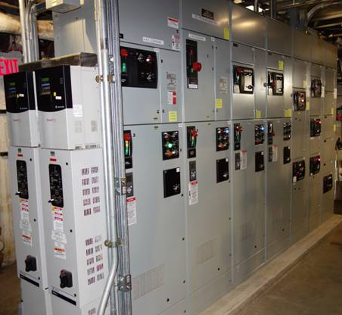
Electrical Systems
Power Distribution Group
Old 929 MCC
New 929 MCC

Slide 24
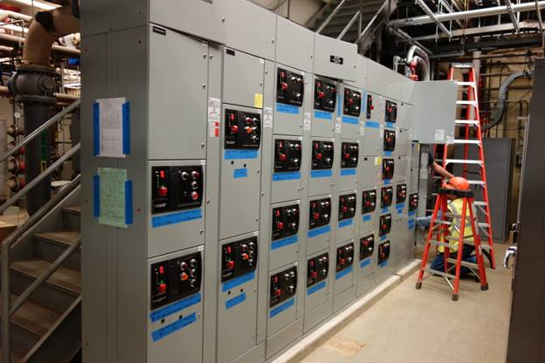
Electrical Systems
Power Distribution Group
New MCC in 928 now under construction

Slide 25
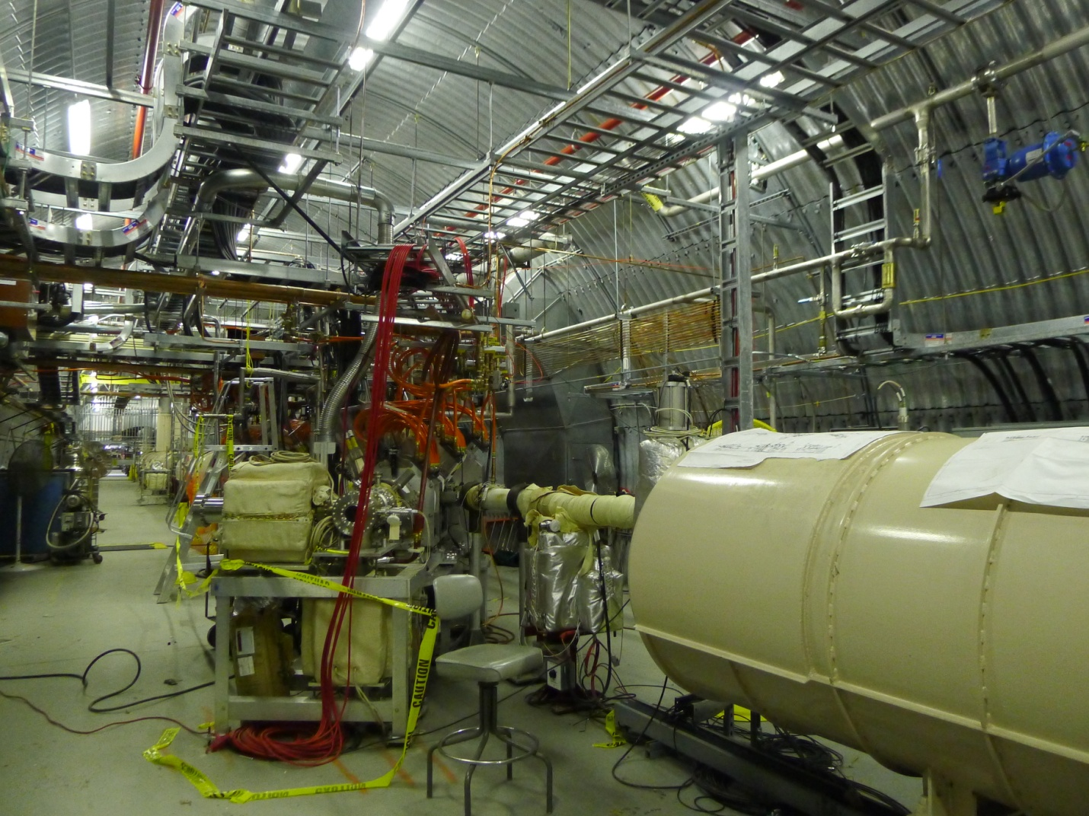
Electrical Systems
Power Distribution Group
eLens Cable Tray and Wireway

Slide 26
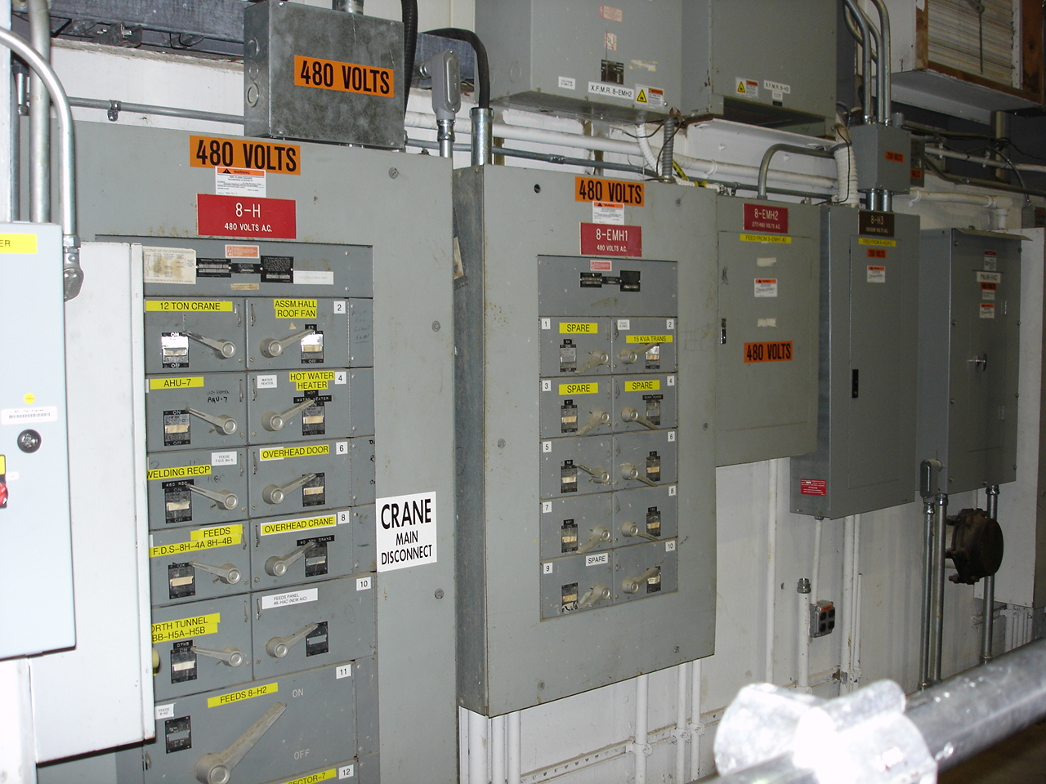
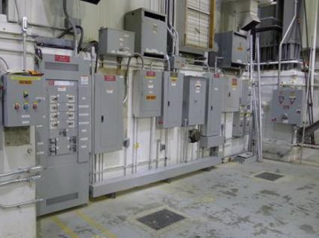
Electrical Systems
Power Distribution Group
Old
New
PHENIX Panel Board Replacement

Slide 27
Electrical Systems

