Slide 1
ESSHQ Management at RHIC
Edward T. Lessard

Slide 2
Introduction and Outline
Mission
Performance
ESSHQ Assurance Programs
Costs and FTEs
FY13/14 ESSHQ Objectives and Targets
Summary
Backup Materials

Slide 3
C-AD ESSHQ Division

Slide 4
C-AD ESSHQ for RHIC Accelerators and Experiments
User Safety, Work Planning, Configuration Control, and Change Management
Procedures, Authorizations, Training and Qualifications for RHIC Operations
ASEs, SAD, USI Process, ARR Program, R2A2s, Credited Engineered Safety Systems for RHIC Accelerator Facilities
Mission: Improve and operate accelerators, support the experimental program, and design and construct new accelerator facilities in an environmentally responsible and safe manner under a rigorous conduct of operations approach
Applicable DOE Orders: O420.2C, Safety of Accelerator Facilities, and O422.1, Conduct of Operations

Slide 5
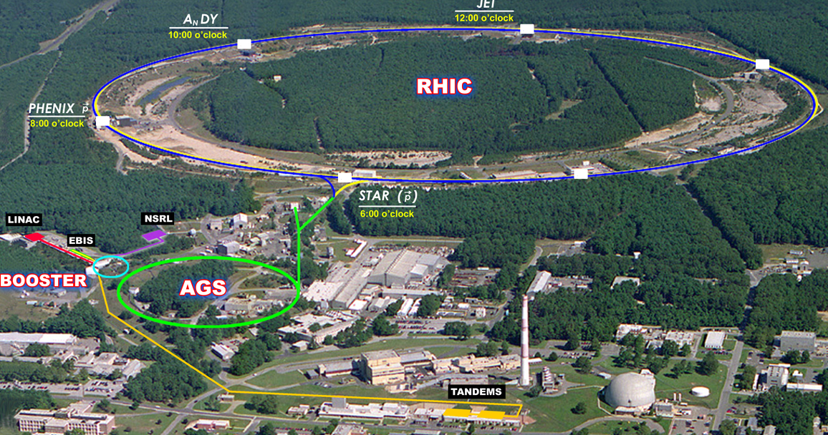
C-AD Accelerator Facilities
H⁻ High Intensity Source; Optically Pumped Polarized Proton Source (OPPIS); Electron Beam Ion Source (EBIS); 200-MeV Linac; Tandem Van De Graaffs (TVDG); Tandem to Booster Line (TTB); Booster; Alternating Gradient Synchrotron (AGS); U-Line and V-Line; AGS to RHIC Transfer Line (AtR); Collider Rings; PHENIX; STAR; JET; NASA Space Radiation Laboratory (NSRL); Prototype Energy Recover Linac (ERL); Accelerator R&D Facility in B912; Brookhaven Linac Isotope Producer (BLIP); Radionuclide Research Processing Laboratory (RRPL); Stochastic Cooling; 56 MHz Cavity in RHIC; Electron Lenses; Coherent Electron Cooling (CEC) Proof of Principle; Accelerator Test Facility (ATF)
JET
eLens
CEC POP
2:00 o’clock
PHENIX
STAR
U, V Lines
Acc. R&D
OPPIS
AtR
ERL
BLIP
MCR
RRPL
TTB
ATF

Slide 6
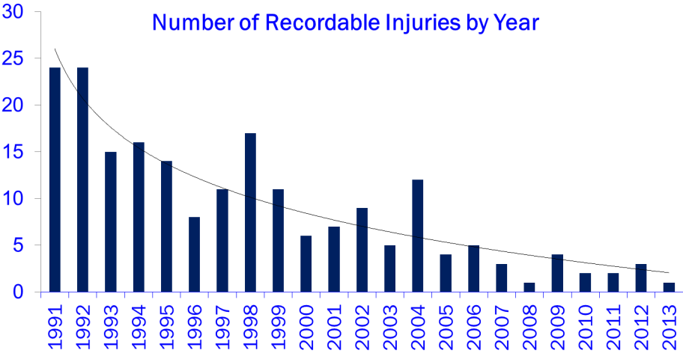
Long-Term Injury Trend at C-AD

Slide 7
Comparison of OSHA Recordable Occupational Injury Rate at C-AD in FY 2012 to Others
Organization | DART Rate Injuries per 100 FTE | TRC Rate Injuries per 100 FTE
C-AD | 0.25 | 0.75
FermiLab | 0.80 | 1.60
BNL | 0.54 | 0.90
JLab | 0.70 | 1.00
DOE Research Contractors | 0.30 | 1.10

Slide 8
Reportable Occurrence Trend at C-AD
Occurrences

Slide 9
Current ESSHQ Challenges at C-AD
Facilities
Roof leaks, cable tray deterioration, inadequate workspace, poor lighting, energy inefficient buildings
Sustainability
Reducing /better utilizing government vehicles
Improving energy efficiency of heating and cooling equipment
Reducing footprint of C-AD (square feet of space)
Code deficiencies in older buildings compared to newer buildings
Equipment
Updating machine shop tools with emergency stops
Replacing fixed vertical ladders not in full OSHA compliance
Replacing relay-based access control systems
Replacing and removing older cables
Replacing motor control centers

Slide 10
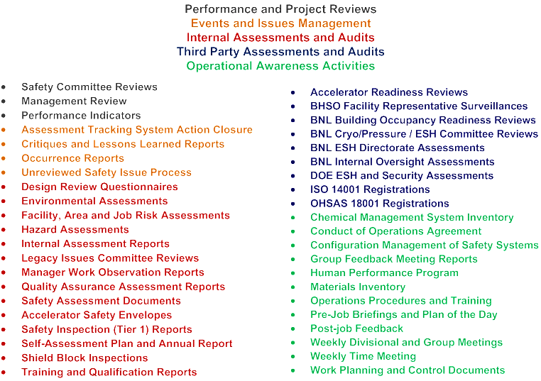
Contractor Assurance Programs at C-AD

Slide 11
FY12 Action Items From Assurance Programs
How we track action items
Action items assigned to accountable individuals
Internal actions entered in Family ATS
External actions in Institutional or Family ATS
Closeout requires concurrence of C-AD management
Internal
(C-AD Family)
ESH 368 (57% closed in FY12)
QA 244 (52% closed in FY12)
Issued to C-AD personnel
External (Institutional)
61 (80% closed in FY 12)
Independent Verification performed as required

Slide 12
ESSHQ Costs – General Notes
Costs do not include the cost of the engineered safety control systems (e.g., radiation interlock systems, ODH systems, access control systems)
Waste streams are the major expense
ESH professionals and technicians:
Training, quality assurance and operations assurance professionals:
13.8 FTEs
9.2 FTEs

Slide 13
C-AD ESSHQ Division = 23 FTE (5% of C-AD Total)
Operations Safety Assurance – 7.0 FTE
Training – 2.0 FTE
QA / Security – 1.5 FTE
Central BNL ESH Purchased Services - 12.5 FTE

Slide 14
Average Annual ESSHQ Projects and Supplies Cost
Routine Safety Equipment Estimate (PPE, TLDs, ODH Monitors and Escape Packs, Calibration Costs…)
Security Improvements
Groundwater Monitoring
$500,000
$70,000
$120,000

Slide 15
C-AD ESSHQ Materials, Projects and Waste Cost Summary 2004 - 2012
Fiscal Year

Slide 16
C-AD ESSHQ FTE Summary 2004 - 2012
Arc Flash Consultants
RRPL RCTs

Slide 17
C-AD ESSHQ FY12 Manpower and Cost Tables
 | ES&H and QA
 | (Dollars in Thousands)
 | 2010 | 2011 | 2012 | 2013*
Salaries | 1,419.0 | 1,406.0 | 1,368.8 | 1,629.9
Other Direct Labor | 13.0 | 11.9 | 13.6 | 14.5
Trade Labor | 31.9 | 19.6 | 45.3 | 20.0
Purchases | 81.3 | 81.3 | 74.9 | 51.6
High Value Procurements | 0.3 | 30.4 | 14.2 | 0.0
Equipment |  | 0.2 | 0.1
Communications
Total Programmatic Cost | 1,545.5 | 1,549.4 | 1,516.9 | 1,716.0
Material Handling Burden | 4.7 | 7.7 | 6.5 | 3.9
Space
G&A
Total Laboratory Support Cost | 4.7 | 7.7 | 6.5 | 3.9
Total Annual Cost | 1,550.2 | 1,557.1 | 1,523.4 | 1,719.9
* Estimated Annual Cost
 | Manpower
 | FY 2010 | FY 2011 | FY 2012 | FY 2013
ES&H | 8.37 | 8.67 | 8.72 | 10.53
QA | 2.01 | 1.39 | 1.12 | 1.00
Total Organizational Burden FTE's | 10.38 | 10.06 | 9.84 | 11.53
Project Numbers | 18007
 | 18008

Slide 18
FY13/14 ESSHQ Objectives and Targets That Require Continued Support
Objectives: Zero Injuries, Zero Non-Compliances, Improve Energy Efficiency In Operations, Reduce Hazardous Materials/Conditions
Some FY13/14 Targets:
Continue to request HEP funds to remove HEP wastes
Continue to request smaller building footprint for ESH and productivity improvement
Continue to update life safety / fire protection in existing buildings and improve energy efficiency where practicable
Identify “critical” machine shop tools and perform upgrades; remove others from service
Bring ~70 vertical fixed ladders associated with NP programmatic equipment into “working compliance”
Continue to secure C-AD facility doors and work spaces
Obtain DOE authorization to commission and operate ERL in Building 912

Slide 19
Summary
C-AD has a good track record; injury rates and occurrences are low and have been trending downward for many years, which reduces cost
C-AD management has well defined assurance programs patterned after the world’s safest companies
C-AD managers are engaged; C-AD workers are participating in ESSHQ programs beyond their normal job; safety is totally integrated into the C-AD culture
C-AD has continuous improvement programs to set ESSHQ goals each year
C-AD ESSHQ goals include reducing hazardous materials, hazardous equipment and waste, making older facilities code-compliant and energy efficient, and ensuring facility security

Slide 20
Backup Materials

Slide 21
Links to Backup Materials
Senior Management Reviews of C-AD ESSHQ for Last 13 Years
  http://www.c-ad.bnl.gov/ESSHQ/SND/environmental_management_review.htm
Service Level Agreements with BNL ESH Directorate and Quality Office
  http://www.c-ad.bnl.gov/ESSHQ/SND/Service_Level_Agreements.htm
C-AD Authorization Basis Documents
  http://www.c-ad.bnl.gov/ESSHQ/SND/authbasis.htm
C-AD NEPA Documents
  http://www.c-ad.bnl.gov/ESSHQ/SND/envdoc.htm
C-AD Occurrence Reports
  http://www.c-ad.bnl.gov/ESSHQ/SND/occurrences.htm
C-AD Unreviewed Safety Issue Process Documents
  http://www.c-ad.bnl.gov/ESSHQ/SND/unreviewed_safety_issues.htm

Slide 22
C-AD First Aid Cases

Slide 23
Annual Injury Cost 2005 - 2012

Slide 24
C-AD Low-Level Radioactive Waste
Shipped, Cubic Feet (2000 -2012)

Slide 25
Future HEP Related Waste Efforts
Appears to be enough in HEP legacy waste funds in FY13 to complete B and C line cleanups, and g-2 equipment re-use at Fermi-Lab
Future HEP cleanup depends on HEP funding being maintained
FY14: HEP radioactive magnets and components from B912 switchyard, and g-2 primary beam line

