Slide 1
Accelerator Operations Overview
Thomas Roser

Slide 2
Outline
RHIC facility: performance, availability, upgrades, complexity and size
Operating budgets, staffing, cost drivers, operating efficiency
Operations planning and organization, resource allocations among operations, set-up, maintenance & repairs, accelerator R&D
Brief overview of activities other than RHIC

Slide 3
RHIC Operations Organization
Nuclear and Particle Physics Directorate
Program Advisory
Committee
Collider-Accelerator Department
Physics Department
KB020201-1 + KB020201-2
350 FTEs
KB020201-2
71 FTEs
RHIC Accelerator Operations
RHIC Exp. Support
Infrastructure Support
RHIC Exp. Support
Detector Ops and RCF
T. Roser, W. Fischer, I. Ben-Zvi, P. Pile
J. Dunlop

Slide 4
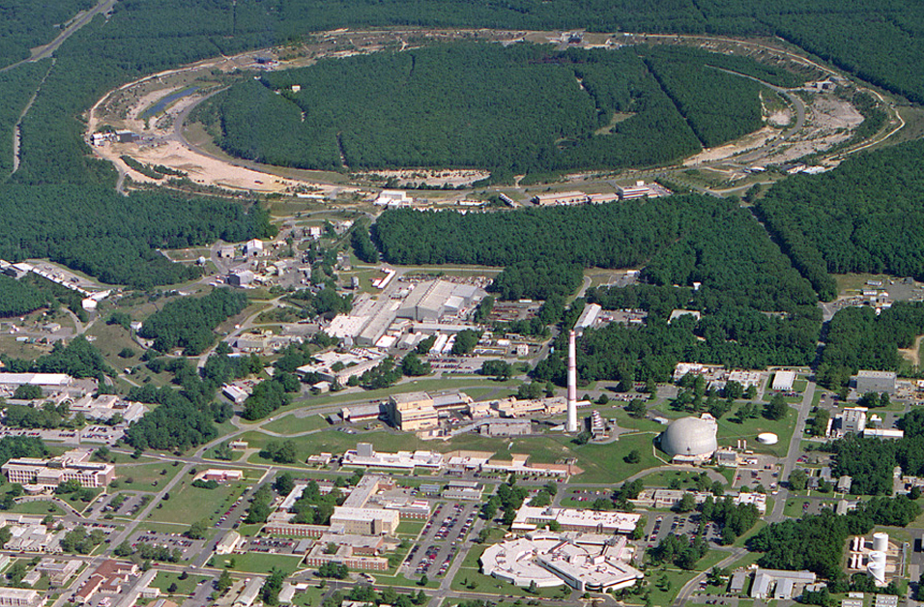
RHIC – a High Luminosity (Polarized) Hadron Collider
Polarized Jet Target
12:00 o’clock
Electron lenses
10:00 o’clock
RHIC
(Electron cooling)
2:00 o’clock
PHENIX
8:00 o’clock
RF
4:00 o’clock
STAR
6:00 o’clock
LINAC
NSRL
EBIS
Booster
BLIP
AGS
Operated modes (beam energies):
Au – Au 3.8/4.6/5.8/10/14/32/65/100 GeV/n
U – U 96.4 GeV/n
Cu – Cu 11/31/100 GeV/n
p↑ – p↑ 11/31/100/205/250/255 GeV
d – Au* 100 GeV/n
Cu – Au* 100 GeV/n
Planned or possible future modes:
Au – Au 2.5 GeV/n
p↑ – A* 100 GeV/n (A = Au, Cu, Al)
³He – A* 100 GeV/n (A = Au, Cu, Al)
p↑ – ³He↑* 166 GeV/n (*asymmetric rigidity)
Tandems
Achieved peak luminosities:
Au – Au (100 GeV/n) 195 × 10³⁰ cm⁻² s ⁻¹
p↑ – p↑ (255 GeV) 238 × 10³⁰ cm⁻² s ⁻¹
Other large hadron colliders (scaled to 255 GeV):
Tevatron (p – pbar) 110 × 10³⁰ cm⁻² s ⁻¹
LHC (p – p) 493 × 10³⁰ cm⁻² s ⁻¹

Slide 5
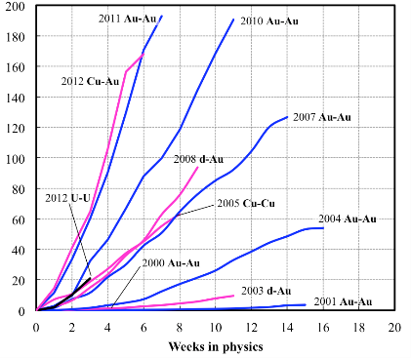
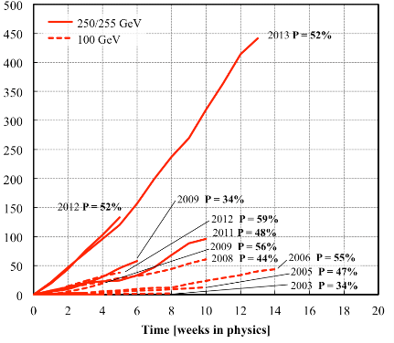
RHIC Integrated Luminosity and Polarization
(RHIC II performance!)
Heavy ion runs
Polarized proton runs
Integrated nucleon-pair luminosity L_{NN} [pb⁻¹]
Integrated luminosity L [pb⁻¹]
Facility availability is typically well above 80% (FY12: 85%; FY13: 84%)
Calendar time-in-store (physics) is about 60% (~100 hours per week)
Nucleon-pair luminosity: luminosity calculated with nucleons of nuclei treated independently; allows comparison of luminosities of different species; appropriate quantity for comparison runs.

Slide 6
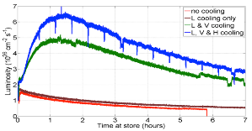
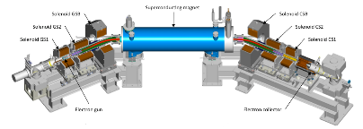
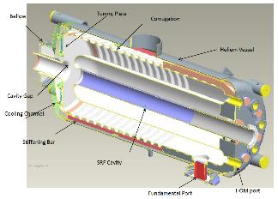
Major RHIC upgrade projects
U-U luminosity with 3-D cooling
Electron Beam Ion Source (EBIS) pre-injector provides all ion species, including uranium, and reduces operations staffing (- 9 FTEs)
3-D stochastic cooling successfully completed during run-12 with further improvements installed for run-14
Beam-beam compensation with electron lenses. Engineering tests during run-13 and commissioning during run-14
New 56 MHz storage cavity for shorter vertex length to be installed for commissioning during run-14
RHIC “low energy” (<10 GeV/n) cooling project; completion planned for run-18 (Review: August 13-14, 2013)
Electron lens
56 MHz quarterwave srf cavity

Slide 7
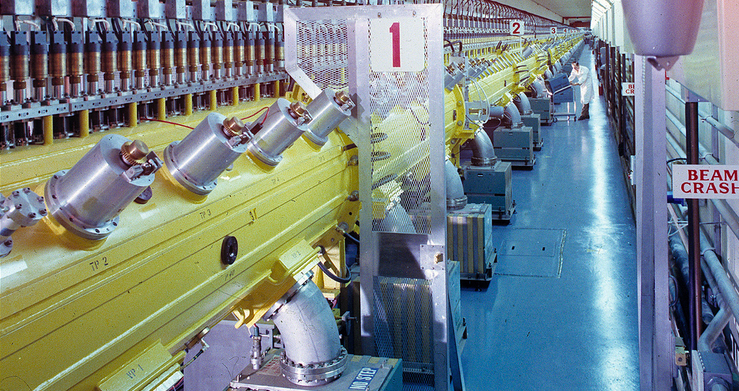
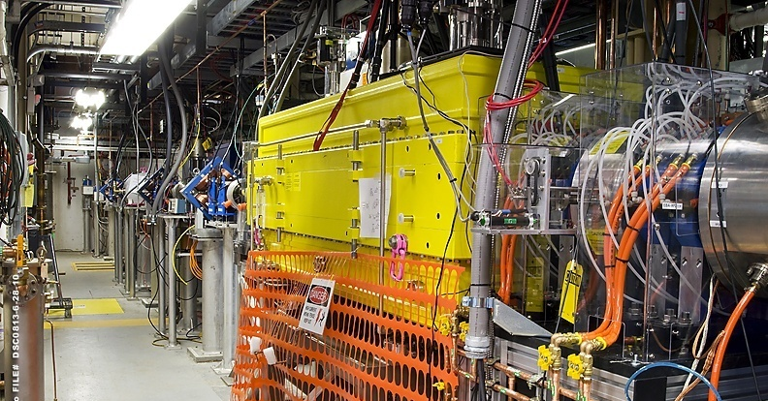
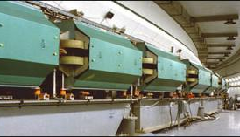
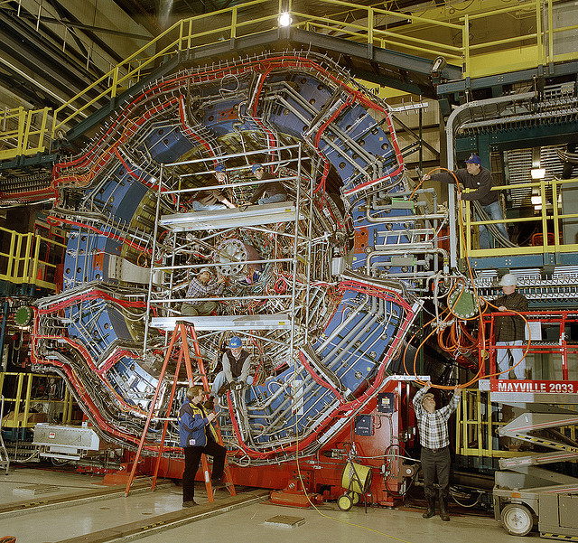
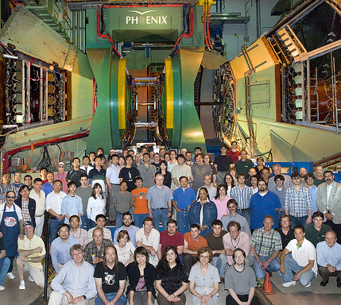
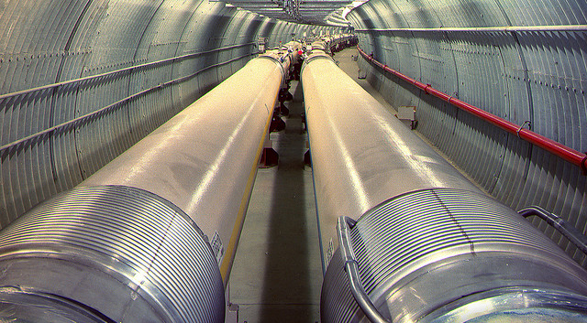
RHIC Facility Size and Complexity
5 major accelerator systems: EBIS pre-injector, 200 MeV Linac, 3 GeV Booster, 30 GeV AGS, two 250 GeV s.c. RHIC rings
Covers many types of accelerators and state-of-the-art and unique accelerator technologies: high luminosity heavy ion collider with high energy stochastic cooling, high energy polarized proton collider, world record ion and polarized proton sources, …
2 major multipurpose detectors STAR and PHENIX
1000 multi-core servers and 23 PB of storage at the RHIC Computing Facility
The only US particle beam collider.

Slide 8
RHIC Facility Size and Complexity (cont’d)
17 km of evacuated beam lines (large part of it below 10⁻¹⁰ Torr)
7.3 km superconducting magnets and cryostats (~1800 s.c. magnets)
25 kW@4.5K He refrigerator (12 turbines, 25 compressors,…)
2 rapid cycling synchrotrons (16 MW and 40 MW power supplies)
~ 40 high power rf systems (100 kHz – 9 GHz)
1400 programmable power supplies and 65 pulsed power systems
~1000 BPM planes, ~45 profile monitors, 300 axes of motion controls, 800 loss monitors
1.4 million control points and thousands of embedded processors
Replacement value is at least $2B

Slide 9
RHIC Operations Organization
Nuclear and Particle Physics Directorate
Collider-Accelerator Department
Physics Department
Program Support
Operations & Operations Support
STAR Detector Operations
Pre-Injectors
RF
PHENIX Detector Operations
Instrumentation
Mechanical Systems
RHIC Computing Facility
Electrical Systems
Vacuum Systems
Cryogenic Systems
Controls & Access Controls
Accelerator Physics
Superconducting Magnets
Facilities & Infrastructure
Mid-term Accelerator R&D
Technical staff is matrixed to achieve the tasks of the functional groups
Administrative and ESSH&Q functions are covered through organization burdens
Building maintenance is provided by lab services and covered through a “space charge”

Slide 10
RHIC Facility Funding and Cost (k$)
Well below the typical yearly operation funding level of 10 % of replacement cost
Four years of flat budgets amounts to an effective 10% budget cut!

Slide 11
RHIC operations cost drivers
Majority of operating cost is independent of run length (salaries, overheads, space charge, most of M&S, AIP, CAP,…)
Typical incremental cost: ~ $0.5M/wk (el. power: $0.25M/wk for $60/MWhr; incr. M&S: $0.25M/wk) → 22 weeks requires $11M
Four years of flat funding resulted in steadily diminishing number of cryo-weeks

Slide 12
C-AD RHIC Operations Funding
FY14 Guidance allows for sustainable ops. and is similar to FY12 budget:
  22 cryo-weeks per year ($62/MWhr)
  345 FTE accelerator operations including 19 FTE funded through exp. support
  AIP/CAP/M&S maintained at suboptimal level
Optimal facility operations:
  28 cryo-weeks and 24 weeks of shutdown per year; 24 weeks of shutdown per year is deemed the minimum for maintenance plus implementing accelerator and detector upgrades that optimize total integrated luminosity of the facility
  357 FTE (Accelerator operations and experiment support: 323; SMD support: 9; Mid-term accelerator R&D (eRHIC): 25)
  AIP/CAP supports growing program capabilities and efficient facility operations

Slide 13
C-AD RHIC operations cost

Slide 14
C-AD RHIC Operations – Functional Group FTEs and Cost
Summary of each technical group’s mission, scope of effort, detailed staffing and cost is provided as background material.

Slide 15
Staffing of Technical Groups by Fiscal Year
Electrical
Systems
Controls &
Access Cntrls
Total RHIC Accelerator Operations (FTE/10)
Pre-Injectors
Cryogenic Systems
Operations &
Operations Support
Instrumentation
Accelerator Physics
Facilities & Infrastructure
Mid-term Accelerator R&D
Superconducting Magnet Support
Mechanical Systems
Vacuum Systems
RF
Program Support
Staffing optimization of basically constant RHIC operations staff and slowly eroding budget:
  Savings from improved operations efficiency were used effectively to implement RHIC II and to start mid-term Accelerator R&D
  Staff increase in 2009/10 for critical hires and in anticipation of retirements.
  Removal of Tandem operation after completion of EBIS
  Electrical systems:
    Major effort to refurbish RHIC power supplies since it is the main source of failure; many new power systems for EBIS, ERL, eLens; electrical infrastructure upgrades
  Instrumentation:
    New systems (stochastic cooling, polarimeters); beam-based feed-back needs high reliability of instrumentation
  Mechanical systems:
    Increased design work for stochastic cooling, ERL (SRF), eLens, Coherent electron Cooling (SRF), …

Slide 16
RHIC operations cost reductions
Cut power consumption of RHIC refrigerator since beginning of RHIC by
~ 7 MW
Renegotiated BNL power contract with NYPA, allowing retention of power rates at ~ $60/MWhr
Reduced Superconducting Magnet Division staff supported by RHIC operations from 20 to 9
Phasing out Tandem Van de Graaff operations staff of 9 FTE in FY12
Staff turnover has improved age distribution and neutralized inflation in cost per FTE
FY06-07 merger of RHIC and ATLAS Computing Facilities permits savings of ~ 6 FTE to RHIC operations budget, by exploiting synergies with HEP-funded efforts
Replaced electron cooling plan with stochastic cooling to achieve
RHIC II luminosity upgrade during FY08 - 12 (~ $12M of AIPs instead of
~$100M project)
Continued and expanded use of facilities by other programs (NSRL, BLIP, Tandem Commercial Users Program, etc.) under full cost recovery, reducing RHIC operations cost via synergies and effective use of staff, and also leading to improved performance and flexibility of the facility.
Bottom line: above changes have led to ~ $115M cumulative savings in the FY07-13 period. Some of these savings were reinvested to allow RHIC to remain competitive well into the future.

Slide 17
Collider-Accelerator Department
Responsible for the safe and efficient operation and development of particle accelerators in support of the national mission, mainly for ONP (RHIC, BLIP) but also for NASA.
3 Divisions:
  Accelerator Division (W. Fischer): main responsibility for the operation and development of all accelerators, also participating in R&D activities
  Accelerator R&D Division (I. Ben-Zvi): main responsibility for R&D towards future facilities, also participating in RHIC operations activities
  Experimental Support & Facilities Division (P. Pile): main responsibility for support of RHIC experiments and facility infrastructure.

Slide 18
Operations Planning and Organization
Detailed RHIC performance projections are produced yearly (see background material)
During running periods:
  1 week for 50K to 4K machine cool-down
  2 weeks of machine set-up and commissioning led by accelerator physicists or operations specialists
  For troubleshooting and repair of equipment: call-in lists for each group (everybody is on call!), remote controls access is used extensively for troubleshooting
  Daily run coordinator meeting and weekly scheduling meeting.
  Weekly run planning meeting of machine and experiment coordinators with ALD
  Scheduled maintenance periods of 14 hours every two weeks. Carefully planned and coordinated by the maintenance coordinator to reduce recovery time.
  Beam studies (APEX) period of 16 hrs (end-to-end) every two weeks is proposal-driven and reviewed by ALD-appointed committee (AEAC)
  1 – 2 weeks to change species during run
  ½ week for machine warm-up

Slide 19
Operations Planning and Organization (cont’d)
During shutdown periods:
  Preventive maintenance and replacement of equipment.
  Installation of enhancements and upgrades
  Overall shut-down work planned as project with GANTT chart
  All newly installed systems or system modifications undergo engineering review and a review by the Accelerator Systems Safety Review Committee, the Experimental Safety Review Committee and/or the “Radiation Safety Committee” as appropriate.
  2 ½ day retreat at beginning of shutdown to review operations performance and shutdown work
  Yearly review of Accelerator Development and Accelerator R&D by external
  C-AD Machine Advisory Committee (Present membership: J. Jowett (CERN), G. Krafft (TJNAF), SY Lee (Indiana University), K. Ohmi (KEK), V. Shiltsev (FNAL), P. Spiller (GSI), R. Talman (Cornell), F. Zimmermann (CERN, Chair))

Slide 20
24/7 Operations Staffing
Running periods (reduced from 11 to 7 seats):
  In Main Control Room (MCR) one Operations Coordinator (OC, central point-of-contact) and two operators: 3
  Collider Accelerator Support: 2
  Refrigerator operations: 3 ￫ 2
  Siemens motor generator: 1 ￫ 0
  Tandem van de Graaff (replaced by EBIS): 2 ￫ 0
For long term operation need 5 - 6 FTE per seat to account for sick time, vacation time, training…

Slide 21
Preventive Maintenance
C-AD has an aggressive annual maintenance plan for Electrical Systems, Vacuum Systems, RF Systems, Mechanical Systems, Instrumentation & Beam Components, Cryogenic Systems, Pre-injector Systems, and Controls that is executed during the by-weekly maintenance periods and the summer shutdown.
The maintenance frequency of technical systems is based on manufacturers’ specifications or gained experience with the system and is prioritized based on how critical it is for operations (credited controls have highest priority)
The shutdown preventive maintenance list is available in the background material.

Slide 22
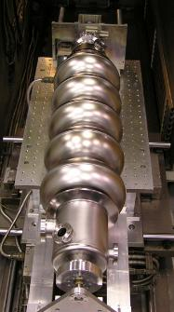
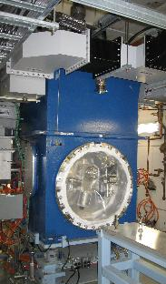
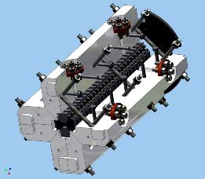
Main Mid-Term Accelerator R&D Items
High intensity srf accel. cavity
High power srf electron gun
eRHIC design for 5 GeV electron beam and 10³² cm⁻² s⁻¹ luminosity for $550M (FY12$) completed, R&D underway for 10 GeV and 10³³ cm⁻² s⁻¹ luminosity.
R&D on high intensity polarized electron gun using multiple cathodes (Gatling gun): results with 2 cathodes in 2014
High intensity test Energy Recovery Linac (ERL): circulating beam in 2014
Test of Coherent electron Cooling in RHIC: planned for run-15/16.
Helical wiggler prototype

Slide 23
Accelerator R&D Investment
Accelerator R&D for Electron Ion Collider recommended in 2007 NP Long Range plan. Present level is at 5% of total RHIC operations funding, arrived at in communication with ONP
The ~ 5% (of RHIC operations budget) investment in R&D is considered appropriate and essential among forefront accelerator facilities.
Effort limited to ~ 25 FTEs and ~ $1.5M M&S
Note: stochastic cooling, saving ~ $100M to reach RHIC II performance, illustrates the long-term cost effectiveness of R&D investments.

Slide 24
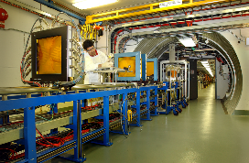
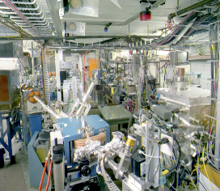
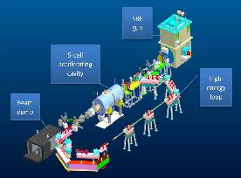
C-AD activities other than RHIC
Activities other than RHIC, under full cost recovery, are using the existing unused capabilities of the complex to address national needs and benefit the RHIC facility by co-funding facility enhancements, reducing RHIC operations cost via synergies and effective use of staff and also lead to improved performance and flexibility of the facility.
  NASA Space Radiation Laboratory (NSRL)
    Ion beams from Booster to simulate deep space
    radiation fields; annual budget ~ $9M ($5M to C-AD)
    Funded projects: $4M for EBIS ($19M total), new laser ion source for EBIS for rapid species switching (ongoing)
    Also used for radiation effects studies by National Reconnaissance Office (NRO); ~ $1.5M/year
  Brookhaven Linac Isotope Producer (BLIP) and Target Processing Laboratory (TPL)
    Medical isotope production and R&D using 200 MeV Linac. ONP funding of ~ $8M
  Accelerator Test Facility (ATF) funded by HEP and BES
    First user facility for accelerator R&D, recently moved organizationally to C-AD for better synergy with RHIC accelerator expertise. ~ $3.3M budget
  Applied use of the Tandem facility
    Radiation effects studies, molecular filter production
    Stand-alone Tandem operations started in 2012, ~ $2M/yr
  NAVY funding of R&D on ERL-based high power IR FEL
  (~ $10.8M so far)
Notes:
----- Meeting Notes (1/25/13 14:56) -----
NSRL more expensive if stand alone
additional slide with growth opportunities and no RHIC impact

Slide 25
RHIC operations – response to the charge #1 and #2
Is the current scope of RHIC operations optimally organized to successfully achieve established science goals and facility objectives?
The RHIC facility has successfully achieved safe, reliable and highly efficient operation with a unprecedented science output during its first 13 years. It consists of an efficient accelerator and detector operations organization, a focused upgrade program that led to a more than ten-fold luminosity increase and vastly expanded detector capabilities, and a dedicated accelerator and detector R&D effort towards a next generation electron-ion collider.
Are the RHIC operations effectively planned and performed in pursuit of the established experimental program?
The RHIC science program is guided by the Nuclear Physics science milestones and the external RHIC Program Advisory Committee reviewing the yearly experimental proposals. It is then implemented using the unmatched flexibility of the RHIC facility that also allows for multiple operating modes within the same yearly running period. Accelerator upgrades have increased the capabilities of the RHIC facility, which in-turn greatly expanded the RHIC experimental program.

Slide 26
RHIC operations – response to the charge #3 and #4
Are the costs for operating all aspects of the RHIC facility in support of the established experimental program reasonable and optimized?
The RHIC operating cost is lean for the size and complexity of a facility with a $2B replacement value and also in comparison with the FNAL Tevatron. Over its 13 year life the facility operations cost has been reduced substantially through targeted investments while at the same time improve performance dramatically. A focused R&D program was started towards a next generation facility using about 5% of the operating funds. The FY14 guidance allows for yearly 22-week runs. Optimum facility utilization would be achieved with yearly 28-week runs.
Are all aspects of the RHIC facility and its operations appropriately and effectively managed?”
The scientific program is laid out with advice from the external Program Advisory Committee and implemented efficiently with continuing management oversight. The RHIC facility is operated under “conduct-of-operations” with procedures for all the essential operations tasks and a clearly defined management structure. The facility availability is maximized with appropriate maintenance and investments based on systematic failure analysis.

Slide 27
Summary
Safe and efficient operation of RHIC facility (a ~ $2B accelerator complex) with high availability
Highly efficient operation – RHIC operations cost is well below the typical yearly operation funding level of 10 % of replacement cost
All equipment is continuously maintained or, if necessary, replaced to preserve the high availability
FY14 budget guidance allows for 80% of optimized operations

Slide 28
Back-up slides

Slide 29
COLLIDER PROGRAMS AT BNL and FNAL (FY2001)
Operations (non-research) Funding Comparison*
*Communications of D. Lowenstein (BNL) with S. Holmes and B. Chrisman (FNAL)
RHIC Tevatron
Accelerator
Staffing (FTE) 315 520
$M $M
Operating 64 86
AIP 2 4
Equipment 1 0.3 ??
R&D 1.5 6
STAR, PHENIX
Experimental Support + Infrastructure BRAHMS, PHOBOS CDF + D0
Staffing (FTE) 81 100
Computing Staffing (FTE) 18 70
$M $M
Operating 24 33
Equipment 1.9 0.2 ??
Computing Equipment 2 6
Power 6.5 12
FY01 TOTAL COST ($M) 103 147.5
TOTAL STAFFING (FTE) 414 690

Slide 30
RHIC-Related NP Performance Milestones…
Year | # | Milestone
2013 | HP8 | Measure flavor-identified q and anti-q contributions to the spin of the proton via the longitudinal-spin asymmetry of W production.
2013 | HP12 (update of HP1) | Utilize polarized proton collisions at center of mass energies of 200 and 500 GeV, in combination with global QCD analyses, to determine if gluons have appreciable polarization over any range of momentum fraction between 1 and 30% of the momentum of a polarized proton.
2015 | HP13 (new) | Test unique QCD predictions for relations between single-transverse spin phenomena in p-p scattering and those observed in deep-inelastic lepton scattering
2014 | DM9 (new) | Perform calculations including viscous hydrodynamics to quantify, or place an upper limit on, the viscosity of the nearly perfect fluid discovered at RHIC.
2014 | DM10 (new) | Measure jet and photon production and their correlations in A≈200 ion+ion colli-sions from medium RHIC energies to the highest achievable energies at LHC.
2015 | DM11 (new) | Measure bulk properties, particle spectra, correlations and fluctuations in Au + Au collisions at √sNN between 5 and 60 GeV to search for evidence of a critical point in the QCD matter phase diagram.
2016 | DM12 (new) | Measure production rates, high pT spectra, and correlations in heavy-ion collisions at √sNN = 200 GeV for identified hadrons with heavy flavor valence quarks to constrain the mechanism for parton energy loss in the quark-gluon plasma.
2018 | DM13 (new) | Measure real and virtual thermal photon production in p + p, d + Au and Au + Au collisions at energies up to √sNN = 200 GeV.
spin
Heavy ion

Slide 31
Illustration of Base and Incremental Operating Costs

Slide 32
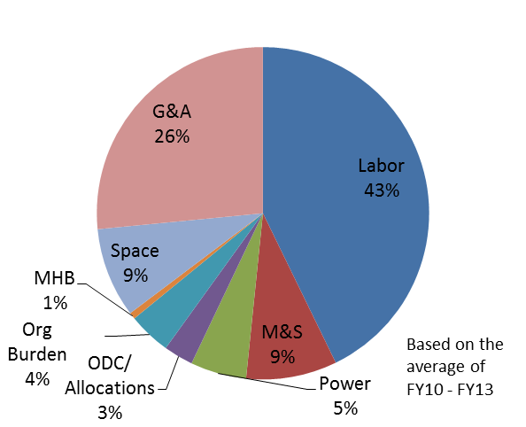
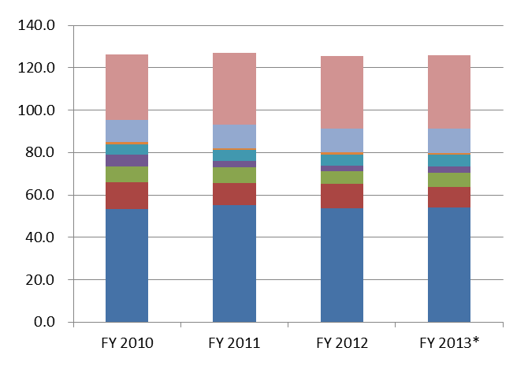
RHIC Operations Cost Drivers
Electric power consumption
  Determines the number of running weeks
Labor costs to run and maintain accelerators and experiments
  24/7 RHIC operations
  Complex facility needing substantial maintenance
Materials purchases and consumables to maintain accelerators
FY 2012 Laboratory Support totals: Space charge - $11.5M, Waste Management - $1.1M, G&A - $35M (including LDRD - $4.1M)

Slide 33
C-AD Age Demographics

Slide 34
RHIC Facility System Failure Analysis
Run-10:
Total failures: 18% of scheduled ops.
Run-11:
Total failures: 19% of scheduled ops.
Run-12:
Total failures: 14% of scheduled ops.
Run-13:
Total failures: 15% of scheduled ops.

Slide 35
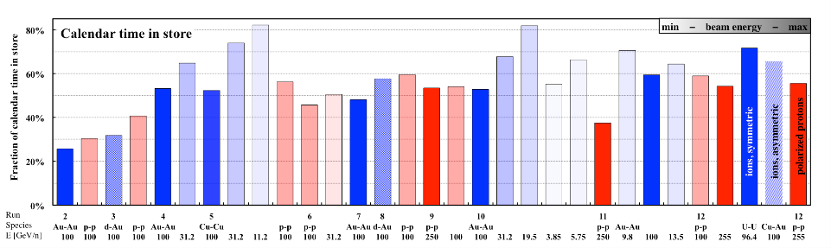
Calendar time-in-store after setup
Time-in-store: hours at store / total number of calendar hours
Time-in-store is useful to calculate integrated luminosity
Increased from 25% (42 hrs/week) to an average of ~ 60% (101 hrs/wk)

Slide 36
RHIC Facility Hours and Availability
Typical times:
50K to 4K cool-down: 1 week
Initial set-up: 2 weeks
Changing species: 1 - 2 weeks
Beam studies (APEX): 16 hrs / 2 weeks
Maintenance: 14 hrs / 2 weeks
Warm-up: 0.5 week

