Slide 1
Needs of radhard studies: barrel HCal
Stefan Bathe
Megan Connors
TIC Meeting
December 11, 2023

Slide 2
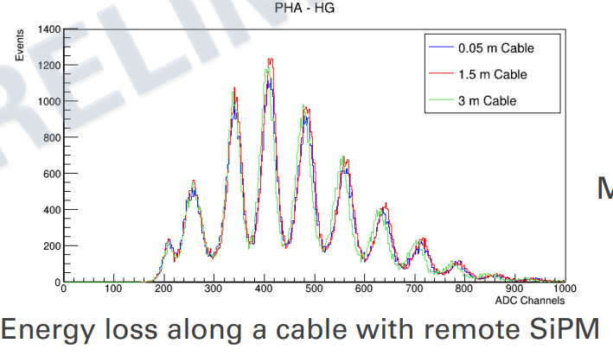
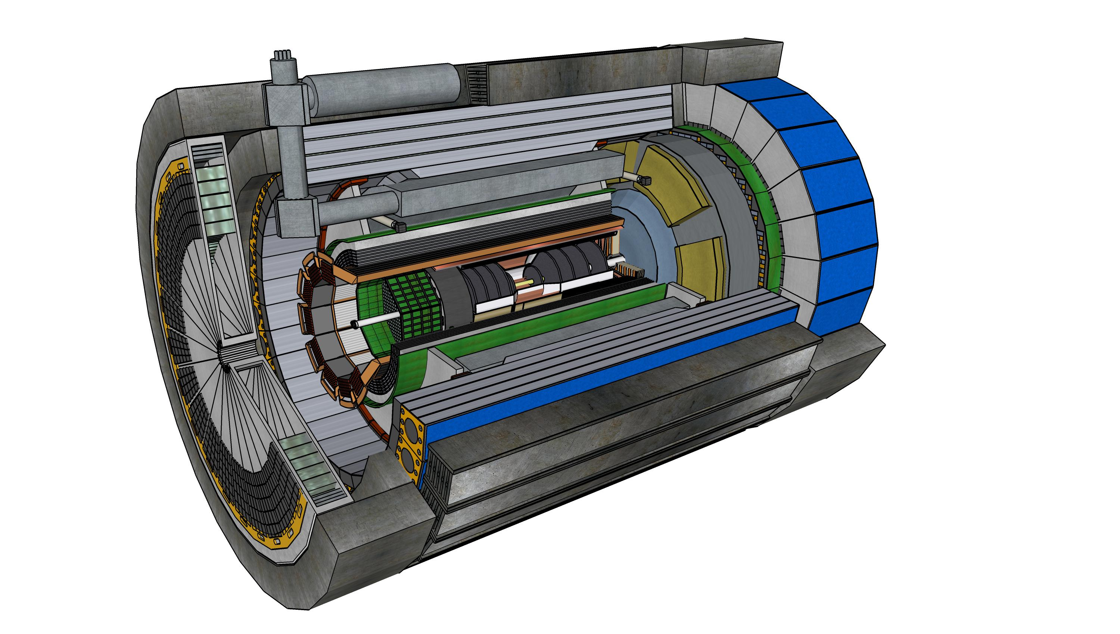
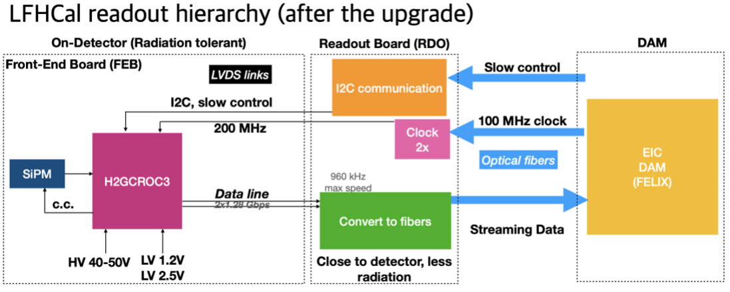
Readout Chain
One half-sector -> 54 H2GCROC3 boards (72 channels each). Cable SiPM’s out to end of barrel HCAL to keep accessible for maintenance.
~3m (μcoax)
120 cables/half-sector
~5m (Cu)
RDO’s
H2GCROC3 (54 per half-barrel) + LED driver boards
Fiber(s) to DAM

Slide 3
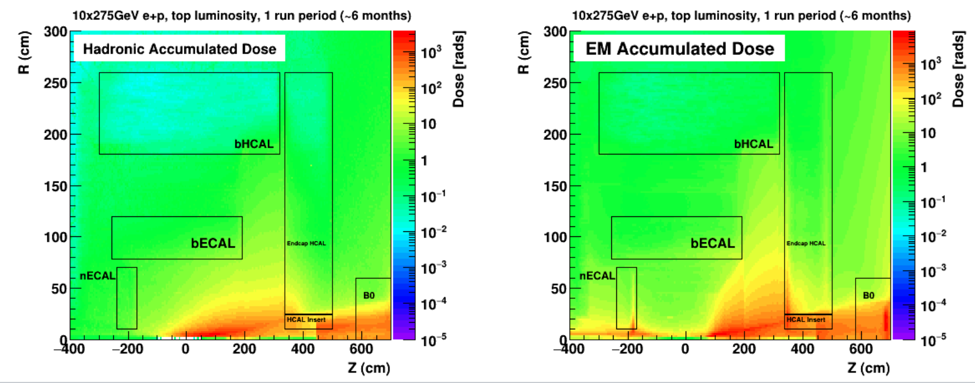
Barrel Hcal Radiation exposure
Orders of magnitude lower dosage than fHCal
Anticipate testing for other subsystems will be sufficient

Slide 4
Summary
Neutron fluence low enough that it is not an issue for SiPMs
Neutron fluence lower than in sPHENIX
In sPHENIX dark current increase after first year of running consistent with expectations
H2GCROCs should be radiation tested
Participation in coordinated testing
RDOs have FPGAs, but sit well outside the detector
No concern for single event upsets (SEUs)
Considering radiation test of spare sPHENIX scintillating tiles

