Slide 1
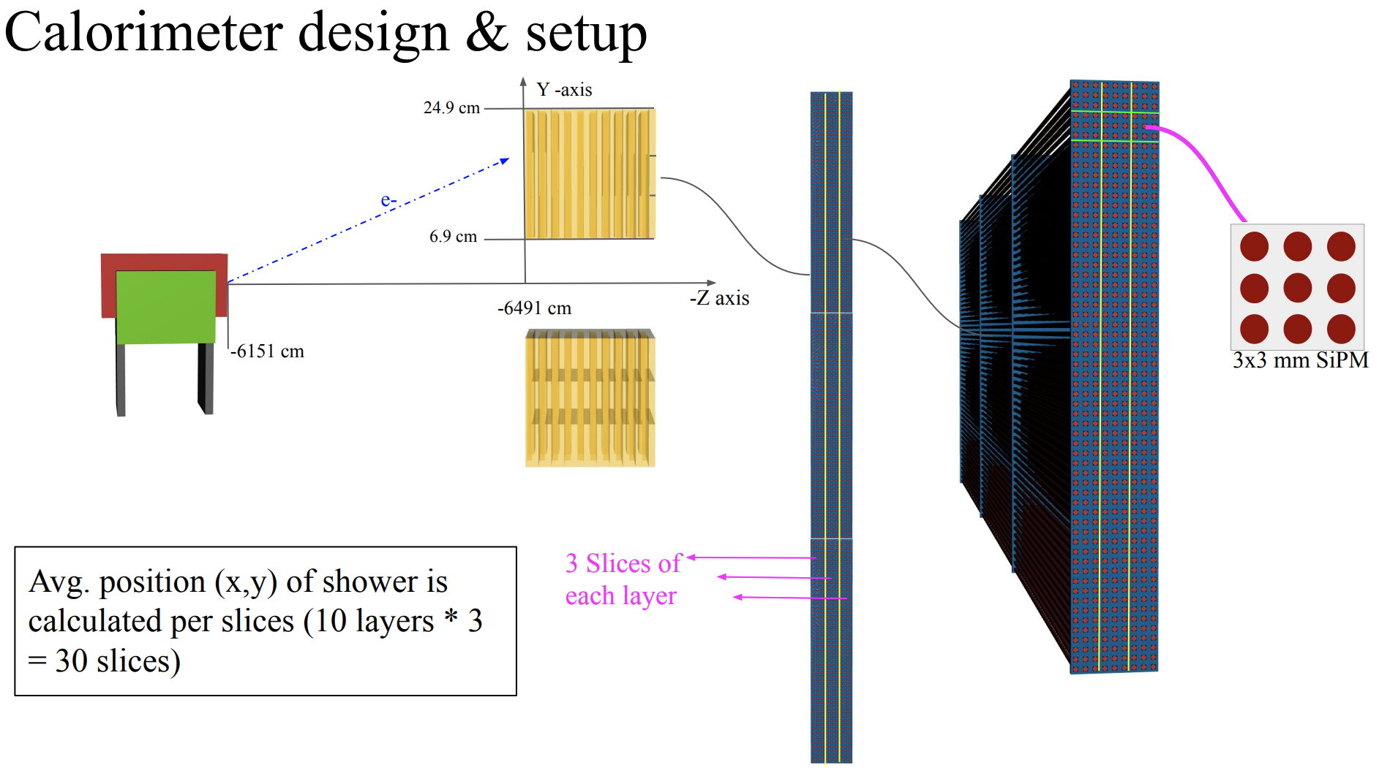
Pair Spectrometer – Rad Hard Studies
Studies needs follow closely from those of forward E-cal as design is similar
PS will have Low rates and will be placed outside the sync. Radiation fan.
Do not anticipate mechanical properties degradation of epoxy
Do not anticipate noticeable changes in transparency and light yield of scintillating fibres (Rradiation hardness known)
Tests to check the radiation effects of SiPMs will need to be carried out. We can learn a lot from studies carried out by O. Tsai (F. ECAL).
Plans to build a small prototype Calorimeter in early 2024 with tests carried out at MAINZ (and possibly Jlab/Hall D).
Simulation studies are underway to establish the expected dose.
N. Zachariou
Apologies for missing the meeting -- Teaching

