Slide 1
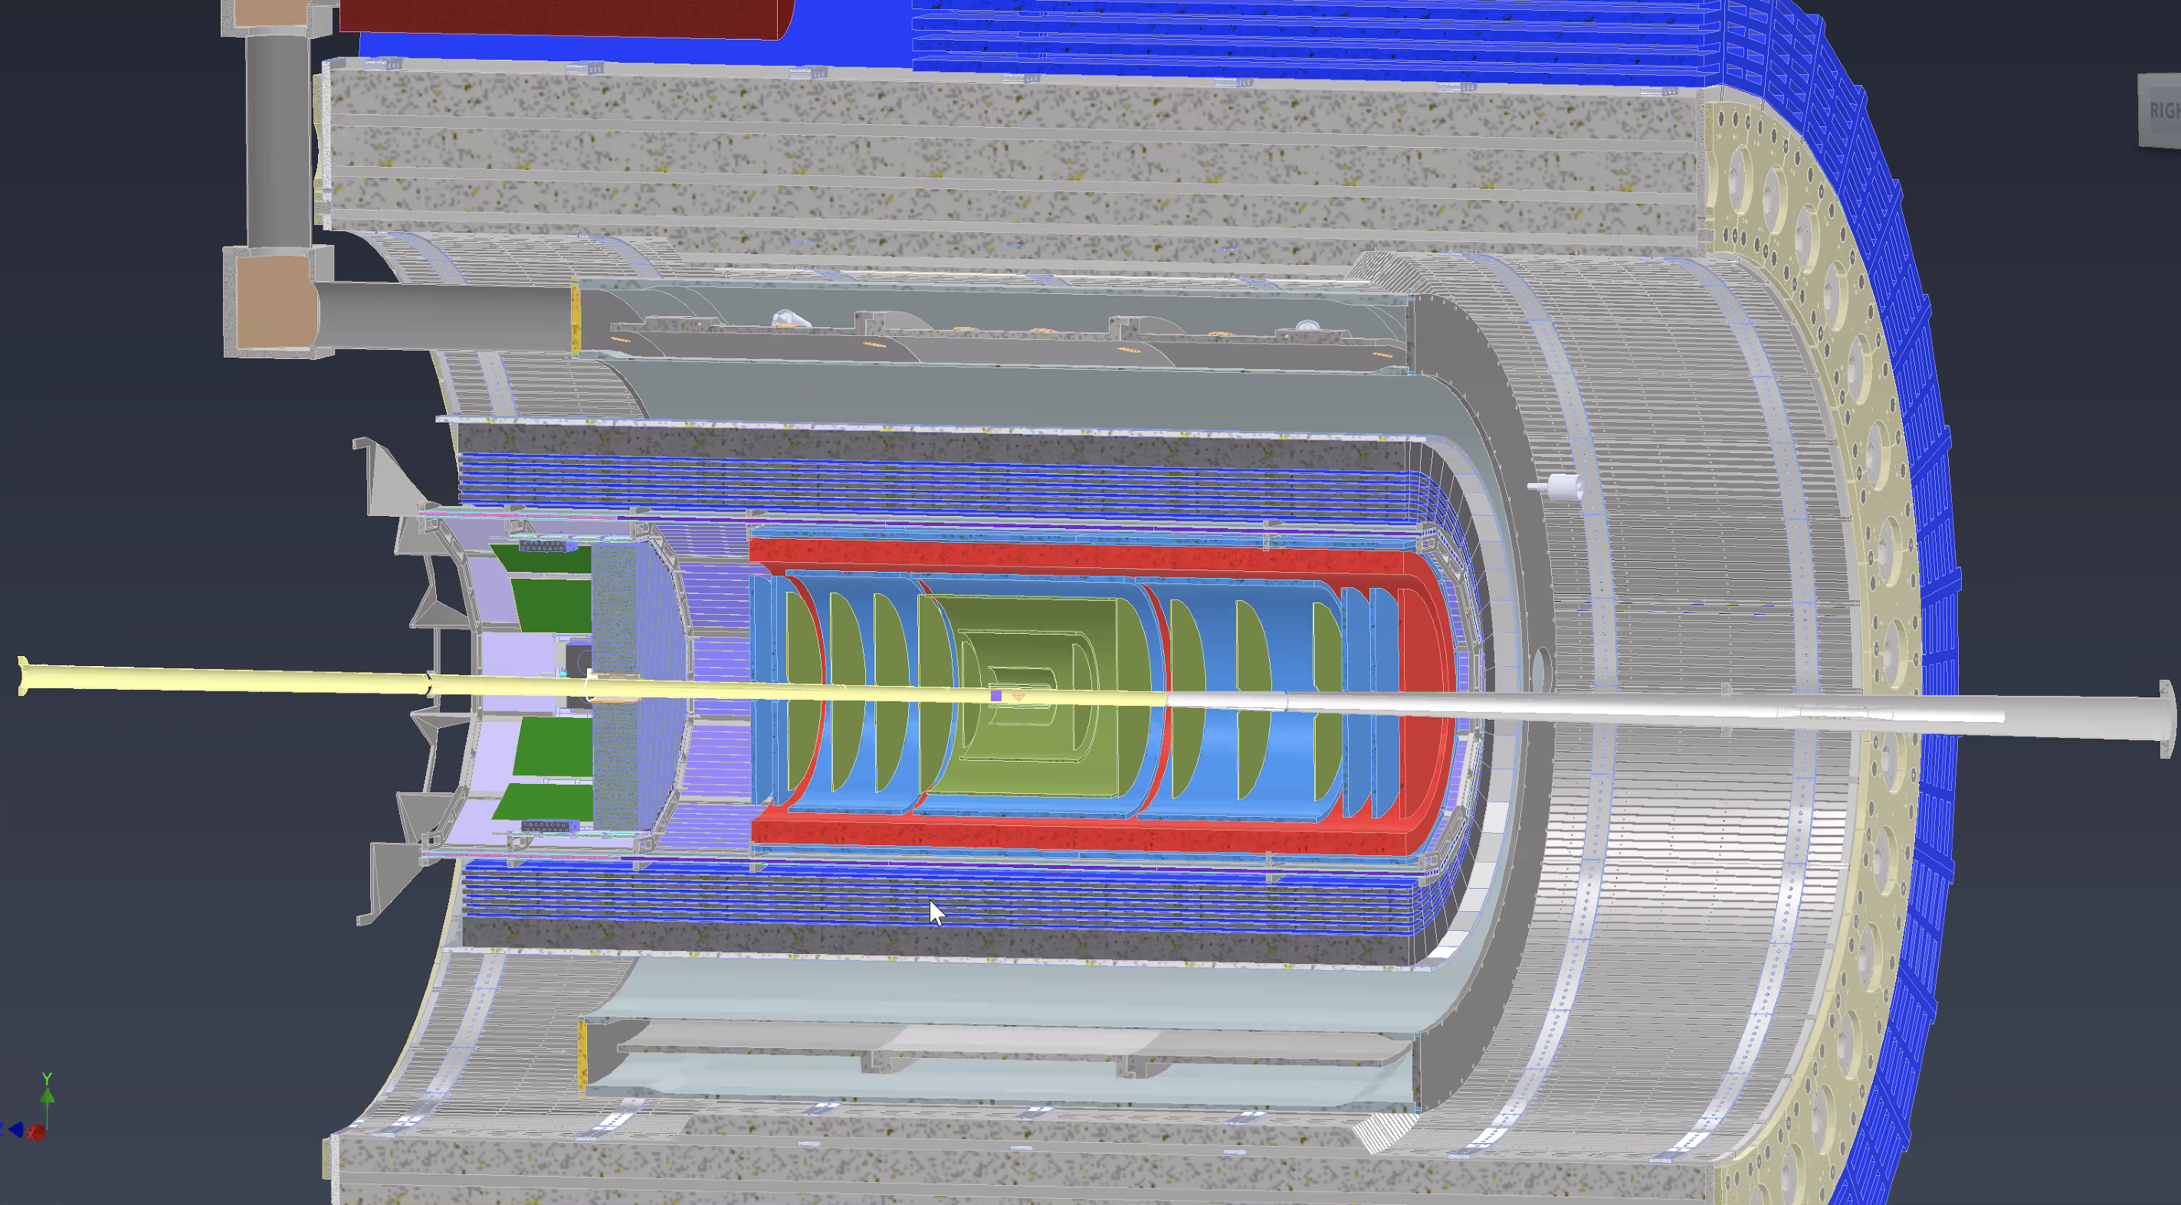
$μ−$ $Rwell detectors for the EPIC tracking at EIC$
Options for the Endcaps
Annalisa D’Angelo
University of Rome Tor Vergata & INFN Rome Tor Vergata Rome – Italy
for the EIC Collaboration

Slide 2
Options
Options for Endcap geometry:
4 Quadrants vs 2 semi-circles
(R,$θ$) readout vs (X,Y) vs (U,V)
50 cm external radius
5$÷7$ cm internal hole

Slide 3
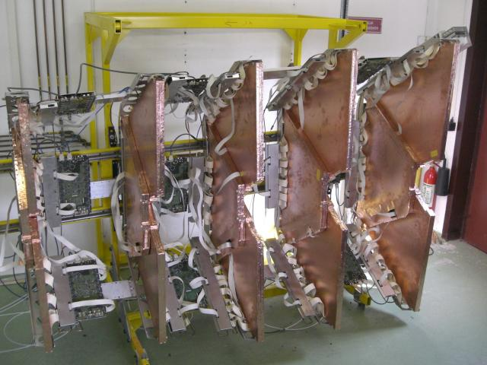
Totem T1 @CERN
10 semicircles of 190 degrees aperture
Each semicircle is segmented into three
subsections

Slide 4
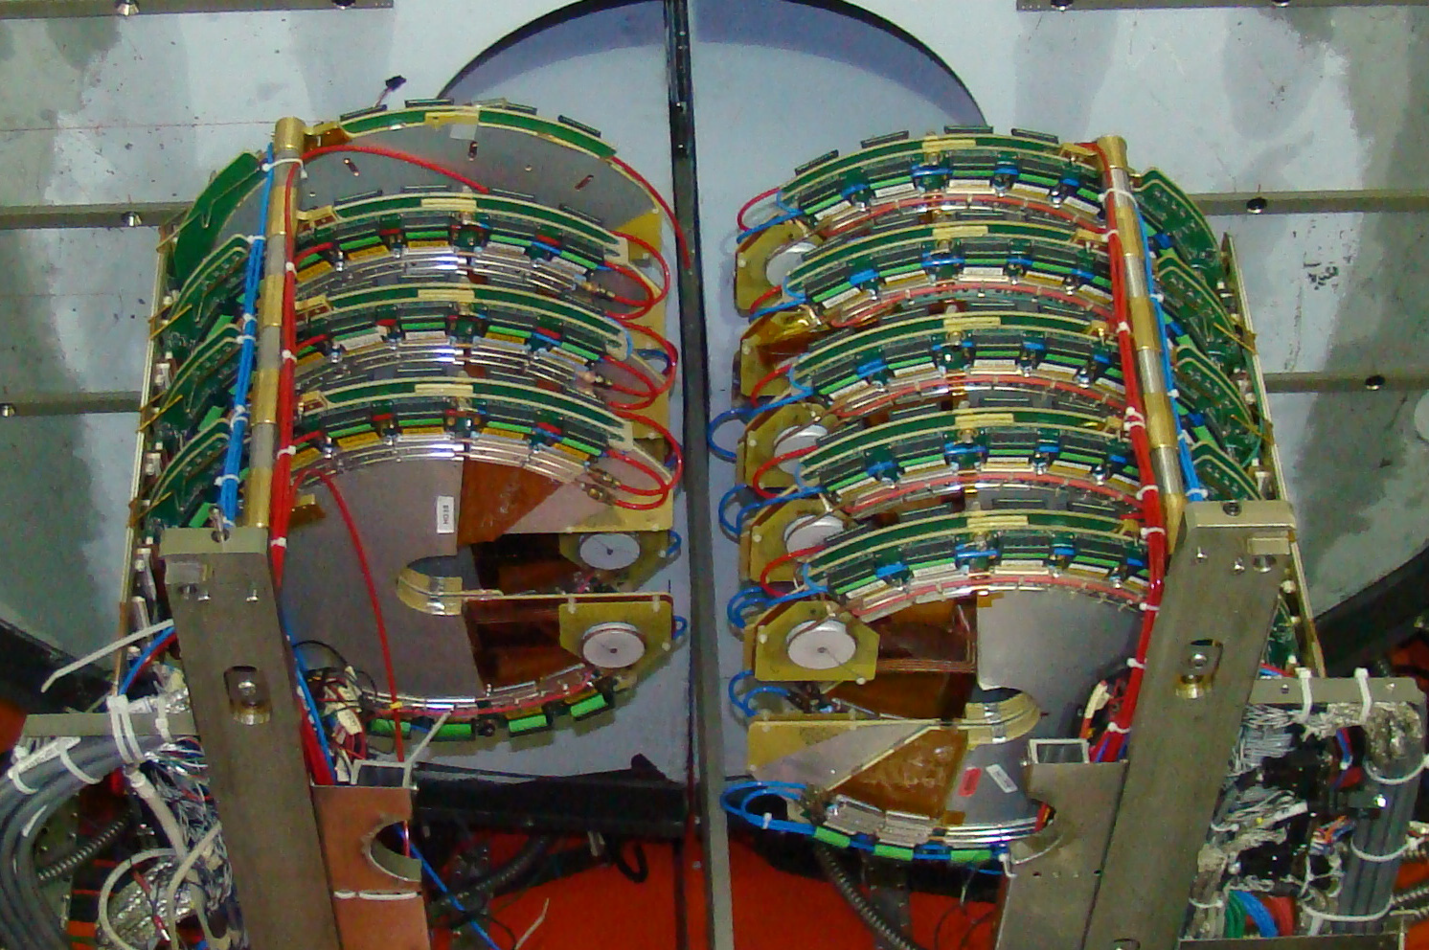
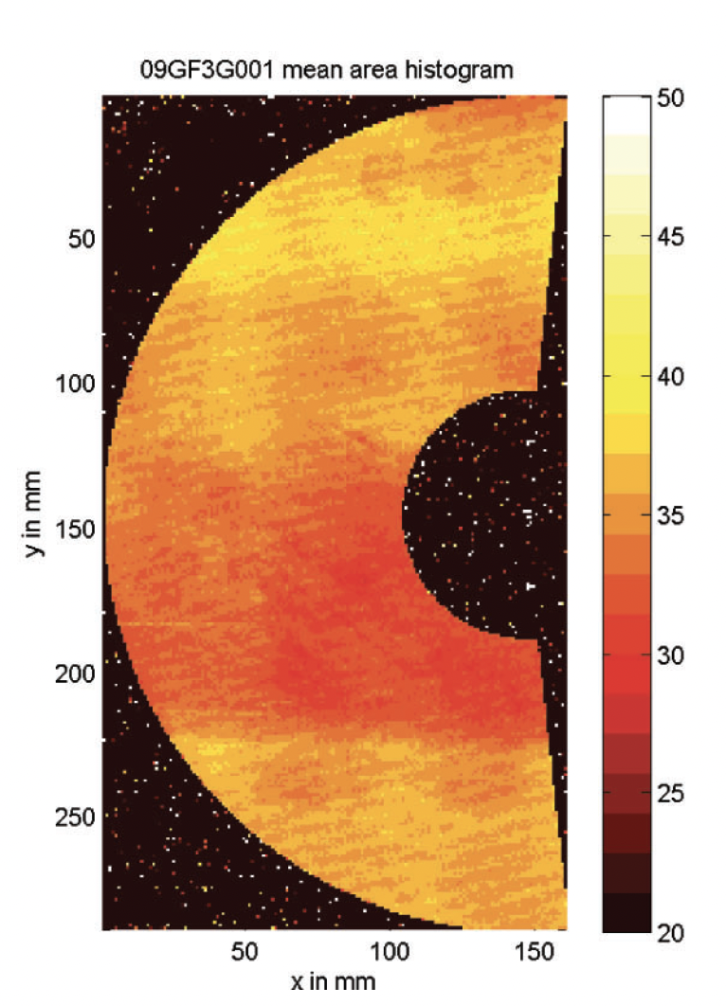
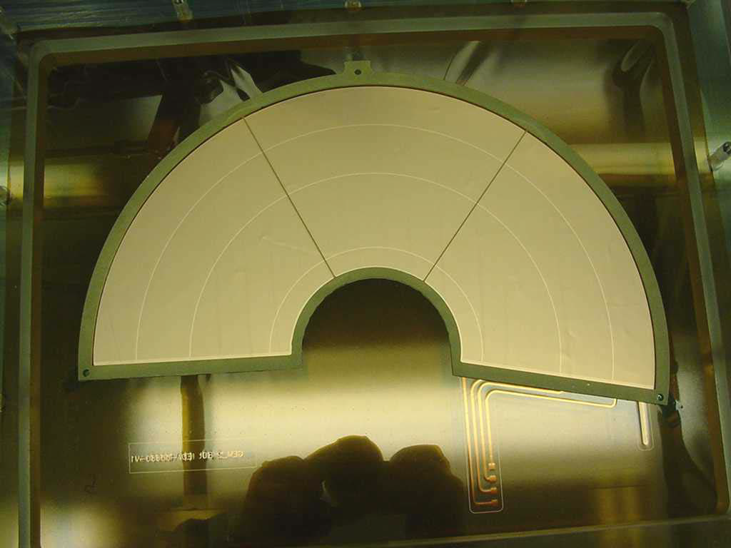
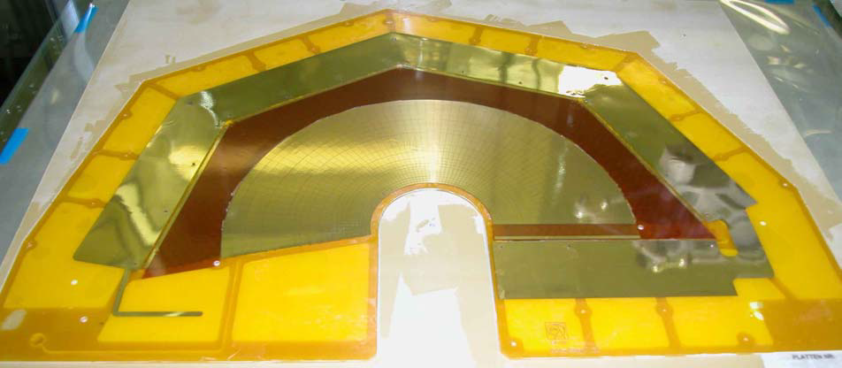
Totem T2 @CERN
10 semicircles of 190 degrees aperture
Tracking and trigger performances
Radial and azimuthal readout
15 cm external radius
$\sim$4 cm internal hole

Slide 5
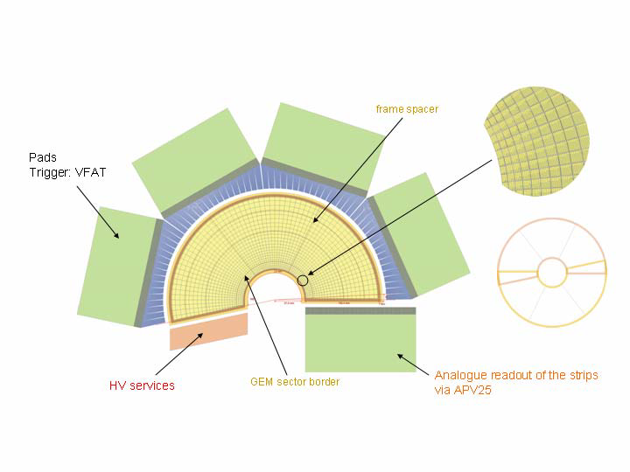
Totem T2 @CERN
256 concentric semicircular strips 400$μm$ pitch and 80 $μm$ width
1560 pads for azimuthal readout 2x2 mm$2 ÷$ 7x7 mm$2$

Slide 6
EIC Endcaps
54 cm
100$°$
54 cm
190$°$
100 cm
54 cm
2 x 5$°$overlap
4 x 5$°$overlap

Slide 7
EIC Endcaps
54 cm
190$°$
100 cm
54 cm
100$°$
2 semi-circles
54 cm
4 Quadrants
PROs | CONs
Smaller dimensions are easier to handle | Two vertical and horizontal overlapping regions – more material
Each endcap is intrinsically symmetric
Strips length are shorter
PROs | CONs
One vertical/horizontal overlap only – less material | Larger detector surfaces are more difficult to handle.
The two endcaps may be rotated by 90$°$ one respect to the other to recover overall symmetry | Longer strips: $→$Readout should be segmented into two sectors to avoid too long strips

Slide 8
EIC Endcaps
54 cm
100 cm
190$°$
100$°$
54 cm
54 cm
𝐶 = 𝜀₀×𝜀_{𝑟}×$\frac{S}{t}$ =120 𝑝𝐹×𝐿(𝑚) - 𝑤=0.2 𝑚𝑚, 𝑝=0.4 𝑚𝑚 strip

Slide 9
EIC Endcaps
R,$φ$
X,Y
PROs | CONs
Direct radial and azimuthal information | The linear density of the azimuthal strips increases by a factor 10 on the inner hole
 | The radial readout hybrid FE overlaps the active area or flex cables should be used.
 | Radial strip length varies by a factor 10.
PROs | CONs
The strip length does not vary much along the active area | Alignment is critical
All readout FE hybrids may be located outside the active area | Routes to read-out connectors must be accurately studied

Slide 10
To be studied
Compass @ CERN
Forward Micromega Tracker @ CLAS12
Material budget:
Active area
At the overlapping region

