Slide 1
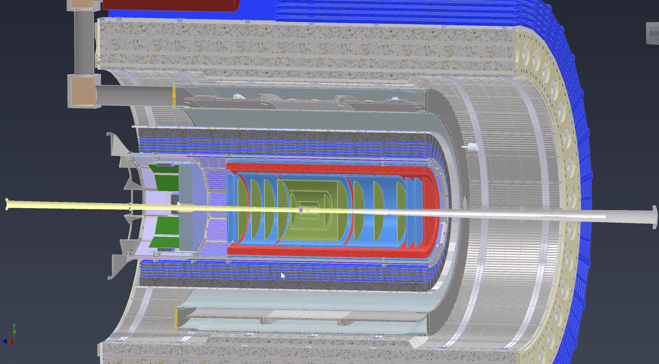
$μ−$ $Rwell detectors for the EPIC tracking at EIC$
To Do List
Annalisa D’Angelo
University of Rome Tor Vergata & INFN Rome Tor Vergata Rome – Italy
for the EIC Collaboration

Slide 2
To do List
Understand the Mechanical envelope available for uRwell endcaps - Seung joon
Define the detector active area and final segmentation – try to start with semi-circles
Servings & Cooling - Seung Joon, Electronic cables: Irakli Damien (Saclay)
Geometrical Constraints on SALSA FEB?
Read-out system definition
Gap-size definition (with or without GEM foil)
Material budget assessment ( with/without GEM pre-amplifier)
Detector geometry simulation Mariangela & Matt
Detector response simulation Mariangela+ Roma group + Matt
On-Line Calibration -> Alignment -> SVT/Tracking->TIC: survey/photogrammetry plans – targets to be installed?
Stability against magnetic field forces (2 Tesla) (carbon fiber support)
Mounting procedure and related constraints ?

Slide 3
Options
Options for Endcap geometry:
4 Quadrants vs 2 semi-circles
(R,$θ$) readout vs (X,Y) vs (U,V)
50 cm external radius includes services
-> the maximum active area needs to be assessed and may provide constraints on the SALSA FEB
5$÷7$ cm internal hole
1 mm strip read-out pitch -> 500 channels per sector per quadrant -> 16 FEB/disc

