Slide 1
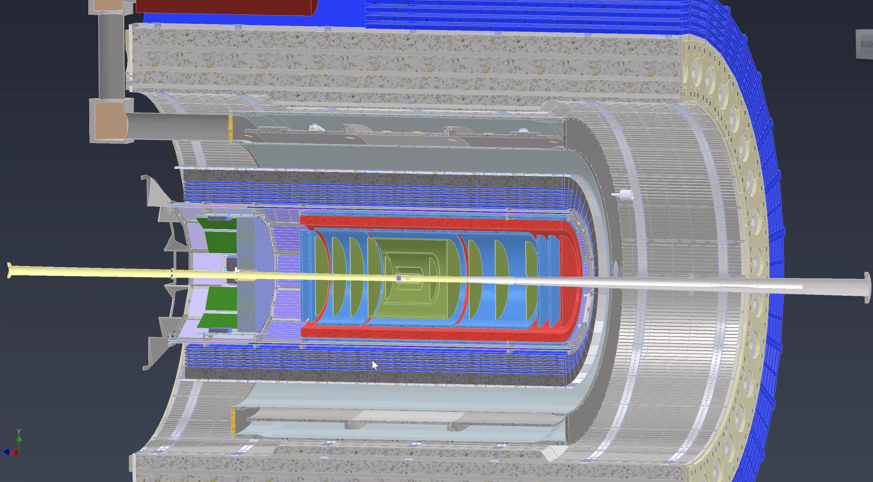
$μ−$ $Rwell Endcaps detectors for the EPIC tracking at EIC$
February 1st 2024
Annalisa D’Angelo
University of Rome Tor Vergata & INFN Rome Tor Vergata Rome – Italy
for the EIC Collaboration

Slide 2
ENDCAPS
The envelope defined in the geometry database does not refer to the expected active area of the endcaps but the total available space, including signal connectors, gas frame, gas inlet $ outlet, HV.
The expected active area radius is 45-46 cm, with an outer service region of 4-5 cm thickness.
The electronics front end boards (FEB) may be mounted at 90 degrees, parallel to the beam pipe, sticking out of the 2.5 cm thick envelope.
The integration team (Andy Jung) has informed us that they will provide 3 mounting points on rail to support each semi-circle.
The integration team (Andy Jung) has confirmed that they expect that all the disks (Silicon trackers and MPDG) should be mounted in two semi-circles.

