Slide 1
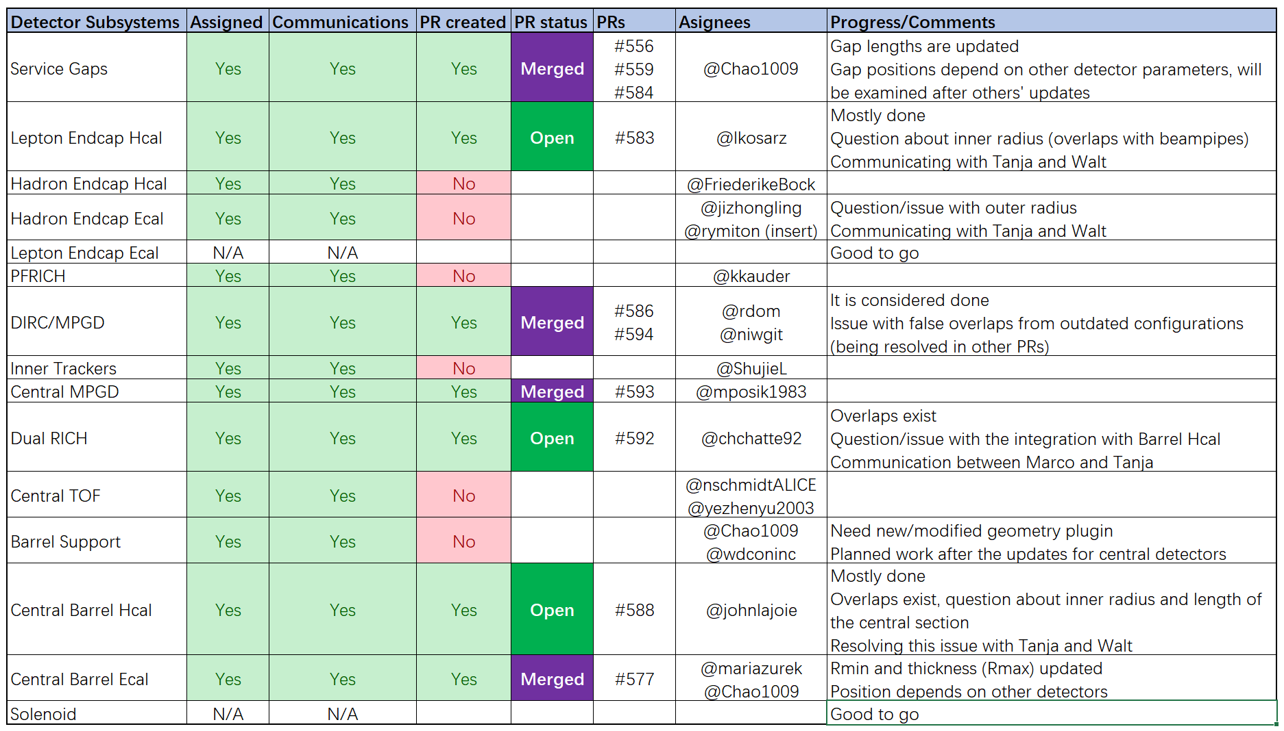

Slide 2
Summary
Many DSCs have been actively working on the updates
It is more complicated than expected (many tiny overlaps)
Communications with the Detector Geometry Management System
There are already 3 new versions of the geometry table, will be more
A few DSCs have been working on local copy or not starting yet
Communicated to encourage commencing the work on PRs
Updates for non-conflicting parameters are aimed for December campaign

