Slide 1
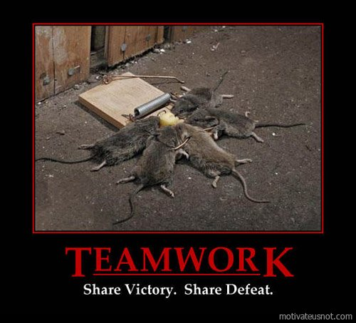
56MHz for Run (14, 15) 16, 17, 18 …
Kevin Smith
July 29, 2016
Notes:
Beam driven cavity

Slide 2
Syllabus
Refreshments Are Being Served
How it’s supposed to work.
How it’s not supposed to work.
Maybe it works without an HOM Damper!
When You Come to a Fork in the Road – Take It.
Once more unto the breach, dear friends, once more.
Solving For Unknowns.
Navigating The Minefield.
Final Exam Results
Forward – Ever Forward …
Acknowledgements
Looking Forward
Acknowledgment

Slide 3
Refreshments Are Being Served
Notes:
Brief Background
Describe some of the primary unknowns and how they were resolved
Show how exactly we were able to wade our way through the minefield
What the next steps are for this project
Acknowledge how much work went into this effort

Slide 4
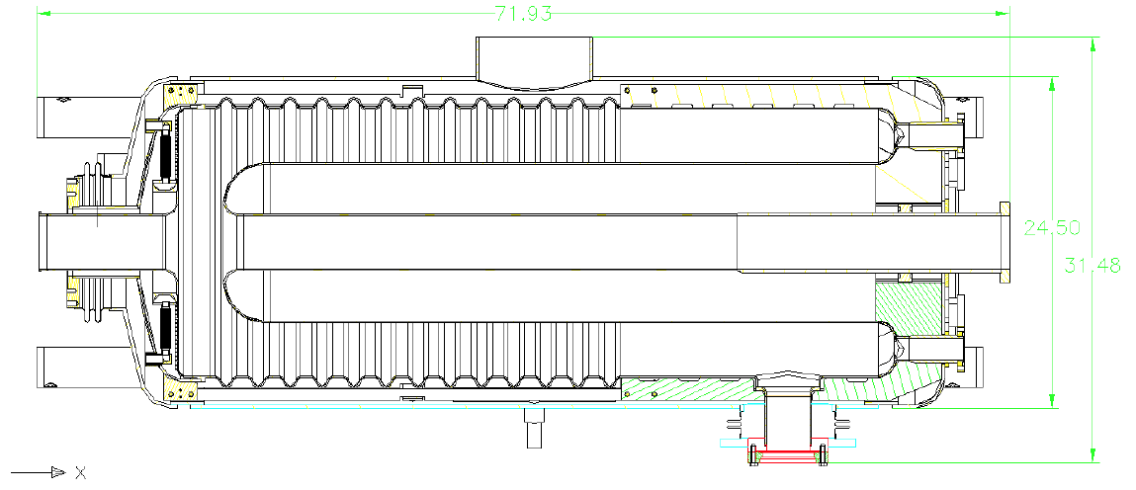
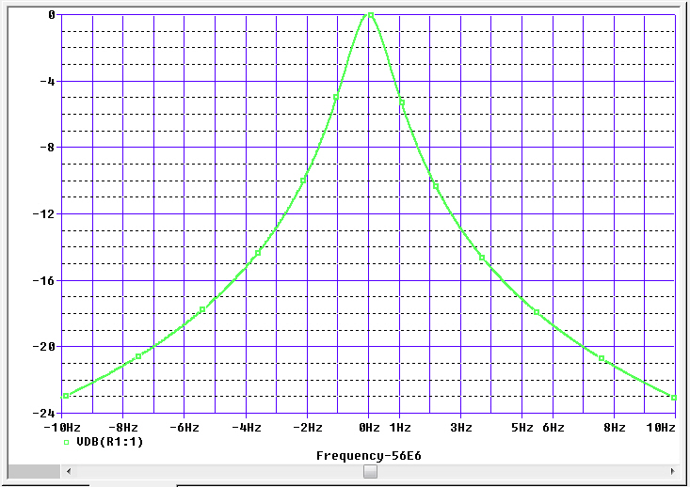
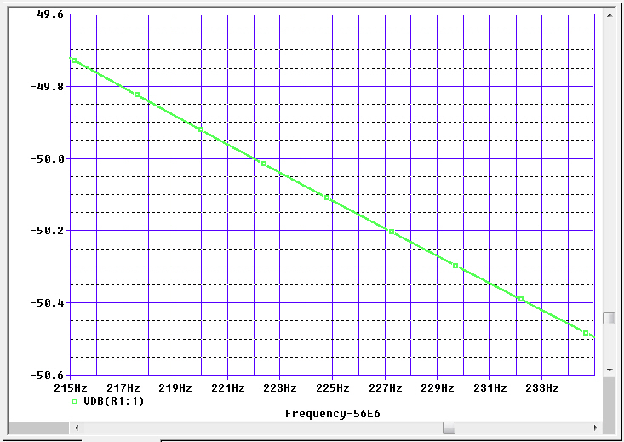
Refresher on How This Thing Works
(mode d'opération)
A “Passive” Beam Driven Cavity
$\left|\text{V}\text{cav}\right|$=I_{h=720}*$\left|Zcav\right|$_{h=720}
I_{h=720} = 0.5A
$\left|Zcav\right|f0$ = R₀ = 1.6E9 ohm !!!
(Qext = 4E7, Q0 = 3E9)
800 MV on resonance ???!!!
Detune …
800 MV – 50dB => 2.5 MV
$Zcav =\frac{R0}{1+j\frac{∆f}{BW\text{½} }}$ $∆f≫BW\text{½} =⇒ \left|Zcav\right|=\frac{\left(R/Q\right)∗f0}{2∗∆f0}$
(i.e. ind. Of Qext)

Slide 5
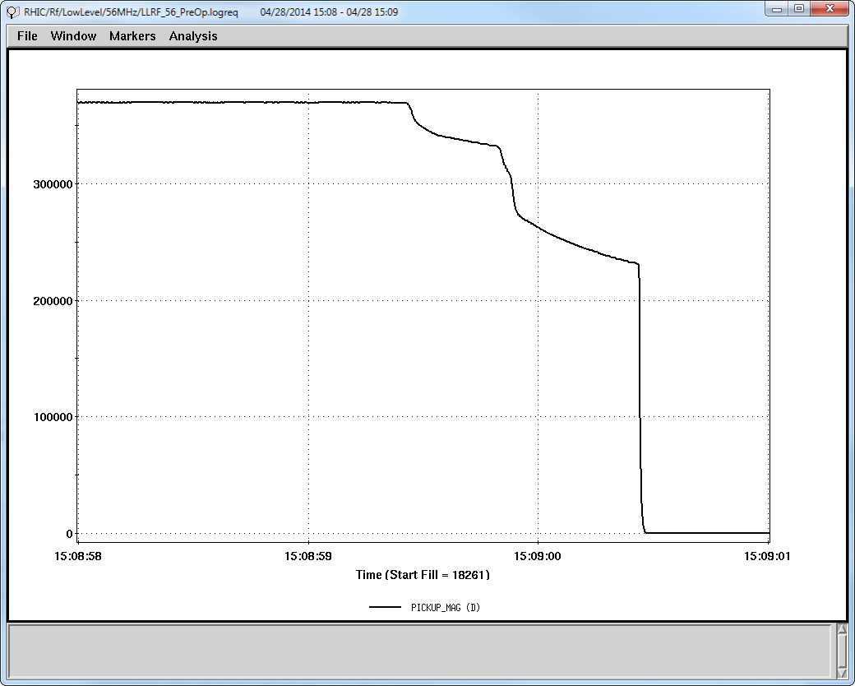
Refresher on How It’s Not Supposed to Work (Run 14 raison d‘nêtre: le éteindre de amortisseur mode haut original)
Run 14 HOMD Quench
No worries! We’ll fix this in a jiffy.
Run 15 – No HOMD.
Modified HOMD ready and installed Oct 2015.

Slide 6
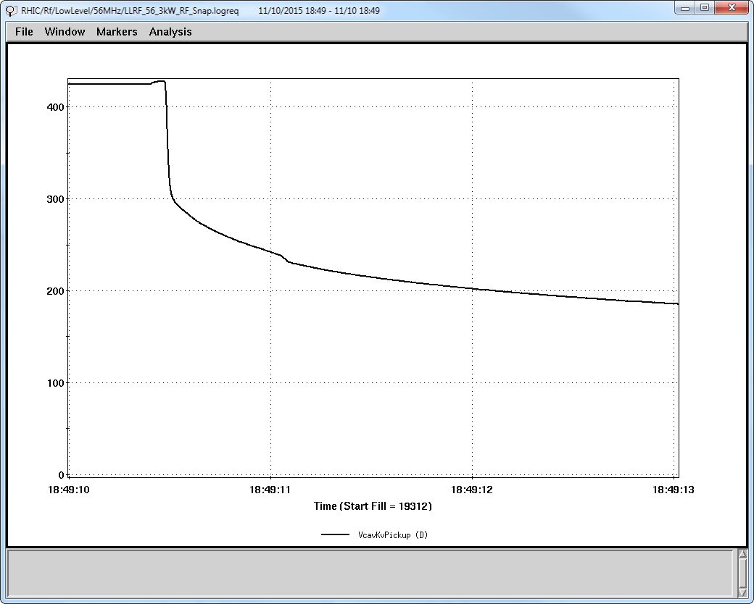
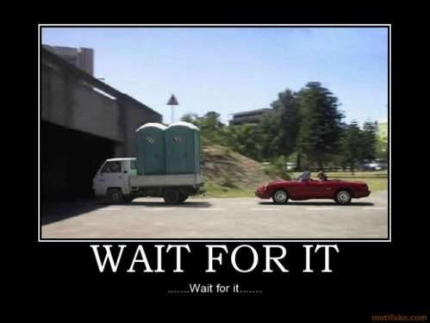
Refresher on How It’s Not Supposed to Work (Run 16 raison d‘nêtre: le éteindre de amortisseur mode haut nouveau)
Pre Run 16 Dewar Testing: The Agony of Defeat
Pre Run 16 HOMD Quench

Slide 7
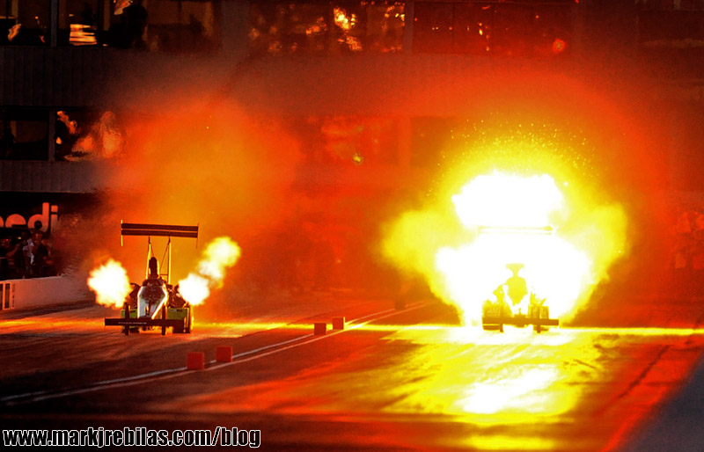
Refresher on How It’s Not Supposed to Work (Run 16 raison d‘nêtre: le éteindre de amortisseur mode haut nouveau)
Simulated
HOM Damper Loop
RF Power Dissipation
“Observed”
HOM Damper Loop
RF Power Dissipation

Slide 8
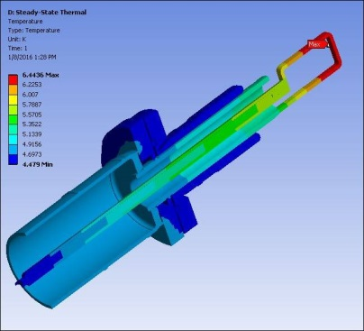
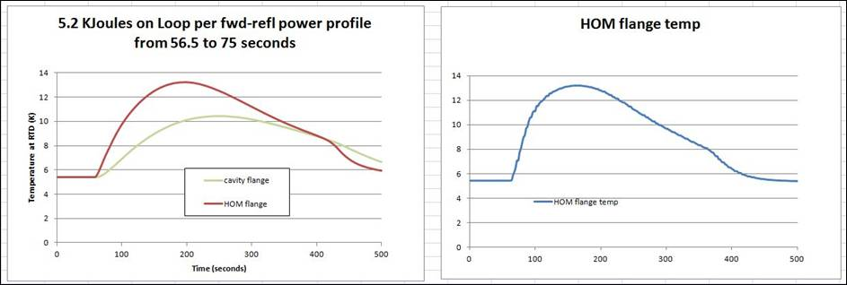
Refresher on How It’s Not Supposed to Work (Run 16 raison d‘nêtre: le éteindre de amortisseur mode haut nouveau)
e-mail, S. Bellavia, 12/20/2015
Maybe we’ve found the real problem?
Hi,
After a concentrated effort by Scott and I, during this short work week, we have attained a positive ID on the thermal transient fingerprint, for the 56 MHz HOM damper.
We built a simple, but very representative FEA model, and ran several cases, applying the 5 KJoules of energy to various portions of the HOM.
Only one case gives a match like this, and that is when it is applied to the loop:
The curve on the left is from the simulation, the curve on the right is the temperature readout from the RTD on the flange.
I have attached a detailed report, but we should have a meeting to discuss this further.
Happy New Year!
Steve
P.S. This successful simulation is in large part due to Scott Seberg’s relentless perseverance to not only find a solution to the problem, but to find its root cause as well.

Slide 9
Refresher on How It’s Not Supposed to Work (Run 16 raison d‘nêtre: le éteindre de amortisseur mode haut nouveau)
Editorial Digression: See Title Slide – Share Victory. Share Defeat.
No fewer than 10 people spent a significant amount of time analyzing the Run 14 HOMD quench problem – a lot of smart people, and me as well. In the end, we all agreed on the apparently obvious problem – don’t put normal conducting braze in an SRF HOMD. A lot more work went into removing the sapphire window (and braze) and then overcoming new issues resulting from that. In the end, it turned out that the HOMD had still more problems and continued to quench at “low” field.
We lick our wounds, learn from our mistakes and move on.
My own personal thoughts:
SRF is hard living – don’t underestimate just how hard.
New (“innovative”) SRF designs will always take A LOT of time to validate. Many things can go awry.
It is imperative to perform thorough testing of fully dressed SRF systems prior to operational installation – aka horizontal test.
In the case of the 56MHz, RHIC was our horizontal test.
Same for the CeC PoP Gun and 5-Cell.
We need to avoid this going forward. But right now, we play the hand we’re dealt.

Slide 10
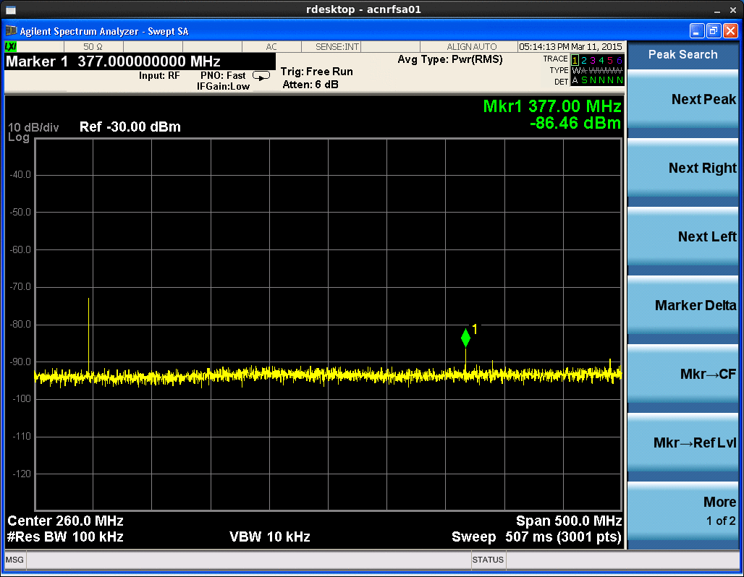
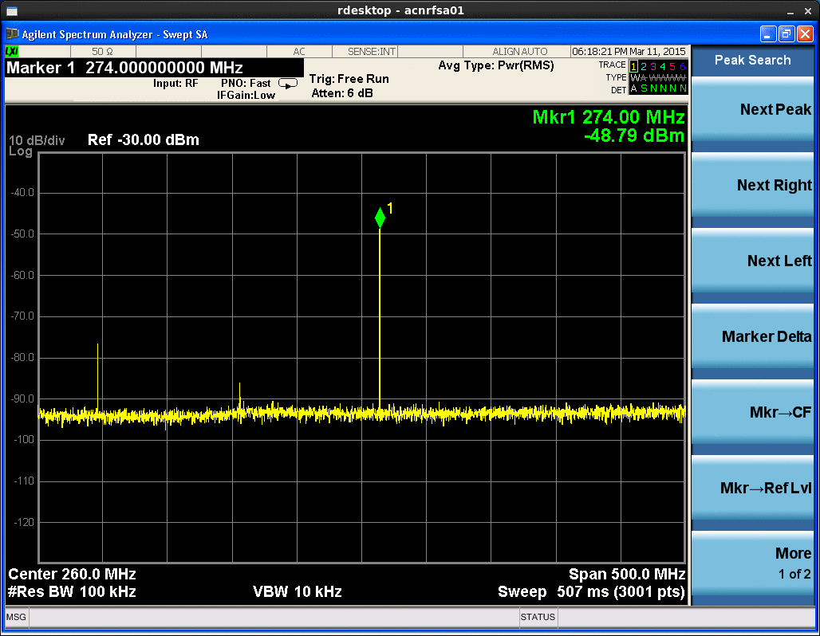
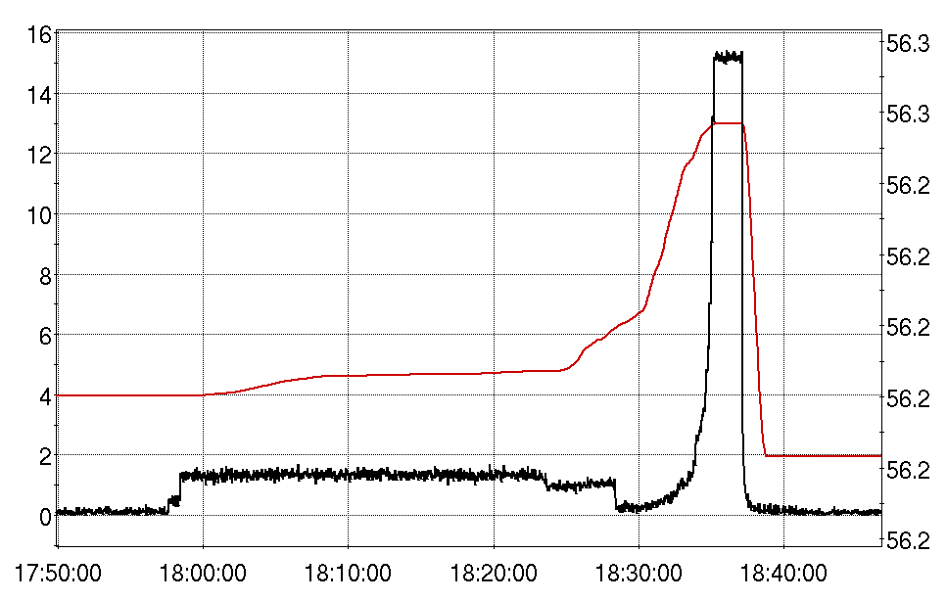
Refresher on How This Thing Works without an HOMD
(It Doesn’t - Retreat 2015, Q.Wu)
11 bunches of proton in a 12 bunch pattern.
Total intensity: 2.39e12
Cavity Voltage [kV]
Cavity Frequency [MHz]

Slide 11
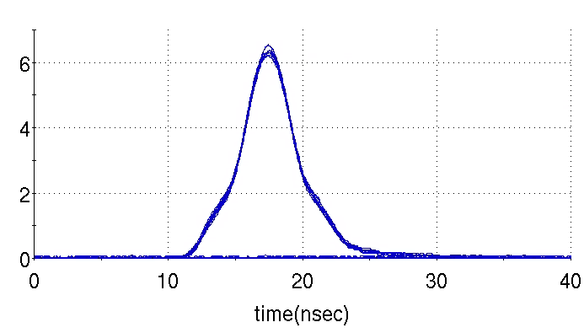
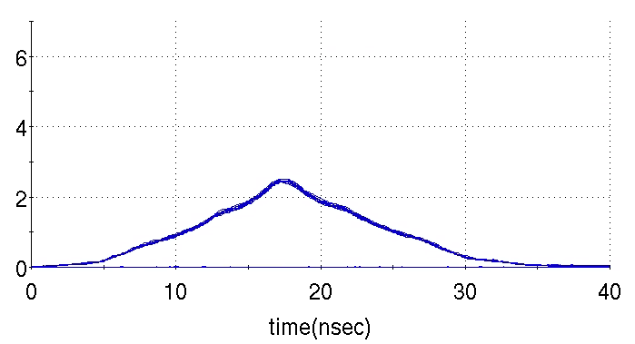
Refresher on How This Thing Works without an HOMD
(It Doesn’t - Retreat 2015, Q.Wu)
Beam profile 1
Beam profile before we swept through multiple (5) HOM resonance lines
Conclusion for APEX
The cavity frequency sweeps through first four monopole HOM resonance lines within the full tuning range.
No observation of excited dipole/quadrupole HOMs.
Beam is affected greatly by the excited HOMs in the cavity.
We need HOM damper(s).
Beam profile 2
Beam profile after we swept through multiple HOM resonance lines

Slide 12
When You Come to a Fork in the Road – Take It.

Slide 13
Once more unto the breach, dear friends, once more.
So we have an HOMD which limits the cavity to ~350kV – 400 kV and we need to make this cavity work in RHIC.
Took the decision to remove the “new” HOMD and try hard to find a way to make the cavity operational without it, with a goal of achieving 1MV at Store.
Needed some alternative for damping the dangerous HOMs.
Best option: trying to dual purpose the Fundamental Mode Damper (FMD) as an FMD & HOMD.
A daunting challenge with many unknowns, requiring a lot of effort in a short period of time.

Slide 14
Solving For Unknowns
Goal:
Use the fundamental damper to damp the high order modes too.
Unknowns:
Important modes to avoid.
Need to know the mode spectrum, and which one’s are a problem.
Need to know to beam spectrum.
Mode Frequency and Qext variation as a function of tuner and damper positions for all pertinent modes.
Not a static problem.
Power limitations of FMD and FPC.
FPC never designed for high CW power.
FMD designed for high transient power.
Not designed for high power CW operation.
Figure out the solution in two months.

Slide 15
Solving For Unknowns (Modes)
Reduced the complexity of the problem by only analyzing monopole modes below 500MHz.
Run 15 experience showed that these are the primary troublemakers.
Monopole Modes Considered for Analysis (Roughly h=1,3,5,7,9)
fo ≈ 56MHz (the fundamental mode)
fo ≈ 166MHz
fo ≈ 274MHz
fo ≈ 377MHz
fo ≈ 474MHz
Qiong Wu performed RF simulations.
Kevin Mernick performed careful and tedious measurements of frequency and external Q for various tuner and damper positions.
S. Polizzo translated the data into a usable map.
Used the map to walk through the minefield.

Slide 16
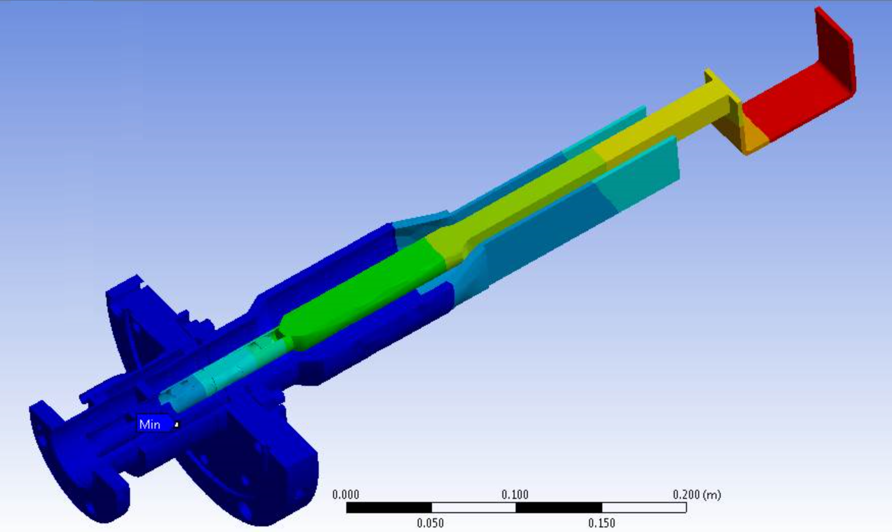
Solving For Unknowns (Power)
Performed steady state and transient thermal simulations of the fundamental damper
Power extracted = 20kW
Damper Loop Temperature and Radiated Power
Empirically optimized FPC extracted power and required amplifier power.
Closely monitored pertinent cyro heat loads.
This operating mode was never envisioned in original design.
Time (s) | Temp (K) | Rad Power (W)
0 | 298.15 | 0.044520175
5 | 325.0978 | 0.062932298
10 | 340.2814 | 0.075538822
30 | 377.0896 | 0.113918969
60 | 412.1609 | 0.162586603
120 | 453.4506 | 0.238197767
3600 | 655.378 | 1.039405542

Slide 17
Navigating The Minefield
Matlab code written to map the HOM landscape.
Code compiles the mode frequencies and associated external Q data into matrices that are then interpolated to improve data resolution.
These matrices are then used to resolve the HOM impedances for all applicable damper and tuner positions.
A time domain bunch train is created to have the same characteristics as post re-bucketed beam at the 56MHz gap.
Each beam revolution line within a given HOM tuning range is evaluated independently and the cumulative sum of the resulting voltages are displayed.

Slide 18
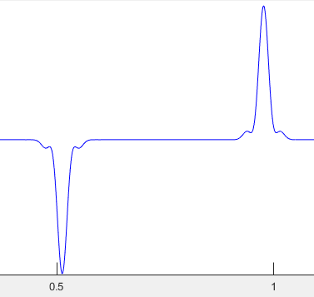
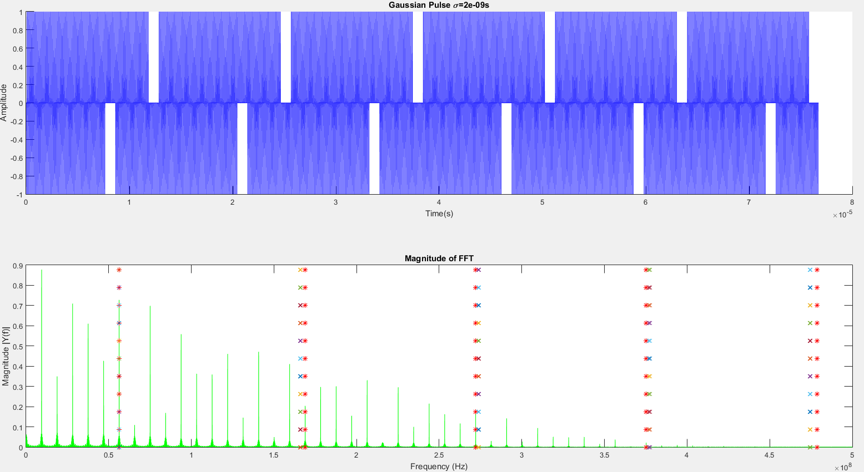
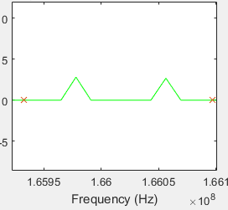
Navigating The Minefield
Bunch Train at 56MHz Gap
H=3 Example
Notes:
None of the HOM resonant frequencies fell directly on a 9MHz harmonic

Slide 19
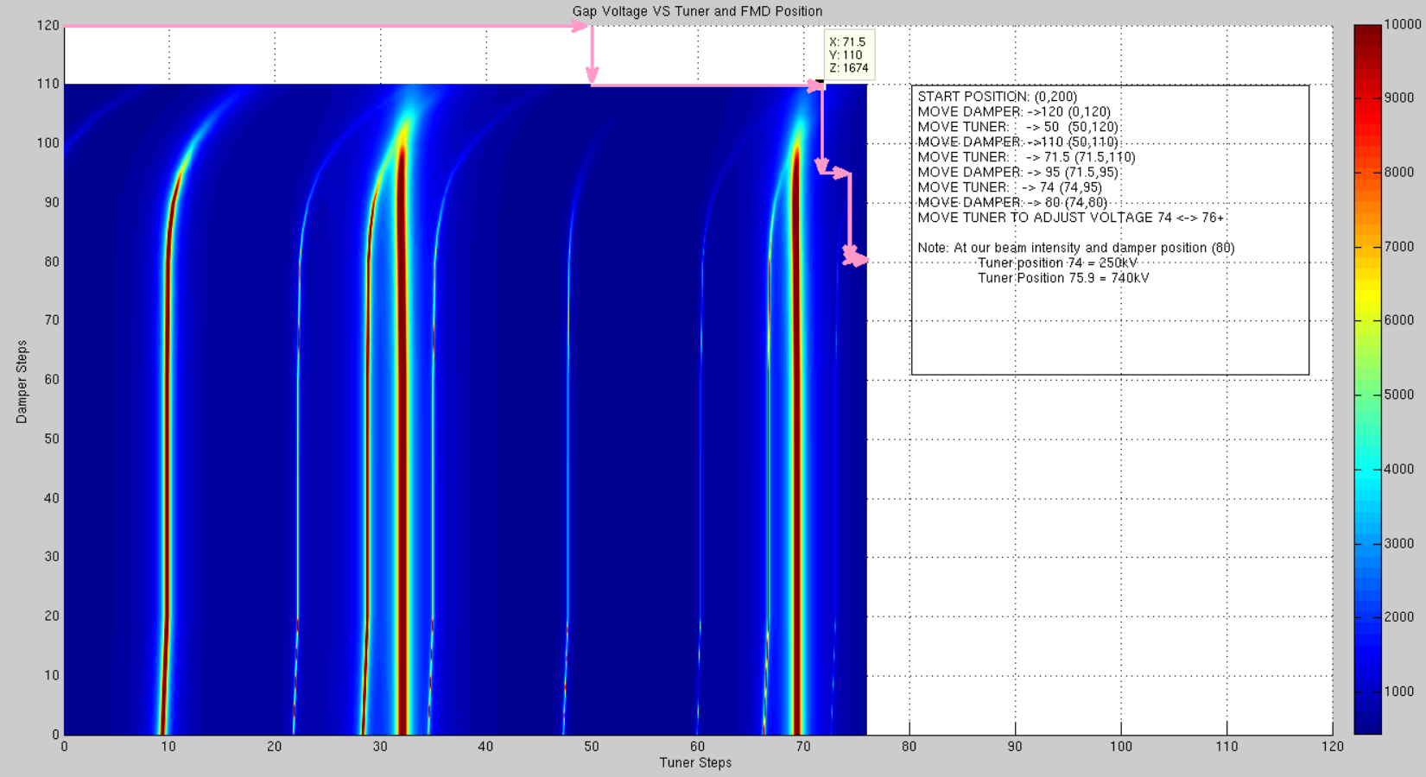
Navigating The Minefield
The complete map combines all HOM voltage matrices
Well this looks like it couldn’t be any easier!
No.

Slide 20
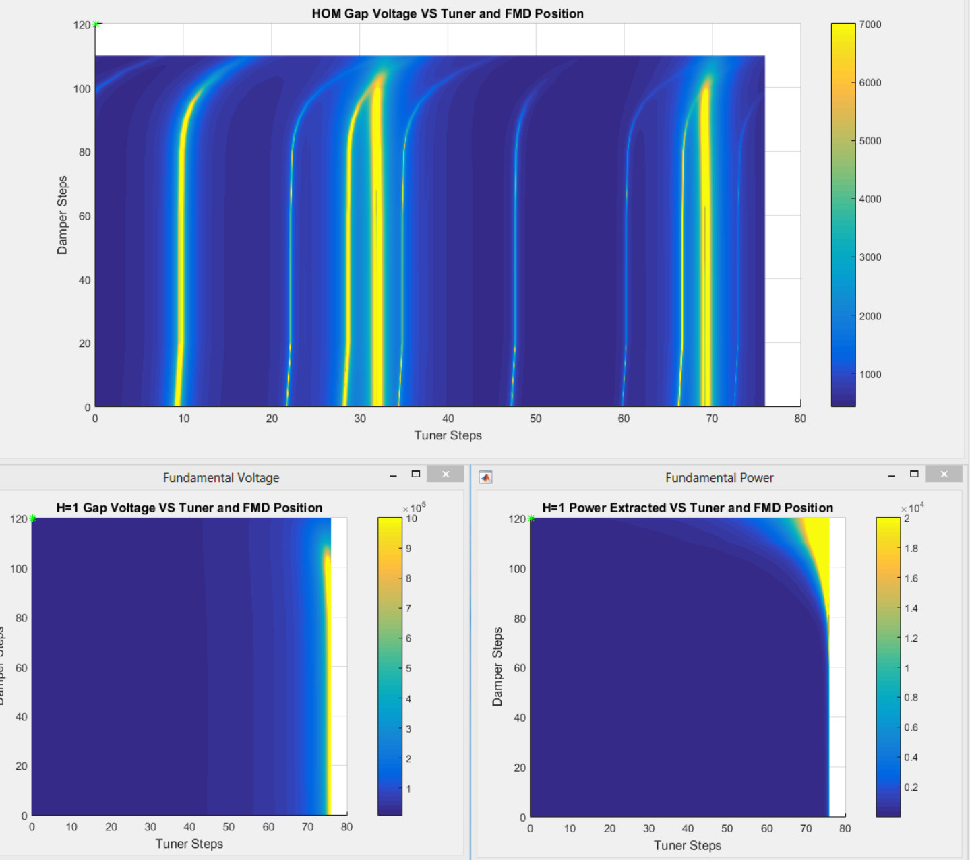
Navigating The Minefield
Putting it all together with fundamental mode stress considerations.
Movie Time …

Slide 21
Final Exam Results
Notes:
Brief Background
Describe some of the primary unknowns and how they were resolved
Show how exactly we were able to wade our way through the minefield
What the next steps are for this project
Acknowledge how much work went into this effort

Slide 22
56 MHz SRF Cavity Run 16 Timeline
Nov 3-4 2015 : Test of modified HOMD reveals continued quench problem.
Nov 2015 – Jan 2016:
Open cryomodule, remove HOMD, close cryomodule.
Evaluate options and settle on FMD as best path forward.
Detailed RF simulations, HOM mapping, power / thermal simulations.
Develop recipe for turn on path.
Jan 26 : Cavity cold and RF (no beam) testing began.
Feb 25 : First testing with beam.
March 3 : Reached 1MV with beam (1/2 intensity).
April 13 : Reached 750kV with full intensity beam, lost control due to RF power saturating, quench.
April 22 : Reached 725kV with full intensity, stable. Thwarted by machine issues.
April 25 : Reached 750 kV with full intensity, stable. Thwarted by FMD motion.
April 27 : Reached 750 kV with full intensity, stable. Thwarted by a “discharge event”.
…
May 13 : First full store operation, at 500kV (d-Au).
May 14 : Full store at 600kV (d-Au).
May 16 : Full store at 700kV (d-Au).
May 17-18 : Full store at 800kV & 900kV (d-Au).
May 19 : Half store at 900kV, half at 1MV.
May 19 : 10 minutes at 1MV, then “discharge event”.
May 19 : Full store at 1MV.
May 19-20 : 1.5 hour store, then another “discharge event” at 1MV. Burst disc rupture.
June 24 : Final attempt. FMD partially inserted for operation to damp parasitic FPC resonance. At 900kV, tripped MPS and pulled permit on a cryo interlock. FMD RF dissipation is the likely cause, but this hasn’t been analyzed yet.

Slide 23
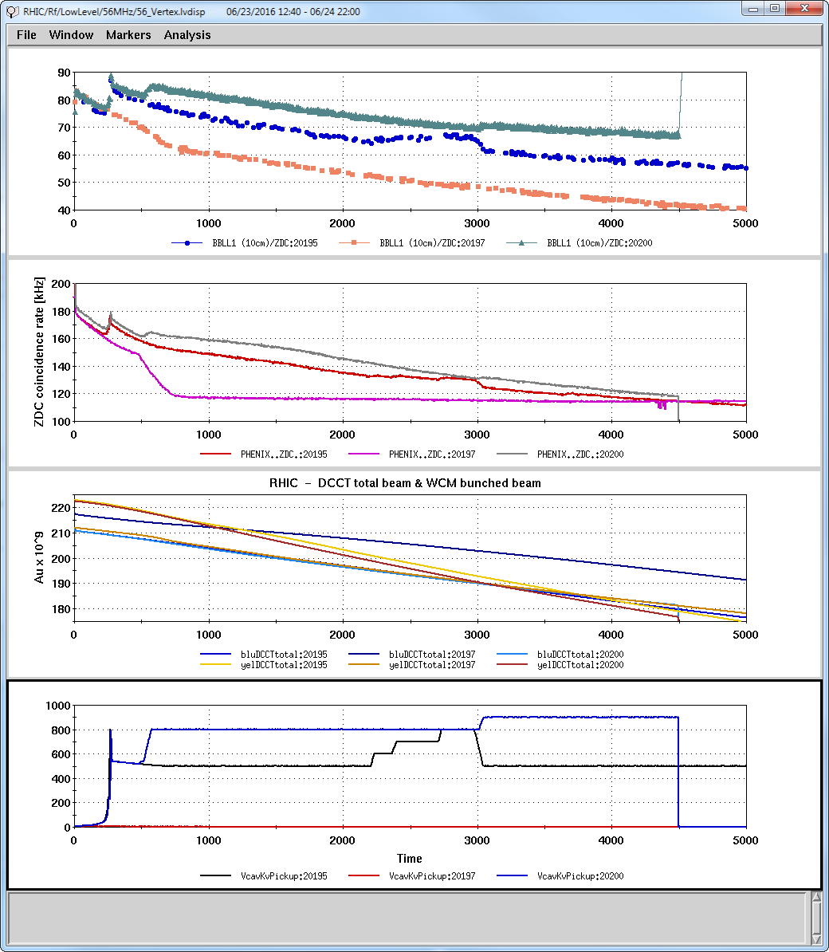
What Effect Does the 56MHz Have?
PHENIX 10cm / ZDC
PHENIX ZDC
Au-Au 100 GeV
B&Y DCCT
56 MHz Voltage (kV)

Slide 24
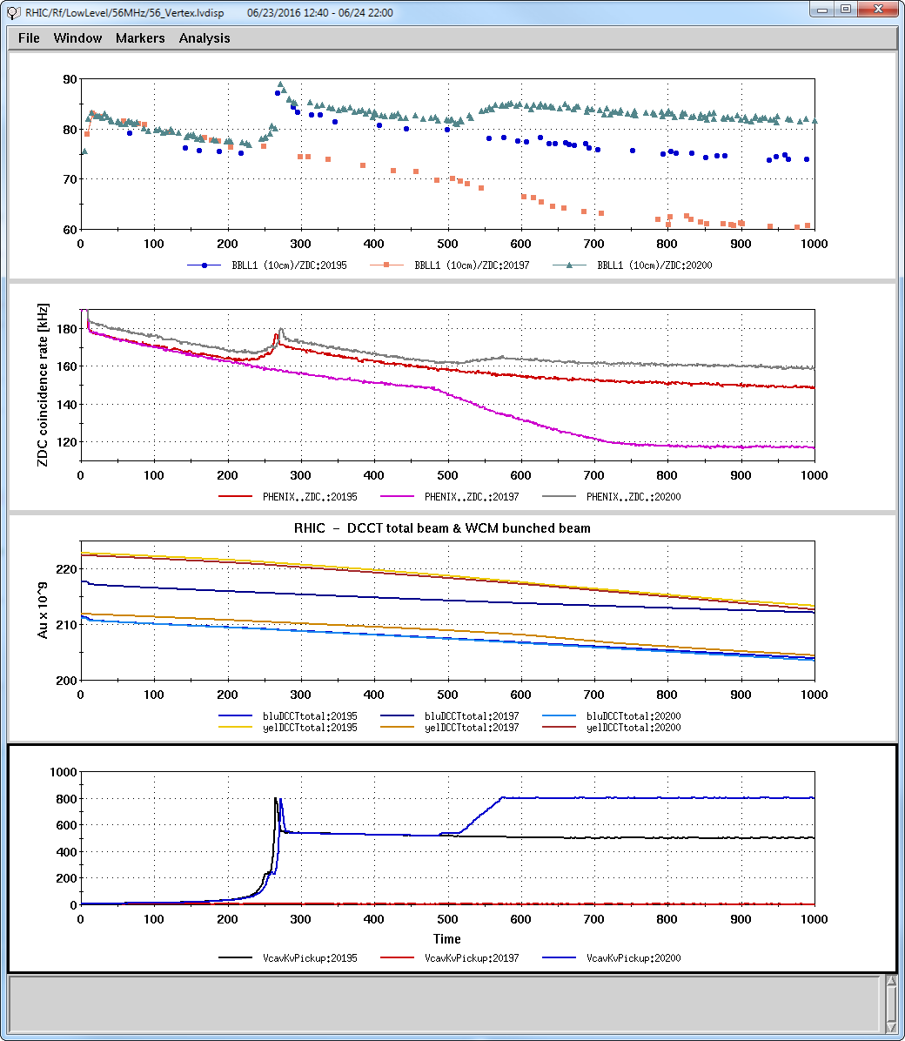
What Effect Does the 56MHz Have?
PHENIX 10cm / ZDC
PHENIX ZDC
Au-Au 100 GeV
B&Y DCCT
56 MHz Voltage (kV)

Slide 25
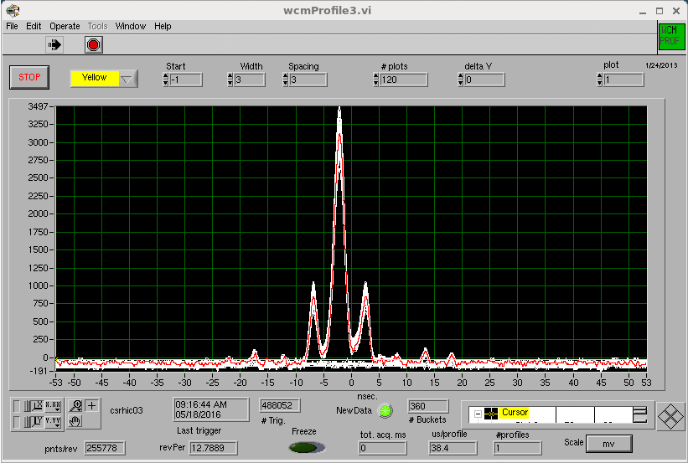
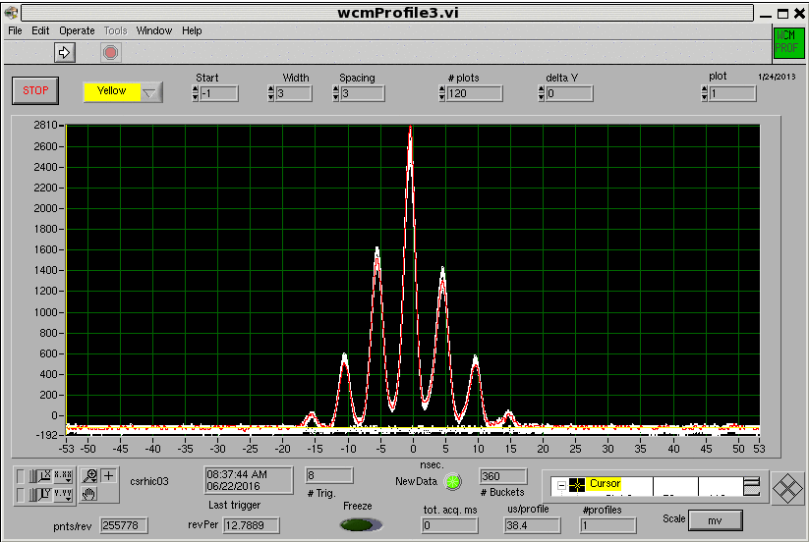
What Effect Does the 56MHz Have?
2Hours @ 0 kV
6 Hours @ 900kV
d-Au: Yellow Au WCM

Slide 26
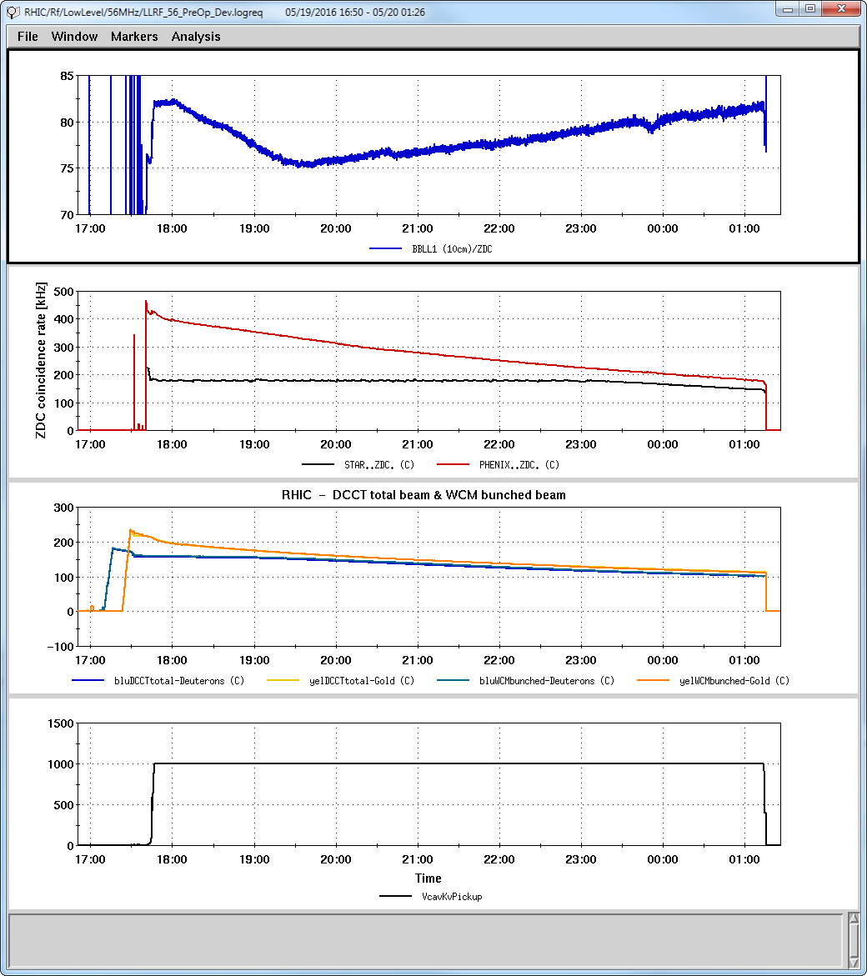
Full d-AU Store with 1MV on the 56MHz
PHENIX 10cm / ZDC
2Hours @ 0 kV
PHENIX & STAR ZDC
6 Hours @ 900kV
B&Y DCCT
d-Au Store at 1MV on 56 MHz!
56 MHz Voltage (kV)

Slide 27
Full d-AU Store with 1MV on the 56MHz
Achieving 1MV operation is a great step forward for C-AD.
Proved that we can successfully operate an SRF cavity in an operational machine.
A very good first step in establishing SRF credibility.

Slide 28
Forward – Ever Forward
Notes:
Brief Background
Describe some of the primary unknowns and how they were resolved
Show how exactly we were able to wade our way through the minefield
What the next steps are for this project
Acknowledge how much work went into this effort

Slide 29
Looking Forward
Achieving 1MV operation is a great step forward for C-AD.
Proved that we can successfully operate an SRF cavity in an operational machine.
A very good first step in establishing SRF credibility.
Provided us with a tremendous amount of experience and information as to overall cavity operation and behavior.
Validated the HOM map and the dominance of the monopole modes.
Proved that we can provide adequate HOM damping up to 1MV using only the FMD.
Provided valuable data on optimization of the FPC Qext.
Trade offs between FPC emitted power and PA forward power required for stabilization.
Exposed weaknesses in the cavity and RF.
Drift in the high power circulator.
Parasitic resonance in the FPC.
Limited CW power handling in the FPC and FMD.
Exposed weakness in the LLRF protection scheme.
Provided validation of new protection methods.
Problematic spurs in the RF PA output.
Provided validation of the LLRF feedback loops used to stabilize the cavity.

Slide 30
Looking Forward
Run 17 (250 GeV PP)
The cavity is not needed for operational running.
But need to continue to operate and gain experience.
And, we may get some ion running.
Shutdown 16/17
Opening the cryomodule to assess and remediate observed problems with the FPC.
Will likely be replacing the internal FPC heliax RF cable with a more robust transmission line.
We suffered what appear to be multiple breakdown events internal to the FPC cable.
See what else we find that needs fixing or modification.
Run 17
Expect to initially run the cavity during MD.
Desirable to run operationally at store as well, if benign.
Primary goal is to improve our understanding of the cavity, its limitations, etc.
Because …

Slide 31
Looking Forward
Run 18 (Fancy Ions)
The cavity is needed for operational running.
Our goal is to operate stably at store at greater than 1MV.
But …
1MV was essentially our observed operational limit in Run 16, due to:
PA power limitations and non-linearity.
FPC power limitations.
FMD power limitations.
FPC parasitic resonance.
In order to achieve stable operation above 1MV, we need to address these issues.
Run 17 provides our last chance to learn what we need to learn.
Run 17/18 Shutdown
Have a well conceived and detailed plan to make all remaining required modifications to provide stable running above 1MV in Run 18.
Another very resource heavy effort which has to begin before Run 17 ends.

Slide 32
Looking Forward
sPHENIX (2022?)
The 56 MHz cavity will need to run at its design voltage of 2MV.
Following Run 18:
Remove the cavity from RHIC and relocate to the 912 test cave (former ERL experiment).
Develop and test all modifications needed for 2MV.
Final HOM Damper scheme.
Not yet clear what this is.
I do not expect it to involve SRF HOM Dampers.
Final FPC scheme.
Not yet clear what this is.
Disassemble cryomodule, reprocess cavity, vertical testing, reassemble cryomodule.
Modifications to internal cryo plumbing.
Cavity conditioning to operational 2MV CW.
Reinstall in the 4IR.

Slide 33
Acknowledgments
There were many challenges and many parallel efforts that needed to be addressed along the way. The 56 team had to put forth a tremendous amount of effort to pave this path to 1MV.
Efforts and Difficulties
HOMD Install & Removal (S. Seberg, Cryo, Vacuum, Instrumentation …)
Linearizing the 3kW QEI amplifier with a pre-distortion scheme
AC coupled IQ loop margin – circulator temperature drift
Optimization of FPC forward vs reflected power
If it could go wrong, it did (blown cable, S/A glitches, …)
FPC parasitic resonance
Very limited time available for testing and debug
Development of added cavity protection mechanisms in LLRF
Some other projects that required the team’s attention
Development, installation and commissioning of five new Linac LLRF systems.
Development and commissioning of CeC RF systems, including 704 MHz 5-Cell SRF cavity, new this year.
Roll-out and commissioning of new LLRF FPGA firmware across all machines to support 2Gb/s Update Link.
Commissioning of new 9MHz cavity.
Support of operations across all machines.

Slide 34
More Acknowledgments
There are many, many people and groups who contributed to this effort – too many to list, but don’t doubt your efforts are recognized.
I’d like to specifically thank:
Sal Polizzo
Sal’s extensive RF expertise, creativity and tenaciousness were the key to our success.
W. Fischer and A. Zaltsman
Provided unwavering support under very challenging circumstances.
B. Christie
Supported the effort and gave us every opportunity we requested.
This was a critical run for STAR.
Made very difficult choices and did a great job wearing both his hats.
Even gave us a shot in the final week when the stakes were highest!

Slide 35
Thank You

