Slide 1
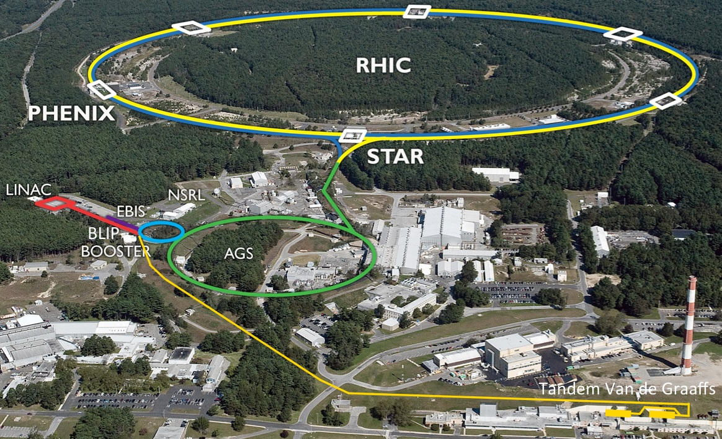
Projections for Run-17/18 and accelerator upgrades Wolfram Fischer
28 July 2016
RHIC Retreat, BNL
Notes:
27 July 2015, 09:50, 20 min (incl. questions)

Slide 2
Contents
Performance in Run-16 Au+Au 100 GeV/nucleon d+Au 100, 31.2, 9.8, 19.5 GeV/nucleon
Projections for Run-17 (p↑+p↑ 255 GeV) and Run-18 (Zr+Zr, Ru+Ru 100 GeV/nucleon)
Ongoing and planned upgrades LEReC, RADTIU RHIC 9 MHz RF Extended EBIS Linac (Raster, Reliability, Intensity Phase I+II)

Slide 3
Run-16 achievements
the highest Au+Au luminosity yet with more collisions in 10 min than in the entire 5-week commissioning run in 2001, and at the same time luminosity for STAR delivered at an almost constant rate
a replacement of a RHIC dipole cold quench protection diode in just 19 days
d+Au collision of about 1 week each at 4 different energies and a return to Au+Au for a week demonstrating an unparalleled collider flexibility
record Au amounts from EBIS, the Booster and the AGS for RHIC
record deuteron intensity from the Tandem, Au delivery during 2 EBIS outages, and demonstration of ruthenium-96 (which has only 5.5% natural abundance) for future runs
56 MHz SRF operation at 1 MV without any HOM dampers - the first operational SRF cavity in RHIC
demonstration of Au+Au luminosity at 10 GeV/nucleon without cooling for BES-II, and a critical recombination monitor for LEReC
CeC beam delivered from the gun to the dump
in parallel to the RHIC program record intensity delivered to BLIP thanks to a new raster system and Linac intensity upgrades, as well as reliable beam delivery to NSRL

Slide 4
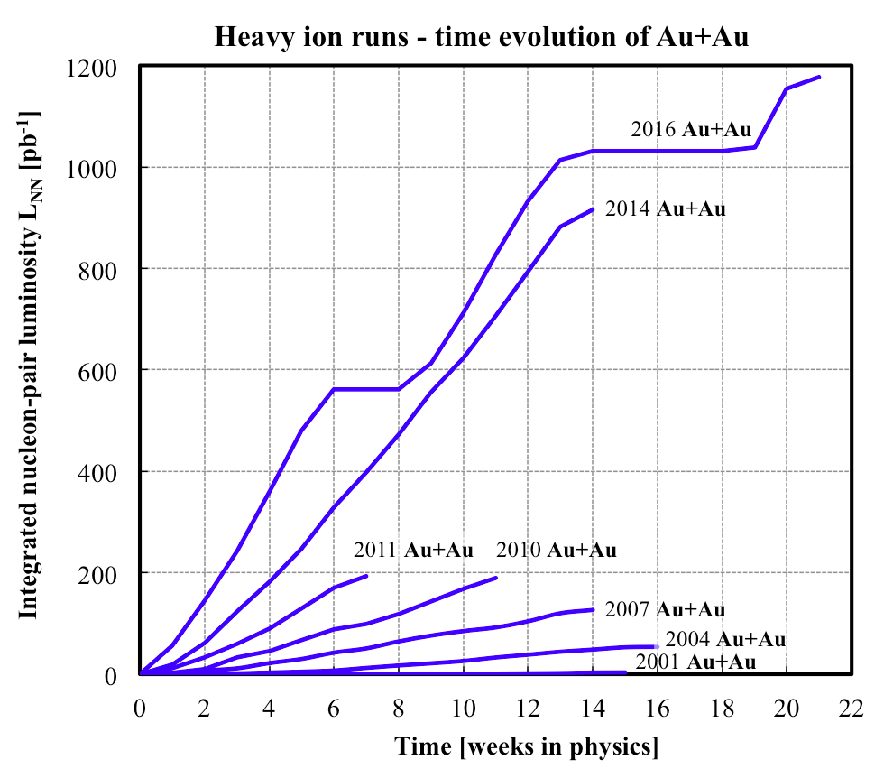
Run-16 Au+Au at 100 GeV/nucleon Integrated luminosity
Run Coordinator: Xiaofeng Gu
L = 3.0 nb⁻¹/week (+33% vs. 2014)
more collisions in 10 min than in the entire 5-week commissioning run in 2001
1st plateau: 2.8 weeks (not good – diode failure)
2nd plateau: 5.6 weeks (good – switched in and out of d+Au quickly)

Slide 5
Run-16 d+Au at 100, 31.2, 9.8, 19.5 GeV/nucleon Luminosity
Run Coordinator: Chuyu Liu
L = 125 nb⁻¹/week at 100 GeV/n (9.25x vs. 2008)
d+Au collision of about 1 week each at 4 different energies and a return to Au+Au for a week demonstrating an unparalleled collider flexibility (record 6 setups for physics)
record deuteron intensity from the Tandem, Au delivery during 2 EBIS outages

Slide 6
Operational efficiency
Availability (as reported to DOE)
Set-up time
Store-to-store time
Time-in-store (primary internal efficiency measure)

Slide 7
Operational efficiency availability reported to DOE
Facility Operations | FY2002 | 2003 | 2004 | 2005 | 2006 | 2007 | 2008 | 2009 | 2010 | 2011 | 2012 | 2013 | 2014 | 2015 | 2016
Research (physics, machine development) | 1379 h | 1238 | 1611 | 2282 | 1920 | 1117 | 1198 | 1352 | 2194 | 1563 | 1752 | 1290 | 2116 | 1909 | 1775
Beam Studies (APEX) | 58 h | 92 | 136 | 158 | 129 | 104 | 103 | 163 | 173 | 64 | 118 | 75 | 90 | 112 | 70
Setup/Tuning | 739 h | 2111 | 1439 | 1422 | 775 | 820 | 1228 | 1639 | 1163 | 1486 | 1202 | 1291 | 852 | 1368 | 851
Total Operating Hours | 2176 h | 3441 | 3186 | 3862 | 2824 | 2041 | 2529 | 3154 | 3530 | 3113 | 3072 | 2655 | 3060 | 3389 | 2696
Failure | 461 h | 975 | 791 | 696 | 699 | 882 | 516 | 773 | 721 | 762 | 526 | 517 | 466 | 485 | 554
Availability (%) | 82.5% | 77.9 | 80.1 | 84.7 | 80.2 | 69.8 | 83.1 | 80.3 | 83.0 | 76.3 | 85.4 | 83.7 | 86.6 | 87.5 | 83.0
Scheduled shutdown (maintain cool-down) | 252 h | 378 | 287 | 803 | 509 | 604 | 158 | 273 | 451 | 262 | 301 | 187 | 195.3 | 254.8 | 528
Injectors/RHIC Beam Operations | 17.2 wks | 28.5 | 25.4 | 31.9 | 24.0 | 21.0 | 19.3 | 25.0 | 28.0 | 25.5 | 26 | 20.0 | 22.1 | 25 | 25
Cryogenic Operation | 17.0 wks | 30.4 | 26.7 | 31.4 | 21.2 | 18.4 | 19.0 | 22.0 | 27.1 | 24.4 | 22.9 | 17.0 | 22.0 | 22.4 | 22
Availability = beam time / scheduled beam time (denominator excludes scheduled maintenance)
Availability goal: 80%
Typical times:
50K to 4K cool-down : 0.5 weeks
Initial set-up : 2 weeks
Changing species : 0.5 weeks
Beam studies (APEX): 16h / 2 weeks
Maintenance : 14h / 2 weeks
Warm-up : 0.5 weeks
FY2016 met availability goal (not a record year)

Slide 8
Operational efficiency setup time
Setup time: - for 1st species in run: from both rings cold to 1st physics store - for following species: from beginning of setup to 1st physics store
Run-16
19 days for Au+Au
≤ 3 days for d+Au each
TRANSPARENT: low energy
BLUE: heavy ion runs
INTRANSPARENT: high energy
RED: polarized proton runs

Slide 9
Operational efficiency store-to-store, time in store
Run-16
Time in store = store time / calendar time (denominator includes scheduled maintenance, failure, setup, beam experiments)
Time in store goal: 60%
TRANSPARENT: low energy
BLUE: heavy ion runs
INTRANSPARENT: high energy
RED: polarized proton runs

Slide 10
RHIC – all running modes to date 2001 to 2016
2017
2016
2019/20 LEReC
2018
nominal injection energy

Slide 11
RHIC ultimate luminosity and polarization goals
parameter | unit | achieved |  | goals
Au-Au operation |  | 2016 |  | ≥ 2021 56 MHz SRF + AGS + 9 MHz RF
energy | GeV/nucleon | 100 |  | 100
no colliding bunches | … | 111 |  | 111
bunch intensity | 10⁹ | 2.0 (1.6) |  | 2.5 (2.0)
avg. luminosity | 10²⁶ cm⁻²s⁻¹ | 87 (50) |  | 175 (100) 2× achieved
p↑-p↑ operation |  | 2015 |  | ≥ 2021 OPPIS + 9 MHz RF + e-lenses
energy | GeV | 100 | 255 | 100 | 255
no colliding bunches | … | – 111 – |  | – 111 –
bunch intensity | 10¹¹ | 2.25 | 1.85 | 3.0 | 3.0
avg. luminosity | 10³⁰ cm⁻²s⁻¹ | 63 | 160 | 175 2.8× achieved | 600 3.8× achieved
avg. polarization* | % | 55 | 52 | 60 | 55
Last year’s numbers in brackets
*Intensity and time-averaged polarization as measured by the H-jet. Luminosity-averaged polarizations, relevant in single-spin colliding beam experiments, are higher.

Slide 12
Outlook RHIC Run-17 and Run-18
PAC recommendations (STAR only while PHENIX => sPHENIX):
Run-17
ph+ph at 255 GeV, ~12 weeks (400 pb⁻¹) leveled luminosity at 1.6x10³² cm⁻²s⁻¹
CeC PoP ~ 1 week
Au+Au at 31.3 GeV/nucleon – can be considered when other goals were met
Run-18
Ru+Ru (Z = 44, A = 96) no enriched Ru-96 source material, from Tandem
Zr+Zr (Z = 40, A = 96) enriched Zr-96 foils available, from EBIS
CeC PoP
Au+Au at 13.5 GeV/nucleon – endorsed if enough time available

Slide 13
Run-17: ph+ph 255 GeV Luminosity leveled at 1.6x10³² cm⁻²s⁻¹
Run Coordinator: Vahid Ranjbar
Calculation with multiple β* squeezes (expect only one in Run-17) – Y. Luo
Goal: L within ±10% of target
Luminosity [10³² cm⁻²s⁻¹]

Slide 14
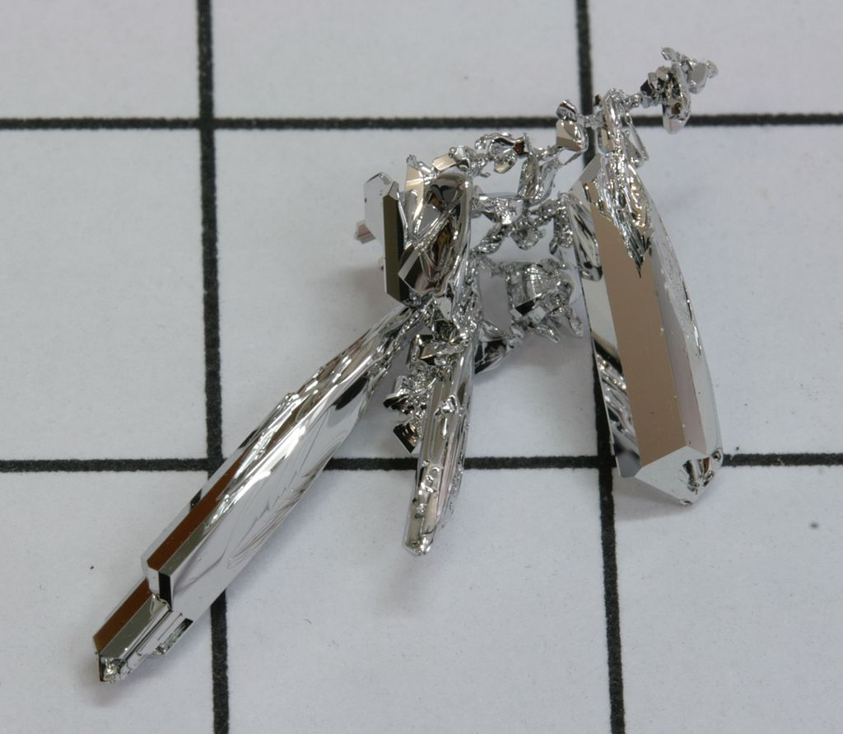
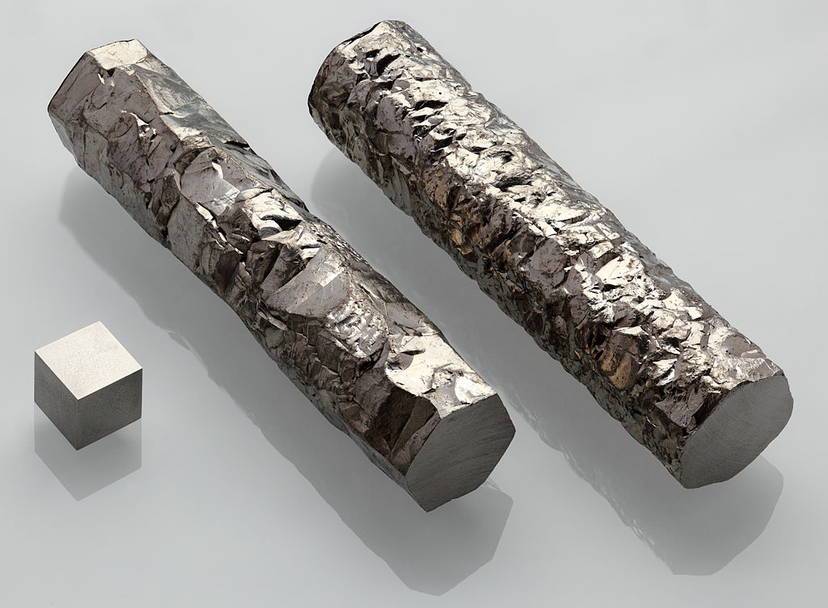
Run-17 Ru+Ru and Zr+Zr at 100 GeV/nucleon
Request for Ru-96 and Zr-96
Full intensity: Ru, Zr charge per bunch = Au charge per bunch Expect ~50% of full intensity, ~2x10⁹ ions per bunch
Ru-96 natural abundance: 5.52%
Zr-96 natural abundance: 2.78%
Enriched Zr-96 available in metallic form, => can run from EBIS
Enriched Ru-96 not available from any source, => Tandem demonstrated 0.5 pμA on 02/18/16
ruthenium grown out of gas phase (Wikipedia)
zirconium (Wikipedia)

Slide 15
Run-18: ⁹⁶Zr + ⁹⁶Zr, ⁹⁶Ru + ⁹⁶Ru Luminosity estimates
based on 2016 test, natural Ru, from Tandem
estimate from last year (likely too conservative)

Slide 16
RHIC Upgrades Overview
Low-Energy RHIC electron Cooling (LEReC)
Accelerator Development Technical Infrastructure Upgrade (RADITU)
RHIC 9 MHz RF Upgrade
Extended EBIS
Linac Upgrades Raster, Reliability, Intensity Phase I+II

Slide 17
Low Energy RHIC electron Cooling (LEReC)
A. Fedotov
64 m to IP2
(not to scale)
Commissioning
Diagnostic Line 1
704 SRF
Booster Cavity
Commissioning
Diagnostic Line 2
704 MHz Cu Cavity
9 MHz Cu Cavity
2.1 GHz Cu Cavity
DC e⁻ Gun
e⁻
COOLING
in Yellow RHIC ring
e⁻
RHIC TRIPLET
RHIC DX
e⁻
COOLING
in Blue RHIC ring
LEReC Solenoids
Compensating (LF)
Matching (HF)
Merger/Transport
180° Bending Magnet
20° Bending Magnets
Beam Dump
Energies E : 1.6, 2.0 (2.65) MeV Avg. current I_{avg} : 27 mA Momentum δp/p : 5×10⁻⁴
Luminosity gain : 4×
1st bunched beam electron cooler planned operation in 2019/2020

Slide 18
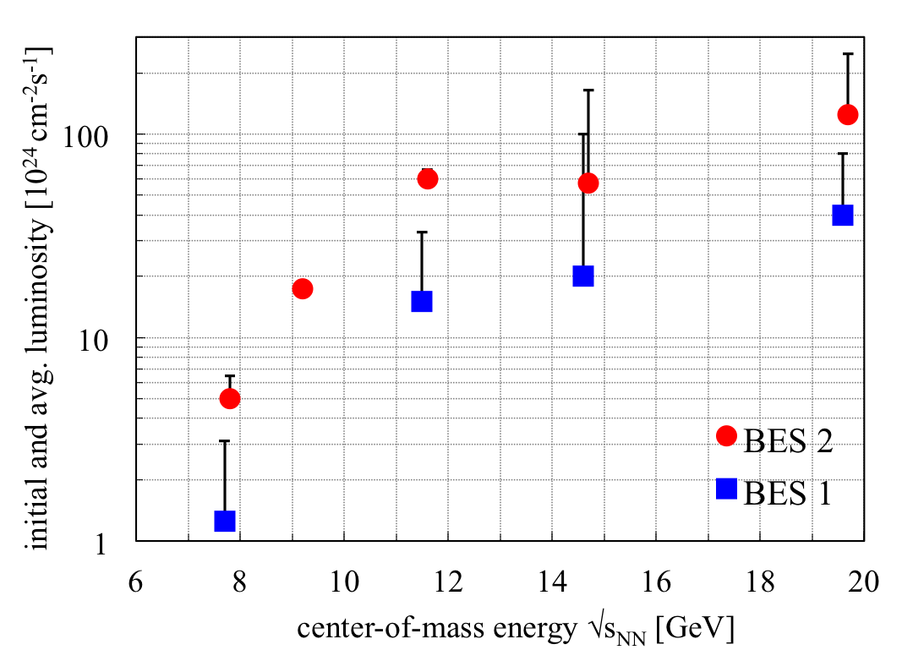
BES-II 2019/2020 BES-I and BES-II luminosities
4x increase in L_{avg} with e-cooling
3x increase in L_{avg} without e-cooling

Slide 19
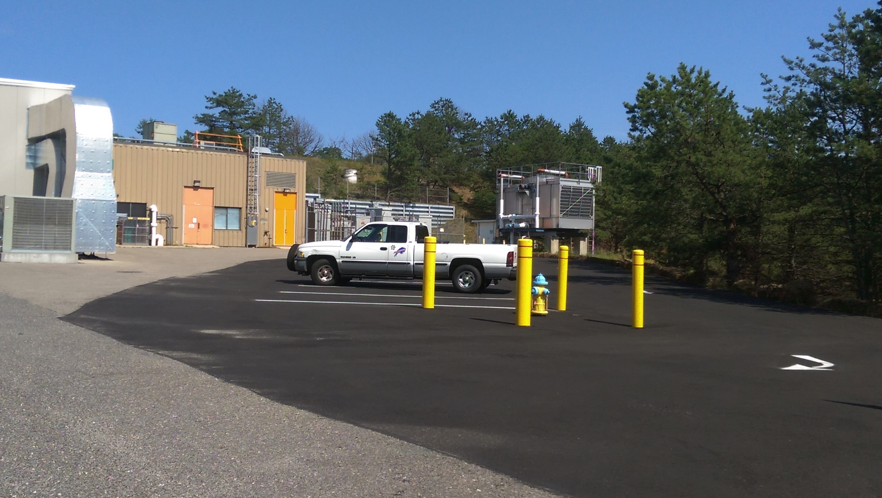
RHIC Accelerator Development Technical Infrastructure Upgrade
C. Folz
Scope
upgrade of buildings, tunnel, and technical infrastructure in RHIC Interaction Region 2 (electrical, water, and cryogenic distribution, access controls)
Cost and funding
Schedule
started: 03/2015
planned early completion: 12/2016
Status
presently on track for for completion as planned
FY2014 | 2015 | 2016 | Total
$1.0M (A) | − | 0.5M | 1.5M
New parking lot at IR2 provided by lab

Slide 20
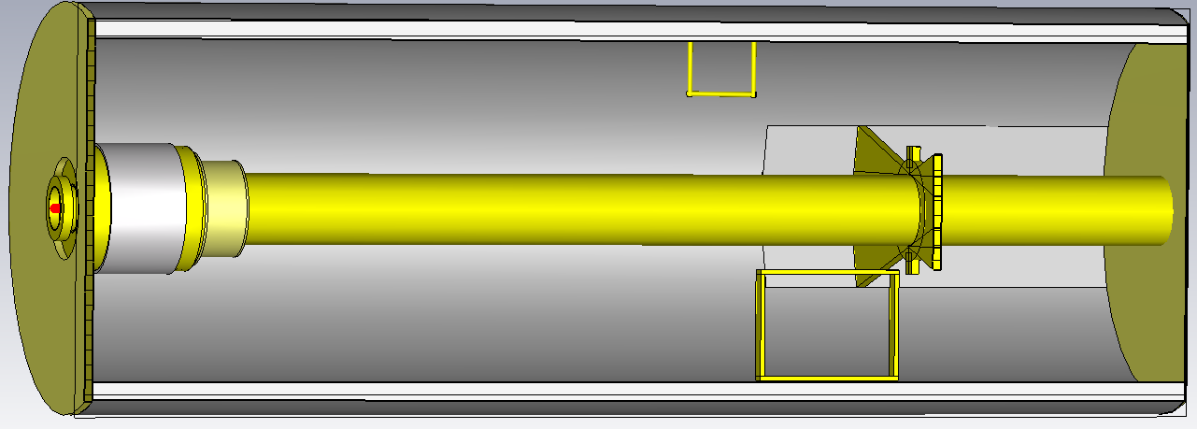
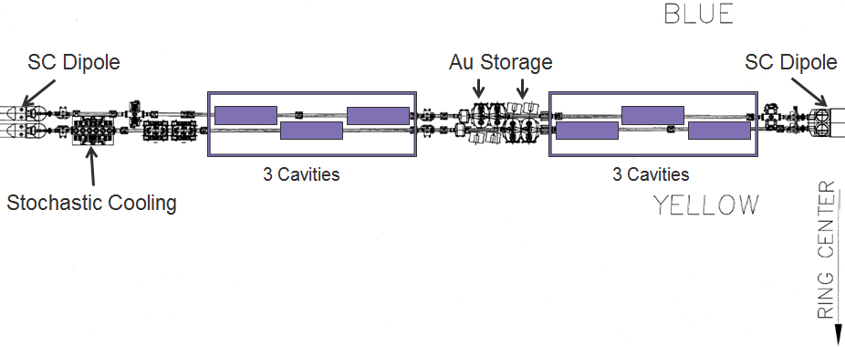
RHIC 9 MHz RF Upgrade
A. Zaltsman, S. Polizzo
Scope
3 cavities per ring (60 kV per cavity) [existing 9 MHz RF: 22 kV (p↑+p↑)]
3 areas of benefit:
Larger bucket and ramp speed for protons (avoids squeeze out on early part of ramp, faster crossing of spin resonances)
Lower peak current for transition crossing (increase in bunch intensity)
Operation with long bunches at low energy ions (enhancement to LEReC)
Cost and funding
Schedule
started: 08/2013
planned completion: 12/2017 (begin of beam commissioning)
Status
first article demonstrated design voltage in RHIC ring 07/2015
installation of 1 cavity per ring for Run-17, complete system for Run-18
presently on track for completion as planned
FY2014 | 2015 | 2016 | Total
$675k (A) | 700k (A) | 625k (A) | 2.0M
Notes:
Mar-2015: install first article in RHIC ring
Nov-1016: complete installation in RHIC
Oct-2017: start commissioning with beam

Slide 21
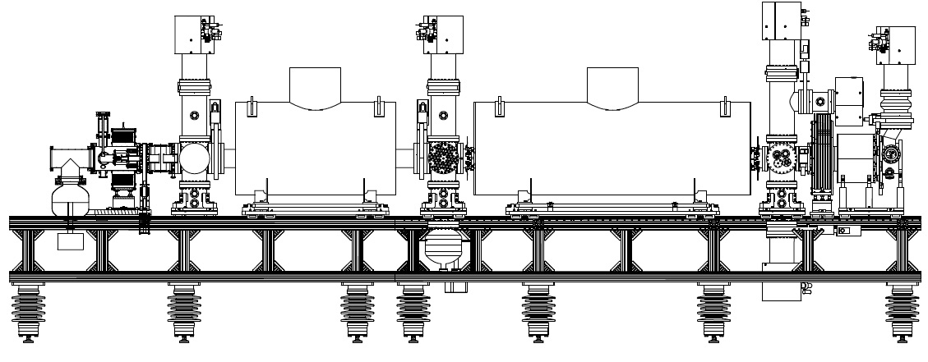
Extended EBIS
trap length extension
Scope
Add superconducting solenoid for trap length extension, expect +40% Au intensity
(early completion would shorten time for 2 highest energies in BES-II; also allows for next step in polarized ³He R&D)
Cost and funding
Schedule
2016 start (solenoid acquisition)
2020 planned completion largest risk (cost, schedule and performance): superconducting solenoid magnet
FY2016 | 2017 | Total
$475k (P) | 1350k (P) | 1.8M
High-field ³He polarization cell (R&D collaboration with MIT)

Slide 22
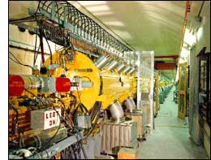
Linac / BLIP upgrades
First beam 1970
BLIP Raster – R. Michnoff double circle beam motion on target + instrumentation $4.5M – completed early and below cost
Linac reliability – D. Raparia 5 kW solid state amplifiers, LLRF, instrumentation almost complete
Linac intensity upgrade phase I – D. Raparia, J. Ritter average current increase from 125 to 140 μA, evaluation for phase II completed, current up to 165 μA
Linac intensity upgrade phase II – D. Raparia, J. Ritter 2x increase in pulse length => average current 250 μA proposal to DOE isotope program in preparation
2016
Notes:
6 tube amplifiers in operation:
7651: 1 per tank, 5 kW pulsed power, need about 15/year (total $35k/year w/o overhead)
4616: 1 per tank, 200 kW pulsed power, need about 4/year (total $135k/year w/o overhead)
7835: 1 Per tank, 2.5 MW pulsed power, need about 4/year (total $520k/year w/o overhead)
8616: 1 Per tank, ?? kW pulsed power, need about 9/year (total $80k/year w/o overhead)

Slide 23
Summary
Run-17 new luminosity records in Au+Au and d+Au record 6 setups for physics record intensity from injectors quench protection diode failure and repair Maintained high operational efficiency 83% availability (goal: 80%), >60% of calendar time in store for all modes except d+Au at 9.8 GeV/nucleon (goal: 60%)
Preparation for next runs Run-17: p↑+p↑ at 255 GeV (+ Au+Au), CeC PoP Luminosity leveling at 1.6×10³² cm⁻²s⁻¹ at STAR
Run-18: Zr+Zr, Ru+Ru 100 GeV/nucleon, (+ Au+Au) , CeC PoP
Ongoing and planned upgrades LEReC, RADTIU RHIC 9 MHz RF Extended EBIS Linac (Raster, Reliability, Intensity Phase I+II)

