Slide 1
High Brightness Beams for Linac
D. Raparia
7/28/2016

Slide 2
Acknowledgements
G. Atoian, B. Briscoe, V. Lodestro, J. Ritter, A. Zelenski, K. Zeno

Slide 3
Questions
Why changing quadrupole emittance changed ?
Why lowering tank 1 RF amplitude , transverse emittance reduces ?
What is the minimum emittance we can get out of linac ?
Simulations for low energy

Slide 4
outlines
Introduction
Brightness
x-y and x-z coupling
Changes in 2009
Emittance out of linac and out of Booster
Emittance 2016 out of linac and Booster

Slide 5
Brightness
X and Y emittance are uncoupled

Slide 6
Source of x-y coupling
Coupling in the beam
-Charged acquired in the longitudinal filed (OPPIS)
Coupling in the machine
-Rotational error in quads (linac)
-Vertical off center in the dipole (HEBT, LTB)

Slide 7
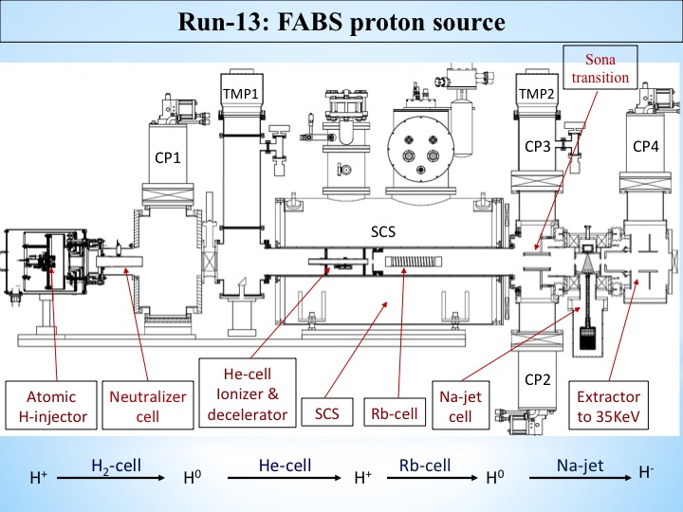
Zelenski
Coupling in beam

Slide 8
Coupling in machine
Example 35 keV in Helical Quadrupole Channel (0 mA)

Slide 9
Example 35 keV in Helical Quadrupole Channel 200 mA

Slide 10
Phase Space Projection
If beam is uncoupled at the beginning of the system and the initial x and y emittance are equal, then at all the the point downstream , the projected emittances in the x and y planes will be equal to each other, and independent of the magnitude of the x-y coupling at that point. Their magnitude may, be equal to or grater than the values of the initial, uncoupled emittances
At any position downsteam, where x-y xoupling is present the sum of the square of projected x and y emittances will be equal to or greater than the Kinematic moment I2
Cross-plane coupling and its effects on projected emittance
SLAC-PUB-4679, August 1989

Slide 11
MEBT Measurements
Comparison Between Modeling and Measured performance of the
BNL Linac (1996 Linac Conf.)

Slide 13
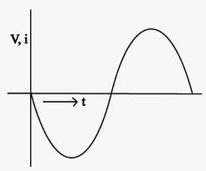
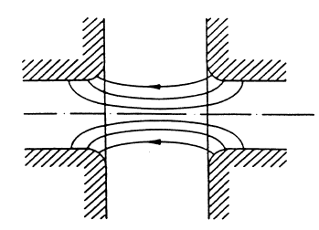
X-Z coupling
RF Gap in Buncher
RF Defocusing in the transverse motion
On the longitudinal phase
Dependence on the transit time factor
In the longitudinal motion on the transverse
position
δφ
Force very along the length of the bunch causing
emittance Δε ~(δφ)²/βγ³
x
Force very across the width of the bunch causing
emittance Δε ~ x⁴ /β² γ

Slide 14
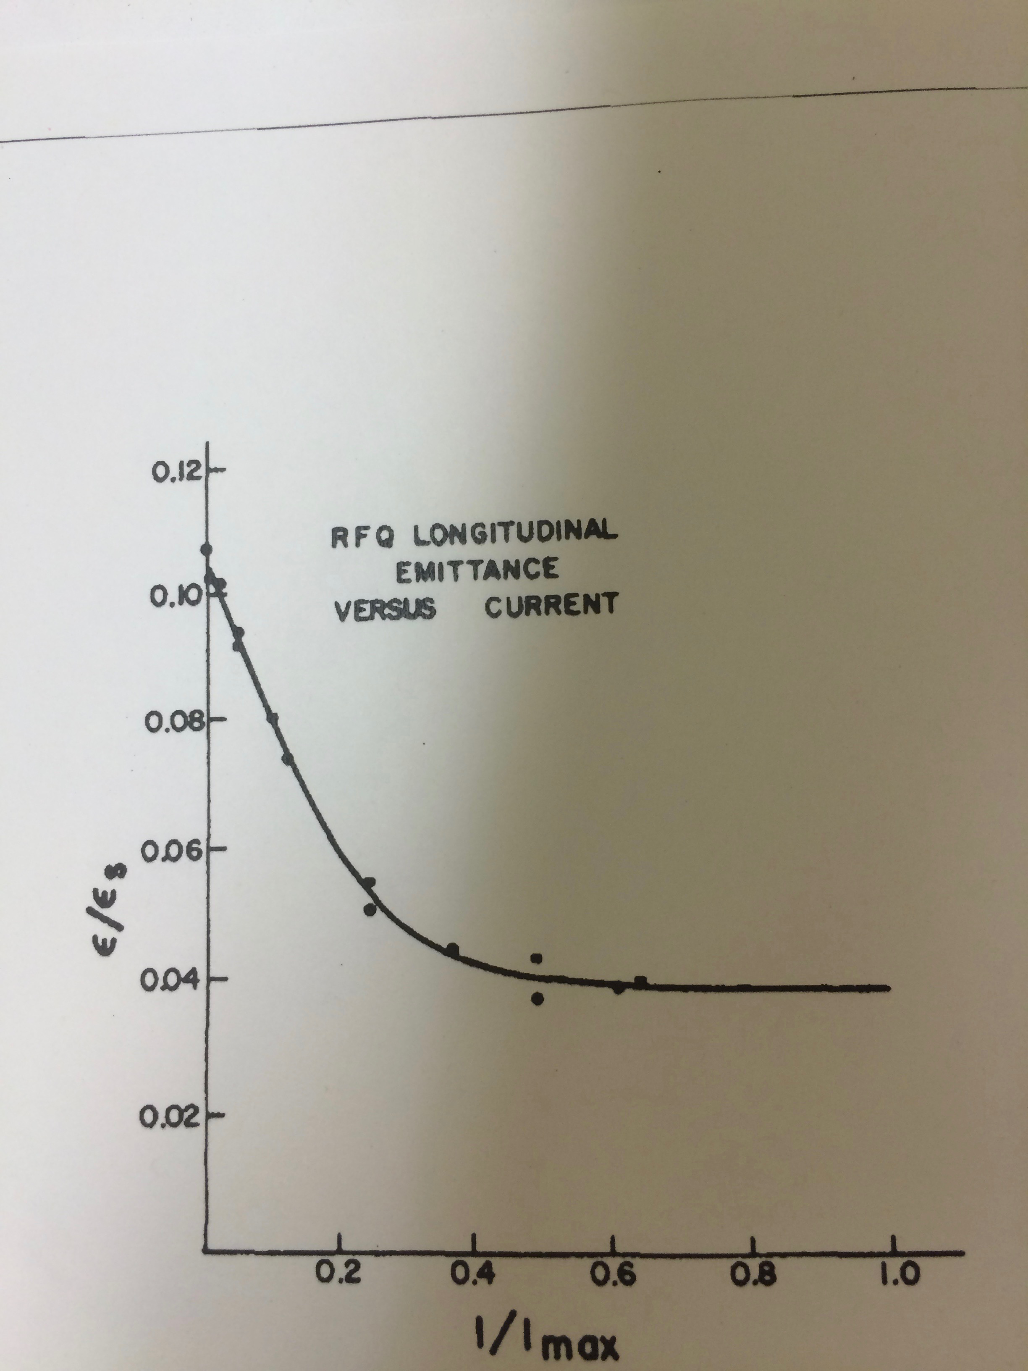
Longitudinal emittance in RFQ

Slide 15
LEBT and MEBT in 2008
35 keV
7 m
750 keV
DC
B
B
B
DTL
H
S
S
RFQ
Q
C
Q
S
D
Q
Q
H
Polarized
B
Q
Quadrupole
Buncher
S
Solenoid
C
Chopper
S
Beam Stop
E
ES Lens

Slide 16
RFQ
B 1
B 2
At Cell 20 in DTL
B3
At DTL

Slide 17
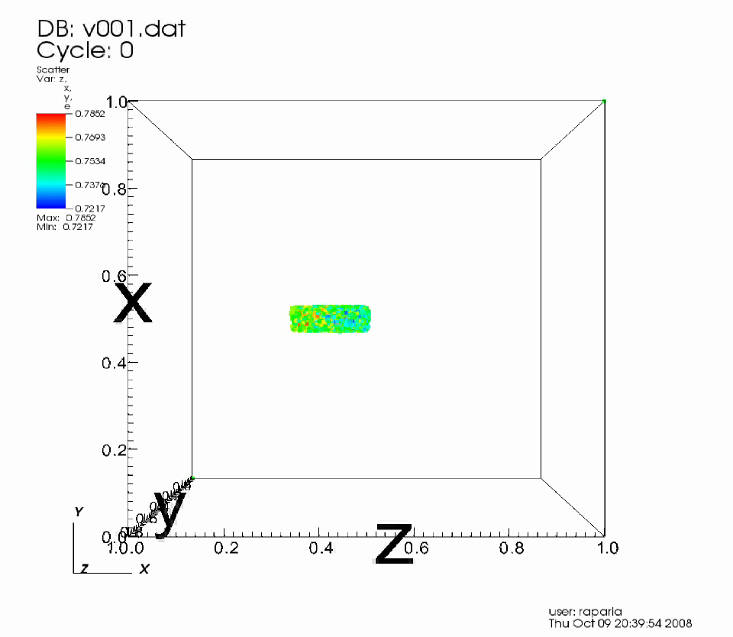

Slide 18
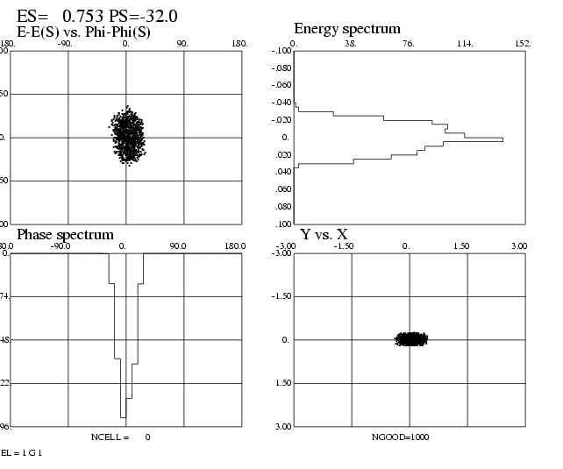
LEBT and MEBT in 2010
B
DTL
E
Q
S
C
S
S
RFQ
Q
Q
Q
S
E
H
H
Entrance of DTL
B
Q
Quadrupole
Buncher
S
Solenoid
C
Chopper
S
Beam Stop
E
ES Lens

Slide 19


Slide 20
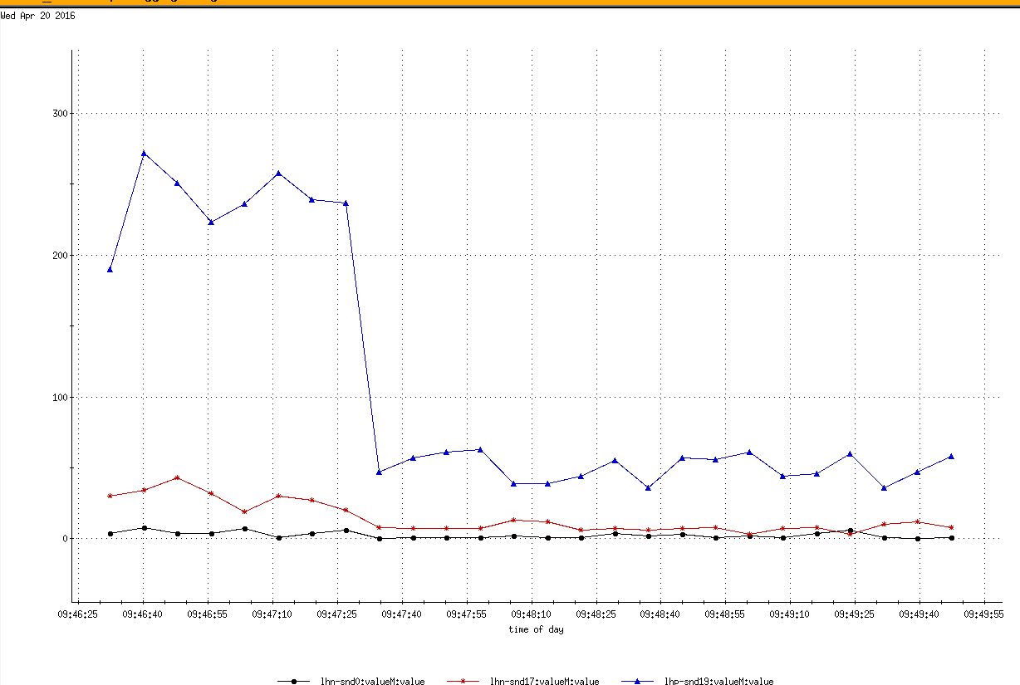
Beam loss reduction at BM1 after Tk1 amplitude tune

Slide 21
Performance of New AGS RFQ Preinector ( 1989 PAC)

Slide 22
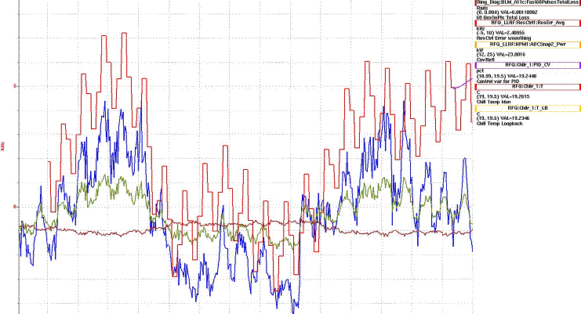
SNS RFQ Freq vs Losses at 1 GeV
Galambos
Freq 402.5 MHz

Slide 23
Measurements

Slide 24
SEM locations in the HEBT
Ritter
T9

Slide 25
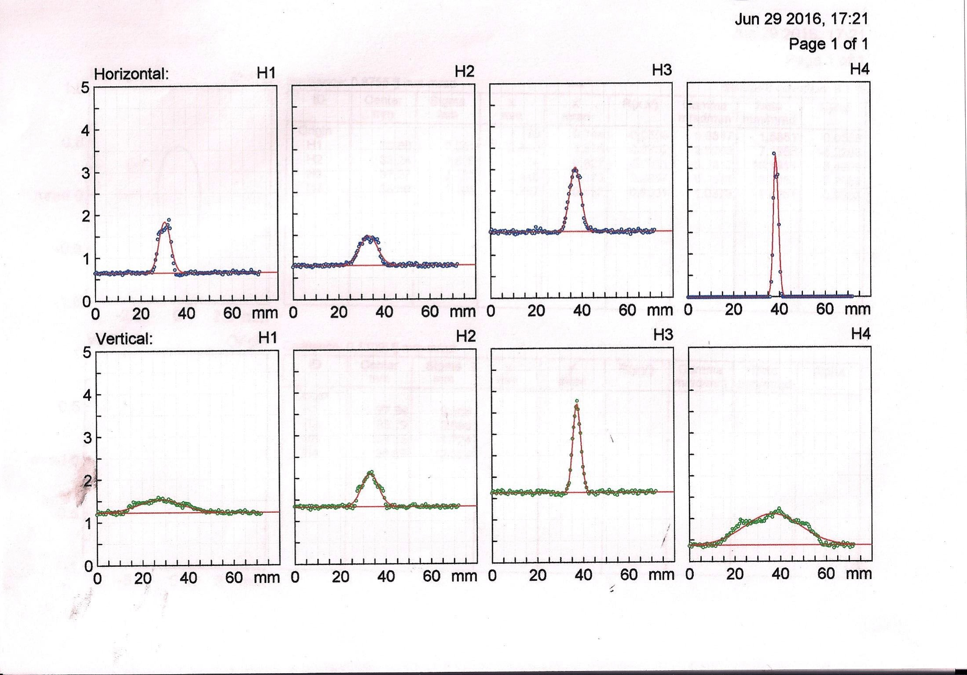
SEM Profiles

Slide 26
Emittance after MEBT reconfiguration
Year H(N, (9%) V(N,95%)
2007 11.04 12.075
2008 10.69 15.87
2009 4.5 5.5

Slide 27
The Bottom Line
Keith 2009
These effects (new foils, Linac changes, ½ integer injection…) though treated independently above are not really independent. For example, the aim of ½ integer injection is to reduce blowup on the foil, in principle the blowup would be more dramatic if the incoming beam is smaller. Also, if the blowup is less, a foil that causes more scattering than another might still be better than another foil that has poorer stripping efficiency.
So, just comparing the sizes from the Fy ’06 run with that in Fy ’09 could be instructive. This is shown in the table below. It is also worth noting that as we ran with the strip foil most of the time the injection efficiency was about 15% higher in Fy ’09 than in Fy ’06 even with these beam sizes.
Nominal Running Condition with No Scraping
Fy ’06 (100 μg, 400 μs) | Fwhm | Emittance
Horizontal | 5.02 mm | 20.8 π
Vertical | 6.54 mm | 6.7 π
Fy ’09 (strip foil, ½ integer inj., 300 μs pulse, new Linac optics)
Horizontal | 3.59+/-0.20 mm | 10.6+/-1.19 π
Vertical | 6.84+/-0.45 mm | 7.3+/-1.00 π
Note: With half integer injection the width in 1 plane in BtA is more affected by injection steering in
the opposite plane. So, any conclusions about the emittances in either plane at injection from those
in BtA are dubious.

Slide 28
Emittance (Emittance (95%, N , π mm mr)
Run # | H(linac) | V(linac) | H (BTA) | V (BTA)
2006 |  |  | 20.8 | 10.6
2007 | 11.04±2 | 12.75±2
2008 | 11.69±2 | 15.87±2
2009 | 4.5±1 | 5.5±1 | 10.7 | 7.3
2010 |  |  | 16.9 | 10.6
2011 | 5.3±1 | 6.3±1 | 14.1 | 10.64 | 12/14/10
2012 | 4.5±1 | 5.0±1 | 10 | 6 | 1/30/12
2013 | 3.5±0.7 | 3.5±07 | 9.6 | 8.0 | OPPIS Solenoid Off ?
2013 | 4.5±1 | 5.5±1
2014 | 4.8±1 | 4.8±1 | 16.8 | 10.6
2015 | 6.5±1 | 6.5±1 | 15.5 | 9.6
2016 | 4±1 | 6.0±1 | 9.1 | 7.0 | 117 MeV quad, Low TK1 Amp,
BTA measurement from Keith

Slide 29
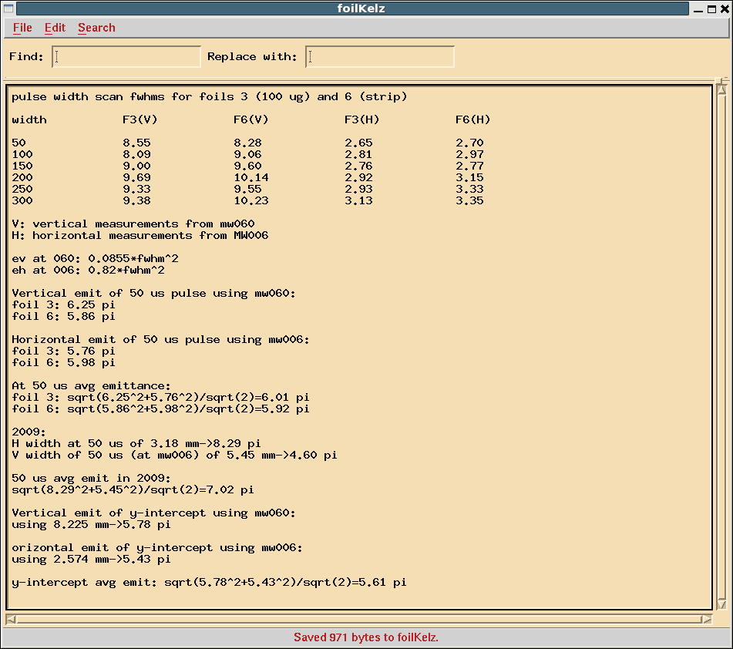
Keith 2016
In 2009, using a similar method I got 6.65 pi for the avg emittance of the 0 us linac pulse (i used mw006 for both H and V). This time I got 5.61 pi.

Slide 30
Current verse Emittance
1/14/2015
Current | Emittance (95%, N , π mm mr)
100 uA | 6.35±1
200 uA | 6.45±1
300 uA | 6.95±1
400 uA | 7.25±1
600 uA | 6.90±1
700 uA | 6.95±1
Rb temp was varied to change the current

Slide 31
More Measurements
Tank 1 Gradient | Emittance (95%, N , π mm mr)
Normal | 10±1 | En7, Buncher power ?
Low (~5 %) | 6±1 | June 29 2016
Tank1 Gradient | H Emittance (95%, N , π mm mr)
Normal | 8.3 ±1 | 4/26/2016
Low (~5 %) | 2.0±1 | Sol 2 instead of En7 Buncher power ?
Buncher power | Emittance (95%, N , π mm mr)
3.75 kw | 5±1 | Jan 2015
4.0 kW | 4±1

Slide 32
More Measurement
OPPIS Solenoid | Emittance (95%, N , π mm mr)
ON | 4.6±1 | 4/20/2012
OFF | 2.3±0.5 | ECR
ON | 5.0±1 | 12/14/2012
OFF | 3.5±0.7 | FABS
quad | Emittance (95%, N , π mm mr)
200 MeV Quad | 6±1 | Jun 2016
117 MeV quad | 5±1

Slide 33
Questions
Why changing quadrupole emittance changed ?
X-Y coupling
Why lowering tank 1 RF amplitude , transverse emittance reduces ?
T-Z coupling
What is the minimum emittance we can get out of linac ?
We are almost there (simulations)
Simulations for low energy
Lots of simulations has been done

Slide 34
Next year
Will try to increase Buncher power by combining power from two amplifiers
We will able to log buncher amplitude and phases and closed the frequency loop
Now we have new code Wintrace, David Maffei will simulate our linac
Electronics for inter-tank BPM will be tested
Tank 9 SEM ?

Slide 35
Source intensity and polarization.
Zelenski
Reliable long-term ∙operation of the source was demonstrated.
Very high suppression of un-polarized beam component was demonstrated.
Small beam emittance (after collimation for energy separation) and high transmission to 200 MeV.
Rb-cell thickness-NL | 4.5 | 5.5 | 7.5 | 10.4
Linac Current, μA | 500 | 560 | 680 | 750
Booster Input ×10¹¹ | 9.0 | 10.0 | 12.2 | 13.5
Pol. %, at 200 MeV | 84 | 83 | 80.5 | 78
Rb-cell thickness ,NL ×10¹³ atoms/cm²

