Slide 1
RHIC Run 16 Radiation Upsets
Kevin Brown
2016 RHIC Retreat
July 28-29, 2016

Slide 2
Acknowledgements
Nick Franco, Bill Eisele
Monitored Network problems
Coordinated with controls HW
Controls HW (Charles Theisen, Ralph Schoenfeld)
Monitor, maintain, & replace FEC’s
Check in-ring fiber quality
John Morris
Analysis scripts and web data pages for network and FEC reset statistics
Al Marusic, John Morris, Jim Jamilkowski
ram pattern measurements now logged
Watch FEC’s very closely
Roger Smith (JTM’s summer intern)
Analysis of reset and memory pattern data
Angelica Drees
Just a good resource – keeps close watch on losses
Kin Yip
Simulations of beam loss and radiation environment
Peter Ingrassia – operations statistics

Slide 3
Outline
History/Background
Alcove Network switch resets/failures
Memory pattern data
Mitigation strategies

Slide 4
History
Radiation Upsets in Alcove equipment have been a problem since RHIC began operating
Problems have been tactically mitigated
Going to Radiation resistant VME Power Supplies
Using ECC memory in (all ps, not qd or inst) FEC processor boards
Using MRAM for WFG boards
ado cache data for alcove FECs is stored on file server - not on local RAM that is vulnerable to rad upsets

Slide 5
Todays Vulnerabilities
Network switches require frequent resets and even fail (2 replaced in Run 14, one replaced in Run 16)
MADCs become corrupted and stop reporting
Alcove FECs & WFGs still fail and require resets at a higher rate than in other locations
QD & BPM FECs can still hang and require resets
UPS units in alcoves have failed (11C & 5C)
Fiber runs in RHIC tunnel darken
Digi TS need AC resets at times
VME PSs still fail at times (rare)

Slide 6
Alcoves

Slide 7
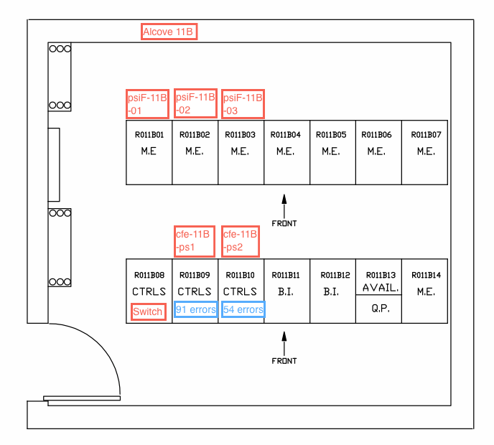
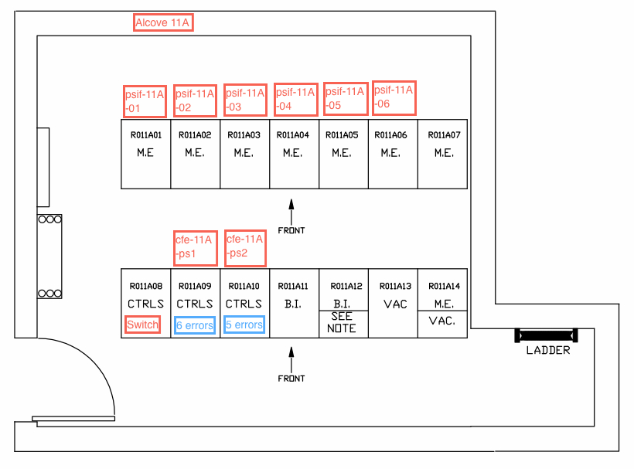
Equipment Layout in Alcoves
18 Alcoves in RHIC, 3 per ARC.
Two basic layouts – rack use is always the same
8
9
10

Slide 8
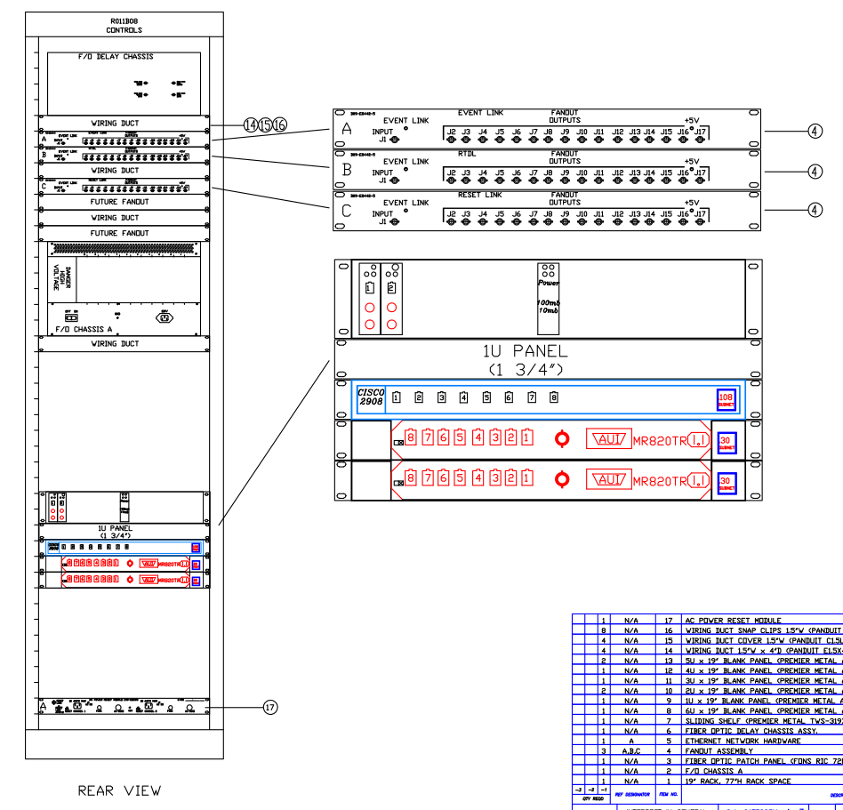
Rack 8

Slide 9
Network Switch & FEC Reset Data
FECs may be rebooted or reset for a variety of reasons - some not indicative of a problem with the FEC.
All FEC reboots/resets are counted but the reasons are only recorded when resets are performed with the “fit” application. The data collected only counts resets that appear to be associated with some kind of failure.
At times multiple resets are attempted (and counted in statistics) for a single problem.

Slide 10
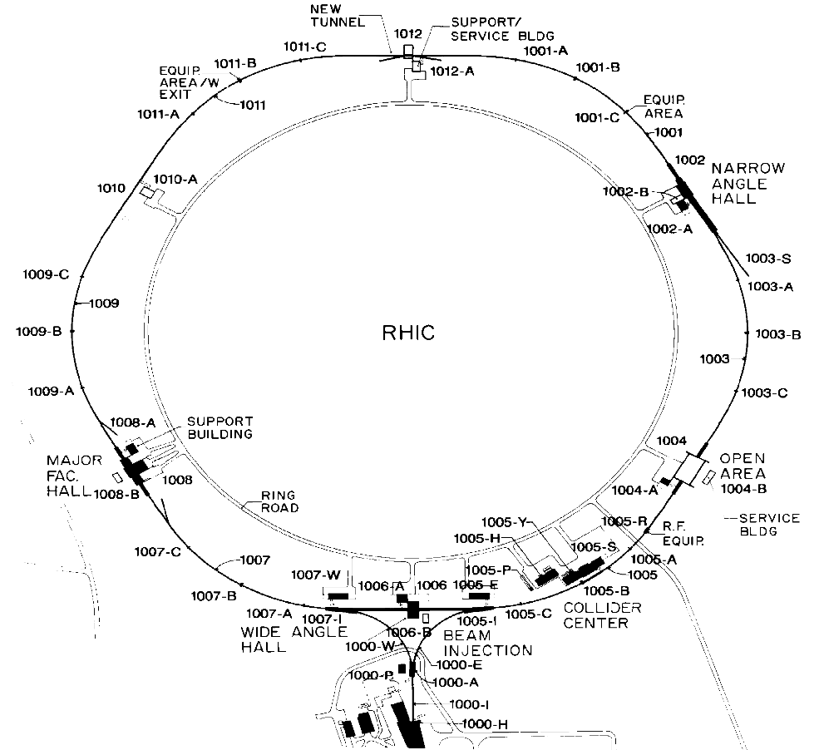
Run 14, 100 GeV/n Au-Au Alcove network switch radiation upset locations
60
48
36
24
12
0

Slide 11
Run 16, 100 GeV/n Au-Au Alcove network switch radiation upset locations
60
48
36
24
12
0

Slide 12
255 GeV p-p Alcove network switch radiation upset locations
12
10
7
5
2
0

Slide 13
Run 16 averaged 2.67 resets/day
Run 14 averaged 1.8 resets/day
Run 11 averaged 0.5 resets/day
For 250 GeV p-p, average 0.15 resets/day

Slide 18
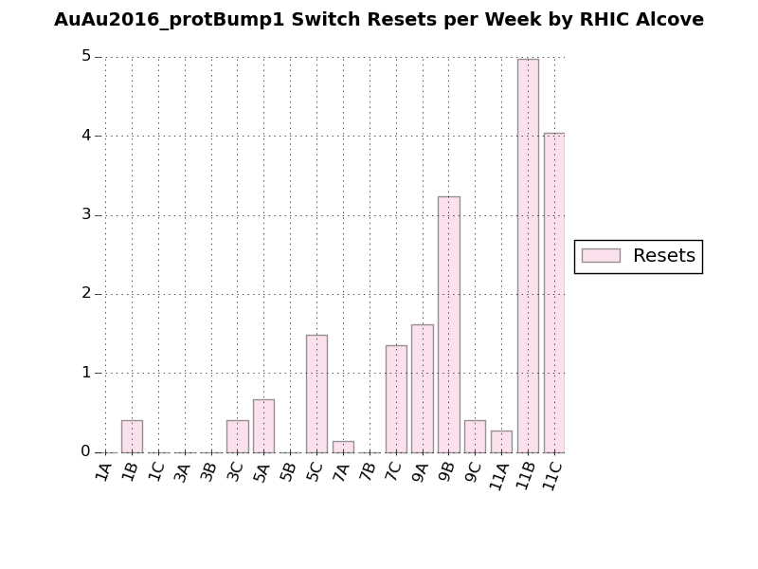
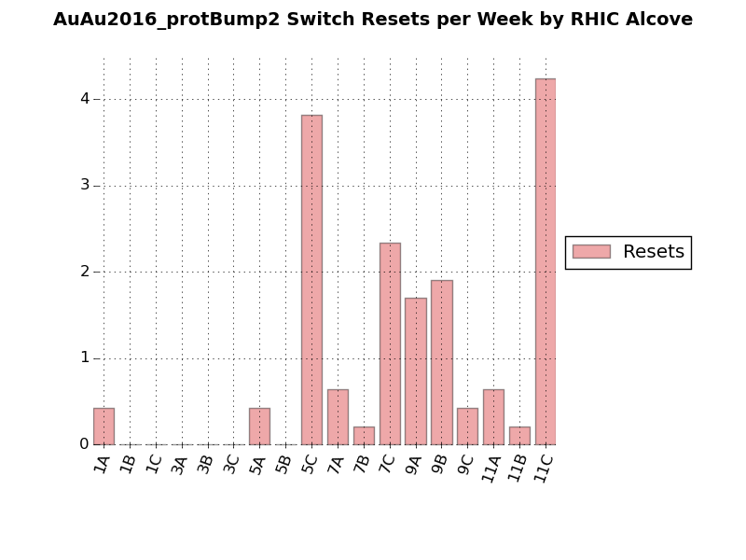
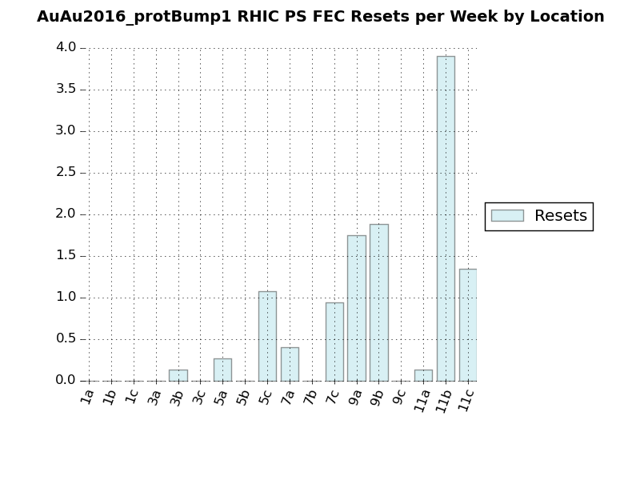
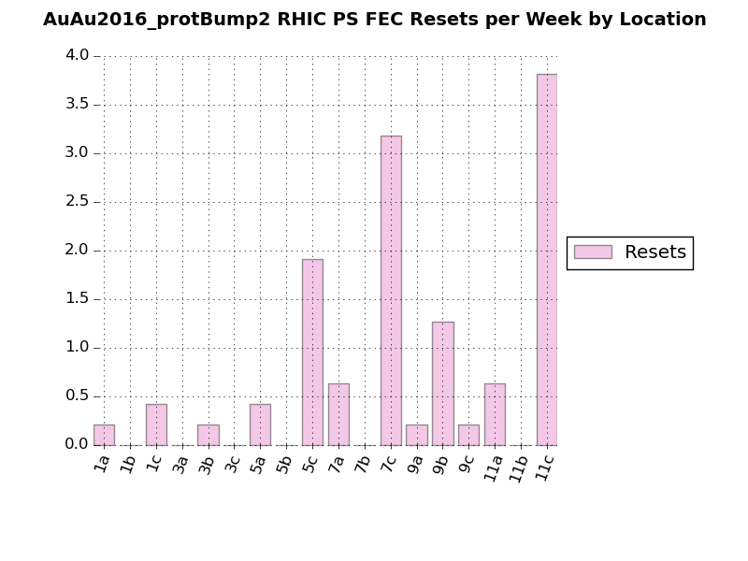

Slide 19
Memory Upset Measurements
Logging data this year, starting in early Feb.
Using Ram Disks in Alcove PS FECs
Place 64 bit pattern repeatedly into 2 Mbytes of memory
Creates 262,144 samples per FEC
Patterns are read on down-ramp of every store
Almost always, changes are at the single bit level [that is: the number of bit changes is small compared to the sample set, so the probability of a single bit changing twice in a sample period is insignificantly small.]

Slide 20
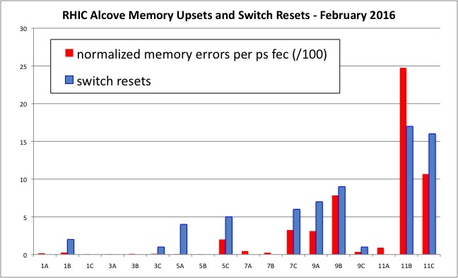
Correlation between Resets and Memory Upset Statistics

Slide 21
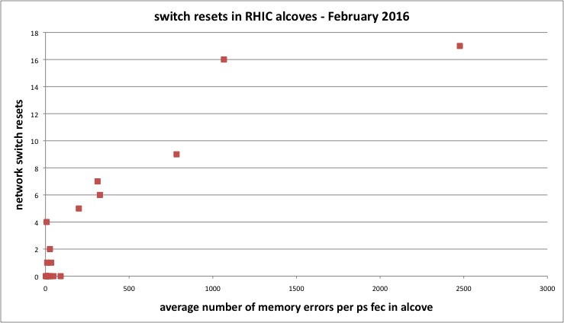

Slide 22
Mitigation Ideas of the Past
Network switches that use ECC memory
Costs are high, >$30k/switch
Memory corruption is not the main problem
Address corruption hangs the switch – addresses not in ECC
Shielding Alcoves?
Kin’s simulations (2014) suggest reduction factors are small (reduction at most ½ with lot’s of shielding – not practical)
Could move sensitive equipment to “quiet” alcoves
Some new equipment required & labor intensive
Space is tight & distances long
Could move some network switches out of alcoves to service buildings
Distances are large (~1400 ft)
Technology issues need investigation
Use copper cable instead of fiber?
Need to use converters, which may be susceptible and may pose operational challenges.

Slide 23
Improvements since 2014
Improved on the data collection to better monitor the “health” of the equipment in the alcoves.
Automate & Log data from memory pattern scans
Monitoring network statistics
Addition of the protection masks and moving the Experiment protection bumps led to noticeable changes, although Run 16 was still worse than Run 14 ☹
Removed UPS units from some alcoves (during run).
Automated (Tape) mass rebooting FECs on down-ramp of every store.
helps reduce impact of madc problems
No clear evidence it reduces impact of rad upsets in FECs

Slide 24
Future Possibilities
Small form factor network switches placed in shielded boxes or externally (commonly used in military)
Can come NEMA rated
Designed for harsh environments
May be difficult to find good compatibility with existing hardware.
External NEMA rated enclosures for network switches & possibly other equipment [cost is roughly $2k per enclosure + installation]
Cable runs ~200 ft, could be done with copper (avoids fiber transceivers in the tunnel)
No tunnel access to service
Shield just the network switch in the alcove
Improve on reset strategies

Slide 25
NEMA† Ratings for External Enclosures
† National Electrical Manufacturer Association (NEMA)

Slide 26
Shielding Small devices?
Kin Yip is simulating how effectively a small device can be shielded inside an Alcove
If the results are encouraging, a test will be done in Run 17. [use Alcoves 7b or 9c for proton operations]
Where in alcove?

Slide 27
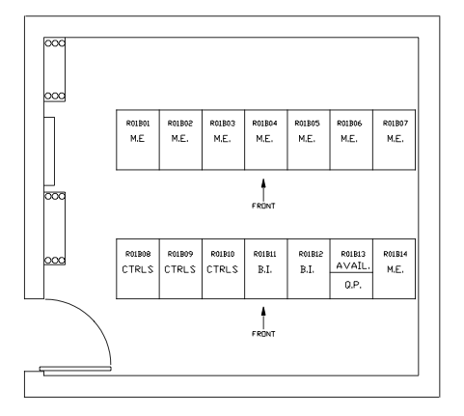
Assume Alcove 7B
17 ft
16 ft
12 ft

Slide 28
Summary
Single Event Upsets cause equipment in Alcoves to hang and fail – Run 16 had the highest number of upsets ever.
Mitigations taken to reduce upsets over the years have kept the impact to a manageable level, although vulnerabilities remain a concern
Most significant vulnerability is in network switch upsets
No easy solutions, but there are still things that can be done
External enclosures
E.g., Improve reaction using memory pattern data

Slide 29
Backup/Auxiliary Slides

Slide 30
Some Terminology
ECC memory: Error-correcting code memory
Detects and corrects most common kinds of internal data corruption.
Is immune to single-bit errors
Makes use of additional circuitry that checks accuracy of data during I/O operations.
E.g., data read from a word of memory will remain uncorrupted even if a single bit in that memory was flipped.
MRAM: Magneto-resistive random-access memory
Non-volatile memory
Data is not stored as electrical charge, but by magnetic storage elements (via two ferromagnetic plates), so works on spin, not charge.
Single Event Upsets, Single Event Latchups, Single Event Gate Rupture, & Single Event Burnouts
radiation striking a sensitive node in a micro-electronic device
Most common are upsets, which are not permanent damage
Result is at least a single bit change

Slide 31
History – 2004
Front End Processors
Power 3E processors lacked ECC memory
Some locations had CPUs with ECC memory
1007C, 1009A, 1009C
Began process of replacing select CPUs with MVME2112 processors, that have ECC memory
VME Chassis (250 in field, 40 in Alcoves)
13 VME PS Failures in Alcoves (38%)
3 VME PS Failures in Service buildings (<1%)
Collaboration: VME Chassis Rad Tested for LHC at CERN (Wiener Chassis now in use)
Began looking at Rad Resistant PSs = found one that performed well (Vicor PS now in use)

Slide 32
V115 (WFGs)
Tried ECC memory in WFGs (in 2004)
To replace 128K x 32 static ram
Plugged into existing memory footprint
Initially performed well in tests
Didn’t perform as well as expected in alcoves
After 2004 switched to MRAM
Finished MRAM installation by 2011
In addition
Alcove FECs (for PSs) were upgraded to use ECC memory
Stopped using RAM disks to save files
Code was modified to save 3 copies of data that had to remain in RAM disks (to avoid corruption)
RAM disks for FECs that did not need them were removed (i.e., BPMs and QD FECs)

