Slide 1
Post Mortem of Injection Kicker Vacuum Failure from single event upsets … to beam loss and vacuum failure
What happened?
How did it happen?
How can we prevent it from happening again?
Don Bruno
John Morris
RHIC Retreat
July 29, 2016

Slide 2
What happened?

Slide 3
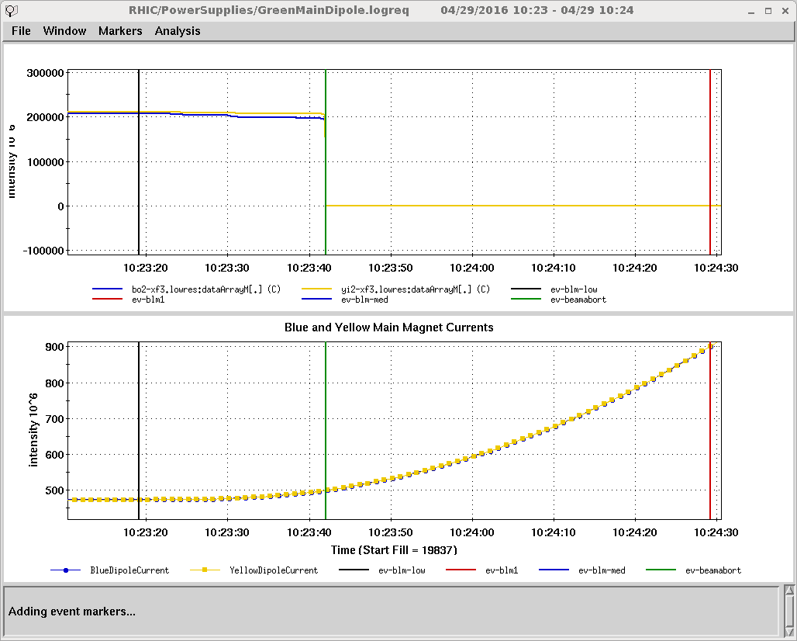
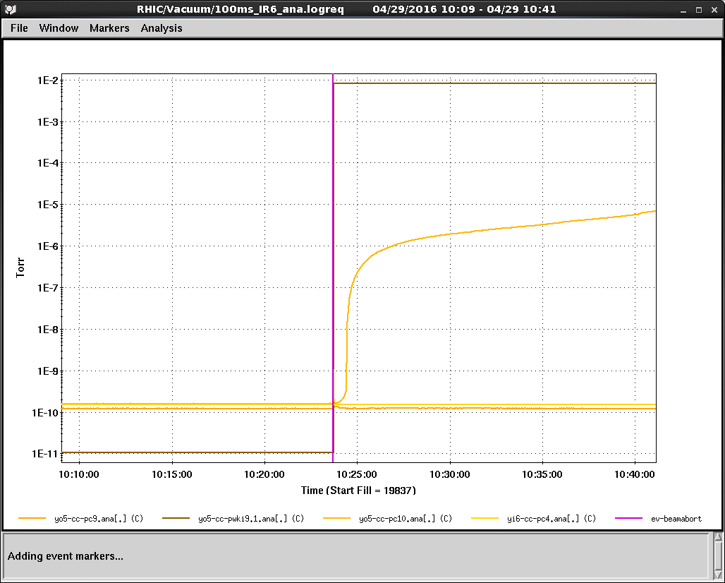
April 29, 2016 10:23am
What happened? The basics
Loss of vacuum at yellow injection kicker in sector 5 – which eventually was determined to be due to holes in the beam pipe.
Beam abort 23 seconds into 111x111bunch ramp

Slide 4
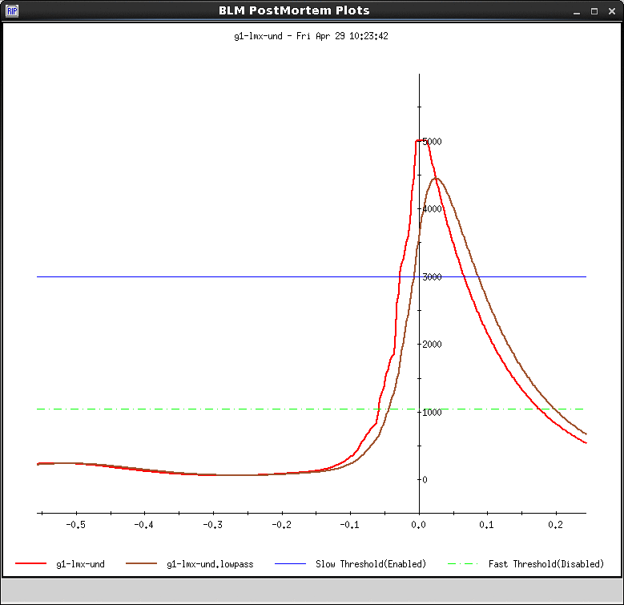
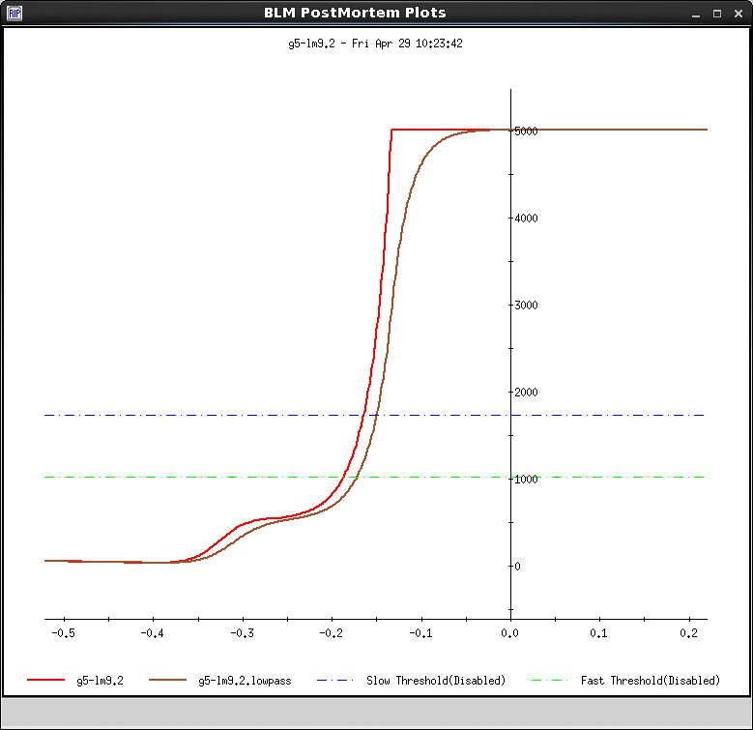
What happened? Losses
Loss monitors in sector 5 saw losses much earlier – starting about 350ms before abort.
g1-lmx-und pulled the permit
Note that most loss monitors were masked at this stage of the ramp. The masking strategy was reviewed after this event. It’s not clear that a loss monitor permit pull would have saved the beam pipe. We’re not focusing on the loss monitor system in this talk.

Slide 5
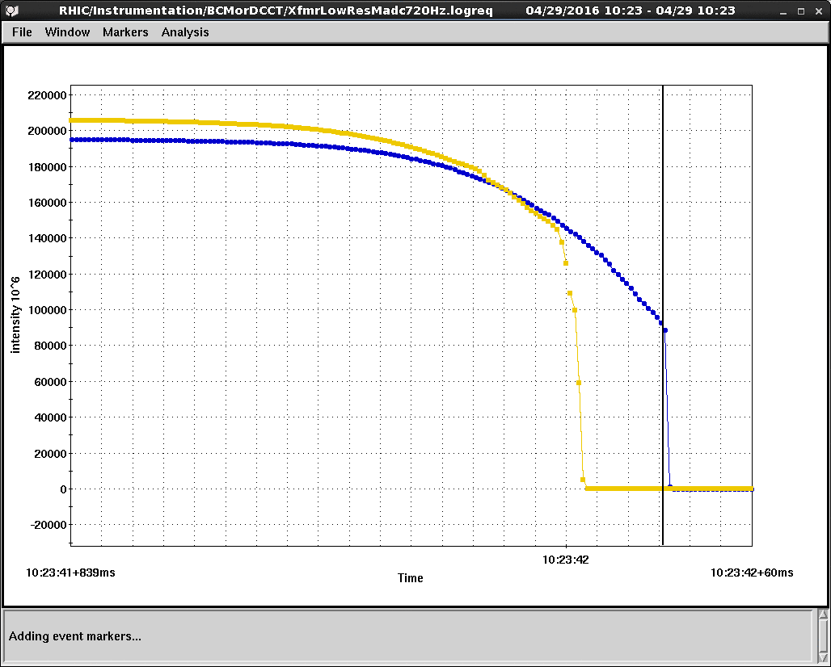
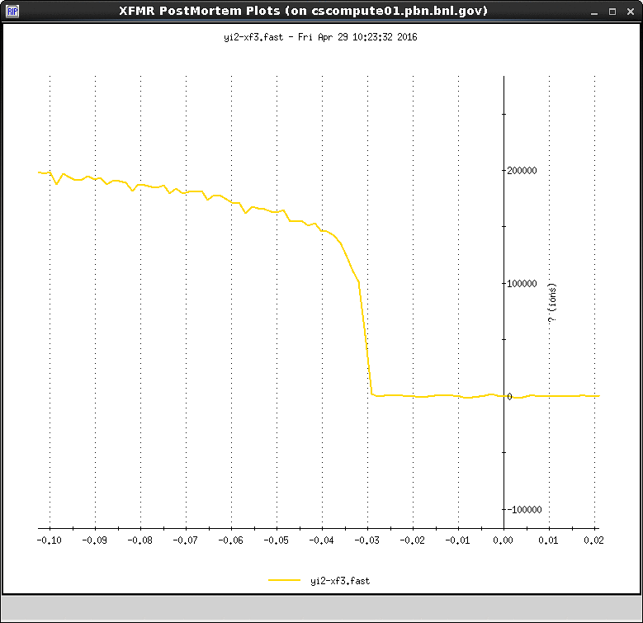
What happened? The beam
720hz low res current xfmr data. Yellow beam was all gone 30ms before the beam abort.
“Two-thirds of the yellow beam is lost in the last 10 ms” – vhs in RHIC elog

Slide 6
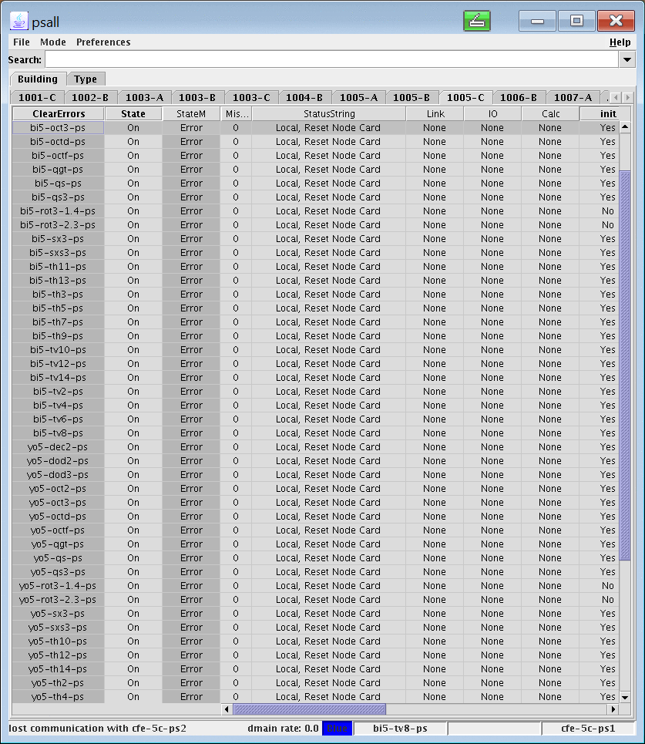
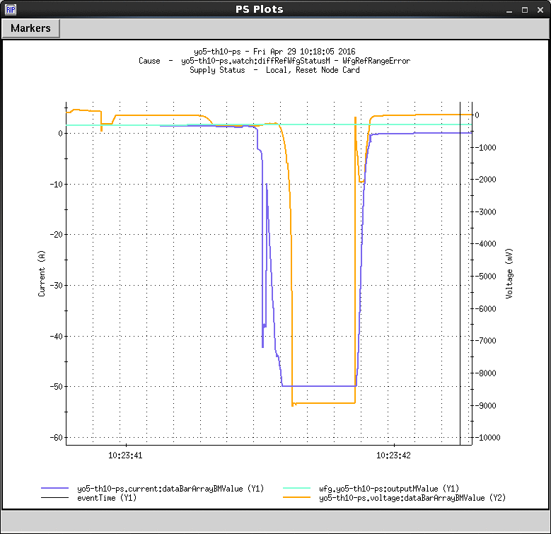
What happened? Power supplies
Faults for every ps in alcove 5c.
"Alcove 5C all Node Cards are down?” – greg heppner in RHIC elog
Behavior of a representative ps in 5c. “behavior is consistent with all 50 PS being turned off simultaneously.” – al m in RHIC elog

Slide 7
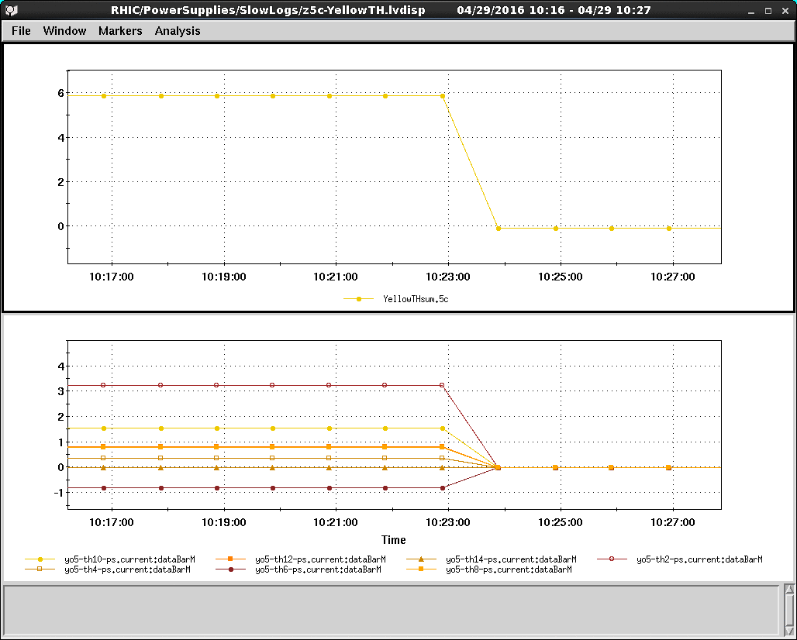
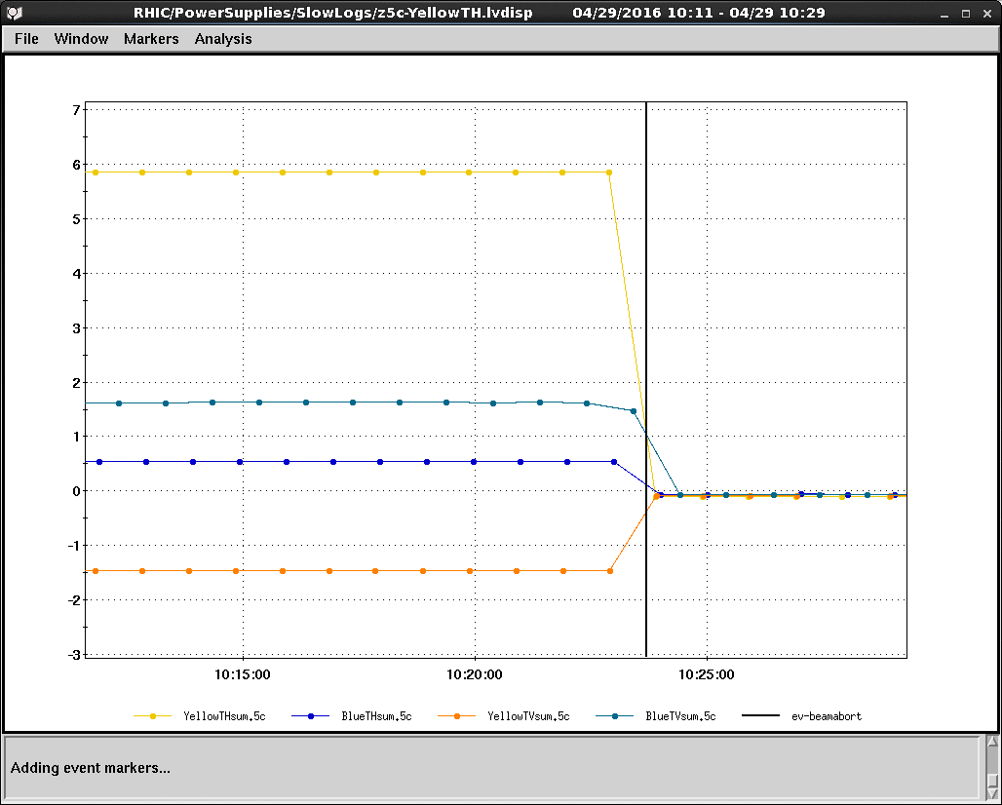
What happened? Power supplies (2)
Add picture here
Other dipole correctors (6 bh, 6 yv, 7 bv) had much smaller corrections than yh. There are also 30 nonlinear corrector power supplies in 5c. We don’t believe these played a significant role in creating beam loss.
There were 7 yellow horizontal dipole correctors in alcove 5c with a total current of 6amps at the time of this event.

Slide 8
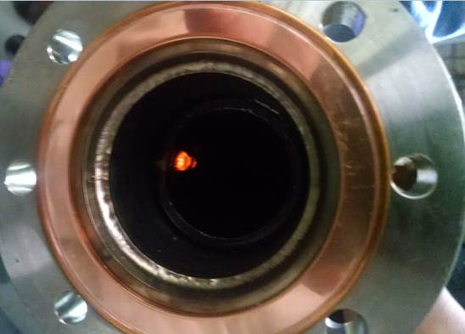
The picture above is the larger leak on the upstream end of the number 4 kicker. What is seen is the epoxy stalactite that came through the leak into the vacuum. The stalactite is lighting up from a flash light outside the beam pipe. -Joe Tuozzolo e-mail
What happened? Beam pipe
Hole in beam pipe consistent with yellow horizontal corrector strengths, towards inside of ring

Slide 9
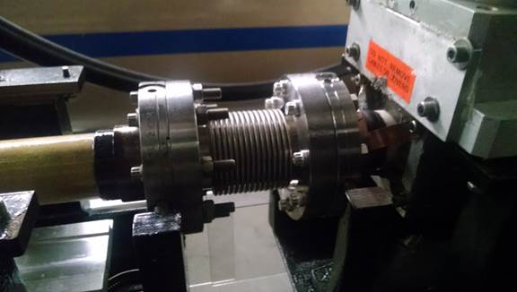
In the picture above the upstream end of the number 4 kicker is in the picture on the right after it was reinstalled with the new beam tube. On the left is the number 3 kicker (removed) ceramic beam tube going into the ceramic to metal transition. The shiny material is the vacuum leak spray that was applied to the metal to ceramic transition where there was a strong leak indication. - Joe Tuozzolo e-mail
What happened? Beam pipe (2)

Slide 10
How did it happen?

Slide 11
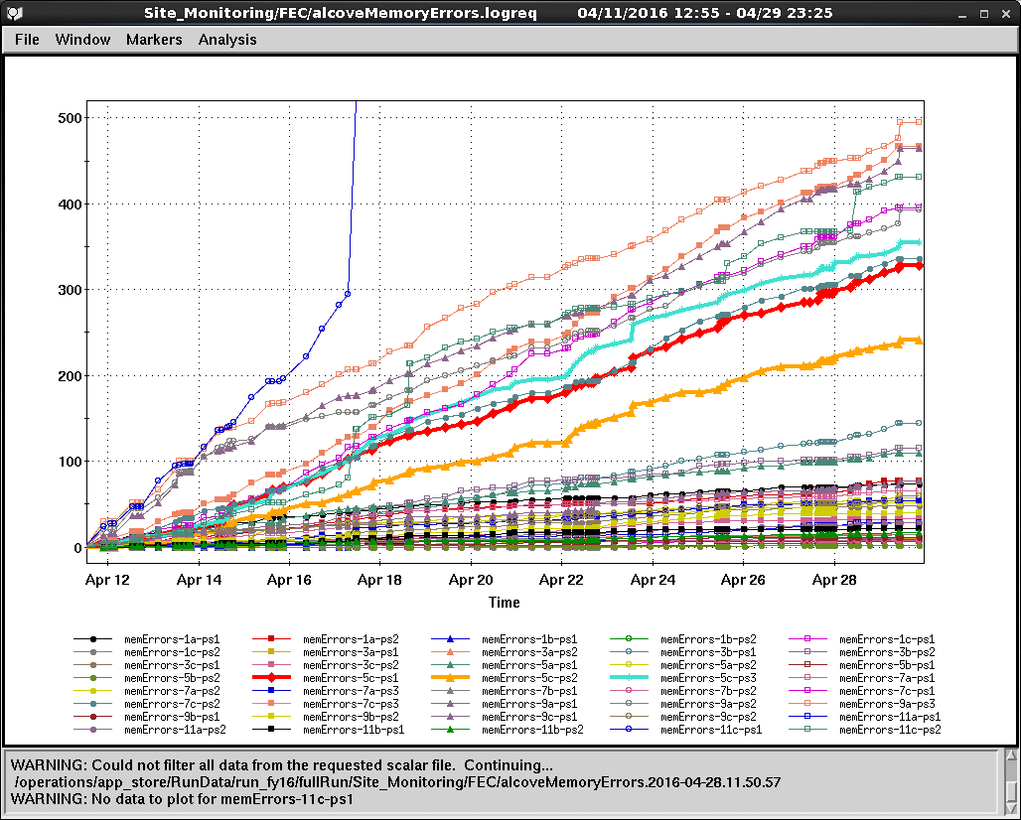
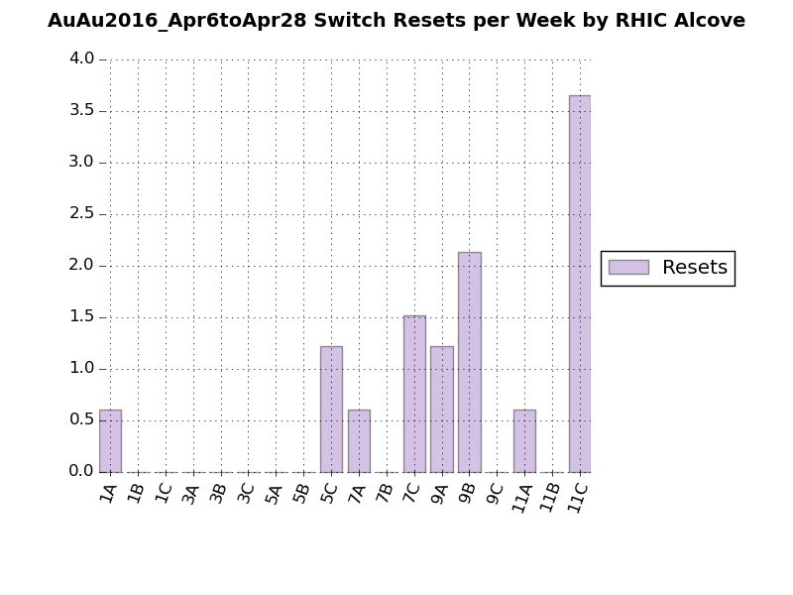
How did it happen? Background
Upsets detected in test memory pattern in alcove FECs after each fill.
Alcove 5c FECs (bold lines) are among those with the most upsets.
Network Switch Resets April 6 to May 9.
Alcove 5c is in the top 5.
Equipment in alcove 5c was vulnerable to radiation upset.
Alcove UPS units have had problems before that may have been due to radiation upsets.
Note similar event in alcove 9b at store during fill 19681 on Mar 12, 2016 (beam from that event primarily went into collimators)

Slide 12
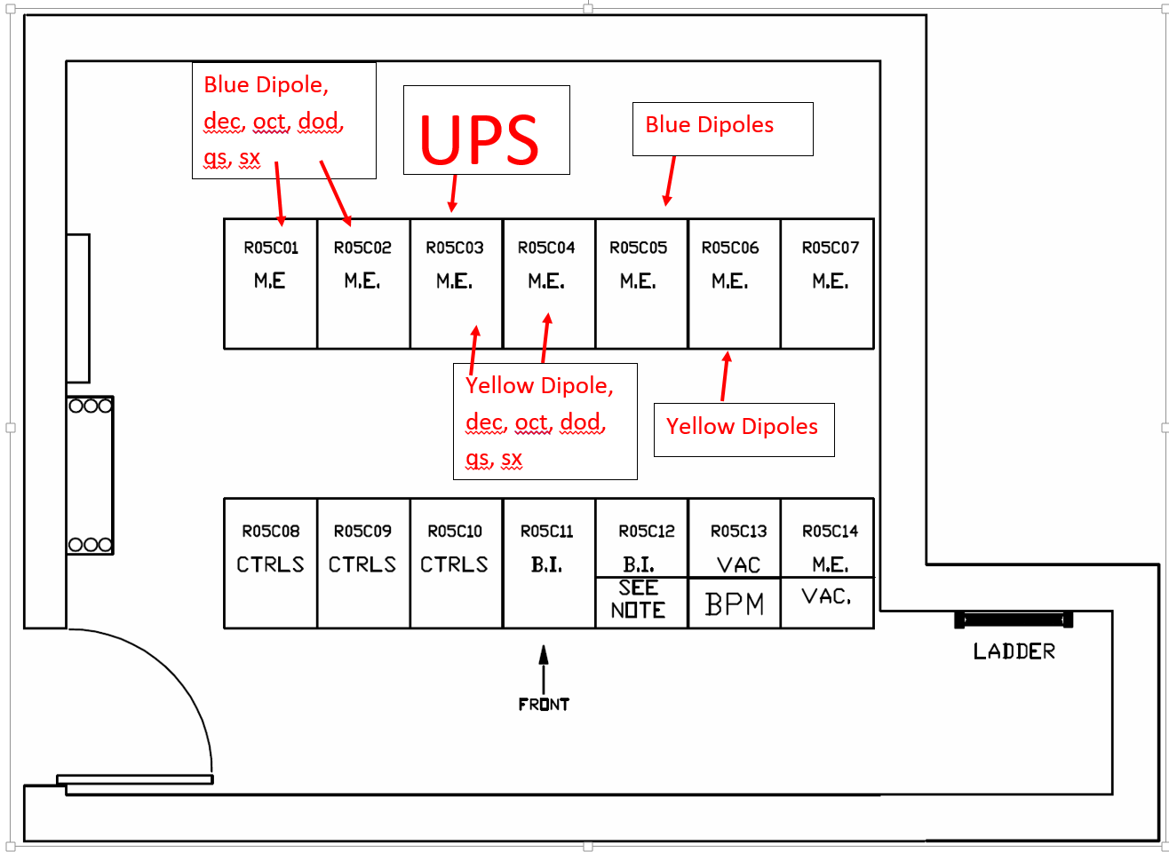
Alcove Layout

Slide 13
How did it happen? Timeline
111x111 ramp begins at 10:23:18.
Loss mon permit configuration is desensitized at 10:23:19 by ev-blm-low event.
UPS in alcove 5c loses power at 10:23:41
AC reset unit plugged into UPS loses power.
6 PS node cards plugged into reset unit lose power
All power supplies connected to node cards simultaneously turn off.
All corrections powered by those supplies quickly go to zero (including 6 amps of yellow horizontal steering).
Blue and yellow beam losses begin. Yellow beam is all gone soon after 10:23:42.
30ms later, the permit is pulled by loss monitor in sector 1.
Cracks are discovered in beam pipe in sector 5 at injection kicker
UPS in 5c is reset by CAS and power is restored at 11:42.

Slide 14
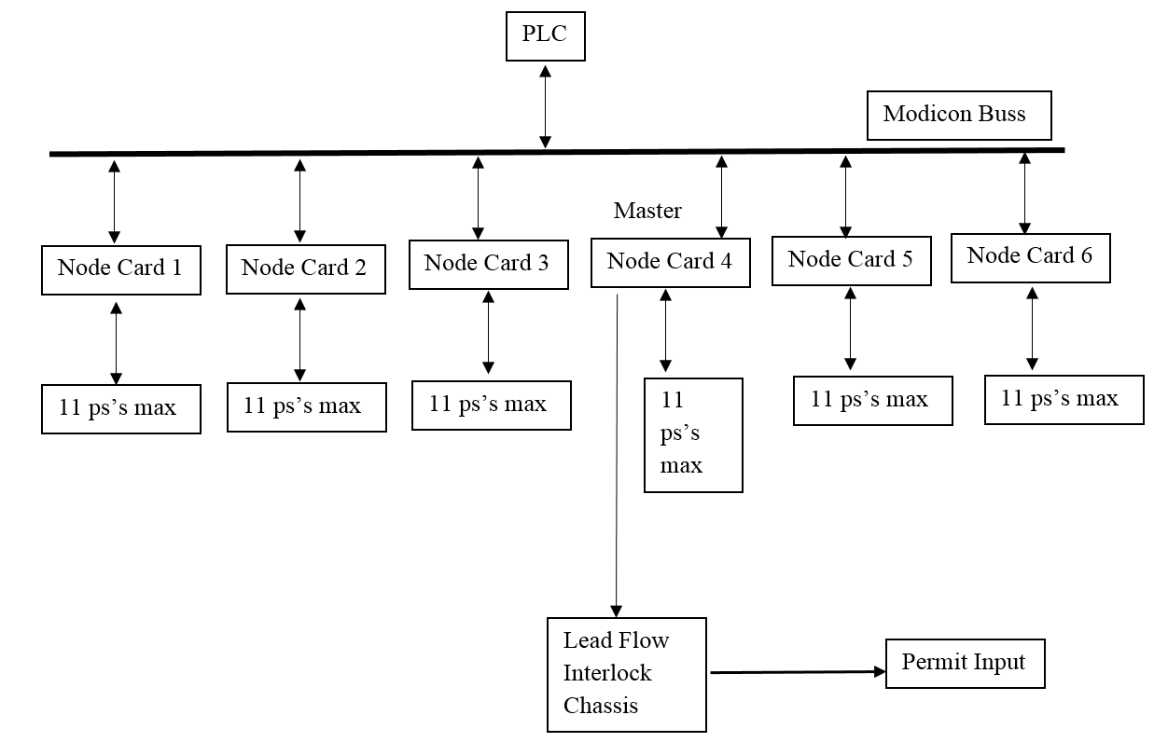
Corrector Permit System 1

Slide 15
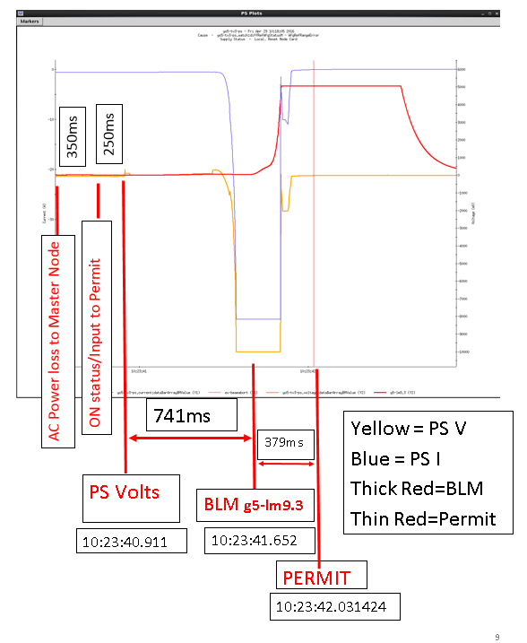
PS Voltage, BLM, Permit Times from 4/29/16 event
Added AC Pwr Loss and ON status/Input to Permit, from test done on 7/27/16
Note: with new node cards time from AC Pwr loss to ON status loss = 70ms

Slide 16
How can we prevent it from happening again?

Slide 17
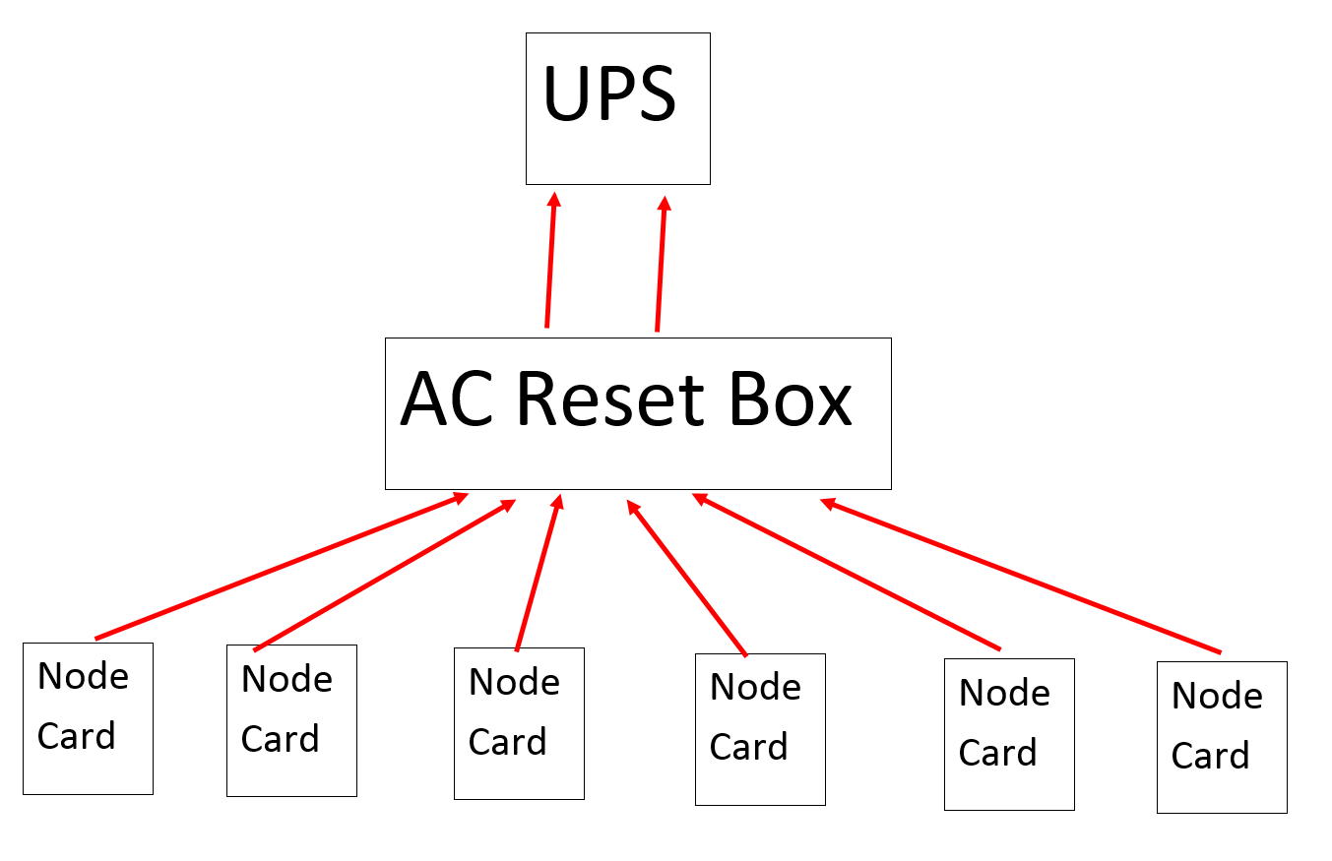
Original UPS Connections

Slide 18
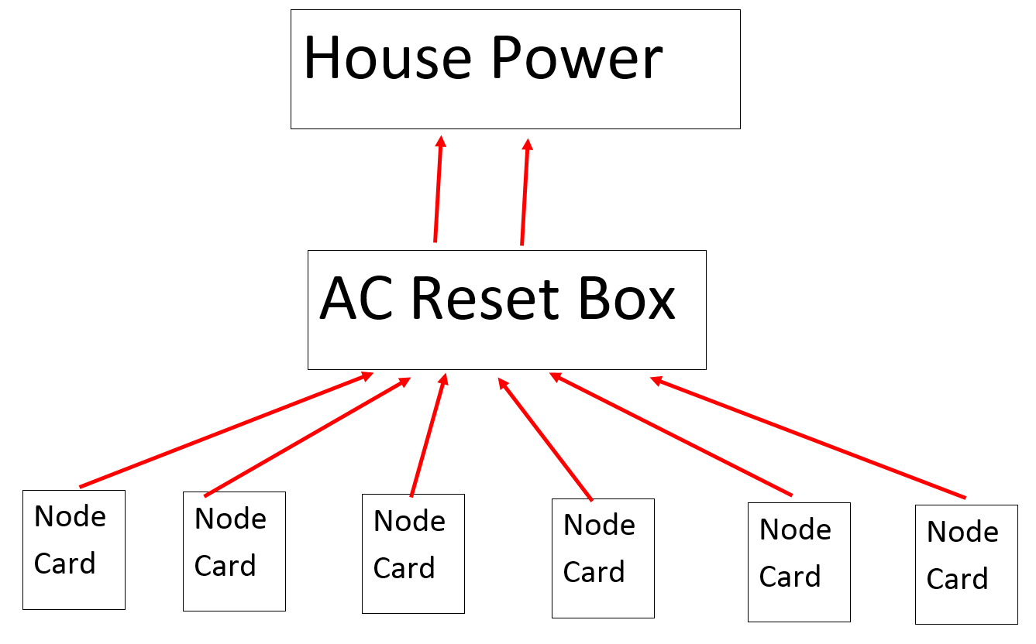
New Connections, No UPS

Slide 19
Corrector Permit System 1
Hardware installed for many years. Never made operational. Concerns about nuisance trips.
As is now it will trip Permit if ps trips to STBY-FLT only.
This system may not be fast enough in some cases to trip the permit if the scan time of the PLC is too long. Ran 10 tests. Tripped ps on Lead flow Interlock. Time from losing ON status to permit input trip 30ms-390ms, Could be 1 sec?
System as is does not trip permit if ps in OFF, STBY, Node Card loses ac power (unless master) or if Low Res setpoint chassis loses ac power.
Code can be re-written to cover OFF, and STBY. Not sure if node card loses AC power, unless master node card loses ac power. 350ms from loss of ac pwr to loss of on status with old node cards. 70ms with new node cards.
First Tested in 2006
Tested ps with STBY-FLT trips permit
Trip Count code not tested. PS masking code not written.
Run 2016
Tested Trip Count code worked. PS masking code written and tested.
If enabled this system may have tripped the permit before beam pipe damage occurred since the Master Node Card lost AC power.

Slide 20
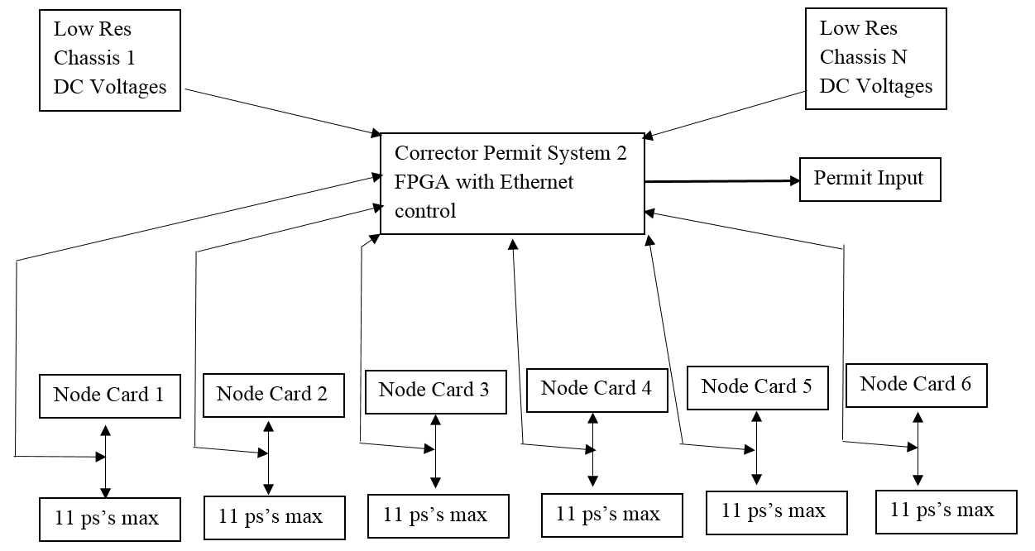
Corrector Permit System 2

Slide 21
Corrector Permit System 2
Carl Schultheiss and Theo Samms are working on this new FPGA board.
Plan is to try and have this ready for run 2017
Bypasses node card and PLC. Looks at PS ON status directly from PS.
Faster response time than system 1. No PLC Scanning.
Trips input to permit in less than 10ms after PS trips from ON.
Will trip permit if ps in OFF, STBY, STBY-FLT, if Low Res setpoint chassis or node card loses ac power.
A PC board needs to be built by controls to monitor DC voltages in Low Res Chassis. This gets fed into new corrector permit system 2 board.
Will have trip count
Will be able to mask PS’s.
Will connect directly to Ethernet.
System 2 will go to input 5. System 1 is on input 6.

Slide 22
Summary Table: Which States/Situations are protected by each System
States | System 1 (re-written PLC code) | System 2
OFF | Depends on PLC Scan time | Yes
STANDBY | Depends on PLC Scan time | Yes
STANDBY FAULT | Depends on PLC Scan time | Yes
Node Card Loses AC Power, other than Master. Master still has AC Power | No (?) To review | Yes
Master Node Card Loses AC PWR | Yes | Yes
Low Res Chassis Loses AC PWR | No | Yes
Should do more tests. Trip to OFF, STBY, STBY-FLT monitor PS V, ON, Input to permit

Slide 23
Questions?

Slide 24
Backup slides

Slide 25
Test in Alcove 5C with System 1
Corrector Input to permit drops
Corrector Input to permit drops
PS ON to STBY-FAULT
AVG Time Corrector Input to Permit

Slide 26
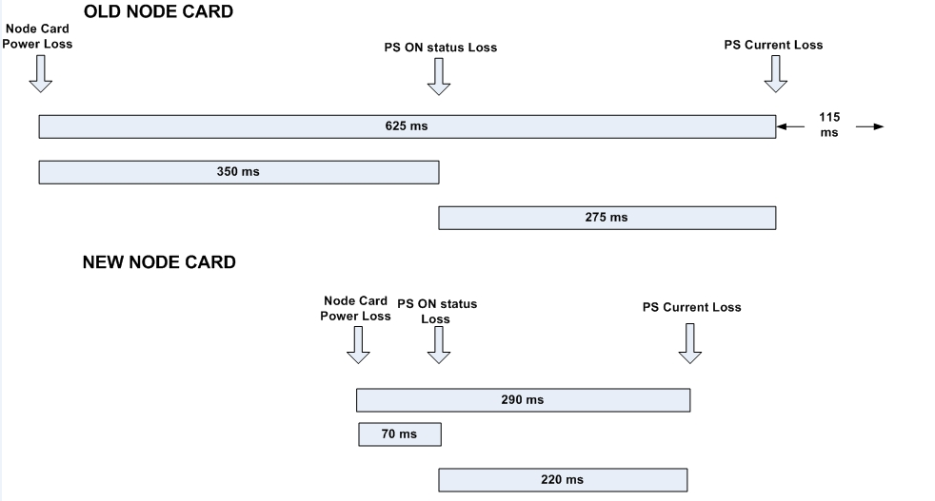
Bench Test Loss of AC Pwr to Node Card

Slide 27
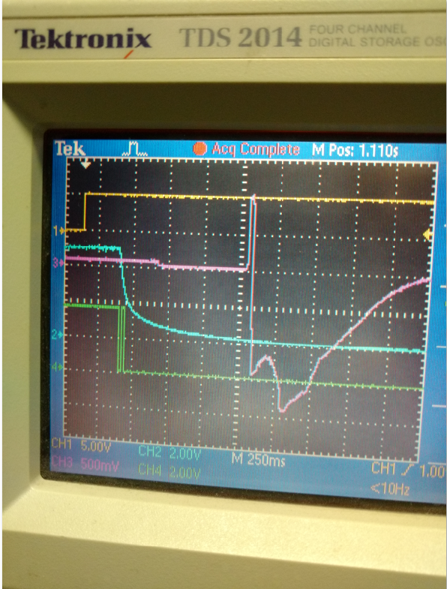
Scope Picture of 7/27/16 test
Yellow= AC power Loss to master node card
Blue=PS ON status
Green=Input to Permit
Pink=PS Voltage

Slide 28
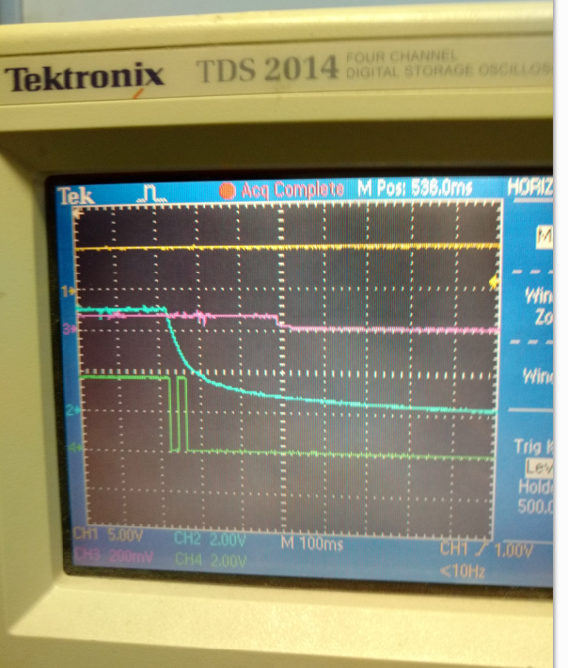
Zoomed in Scope Picture of 7/27/16 Test in Tunnel

Slide 29
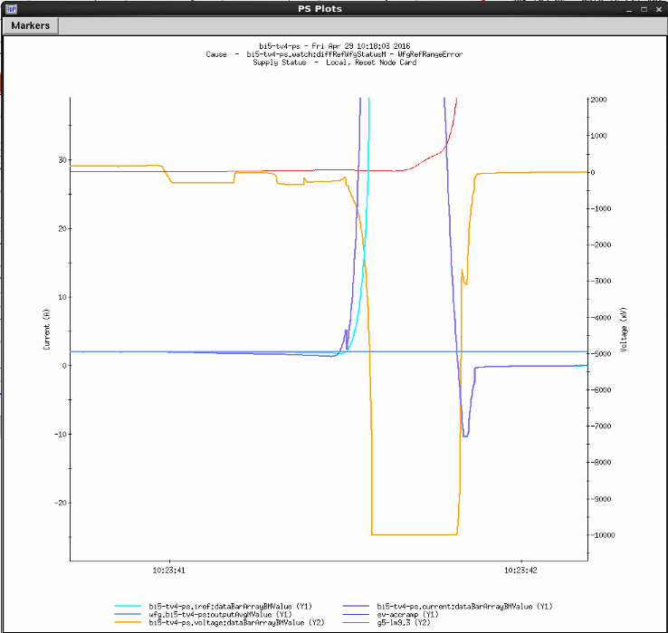
Blown Up Plot of Voltage waveform from Trip 4/29/16 and test on 7/27/16

Slide 30
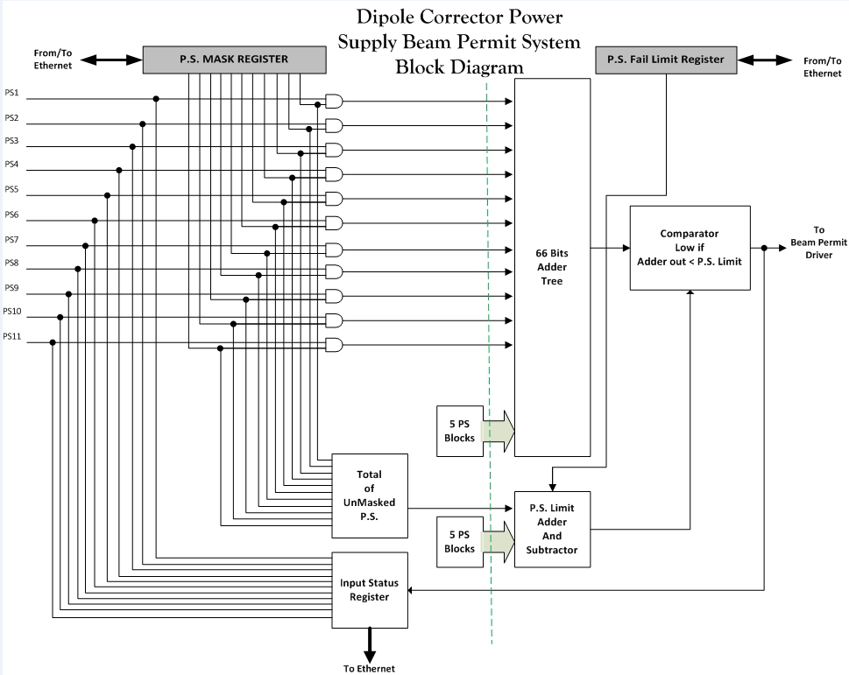

Slide 31
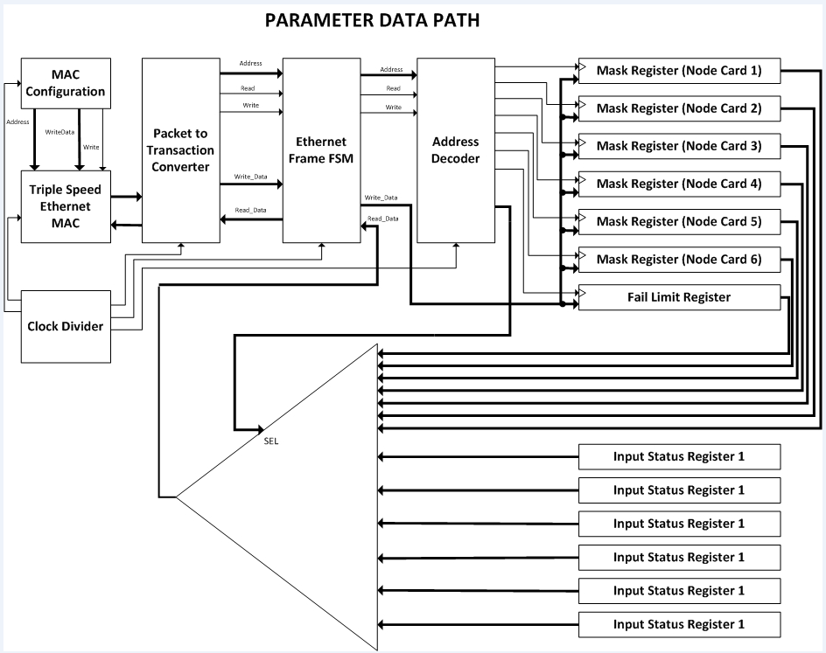

Slide 32
