Slide 1
Uncovering New Laws of Nature at the EIC
FY2025 NPP LDRD Type B Pre-Proposal
Principal Investigator(s) - Presenter(s) Hooman Davoudiasl
Date 12/5/2023

Slide 2
FY2025 NPP LDRD Type B Pre-Proposal
Proposal title: Uncovering New Laws of Nature at the EIC
Primary Investigator: Hooman Davoudiasl
Other Investigators: Sally Dawson, Robert Szafron
Indicate if this is a cross-directorate proposal: Yes ___ No _X_
If yes, identify other directorates/organizations:
Proposal Term: From: 10/1/2024 To: 9/30/2026

Slide 3
FY2025 NPP LDRD Type B Pre-Proposal
Title: “Uncovering New Laws of Nature at the EIC”
Abstract:
Open fundamental questions - such as the origin of ordinary matter, or the identity of the invisible substance that dominates galactic structures, i.e. dark matter - strongly motivate new particles and interactions. In this proposal, we point out that the Electron Ion Collider (EIC) can not only provide a powerful tool for studying the structure of atomic nuclei and their constituents, as originally envisioned, but also great opportunities to probe and possibly discover new physics that goes beyond the standard paradigm, potentially leading to a revolution in our understanding of the laws that govern the Universe.
Program: DOE HEP
Return on Investment: Optimizing the substantial investment in the EIC by enlarging its overall impact in physics, which can significantly improve its cost-benefit analysis in terms of tax-payers support. The larger impact can also attract additional scientific stakeholders in EIC’s future development.
Broader impact on the activities at the laboratory: Enhanced collaboration between nuclear and high energy physics communities, establishing new research programs that can attract additional funding to BNL and expand the user community for the EIC.
Total planned funding per year in FY25 and FY26: $250k

Slide 4
Description of the LDRD
The EIC will be the premier nuclear physics facility studying the structure of protons and nuclei.
The current flagship high energy facility in the world, the Large Hadron Collider (LHC) at CERN, collides protons to probe laws of physics at the smallest (sub-nuclear) distance scales or, equivalently, the highest energies. As such, detailed information on the internal structure of the proton, obtained at the EIC, would be critical to LHC’s ability to uncover new microscopic phenomena emerging from collisions.
The EIC beams energy, polarization, heavy ion option, and significant luminosity provide excellent opportunities for probing feebly interacting low energy physics, corresponding to nuclear distance scales, which may be part of a hidden sector that includes dark matter, among other states. We show how the EIC could be a venue, complementary to the LHC, for discovering new fundamental laws of Nature.
The combined significant synergy and complementarity of our proposed EIC research with that at the LHC can make BNL an international hub, not only for nuclear physics but also, in parallel, for exciting investigations of particle physics in the coming decades.

Slide 5
Technical Description
(A) High-Mass Physics
Proton’s “parton distribution functions (PDFs)” encode its composition in terms of quarks and the strong force carriers, gluons (strong force analogs of photons).
New high-mass physics, at the shortest distance scales, appears as point interactions, which can perturb the Standard Model (SM) processes. These perturbations can be systematically formulated using the SM effective field theory (SMEFT).
We plan to study how the future EIC data, with the aid of machine learning techniques, can be used to account for the SMEFT perturbations to the expected behavior of PDFs. This would be key to extracting further inferences from the LHC data regarding a more fundamental understanding of short-distance physics.
New Physics (Anomalous couplings)
Standard Model

Slide 6
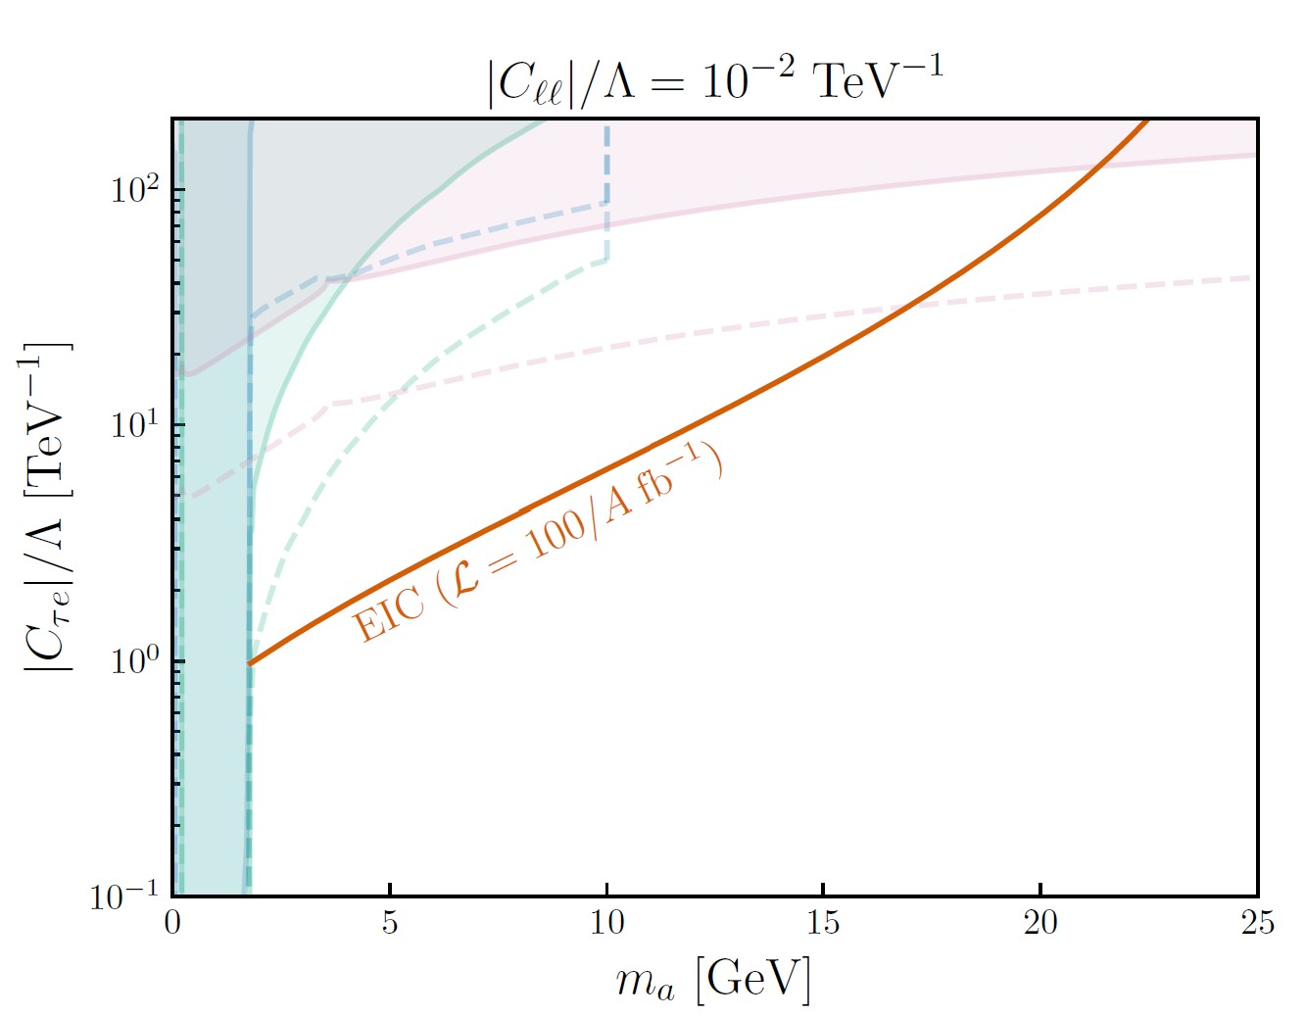
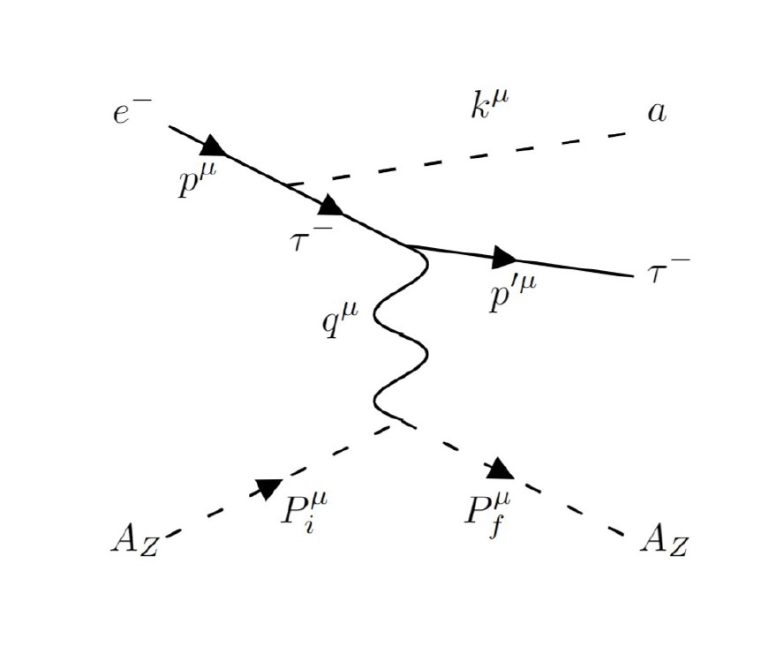
Technical Description
(B) Low-Mass Physics
New physics may be at low (GeV) scales but hard to produce and detect due to its feeble interactions (weakly interacting SM neutrinos are well-known examples). Dark matter and its associated states can be of this kind: intense beams and suitable detectors may uncover such physics.
Electron scattering from high Z ions (e.g., gold) at the EIC can provide the requisite effective intensity in specific regimes, leading to the possible emission of light new states. Examples are certain scalar (spin-0) states whose emission can change an electron (from the beam) to a tau lepton (a much heavier version of the electron). Another example is a weakly interacting vector (spin-1, “massive photon”) that could travel macroscopic distances in a detector before decaying.
Such new states can yield distinct signals, but it is important to know potential SM backgrounds well for reliable estimates of discovery prospects.
Constraints (shaded, solid)
Projections (dashed),
Belle II 50 1/ab
Assuming suppressed flavor-preserving interactions; figures from H.D., Marcarelli, Neil, 2112.04513 (JHEP, 2023)
Scalar-mediated e-tau transition in e A scattering

Slide 7
Milestones
FY 2025
FY 2026
Set up a machine learning framework for realistic simulation for PDFs in the presence of New Physics
Explore new ideas and directions for weakly interacting particle studies
Organize a workshop on New Physics at EIC
Recruit a postdoc to perform computations and explore new theoretical directions enabled by the EIC
Present results in refereed journals and international conferences

Slide 8
Summary Slide
The capabilities of the EIC can be leveraged to search for new physics in the high mass (point-like interaction) and low mass (direct emission) regimes.
Our proposed research can be synergistic and complementary to the activities at CERN and enhance the physics impact of the EIC beyond its initially envisioned program. Ignoring this possibility translates to a diminished return on the considerable DOE investment in the EIC.
A broader physics program at the EIC, as proposed here, would provide an opportunity for BNL to strengthen its position as one of the leading international centers of activity in particle physics. This can create additional research funding justification and improved prospects for recruiting new talents. Some of the methods employed in our study, especially machine learning techniques, can be of interest to the broader DOE mission and support national programmatic priorities.

