Slide 1
Vector meson production in ultraperipheral collisions in ATLAS
FY2025 NPP LDRD Type B Pre-Proposal
Peter Steinberg, Kong Tu
6 December 2023

Slide 2
FY2025 NPP LDRD Type B Pre-Proposal
Proposal title:
Vector meson production at the LHC (en route to the EIC)
Primary Investigator:
Peter Steinberg & Kong Tu
Other Investigators:
D. Derendarz (IFJ PAN, Krakow), M. Dyndal (AGH UST, Krakow)
Indicate if this is a cross-directorate proposal: Yes ___ No_X__
If yes, identify other directorates/organizations:
Proposal Term: 2 years From: Oct 2024 To: Oct 2026

Slide 3
FY2025 NPP LDRD Type B Pre-Proposal
Proposal title and brief abstract:
“Vector meson production at the LHC (en route to the EIC)”
One of the key scientific topics of the upcoming Electron-Ion Collider (EIC) at BNL is the exclusive production of coherent vector mesons off of nuclei, which are sensitive to both the nuclear gluon momentum and spatial distributions. To advance this physics before the EIC era, it is proposed to study vector meson (particularly J/psi) production at the LHC using ultraperipheral data from the ATLAS experiment taken during the Run 3 heavy ion periods. As of 2023, a first dataset has now been acquired with a newly commissioned low-multiplicity trigger, and data and MC studies are underway. First discussions have already begun on how to optimize the program for a longer Pb+Pb run, which may occur in 2025 (or even late 2024). A postdoc dedicated to this dataset (and also working part time on ePIC) would significantly advance the data analysis, and make a major contribution to first ATLAS results on this topic. They could also contribute to the design of the trigger and analysis strategy for the next long ion run. Results from this analysis would seed further phenomenology pertinent to EIC physics and more generally improve our understanding of how vector mesons can be used to elucidate nPDF and saturation physics.
Program: NP
Return on Investment:
DOE ECA NP heavy ion for PI Tu.
Consolidation of BNL as a center of expertise for J/psi physics over energy ranges including and beyond the EIC
Broader impact on the activities at the laboratory:
Provides useful experience for younger generation on exciting research on active experiments, in advance of the EIC experimental program
Attract LHC community to the EIC with common physics interests.
Total planned funding per year in FY25 and FY26: $200 (each year $170k (RA1 salary & overhead) and $15k travel. One time purchase of lab laptop if needed, $3500. Travel support for PIs)

Slide 4
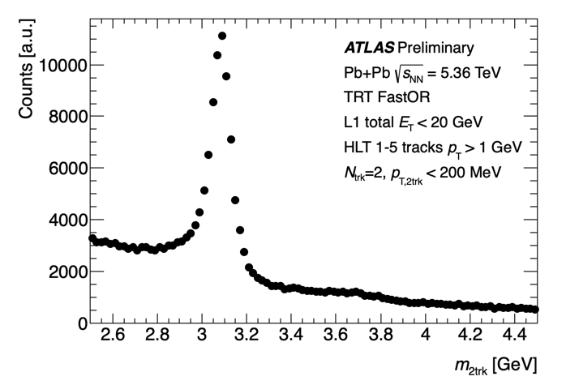
Scientific concept
Heavy ion program most famous for QGP, but ultraperipheral (UPC) physics programs (𝛄𝛄, 𝛄A) gaining in prominence
  At LHC, UPC addresses physics pertinent to NP and HEP (SM&BSM), with large groups of non-HI people joining effort
  Many physics topics of clear relevance to EIC program: saturation, nPDFs, GPDs
  Many of these issues are receiving renewed interest as they pertain to a 2nd detector
BNL has made major contributions to ATLAS UPC program
  first µµ measurement
  ATLAS ZDC detector built here and PAS is co-project leader
  Ongoing work on trigger design, UPC operations, subgroup coordination
In 2023, ATLAS implemented a trigger which can select low-multiplicity events at L1 → new physics capabilities based on ATLAS transition radiation tracker (TRT)
  In particular, we took a large (50k+ J/ψ) sample of 2 track events which are enriched in vector meson production (also includes ρ)
For the first time, a large sample of J/psi in ATLAS
  Large kinematic coverage |y|<2.5
  Fills regions uncovered by CMS & ALICE
  Covers wide range in W𝛄A 40-450 GeV
    beyond STAR and even exceeding HERA
  Well performing ZDCs to tag event classes
𝛄
J/ψ
ℙ

Slide 5
LDRD proposal & deliverables
BNL staff share interest in exclusive J/psi production
  Steinberg, Ullrich, Tu - contributed studies to ECCE and ATHENA proposals, and now ePIC
  PI Tu will be submitting ECA proposing to combine work on J/psi and jet production in ATLAS (new paper detailed this measurement (https://arxiv.org/abs/2311.12208)
10+ years until start of EIC program and we need to keep making contributions to this physics
  UPC offers many opportunities
A new postdoc would substantially increase our capabilities to explore this physics
  Ongoing preparations for MC samples, trigger and detector performance, data analysis, extraction of physics quantities
  Contributing to scientific output of photonuclear program
  This will also advance theory efforts, which are currently quite varied in approach, each of which faces difficulties
Postdoc would lead the physics analysis and contribute to ATLAS preparations for follow-up data in Run 3
  Would become an expert on photoproduction, vector meson reconstruction, data analysis
  Possible contributions via ATLAS service tasks (ZDC, luminosity, trigger, tracking, particle ID, etc.)
  Major goal is to optimize trigger strategy to use available beamtime more effectively
Would make contributions to the EIC at the same time (e.g. pfRICH, calorimetry, software, exclusive/diffractive physics, 2nd detector)
  Progress in UPC science should lead directly to advances that could inform ePIC program and provide motivation for 2nd detector (e.g. specific studies of incoherent processes, strategies to measure GPDs, perhaps even ideas for µ PID)
Deliverables: publication on J/psi and potentially related issues (e.g. dileptons, polarization, phenomenology, etc.)

Slide 6
Detailed plan
Postdoc would start on October 1, 2024
Travel to CERN would be required up to 3x year
  Participation in software development for run and possibly ATLAS qualification (technical work over 1 year)
  Monte Carlo generator tuning & validation
  Physics performance work (e.g. ML-based particle ID)
  Trigger development work during 24/25 (e.g. improvement of TRT trigger)
  Participation in ATLAS ZDC operations, monitoring, analysis
  ATLAS Pb+Pb operations during heavy ion running in late 2024 & 2025 (latest from CERN RB)
Physics analysis
  Studies of trigger and lepton efficiencies
  Unfolding to Born cross sections
  Multi-component fits incorporating best knowledge
  of vector meson and dilepton production
  Detailed assessment of backgrounds
  Fits to extract photonuclear cross section vs.
  W or xBJ, extending CMS/ALICE work on this topic
  utilizing excellent ATLAS ZDCs
Publications
  J/psi yields over large, continuous rapidity region, using full Run 3 dataset
  Work toward UPC upsilons (challenging due to small signal/background)
  Combinations with jet cross sections (e.g Kong Tu’s ECA)
  Phenomenology of J/psi including connections to nPDF, GPD, saturation physics

Slide 7
Summary Slide
Photoproduction of vector mesons is a major topic of interest for EIC, particularly at BNL
  BNL can be a center for vector meson physics across wide range of energy and systems (RHIC, LHC, EIC)
  Would attract LHC-focused people to BNL to work on the EIC
ATLAS has revived a trigger that is capable of taking large sample of low-multiplicity events, including J/psi
New postdoc arriving in 2024 could make substantial contribution to this effort, particularly for preparing for large dataset in late 2025 (or 2024 if plans change)
Costs fit within LDRD B envelope: $170k salary/year, $15k travel to CERN & conferences

