Slide 1
Detector design for a far forward liquid argon TPC at the high luminosity LHC.
FY2025 NPP LDRD Type B Pre-Proposal
Milind Diwan (PI), Steven Linden, Matteo Vicenzi
Date: November 29, 2023

Slide 2
FY2025 NPP LDRD Type B Pre-Proposal
Proposal title: Detector design for a far forward liquid argon TPC at the hi luminosity LHC.
Primary Investigator: Milind Diwan
Other Investigators: Steven Linden, Matteo Vicenzi
Indicate if this is a cross-directorate proposal: Yes __x_ No___
If yes, identify other directorates/organizations: ATRO
Proposal Term: From: 10/1/ 2024 To: 9/30/2026

Slide 3
FY2025 NPP LDRD Type B: Abstract
Proposal title: Detector design for a far forward liquid argon TPC at the high luminosity LHC.
This project is focused on the simulations and analysis necessary to develop the detector design for the FLArE (liquid argon) detector in the forward physics facility (FPF) at CERN. The proposal will also contribute to the scientific requirements for other needed detector facilities for the FPF.
The Forward Physics Facility (FPF) promises to provide a unique beam of neutrinos (and light dark matter if it exists) with the highest human-made energies, including an intense flux of tau neutrinos for the first time. The FPF will be a new underground facility at the Large Hadron Collider (LHC) in the forward direction of ATLAS to host a suite of experiments during the High-Luminosity LHC era. The existing large LHC detectors mostly cover proton-proton interactions at high transverse momentum, and so do not cover the physics opportunities provided by the enormous flux of particles produced in the far forward direction. The FPF will realize this physics potential.
FLArE’s liquid argon TPC would be a key detector with broad capability for the FPF. The detector will be designed to measure the LHC neutrino flux with high statistics and excellent particle identification. Consequently, the detector will also detect rare interactions of BSM particles, if they exist. The readout, trigger, and background performance needs to be thoroughly investigated to for the next stage of FLArE detector design.
There has been investment from BNL in the past few years towards the scientific case and project planning for the FPF. This has placed BNL in leadership for this project. This LDRD plan will continue BNL leadership in promoting excellent physics proposals in the field of accelerator-based neutrino and dark matter physics. It will enhance the existing Energy Frontier and Intensity Frontier activities and CERN/BNL relationship. The work will build upon our recent work on calculations of the tau neutrino flux, relation of these measurements to fundamental understanding of parton distributions, as well as the work carried out in the BNL-based working group to establish the feasibility of the proposed measurements.

Slide 4
FY2025 NPP LDRD Type B Proposal
Program: DOE/HEP
Proposal title and abstract: Detector design for a far forward liquid argon TPC at the high luminosity LHC
Return on Investment: A new program of Standard Model and Beyond Standard model physics is being initiated at the LHC using the unexplored far forward regions of phase space. Previous successful investments (LDRD-23-013) have laid the framework for the scientific justification and conceptual design. This LDRD will provide the needed resources for detector design based on the newly understood scientific requirements . It is a leadership effort with excellent scientific synergy with the EIC program, the Energy Frontier, Intensity Frontier and Detector R&D programs.
The proposed work is strategic for BNL as it enhances BNL/CERN relationship and leads to a long-term program based on existing HL-LHC plans. Scientifically it will lead to technologies for detection of neutrinos at very high energies including the tau neutrino with with high statistics.
Proposed research is central to the laboratory mission according to contract Section C.2 (DOE Mission for BNL) and C.3 (Core expectations): This effort is innovative and in direct response to the mission: to detect and measure highest energy man-made neutrinos in a laboratory setting with BNL developed technologies. The same detector will be sensitive to low mass dark matter.
Total Effort (FTE) (FY25 and FY26 total)
Scientific 0.3 FTE
Post Doc 1.0 FTE
Other $50k for university student or postdoc support and travel.
Total funding per year in FY25 ($250k) and FY26 ($250k)

Slide 5
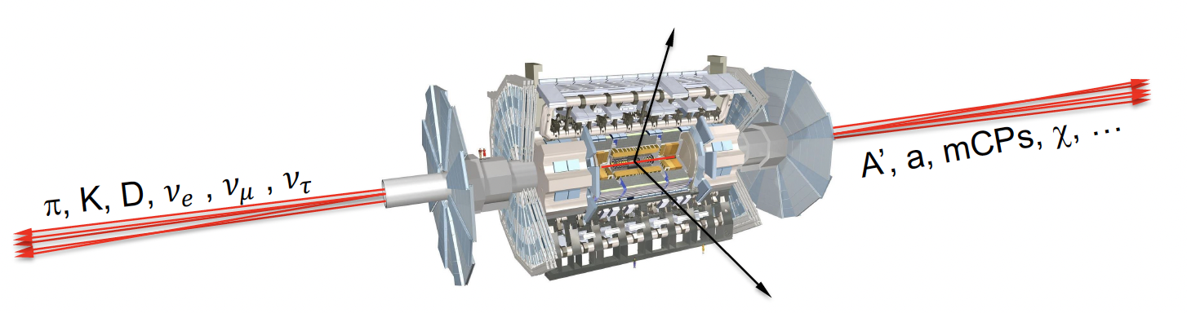
Physics
What is the physics in the forward direction of the LHC ?
Incredible progress in particle physics examining physics at high Pt. Are we missing opportunities in the forward direction ? The largest flux of light high energy particles (mesons and neutrinos) is far forward.
Could there be discoveries such as: dark photons, axion-like particles, millicharged particles, light dark matter scattering, etc? What can be measured with TeV neutrinos, especially tau neutrinos ?
The large neutrino flux could be exploited to perform SM measurements including PDFs at lower x and for charm production. Are such measurements valuable for collider physics ?
Unique characteristics may make such discoveries possible: the intense flux, and extremely high energies (~TeV).
This is the only intense tau neutrino beam, and should be exploited to get data which is recognized to be important for future of neutrino physics and astrophysics.
Highest priority for HEP: is the utilization of the High Luminosity LHC – can be achieved by placing detectors in the currently uncovered regions.

Slide 6
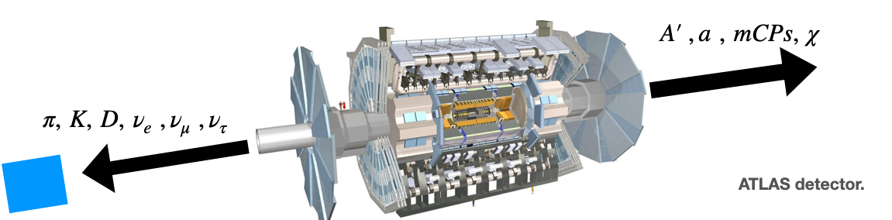
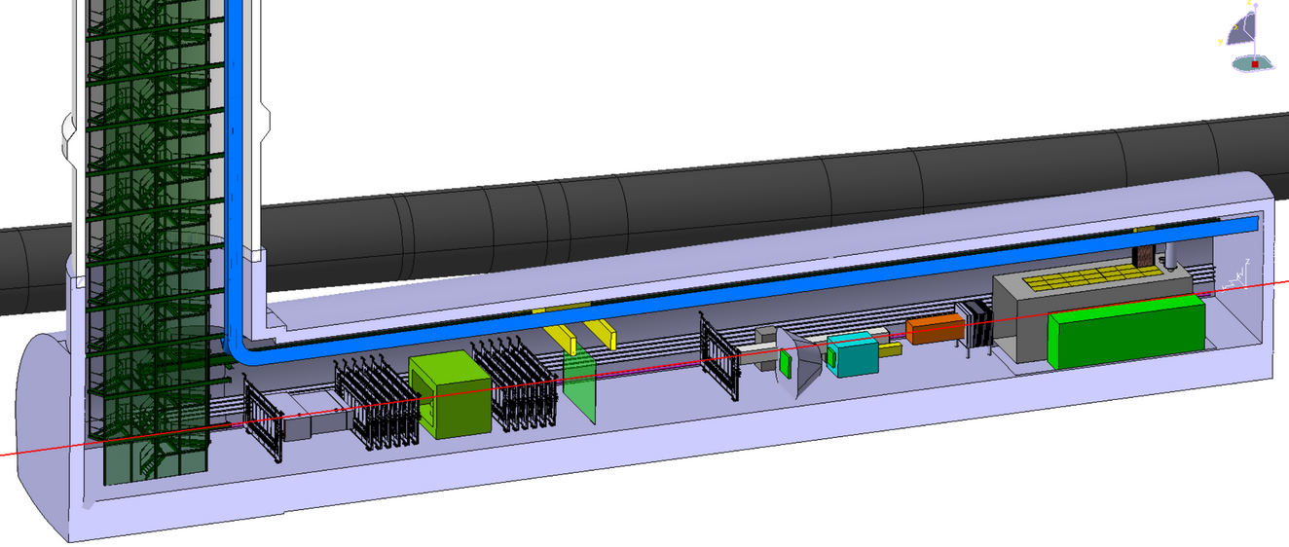
Progress: Forward physics facility (FPF) at the LHC and the Forward Liquid Argon detector (FLArE).
The project plan for FPF, and FLArE has benefitted from BNL leadership. A unique and long term program of science could result for the high luminosity LHC (from 2030 to 2045). (see FNAL W/C colloquium: https://indico.fnal.gov/event/57045/
FLARE in FPF
Strengthening the science case and detailed simulations
  Understanding of neutrino flux: (Jeong et al.) JHEP 10 (2023) 142. (Bai et al.)JHEP 06 (2022) 148.
  The forward physics facility: sites, experiments, and physics potential: Phys.Rept. 968 (2022)
  Detailed science report for Snowmass’21. https://arxiv.org/abs/2203.05090
  Complete GEANT/GENIE based simulation package for FPF and FLARE is getting ready. (Matteo Vicenzi, Wenjie Wu)
  Event rates, acceptance, and single particle reconstruction have been examined.
BNL has invested with other US partners (University of California, Irvine, University of Iowa, etc.) to examine the science and feasibility of this idea. LDRD-23-013(PO) and PD-23-018(ATRO)
Project is also supported by the Heising-Simons foundation.
Engineering coordination group has produced initial requirements for facility integration and a 3D model.
A first draft project plan was submitted to the HEP P5 committee. https://www.osti.gov/servlets/purl/1972463
Three international working groups are working together: Physics, FLARE detector design, and Engineering coordination. All with BNL, CERN and university partnerships.

Slide 7
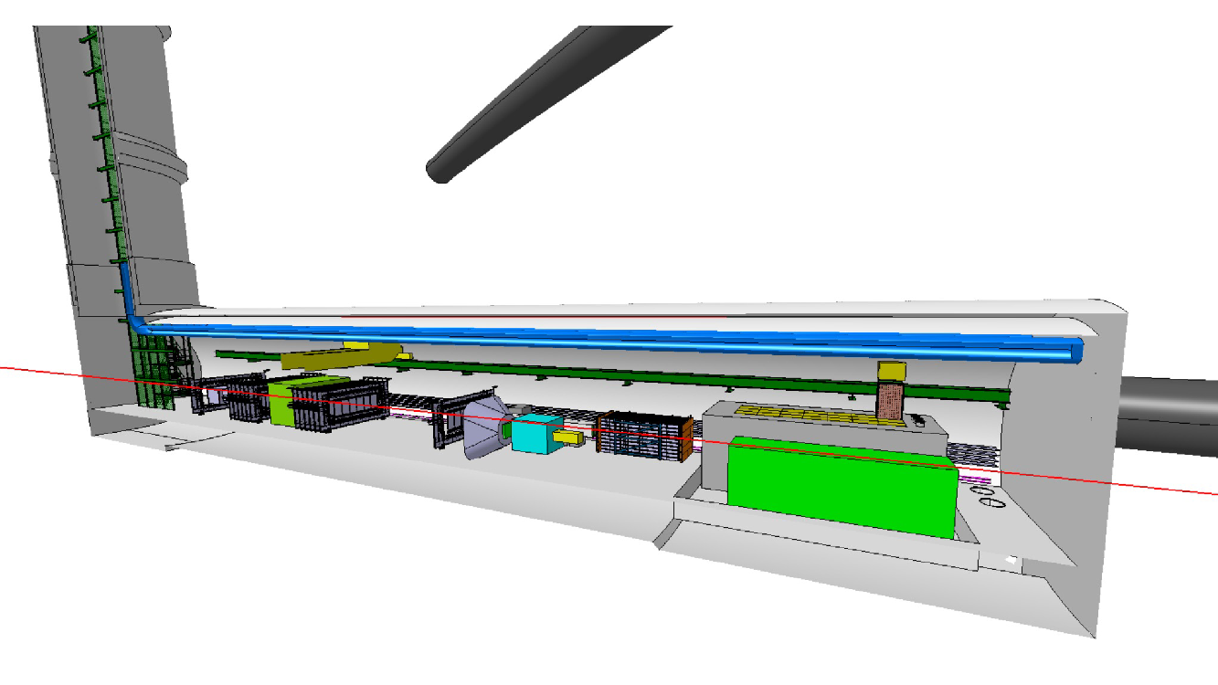
Progress on experimental configuration.
5 Experiments in development
Pseudo-rapidity > 5.5
Strong coordinated experimental program on the line of sight (LOS)
FASER2
Magnetic spectrometer
FASERnu2
emulsion
FLArE
Liquid argon TPC
AdvSND
calorimter
Magnet
FORMOSA
Scintillation stack
beam
Focus of this proposal: detector design for FLArE and its hadron/muon finder.

Slide 8
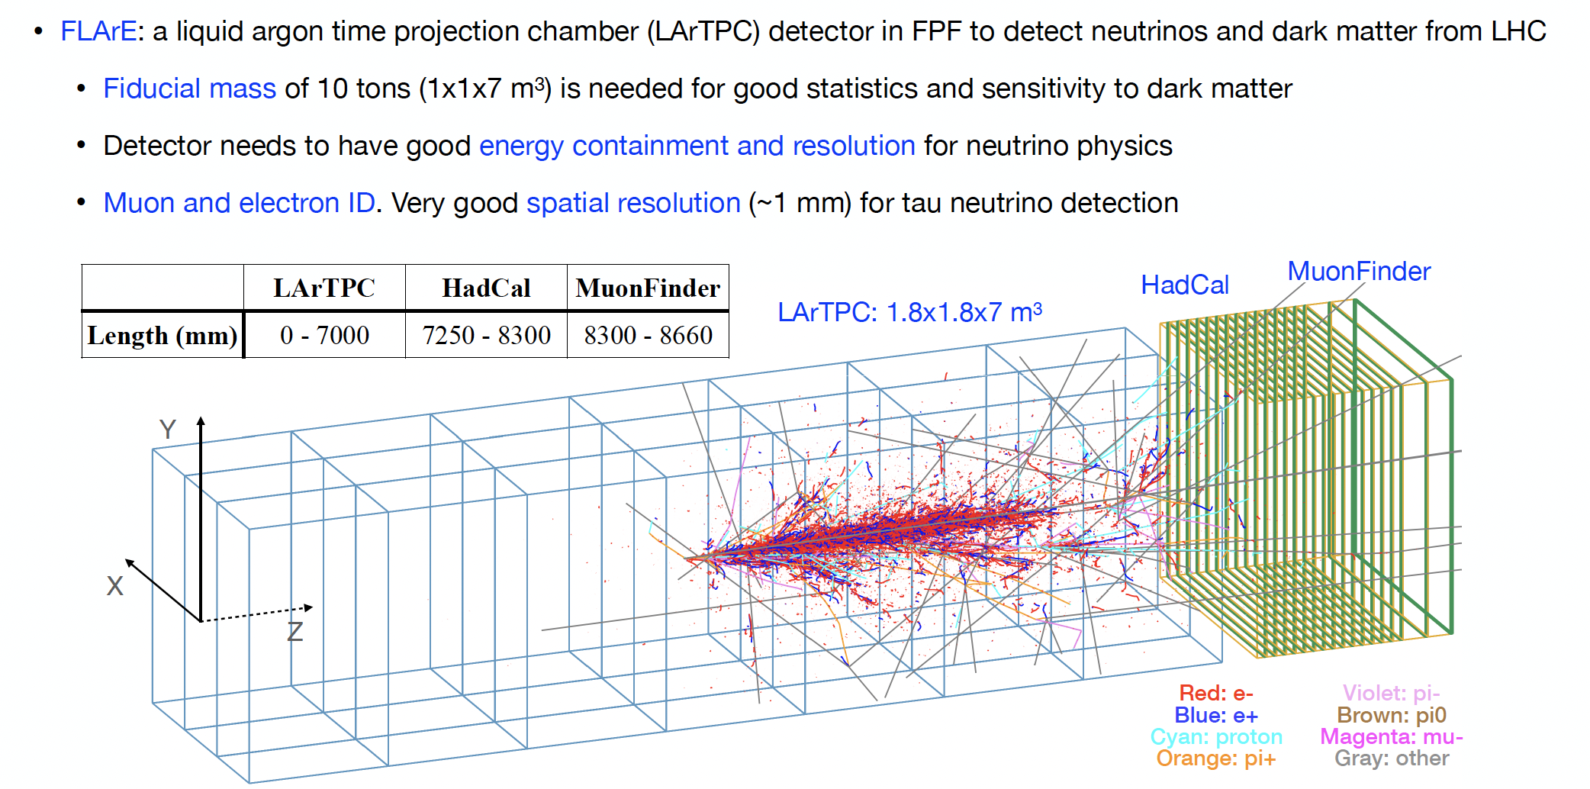
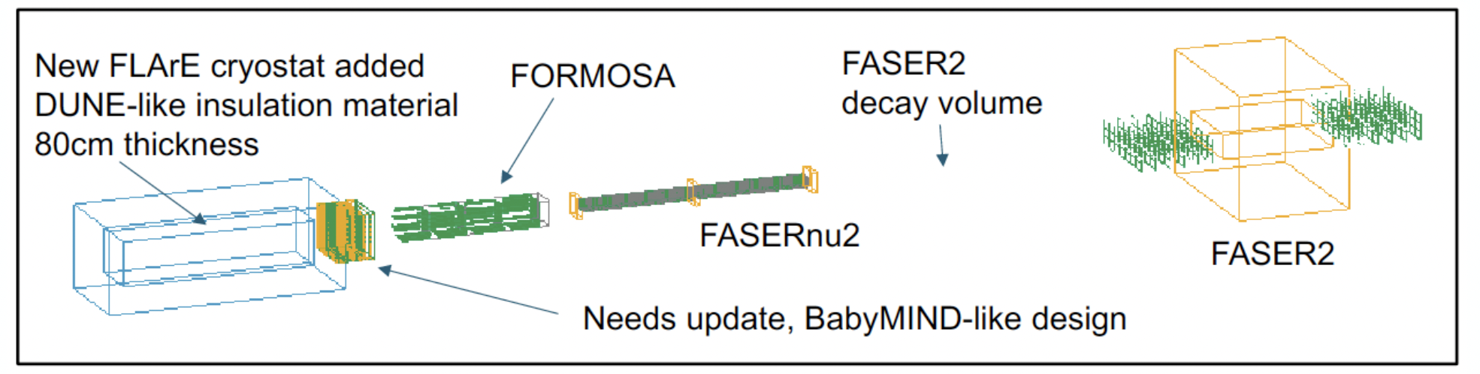
Progress on simulations and optimization
Detector has been optimized for good energy containment and fiducial mass. A magnetized hadron calorimeter is necessary for both energy containment, muon identification and low energy muon coverage.
Baby-MIND like design

Slide 9
Description of the LDRD: tasks
Completion of the GEANT model for FPF and FLArE.
Simulation studies for supporting the engineering design for FLArE and integration in the FPF hall.
Optimization of the FLArE detector modular design and definition of technical requirements for conceptual design report. Investigation of charge and light readout options for FLARE.
Analysis of background rates from muon and other radiations.
Analysis of trigger rates and timing.
Physics studies to evaluate complete neutrino event reconstruction and synergy with other detectors in the FPF. Muon reconstruction with FLArE and FASER2 spectrometers.
Physics studies for sensitivity to dark matter decay or scattering searches.
Deliverables: conceptual design report as part of the report for the LHC forward physics facility (FPF). Technical notes on event reconstruction and detector design. Joint working group reports with other FPF working groups.

Slide 10
Budget sheet for the LDRD
1 FTE postdoc for 2 years
0.3 FTE scientific labor
$40k university student subcontract
$10k travel and visitors

Slide 11
Summary Slide
FPF and FLArE are unique with outstanding alignment for BNL: Science is of very high energy neutrinos and dark matter from the LHC high luminosity collider running, and has excellent overlap with EIC. The relevant technologies are liquid argon TPC, with high resolution, fast timing, and modern data acquisition. The project scope (of medium scale) will allow a graded approach to management according to BNL SBMS rules.
Examination of the regions of LHC phase space not currently covered was specifically called for in the Snowmass report. We expect full support from the P5 report for the FPF project.
The event rates for high energy neutrinos are ~ 500 events/ 10 ton/ day with mean energy ~300-500 GeV. About ~ 1-5 nutauCC events per day.
We have done an excellent job in promoting the science case, and putting together an initial design with simulations. This has put BNL in a leadership position for FPF and FLArE.
This proposal is to provide 1) detailed simulation studies for a conceptual design report with specific requirements on the FLARE detector, 2) Baseline of the detector design, including trigger, and readout.
This is an extremely challenging task; well suited for BNL.

