Slide 1
Use of high performance computing for finite element analysis of interaction region magnets
FY2025 NPP LDRD Type B Pre-Proposal
Racquel Lovelace
6 December 2023

Slide 2
FY2025 NPP LDRD Type B Pre-Proposal
Proposal title: Use of high performance computing for finite element analysis of interaction region magnets
Primary Investigator: Racquel Lovelace
Other Investigators: Holger Witte, Peng Xu
Indicate if this is a cross-directorate proposal: Yes _X_ No___
If yes, identify other directorates/organizations: NSLS-II
Proposal Term: From: October 2024 To: September 2025

Slide 3
FY2025 NPP LDRD Type B Pre-Proposal
Proposal title and brief abstract:
Use of high performance computing for finite element analysis of interaction region magnets
In this proposal we will mitigate risks of a novel superconducting cable winding pattern for interaction region (IR) magnets using High Performance Computing (HPC). Modern colliders, such as EIC, push the limits of conventional magnet technology. This drives the need for modern magnet technology approaches, which are more challenging to simulate and push limits of conventional computers. Using HPC allows us to perform simulations in sufficient detail for a key magnet technology called Canted Cosine Theta (CCT), which has planned uses in modern colliders such as EIC and FCC-ee. We will employ a standard commercial finite element program, COMSOL, which is commonly used for analyzing magnets. 3D simulations with coupled Multiphysics models are limited to RAM size in typical workstations, which will be overcome by HPC. This project aims to demonstrate the feasibility and practicality of this approach by successfully simulating one EIC IR magnet in a coupled Multiphysics 3D simulation.
Program: NP
Return on Investment: Reduce time spent to investigate risk for EIC IR magnet
Broader impact on the activities at the laboratory: Expand existing HPC cluster for future analyses of accelerator components
Total planned funding per year in FY25 and FY26: $250k

Slide 4
Description of the LDRD
Up to 3 slides: provide a summary of the scientific/technological concept of the proposed project including the motivation for the research and the approach that will be used to conduct the investigation, deliverables, personnel involved, required procurements, and related information

Slide 5
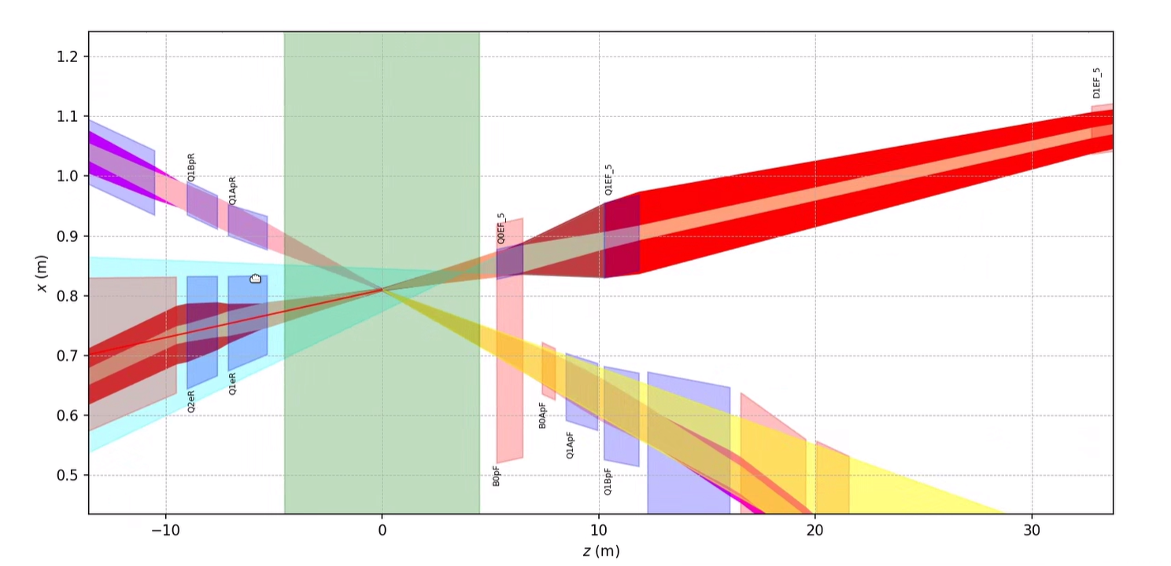
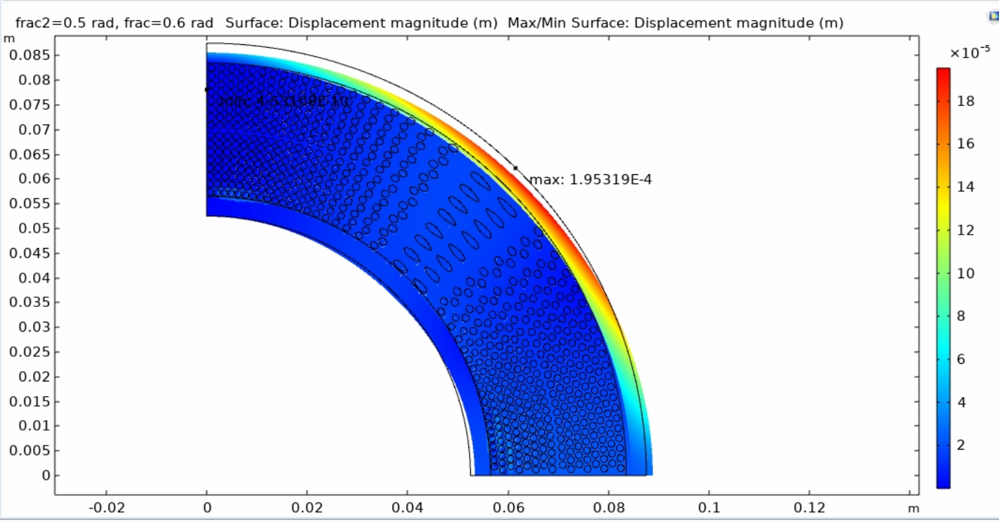
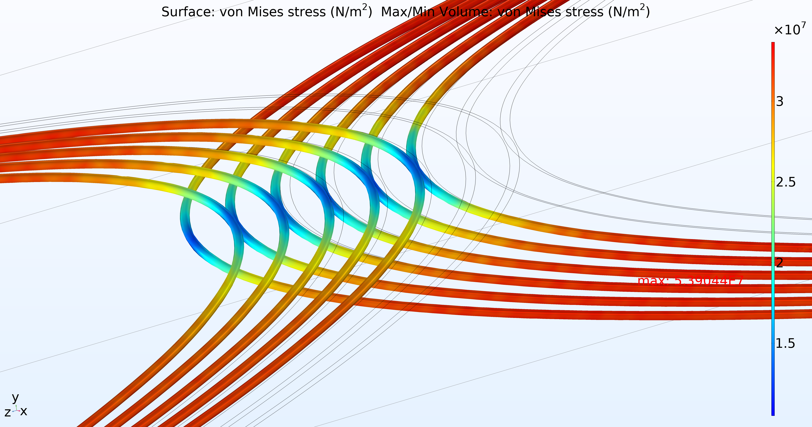
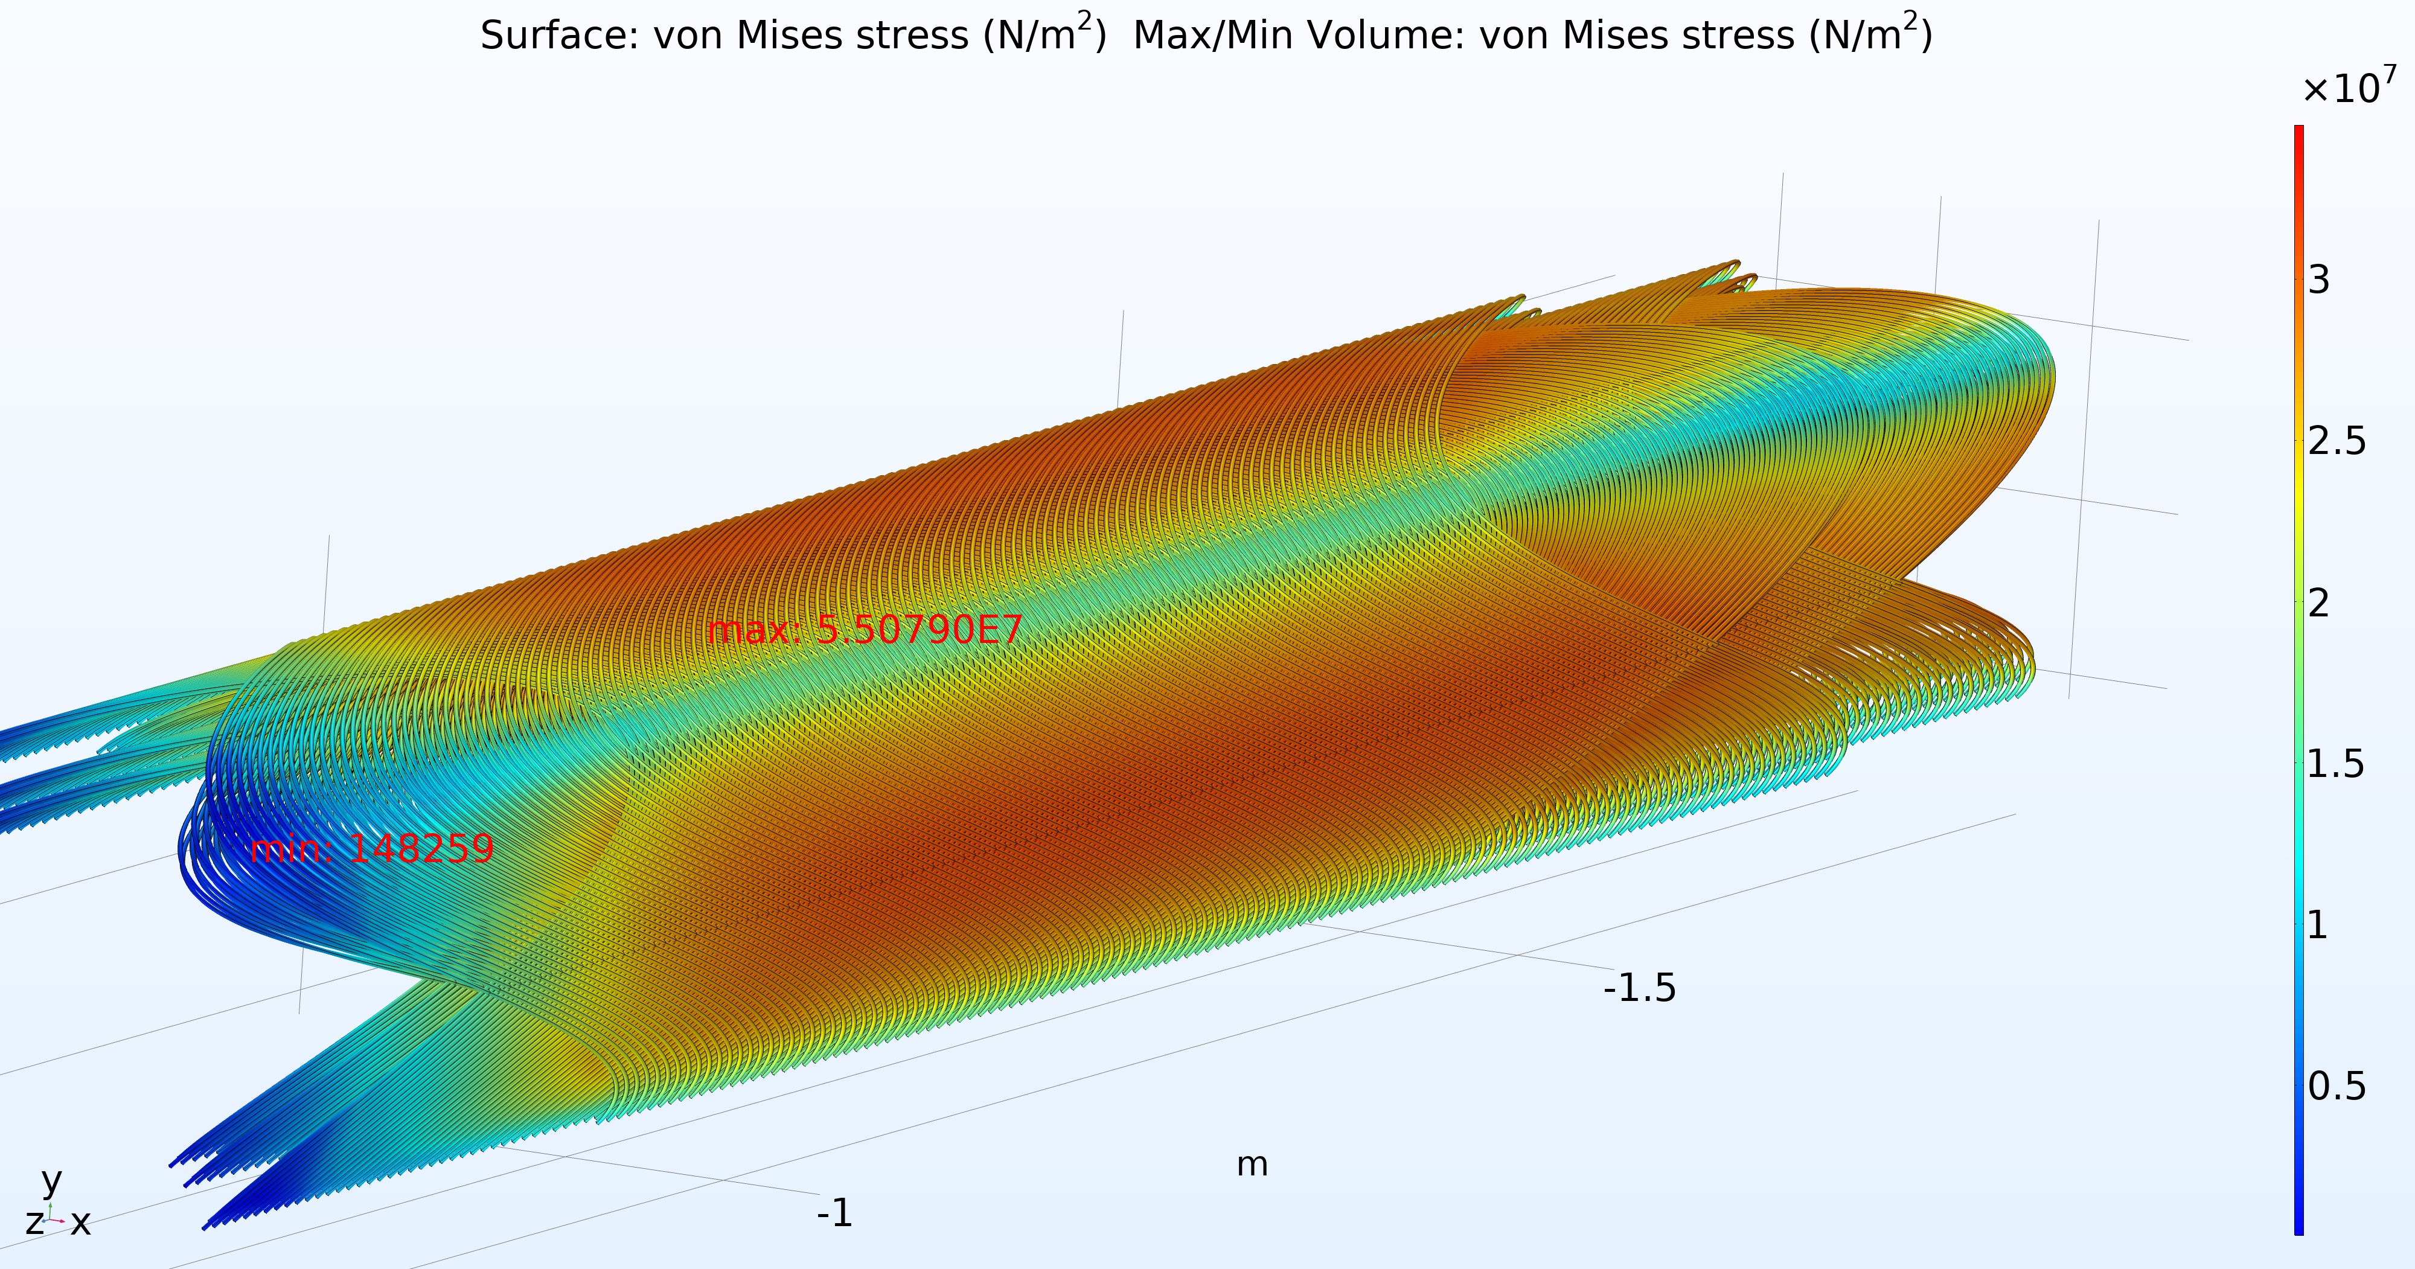
EIC IR Magnet Technology
Severe space constraints in the interaction region
Small crossing angle
Beams close together
Tapered magnet
Challenge:
Experimental results with scaled version
Simulated results 2D only, does not capture the complexity of the winding
Images courtesy of H. Witte

Slide 6
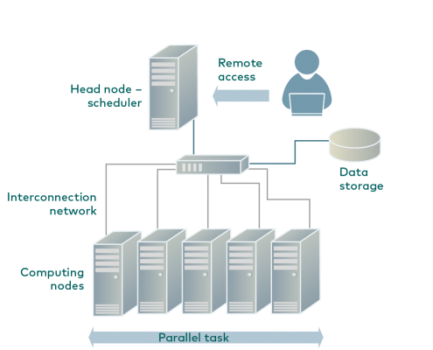
High performance computing (HPC)
HPC clusters – collection of separate servers connected via a fast interconnect, performing tasks in parallel
Leverage in-house architecture
NSLS-II cluster (32 nodes, 5 owned by EIC)
COMSOL Multiphysics
Coupled electromagnetic, thermal and structural simulation compared to experimental results
HPC cluster example [2]
Notes:
A standard computing system solves problems primarily using serial computing—it divides the workload into a sequence of tasks, and then executes the tasks one after the other on the same processor.
In contrast, HPC leverages
Massively parallel computing. Parallel computing runs multiple tasks simultaneously on multiple computer servers or processors. Massively parallel computing is parallel computing using tens of thousands to millions of processors or processor cores.
Computer clusters (also called HPC clusters). An HPC cluster consists of multiple high-speed computer servers networked together, with a centralized scheduler that manages the parallel computing workload. The computers, called nodes, use either high-performance multi-core CPUs or, more likely today, GPUs (graphical processing units), which are well suited for rigorous mathematical calculations, machine learning models and graphics-intensive tasks. A single HPC cluster can include 100,000 or more nodes.

Slide 7
Additional Information
Expected results
Simulated 3D EIC IR magnet with CCT winding pattern in coupled simulation
Expanded HPC architecture, make available for future magnet analyses
Personnel
Racquel Lovelace – 0.25 FTE
Holger Witte – 0.1 FTE
Peng Xu – 0.1 FTE
NSLS-II scientific staff – 0.1 FTE
Procurement
Additional nodes

Slide 8
Summary Slide
Risks associated with EIC IR magnets, that employ a tapered design with the CCT winding pattern, can be reduced by simulating a complete 3D model of the magnet with coupled Multiphysics of electromagnetic, thermal and structural. Multiphysics simulations of complex geometries are limited by memory in typical workstations. This issue can be overcome with the use of in-house high performance computing cluster architecture.

Slide 9
References
LDRD Type B FY2022: Direct Wind High Field Performance and Harmonic Study
HPC cluster. (n.d.). HPC Center. Retrieved December 5, 2023, from https://hpc.rtu.lv/hpc/?lang=en.

