Slide 1
A study comparing the accuracy of FEA sub-modeling methods against physical testing for the mechanical analysis of a CCT magnet
FY2025 NPP LDRD Type B Pre-Proposal
Sara Notaro
December 6, 2023

Slide 2
FY2025 NPP LDRD Type B Pre-Proposal
Proposal title: A study comparing the accuracy of FEA sub-modeling methods against physical testing for the mechanical analysis of a CCT magnet
Finite element analysis (FEA) software packages such as COMSOL and ANSYS are used to study the mechanical behavior of a magnet due to magnetic forces. While FEA allows engineers to analyze structures that would otherwise be too complex for classical methods, large scale models require assumptions and simplifications. The Canted Cosine Theta (CCT) magnet for EIC is a challenge for detailed structural analysis due to the size and geometric complexity of the design, and therefore it is necessary to simplify the model by using techniques such as sub-modeling, geometry de-featuring, and material modeling. To study the accuracy of these methods, a simple physical structure is built, tested, and then modeled using FEA software. The simulation results for sub-modeling methods are compared to data obtained through testing of the physical structure.
Primary Investigator: Sara Notaro
Indicate if this is a cross-directorate proposal: Yes X No___
If yes, identify other directorates/organizations: C-AD and EIC
Proposal Term: From: 10/2024 To: 9/2025

Slide 3
FY2025 NPP LDRD Type B Pre-Proposal
Proposal title and brief abstract: A study comparing the accuracy of FEA sub-modeling methods against physical testing for the mechanical analysis of a CCT magnet
Program: NP
Return on Investment: Test data and related models will provide a framework for how to approach the CCT magnet structural analysis
Broader impact on the activities at the laboratory: A deeper and quantifiable understanding of the way that different methods of model simplifications will benefit engineers and scientists working on designs that require these strategies. The findings will be documented in reports and archived models that can be used by other engineers and scientists working on similar projects.
Total planned funding per year in FY25 and FY26
Engineering 0.25 FTE
Scientific 0.1 FTE
Technician 0.25 FTE

Slide 4
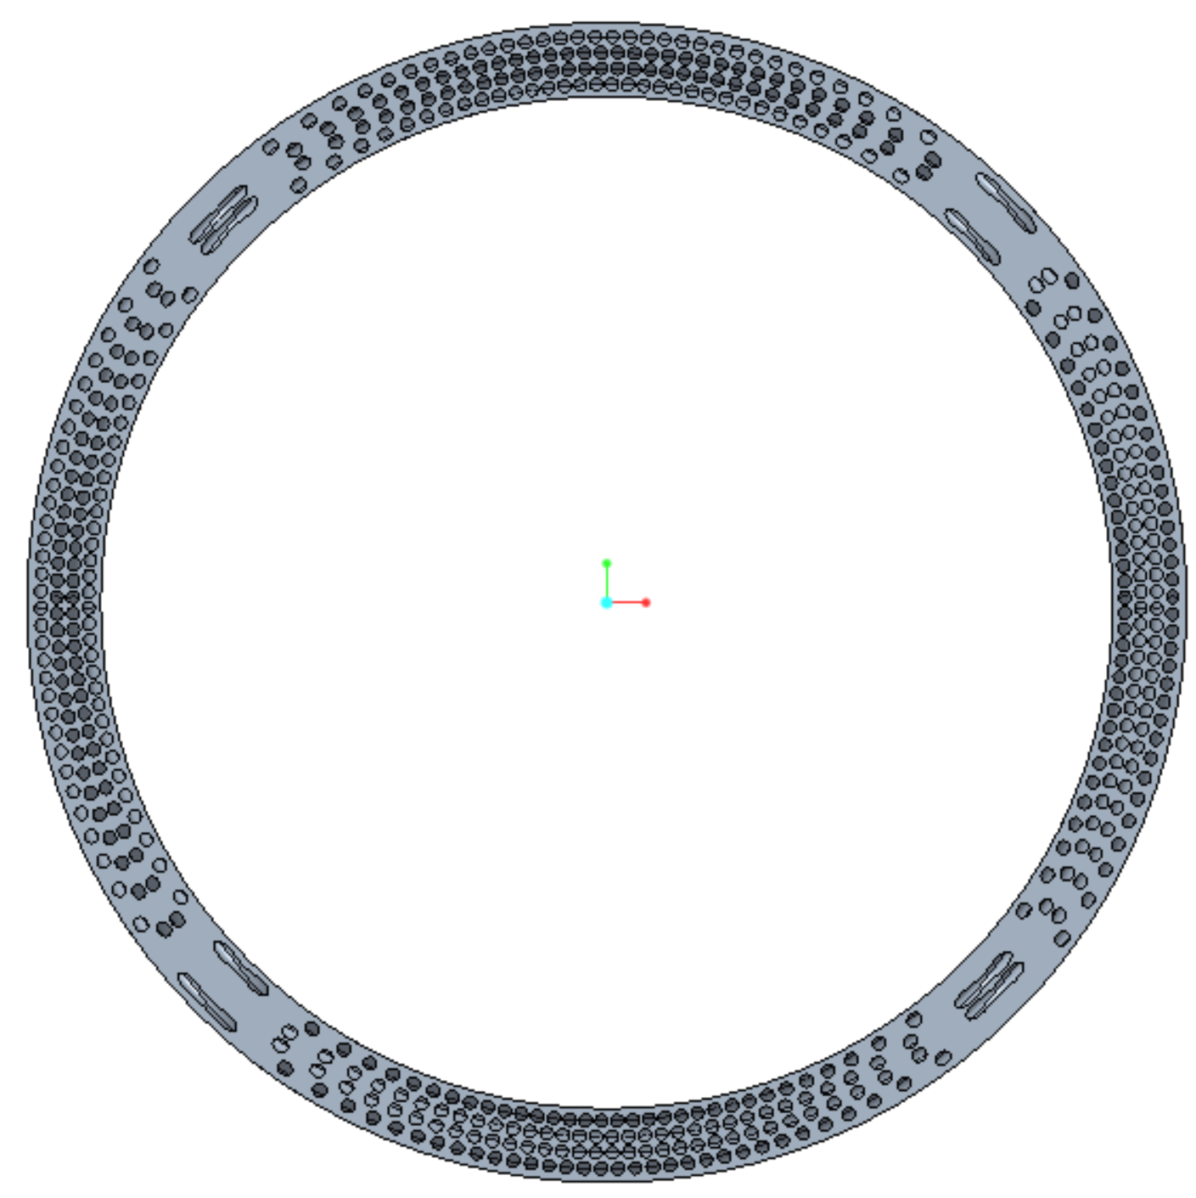
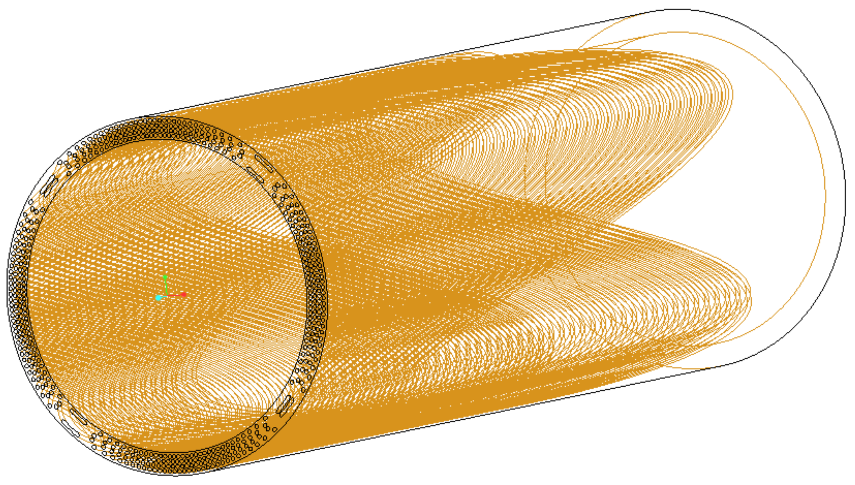
Description of the LDRD
New Canted Cosine Theta (CCT) magnet design is a technology for modern colliders, and for the EIC Interaction Region – small diameter wire wound close together over a long length with a tapered cylindrical winding and fill
Small features over a long length are difficult to mesh, difficult to solve as a full 3D solid model without using simplifications to the model
Simplification strategies:
  Geometry defeaturing: removing small details in the geometry, usually holes or fillets reduces the need to use smaller mesh sizes
  Taking advantage of symmetry
  Submodeling: using initial full model results to apply to smaller subsections which allows more detailed analysis

Slide 5
Description of the LDRD
CCT mechanical analysis challenges
  Inherently small features cannot be defeatured without significant assumptions
  Magnet is asymmetrical
  Magnet end effects require a full 3D analysis – 2D can only capture behavior at the midplane or at a slice along the length of the magnet
Proposed work
  Use physical representative test cases that are mechanically tested and simultaneously simulated using FEA software using various strategies
  Study the results of the tests and compare to the results of the simulations to understand how the simplifications and assumptions are interpreted by the FEA software
  The collected data will be used to validate or challenge assumptions
  Data to be reviewed by internal SMEs
  These studies will enhance our confidence in our modelling

Slide 6
Summary Slide
The mechanical analysis of the CCT magnet is challenging due to the complicated geometry. Simplification assumptions will be tested using a representative model, and the resulting data will be studied. What we learn from these studies will be used to analyze a full CCT magnet. These results can also be used by other engineers and scientists facing similar modelling challenges.

