Slide 1
Implementation of a Drift Chamber in DD4hep
Cheuk-Ping Wong
07-05-2024

Slide 2
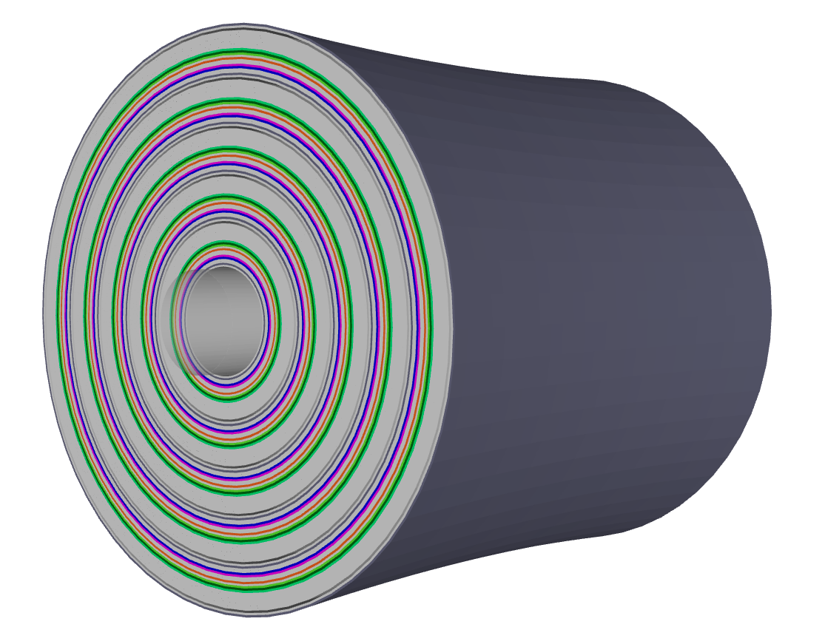
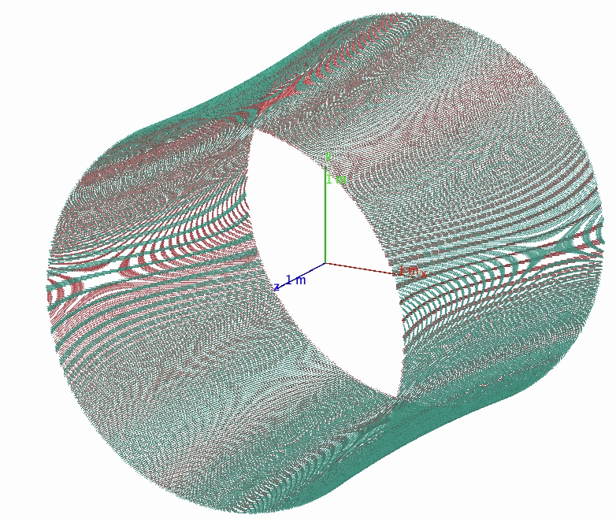

IDEA Drift Chamber Implementation in DD4hep
Source codes:
  https://github.com/key4hep/k4geo/blob/main/detector/tracker/DriftChamber_o1_v02.cpp
  https://github.com/AIDASoft/DD4hep/blob/master/DDRec/include/DDRec/DCH_info.h
XML: https://github.com/key4hep/k4geo/blob/main/FCCee/IDEA/compact/IDEA_o1_v03/DriftChamber_o1_v02.xml
Hyperboloid
r=2m
I fixed major overlapping issue
Figured out how to draw each
wires in event display
The drift chamber include
a cylinder vessel (carbon fiber)
and endcaps
Inside the vessel, the detector
is separated by 112 layers of gas
<fraction n="0.382635100446205" ref="He"/>
<fraction n="0.107061807167701" ref="H"/>
<fraction n="0.510303092386095" ref="C"/>
4.5m
Within a layer of gas are the wires
Sense wires: d=20.3 um, tungsten coated by gold
Field wires: d=40.3 um / 50.3 um, aluminum coated by gold
Two layers of wires

Slide 3
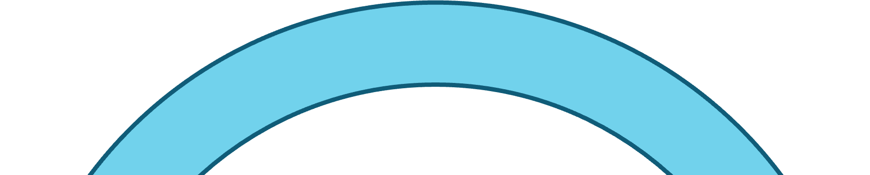
Drawing of a Single Layer
Trying to set each layer as approach, and set the sense wires to be representative
Gas (sensitive)
Sense wires (passive)
Field wires (passive)
Approach
Representative
My branch: https://github.com/eic/D2EIC/tree/19-implementation-of-a-drift-chamber
Source code (DriftChamber.cpp)
Gas layer: https://github.com/eic/D2EIC/blob/492c30d2122b0c60b9192185141fdd5925a9da2a/src/DriftChamber.cpp#L260
Sense and field wires: https://github.com/eic/D2EIC/blob/492c30d2122b0c60b9192185141fdd5925a9da2a/src/DriftChamber.cpp#L467C8-L467C42

Slide 4
Related files
compact/definitions.xml (https://github.com/eic/D2EIC/blob/19-implementation-of-a-drift-chamber/compact/definitions.xml)
<constant name="DCH_0_ID" value="87"/>
compact/tracking/definitions_dch.xml
(https://github.com/eic/D2EIC/blob/492c30d2122b0c60b9192185141fdd5925a9da2a/compact/tracking/definitions_dch.xml#L111)
<detectors>
<detector id="DCH_0_ID"
name="DCHTrackerSubAssembly"
type="DD4hep_SubdetectorAssembly"
vis="TrackerSubAssemblyVis">
<composite name="DCH"/>
</detector>
</detectors>
compact/tracking/dch.xml (https://github.com/eic/D2EIC/blob/492c30d2122b0c60b9192185141fdd5925a9da2a/compact/tracking/dch.xml#L83)
* Reduce number of layers by changing “DCH_nsuperlayers” and "DCH_nlayersPerSuperlayer"
D2EIC/D2EIC_dch_only.xml
Beam pipe + drift chamber

Slide 5
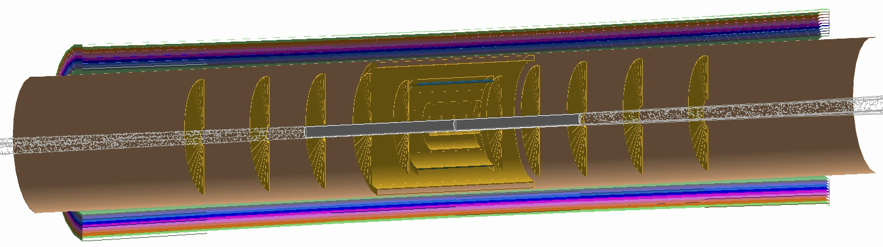
Integrated Tracking Design
10 sensitive layers of drift chamber (other layers not shown)
~35cm
Silicon tracker
Beam pipe
The maximum radius of the silicon tracker is reduced to 30cm

Slide 6
Generating Material Map
jug_xl> cwong1@eic0105:/gpfs/mnt/gpfs02/eic/pingwong/DD4hep/detectorXML/D2EIC/install/share/D2EIC/myMaterialMap$ ../../../../../material_maps_new/run_matmap_py.sh 1 | tee log
……
---------------------
mat:
---------------------
{'layer': 1, 'value': {'bounds': {'type': 'CylinderBounds', 'values': [13.500349999999997, 736.0, 3.141592653589793, 0.0, 0.0, 0.0]}, 'geo_id': 72057662757404672, 'material': {'binUtility': {'binningdata': [{'bins': 1, 'max': 3.1415927410125732, 'min': -3.1415927410125732, 'option': 'closed', 'type': 'equidistant', 'value': 'binPhi'}, {'bins': 1, 'max': 736.0, 'min': -736.0, 'option': 'open', 'type': 'equidistant', 'value': 'binZ'}]}, 'mapMaterial': False, 'mappingType': 'Default', 'type': 'proto'}, 'transform': {'rotation': None, 'translation': None}, 'type': 'CylinderSurface'}, 'volume': 1}
---------------------
---------------------
mat:
---------------------
{'boundary': 1, 'value': {'bounds': {'type': 'RadialBounds', 'values': [0.0, 30.500699999999995, 3.141592653589793, 0.0]}, 'geo_id': 72339069014638592, 'material': {'binUtility': {'binningdata': [{'bins': 1, 'max': 3.1415927410125732, 'min': -3.1415927410125732, 'option': 'closed', 'type': 'equidistant', 'value': 'binPhi'}, {'bins': 1, 'max': 30.500699996948242, 'min': 0.0, 'option': 'open', 'type': 'equidistant', 'value': 'binR'}]}, 'mapMaterial': False, 'mappingType': 'Default', 'type': 'proto'}, 'transform': {'rotation': None, 'translation': [0.0, 0.0, -737.0]}, 'type': 'DiscSurface'}, 'volume': 1}
---------------------
---------------------
mat:
---------------------
{'boundary': 2, 'value': {'bounds': {'type': 'RadialBounds', 'values': [0.0, 30.500699999999995, 3.141592653589793, 0.0]}, 'geo_id': 72620543991349248, 'material': {'binUtility': {'binningdata': [{'bins': 1, 'max': 3.1415927410125732, 'min': -3.1415927410125732, 'option': 'closed', 'type': 'equidistant', 'value': 'binPhi'}, {'bins': 1, 'max': 30.500699996948242, 'min': 0.0, 'option': 'open', 'type': 'equidistant', 'value': 'binR'}]}, 'mapMaterial': False, 'mappingType': 'Default', 'type': 'proto'}, 'transform': {'rotation': None, 'translation': [0.0, 0.0, 737.0]}, 'type': 'DiscSurface'}, 'volume': 1}
---------------------
---------------------
mat:
---------------------
{'boundary': 3, 'value': {'bounds': {'type': 'CylinderBounds', 'values': [30.500699999999995, 737.0, 3.141592653589793, 0.0, 0.0, 0.0]}, 'geo_id': 72902018968059904, 'material': {'binUtility': {'binningdata': [{'bins': 1, 'max': 3.1415927410125732, 'min': -3.1415927410125732, 'option': 'closed', 'type': 'equidistant', 'value': 'binPhi'}, {'bins': 1, 'max': 737.0, 'min': -737.0, 'option': 'open', 'type': 'equidistant', 'value': 'binZ'}]}, 'mapMaterial': False, 'mappingType': 'Default', 'type': 'proto'}, 'transform': {'rotation': None, 'translation': None}, 'type': 'CylinderSurface'}, 'volume': 1}
---------------------
Namespace(inputFile='config-map.json', outputFile='config-map_new.json')
Volume ID Name Approaches
1 acts_beampipe_central::Barrel 1, 2
1 acts_beampipe_central::Barrel X
Done! Updated config file at config-map_new.json
drift chamber doesn’t show up

Slide 7
Summary
Finished initial drift chamber implementation in DD4hep
  Fixed overlapping issue
To-do: add the drift chamber in ACTS for track reconstruction
Message Shujie for help

Slide 8
LDT Silicon Disk Dimensions
 | Z (mm) |  | Inner r (mm) |  | Outer r (mm)
Disk | DD4hep | LTD | DD4hep | LTD | DD4hep | LTD
1 | 249.8 | 250 | 36.8 | 36.7 | 240 | 240
2 | 449.8 | 450 | 36.8 | 36.7 | 415 | 415
3 | 699.8 | 700 | 38.8 | 36.7 | 421.4 | 421.4
4 | 999.8 | 1000 | 40.1 | 40.1 | 421.4 | 421.4
5 | 1349.8 | 1350 | 46.4 | 46.4 | 421.4 | 421.4
<0.1% difference in z position
Cannot explain the resolution discrepancy in the backward region

Slide 9
LDT Silicon Barrel Layer Dimensions
 | Half length (mm) |  | Inner r (mm) |  | Outer r (mm)
Barrel | DD4hep | LTD | DD4hep | LTD | DD4hep | LTD
1 | 135 | 135 | 35 | 35 | 37 | n/a
2 | 135 | 135 | 47 | 47 | 49 | n/a
3 | 135 | 135 | 119 | 119 | 121 | n/a
4 | 261 | 260 | 270.5 | 271 | 301 | n/a
5 | 420 | 420 | 429 | 430 | 460 | n/a

